Slide 1
THE SCOPE OF RESEARCH IN ELT INCLUDING THE USE OF TECHNOLOGY (AI) AND QUALITY OF EDUCATION ENHANCEMENT IN ELT
Annisah & Wiwik Mardiana
PROGRAM STUDI PENDIDIKAN BAHASA INGGRIS
STKIP TAMAN SISWA BIMA & UNIVERSITAS ISLAM MAJAPAHIT
2024

Slide 2
After Learn this material students are able to:
1
Able to define the concept of research in English language classroom
Able to use technology (AI) in research
3
2
Able to define the Scope of research in English language classroom
Enhance the quality of education in ELT
4

Slide 3
SOME TYPES OF RESEARCH IN LANGUAGE EDUCATION
QUALITATIVE APPROACHES:
Narrative Research
Ethnography Research
Grounded Theory
Case Study
Descriptive Research

Slide 4
Narrative Research
This method allows
researchers to get a comprehensive understanding of the subject's life and
activities. By enabling researchers to see how people interact with one another, it
can demonstrate what drives people and give a greater understanding of the society
that the subjects live in.

Slide 5
Ethnography Research
Ethnography is a qualitative data gathering technique that is often used in
the social and behavioral research sciences. Data are obtained through observations
and interviews to find out how communities and individuals function. An ethnographic study
looks at how a group of individuals behave and communicate with one another.
Making observations about individuals is more important than concentrating on
intricate statistics and figures.

Slide 6
Grounded Theory
The grounded theory approach is a qualitative research methodology that attempts to unravel the meanings of people’s interactions, social actions, and experiances. This method enables you to discover new theories based on the analysis of real world data.

Slide 7
Case Study
A case study is a comprehensive examination of one individual, family, or
event. In order to look for patterns and causes of behavior, practically every aspect
of the subject's life and background is examined in a case study. A case
study aims to learn as much as possible about a person or group so that the findings
can be applied to a wide range of people. Unfortunately, case studies can involve a
great deal of subjectivity, making it challenging to extrapolate findings to a wider
audience.

Slide 8
Descriptive Research
Descriptive investigations frequently create new knowledge
concepts and offer answers to pressing problems in addition to making
observations and comparing, contrasting, and analyzing them. It always seeks to
explain the circumstances surrounding an event, including when, when, how, and
what the issue or phenomena is. The researchers can employ both quantitative and qualitative techniques to gather the data.

Slide 9
SOME TYPES OF RESEARCH IN LANGUAGE EDUCATION
QUANTITATIVE APPROACH:
Experimental Research
Causal-comperative research
Correlational research

Slide 10
EXPERIMENTAL
Experimental research is a research method usually used to find out the strength of
relationship between variables. In order to be able to use this research method properly we need to know about variables, population, and sample.

Slide 11
EXPERIMENTAL
Variables can be classified into two categories independent and dependent variables. An independent variable is an element or item used by the researcher to influence the other variable, for instance a teaching method. A dependent variable is an element or item that is influenced or affected by an independent variable, for example the test scores of students under investigation.

Slide 12
EXPERIMENTAL
A population is all cases, situations, or individuals who have one or more similar characteristics. For
example, seventh semester students of a faculty of letters who have passed a scientific writing course. Meanwhile a sample is a subset of individuals or cases taken from a population. A sample is needed when a population of an experimental research is too big as it will be very tedious and time consuming to do a research on the whole population.

Slide 13
TYPES OF EXPERIMENTAL
Pre Experimental
True Experimental
The experimental group and the control group
Quasi Experimental

Slide 14
Causal-Comperative Research
The Causal Comparative approach aims to identify the causes of events and circumstances. In other words, it determines the reasons why certain events happen or don't happen. A causative relationship between an independent variable and a dependent variable is sought after in causal-comparative research.

Slide 15
Correlational
Correlational research a type of non-experimental reserach method in which a reseracher measures two variables and understands, then assesses the statistical relationship between them with no influence from any extraneous variable. When using a correlational study design no variables are within the researcher’s direct control or manipulation. The degree and/or direction of the association between two (or more) variables is reflected in a correlation.

Slide 16
Classroom Action Research
systematic inquiry conducted by teacher, principals school counselors, or other stakeholders in teaching-learning environment to gather information about the ways in which their particular schools operate, the teachers teach, and the students learn.
Its purpose is to provide teacher-researchers with a method for solving everyday problems in their own setting.
1
2

Slide 17
Research and Development
Reseach and Development (R&D) is the process of developing a new product, new body of information about an existing process, or both. The new information generated by this methodical creative activity is then applied to the formulatin of new materials orentirely new goods, as well as to the modification and enhancement of already existing ones.

Slide 18
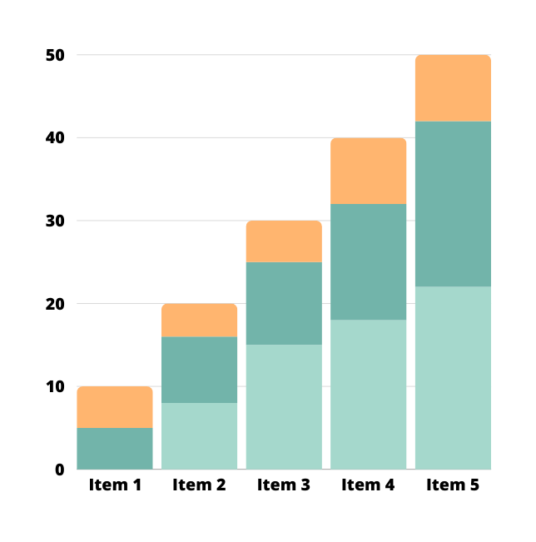
Data Collection
The process of gathering and analyzing accurate data from various source to find answer to research problems, trends and probabilities, to evaluate possible outcomes is known as data collection.

Slide 19
Types of Data Collection
1
Observation
Interview
3
2
Survey
Testing
4

Slide 20
r
Tugas?
Mahasiswa mencari satu jurnal yang menggunakan salah satu dari beberapa jenis penelitian yang telah di jelaskan pada materi. Perhatikan cara pengumpulan data yang tertera pada jurnal, kemudian jelaskan secara singkat di pertemuan selanjutnya.

Slide 21
Terima Kasih

