Slide 1
Structural Analysis
FRAMES and MACHINES
week #8

Slide 2
Frames and Machines
Frames and machines are two types of structures which are often composed of pin-connected multi force members, i.e., members that are subjected to more than two forces.
Frames are used to support loads, whereas machines contain moving parts and are designed to transmit and alter the effect of forces.

Slide 3
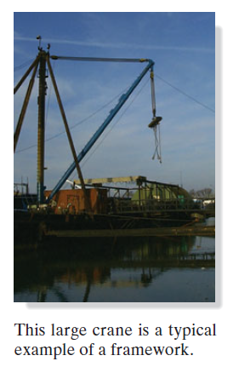
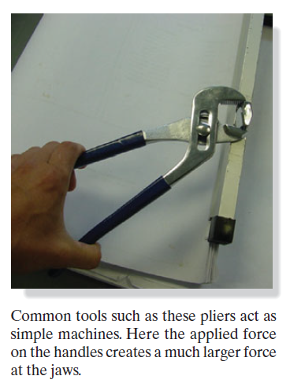

Slide 4
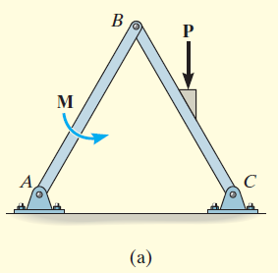
Examples
For the frame shown in Fig. 6–21a, draw the free-body diagram of (a) each member, (b) the pin at B, and (c) the two members connected together.

Slide 5
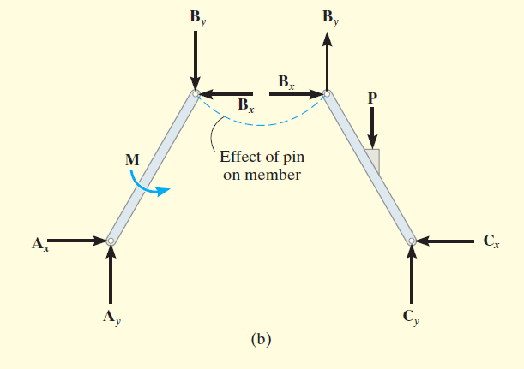
Part (a). By inspection, members BA and BC are not two-force members. Instead, as shown on the free-body diagrams, Fig. 6–21b,BC is subjected to a force from the pins at B and C and the external force P. Likewise, AB is subjected to a force from the pins at A and B and the external couple moment M. The pin forces are represented by their x and y components.

Slide 6
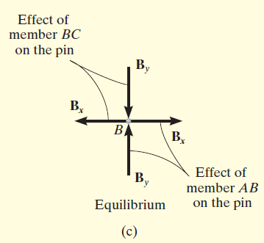
Part (b). The pin at B is subjected to only two forces, i.e., the force of member BC and the force of member AB. For equilibrium these forces or their respective components must be equal but opposite, Fig. 6–21c. Realize that Newton’s third law is applied between the pin and its connected members, i.e., the effect of the pin on the two members, Fig. 6–21b, and the equal but opposite effect of the two members on the pin, Fig. 6–21c.

Slide 7
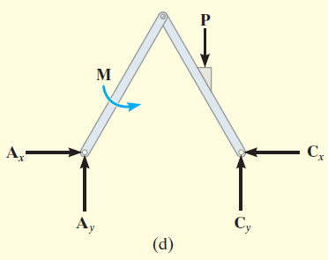
Part (c). The free-body diagram of both members connected together, yet removed from the supporting pins at A and C, is shown in Fig. 6–21d. The force components B_{x} and B_{y} are not shown on this diagram since they are internal forces (Fig. 6–21b) and therefore cancel out. Also, to be consistent when later applying the equilibrium equations, the unknown force components at A and C must act in the same sense as those shown in Fig. 6–21b.

Slide 8
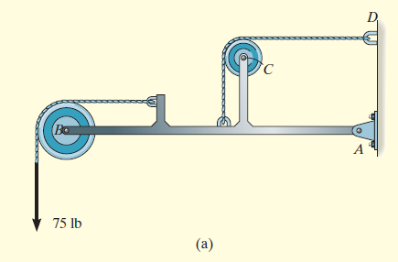
Examples
For the frame shown in Fig. 6–23a, draw the free-body diagrams of (a) the entire frame including the pulleys and cords, (b) the frame without the pulleys and cords, and (c) each of the pulleys.

Slide 9
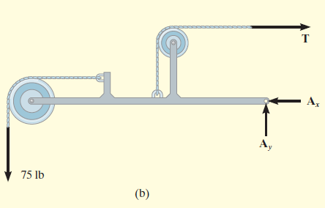
Part (a). When the entire frame including the pulleys and cords is considered, the interactions at the points where the pulleys and cords are connected to the frame become pairs of internal forces which cancel each other and therefore are not shown on the free-body diagram, Fig. 6–23b.

Slide 10
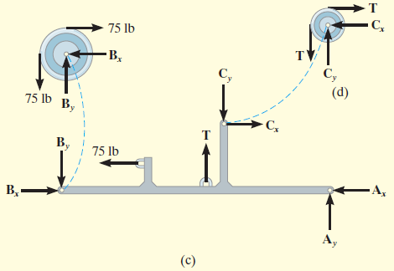
Part (b). When the cords and pulleys are removed, their effect on the frame must be shown, Fig. 6–23c.
Part (c). The force components of the pins on the pulleys, Fig. 6–23d, are equal but opposite to the force components exerted by the pins on the frame, Fig. 6–23c.Why?

Slide 11
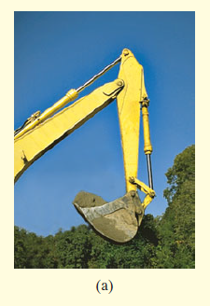
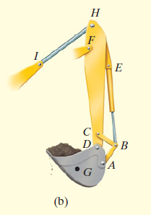
Examples
Draw the free-body diagrams of the bucket and the vertical boom of the backhoe shown in the photo, Fig. 6–24a. The bucket and its contents have a weight W. Neglect the weight of the members.

Slide 12
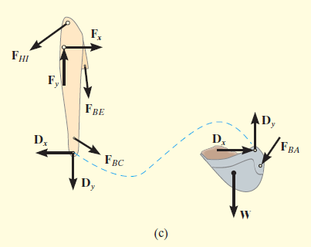
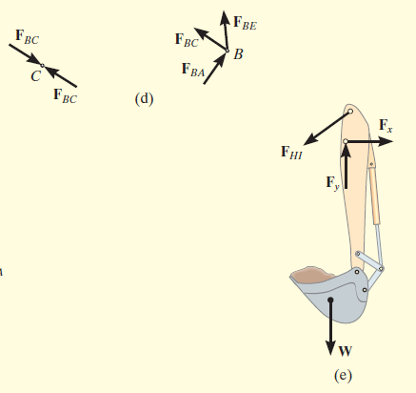

Slide 13
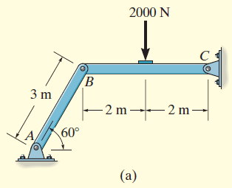
Examples
Determine the horizontal and vertical components of force which the pin at C exerts on member BC of the frame in Fig. 6–26a.

Slide 14
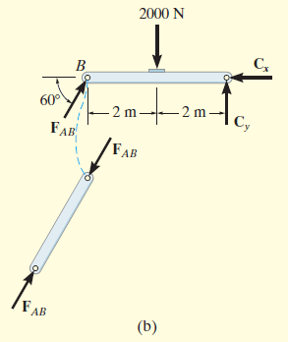
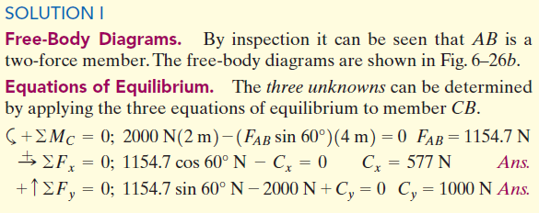

Slide 15
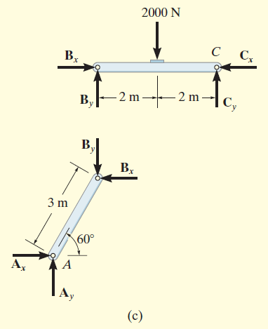
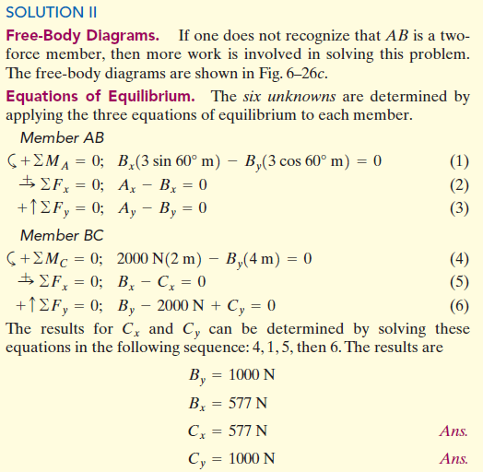
save yourself some time and effort by always identifying the two-force members before starting the analysis!

Slide 16
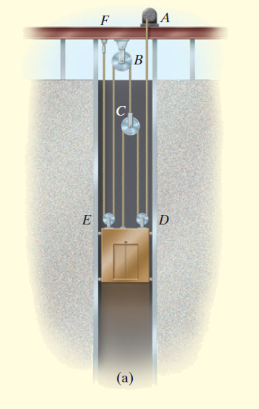
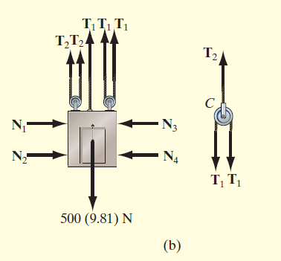
Examples
A 500-kg elevator car in Fig. 6–28a is being hoisted by motor A using
the pulley system shown. If the car is traveling with a constant speed,
determine the force developed in the two cables. Neglect the mass of
the cable and pulleys.

Slide 17
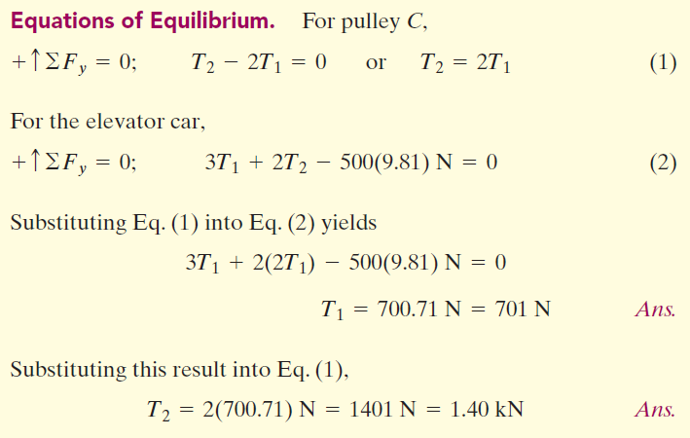

Slide 18
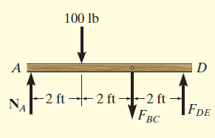
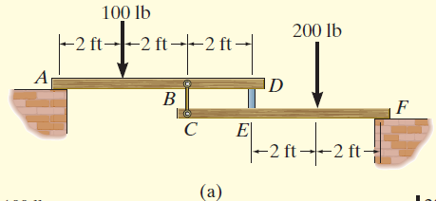
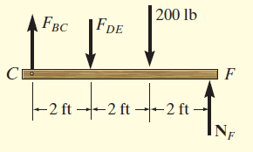
Examples
The two planks in Fig. 6–31a are connected together by cable BC and a smooth spacer DE. Determine the reactions at the smooth supports A and F, and also find the force developed in the cable and spacer.

Slide 19
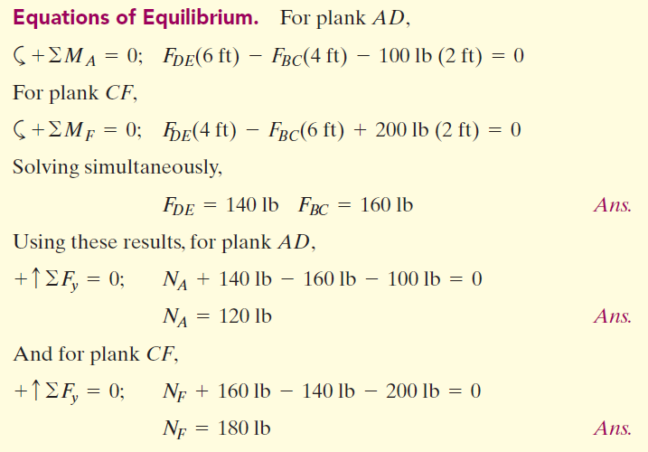

Slide 20
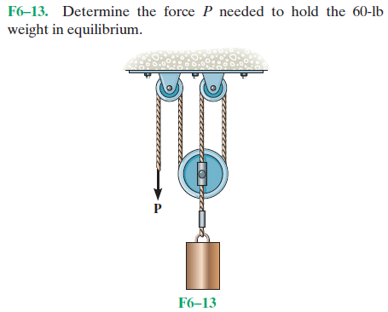
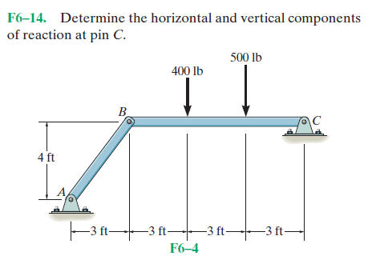
Problems

Slide 21
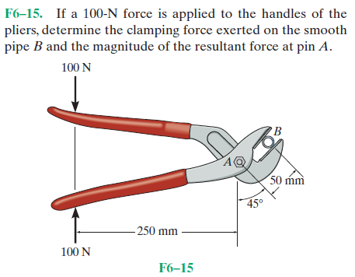
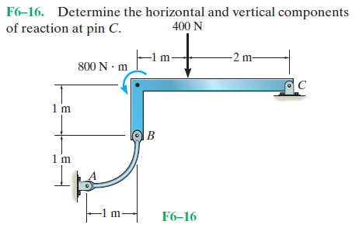
Problems

Slide 22
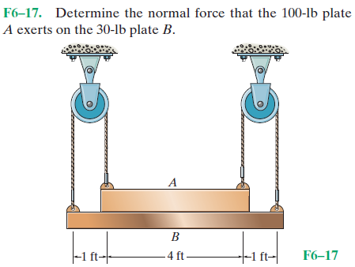
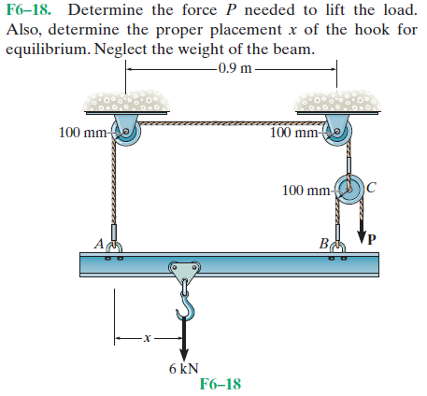
Problems

Slide 23
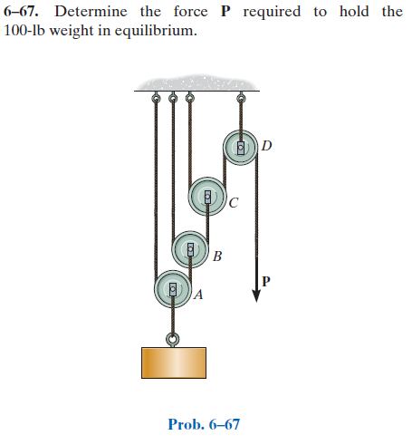
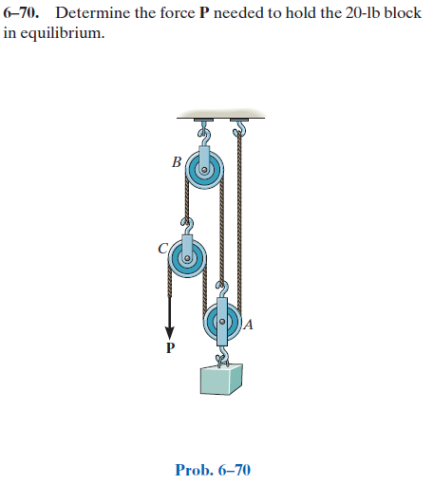
Problems

Slide 24
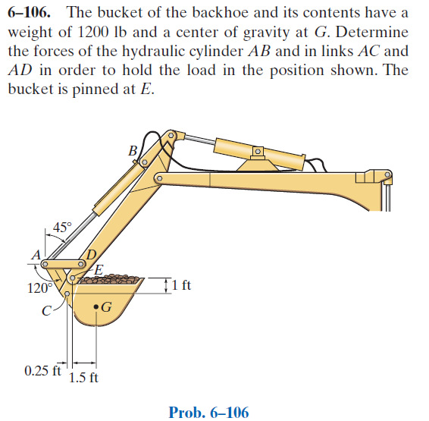
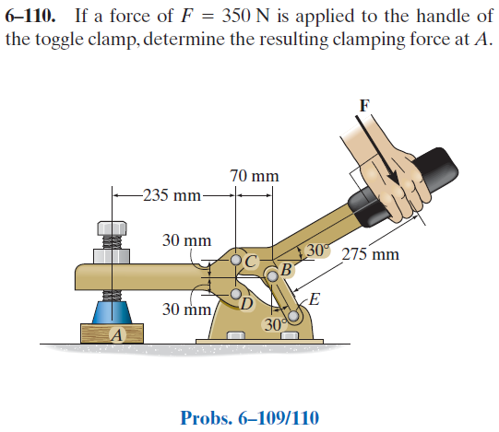
Problems

