Slide 1
PROGRAM BANTUAN PDK
KEMDIKBUD 2024
PROGRAM STUDI TEKNOLOGI PANGAN
UNIVERSITAS PGRI SEMARANG
&
PROGRAM STUDI TEKNOLOGI HASIL PERTANIAN
UNIVERSITAS VETERAN BANGUN NUSANTARA SUKOHARJO

Slide 2
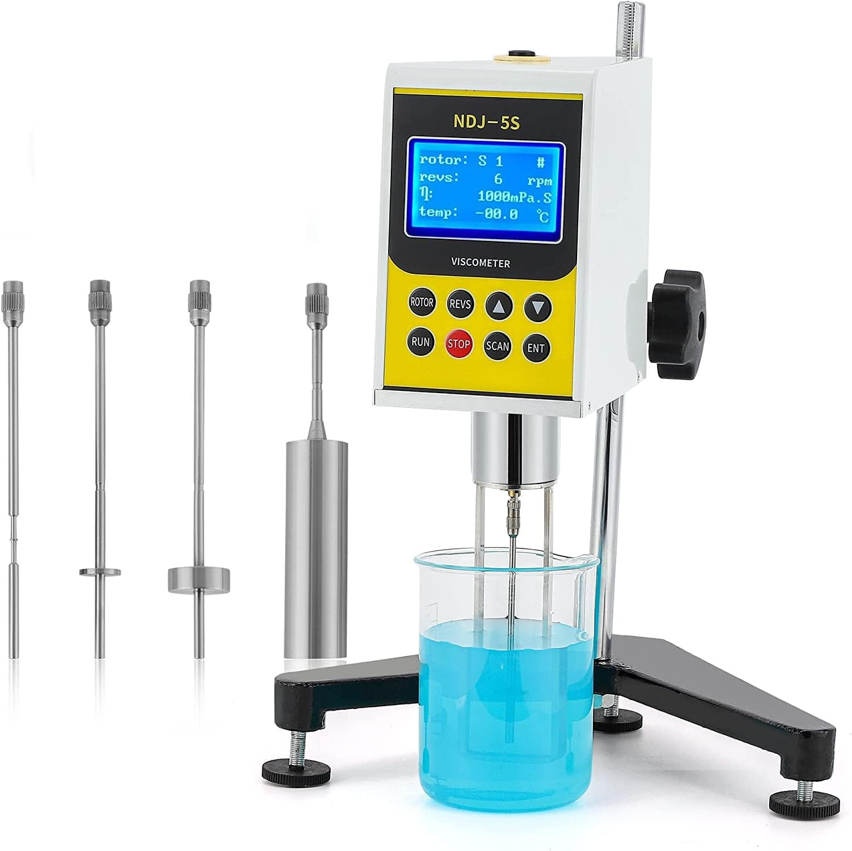
Analisis
VISKOSITAS
Program Studi Teknologi Pangan
Universitas PGRI Semarang
&
Program Studi Teknologi Hasil Pertanian
Universitas Veteran Bangun Nusantara Sukoharjo

Slide 3
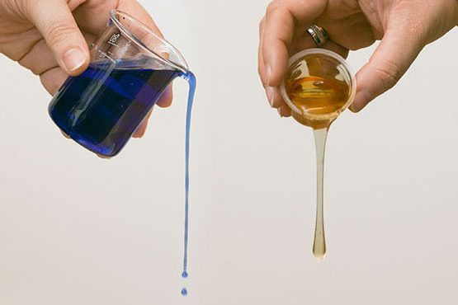
Pengertian rheology
Rheologi adalah ilmu yang mempelajari sifat aliran dan perubahan bentuk (deformasi) suatu bahan akibat adanya pengaruh gaya mekanis yang mengenainya.
REOLOGI
Bahan pangan fluida??
saus tomat
es krim
coklat
pudding/gel?
Kenapa rheologi penting ?
Keperluan Disain Proses
Evaluasi Proses
QC
Konsumen
Pengujian umur simpan
PROGRAM BANTUAN PDK KEMDIKBUD 2024

Slide 4
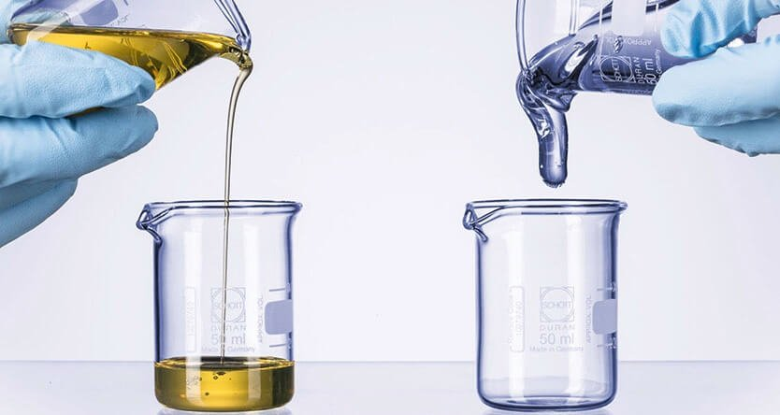
Viscosity properties
FLUIDA :
Senyawa/bahan yang dapat mengalir tanpa mengalami disintegrasi jika dikenakan tekanan kepada bahan tersebut.
FLUIDA :
GAS CAIRAN PADATAN
Karakteristik Aliran ………………> REOLOGI

Slide 5
Viscosity properties
Densitas :
massa per satuan volume
Satuan
SI : kg.m⁻³
Lainnya : lb_{m}.ft⁻³ , g.cc⁻¹ atau g.cm⁻³
Kompresabilitas :
Perubahan densitas fluida karena perubahan suhu atau tekanan
sangat penting untuk gas
dapat diabaikan untuk cairan
Viskositas................?

Slide 6
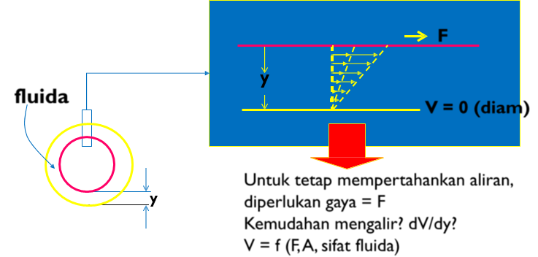
Viscosity properties
Batasan Viskositas
Perhatikan dua silinder Konsentrik :
Silinder dalam : BERGERAK/BERPUTAR
Silinder luar : DIAM
Fluida terdapat diantara dua tabung

Slide 7
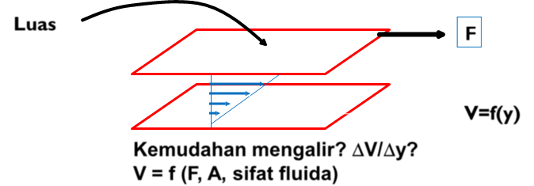
Viscosity properties
Viskositas :
Suatu ukuran mudah atau sukarnya suatu bahan untuk mengalir

Slide 8
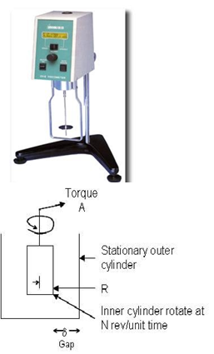
Viscosity Analysis
Pengukuran Viskositas Dengan Rotational viscometer
Untuk mengukur kekentalan dan sifat aliran suatu cairan
Didasarkan pada gaya rotasi oleh spindle yang diatur kecepatan putarnya.
Diameter dan bentuk spindle berbeda-beda yang biasanya diberi nomor #1, #2, #3, dst
Torque: Persen terhadap maksimum kecepatan rotasi dari spindle.
100%: spindle berputar pada kecepatan maksimumnya,
0%: spindle dalam keadaan diam.

Slide 9
Viscosity Analysis
Kecepatan rotasi (rpm) | Faktor
0,3 0,6 1,5 3 6 12 30 60 | 4000 2000 800 400 200 100 40 20
Contoh:
Bila suatu cairan dilakukan pengukuran viskositas pada kecepatan rotasi 6 rpm dengan spindle #3, nilai torque yang terbaca adalah 40.6%. Dengan demikian, nilai viskositas adalah 40.6%*200 = 8120 mPa.s = 8.12 Pa.s.

Slide 10
Texture Analyzer
Note µ [=] g cm⁻¹det⁻¹ = poise
1 poise = 100 cp
Contoh:
air (20ºC, 1 atm) = 1.0019 cp
air (80ºC, 1 atm) = 0.3548 cp
udara (20ºC, 1 atm) = 0.01813 cp
C₂H₅OH (lq; 20ºC, 1 atm) = 1.194 cp
H₂SO₄ (lq; 25ºC, 1 atm) = 19.15 cp
glycerol (lq; 20ºC, 1 atm) = 1069 cp

Slide 11
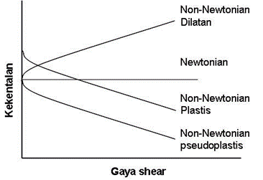
Newtonian and Non-Newtonian Foods
Newtonian foods:
bahan yang nilai kekentalannya tidak dipengaruhi oleh besarnya gaya yang mengalirkan atau menggerakkannya
Non-Newtonian foods: nilai kekentalan akan sangat dipengaruhi oleh gaya yang diberikan
Gambar 8.2. Pengaruh gaya pengadukan terhadap nilai kekentalan untuk cairan Newtonian dan non-Newtonian

Slide 12
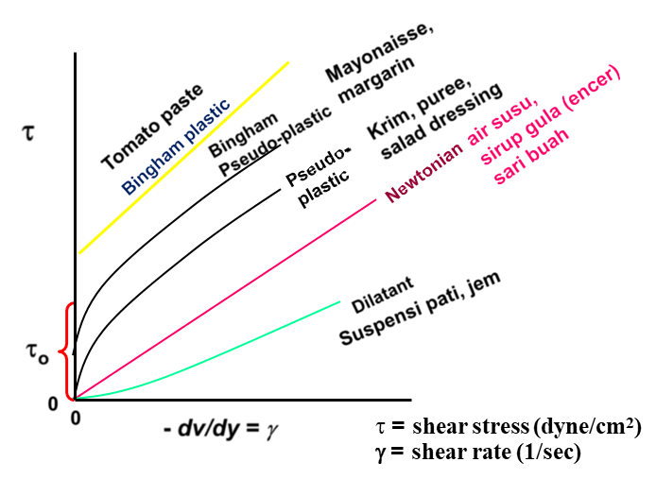
Newtonian and Non-Newtonian Foods
Hubungan antara gaya geser vs. laju geser (gradien kecepatan) untuk fluida newtonian dan non-newtonian

Slide 13
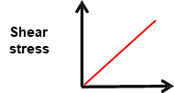
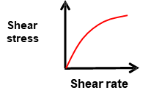
Newtonian and Non-Newtonian Foods
Newtonian Foods
Pseudoplastic (Shear thinning) Foods
Examples:
Water
Milk
Vegetable oils
Fruit juices
Sugar and salt solutions
Examples:
Apple sauce
Banana puree
Orange juice concentrate
Oyster sauce
CMC solution

Slide 14
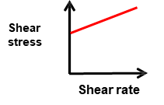
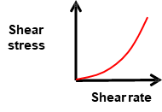
Newtonian and Non-Newtonian Foods
Dilatant (Shear thickening) Foods
Bingham Plastic Foods
Examples:
Liquid Chocolate
40% Corn starch solution
Examples:
Tooth paste
Tomato paste

Slide 15
Importance of yield stress
When stress is less than yield stress, material does not flow. It behaves like a solid
Important for development of materials like butter, yogurt, cheese spread
PROGRAM BANTUAN PDK KEMDIKBUD 2024

Slide 16
Examples and characteristics of Newtonian and non-Newtonian foods
PROGRAM BANTUAN PDK KEMDIKBUD 2024

Slide 17
PROGRAM BANTUAN PDK KEMDIKBUD 2024

Slide 18
Shear Thinning Behavior
➲ Shear thinning behaviour is often a result of:
 Orientation of non-spherical particles in the direction of flow. An example of this phenomenon is the pumping of fibre slurries.
 Orientation of polymer chains in the direction of flow and breaking of polymer chains during flow. An example is polymer melt extrusion
 Deformation of spherical droplets to elliptical droplets in an emulsion. An industrial application where this phenomenon can occur is in the production of low fat margarine.
 Breaking of particle aggregates in suspensions. An example would be stirring paint.
PROGRAM BANTUAN PDK KEMDIKBUD 2024

Slide 19
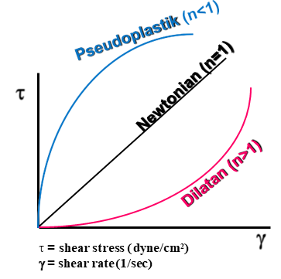
Non-Newtonian
τ= K (γ )^{n ...............}> model Power law
n : Indeks tingkah laku aliran (flow behavior index)
K : Indeks konsistensi (consistency index)
A. Newtonian
τ = μ (γ ),
model power law dgn K=μ dan n=1
B. Pseu.doplastik
τ= K(γ )^{n}, n<1
C. Dilatan
τ= K(γ )^{n}, n>1
PROGRAM BANTUAN PDK KEMDIKBUD 2024

Slide 20
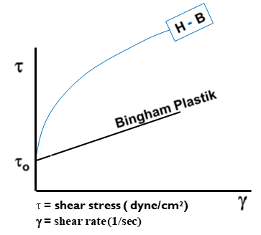
Pengukuran Sifat Aliran Dengan Rotational Viscometer
Non-Newtonian
τ= τ₀ + K (γ)^{.n ...............}> model Herschel-Bulkley
K : Indeks tingkah laku aliran (flow behavior index)
n : Indeks konsistensi (consistency index)
τ_{o} : gaya geser awal (yield stress)
A. Bingham plastik
τ = τ_{o} + K(γ); n = 1
B. Fluida H – B
τ= τ_{o} + K(γ)^{n}; n<1
PROGRAM BANTUAN PDK KEMDIKBUD 2024

Slide 21
Pengukuran Sifat Aliran Dengan Rotational Viscometer
Gunakan:
τ= K (γ )^{n ...............}> model “Power law”
Shear stress dihitung dengan rumus berikut:
$τ=\frac{A×I}{R.2πRL}$
Shear rate dihitung dengan rumus berikut:
$γ=\frac{2πRN}{δ}$
PROGRAM BANTUAN PDK KEMDIKBUD 2024

Slide 22
Standard Operating Procedures (SOP)- Viscometer
Sumber : https://www.youtube.com/watch?v=DGtmrxz3Xko
PROGRAM BANTUAN PDK KEMDIKBUD 2024

Slide 23
Prosedur Analisis
Gunakan spindle silinder atau plate. Untuk spindle berbentuk silinder, dapat dilengkapi dengan thermo jacket housing untuk meletakkan sampel. Thermo jacket housing ini dihubungkan dengan thermostatic circulator, sehingga suhu sampel dapat konstan.
Dengan menggunakan thermo jacket housing ini, gap (δ) antara dinding spindle dengan dinding jacket cukup kecil, sehingga jumlah sampel yang diukur pun sedikit (maksimum 16 ml).
Pada alat ini data shear stress dan shear rate bisa langsung diperoleh, sehingga data yang dikumpulkan dapat diperoleh dengan menggunakan persamaan model Power law.
Untuk menentukan apakah terdapat yield stress, maka model Herchel-Bulkley dapat digunakan.
Nilai viskositas apparent (dalam mPa) dapat ditentukan pada shear rate tertentu, dimana nilainya dapat dihitung dengan menggunakan rumus : μ=τ/γ*100 (pengali 100 adalah untuk mengkonversi nilai Pa menjadi mPa).
PROGRAM BANTUAN PDK KEMDIKBUD 2024

Slide 24
Factors Affecting Viscosity
Temperature
Usually there is an inverse relationship between viscosity and temperature
The temperature increase, the viscosity decrease
2. Solute Concentration
Usually it is a direct non-linear relationship between solute concentration and viscosity at affixed temperature
3. Molecular Weight of Solute
There is usually a non-linear relationship between the molecular weight of the solute and the viscosity of the solution at equilibrium concentration
Corn syrup is made by hydrolyzing with high molecular weight starch to dextrose
PROGRAM BANTUAN PDK KEMDIKBUD 2024

Slide 25
Factors Affecting Viscosity
4. Pressure
The viscosity of most liquids is basically constant at a pressure range of 0-100 atm
So the effect of pressure can usually be ignored for food
5. Material Suspension
Usually this slightly increase the viscosity when at low concentrations, but high suspended material can cause a significant increase
PROGRAM BANTUAN PDK KEMDIKBUD 2024

Slide 26
Rapid Visco Analyzer
Pengukuran Sifat Gelatinisasi Pati
Profil viskositas dan kemampuan membentuk gel dari pati selama proses pemasakan
Instrumen:
Rapid Visco Analyzer (RVA)
Brabender Amylograph
Brabender Farinograph
Brabender Extensograph
Satuan viskositas: cP, Brabender Unit (BU), Rapid Visco Unit (RVU)
PROGRAM BANTUAN PDK KEMDIKBUD 2024

Slide 27
Rapid Visco Analyzer
Principles:
The rapid visco analyzer indicates starch viscosity by measuring the resistance of a flour and water slurry to the stirring action of a paddle.
When the slurry is heated, the starch granules swell and make the slurry thicker.
A thicker slurry has more resistance to the paddle during stirring and has a higher peak viscosity.
The highest point during the heating cycle is the peak viscosity which is expressed in rapid visco units (RVU).
PROGRAM BANTUAN PDK KEMDIKBUD 2024

Slide 28
Rapid Visco Analyzer
Example Method:
A sample of 3.5 grams of flour is mixed with 25 millilitres of water to form a slurry.
The rapid visco analyzer stirs the slurry as it is heated from 60 to 95 degrees Celsius in 6 minutes.
The maximum viscosity (peak viscosity) is recorded as a curve by the rapid visco analyzer.
PROGRAM BANTUAN PDK KEMDIKBUD 2024

Slide 29
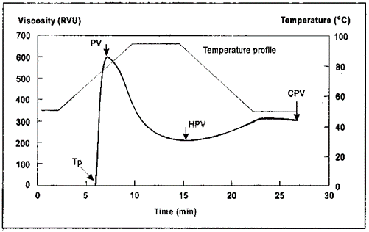
Rapid Visco Analyzer
Why is this important?
The RVA test measures flour starch properties.
For Asian noodle products, medium to high-peak viscosity flour is preferred because it gives the noodles better texture characteristics.
The rapid visco analyzer can also be used to determine the stirring number, which is related to sprout damage. A stirring number test is performed to measure enzyme activity that results from sprout damage (alpha-amylase enzyme activity).
Sprouting in wheat results in flour that produces sticky dough, poor colour and weak texture.
Unit Measurements in RVA:
SNU (Stirring Number Unit)
RVU (rapid visco unit)
Conversion: 1 RVU = 12 cp = 12 mPa.s
PROGRAM BANTUAN PDK KEMDIKBUD 2024

Slide 30
Rapid Visco Analyzer
Perbedaan suhu gelatinisasi dari beras varietas A dan B
PROGRAM BANTUAN PDK KEMDIKBUD 2024

