Slide 1
Effective Paragraph
Mariyatul Kiptiyah, M.Pd
Adolfina M.S Moybeka, M.Pd.

Slide 2
Paragraph
a group of sentences about one topic. It contains a topic sentence, supporting details and sometimes a concluding sentence. The sentences follow one another from the beginning to the end of the paragraph. A paragraph is usually part of a longer piece of writing, such as a letter or essay

Slide 3
Types of Paragraph
The descriptive paragraph
The narrative paragraph
The expository paragraph
The persuasive paragraph

Slide 4
Structure of Paragraph
A topic sentence: this states the main topic of the paragraph and the controlling idea
Supporting sentences: these develop the topic sentence
A concluding sentence: this signals the end of the paragraph and leaves the reader with important points to remember, but is often unnecessary

Slide 5
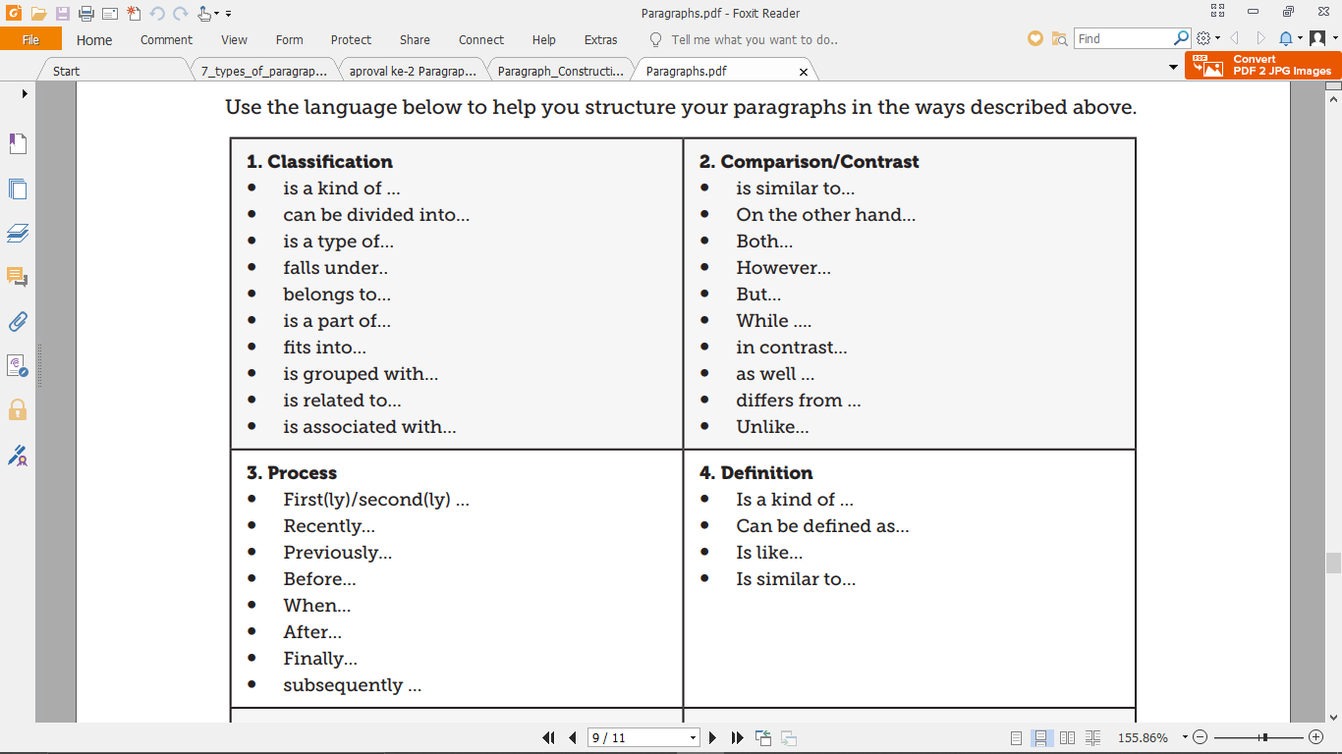
Language to develop ideas within paragraphs

Slide 6
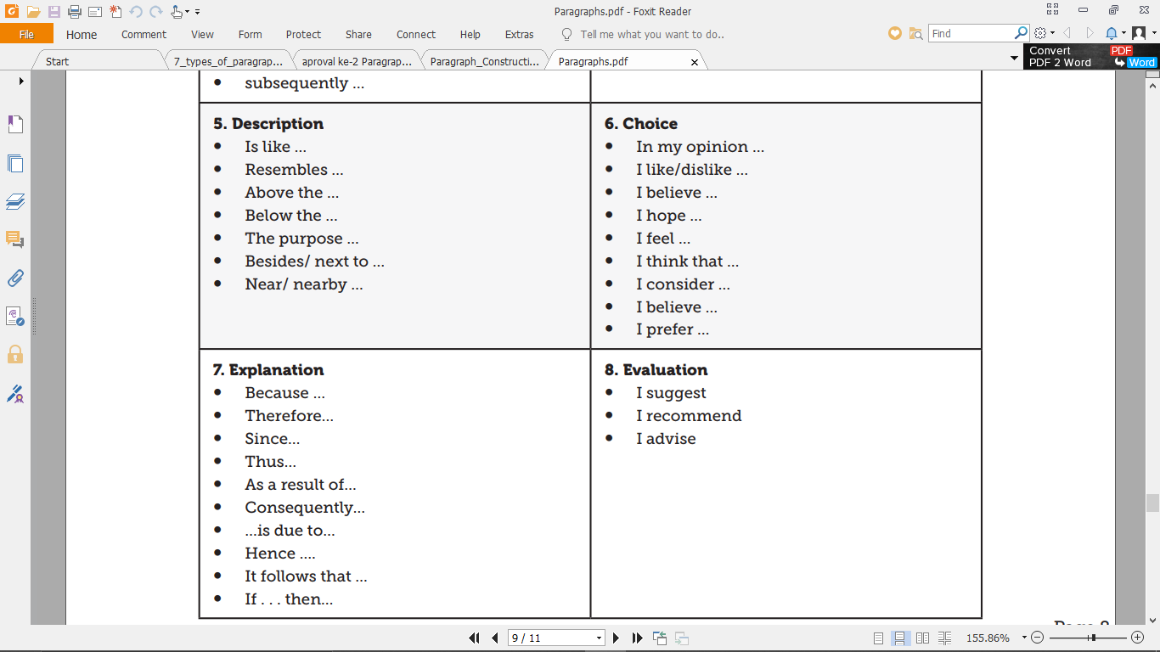

Slide 7
The layout of paragraph.

Slide 8
Thankyouu
Hopefully you can gain useful knowledge from this material. Good luck !

