Slide 1
Critical Listening
Meeting 13

Slide 2
Intercultural Communication

Slide 3
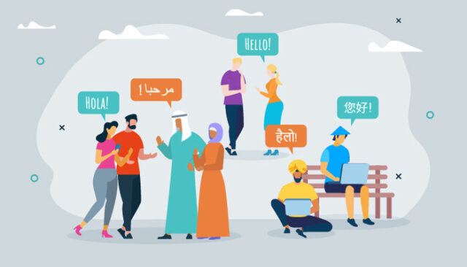

Slide 4
The process of sharing and interpreting messages and meaning between people from different cultures.

Slide 6
What happened in the video?
Why did that happen
What do you suggest to avoid such situation?

Slide 7
Intercultural Awareness
The ability to recognize, respect, and appreciate the differences between cultures.

Slide 8
The Advantages
Intercultural awareness can help people break down cultural barriers and build bridges.
It helps people relate better to people with cultural differences, which can lead to less cultural conflict and more cultural connection.

Slide 10
Why is intercultural understanding important?
We are now more connected than ever to other people worldwide, thanks to fast transportation, global media, and the world wide web.
Misunderstanding resulting from a lack of familiarity with another culture are often embarrassing.
Blunders like this can make it difficult, if not possible , to reach an agreement with another country or close a business contract with a foreign partner.
For travelers, a faux pas can also make interactions more awkward.

Slide 12
Ways to Increase Cultural Awareness
Understand your own culture
Increase self-awareness
Learn about the history of other cultures
Converse with people from different cultures
Develop friendships
Read literature and watch movies
Learn some languages

Slide 14
What are the body and hand gestures in Indonesia?
What did you learn from today’s discussion?

Slide 15
Thank you

