Slide 1
Equilibrium of a Particle
Statics
Week #4

Slide 2
Condition for the Equilibrium of a Particle
however, the term “equilibrium” or, more specifically, “static equilibrium” is used to describe an object at rest
it remains at rest if originally at rest
A particle is said to be in equilibrium IF
or has a constant velocity if originally in motion
To maintain equilibrium, it is necessary to satisfy
Newton’s first law of motion,
Equation of equilibrium

Slide 3
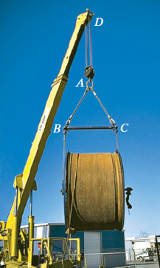
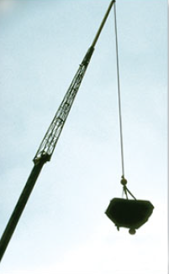
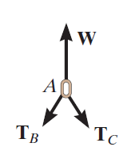
The Free Body Diagram (FBD)
FBD
drawing that shows the particle with all the forces that act on it

Slide 4
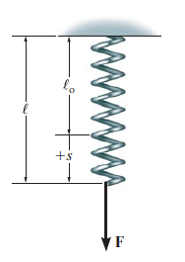
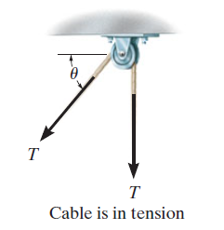
connections often encountered in particle equilibrium problems
Springs
Cables and Pulleys

Slide 5
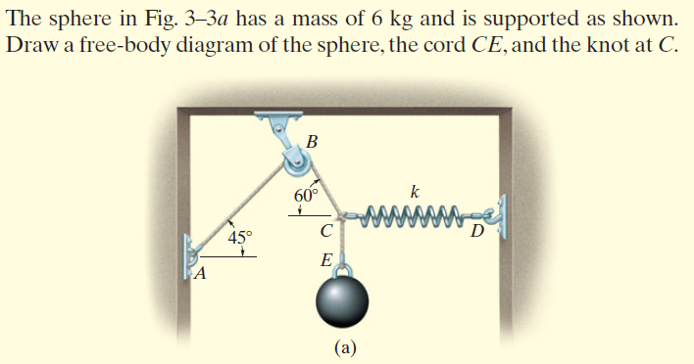
Examples

Slide 6
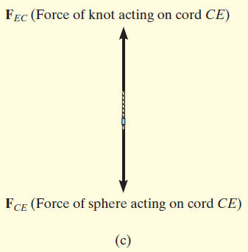
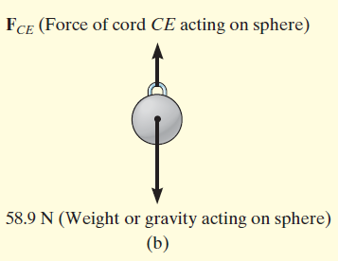
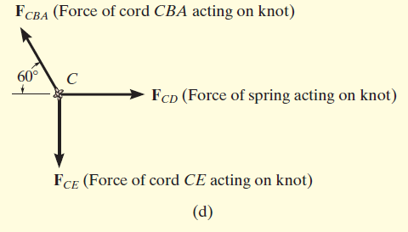

Slide 7
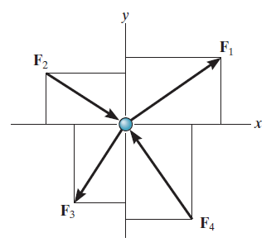
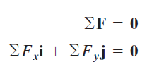
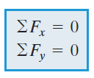
Equilibrium of Coplanar Force System
If a particle is subjected to a system of coplanar forces that lie in the x–y
Plane then each force can be resolved into its i and j components.
For this vector equation to be satisfied, the force’s x and y components must both be equal to zero

Slide 8
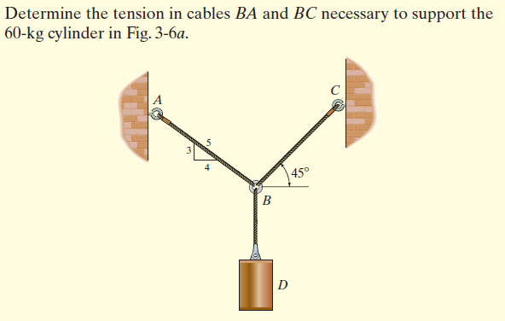
Examples

Slide 9
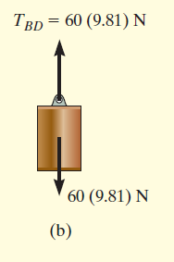
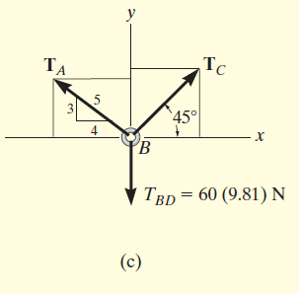
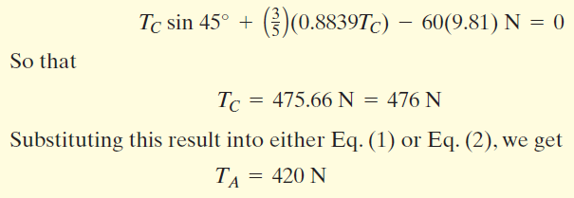
Equations of Equilibrium
(1)
(2)
Free Body Diagram
Substitute (1) to (2)

Slide 10
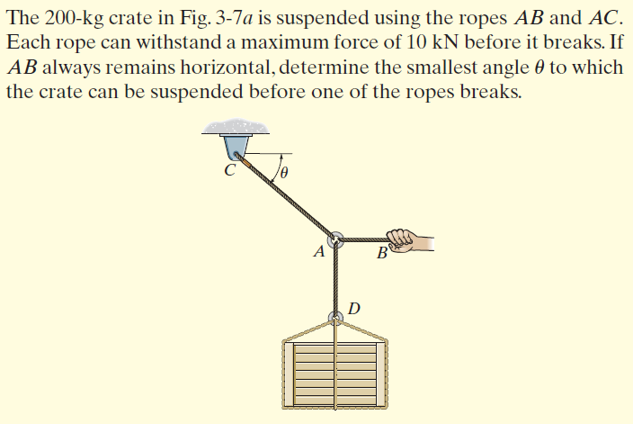
Examples

Slide 11
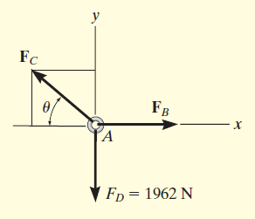
Free Body Diagram
Equations of Equilibrium

Slide 12
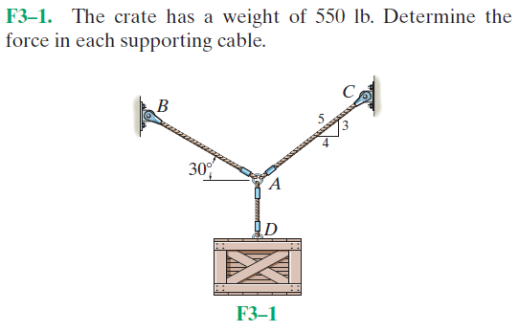
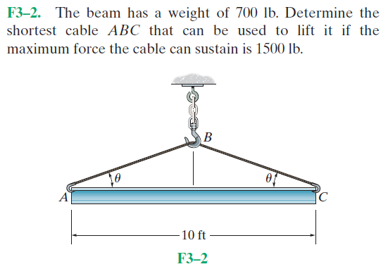
Fundamental Problems
All problem solutions must include an FBD

Slide 13
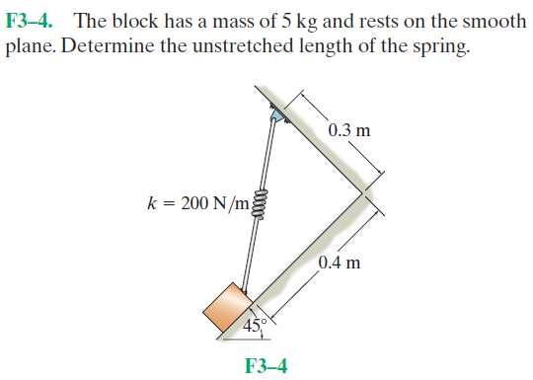
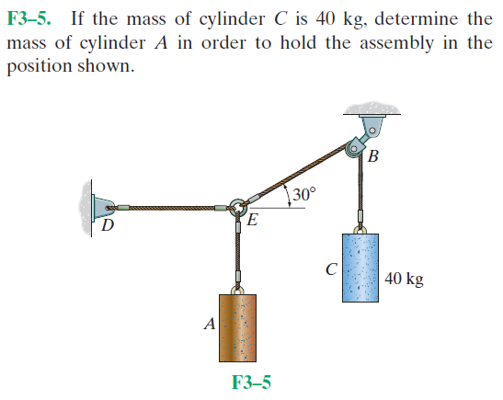
Fundamental Problems

Slide 14
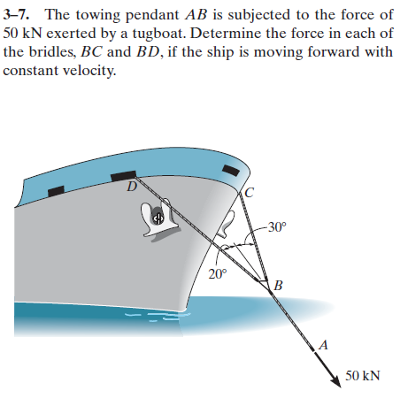
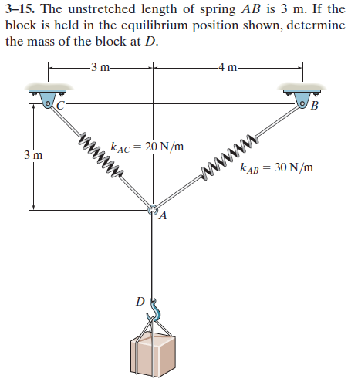
Advanced Problems

Slide 15
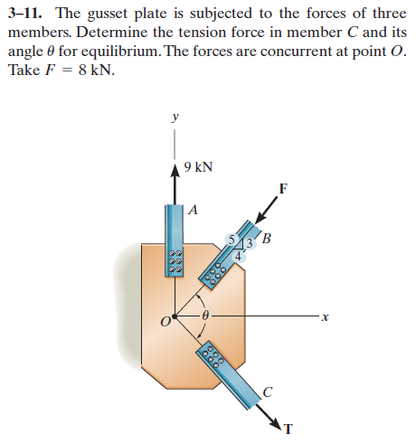
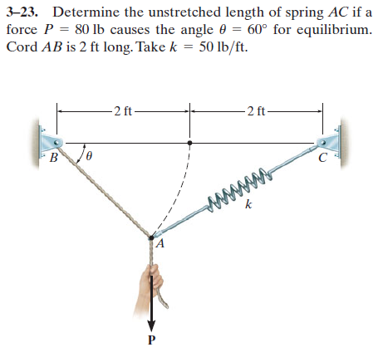
Advanced Problems

Slide 16
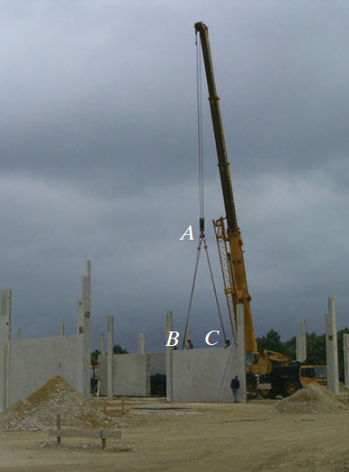
Conceptual Problems

Slide 17
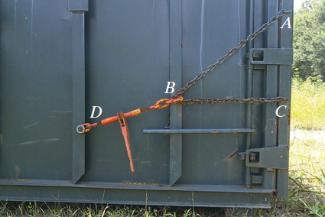
Conceptual Problems

