Slide 1
Pertemuan 3 Pengantar Sistem dan Teknologi Informasi
Khusnul Khotimah, S.Kom., M.T.I.

Slide 2
Perangkat Keras Komputer (Hardware)
Komponen Hardware
Central Processing Unit(CPU)
Media Penyimpanan atau Memory
Input Device (Peralatan Input)
Output Device (Peralatan Output)
Communication Device (Peralatan Komunikasi)

Slide 3
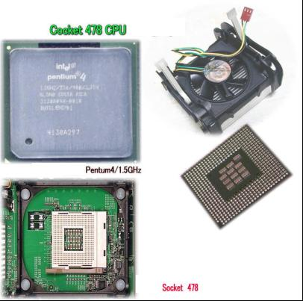
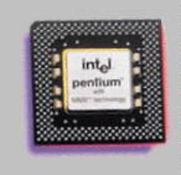
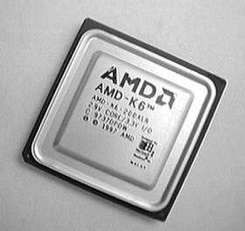
Perangkat Keras Komputer (Hardware) (cont.)
Central Processing Unit (CPU)
Komponen CPU :
Control Unit
Arithmatic Logic Unit (ALU)

Slide 4
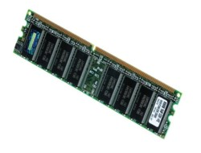
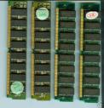
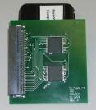
Perangkat Keras Komputer (Hardware) (cont.)
Media Penyimpanan (Storage)
Primary Storage
RAM (Random Access Memory)
DRAM (Dynamic RAM)
SRAM (Static RAM)
EDORAM (Extended Data Out RAM )
72 pin
SDRAM
168 pin

Slide 5
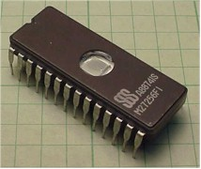
Perangkat Keras Komputer (Hardware) (cont.)
ROM (Read Only Memory)
PROM EEPROM
EPROM

Slide 6
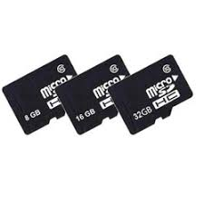
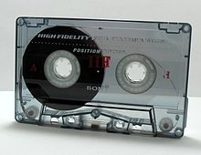
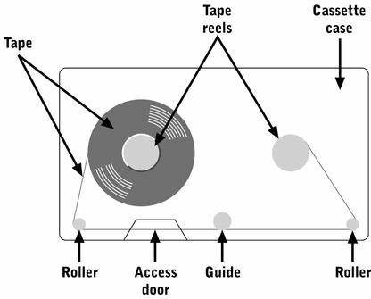
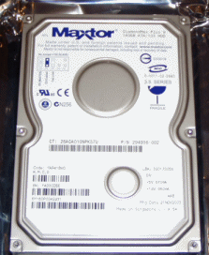
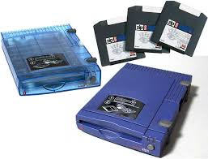
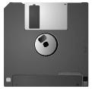
Secondary Storage (Cont..)
Magnetic Storage
Magnetic tape
Magnetic Disk
Hard Disk
Floppy Disk (Diskette) MMC
Flash Memory Zip Drive

Slide 7
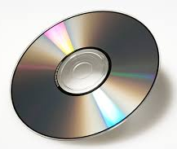
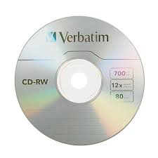
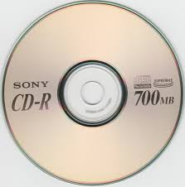
Secondary Storage (Cont..)
Optical Storage
CD
CD-R
CD-RW
DVD

Slide 8
Perangkat Keras Komputer (Hardware) (cont.)
Perbandingan Primary Storage dan Secondary Storage :
Temporary vs Permanent
Hanya dapat menyimpan data jika komputer nyala vs Dapat menyimpan data jika komputer mati

Slide 9
Perangkat Keras Komputer (Hardware) (cont.)
Peralatan Input (Input Device)
Keyboard
Pointing Device
Mouse
Trackball
Joystick

Slide 10
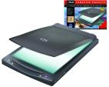
Perangkat Keras Komputer (Hardware) (cont.)
Optical Reading Device (scanner)
Barcode Reader Image Scanner
Handprint Reader

Slide 11
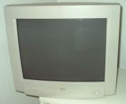
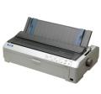
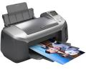
Perangkat Keras Komputer (Hardware) (cont.)
Peralatan Output (Output Device)
Visual Display (Monitor)
Printer
Impact Printer
: dot matrix printer
Non Impact Printer
: inkjet printer

Slide 12
Perangkat Keras Komputer (Hardware) (cont.)
Plotters
Computer Output Microfilm (COM)
Audio Response Unit (ARU)
Voice Output Device dalam bentuk Flash Memory

Slide 13
Perangkat Keras Komputer (Hardware) (cont.)
Peralatan Komunikasi (Communication Device)
Modem (Modulation Demodulation)
External vs Internal Modem
Smart Modem
Fax modem

Slide 14
End

