Slide 1
Addition of a System of Coplanar Forces

Slide 2
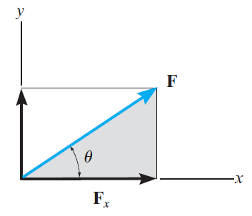
Rectangular Components of a Force
When a force is resolved into two components along the x and y axes, the components are then called rectangular components
Scalar Notation
F = F_{x} + F_{y}
Rectangular components of F
their magnitudes can be determined from

Slide 3
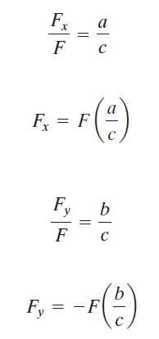
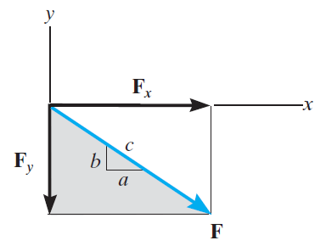
Rectangular Components of a Force
The magnitudes of the rectangular components can also be defined as:

Slide 4
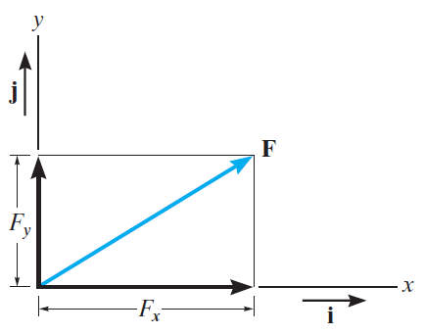
Rectangular Components of a Force
Cartesian Vector Notation
It is also possible to represent the x
and y components of a force in terms of Cartesian unit vectors i and j
Each of these unit vectors has a dimensionless magnitude of one, and so
they can be used to designate the directions of the x and y axes, respectively
Cartesian vector notation of F then can be defined as:

Slide 5
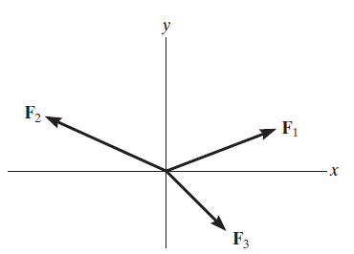
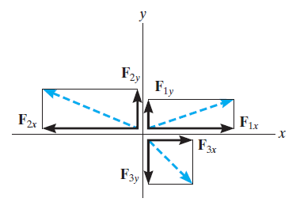
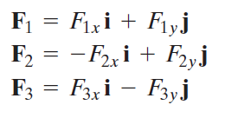
Rectangular Components of a Force
Coplanar Force Resultants
Using Cartesian vector notation, each force is first represented as a Cartesian vector
The vector resultant is
therefore

Slide 6
Rectangular Components of a Force
If scalar notation is used, then we have

Slide 7
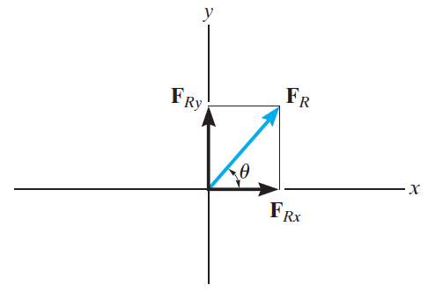
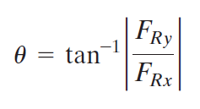
Rectangular Components of a Force
The magnitude of F_{R} then can be found from the Pythagorean theorem, that is:
and the direction of resultant,

Slide 8
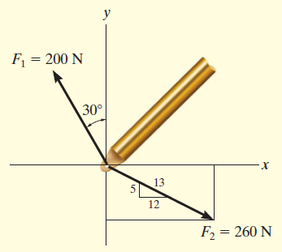
Examples

Slide 9
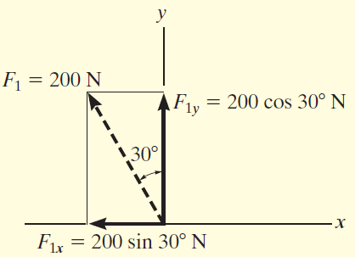
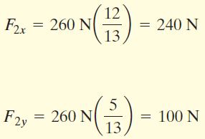
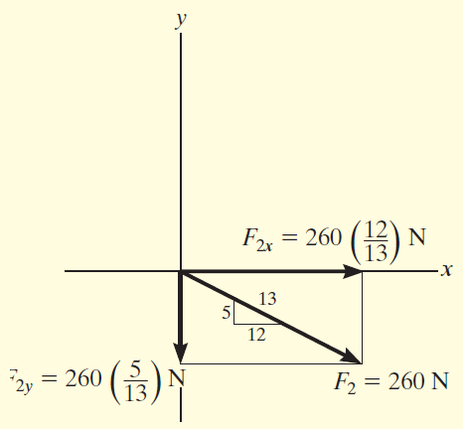
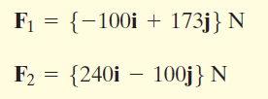
Hence cartesian vector notation is as follow,

Slide 10
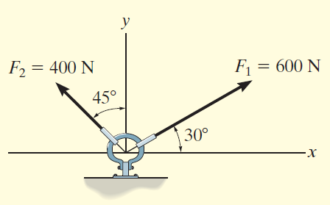
Examples

Slide 11
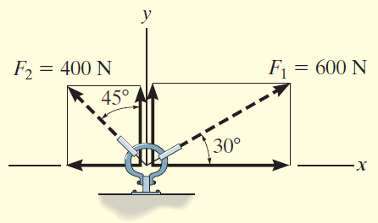
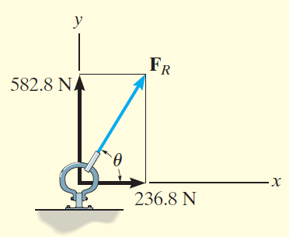
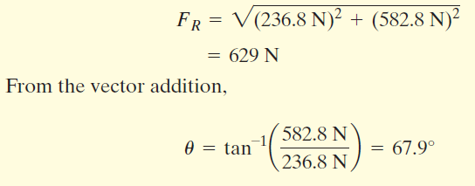
Solution I, Scalar notation

Slide 12
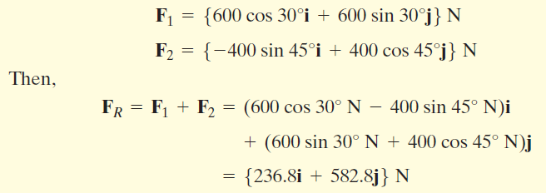
Solution II, Vector notation

Slide 13
“The most effective way of learning the principles of engineering mechanics
is to solve problems”
(R.C. Hibbeler)

Slide 14
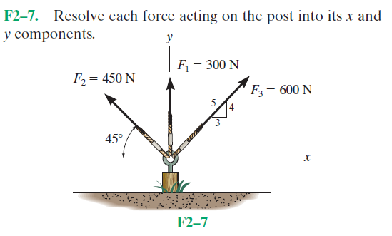
Fundamental Problems

Slide 15
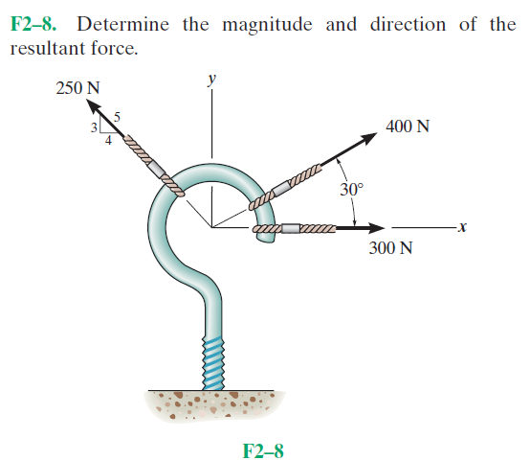
Fundamental Problems

Slide 16
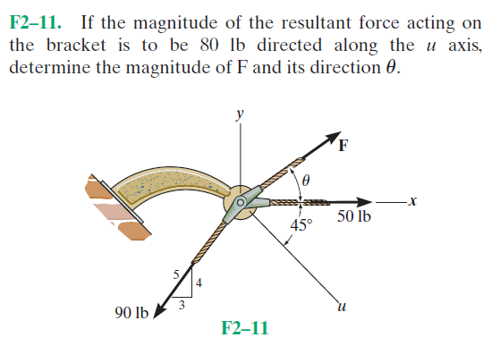
Fundamental Problems

Slide 17
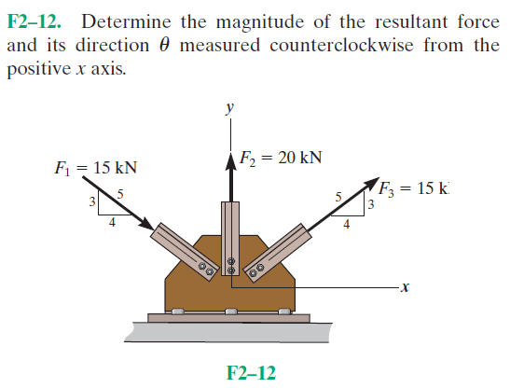
Fundamental Problems

Slide 18
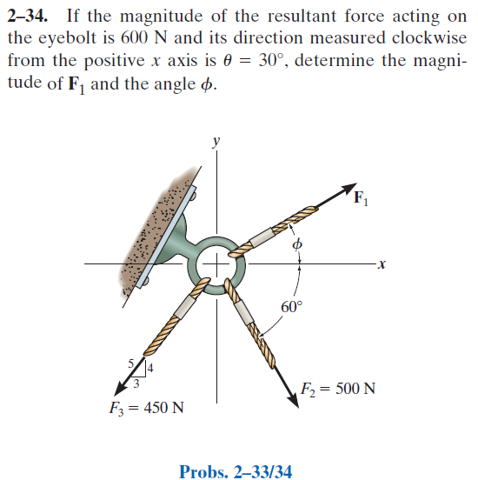
Advanced Problems

Slide 19
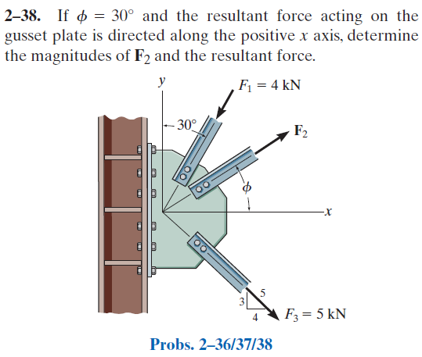
Advanced Problems

Slide 20
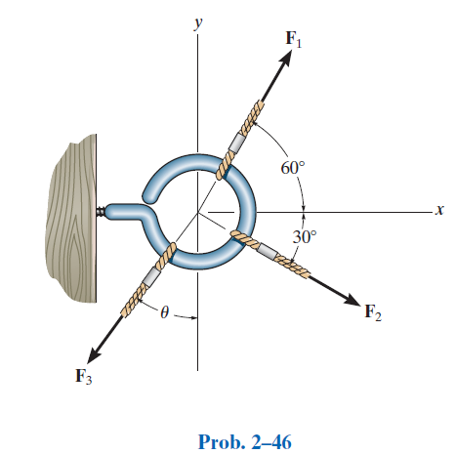
Advanced Problems

