Slide 1
K NEAREST NEIGHBORS
Muchamad Kurniawan., S.Kom., M.Kom

Slide 2
INTRODUCTION
K- Neirest Neighbor (KNN) merupakan algoritma klasifikasi (supervised) yang sangat popular.
Algoritma ini merupakan algoritma klasifikasi berdasarkan jarak
KNN first developed by Evelyn Fix and Joseph Hodges in 1951

Slide 3
KONSEP
X
Blue or Red?
Y

Slide 4
KONSEP
X
D3
D2
D4
D1
Algorithm
Set k
Calculate Distance (D)
Sorting Distance
Determine Class based on majority Class of k Data
D5
Blue or Red?
Y

Slide 5
EXAMPLE
X | Y | Class
1 | 6 | 1
1,9 | 1,2 | 1
1,9 | 3,2 | 1
7,5 | 29 | 2
7,5 | 30 | 2
6 | 3 | ?
Algorithm
Set k = 3
Calculate Distance (D)
Sorting Distance
Determine Class based on majority Class of k Data
X
D3 = 5
D2 = 2
D4 = 3
D1 = 7
D5 = 4
Blue or Red?
Y

Slide 6
EXAMPLE
Algorithm
Set k = 3
Calculate Distance (D)
Sorting Distance
Determine Class based on majority Class of k Data
X
D2 = 2
D4 = 3
D5 = 4
Blue or Red?
Y

Slide 7
EXAMPLE
Algorithm
Set k = 3
Calculate Distance (D)
Sorting Distance
Determine Class based on majority Class of k=3 Data
X
D2 = 2
D4 = 3
D5 = 4
Y

Slide 8
CODE
Flow Process:
Read Dataset
Data Preparation
Data Preprocessing
Split Data
Set k
Calculate distance
Sorting
Voting

Slide 9
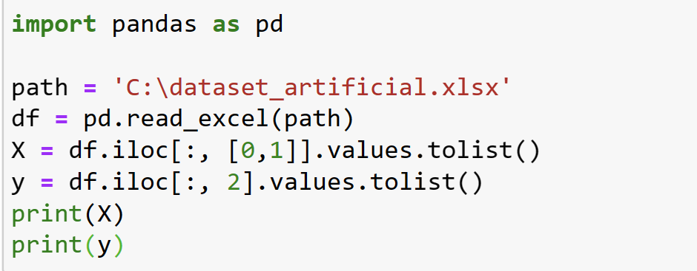
CODE
Flow Process:
Read Dataset
Data Preparation
Data Preprocessing
Split Data
Set k
Calculate distance
Sorting
Voting
Create Excel Dataset
Create New Project
Read Excel File to Data Structured (List)

Slide 10
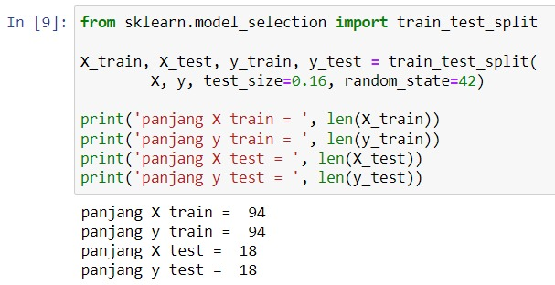
CODE
Flow Process:
Read Dataset
Data Preparation
Data Preprocessing
Split Data
Set k
Calculate distance
Sorting
Voting
Split Dataset

Slide 11
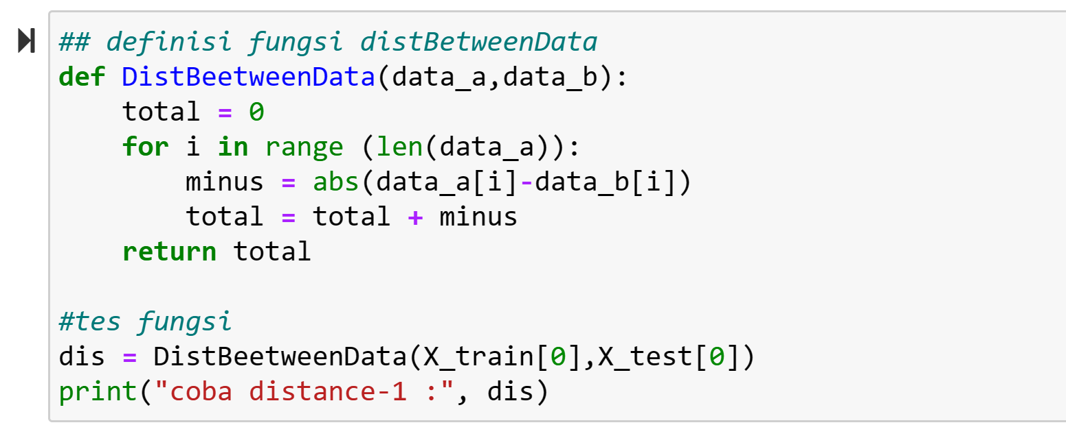
CODE
Calculate distance

