Slide 1
Force System Resultants
Statics
Week #5

Slide 2
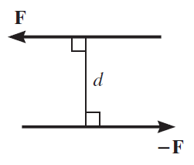
Moment of Couple
A couple is defined as two parallel forces that have the same magnitude,
but opposite directions, and are separated by a perpendicular distance d,
Since the resultant force is zero, the only effect of a couple is to produce a rotation or tendency of rotation in a specified direction

Slide 3
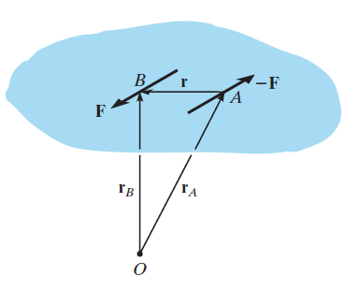
Moment of Couple
The moment produced by a couple is called
a couple moment.
The couple moment determined about O is therefore,

Slide 4
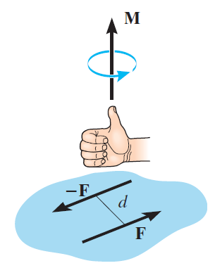
Moment of Couple
Scalar formulation
The moment of a couple, M, is defined as having a magnitude of
Vector formulation

Slide 5
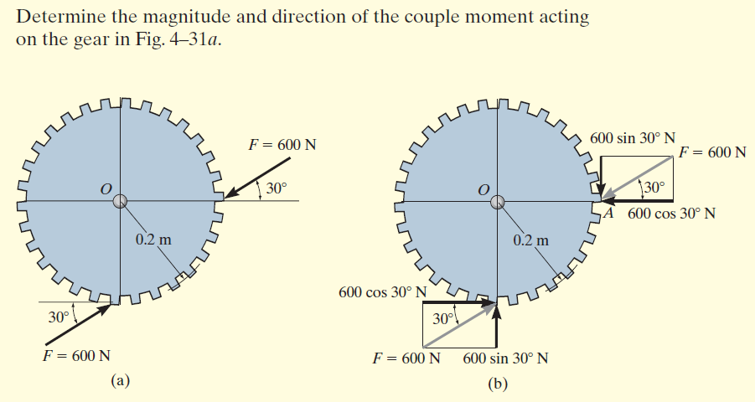
Example

Slide 6
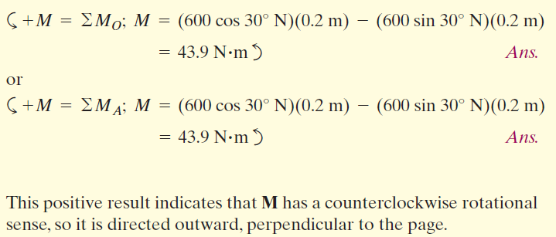

Slide 7
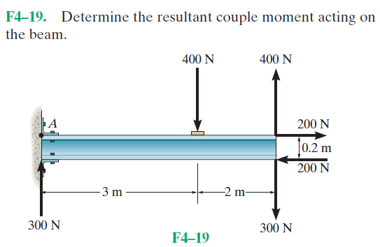
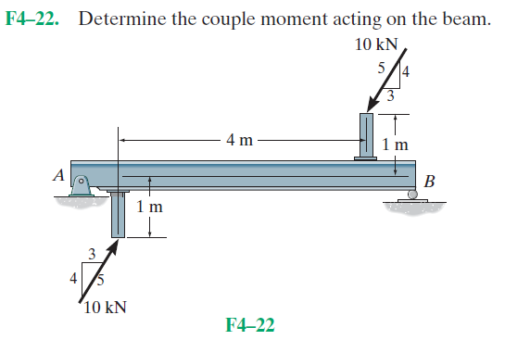
Problems

Slide 8
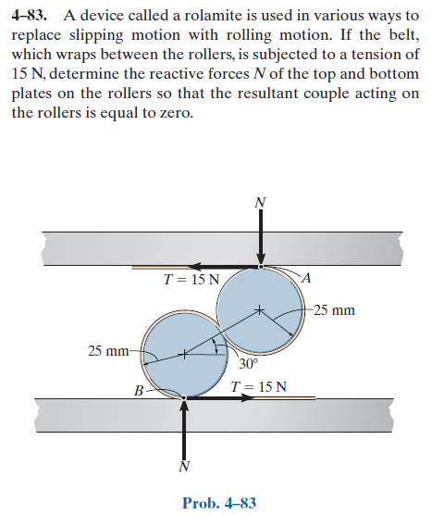
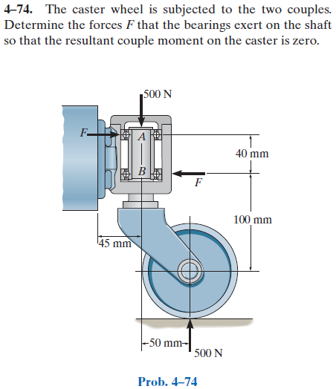
Advanced Problems

Slide 9
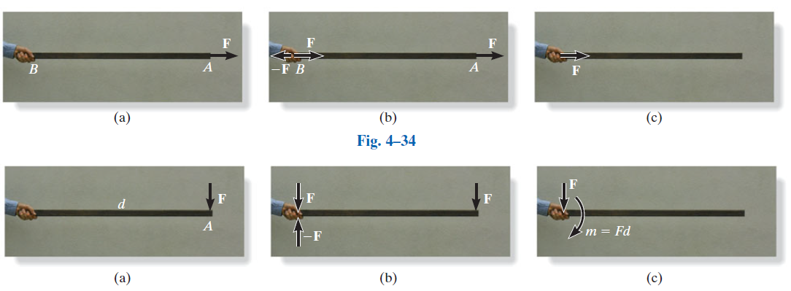
Simplification of a Force and Couple System

Slide 10
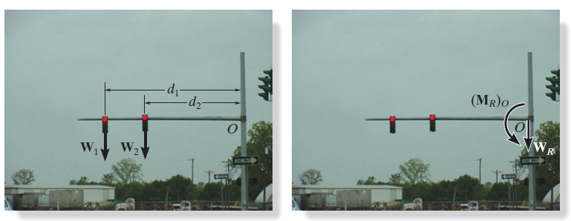
Simplification of a Force and Couple System
The weights of these traffic lights can be replaced by their equivalent resultant force
W_{R} = W₁ + W₂ and a couple moment (M_{R})_{O} = W₁d₁ + W₂d₂ at the support, O.

Slide 11
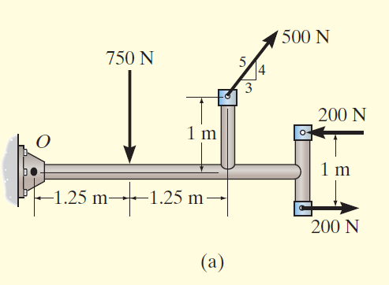
Example

Slide 12
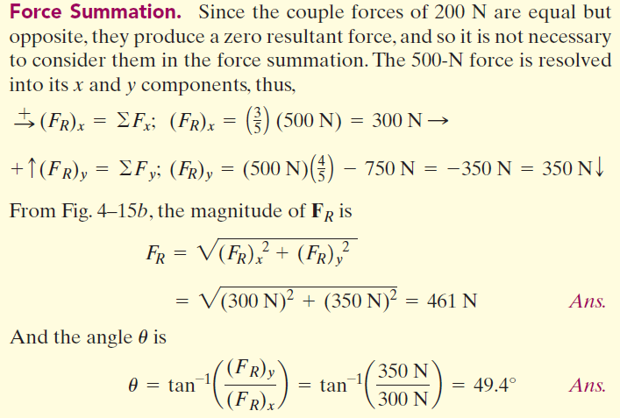
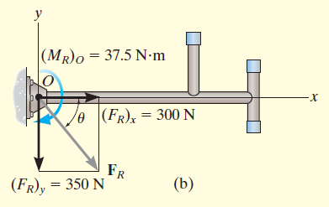

Slide 13
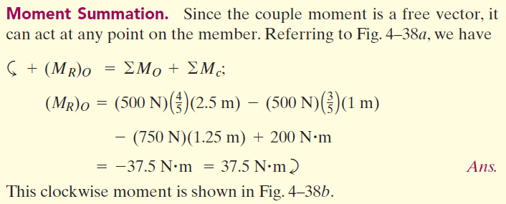

Slide 14
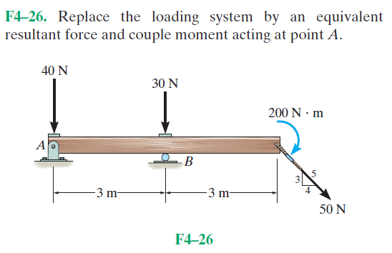
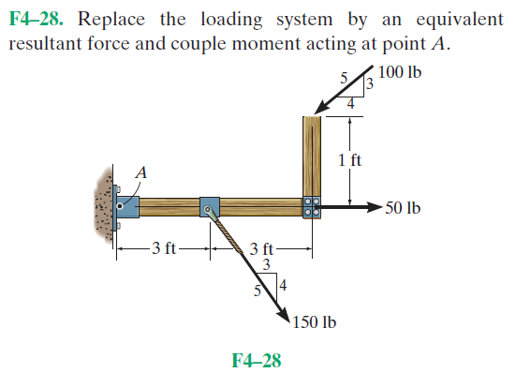
Fundamental Problems

Slide 15
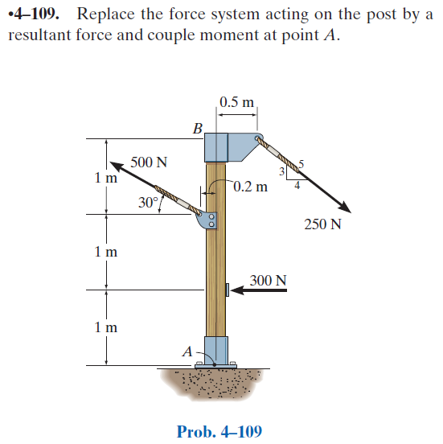
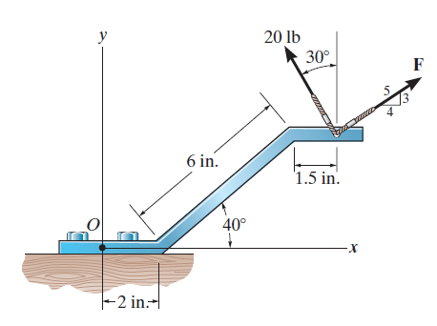
Advanced Problems

