Slide 1

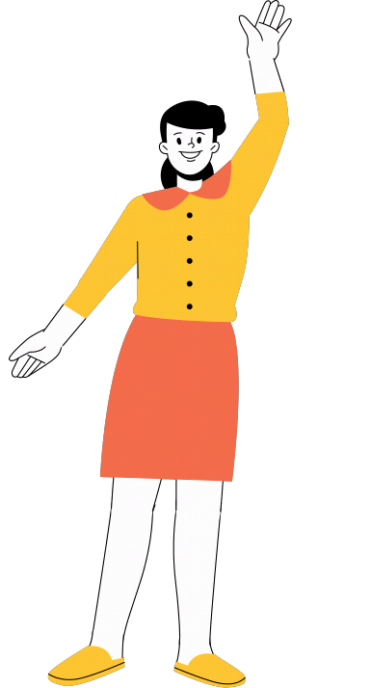
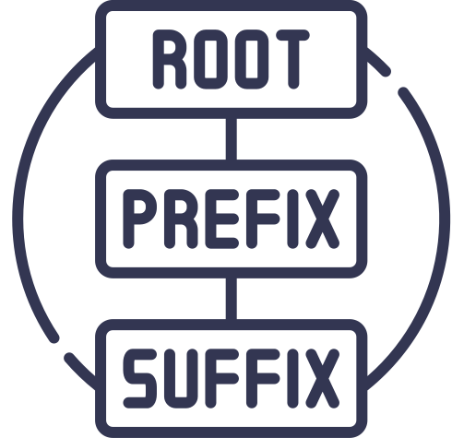

basic concept of english morphology
Presented By:
Sianna, S.Pd., M.Pd.

Slide 2
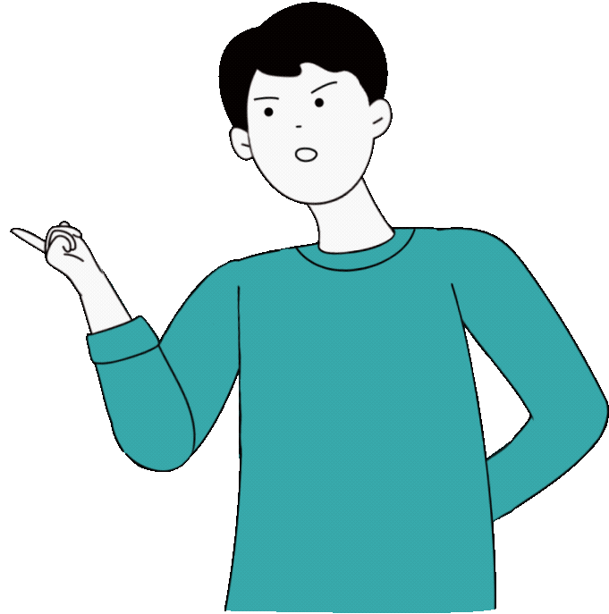
  Define the concept of morphology and explain its role in English linguistics.
  Differentiate between free morphemes and bound morphemes with relevant examples.
  Identify and classify types of morphemes (derivational vs. inflectional).
  Analyze word formation processes in modern English (affixation, compounding, blending, etc.).
  Break down complex words into their morphemic components.
  Apply morphological knowledge to improve vocabulary building and reading comprehension.
learning obectives

Slide 3
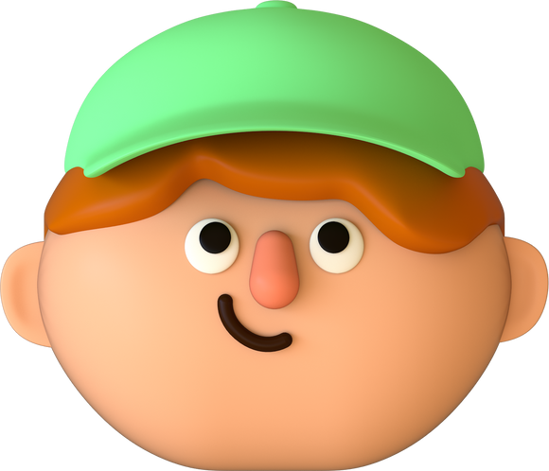

Morphology is the study of word structure and formation
It analyzes how morphemes (the smallest units of meaning) combine to create words
Example:
cats = cat (base) + -s (plural)
What is Morphology?

Slide 4
Morpheme is smallest meaningful unit of language.
  Free morphemes: can stand alone (e.g., book, run, happy).
  Bound morphemes: must attach to others (e.g., -s, -ed, un-, -ly).
  Example: unhappy = un- (bound) + happy (free).
What is Morheme?
UNHAPPY
INSTAGRAMABLE
UN-
HAPPY
INSTAGRAM
ABLE
BOUND
FREE
FREE
BOUND
not
can be
Quiz:
How many morphemes in "Disinformation"?

Slide 5

morphological process
inflectional
derivational
Modifies word for grammar without changing meaning/class
Creates new words + may change word class
Prefixes/Suffixes:
Verb → Noun: "-ment"
(invest → investment),
Adj → Verb: "-ize"
(digital → digitalize),
Noun → Adj: "-less"
(care → careless).
English’s 8 Inflectional Morphemes:
  "-s" (3rd person sing.: She streams),
  "-ed" (past tense: posted),
  "-ing" (continuous: gaming),
  "-en/-ed" (past participle: eaten),
  "-s" (plural: emojis),
  "-’s" (possessive: Twitter’s),
  "-er" (comparative: smarter),
  "-est" (superlative: dimmest).

Slide 6
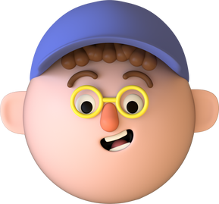

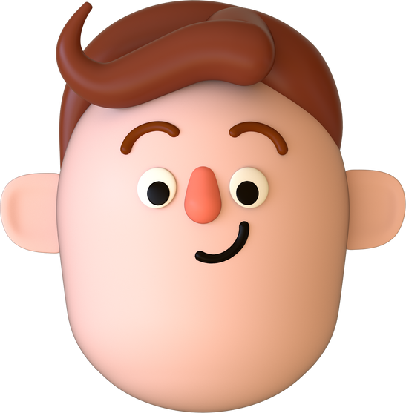

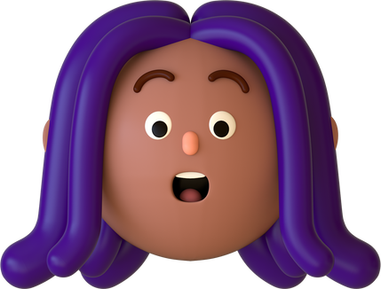
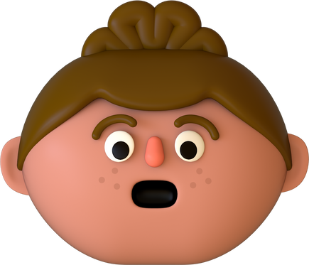
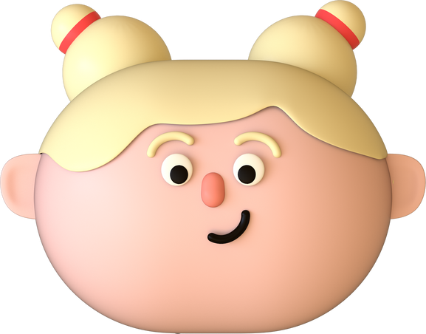
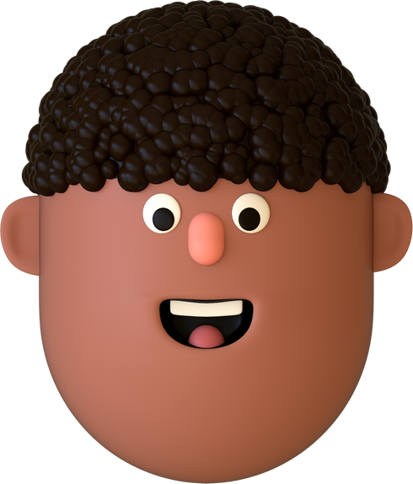
other word formation process
Affixation:
rewrite, nationalize
Acronyms:
"FOMO" (Fear Of Missing Out).
Compounding:
"Crowd" + "source" = Crowdsource,
toothbrush, laptop
Reduplication (rare in English):
bye-bye
Blending:
"Brunch" (breakfast + lunch),
"Webinar" (web + seminar)
Clipping:
"App" (application), "Bio" (biography),
“ad” (advertisement)
Conversion:
"Google" (noun → verb: Google it)

Slide 7
Real-World Application
Discussion:
How does morphology explain "adulting"?
Why is "ghosting" recognizable?
→ Adult (noun) + -ing (derivational: verb for action)
→ Ghost (free) + -ing (familiar pattern).

Slide 8

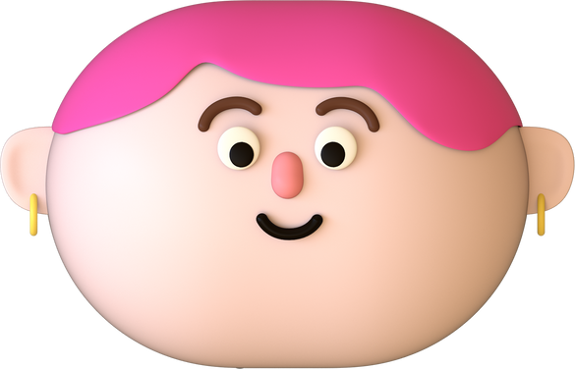
Why Morphology Matters
  Helps learners understand word meaning & grammar.
  Improves vocabulary building (e.g., recognize roots & affixes).
  Supports reading comprehension and writing skills.

Slide 9
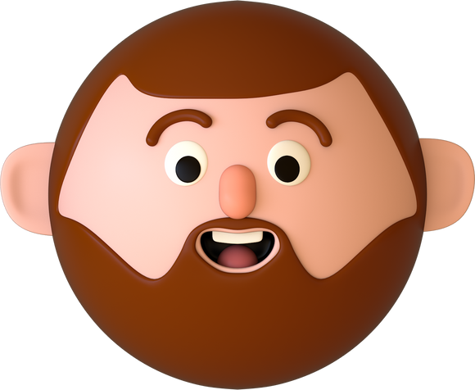

Wrap-Up
✔ Morphology = study of word structure.
✔ Morphemes = smallest meaning units.
✔ Key processes = inflection, derivation, compounding, etc.
✔ Application: better vocabulary, grammar, and fluency.
Final Thought: "Morphology unlocks word creativity in the digital age!"

Slide 10



