Slide 1
T7203 – Knowledge Data Discovery
TOPIC 1 - Introduction
Bambang Heru Iswanto
Sani M. Isa
Antoni Wibowo

Slide 2
Course outline
Motivation: Why data mining?
What is data mining?
Data Mining: On what kind of data?
Data mining functionality
Classification of data mining systems
Top-10 most popular data mining algorithms
Major issues in data mining

Slide 3
Note:
This slides are based on the additional material provided with the textbook that we use: J. Han, M. Kamber and J. Pei, “Data Mining: Concepts and Techniques” and P. Tan, M. Steinbach, and V. Kumar "Introduction to Data Mining“.

Slide 4
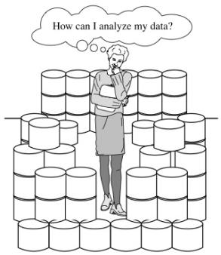
Why Data Mining?
The explosive growth of data from terabytes to petabytes
  Data collection and data availability
    Automated data collection tools, database systems, Web, computerized society
  Major sources of abundant data
    Business: Web, e-commerce, transactions, stocks, …
    Science: Remote sensing, bioinformatics, scientific simulation, …
    Society and everyone: news, digital cameras, YouTube
We are drowning in data, but starving for knowledge!
“Necessity is the mother of invention”—Data mining—Automated analysis of massive data sets

Slide 5
Evolution of Sciences
Before 1600, empirical science
1600-1950s, theoretical science
  Each discipline has grown a theoretical component. Theoretical models often motivate experiments and generalize our understanding.
1950s-1990s, computational science
  Over the last 50 years, most disciplines have grown a third, computational branch (e.g. empirical, theoretical, and computational ecology, or physics, or linguistics.)
  Computational Science traditionally meant simulation. It grew out of our inability to find closed-form solutions for complex mathematical models.
1990-now, data science
  The flood of data from new scientific instruments and simulations
  The ability to economically store and manage petabytes of data online
  The Internet and computing Grid that makes all these archives universally accessible
  Scientific info. management, acquisition, organization, query, and visualization tasks scale almost linearly with data volumes. Data mining is a major new challenge!
Jim Gray and Alex Szalay, The World Wide Telescope: An Archetype for Online Science, Comm. ACM, 45(11): 50-54, Nov. 2002

Slide 6
Evolution –
Database Technology
1960s:
  Data collection, database creation, IMS and network DBMS
1970s:
  Relational data model, relational DBMS implementation
1980s:
  RDBMS, advanced data models (extended-relational, OO, deductive, etc.)
  Application-oriented DBMS (spatial, scientific, engineering, etc.)
1990s:
  Data mining, data warehousing, multimedia databases, and Web databases
2000s
  Stream data management and mining
  Data mining and its applications
  Web technology (XML, data integration) and global information systems
Notes:
Two slides should be added after this one
1. Evolution of machine learning
2. Evolution of statistics methods

Slide 7
Why Data Mining?—Potential Applications
Data analysis and decision support
  Market analysis and management
    Target marketing, customer relationship management (CRM), market basket analysis, cross selling, market segmentation
  Risk analysis and management
    Forecasting, customer retention, improved underwriting, quality control, competitive analysis
  Fraud detection and detection of unusual patterns (outliers)
Other Applications
  Text mining (news group, email, documents) and Web mining
  Stream data mining (cctv, etc.)
  Bioinformatics and bio-data analysis

Slide 8
Example 1: Market Analysis & Management
Where does the data come from?—Credit card transactions, loyalty cards, discount coupons, customer complaint calls, plus (public) lifestyle studies
Target marketing
  Find clusters of “model” customers who share the same characteristics: interest, income level, spending habits, etc.
  Determine customer purchasing patterns over time
Cross-market analysis—Find associations/co-relations between product sales, & predict based on such association
Customer profiling—What types of customers buy what products (clustering or classification)
Customer requirement analysis
  Identify the best products for different groups of customers
  Predict what factors will attract new customers
Provision of summary information
  Multidimensional summary reports
  Statistical summary information (data central tendency and variation)
Notes:
Example: amazon product recommendation
https://blog.kissmetrics.com/data-mining/

Slide 9
Example 2: Corporate Analysis & Risk Management
Finance planning and asset evaluation
  cash flow analysis and prediction
  contingent claim analysis to evaluate assets
  time series analysis (financial-ratio, trend analysis, etc.)
Resource planning
  summarize and compare the resources and spending
Competition
  monitor competitors and market directions
  group customers into classes and a class-based pricing procedure
  set pricing strategy in a highly competitive market

Slide 10
Example 3: Fraud Detection & Mining Unusual Patterns
Approaches: Clustering & model construction for frauds, outlier analysis
Applications: Health care, retail, credit card service, telecomm.
  Auto insurance: ring of collisions
  Money laundering: suspicious monetary transactions
  Medical insurance
    Professional patients, ring of doctors, and ring of references
    Unnecessary or correlated screening tests
  Telecommunications: phone-call fraud
    Phone call model: destination of the call, duration, time of day or week. Analyze patterns that deviate from an expected norm
  Retail industry
    Analysts estimate that 38% of retail shrink is due to dishonest employees
  Anti-terrorism

Slide 11
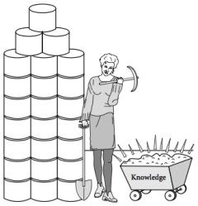
What Is Data Mining?
Data mining (knowledge discovery from data)
  Extraction of interesting (non-trivial, implicit, previously unknown and potentially useful) patterns or knowledge from huge amount of data
Alternative names
  Knowledge discovery (mining) in databases (KDD), knowledge extraction, data/pattern analysis, data archeology, data dredging, information harvesting, business intelligence, etc.
Watch out: Is everything “data mining”?
  Simple search and query processing
  (Deductive) expert systems

Slide 12
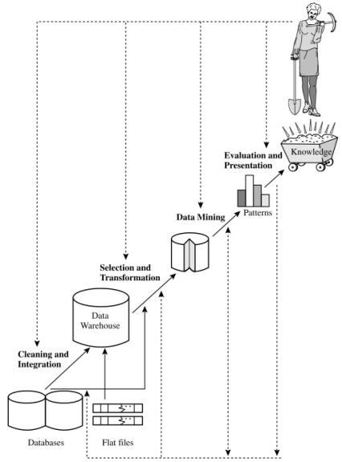
Knowledge Discovery Process

Slide 13
KDD Process-
Several Key Steps
Learning the application domain
  relevant prior knowledge and goals of application
Creating a target data set: data selection
Data cleaning and preprocessing: (may take 60% of effort!)
Data reduction and transformation
  Find useful features, dimensionality/variable reduction, invariant representation
Choosing functions of data mining
  summarization, classification, regression, association, clustering
Choosing the mining algorithm(s)
Data mining: search for patterns of interest
Pattern evaluation and knowledge presentation
  visualization, transformation, removing redundant patterns, etc.
Use of discovered knowledge

Slide 14
Why Not Traditional
Data Analysis?
Tremendous amount of data
  Algorithms must be highly scalable to handle such as tera-bytes of data
High-dimensionality of data
  Micro-array may have tens of thousands of dimensions
High complexity of data
  Data streams and sensor data
  Time-series data, temporal data, sequence data
  Structure data, graphs, social networks and multi-linked data
  Heterogeneous databases and legacy databases
  Spatial, spatio-temporal, multimedia, text and Web data
  Software programs, scientific simulations
New and sophisticated applications

Slide 15
Data Mining –
On What Kinds of Data?
Database-oriented data sets and applications
  Relational database, data warehouse, transactional database
Advanced data sets and advanced applications
  Data streams and sensor data
  Time-series data, temporal data, sequence data (incl. bio-sequences)
  Structure data, graphs, social networks and multi-linked data
  Object-relational databases
  Heterogeneous databases and legacy databases
  Spatial data and spatiotemporal data
  Multimedia database
  Text databases
  The World-Wide Web
Notes:
Regarding temporal data, for instance, we can mine banking data for changing trends,
which may aid in the scheduling of bank tellers according to the volume of customer
traffic.
Stock exchange data can be mined to uncover trends that could help you plan
investment strategies (e.g., the best time to purchase AllElectronics stock).
We could mine computer network data streams to detect intrusions based on the anomaly of message flows, which may be discovered by clustering, dynamic construction of stream models or by comparing the current frequent patterns with those at a previous time.
With spatial data, we may look for patterns that describe changes in metropolitan poverty rates based on city distances from major highways. The relationships among a set of spatial objects can be examined in order to discover which subsets of objects are spatially autocorrelated or associated.
By mining text data, such as literature on data mining from the past ten years,
we can identify the evolution of hot topics in the field.
By mining user comments on products (which are often submitted as short text messages), we can assess customer sentiments and understand how well a product is embraced by a market.
From multimedia data, we can mine images to identify objects and classify them by assigning semantic labels or tags.
By mining video data of a hockey game, we can detect video sequences corresponding to goals.
Web mining can help us learn about the distribution of information on the WWW in general, characterize and classify web pages, and uncover web dynamics
and the association and other relationships among different web pages, users, communities, and web-based activities.

Slide 16
Data Mining Functionalities
Multidimensional concept description: Characterization and discrimination
  Generalize, summarize, and contrast data characteristics, e.g., dry vs. wet regions
Frequent patterns, association, correlation vs. causality
  Diaper → Beer [0.5%, 75%] (Correlation or causality?)
Classification and prediction
  Construct models (functions) that describe and distinguish classes or concepts for future prediction
    E.g., classify countries based on (climate), or classify cars based on (gas mileage)
  Predict some unknown or missing numerical values

Slide 17
Data Mining Functionalities (2)
Cluster analysis
  Class label is unknown: Group data to form new classes, e.g., cluster houses to find distribution patterns
  Maximizing intra-class similarity & minimizing interclass similarity
Outlier analysis
  Outlier: Data object that does not comply with the general behavior of the data
  Noise or exception? Useful in fraud detection, rare events analysis
Trend and evolution analysis
  Trend and deviation: e.g., regression analysis
  Sequential pattern mining: e.g., digital camera → large SD memory
  Periodicity analysis
  Similarity-based analysis

Slide 18
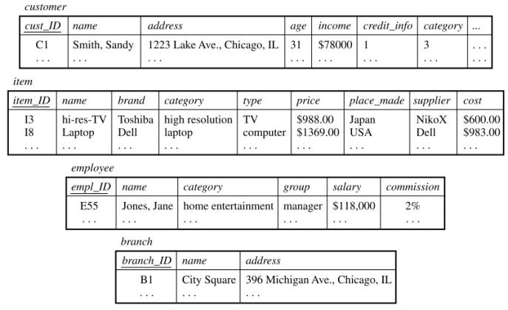
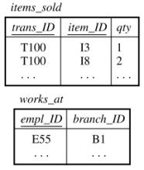
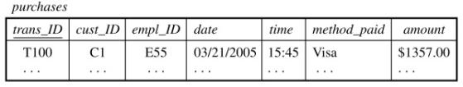
Example : Data Mining Functionalities

Slide 19
Example : Data Mining Functionalities
Data characterization
  the characteristics of customers who spend more than $1,000 a year at AllElectronics. The result could be a general profile of the customers, such as they are 40–50 years old, employed, and have excellent credit ratings.
Data discrimination
  compare two groups of AllElectronics customers, such as those who shop for computer products regularly (more versus those who rarely shop for such products (i.e., less than three times a year)
Mining frequent patterns
  determine which items are frequently purchased together within the same transactions

Slide 20
Example : Data Mining Functionalities
Classification
  classify a large set of items in the store, based on three kinds of responses to a sales campaign: good response, mild response, and no response
Prediction
  predict the amount of revenue that each item will generate during an upcoming sale at AllElectronics, based on previous sales data
Cluster analyisis
  identify homogeneous subpopulations of customers
Outlier analysis
  uncover fraudulent usage of credit cards by detecting purchases of extremely large amounts for a given account number in comparison to regular charges incurred by the same account.

Slide 21
Are All the “Discovered” Patterns Interesting?
Data mining may generate thousands of patterns: Not all of them are interesting
  Suggested approach: Human-centered, query-based, focused mining
Interestingness measures
  A pattern is interesting if it is easily understood by humans, valid on new or test data with some degree of certainty, potentially useful, novel, or validates some hypothesis that a user seeks to confirm
Objective vs. subjective interestingness measures
  Objective: based on statistics and structures of patterns, e.g., support, confidence, etc.
  Subjective: based on user’s belief in the data, e.g., unexpectedness, novelty, actionability, etc.
Notes:
For example, patterns describing the characteristics of customers who shop frequently at AllElectronics
support, representing the percentage of transactions from a transaction database that the given rule satisfies
confidence, which assesses the degree of certainty of the detected association

Slide 22
Find All and Only Interesting Patterns?
Find all the interesting patterns: Completeness
  Can a data mining system find all the interesting patterns? Do we need to find all of the interesting patterns?
  Heuristic vs. exhaustive search
  Association vs. classification vs. clustering
Search for only interesting patterns: An optimization problem
  Can a data mining system find only the interesting patterns?
  Approaches
    First general all the patterns and then filter out the uninteresting ones
    Generate only the interesting patterns—mining query optimization

Slide 23
Data Mining - Classification Schemes
General functionality
  Descriptive data mining
  Predictive data mining
Different views lead to different classifications
  Data view: Kinds of data to be mined
  Knowledge view: Kinds of knowledge to be discovered
  Method view: Kinds of techniques utilized
  Application view: Kinds of applications adapted

Slide 24
Data Mining and Business Intelligence
Increasing potential
to support
business decisions
End User
Decision Making
Data Presentation
Business
Analyst
Visualization Techniques
Data Mining
Data
Analyst
Information Discovery
Data Exploration
Statistical Summary, Querying, and Reporting
Data Preprocessing/Integration, Data Warehouses
Data Sources
DBA
Paper, Files, Web documents, Scientific experiments, Database Systems
Notes:
Business intelligence (BI) technologies provide historical, current, and predictive views of business operations. Examples include reporting, online analytical processing, business performance management, competitive intelligence, benchmarking, and predictive analytics.
data mining is the core of business intelligence

Slide 25
Data Mining - Confluence of Multiple Disciplines
Database
Technology
Statistics
Machine
Learning
Data Mining
Visualization
Pattern
Recognition
Other
Disciplines
Algorithm

Slide 26
Major Issues in Data Mining
Mining methodology
  Mining different kinds of knowledge from diverse data types, e.g., bio, stream, Web
  Performance: efficiency, effectiveness, and scalability
  Pattern evaluation: the interestingness problem
  Incorporation of background knowledge *)
  Handling noise and incomplete data
  Parallel, distributed and incremental mining methods **)
  Integration of the discovered knowledge with existing one: knowledge fusion
User interaction
  Interactive mining
  Expression and visualization of data mining results
Society
  Social impacts of data mining
  Privacy preserving data mining
  Invisible data mining
Notes:
*) natural language processing in text mining for example
**) hadoop

Slide 27
Integration of Data Mining & Data Warehousing
Data mining systems, DBMS, Data warehouse systems coupling
  No coupling, loose-coupling, semi-tight-coupling, tight-coupling
On-line analytical mining data
  integration of mining and OLAP technologies
Interactive mining multi-level knowledge
  Necessity of mining knowledge and patterns at different levels of abstraction by drilling/rolling, pivoting, slicing/dicing, etc.
Integration of multiple mining functions
  Characterized classification, first clustering and then association

Slide 28
Coupling Data Mining with DB/DW Systems
No coupling—flat file processing, not recommended
Loose coupling
  Fetching data from DB/DW
Semi-tight coupling—enhanced DM performance
  Provide efficient implement a few data mining primitives in a DB/DW system, e.g., sorting, indexing, aggregation, histogram analysis, multiway join, precomputation of some stat functions
Tight coupling—A uniform information processing environment
  DM is smoothly integrated into a DB/DW system, mining query is optimized based on mining query, indexing, query processing methods, etc.

Slide 29
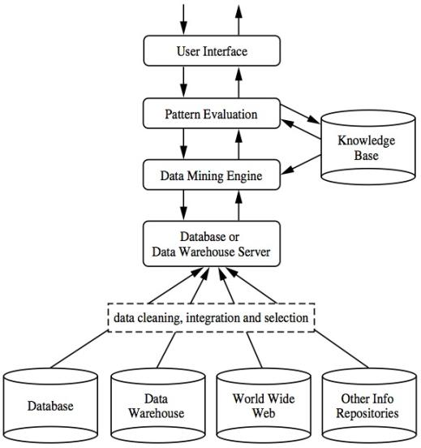
Typical Data Mining Architecture

Slide 30
Summary
Data mining: Discovering interesting patterns from large amounts of data
A natural evolution of database technology, in great demand, with wide applications
A KDD process includes data cleaning, data integration, data selection, transformation, data mining, pattern evaluation, and knowledge presentation
Mining can be performed in a variety of information repositories
Data mining functionalities: characterization, discrimination, association, classification, clustering, outlier and trend analysis, etc.
Data mining systems and architectures
Major issues in data mining

Slide 31
References
Han, J., Kamber, M., & Pei, Y. (2006). “Data Mining: Concepts and Technique”. Edisi 3. Morgan Kaufman. San Francisco
Tan, P.N., Steinbach, M., & Kumar, V. (2006). “Introduction to Data Mining”. Addison-Wesley. Michigan
Witten, I. H., & Frank, E. (2005). “Data Mining : Practical Machine Learning Tools and Techniques”. Second edition. Morgan Kaufmann. San Francisco

