Slide 1
Knowledge Data Discovery TOPIC 3 - Data Mining Tools
Antoni Wibowo

Slide 2
Course outline
Data Mining Tools: An Overview
Comparing Data Mining Tools
RapidMiner
Weka

Slide 3
Data Mining Tools: An Overview
Knowledge discovery in databases is a rapidly growing field, whose development is driven by strong research interests as well as urgent practical, social, and economical needs.
The last few years, knowledge discovery tools have been used mainly in research environments, sophisticated software products are now rapidly emerging.
In this course, we provide an overview of data mining tools and discuss open source tools to study basic data mining methods, including preprocessing data and association rule method:
RapidMiner
WEKA

Slide 4
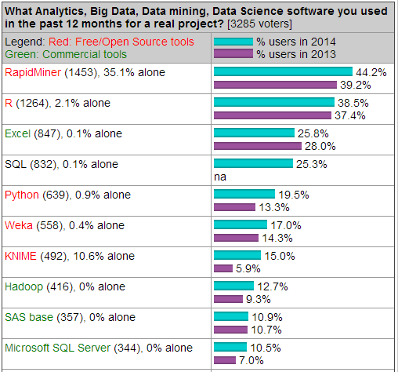
Most Popular DM Tools
The top 10 tools by share of users were (Kdnuggets-2014)
Source: http://www.kdnuggets.com
Most popular open source tools:
RapidMiner, 44.2% share (39.2% in 2013)
R, 38.5% ( 37.4% in 2013)
Python, 19.5% ( 13.3% in 2013)
Weka, 17.0% ( 14.3% in 2013)
KNIME, 15.0% ( 5.9% in 2013)
Most popular commercial tools:
SAS Enterprise Miner
MATLAB
IBM SPSS Modeler

Slide 5
Popular Open Source DM Tools
RapidMiner: many DM algorithms (also can import Weka’s methods), extendable, steady learning curve, recent problems with licensing
Weka: many DM algorithms, user-friendly, extendable, not the best choice for data visualization or advanced DM tasks at this time
R: strong in statistics and DM algorithms, extendable, fast implementations, complexity of extensions, not user-friendly – some improvement with Rattle GUI
KNIME: user-friendly, extendable (e.g. Weka, R), covers most of the advanced DM tasks as add-ons, no significant downsides
Orange: user-friendly, visually appealing GUI, moderate DM algorithms coverage, doesn’t cover advanced DM tasks at this time
scikit-learn: great documentation, fast implementations, moderate DM algorithms coverage, not user-friendy

Slide 6
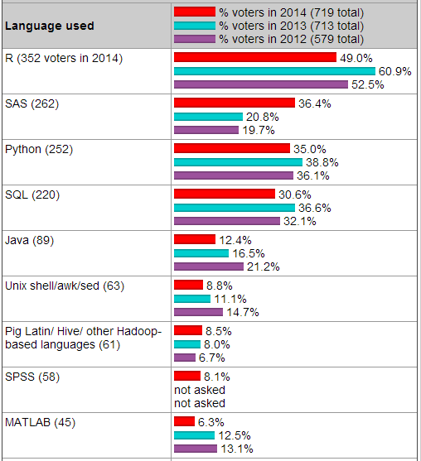
Programming/statistics Language
Top ten of programming/ statistics languages used for an analytics/data mining/data science work in 2014:
R
SAS
Python
Java
Unix
Pig Latin/Hive/Hadoop
SPSS
Matlab
Source: http://www.kdnuggets.com

Slide 7
Comparing DM Tools
Characteristic | RapidMiner | R | Weka | Orange | KNIME | scikit-learn
Developer: | RapidMiner, Germany | worldwide development | Univ. of Waikato, New Zealand | Univ. of Ljubljana, Slovenia | KNIME.com AG,Switzerland | multiple; support: INRIA, Google
Programming language: | Java | C, Fortran, R | Java | C++, Python, Qt framew. | Java | Python+NumPy+ SciPy+matplotlib
License: | open s. (v.5 or lower); closed s., free Starter ed. (v.6) | free software, GNU GPL 2+ | open source, GNU GPL 3 | open source, GNU GPL 3 | open source, GNU GPL 3 | FreeBSD
GUI/CL: | GUI | both; (GUI for DM = Rattle) | both | both | GUI | command line
Main purpose: | general data mining | sci. computation and statistics | general data mining | general data mining | general data mining | machine learning package add-on
Community support (est.): | large (~200 000 users) | very large (~ 2 M users) | large | moderate | moderate (~ 15 000 users) | moderate

Slide 8
RapidMiner

Slide 9
Introduction
RapidMiner, formerly known as YALE (Yet Another Learning Environment), was developed starting in 2001 at the Artificial Intelligence Unit of Technical University of Dortmund, Germany.
RapidMiner is an open source software platform that provides an integrated environment for machine learning, data mining, text mining, predictive analytics and business analytics.
Written in the Java programming language.
Follows a modular operator concept which allows the design of complex nedted operator chains for a huge number of learning problems.
Used for business and industrial applications as well as for research, education, training, rapid prototyping, and application development and supports all steps of the data mining process.
Available to download from https://rapidminer.com

Slide 10
Preparation
Download the free version of RapidMiner software from
http://www.rapidminer.com
Documentation
http://docs.rapidminer.com/studio
RapidMiner Installation Guide:
http://docs.rapidminer.com/studio/installation/index.html
RapidMiner manual guide
https://rapidminer.com/wp-content/uploads/2014/10/RapidMiner-v6-user-manual.pdf
Tutorial Video
http://videos.rapidminerresources.com/course/index.php?categoryid=4

Slide 11
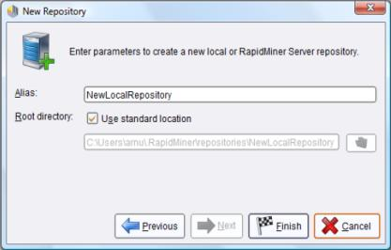
Installation and First Repository
Download the appropriate installation package for your OS and install RapidMiner Studio according to the instructions on the website. https://rapidminer.com
RapidMiner is written in the Java programming language, so that an up-to-date Java Runtime is needed.
Create a local repository on your computer to begin with the first use of RapidMiner Studio.

Slide 12
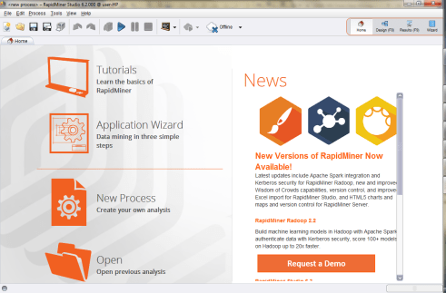
Home Perspective
RapidMiner Studio is the GUI-based software where data mining and predictive analytics workflows can be built and deployed.
You can select which perspective:
Home perspective
Design perspective
Results perspective
Wizard perspective
Launch view of RapidMiner 6.2 in Home Perspective

Slide 13
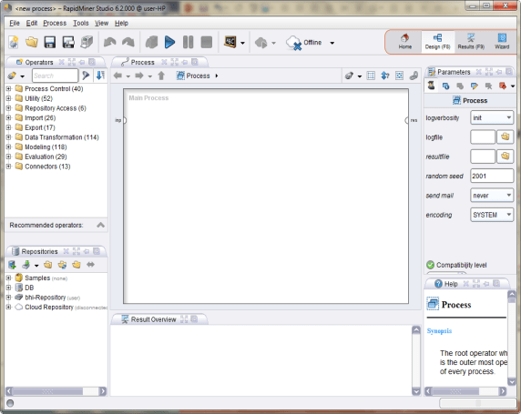
Design Perspective
Design Perspective: This is the central RapidMiner Studio perspective where all analysis processes are created, edited and managed.
It does not only an almost comprehensive set of operators, but also structures that express the control ow of the process.
Selecting views using “Show View” menu option
Design Perspective of RapidMiner.

Slide 14
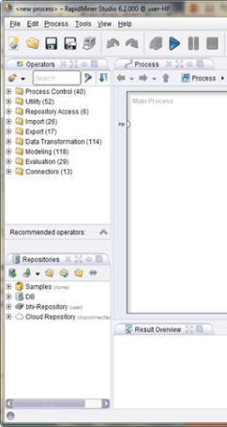
Operators & Repositories View
There are two very meaningful views in this Design area:
Operators View
All work steps (operators) available in RapidMiner Studio are presented in groups here and can therefore be included in the current process.
Repositories View
The repository is a central component of RapidMiner Studio which was introduced in Version 5. It is used for the management and structuring of your analysis processes into projects and at the same time as both a source of data as well as of the associated meta data.

Slide 15
Process View
In RapidMiner, process components are called operators.
An operator is dened by several things:
The description of the expected inputs,
The description of the supplied outputs,
The action performed by the operator on the inputs, which ultimately leads to the supply of the outputs,
A number of parameters which can control the action performed.
PROCESS VIEW

Slide 16
Operator
An operator is an atomic piece of functionality (which in fact is a chunk of encapsulated code) performing a certain task.
The data mining tasks:
importing a data set into the RapidMiner repository,
cleaning it by getting rid of spurious examples,
reducing the number of attributes by using feature selection techniques,
building predictive models, or scoring new data sets using models built earlier.
An operator can be connected via its input ports (left) and output ports (right). Below: status indicator of operators

Slide 17
Groups of operators
Groups of operators in the tree structure.
Process Control: Operators such as loops or conditional branches which can control the process ow.
Utility: Auxiliary operators which, alongside the operator"Subprocess" for grouping subprocesses, also contain the important macro-operators as well as the operators for logging.
Repository Access: Contains operators for read and write access in repositories.
Import: Contains a large number of operators in order to read data and objects from external formats such as les, databases etc.
Export: Contains a large number of operators for writing data and objects into external formats such as les, databases etc.

Slide 18
Process
All data mining and predictive analytics problem solving require a series of calculations and logical operations, therefore a single operator by itself cannot perform data mining.
All of these steps can be accomplished by connecting a number of different operators, each uniquely customized for a specific task as we saw earlier.
There is typically a certain flow to these problems:
import data,
clean and prepare data,
train a model to learn the data,
validate the model and rank its performance, then finally apply the model to score new and unseen data.

Slide 19
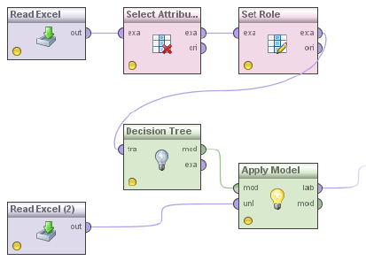
Process (2)
An analysis process consisting of several operators.
You can insert new operators into the process in dierent ways, e.g.: Via drag & drop from the Operators View as described above.
After you have inserted new operators, you can interconnect the operators inserted.

Slide 20
Further Options of the Process View
The ve icons on the right-hand side of the Process View toolbar perform the following actions:
Auto-wire and Re-wire connections The plug symbol allows to auto-wire and re-wire the connections between operators.
Automatic arrangement: Rearranges all operators of the current process according to the connections and the current execution order.
Show and alter execution order This action allows you to see the execution order of the operators and to change it.
Automatic size: Changes the size of the white working area in such a manner that all operators currently positioned have just enough space.

Slide 21
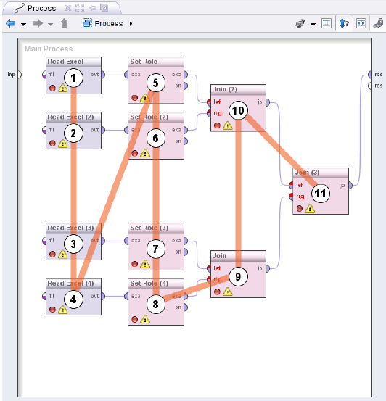
Further Options of the Process View
In further options of the Process View, representation of the execution order is unfavourable however, since more data sets have to be handled at the same time.

Slide 22
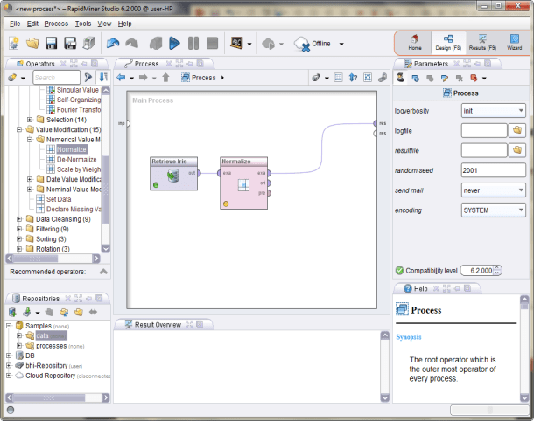
Parameter View
Parameters of the currently selected operator are set in the parameter view.
Numerous operators require one or several parameters to be indicated for a correct functionality.

Slide 23
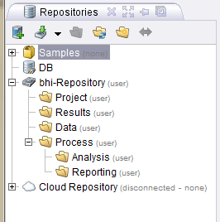
Creating A New Process
You can start a new process by selecting the “New” button under the “File" menu from the Home Perspective.
In principle, you are completely free in how you structure your repository.
A repository structured into projects and each of those structured according to data, processes and results.

Slide 24
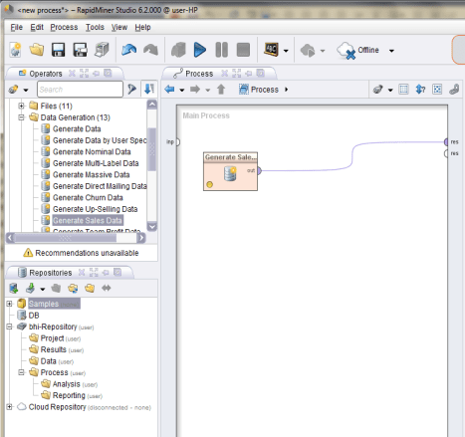
The First Analysis Process
After the creation of the process, RapidMiner Studio automatically switches to the Design Perspective and you can start with the process design.
Now we will begin our new process starting with the generating of data which we can work on.
Expand the group “Utility" in the Operators View and then the group Data Generation“, e.g. the operator “Generate Sales Data"

Slide 25
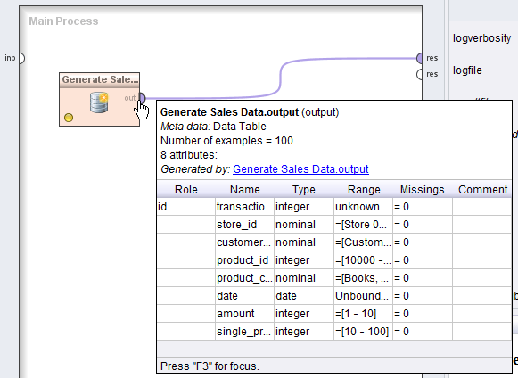
Transforming Meta Data
The most fascinating aspects of RapidMiner Studio, namely the ability to compute the output of an operator or process beforehand and to even do this during the design time, so without having to load the actual data or even perform the process.
This is made possible by the so-called meta data transformation of RapidMiner Studio.
The meta data of the output port of the operator “Generate Sales Data".

Slide 26
Transforming Meta Data (2)
The most important part of the meta data is the table which describes the meta data of the individual attributes. The individual columns are:
Role: The role of the attribute. If nothing is indicated then it is a regular attribute
Name: The name of the attribute
Type: The value type of the attribute
Range: The value range of the attribute, so the minimum and maximum in the case of numerical attributes and an excerpt of possible values in the case of nominal attributes
Missings: The number of examples where the value of this attribute is unknown
Comment: A comment depending on the attribute

Slide 27
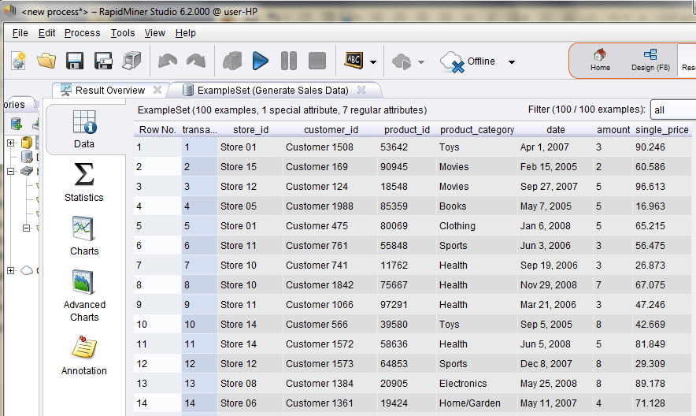
Transforming Meta Data (3)
View Meta Data:
In the data we see that, whilst the number and the individual price of the objects are given within the transaction, the associated total turnover however is not.

Slide 28
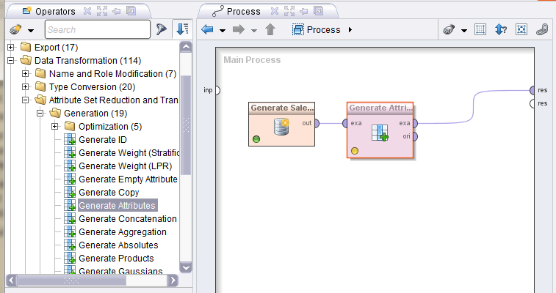
View Meta Data (4)
When we want to generate a new attribute with the name "total price", we will use a further operator named "Generate Attributes", which is located in the group "Data Transformation" - Attribute Set Reduction and Transformation -"Generation".

Slide 29
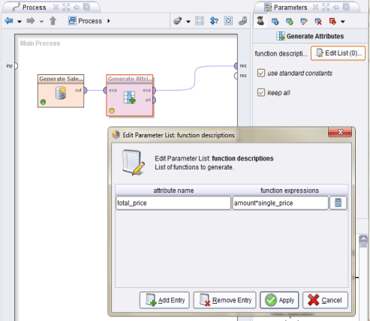
Generate New Attribute
The parameters of the operator “Generate Attributes".
Computation of the new attribute “total price" as a product of “amount" and “single price“ can be done by select “Edit List” in “Generate Attribute”
A new attribute “total_price” will be created by selecting “Apply” button.

Slide 30
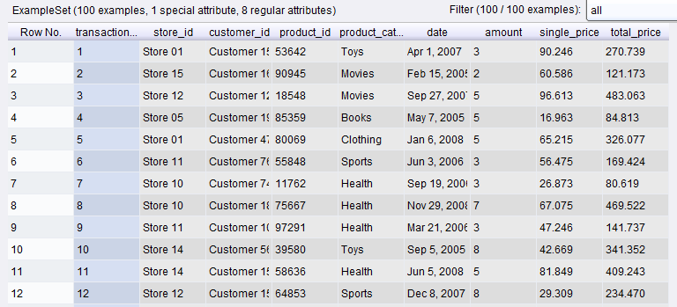
Generate New Attribute
A new attribute “total_price” has been created

Slide 31
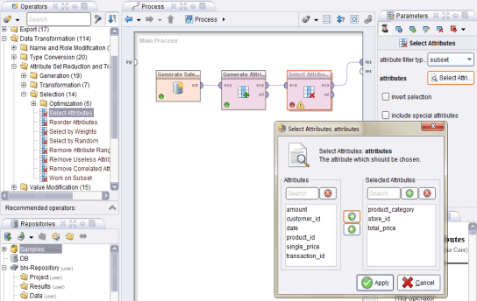
Selection of Attributes
RapidMiner allows generation of data, generation of a new attribute, and also selection of a subset of attributes.
We can try : Open the group “Data Transformation" – “Attribute Set Reduction and Transformation" “Selection" and drag the operator named “Select Attributes" into the process
Individual attributes or subsets can be selected or even deleted with the operator “Select Attributes".

Slide 32
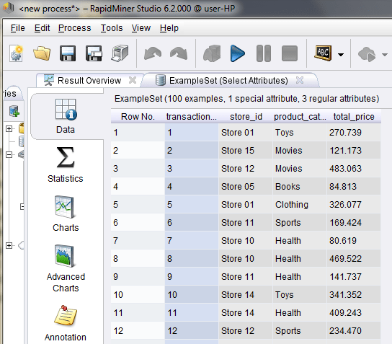
Executing Processes and Results
Executing Processes:
You have the following options for starting the process:
Press the large play button in the toolbar of RapidMiner,
Select the menu entry “Process" -“Run",
Press F11.
Looking at Results:
After the process was terminated, RapidMiner Studio should have switched to the “Result Perspective”
Result Overview

Slide 33
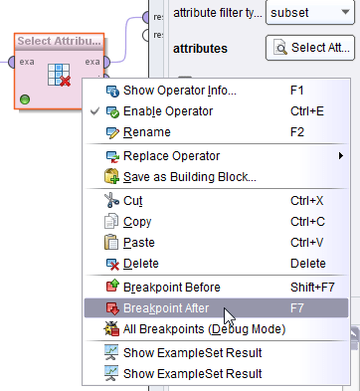
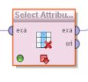
Breakpoints
RapidMiner allows us to restrict inter-operator process by providing process termination through “Breakpoint Before” and “Breakpoint After”
If a breakpoint was inserted after an operator for example, then the execution of the process will be interrupted here and the results of all connected output ports will be indicated in the Results Perspective.

Slide 34
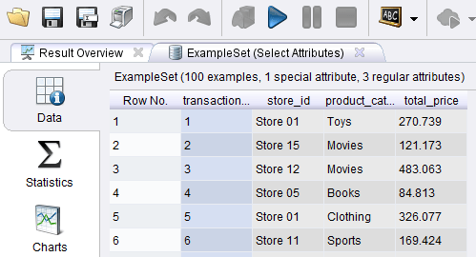
Visualization of Data and Result
Results of a process will be display on Result Perspective of RapidMiner. However, there are some different mode:
Each open result is displayed as an additional tab in the large area on the left-hand side as Automatic Opening.
The second option for displaying results is loading results from one of your repositories.
A third possibility for looking at results and even intermediate results is displaying results which are still at ports.

Slide 35
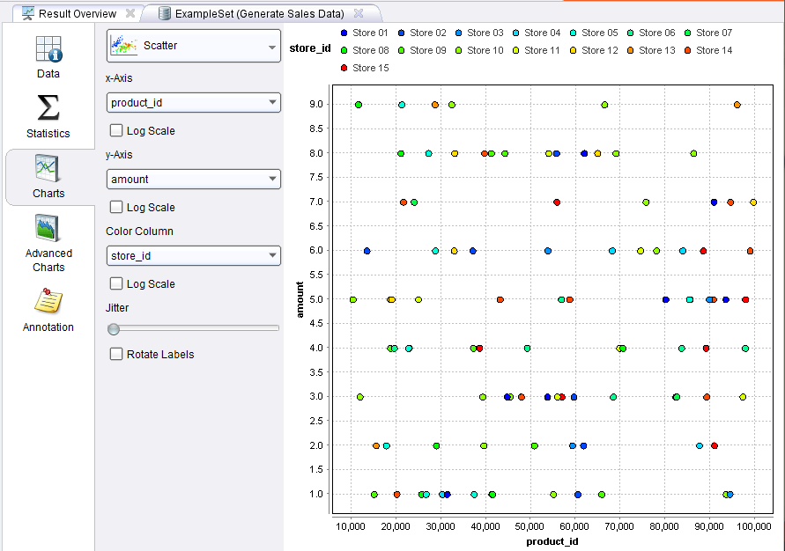
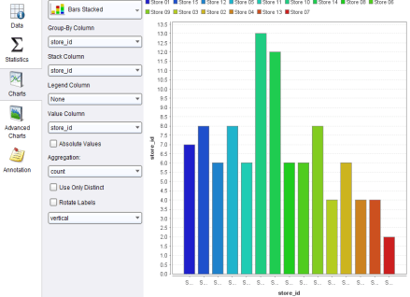
Charts
One of the strongest features of RapidMiner Studio are the numerous visualisation methods for data, other tables, models and results oered in the “Charts View“ and “Advanced Charts View".

Slide 36
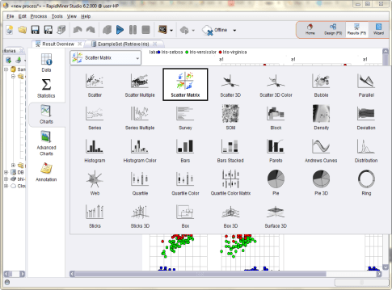
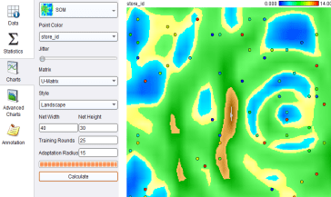
More Complex Visualization
Univariate Plots: RapidMiner provides a lot of options to visualize the data by click Scatter Matrix button in Charts view of ExampleSet
Complex visualisations such as SOMs oer a “Calculate" button for starting the computation. The progress is indicated by a bar.

Slide 37
WEKA

Slide 38
Introduction
Weka (Waikato Environment for Knowledge Analysis) is a collection of machine learning algorithms for data mining tasks written in Java.
Weka is open source software issued under the GNU General Public License.
Developed at the University of Waikato, New Zealand.
The algorithms can either be applied directly to a dataset or called from your own Java code.
Weka contains tools for data pre-processing, classification, regression, clustering, association rules, and visualization.

Slide 39
Installation
Sources:
Software is available to download from: http://www.cs.waikato.ac.nz/ml/weka/
If you are interested in modifying/extending weka there is a developer version that includes the source code
To complete exercise data repository should be also downloaded from http://mlearn.ics.uci.edu/MLRepository.html

Slide 40
Launching WEKA
The Weka GUI Chooser (class weka.gui.GUIChooser) provides a starting point for launching Weka’s main GUI applications and supporting tools.

Slide 41
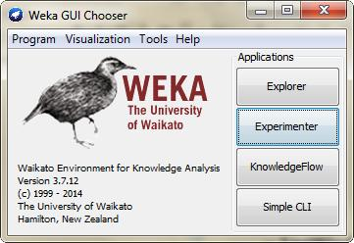
Graphic User Interface
The GUI Chooser consists of four menus and four Applications buttons—one for each of the four major Weka applications.
Menus:
Program
Visualization
Tools
Help
Applications:
Explorer
Experimenter
KnowledgeFlow
Simple CLI

Slide 42
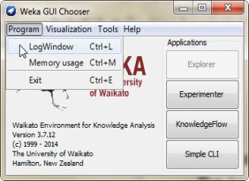
Menu: Program
Program
LogWindow Opens a log window that captures all that is printed to stdout
Memory Usage
Exit Closes WEKA

Slide 43
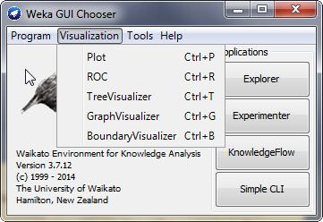
Menu: Visualization
Visualization:
Plot: For plotting a 2D plot of a dataset.
ROC: Displays a previously saved ROC curve.
TreeVisualizer: For displaying directed graphs, e.g., a decision tree.
GraphVisualizer: Visualizes XML BIF or DOT format graphs, e.g., for Bayesian networks.
BoundaryVisualizer: Allows the visualization of classifier decision boundaries in two dimensions.

Slide 44
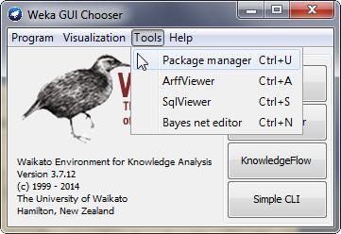
Menu: Tools
Tools Other useful applications.
Package manager: A graphical interface to Weka’s package management system.
ArffViewer: An MDI application for viewing ARFF files
SqlViewer: Represents an SQL worksheet, for querying databases via JDBC.
Bayes net editor: An application for editing, visualizing and learning Bayes nets.

Slide 45
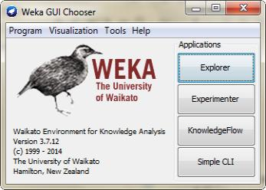
WEKA: Applications
The buttons can be used to start the following WEKA major application:
Explorer
An environment for exploring data with WEKA
Experimenter
An environment for performing experiments and conducting statistical tests between learning schemes.
KnowledgeFlow
This environment supports essentially the same functions as the Explorer but with a drag-and-drop interface. One advantage is that it supports incremental learning.
SimpleCLI
Provides a simple command-line interface that allows direct execution of WEKA commands for operating systems that do not provide their own command line interface.

Slide 46
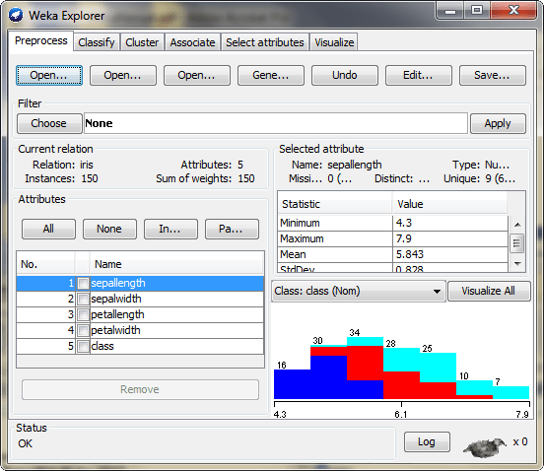
Applications: Explorer
Explorer is an environment for exploring data with WEKA
Preprocess. Choose and modify the data being acted on.
Classify. Train and test learning schemes that classify or perform regres- sion.
Cluster. Learn clusters for the data.
Associate. Learn association rules for the data.
Select attributes. Select the most relevant attributes in the data.
Visualize. View an interactive 2D plot of the data.

Slide 47
Explorer: Preprocessing
The first four buttons at the top of the preprocess section enable you to load data into WEKA:
Open file.... Brings up a dialog box allowing you to browse for the datafile on the local file system.
Open URL.... Asks for a Uniform Resource Locator address for wherethe data is stored.
Open DB.... Reads data from a database. (Note that to make this workyou might have to edit the file in weka/experiment/DatabaseUtils.props.)
Generate.... Enables you to generate artificial data from a variety ofDataGenerators.

Slide 48
Supported data format
Using the Open file button you can read files in a variety of formats:
WEKA’s ARFF format, CSV format, C4.5 format, or serialized Instances format.
ARFF files typically have a .arff extension, CSV files a .csv extension, C4.5 files a .data and .names extension, and serialized Instances objects a .bsi extension.
Data can also be read from a URL or from an SQL database (using JDBC)

Slide 49
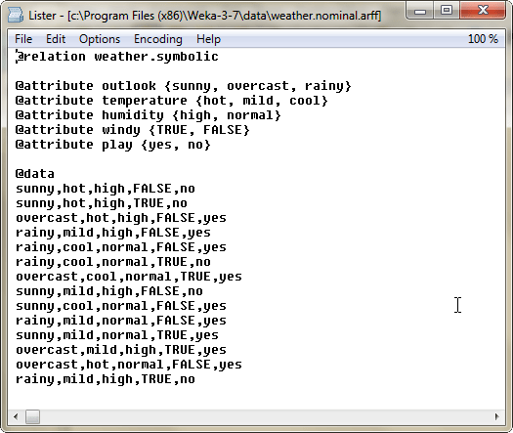
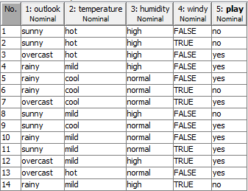
arrf file format
Uses flat text files to describe the data
attribute
instance
A more thorough description is available here http://www.cs.waikato.ac.nz/~ml/weka/arff.html

Slide 50
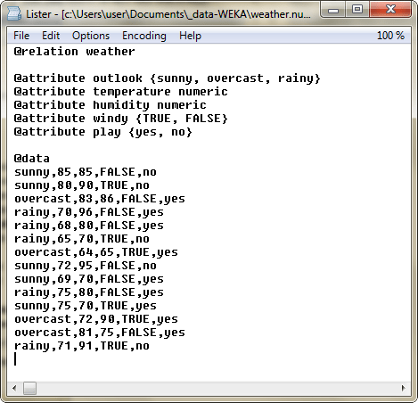
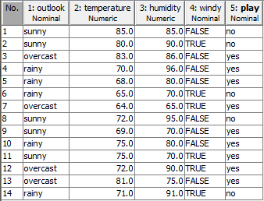
arrf file format ...
Heterogen data types

Slide 51
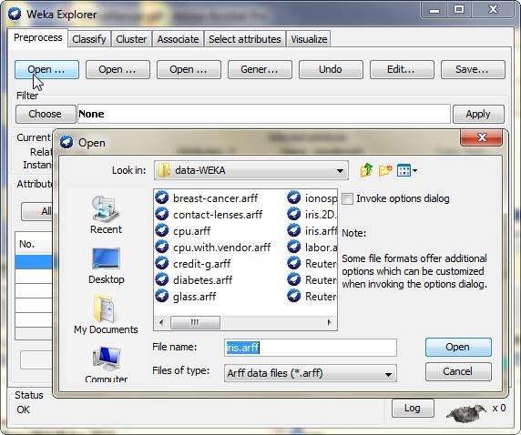
Open File

Slide 52
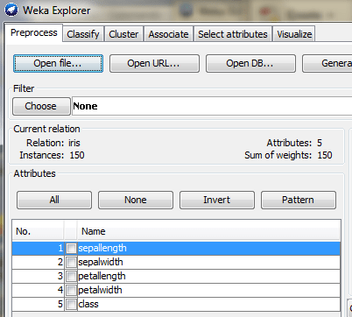
Current Relations
The Current relation box (the “current relation” is the currently loaded data, which can be interpreted as a single relational table in database terminology) has three entries:
Relation. The name of the relation, as given in the file it was loaded from. Filters (described below) modify the name of a relation.
Instances. The number of instances (data points/records) in the data.
Attributes. The number of attributes (features) in the data.

Slide 53
Working With Attributes
Below the Current relation box is a box titled Attributes.
There are four buttons, and beneath them is a list of the attributes in the current relation.
The list has three columns:
No. A number that identifies the attribute in the order they are specified in the data file.
Selection tick boxes. These allow you select which attributes are present in the relation.
Name. The name of the attribute, as it was declared in the data file.

Slide 54
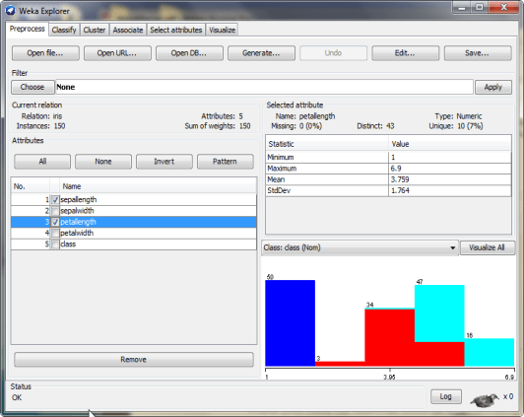
Working With Attributes ...
Selection tick boxes. These allow you select which attributes are present in the relation

Slide 55
Working With Attributes ...
Missing. The number (and percentage) of instances in the data for which this attribute is missing (unspecified).
Distinct. The number of different values that the data contains for this attribute.
Unique. The number (and percentage) of instances in the data having a value for this attribute that no other instances have.
When you click on different rows in the list of attributes, the fields change in the box to the right titled Selected attribute.
Name. The name of the attribute, the same as that given in the attribute list.
Type. The type of attribute, most commonly Nominal or Numeric.

Slide 56
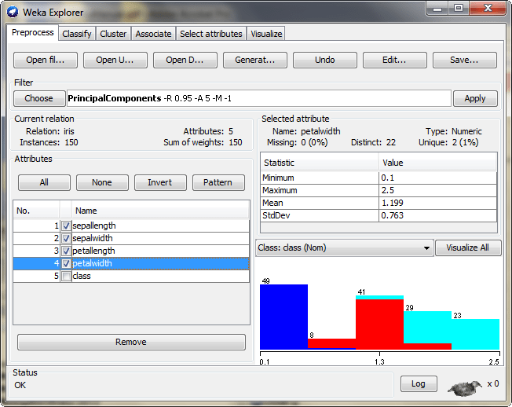
Working With Attributes ...
Statistical description of data

Slide 57
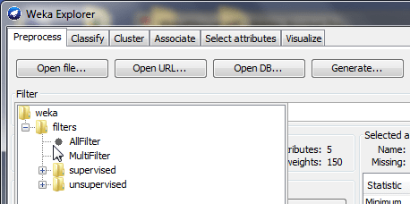
Working With Filters
Preprocess: Allows filters to be defined that transform the data in various ways.
The Filter box is used to set up the filters that are required. At the left of the Filter box is a Choose button. By clicking this button it is possible to select one of the filters in WEKA.
Once a filter has been selected, its name and options are shown in the field next to the Choose button.

Slide 58
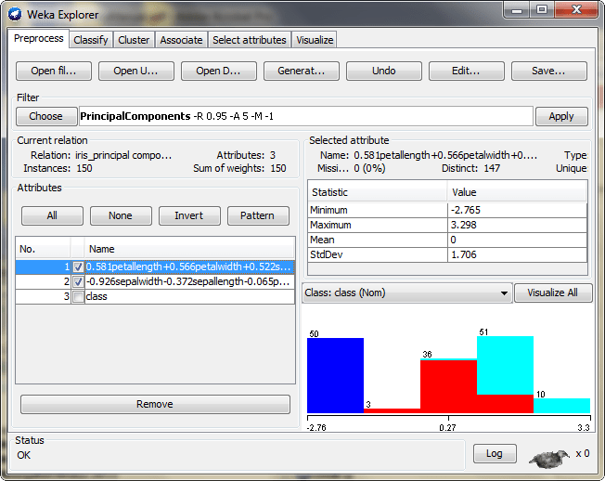
Working With Filters ...
Using Principle Componen Analysis (PCA)

Slide 59
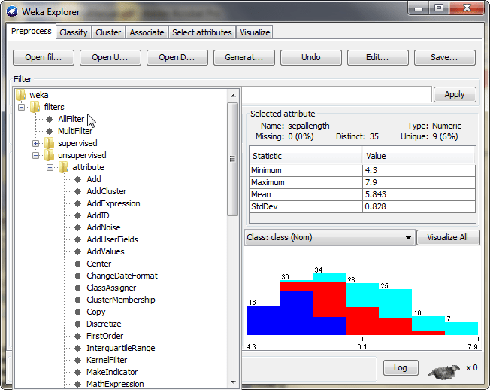
Working With Filters ...
Filters are pre-processing tools in WEKA

Slide 60
Working With Filters ...
Applying Filters
Once you have selected and configured a filter, you can apply it to the data by pressing the Apply button at the right end of the Filter panel in the Preprocess panel.
The Preprocess panel will then show the transformed data.
The result of applying filters can be saved to a new data file.
You can configure a filter by setting values in the GenericObjectEditor dialog box.

Slide 61
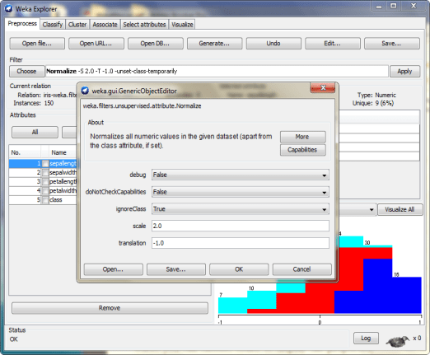
Working With Filters ...
The parameters of the filter can be customized by setting values in GenericObjectEditor dialog box

Slide 62
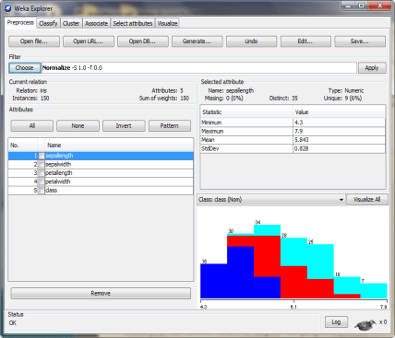
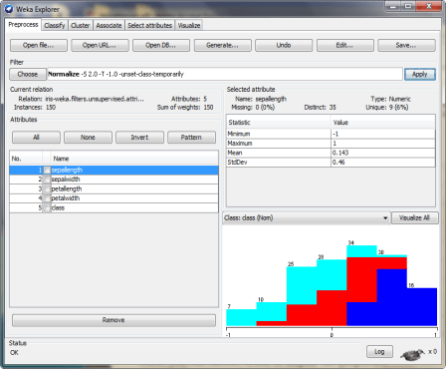
Working With Filters ...
After normalization
Statistical values are changed: Minimum, maximum, mean, Std Deviation of the data, for all attributes.
Here min = -1, max = 1, means is 0, std = 0.5 according to z-score

Slide 63
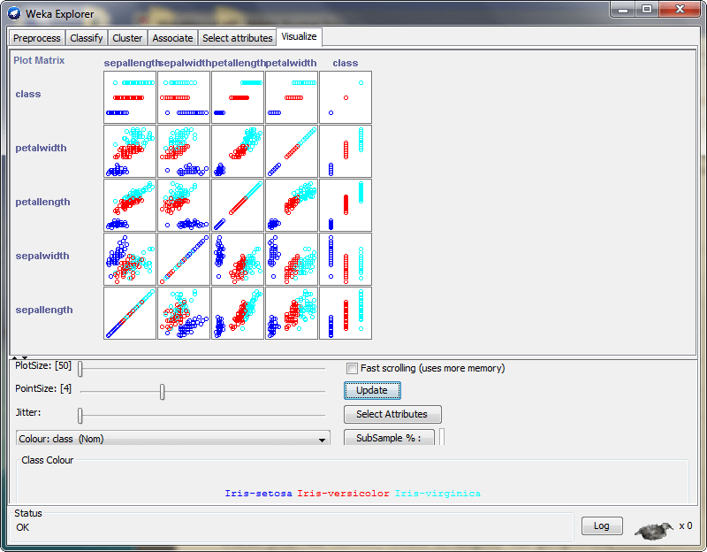
Explorer: Visualization
Visalize menu

Slide 64
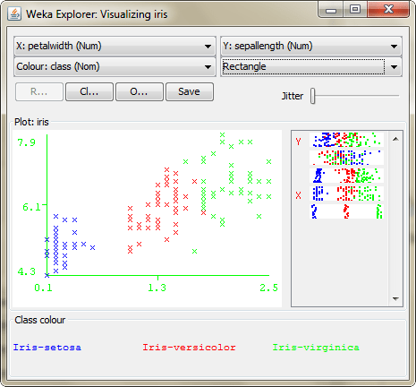
Explorer: Visualization (2)
Weka allows to plotting data by selecting a pair data atribute

Slide 65
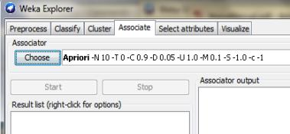
Explorer: Associate
The Associate panel contains schemes for learning association rules, and the learners are chosen and configured in the same way as the clusterers, filters, and classifiers.
Once appropriate parameters for the association rule learner bave been set, click the Start button.
When complete, right-clicking on an entry in the result list allows the results to be viewed or saved.

Slide 66
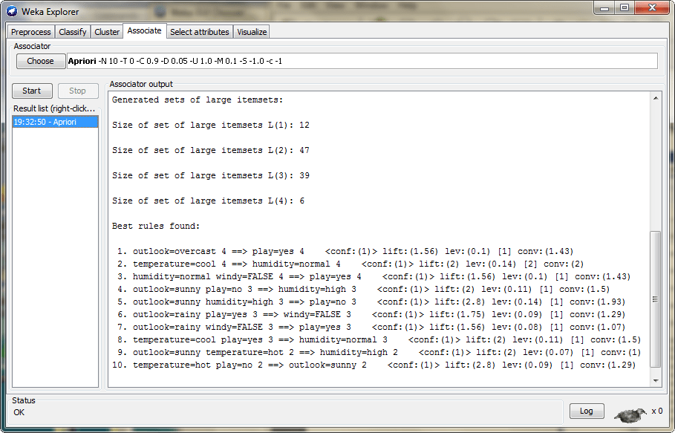
Explorer: Associate (2)
Experiment: Open file: weather.nominal.arff
Choose: Apriori method

Slide 67
Summary
Popular DM Tools, Open Source, Programming/Statistical Language have presented.
Two popular tools in DM, namely Rapid Miner and WEKA, are briefly introduced.

Slide 68
References
Han, J., Kamber, M., & Pei, Y. (2006). “Data Mining: Concepts and Technique”. Edisi 3. Morgan Kaufman. San Francisco
Tan, P.N., Steinbach, M., & Kumar, V. (2006). “Introduction to Data Mining”. Addison-Wesley. Michigan
Witten, I. H., & Frank, E. (2005). “Data Mining : Practical Machine Learning Tools and Techniques”. Second edition. Morgan Kaufmann. San Francisco

Slide 69
Acknowledgements
These slides are based on the paper of RapidMiner Studio Manual v6, WEKA Manual for Version 3-7-12, and book of Kotu and Deshpande “Predictive Analytics and Data Mining, Concepts and Practice with RapidMiner”

