Slide 1
Knowledge Data Discovery
TOPIC 4 - Data Preprocessing
Antoni Wibowo

Slide 2
Course outline
Why preprocess the data?
Data cleaning
Data integration and transformation
Data reduction

Slide 3
Note:
This slides are based on the additional material provided with the textbook that we use: J. Han, M. Kamber and J. Pei, “Data Mining: Concepts and Techniques” and P. Tan, M. Steinbach, and V. Kumar "Introduction to Data Mining“.

Slide 4
Why Data Preprocessing?
Data in the real world is dirty
  Incomplete: lacking attribute
    e.g., occupation=“ ”
  Noisy: containing errors or outliers
    e.g., Salary=“-10”
  Inconsistent: containing discrepancies in codes or names
    e.g., Age=“42” Birthday=“03/07/1997”
    e.g., Was rating “1,2,3”, now rating “A, B, C”
    e.g., discrepancy between duplicate records

Slide 5
Why is Data Dirty?
Incomplete data may come from
  “Not applicable” data value when collected
  Different considerations between the time when the data was collected and when it is analyzed*)
  Human/hardware/software problems
Noisy data (incorrect values) may come from
  Faulty data collection instruments
  Human or computer error at data entry
  Errors in data transmission
Inconsistent data may come from
  Different data sources
  Functional dependency violation (e.g., modify some linked data) **)
Duplicate records also need data cleaning
Notes:
*) Perkembangan teknologi
**) Break the entity relationship

Slide 6

Why is Data Preprocessing Important?
No quality data, no quality mining results!
  Quality decisions must be based on quality data
    e.g., duplicate or missing data may cause incorrect or even misleading statistics.
  Data warehouse needs consistent integration of quality data
Data extraction, cleaning, and transformation comprises the majority of the work of building a data warehouse (up to 90%)

Slide 7
Multi-Dimensional Measure of Data Quality
A well-accepted multidimensional view:
  Accuracy
  Completeness
  Consistency
  Timeliness
  Believability
  Non-redudancy
  Relevance
  Interpretability
  Accessibility
Notes:
Accuracy. To be useful for subsequent analyses, data must be highly accurate. For instance, it is necessary to verify that names and encodings are correctly represented and values are within admissible ranges.
Completeness. In order to avoid compromising the accuracy of business intelli- gence analyses, data should not include a large number of missing values. How- ever, one should keep in mind that most learning and data mining techniques are capable of minimizing in a robust way the effects of partial incompleteness in the data.
Consistency. The form and content of the data must be consistent across the different data sources after the integration procedures, with respect to currency and measurement units.
Timeliness. Data must be frequently updated, based on the objectives of the analysis. It is customary to arrange an update of the data warehouse regularly on a daily or at most weekly basis.
Believability. reflects how much the data are trusted by users
Non-redundancy. Data repetition and redundancy should be avoided in order to prevent waste of memory and possible inconsistencies. However, data can be replicated when the denormalization of a data warehouse may result in reduced response times to complex queries.
Relevance. Data must be relevant to the needs of the business intelligence system in order to add real value to the analyses that will be subsequently performed.
Interpretability. The meaning of the data should be well understood and correctly interpreted by the analysts, also based on the documentation available in the metadata describing a data warehouse
Accessibility. Data must be easily accessible by analysts and decision support applications.

Slide 8
Major Tasks in Data Preprocessing
Data cleaning
  Fill in missing values, smooth noisy data, identify or remove outliers, and resolve inconsistencies
Data integration
  Integration of multiple databases, data cubes, or files
Data transformation
  Normalization and aggregation
Data reduction
  Obtains reduced representation in volume but produces the same or similar analytical results
Data discretization
  Part of data reduction but with particular importance, especially for numerical data

Slide 9
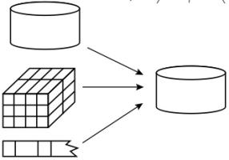
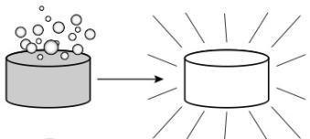
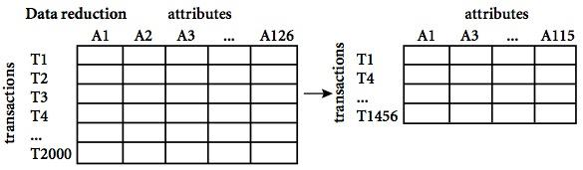
Forms of Data Preprocessing
Data Integration
Data Cleaning
Data Transformation
Data Reduction

Slide 10
Data Cleaning
Importance
  “Data cleaning is one of the three biggest problems in data warehousing”—Ralph Kimball
  “Data cleaning is the number one problem in data warehousing”—DCI survey
Data cleaning tasks
  Fill in missing values
  Identify outliers and smooth out noisy data
  Correct inconsistent data
  Resolve redundancy caused by data integration

Slide 11
Missing Data
Data is not always available
  E.g., many tuples have no recorded value for several attributes, such as customer income in sales data
Missing data may be due to
  Equipment malfunction
  Inconsistent with other recorded data and thus deleted
  Data not entered due to misunderstanding
  Certain data may not be considered important at the time of entry
Missing data may need to be inferred *)
Notes:
*) Not always error, driving license number for example. It should be n.a. but customer filled it with blank

Slide 12
How to Handle Missing Data?
Ignore the tuple: usually done when class label is missing (assuming the tasks in classification—not effective when the percentage of missing values per attribute varies considerably.
Fill in the missing value manually: tedious + infeasible?
Fill in it automatically with
  A global constant : e.g., “Unknown”, a new class?!
  The attribute mean
  The attribute mean for all samples belonging to the same class: smarter
  The most probable value: inference-based such as bayesian formula or decision tree *)
Notes:
*) For example, using the other customer attributes in your data set, you may construct a decision tree to predict the missing values for income

Slide 13
Noisy Data
Noise: random error or variance in a measured variable
Incorrect attribute values may due to
  Faulty data collection instruments
  Data entry problems
  Data transmission problems
  Technology limitation *)
  Inconsistency in naming convention
Other data problems which requires data cleaning
  Duplicate records
  Incomplete data
  Inconsistent data
Notes:
*) Limited buffer size for example

Slide 14
How to Handle Noisy Data?
Binning
  First sort data and partition into (equal-frequency) bins
  Then one can smooth by bin means, smooth by bin median, smooth by bin boundaries, etc.
Regression
  Smooth by fitting the data into regression functions
Clustering
  Detect and remove outliers
Combined computer and human inspection
  Detect suspicious values and check by human (e.G., Deal with possible outliers)

Slide 15
Simple Discretization Methods: Binning
Equal-width (distance) partitioning
  Divides the range into N intervals of equal size: uniform grid
  if A and B are the lowest and highest values of the attribute, the width of intervals will be: W = (B –A)/N.
  The most straightforward, but outliers may dominate presentation
  Skewed data is not handled well
Equal-depth (frequency) partitioning
  Divides the range into N intervals, each containing approximately same number of samples
  Good data scaling
  Managing categorical attributes can be tricky

Slide 16
Binning Methods for Data Smoothing
Sorted data for price (in dollars): 4, 8, 9, 15, 21, 21, 24, 25, 26, 28, 29, 34
* Partition into equal-frequency (equi-depth) bins:
- Bin 1: 4, 8, 9, 15
- Bin 2: 21, 21, 24, 25
- Bin 3: 26, 28, 29, 34
* Smoothing by bin means:
- Bin 1: 9, 9, 9, 9
- Bin 2: 23, 23, 23, 23
- Bin 3: 29, 29, 29, 29
* Smoothing by bin boundaries:
- Bin 1: 4, 4, 4, 15
- Bin 2: 21, 21, 25, 25
- Bin 3: 26, 26, 26, 34

Slide 17
Regression
y
Y1
Y1’
y = x + 1
X1
x
Notes:
Y1’ replaces Y1, this technique makes data smoother

Slide 18
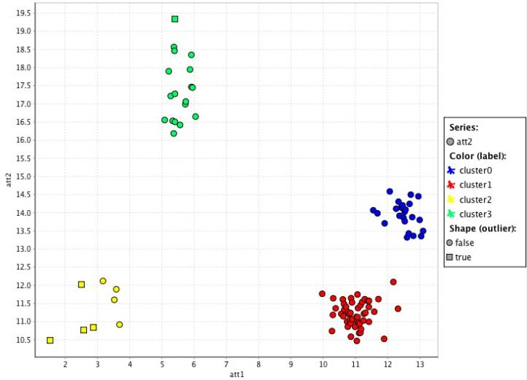
Cluster Analysis

Slide 19
Data Cleaning as a Process
Data discrepancy detection
  Use metadata (e.g., domain, range, dependency, distribution)
  Check field overloading
  Check uniqueness rule, consecutive rule and null rule
  Use commercial tools
    Data scrubbing: use simple domain knowledge (e.g., postal code, spell-check) to detect errors and make corrections
    Data auditing: by analyzing data to discover rules and relationship to detect violators (e.g., correlation and clustering to find outliers)
Data migration and integration
  Data migration tools: allow transformations to be specified *)
  ETL (Extraction/Transformation/Loading) tools: allow users to specify transformations through a graphical user interface
Integration of the two processes **)
  Iterative and interactive (e.g., Potter’s Wheels)
Notes:
Contoh tools
Field overloading happens when developers squeeze new attribute definitions into unused (bit) portions of already defined attributes (e.g., using an unused bit of an attribute whose value range uses only, say, 31 out of 32 bits)
consecutive rule says that there can be no missing values between the lowest and highest values for the attribute
*) Data migration tools allow simple transformations to be specified, such as to replace the string “gender” by “sex”
**) Only after the transformation is complete can the user go back and check that no new anomalies have been created by mistake. Typically, numerous iterations are required before the user is satisfied

Slide 20
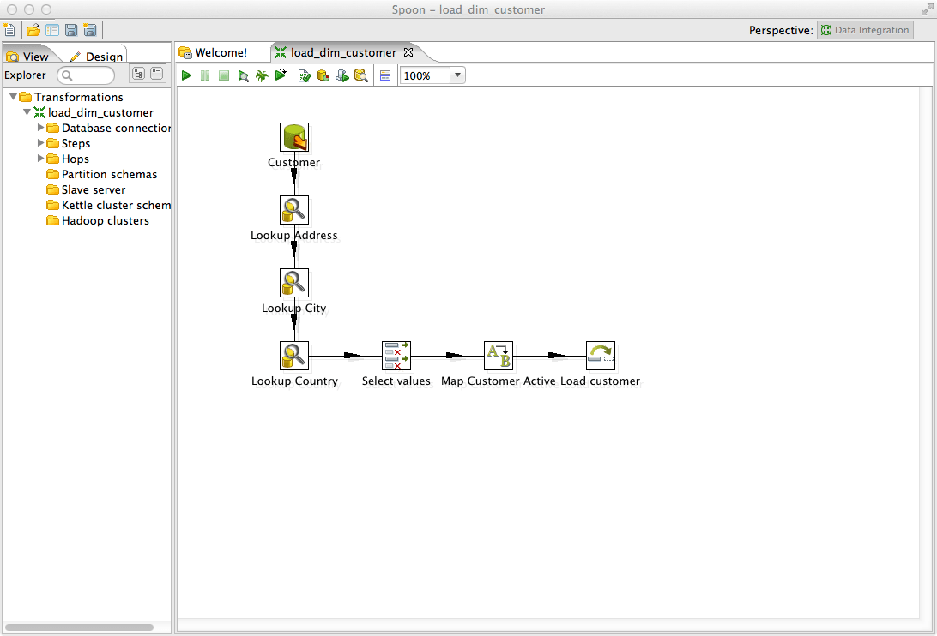
ETL on Pentaho Data Integration (Spoon)
Notes:
Demo in RapidMiner

Slide 21
Data Integration
Data integration:
  Combines data from multiple sources into a coherent store
Schema integration: e.g., A.cust-id ≡ B.cust-#
  Integrate metadata from different sources *)
Entity identification problem:
  Identify real world entities from multiple data sources, e.g., Bill Clinton = William Clinton
Detecting and resolving data value conflicts
  For the same real world entity, attribute values from different sources are different
  Possible reasons: different representations, different scales, e.g., metric vs. British units
Notes:
*) Examples of metadata for each attribute include the name, meaning, data type, and range of values permitted for the attribute, and null rules for handling blank, zero, or null values

Slide 22
Handling Redundancy in Data Integration
Redundant data occur often when integration of multiple databases
  Object identification: The same attribute or object may have different names in different databases *)
  Derivable data: One attribute may be a “derived” attribute in another table, e.g., annual revenue
Redundant attributes may be able to be detected by correlation analysis
Careful integration of the data from multiple sources may help reduce/avoid redundancies and inconsistencies and improve mining speed and quality
Notes:
*) contoh data air formasi dengan fluida reservoar

Slide 23
Correlation Analysis (Numerical Data)
Correlation coefficient (also called Pearson’s product moment coefficient)
  where n is the number of tuples, and are the respective means of A and B, σ_{A} and σ_{B} are the respective standard deviation of A and B, and Σ(AB) is the sum of the AB cross-product.
If r_{A,B} > 0, A and B are positively correlated (A’s values increase as B’s). The higher, the stronger correlation.
r_{A,B} = 0: independent; r_{A,B} < 0: negatively correlated

Slide 24
Correlation Analysis (Categorical Data)
Χ² (chi-square) test
The larger the Χ² value, the more likely the variables are related
The cells that contribute the most to the Χ² value are those whose actual count is very different from the expected count
Correlation does not imply causality
  # of hospitals and # of car-theft in a city are correlated
  Both are causally linked to the third variable: population

Slide 25
Chi-Square Calculation: An Example
Χ² (chi-square) calculation (numbers in parenthesis are expected counts calculated based on the data distribution in the two categories)
It shows that like_science_fiction and play_chess are correlated in the group
Preferred Reading | Male | Female | Sum (row)
Like science fiction | 250(90) | 200(360) | 450
Not like science fiction | 50(210) | 1000(840) | 1050
Sum(col.) | 300 | 1200 | 1500
Notes:
e11 = 300*450/1500 = 90
e12 = 1200*450/1500 = 360
…
For this 2 × 2 table, the degrees of freedom are (2−1)(2−1) = 1. For 1 degree of freedom, the χ2 value needed to reject the hypothesis at the 0.001 significance level is 10.828 (taken from the table of upper percentage points of the χ2 distribution, typically available from any textbook on statistics)

Slide 26
Data Transformation
Smoothing: remove noise from data
Aggregation: summarization, data cube construction
Generalization: concept hierarchy climbing *)
Normalization: scaled to fall within a small, specified range
  min-max normalization
  z-score normalization
  normalization by decimal scaling
Attribute/feature construction
  New attributes constructed from the given ones
Notes:
*) For example, categorical attributes, like street, can be generalized to higher-level concepts, like city or country. Similarly, values for numerical attributes, like age, may be mapped to higher-level concepts, like youth, middle-aged, and senior.

Slide 27
Data Transformation: Normalization
Min-max normalization: to [new_min_{A}, new_max_{A}]
  Ex. Let income range $12,000 to $98,000 normalized to [0.0, 1.0]. Then $73,000 is mapped to
Z-score normalization (μ: mean, σ: standard deviation):
  Ex. Let μ = 54,000, σ = 16,000. Then
Normalization by decimal scaling
Where j is the smallest integer such that Max(|ν’|) < 1
Notes:
Demo in RapidMiner

Slide 28
Data Reduction Strategies
Why data reduction?
  A database/data warehouse may store terabytes of data
  Complex data analysis/mining may take a very long time to run on the complete data set
Data reduction
  Obtain a reduced representation of the data set that is much smaller in volume but yet produce the same (or almost the same) analytical results
Data reduction strategies
  Data cube aggregation:
  Dimensionality reduction — e.g., remove unimportant attributes
  Data Compression
  Numerosity reduction — e.g., fit data into models
  Discretization and concept hierarchy generation

Slide 29
Data Cube Aggregation
The lowest level of a data cube (base cuboid)
  The aggregated data for an individual entity of interest
  E.g., a customer in a phone calling data warehouse
Multiple levels of aggregation in data cubes
  Further reduce the size of data to deal with
Reference appropriate levels
  Use the smallest representation which is enough to solve the task
Queries regarding aggregated information should be answered using data cube, when possible

Slide 30
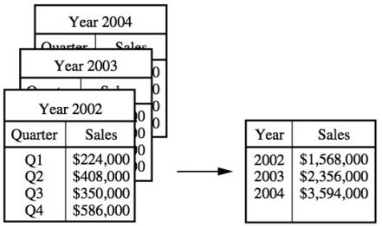
Data Cube Aggregation (Example)
The data consist of the AllElectronics sales per quarter, for the years 2002 to 2004, we only interested in the annual sales (total per year), rather than the total per quarter.
Thus the data can be aggregated so that the resulting data summarize the total sales per year instead of per quarter
Notes:
The resulting data set is smaller in volume, without loss of information necessary for the analysis task
Demo in Pentaho

Slide 31
Attribute Subset Selection
Feature selection (i.e., attribute subset selection):
  Select a minimum set of features such that the probability distribution of different classes given the values for those features is as close as possible to the original distribution given the values of all features
  reduce # of patterns in the patterns, easier to understand
Heuristic methods (due to exponential # of choices):
  Step-wise forward selection
  Step-wise backward elimination
  Combining forward selection and backward elimination
  Decision-tree induction
Notes:
For example, if the task is to classify customers as to whether or not they are likely to purchase a popular new CD at AllElectronics when notified of a sale, attributes such as the customer’s telephone number are likely to be irrelevant, unlike attributes such as age or music taste.
Demo in RapidMiner
1. Stepwise forward selection: The procedure starts with an empty set of attributes as the reduced set. The best of the original attributes is determined and added to the reduced set. At each subsequent iteration or step, the best of the remaining original attributes is added to the set.
2. Stepwise backward elimination: The procedure starts with the full set of attributes. At each step, it removes the worst attribute remaining in the set.
3. Combination of forward selection and backward elimination: The stepwise forward selection and backward elimination methods can be combined so that, at each step, the procedure selects the best attribute and removes the worst from among the remaining attributes.

Slide 32
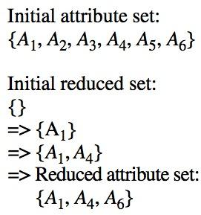
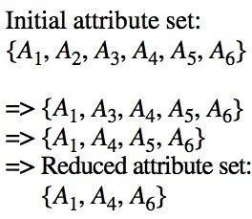
Attribute Subset Selection
Forward selection
Backward elimination

Slide 33
Example of Decision Tree Induction
Initial attribute set:
{A1, A2, A3, A4, A5, A6}
A4 ?
A1?
A6?
Class 1
Class 2
Class 1
Class 2
>
Reduced attribute set: {A1, A4, A6}
Notes:
Demo in RapidMiner

Slide 34
Data Compression
String compression
  There are extensive theories and well-tuned algorithms
  Typically lossless
Audio/video compression
  Typically lossy compression, with progressive refinement
  Sometimes small fragments of signal can be reconstructed without reconstructing the whole (audio streaming, for example)
Time sequence is not audio
  Typically short and vary slowly with time

Slide 35
Dimensionality Reduction: Principal Component Analysis (PCA)
Given N data vectors from n-dimensions, find k ≤ n orthogonal vectors (principal components) that can be best used to represent data
Steps
  Normalize input data: Each attribute falls within the same range
  Compute k orthonormal (unit) vectors, i.e., principal components
  Each input data (vector) is a linear combination of the k principal component vectors
  The principal components are sorted in order of decreasing “significance” or strength
  Since the components are sorted, the size of the data can be reduced by eliminating the weak components, i.e., those with low variance. (i.e., using the strongest principal components, it is possible to reconstruct a good approximation of the original data
Works for numeric data only
Used when the number of dimensions is large

Slide 36
Principal Component Analysis
X2
PC1
PC2
X1
Notes:
PC: Principal Component

Slide 37
Numerosity Reduction
Reduce data volume by choosing alternative, smaller forms of data representation
Parametric methods
  Assume the data fits some model, estimate model parameters, store only the parameters, and discard the data (except possible outliers)
  Example: Log-linear models—obtain value at a point in n-D space as the product on appropriate marginal subspaces
Non-parametric methods
  Do not assume models
  Major families: histograms, clustering, sampling
Notes:
Log-linear models can be used to estimate the probability of each point in a multidimensional space for a set of discretized attributes, based on a smaller subset of dimensional combinations. This allows a higher-dimensional data space to be constructed from lower- dimensional spaces.

Slide 38
Regression Analysis & Log-Linear Models
Linear regression: Y = w X + b
  Two regression coefficients, w and b, specify the line and are to be estimated by using the data at hand
  Using the least squares criterion to the known values of Y1, Y2, …, X1, X2, ….
Multiple regression: Y = b0 + b1 X1 + b2 X2.
  Many nonlinear functions can be transformed into the above
Log-linear models:
  The multi-way table of joint probabilities is approximated by a product of lower-order tables
  Probability: p(a, b, c, d) = αab βacχad δbcd

Slide 39
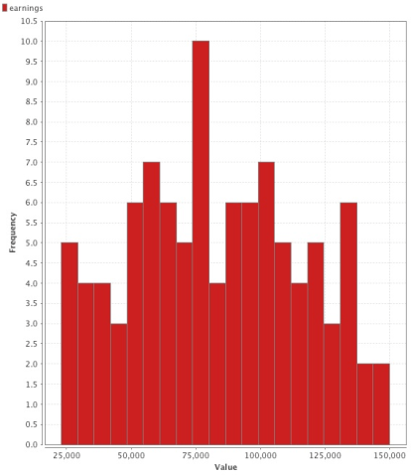
Data Reduction Method: Histograms
Divide data into buckets and store average (sum) for each bucket
Partitioning rules:
  Equal-width: equal bucket range
  Equal-frequency (or equal-depth)
  V-optimal: with the least histogram variance (weighted sum of the original values that each bucket represents)
  MaxDiff: set bucket boundary between each pair for pairs have the β–1 largest differences

Slide 40
Data Reduction Method: Clustering
Partition data set into clusters based on similarity, and store cluster representation (e.g., centroid and diameter) only
Can be very effective if data is clustered but not if data is “smeared”
Can have hierarchical clustering and be stored in multi-dimensional index tree structures
There are many choices of clustering definitions and clustering algorithms

Slide 41
Data Reduction Method: Sampling
Sampling: obtaining a small sample s to represent the whole data set N
Allow a mining algorithm to run in complexity that is potentially sub-linear to the size of the data
Choose a representative subset of the data
  Simple random sampling may have very poor performance in the presence of skew
Develop adaptive sampling methods
  Stratified sampling:
    Approximate the percentage of each class (or subpopulation of interest) in the overall database
    Used in conjunction with skewed data
Note: Sampling may not reduce database I/Os (page at a time)

Slide 42
Sampling: with or without Replacement
SRSWOR
(simple random
sample without
replacement)
SRSWR
Raw Data

Slide 43
Sampling: Cluster or Stratified Sampling
Raw Data
Cluster/Stratified Sample
Notes:
Demo in RapidMiner

Slide 44
Summary
Raw data are dirty usually due to incomplete, noisy and inconsistent.
Data Preprocessing is important to ensure the quality mining results.
Data cleaning is one of the three biggest problems in data warehousing.
  Data integration combines data from multiple sources into a coherent store.
  Data reduction reduces representation of the data set that is much smaller in volume but yet produce the same (or almost the same) analytical results.

Slide 45
References
Han, J., Kamber, M., & Pei, Y. (2006). “Data Mining: Concepts and Technique”. Edisi 3. Morgan Kaufman. San Francisco
Tan, P.N., Steinbach, M., & Kumar, V. (2006). “Introduction to Data Mining”. Addison-Wesley. Michigan
Witten, I. H., & Frank, E. (2005). “Data Mining : Practical Machine Learning Tools and Techniques”. Second edition. Morgan Kaufmann. San Francisco

