Slide 1
Knowledge Data Discovery TOPIC 5 - Data Warehousing and Online Analytical Processing
Antoni Wibowo

Slide 2
Course outline
What is a data warehouse?
A multi-dimensional data model
Data warehouse architecture
From data warehousing to data mining

Slide 3
Note:
This slides are based on the additional material provided with the textbook that we use: J. Han, M. Kamber and J. Pei, “Data Mining: Concepts and Techniques” and P. Tan, M. Steinbach, and V. Kumar "Introduction to Data Mining“.

Slide 4
What is Data Warehouse?
Defined in many different ways, but not rigorously.
A decision support database that is maintained separately from the organization’s operational database
Support information processing by providing a solid platform of consolidated, historical data for analysis.
“A data warehouse is a subject-oriented, integrated, time-variant, and nonvolatile collection of data in support of management’s decision-making process.”—W. H. Inmon
Data warehousing:
The process of constructing and using data warehouses

Slide 5
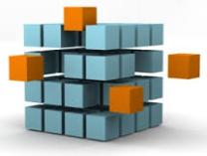
Data Warehouse—Subject-Oriented
Organized around major subjects, such as customer, product, sales
Focusing on the modeling and analysis of data for decision makers, not on daily operations or transaction processing
Provide a simple and concise view around particular subject issues by excluding data that are not useful in the decision support process

Slide 6
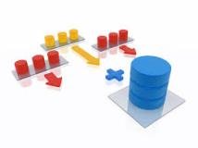
Data Warehouse—Integrated
Constructed by integrating multiple, heterogeneous data sources
relational databases, flat files, on-line transaction records
Data cleaning and data integration techniques are applied.
Ensure consistency in naming conventions, encoding structures, attribute measures, etc. among different data sources
E.g., Hotel price: currency, tax, breakfast covered, etc.
When data is moved to the warehouse, it is converted.

Slide 7
Data Warehouse—Time Variant
The time horizon for the data warehouse is significantly longer than that of operational systems
Operational database: current value data
Data warehouse data: provide information from a historical perspective (e.g., past 5-10 years)
Every key structure in the data warehouse
Contains an element of time, explicitly or implicitly
But the key of operational data may or may not contain “time element”

Slide 8
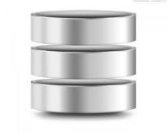
Data Warehouse—Nonvolatile
A physically separate store of data transformed from the operational environment
Operational update of data does not occur in the data warehouse environment
Does not require transaction processing, recovery, and concurrency control mechanisms
Requires only two operations in data accessing:
initial loading of data and access of data

Slide 9
Data Warehouse vs. Heterogeneous DBMS
Traditional heterogeneous DB integration: A query driven approach
Build wrappers/mediators on top of heterogeneous databases
A meta-dictionary is used to translate the query into queries and the results are integrated into a global answer set
Complex information filtering, compete for resources
Data warehouse: update-driven, high performance
Information from heterogeneous sources is integrated in advance and stored in warehouses for direct query and analysis

Slide 10
Data Warehouse vs. Heterogeneous DBMS
OLTP (on-line transaction processing)
Major task of traditional relational DBMS
Day-to-day operations: purchasing, inventory, banking, manufacturing, payroll, registration, accounting, etc.
OLAP (on-line analytical processing)
Major task of data warehouse system
Data analysis and decision making
Distinct features (OLTP vs. OLAP):
User and system orientation: customer vs. market
Data contents: current, detailed vs. historical, consolidated
Database design: ER + application vs. star + subject
View: current, local vs. evolutionary, integrated
Access patterns: update vs. read-only but complex queries

Slide 11
Why Separate Data Warehouse?
High performance for both systems
DBMS— tuned for OLTP: access methods, indexing, concurrency control, recovery
Warehouse—tuned for OLAP: complex OLAP queries, multidimensional view, consolidation
Different functions and different data:
historical data: Decision support requires historical data which operational DBs do not typically maintain
data consolidation: DS requires consolidation (aggregation, summarization) of data from heterogeneous sources
data quality: different sources typically use inconsistent data representations, codes and formats which have to be reconciled
Note: There are more and more systems which perform OLAP analysis directly on relational databases

Slide 12
From Tables and Spreadsheets to Data Cubes
A data warehouse is based on a multidimensional data model which views data in the form of a data cube
A data cube, such as sales, allows data to be modeled and viewed in multiple dimensions
Dimension tables, such as item (item_name, brand, type), or time(day, week, month, quarter, year)
Fact table contains measures (such as dollars_sold) and keys to each of the related dimension tables
In data warehousing literature, an n-D base cube is called a base cuboid. The top most 0-D cuboid, which holds the highest-level of summarization, is called the apex cuboid. The lattice of cuboids forms a data cube.

Slide 13
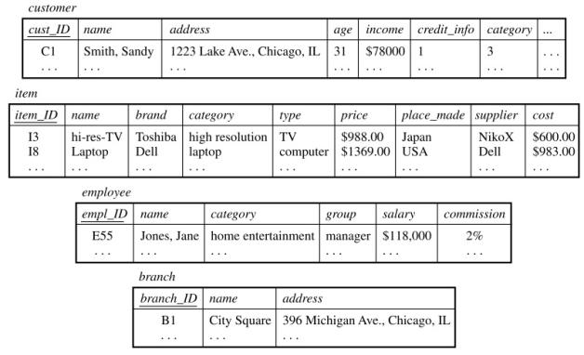
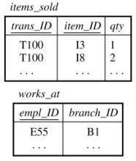
Multidimensional Data Model

Slide 14
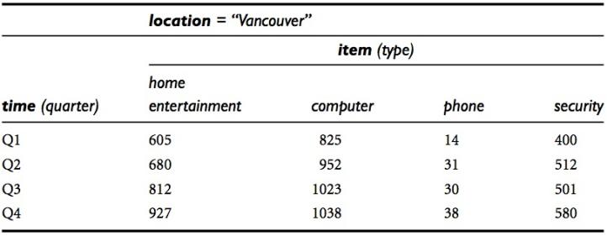
Multidimensional Data Model
2D view

Slide 15
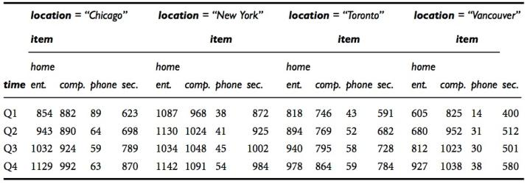
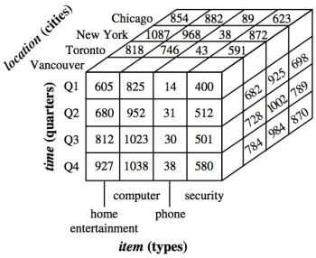
Multidimensional Data Model
3D view

Slide 16
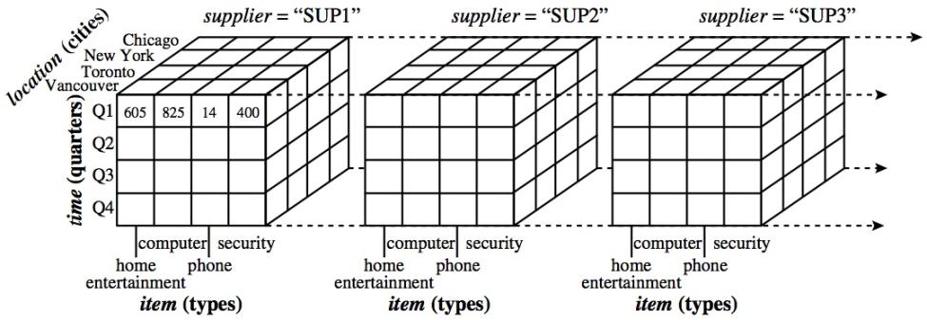
Multidimensional Data Model
4D view

Slide 17
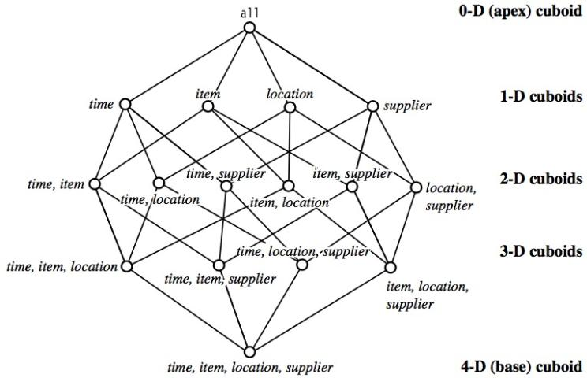
Cube: A Lattice of Cuboids

Slide 18
Conceptual Modeling of Data Warehouses
Modeling data warehouses: dimensions & measures
Star schema: A fact table in the middle connected to a set of dimension tables *)
Snowflake schema: A refinement of star schema where some dimensional hierarchy is normalized into a set of smaller dimension tables, forming a shape similar to snowflake
Fact constellations: Multiple fact tables share dimension tables, viewed as a collection of stars, therefore called galaxy schema or fact constellation
Notes:
*) each dimension is represented by only one table, and
each table contains a set of attributes. Might create redundancy
**) snowflake structure can reduce the effectiveness of browsing,
since more joins will be needed to execute a query

Slide 19
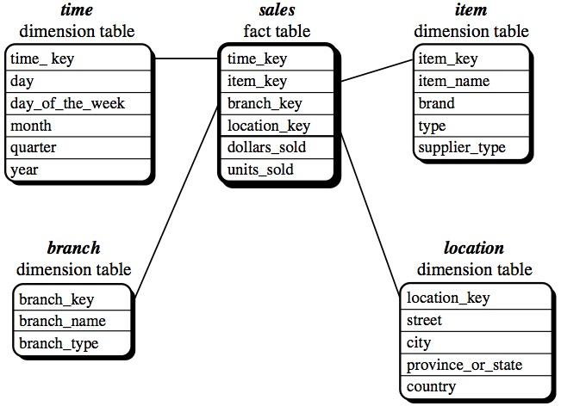
Example: Star Schema

Slide 20
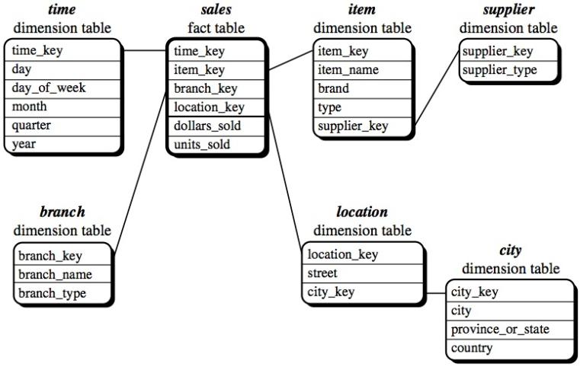
Example: Snowflake Schema

Slide 21
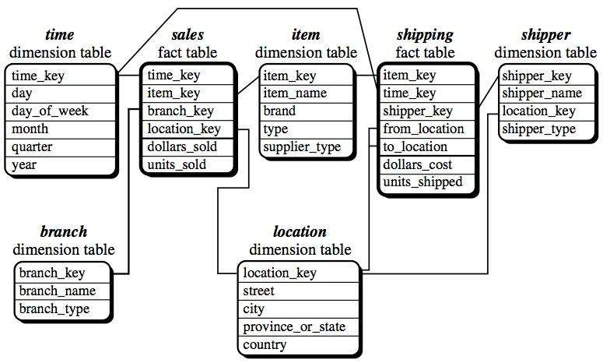
Example: Fact Constellation

Slide 22
Measures of Data Cube: Three Categories
Distributive: if the result derived by applying the function to n aggregate values is the same as that derived by applying the function on all the data without partitioning
E.g., count(), sum(), min(), max()
Algebraic: if it can be computed by an algebraic function with M arguments (where M is a bounded integer), each of which is obtained by applying a distributive aggregate function
E.g., avg(), min_N(), standard_deviation()
Holistic: if there is no constant bound on the storage size needed to describe a subaggregate.
E.g., median(), mode(), rank()
Notes:
A data cube measure is a numerical function that can be evaluated at each point in the data cube space
A measure value is computed for a given point by aggregating the data corresponding to the respective dimension-value pairs defining the given point.
Distributive: the function can be computed in a distributed manner. For example, count() can be computed for a data cube by first partitioning the cube into a set of subcubes, computing count() for each subcube, and then summing up the counts obtained for each subcube.

Slide 23
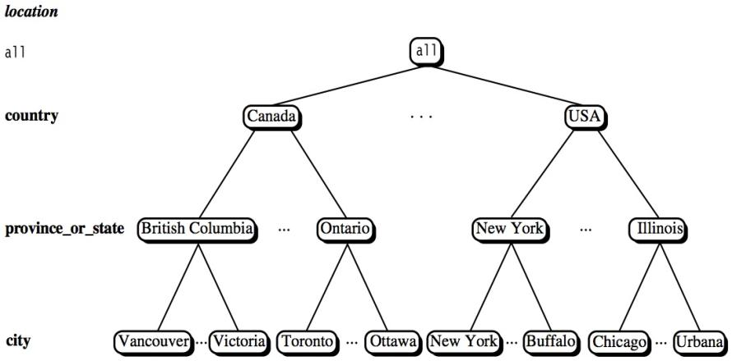
A Concept Hierarchy: Dimension (location)
Notes:
A concept hierarchy defines a sequence of mappings from a set of low-level concepts to higher-level, more general concepts

Slide 24
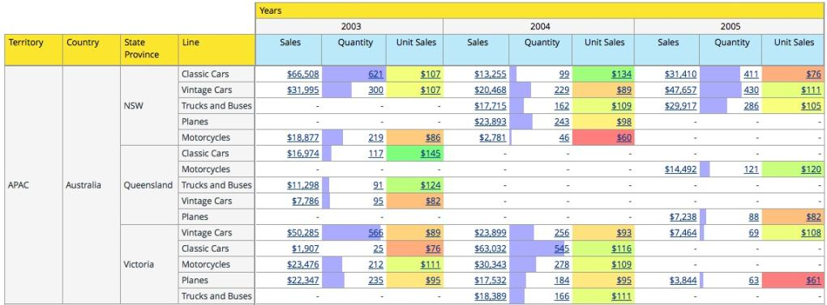
View of Warehouses & Hierarchies
Notes:
www.pentaho.com

Slide 25
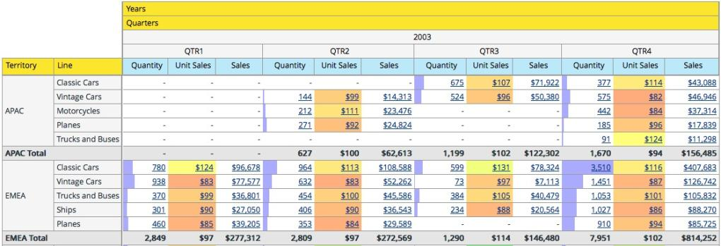
View of Warehouses & Hierarchies
Notes:
www.pentaho.com

Slide 26
A Sample Data Cube
Date
Total annual sales
of TV in U.S.A.
1Qtr
2Qtr
3Qtr
4Qtr
sum
Product
TV
PC
U.S.A
VCR
sum
Canada
Country
Mexico
sum
All, All, All

Slide 27
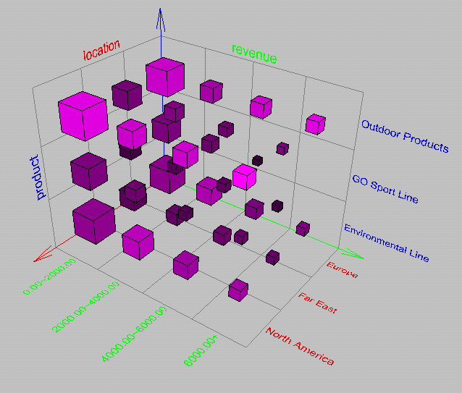
Browsing a Data Cube
Visualization
OLAP capabilities
Interactive manipulation

Slide 28
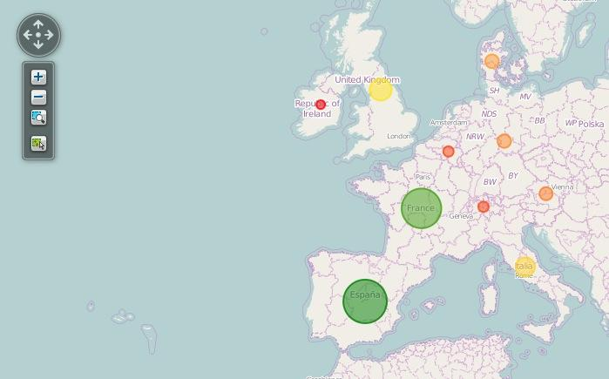
Visualization

Slide 29
Typical OLAP Operations
Roll up (drill-up): summarize data
by climbing up hierarchy or by dimension reduction
Drill down (roll down): reverse of roll-up
from higher level summary to lower level summary or detailed data, or introducing new dimensions
Slice and dice: project and select
Pivot (rotate):
reorient the cube, visualization, 3D to series of 2D planes
Other operations
drill across: involving (across) more than one fact table
drill through: through the bottom level of the cube to its back-end relational tables (using SQL)

Slide 30
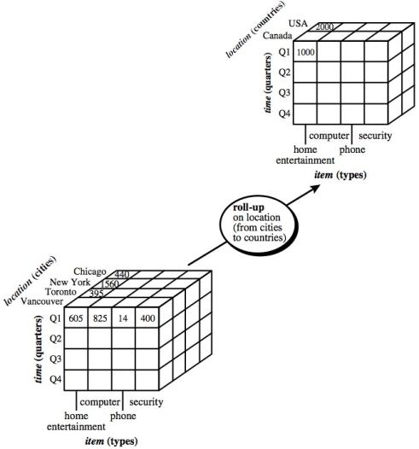
Roll Up

Slide 31
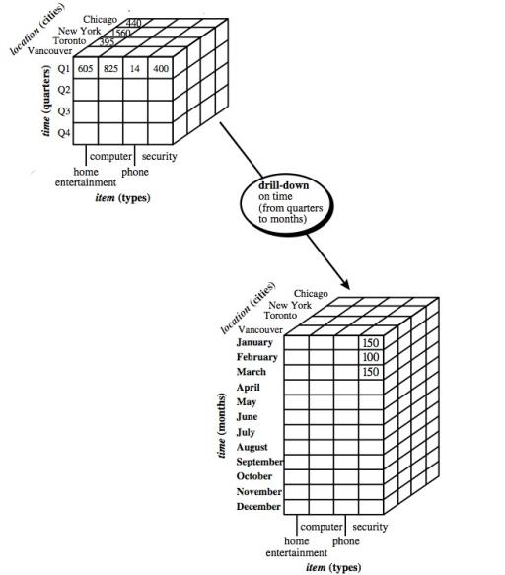
Drill Down

Slide 32
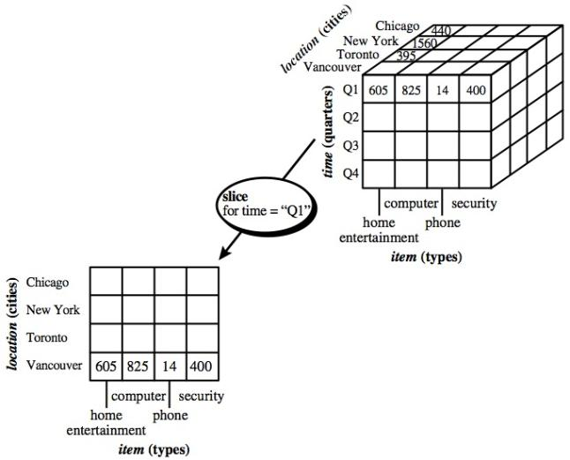
Slice

Slide 33
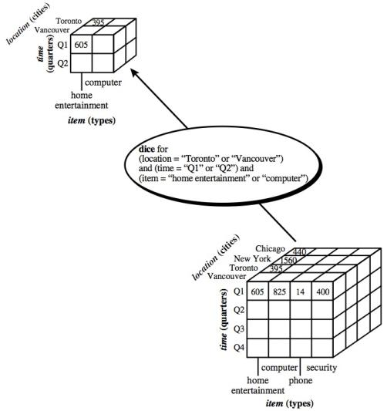
Dice

Slide 34
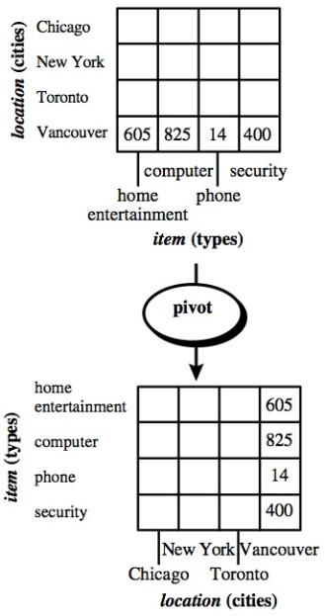
Pivot

Slide 35
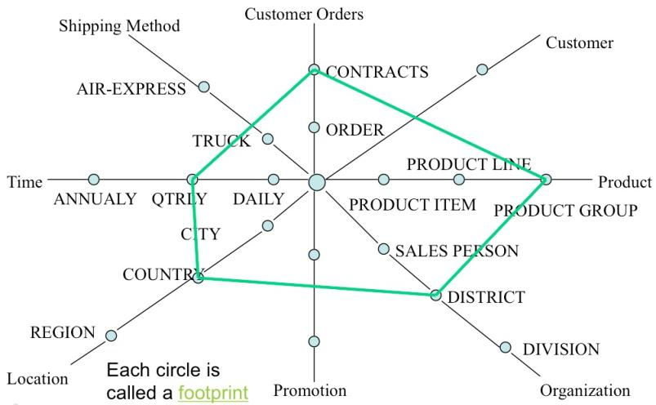
A Star-Net Query Model
Notes:
A starnet model consists of radial lines emanating from a central point, where each line represents a concept hierarchy for a dimension

Slide 36
Design of Data Warehouse: A Business Analysis Framework
Four views regarding the design of a data warehouse
Top-down view
allows selection of the relevant information necessary for the data warehouse
Data source view
exposes the information being captured, stored, and managed by operational systems
Data warehouse view
consists of fact tables and dimension tables
Business query view
sees the perspectives of data in the warehouse from the view of end-user

Slide 37
Data Warehouse Design Process
Top-down, bottom-up approaches or a combination of both
Top-down: Starts with overall design and planning (mature) - Inmon
Bottom-up: Starts with experiments and prototypes (rapid) - Kimball
From software engineering point of view
Waterfall: structured and systematic analysis at each step before proceeding to the next
Spiral: rapid generation of increasingly functional systems, short turn around time, quick turn around
Typical data warehouse design process
Choose a business process to model, e.g., orders, invoices, etc.
Choose the grain (atomic level of data) of the business process
Choose the dimensions that will apply to each fact table record
Choose the measure that will populate each fact table record
Notes:
the software engineering point of view, the design and construction of a data warehouse may consist of the following steps:
planning, requirements study, problem analysis, warehouse design, data integration and testing, and finally deployment of the data ware- house
Atomic level of data: for example, individual transactions, individual daily snapshots, and so on

Slide 38
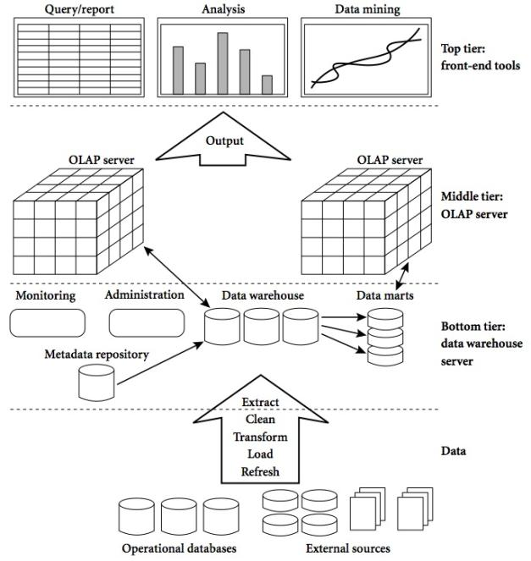
Data Warehouse: A Multi-Tiered Architecture

Slide 39
Three Data Warehouse Models
Enterprise warehouse
collects all of the information about subjects spanning the entire organization
Data Mart
a subset of corporate-wide data that is of value to a specific groups of users. Its scope is confined to specific, selected groups, such as marketing data mart
Independent vs. dependent (directly from warehouse) data mart
Virtual warehouse
A set of views over operational databases
Only some of the possible summary views may be materialized

Slide 40
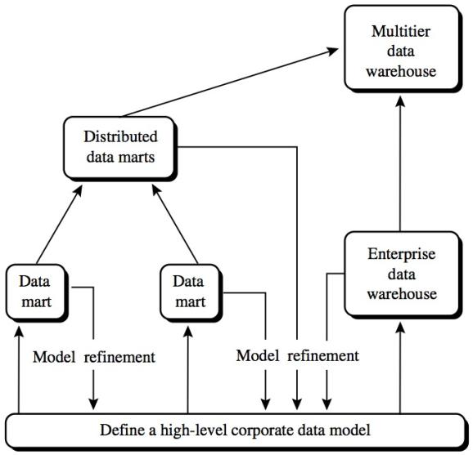
Data Warehouse Development: A Recommended Approach
Notes:
A recommended method for the development of data warehouse systems is to implement the warehouse in an incremental and evolutionary manner

Slide 41
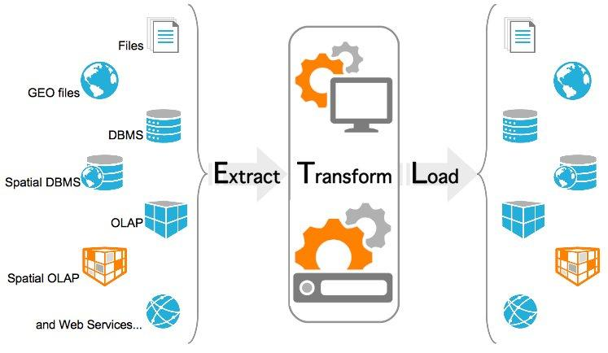
Data Warehouse Back-End Tools and Utilities
&
Clean
&
Refresh
Notes:
Data extraction
get data from multiple, heterogeneous, and external sources
Data cleaning
detect errors in the data and rectify them when possible
Data transformation
convert data from legacy or host format to warehouse format
Load
sort, summarize, consolidate, compute views, check integrity, and build indicies and partitions
Refresh
propagate the updates from the data sources to the warehouse

Slide 42
Metadata Repository
Meta data is the data defining warehouse objects. It stores:
Description of the structure of the data warehouse
schema, view, dimensions, hierarchies, derived data defn, data mart locations and contents
Operational meta-data
data lineage (history of migrated data and transformation path), currency of data (active, archived, or purged), monitoring information (warehouse usage statistics, error reports, audit trails)
The algorithms used for summarization
The mapping from operational environment to the data warehouse
Data related to system performance
warehouse schema, view and derived data definitions
Business data
business terms and definitions, ownership of data, charging policies

Slide 43
OLAP Server Architectures
Relational OLAP (ROLAP)
Use relational or extended-relational DBMS to store and manage warehouse data and OLAP middle ware
Include optimization of DBMS backend, implementation of aggregation navigation logic, and additional tools and services
Greater scalability
Multidimensional OLAP (MOLAP)
Sparse array-based multidimensional storage engine
Fast indexing to pre-computed summarized data
Hybrid OLAP (HOLAP) (e.g., Microsoft SQLServer)
Flexibility, e.g., low level: relational, high-level: array
Specialized SQL servers (e.g., Redbricks)
Specialized support for SQL queries over star/snowflake schemas

Slide 44
ROLAP Datastore (Example)

Slide 45
Data Warehouse Usage
Three kinds of data warehouse applications
Information processing
supports querying, basic statistical analysis, and reporting using crosstabs, tables, charts and graphs
Analytical processing
multidimensional analysis of data warehouse data
supports basic OLAP operations, slice-dice, drilling, pivoting
Data mining
knowledge discovery from hidden patterns
supports associations, constructing analytical models, performing classification and prediction, and presenting the mining results using visualization tools
Notes:
Information processing, based on queries, can find useful information. However, answers to such queries reflect the information directly stored in databases or computable by aggregate functions. They do not reflect sophisticated patterns or regularities buried in the database. Therefore, information processing is not data mining
Data mining covers not only data summary and comparison but also association, classification, prediction, clustering, time-series analysis, and other data analysis tasks
Data mining can:
help business managers find and reach more suitable customers
gain critical business insights that may help drive market share and raise profits.
help managers understand customer group characteristics and develop optimal pricing strategy

Slide 46
OLAP & OLAM
Why online analytical mining?
High quality of data in data warehouses
DW contains integrated, consistent, cleaned data
Available information processing structure surrounding data warehouses
ODBC, OLEDB, Web accessing, service facilities, reporting and OLAP tools
OLAP-based exploratory data analysis
Mining with drilling, dicing, pivoting, etc.
On-line selection of data mining functions
Integration and swapping of multiple mining functions, algorithms, and tasks
Notes:
OLAM integrates on-line analytical processing (OLAP) with data mining and mining knowledge in multidimensional databases

Slide 47
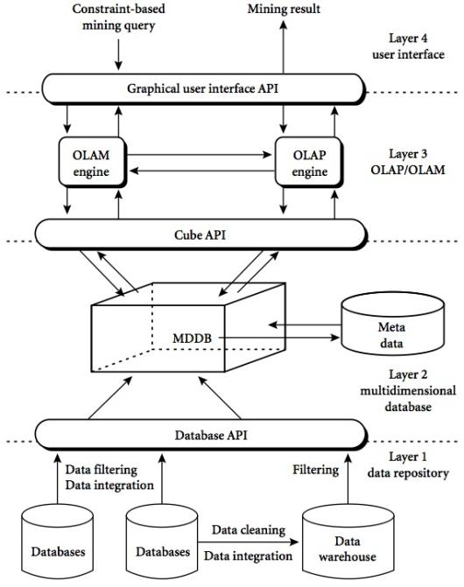
Integrated OLAM & OLAP

Slide 48
Summary
A data warehouse is a subject-oriented, integrated, time-variant, and nonvolatile collection of data in support of management’s decision-making process.
A data warehouse is based on a multidimensional data model which views data in the form of a data cube
Four views regarding the design of a data warehouse : Top-down view, Data source view, Data warehouse view and Business query view.
OLAP Architecture : Relational OLAP (ROLAP) , Multidimensional OLAP (MOLAP) , Hybrid OLAP (HOLAP) (e.g., Microsoft SQLServer) and Specialized SQL servers (e.g., Redbricks) .

Slide 49
References
Han, J., Kamber, M., & Pei, Y. (2006). “Data Mining: Concepts and Technique”. Edisi 3. Morgan Kaufman. San Francisco
Tan, P.N., Steinbach, M., & Kumar, V. (2006). “Introduction to Data Mining”. Addison-Wesley. Michigan
Witten, I. H., & Frank, E. (2005). “Data Mining : Practical Machine Learning Tools and Techniques”. Second edition. Morgan Kaufmann. San Francisco

