Slide 1
Knowledge Data Discovery
TOPIC 6 - Associations Analysis
Antoni Wibowo

Slide 2
Course outline
Basic concepts and a road map
Efficient and scalable frequent itemset mining methods

Slide 3
Note:
This slides are based on the additional material provided with the textbook that we use: J. Han, M. Kamber and J. Pei, “Data Mining: Concepts and Techniques” and P. Tan, M. Steinbach, and V. Kumar "Introduction to Data Mining“.

Slide 4
What Is Frequent Pattern Analysis?
Frequent pattern: a pattern (a set of items, subsequences, substructures, etc.) that occurs frequently in a data set
First proposed by Agrawal, Imielinski, and Swami [AIS93] in the context of frequent itemsets and association rule mining
Motivation: Finding inherent regularities in data
  What products were often purchased together?— Beer and diapers?!
  What are the subsequent purchases after buying a PC?
  What kinds of DNA are sensitive to this new drug?
  Can we automatically classify web documents?
Applications
  Basket data analysis, cross-marketing, catalog design, sale campaign analysis, Web log (click stream) analysis, and DNA sequence analysis.

Slide 5
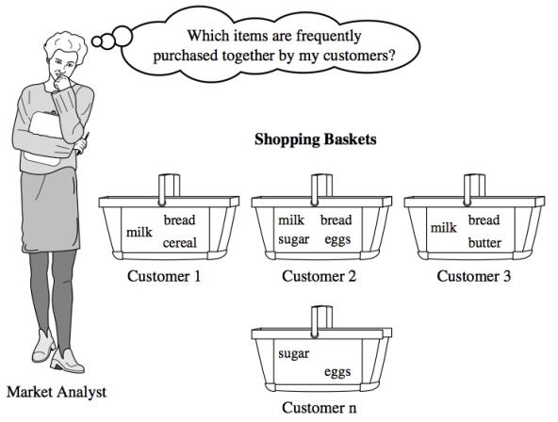
Market Basket Analysis

Slide 6
Why Is Freq. Pattern Mining Important?
Discloses an intrinsic and important property of data sets
Forms the foundation for many essential data mining tasks
  Association, correlation, and causality analysis
  Sequential, structural (e.g., sub-graph) patterns
  Pattern analysis in spatiotemporal, multimedia, time-series, and stream data
  Classification: associative classification
  Cluster analysis: frequent pattern-based clustering
  Data warehousing: iceberg cube and cube-gradient
  Broad applications

Slide 7
Basic Concepts: Frequent Patterns and Association Rules
Itemset X = {x1, …, xk}
Find all the rules X ➔Y with minimum support and confidence
  support, s, probability that a transaction contains X ^ Y
  confidence, c, conditional probability that a transaction having X also contains Y
Transaction-id | Items bought
10 | A, B, D
20 | A, C, D
30 | A, D, E
40 | B, E, F
50 | B, C, D, E, F
Customer
buys both
Customer
buys diaper
Let sup_min = 50%, con_fmin = 50%
Freq. Pat.: {A:3, B:3, D:4, E:3, AD:3}
Association rules:
  A => D (sup=60%, conf=100%)
  D => A (sup=60%, conf=75%)
Customer
buys beer
Notes:
Sup_min = 0.5 = 0.5*5 = 2.5

Slide 8
Scalable Methods for Mining Frequent Patterns
The downward closure property of frequent patterns
  Any subset of a frequent itemset must be frequent
  If {beer, diaper, nuts} is frequent, so is {beer, diaper}
  i.e., every transaction having {beer, diaper, nuts} also contains {beer, diaper}
Scalable mining methods: Three major approaches
  Apriori (Agrawal & Srikant@VLDB’94)
  Freq. pattern growth (FPgrowth—Han, Pei & Yin @SIGMOD’00)
  Vertical data format approach (Charm—Zaki & Hsiao @SDM’02)

Slide 9
Apriori: A Candidate Generation-and-Test Approach
Apriori pruning principle: If there is any itemset which is infrequent, its superset should not be generated/tested! (Agrawal & Srikant @VLDB’94, Mannila, et al. @ KDD’ 94)
Method:
  Initially, scan DB once to get frequent 1-itemset
  Generate length (k+1) candidate itemsets from length k frequent itemsets
  Test the candidates against DB
  Terminate when no frequent or candidate set can be generated

Slide 10
The Apriori Algorithm
Pseudo-code:
    Ck: Candidate itemset of size k
    Lk : frequent itemset of size k
    L1 = {frequent items};
    for (k = 1; Lk !=; k++) do begin
    Ck+1 = candidates generated from Lk;
    for each transaction t in database do
      increment the count of all candidates in Ck+1 that are contained in t
    Lk+1 = candidates in Ck+1 with min_support
    end
    return k Lk;

Slide 11
How to Generate Candidates?
Suppose the items in Lk-1 are listed in an order
Step 1: self-joining Lk-1
  insert into Ck
  select p.item1, p.item2, …, p.itemk-1, q.itemk-1
  from Lk-1 p, Lk-1 q
  where p.item1=q.item1, …, p.itemk-2=q.itemk-2, p.itemk-1 < q.itemk-1
Step 2: pruning
  forall itemsets c in Ck do
    forall (k-1)-subsets s of c do
      if (s is not in Lk-1) then delete c from Ck

Slide 12
Important Details of Apriori
How to generate candidates?
  Step 1: self-joining Lk
  Step 2: pruning
How to count supports of candidates?
Example of Candidate-generation
  L3={abc, abd, acd, ace, bcd}
  Self-joining: L3*L3
    abcd from abc and abd
    acde from acd and ace
  Pruning:
    acde is removed because ade is not in L3
  C4={abcd}
Notes:
Abc & abd = abcd
Abc & acd = abcd
Abc & acd = abcd
Abc & bcd = abcd
Abd & acd = abcd
Abd & ace = abcde *
Abd & bcd = abcd
Acd & ace = acde
Acd & bcd = abcd
Ace & bcd = abcde *
Kandidat = abcd, acde
Subset(abcd) = abc, acd, bcd
Subset(acde) = acd, ade, cde prunned

Slide 13
Illustrating Apriori Principle
Found to be Infrequent
Pruned supersets

Slide 14
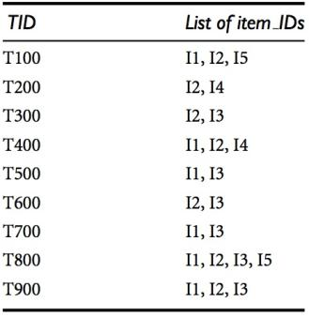
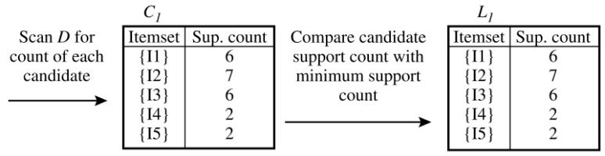
The Apriori Algorithm—An Example
min_sup = 2
Notes:
Min sup = 2 = 2/9 = 0.22…
In the first iteration of the algorithm, each item is a member of the set of candidate 1-itemsets, C1. The algorithm simply scans all of the transactions in order to count the number of occurrences of each item.
Suppose that the minimum support count required is 2, that is, min sup = 2. (Here, we are referring to absolute support because we are using a support count. The corresponding relative support is 2/9 = 22%). The set of frequent 1-itemsets, L1, can then be determined. It consists of the candidate 1-itemsets satisfying minimum support. In our example, all of the candidates in C1 satisfy minimum support.
C2, C3: generated using combination
L1: 1-itemset
L2: 2-itemset
L3: 3-itemset

Slide 15
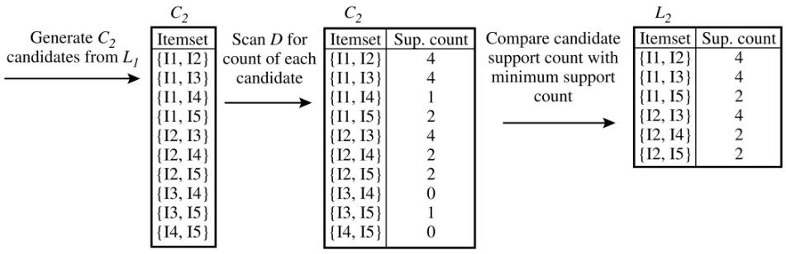
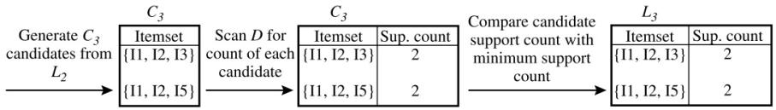
The Apriori Algorithm—An Example
Notes:
To discover the set of frequent 2-itemsets, L2, the algorithm uses the join L1 on L1 to generate a candidate set of 2-itemsets, C2.8 C2 consists of |L1| 2-itemsets. Note that no candidates are removed from C2 during the prune step because each subset of the candidates is also frequent.
Next, the transactions in D are scanned and the support count of each candidate item-set in C2 is accumulated, as shown in the middle table of the first row in Figure
The set of frequent 2-itemsets, L2, is then determined, consisting of those candidate 2-itemsets in C2 having minimum support.
First get C3 = L2 on L2 = {{I1, I2, I3}, {I1, I2, I5}, {I1, I3, I5}, {I2, I3, I4}, {I2, I3, I5}, {I2, I4, I5}}. Based on the Apriori property that all subsets of a frequent itemset must also be frequent, we can determine that the four latter candidates cannot possibly be frequent. We therefore remove them from C3, thereby saving the effort of unnecessarily obtaining their counts during the subsequent scan of D to determine L3. Note that when given a candidate k-itemset, we only need to check if its (k 1)-subsets are frequent since the Apriori algorithm uses a level-wise search strategy. The resulting pruned version of C3 is shown in the first table of the bottom row of Figure
The transactions in D are scanned in order to determine L3, consisting of those candidate 3-itemsets in C3 having minimum support
The algorithm uses L3 on L3 to generate a candidate set of 4-itemsets, C4. Although the join results in {{I1, I2, I3, I5}}, this itemset is pruned because its subset {{I2, I3, I5}} is not frequent. Thus, C4 = f, and the algorithm terminates, having found all of the frequent itemsets.

Slide 16
Generating Association Rules from Frequent Itemsets
Association rules can be generated as follows:
  For each frequent itemset l, generate all nonempty subsets of l
  For every nonempty subset s of l, output the rule “s => (l – s)” if support_count(l)/support_count(s) ≥ min_conf
Example:
  Suppose the data contain the frequent itemset l = {I1, I2, I5}
  The nonempty subsets of l are :
  {I1, I2}, {I1, I5}, {I2, I5}, {I1}, {I2}, and {I5}
  The resulting association rules:
Rule | Confidence
I1^I2 => I5 I1^I5 => I2 I2^I5 => I1 I1 => I2^I5 I2 => I1^I5 I5 => I1^I2 | 2/4 = 50% 2/2 = 100% 2/2 = 100% 2/6 = 33% 2/7 = 29% 2/2 = 100%
Suppose min_conf = 70%
Notes:
Demo in RapidMiner (Association rule 1 and 2)

Slide 17
How to Count Supports of Candidates?
Why counting supports of candidates a problem?
  The total number of candidates can be very huge
  One transaction may contain many candidates
Method:
  Candidate itemsets are stored in a hash-tree
  Leaf node of hash-tree contains a list of itemsets and counts
  Interior node contains a hash table
  Subset function: finds all the candidates contained in a transaction

Slide 18
Reducing Number of Comparisons
Candidate counting:
  Scan the database of transactions to determine the support of each candidate itemset
  To reduce the number of comparisons, store the candidates in a hash structure
    Instead of matching each transaction against every candidate, match it against candidates contained in the hashed buckets

Slide 19
Generate Hash Tree
Suppose we have 15 candidate itemsets of length 3:
{1 4 5}, {1 2 4}, {4 5 7}, {1 2 5}, {4 5 8}, {1 5 9}, {1 3 6}, {2 3 4}, {5 6 7}, {3 4 5},
{3 5 6}, {3 5 7}, {6 8 9}, {3 6 7}, {3 6 8}
You need:
Hash function
Max leaf size: max number of itemsets stored in a leaf node (if number of candidate itemsets exceeds max leaf size, split the node)
Hash function
2 3 4
5 6 7
3,6,9
1 4 5
3 4 5
3 5 6
3 5 7
6 8 9
3 6 7
3 6 8
1,4,7
1 3 6
2,5,8
1 2 4
4 5 7
1 2 5
4 5 8
1 5 9

Slide 20
Association Rule Discovery: Hash tree
Candidate Hash Tree
Hash Function
1,4,7
3,6,9
2,5,8
2 3 4
5 6 7
1 4 5
1 3 6
3 4 5
3 5 6
3 6 7
Hash on 1, 4 or 7
3 5 7
3 6 8
1 2 4
1 5 9
6 8 9
1 2 5
4 5 7
4 5 8

Slide 21
Association Rule Discovery: Hash tree
Candidate Hash Tree
Hash Function
1,4,7
3,6,9
2 3 4
2,5,8
5 6 7
1 4 5
1 3 6
3 4 5
3 5 6
3 6 7
Hash on 2, 5 or 8
3 5 7
3 6 8
1 2 4
1 5 9
6 8 9
1 2 5
4 5 7
4 5 8

Slide 22
Association Rule Discovery: Hash tree
Candidate Hash Tree
Hash Function
1,4,7
2 3 4
3,6,9
2,5,8
5 6 7
1 4 5
1 3 6
3 4 5
3 5 6
3 6 7
Hash on 3, 6 or 9
3 5 7
3 6 8
1 2 4
1 5 9
6 8 9
1 2 5
4 5 7
4 5 8

Slide 23
Subset Operation
Given a transaction t, what are the possible subsets of size 3?
Notes:
15 transactions match

Slide 24
Subset Operation Using Hash Tree
1 2 3 5 6
transaction
Hash Function
1 +
2 3 5 6
2 +
3 5 6
1,4,7
3,6,9
3 +
5 6
2,5,8
2 3 4
5 6 7
1 4 5
1 3 6
3 4 5
3 5 6
3 6 7
3 5 7
3 6 8
1 2 4
1 2 5
1 5 9
6 8 9
4 5 7
4 5 8

Slide 25
Subset Operation Using Hash Tree
1 2 3 5 6
transaction
Hash Function
1 +
2 3 5 6
2 +
3 5 6
1,4,7
3,6,9
1 2 +
3 5 6
3 +
5 6
2,5,8
1 3 +
5 6
2 3 4
1 5 +
6
5 6 7
1 4 5
1 3 6
3 4 5
3 5 6
3 6 7
3 5 7
3 6 8
1 2 4
1 2 5
1 5 9
6 8 9
4 5 7
4 5 8

Slide 26
Subset Operation Using Hash Tree
1 2 3 5 6
transaction
Hash Function
1 +
2 3 5 6
2 +
3 5 6
1,4,7
3,6,9
1 2 +
3 5 6
3 +
5 6
2,5,8
1 3 +
5 6
2 3 4
1 5 +
6
5 6 7
1 4 5
1 3 6
3 4 5
3 5 6
3 6 7
3 5 7
3 6 8
1 2 4
1 2 5
1 5 9
6 8 9
4 5 7
4 5 8
Match transaction against 11 out of 15 candidates

Slide 27
Challenges of Frequent Pattern Mining
Challenges
  Multiple scans of transaction database
  Huge number of candidates
  Tedious workload of support counting for candidates
Improving Apriori: general ideas
  Reduce passes of transaction database scans
  Shrink number of candidates
  Facilitate support counting of candidates
Notes:
Demo in RapidMiner (Association rule 3)
It may need to generate a huge number of candidate sets. For example, if there are 10^4 frequent 1-itemsets, the Apriori algorithm will need to generate more than 10^7 candidate 2-itemsets
It may need to repeatedly scan the database and check a large set of candidates by pattern matching

Slide 28
Mining Frequent Patterns Without Candidate Generation
Frequently Pattern growth or FP-growth mines the complete set of frequent itemsets without candidate generation
FP-growth adopts a divide-and-conquer strategy as follows:
  First, it compresses the database representing frequent items into a frequent-pattern tree, or FP-tree, which retains the itemset association information.
  It then divides the compressed database into a set of conditional databases (a special kind of projected database), each associated with one frequent item or “pattern fragment,” and mines each such database separately

Slide 29
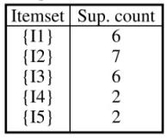
FP-Growth (Example)
Lets use the same mining of transaction database that used in Apriori method
First, scan of the database to get the set of frequent items (1-itemsets) and their support counts
Let the min_sup = 2. The set of frequent items is sorted in the order of descending support count. This resulting set or list is denoted as:
L = {I2: 7}, {I1: 6}, {I3: 6}, {I4: 2}, {I5: 2}}

Slide 30
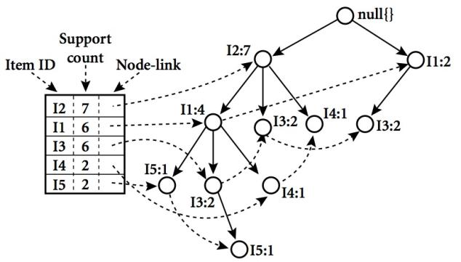
FP-Tree
An FP-tree is then constructed as follows: First, create the root of the tree, labeled with “null.” Scan database D a second time. The items in each transaction are processed in L order (i.e., sorted according to descending support count), and a branch is created for each transaction
Notes:
For example, the scan of the first transaction, “T100: I1, I2, I5,” which contains three items (I2, I1, I5 in L order), leads to the construction of the first branch of the tree with three nodes, hI2: 1i, hI1:1i, and hI5: 1i, where I2 is linked as a child of the root, I1 is linked to I2, and I5 is linked to I1. The second transaction, T200, contains the items I2 and I4 in L order, which would result in a branch where I2 is linked to the root and I4 is linked to I2. However, this branch would share a common prefix, I2, with the existing path for T100. Therefore, we instead increment the count of the I2 node by 1, and create a new node, hI4: 1i, which is linked as a child of hI2: 2i

Slide 31
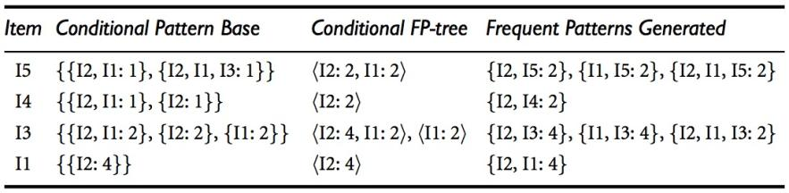
FP-Tree Mining
Notes:
We first consider I5, which is the last item in L, rather than the first. The reason for starting at the end of the list will become apparent as we explain the FP-tree mining process.
I5 occurs in two branches of the FP-tree of Figure 5.7. (The occurrences of I5 can easily be found by following its chain of node-links.) The paths formed by these branches are hI2, I1, I5: 1i and hI2, I1, I3, I5: 1i. Therefore, considering I5 as a suffix, its corresponding two prefix paths are hI2, I1: 1i and hI2, I1, I3: 1i, which form its conditional pattern base. Its conditional FP-tree contains only a single path, hI2: 2, I1: 2i; I3 is not included because its support count of 1 is less than the minimum support count. The single path generates all the combinations of frequent patterns: {I2, I5: 2}, {I1, I5: 2}, {I2, I1, I5: 2}.
For I4, its two prefix paths form the conditional pattern base, {{I2 I1: 1}, {I2: 1}}, which generates a single-node conditional FP-tree, hI2: 2i, and derives one frequent pattern, {I2, I1: 2}. Notice that although I5 follows I4 in the first branch, there is no need to include I5 in the analysis here because any frequent pattern involving I5 is ana- lyzed in the examination of I5.
Similar to the above analysis, I3’s conditional pattern base is {{I2, I1: 2}, {I2: 2}, {I1: 2}}. Its conditional FP-tree has two branches, hI2: 4, I1: 2i and hI1: 2i, as shown in Figure 5.8, which generates the set of patterns, {{I2, I3: 4}, {I1, I3: 4}, {I2, I1, I3: 2}}. Finally, I1’s conditional pattern base is {{I2: 4}}, whose FP-tree contains only one node, hI2: 4i, which generates one frequent pattern, {I2, I1: 4}

Slide 32
Why Is FP-Growth the Winner?
Divide-and-conquer:
  decompose both the mining task and DB according to the frequent patterns obtained so far
  leads to focused search of smaller databases
Other factors:
  no candidate generation, no candidate test
  compressed database: FP-tree structure
  no repeated scan of entire database
  basic ops—counting local freq items and building sub FP-tree, no pattern search and matching

Slide 33
From Association Mining to Correlation Analysis
Although minimum support and confidence thresholds help exclude the exploration of a good number of uninteresting rules, many rules so generated are still not interesting to the users
Statistics can be used as one step toward the goal of excluding uninteresting rules from presentation to the user
Correlation measures
  Lift
  χ²
  All confidence
  Cosine

Slide 34
Interestingness Measure: Correlations (Lift)
Play basketball →
eat cereal [40%, 66.7%] is misleading
  The overall % of students eating cereal is 75% > 66.7%.
Play basketball →
not eat cereal [20%, 33.3%] is more accurate, although with lower support and confidence
Measure of dependent/correlated events: lift
 | Basketball | Not basketball | Sum (row)
Cereal | 2000 | 1750 | 3750
Not cereal | 1000 | 250 | 1250
Sum(col.) | 3000 | 2000 | 5000

Slide 35



Other Interestingness Measure:
correlation using χ² analysis
Given an itemset X = {i₁, i₂, . . . , i_{k}}, the all confidence of X is defined as
Given two itemsets A and B, the cosine measure of A and B is defined as

Slide 36
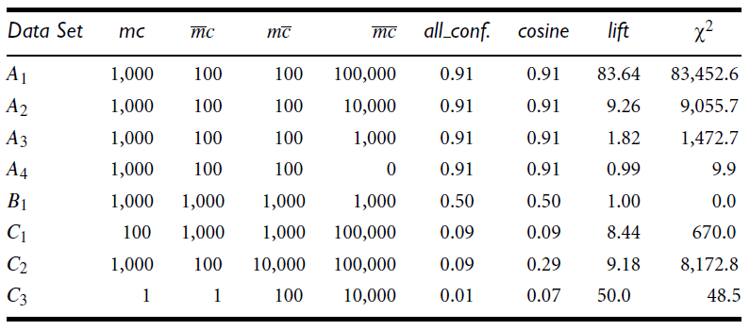
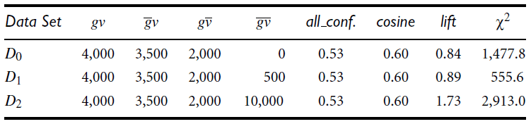
Comparison of four correlation measures
First
dataset
Second dataset
Notes:
Green: positively correlated
Yellow: independent
Red: negatively correlated
First dataset:
All four measures are good indicators for the independent case, B1. Lift and chi square are poor indicators of the other relationships, whereas all confidence
and cosine are good indicators. Another interesting fact is that between all confidence and cosine, cosine is the better indicator when mc and mc are not balanced.
Second dataset:
lift and chi square can show change from rather negative to rather positive correlations. Based on all_conf and cosine, we cannot precisely assert that a set of items are positively or
negatively correlated when the value of all confidence or cosine is around 0.5

Slide 37
Summary
  Frequent pattern is a pattern (a set of items, subsequences, substructures, etc.) that occurs frequently in a data set .
  Frequent pattern discloses an intrinsic and important property of data sets.
The downward closure property of frequent patterns involves Any subset of a frequent itemset must be frequent
Three major approaches in Scalable mining methods: Apriori (Agrawal & Srikant@VLDB’94), Freq. pattern growth (FPgrowth—Han, Pei & Yin @SIGMOD’00) and Vertical data format approach (Charm—Zaki & Hsiao @SDM’02).
Association rules can be generated from Frequent Itemsets.

Slide 38
References
Han, J., Kamber, M., & Pei, Y. (2006). “Data Mining: Concepts and Technique”. Edisi 3. Morgan Kaufman. San Francisco
Tan, P.N., Steinbach, M., & Kumar, V. (2006). “Introduction to Data Mining”. Addison-Wesley. Michigan
Witten, I. H., & Frank, E. (2005). “Data Mining : Practical Machine Learning Tools and Techniques”. Second edition. Morgan Kaufmann. San Francisco

