Slide 1
Knowledge Data Discovery TOPIC 7 - REVIEW
Antoni Wibowo

Slide 2
Course outline
Principle in data mining
Exploring DATA
DATA MINING TOOLS
DATA PREPROCESSING
DATA WAREHOUSE AND OLAP
ASSOCIATION ANALYSIS

Slide 3
Note:
This slides are based on the additional material provided with the textbook that we use: J. Han, M. Kamber and J. Pei, “Data Mining: Concepts and Techniques” and P. Tan, M. Steinbach, and V. Kumar "Introduction to Data Mining“.

Slide 4
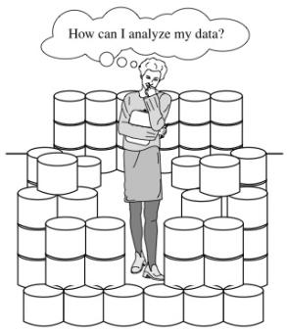
Why Data Mining?
The explosive growth of data from terabytes to petabytes
Data collection and data availability
Automated data collection tools, database systems, Web, computerized society
Major sources of abundant data
Business: Web, e-commerce, transactions, stocks, …
Science: Remote sensing, bioinformatics, scientific simulation, …
Society and everyone: news, digital cameras, YouTube
We are drowning in data, but starving for knowledge!
“Necessity is the mother of invention”—Data mining—Automated analysis of massive data sets

Slide 5
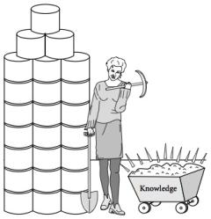
What Is Data Mining?
Data mining (knowledge discovery from data)
Extraction of interesting (non-trivial, implicit, previously unknown and potentially useful) patterns or knowledge from huge amount of data
Alternative names
Knowledge discovery (mining) in databases (KDD), knowledge extraction, data/pattern analysis, data archeology, data dredging, information harvesting, business intelligence, etc.
Watch out: Is everything “data mining”?
Simple search and query processing
(Deductive) expert systems

Slide 6
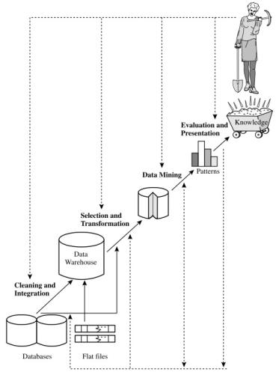
Knowledge Discovery Process
A KDD process includes data cleaning, data integration, data selection, transformation, data mining, pattern evaluation, and knowledge presentation

Slide 7
Applications
Data analysis and decision support
Market analysis and management
Target marketing, customer relationship management (CRM), market basket analysis, cross selling, market segmentation
Risk analysis and management
Forecasting, customer retention, improved underwriting, quality control, competitive analysis
Fraud detection and detection of unusual patterns (outliers)
Other Applications
Text mining (news group, email, documents) and Web mining
Stream data mining (cctv, etc.)
Bioinformatics and bio-data analysis

Slide 8
Data mining functionalities?
characterization,
discrimination,
Mining frequent patterns,
association,
classification,
clustering,
Outlier,

Slide 9
What is Data?
Attributes
Collection of data objects and their attributes
An attribute is a property or characteristic of an object
Examples: eye color of a person, temperature, etc.
Attribute is also known as variable, field, characteristic, or feature
A collection of attributes describe an object
Object is also known as record, point, case, sample, entity, or instance
Objects

Slide 10
Types of Attributes
There are different types of attributes CATEGORICAL
Nominal
Examples: ID numbers, eye color, zip codes
Ordinal
Examples: rankings (e.g., taste of potato chips on a scale from 1-10), height in {tall, medium, short}, professional rank {assistant, associate, professor}
NUMERIC
Numeric: Interval
Examples: calendar dates
Numeric: Ratio
Examples: monetary quantities, counts, age, mass, length, electrical current
Notes:
CATEGORICAL: Qualitative
NUMERIC: Quantitative
Nominal means “relating to names.” The values of a nominal attribute are symbols or names of things.
An ordinal attribute is an attribute with possible values that have a meaningful order or ranking among them, but the magnitude between successive values is not known. Useful for registering subjective assessments of qualities that cannot be measured objectively; thus ordinal attributes are often used in surveys for ratings.
Interval-scaled attributes are measured on a scale of equal-size units. The values of interval-scaled attributes have order and can be positive, 0, or negative. Such attributes allow us to compare and quantify the difference between values
A ratio-scaled attribute is a numeric attribute with an inherent zero-point. That is, if a measurement is ratio-scaled, we can speak of a value as being a multiple (or ratio) of another value.

Slide 11
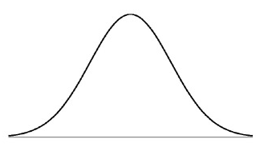
Mining Data Descriptive Characteristics
Motivation
To better understand the data: central tendency, data dispersion
Central tendency characteristics
mean, median, and mode
Data dispersion characteristics
quartiles, interquartile range (IQR), and variance
Dispersion
Central tendency
Notes:
Demo: distribution chart of Iris data
Central tendency: numerical measure of the “center” of a set of data
Dispersion/variance: degree to which numerical data tend to spread

Slide 12
Measuring the Central Tendency
Mean (algebraic measure) (sample vs. population):
Weighted arithmetic mean:
Trimmed mean: chopping extreme values
Median: A holistic measure
Middle value if odd number of values, or average of the middle two values otherwise
Estimated by interpolation (for grouped data):
Mode
Value that occurs most frequently in the data
Unimodal, bimodal, trimodal
Empirical formula (unimodal) :
Notes:
A holistic measure is a measure that must be computed on the entire data set as a whole, It cannot be computed by partitioning the given data into subsets and merging the values obtained for the measure in each subset
Grouped data median: L1 is the lower boundary of the median interval, n is the number of values in the entire data set, ∑ (f)l is the sum of the frequencies of all of the intervals that are lower than the median interval, f_{median} is the frequency of the median interval, and c is the width of the median interval

Slide 13
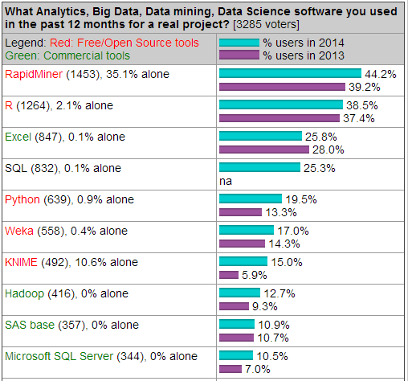
Most Popular DM Tools
The top 10 tools by share of users were (Kdnuggets-2014)
Source: http://www.kdnuggets.com
Most popular open source tools:
RapidMiner, 44.2% share (39.2% in 2013)
R, 38.5% ( 37.4% in 2013)
Python, 19.5% ( 13.3% in 2013)
Weka, 17.0% ( 14.3% in 2013)
KNIME, 15.0% ( 5.9% in 2013)
Most popular commercial tools:
SAS Enterprise Miner
MATLAB
IBM SPSS Modeler

Slide 14
Popular Open Source DM Tools
RapidMiner: many DM algorithms (also can import Weka’s methods), extendable, steady learning curve, recent problems with licensing
Weka: many DM algorithms, user-friendly, extendable, not the best choice for data visualization or advanced DM tasks at this time
R: strong in statistics and DM algorithms, extendable, fast implementations, complexity of extensions, not user-friendly – some improvement with Rattle GUI
KNIME: user-friendly, extendable (e.g. Weka, R), covers most of the advanced DM tasks as add-ons, no significant downsides
Orange: user-friendly, visually appealing GUI, moderate DM algorithms coverage, doesn’t cover advanced DM tasks at this time
scikit-learn: great documentation, fast implementations, moderate DM algorithms coverage, not user-friendy

Slide 15
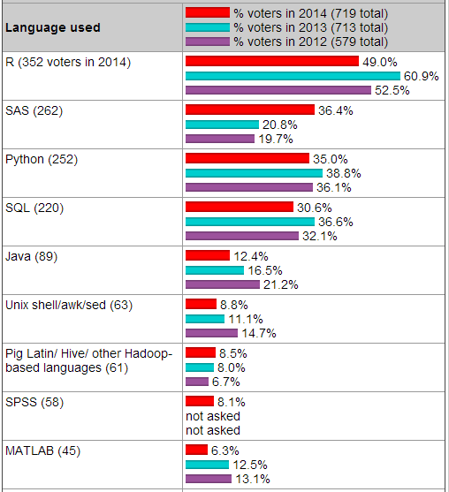
Programming/statistics Language
Top ten of programming/ statistics languages used for an analytics/data mining/data science work in 2014:
R
SAS
Python
Java
Unix
Pig Latin/Hive/Hadoop
SPSS
Matlab
Source: http://www.kdnuggets.com

Slide 16
Comparing DM Tools
Characteristic | RapidMiner | R | Weka | Orange | KNIME | scikit-learn
Developer: | RapidMiner, Germany | worldwide development | Univ. of Waikato, New Zealand | Univ. of Ljubljana, Slovenia | KNIME.com AG,Switzerland | multiple; support: INRIA, Google
Programming language: | Java | C, Fortran, R | Java | C++, Python, Qt framew. | Java | Python+NumPy+ SciPy+matplotlib
License: | open s. (v.5 or lower); closed s., free Starter ed. (v.6) | free software, GNU GPL 2+ | open source, GNU GPL 3 | open source, GNU GPL 3 | open source, GNU GPL 3 | FreeBSD
GUI/CL: | GUI | both; (GUI for DM = Rattle) | both | both | GUI | command line
Main purpose: | general data mining | sci. computation and statistics | general data mining | general data mining | general data mining | machine learning package add-on
Community support (est.): | large (~200 000 users) | very large (~ 2 M users) | large | moderate | moderate (~ 15 000 users) | moderate

Slide 17
Why Data Preprocessing?
Data in the real world is dirty
Incomplete: lacking attribute
e.g., occupation=“ ”
Noisy: containing errors or outliers
e.g., Salary=“-10”
Inconsistent: containing discrepancies in codes or names
e.g., Age=“42” Birthday=“03/07/1997”
e.g., Was rating “1,2,3”, now rating “A, B, C”
e.g., discrepancy between duplicate records

Slide 18
Why is Data Dirty?
Incomplete data may come from
“Not applicable” data value when collected
Different considerations between the time when the data was collected and when it is analyzed*)
Human/hardware/software problems
Noisy data (incorrect values) may come from
Faulty data collection instruments
Human or computer error at data entry
Errors in data transmission
Inconsistent data may come from
Different data sources
Functional dependency violation (e.g., modify some linked data) **)
Duplicate records also need data cleaning
Notes:
*) Perkembangan teknologi
**) Break the entity relationship

Slide 19
Why is Data Preprocessing Important?
No quality data, no quality mining results!
Quality decisions must be based on quality data
e.g., duplicate or missing data may cause incorrect or even misleading statistics.
Data warehouse needs consistent integration of quality data
Data extraction, cleaning, and transformation comprises the majority of the work of building a data warehouse (up to 90%)

Slide 20
Multi-Dimensional Measure of Data Quality
A well-accepted multidimensional view:
Accuracy
Completeness
Consistency
Timeliness
Believability
Non-redudancy
Relevance
Interpretability
Accessibility
Notes:
Accuracy. To be useful for subsequent analyses, data must be highly accurate. For instance, it is necessary to verify that names and encodings are correctly represented and values are within admissible ranges.
Completeness. In order to avoid compromising the accuracy of business intelli- gence analyses, data should not include a large number of missing values. How- ever, one should keep in mind that most learning and data mining techniques are capable of minimizing in a robust way the effects of partial incompleteness in the data.
Consistency. The form and content of the data must be consistent across the different data sources after the integration procedures, with respect to currency and measurement units.
Timeliness. Data must be frequently updated, based on the objectives of the analysis. It is customary to arrange an update of the data warehouse regularly on a daily or at most weekly basis.
Believability. reflects how much the data are trusted by users
Non-redundancy. Data repetition and redundancy should be avoided in order to prevent waste of memory and possible inconsistencies. However, data can be replicated when the denormalization of a data warehouse may result in reduced response times to complex queries.
Relevance. Data must be relevant to the needs of the business intelligence system in order to add real value to the analyses that will be subsequently performed.
Interpretability. The meaning of the data should be well understood and correctly interpreted by the analysts, also based on the documentation available in the metadata describing a data warehouse
Accessibility. Data must be easily accessible by analysts and decision support applications.

Slide 21
Major Tasks in Data Preprocessing
Data cleaning
Fill in missing values, smooth noisy data, identify or remove outliers, and resolve inconsistencies
Data integration
Integration of multiple databases, data cubes, or files
Data transformation
Normalization and aggregation
Data reduction
Obtains reduced representation in volume but produces the same or similar analytical results
Data discretization
Part of data reduction but with particular importance, especially for numerical data

Slide 22
What is Data Warehouse?
Defined in many different ways, but not rigorously.
A decision support database that is maintained separately from the organization’s operational database
Support information processing by providing a solid platform of consolidated, historical data for analysis.
“A data warehouse is a subject-oriented, integrated, time-variant, and nonvolatile collection of data in support of management’s decision-making process.”—W. H. Inmon
Data warehousing:
The process of constructing and using data warehouses

Slide 23
Data Warehouse vs. Heterogeneous DBMS
Traditional heterogeneous DB integration: A query driven approach
Build wrappers/mediators on top of heterogeneous databases
A meta-dictionary is used to translate the query into queries and the results are integrated into a global answer set
Complex information filtering, compete for resources
Data warehouse: update-driven, high performance
Information from heterogeneous sources is integrated in advance and stored in warehouses for direct query and analysis

Slide 24
Data Warehouse vs. Heterogeneous DBMS
OLTP (on-line transaction processing)
Major task of traditional relational DBMS
Day-to-day operations: purchasing, inventory, banking, manufacturing, payroll, registration, accounting, etc.
OLAP (on-line analytical processing)
Major task of data warehouse system
Data analysis and decision making
Distinct features (OLTP vs. OLAP):
User and system orientation: customer vs. market
Data contents: current, detailed vs. historical, consolidated
Database design: ER + application vs. star + subject
View: current, local vs. evolutionary, integrated
Access patterns: update vs. read-only but complex queries

Slide 25
Typical OLAP Operations
Roll up (drill-up): summarize data
by climbing up hierarchy or by dimension reduction
Drill down (roll down): reverse of roll-up
from higher level summary to lower level summary or detailed data, or introducing new dimensions
Slice and dice: project and select
Pivot (rotate):
reorient the cube, visualization, 3D to series of 2D planes
Other operations
drill across: involving (across) more than one fact table
drill through: through the bottom level of the cube to its back-end relational tables (using SQL)

Slide 26
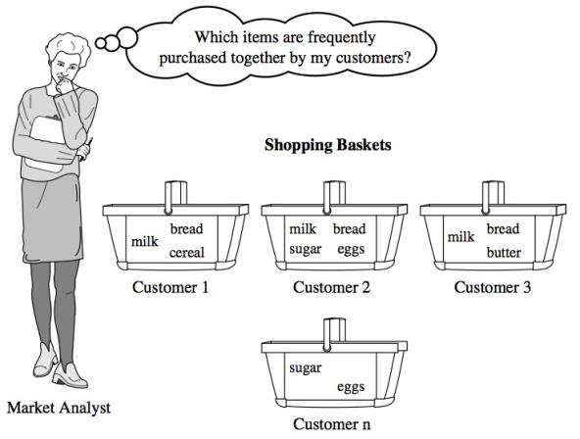
Market Basket Analysis

Slide 27
Why Is Freq. Pattern Mining Important?
Discloses an intrinsic and important property of data sets
Forms the foundation for many essential data mining tasks
Association, correlation, and causality analysis
Sequential, structural (e.g., sub-graph) patterns
Pattern analysis in spatiotemporal, multimedia, time-series, and stream data
Classification: associative classification
Cluster analysis: frequent pattern-based clustering
Data warehousing: iceberg cube and cube-gradient
Broad applications

Slide 28
Basic Concepts: Frequent Patterns and Association Rules
Transaction-id | Items bought
10 | A, B, D
20 | A, C, D
30 | A, D, E
40 | B, E, F
50 | B, C, D, E, F
Itemset X = {x1, …, xk}
Find all the rules X ➔Y with minimum support and confidence
support, s, probability that a transaction contains X  Y
confidence, c, conditional probability that a transaction having X also contains Y
Customer
buys both
Customer
buys diaper
Let sup_min = 50%, con_fmin = 50%
Freq. Pat.: {A:3, B:3, D:4, E:3, AD:3}
Association rules:
A => D (sup=60%, conf=100%)
D => A (sup=60%, conf=75%)
Customer
buys beer
Notes:
Sup_min = 0.5 = 0.5*5 = 2.5

Slide 29
Summary
We have briefly reviewed the fundamental of the materials of
Principle in Data Mining
Exploring DATA
DATA MINING TOOLS
DATA PREPROCESSING
DATA WAREHOUSE AND OLAP
ASSOCIATION ANALYSIS

Slide 30
References
Han, J., Kamber, M., & Pei, Y. (2006). “Data Mining: Concepts and Technique”. Edisi 3. Morgan Kaufman. San Francisco
Tan, P.N., Steinbach, M., & Kumar, V. (2006). “Introduction to Data Mining”. Addison-Wesley. Michigan
Witten, I. H., & Frank, E. (2005). “Data Mining : Practical Machine Learning Tools and Techniques”. Second edition. Morgan Kaufmann. San Francisco

