Slide 1
Knowledge Data Discovery
TOPIC 8 - Classification: Basic Concepts
Antoni Wibowo

Slide 2
Course outline
What is classification?
Regression and classification
General approach of classification taks
Decision Tree methods
Rule-based classifiers
Nearest neighbor classifier (k-NN)

Slide 3
Note:
This slides are based on the additional material provided with the textbook that we use: J. Han, M. Kamber and J. Pei, “Data Mining: Concepts and Techniques” and P. Tan, M. Steinbach, and V. Kumar "Introduction to Data Mining“.

Slide 4
What is Classification?
Classification is the task of assigning objects to one of several predefined classes (or categories) on the basis of a training data set containing observations (or instances) whose class membership is known.
In the terminology of machine learning, classification is consider an instance of supervised learning problem
The training data set is labeled data
  Each record (known as an instance or example) is characterized by a tuple (x, y), where x is the attribute set and y is a special attribute, designated as the class label (also known as category or target attribute)

Slide 5
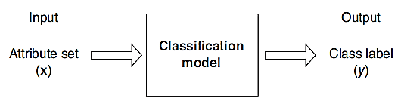
What is Classification?
Classification is the task of learning a classification model that maps each attribute set x to one of the class labels y.
Goal: previously unseen records should be assigned a class as accurately as possible.
    A test data set is used to determine the accuracy of the model. Usually, the given data set is divided into training sets and test sets, with training set used to build the model and test set used to validate it.
    Note: If the test set is used to select models, it is called validation (test) set

Slide 6
Classification vs Regression
Classification:
  Predicts categorical class labels
  Classifies data (constructs a model) based on the training set and the values (class labels) in a classifying attribute and uses it in classifying new data
Regression:
  models continuous-valued functions, i.e., predicts unknown or missing values

Slide 7

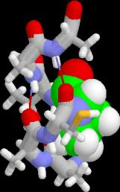
Examples of Classification Task
Banking: Credit/loan approval
Fraud detection: if a transaction is fraudulent
Detecting spam email messages based upon the message header and content
Medical diagnosis: Predicting tumor cells as benign or malignant based upon the results of MRI scans
Biology: Classifying secondary structures of protein as alpha-helix, beta-sheet, or random coil
Web page categorization: Categorizing news stories as finance, weather, entertainment, sports, etc

Slide 8
Classification— Two-Step Process
Model Construction: describing a set of predetermined classes
  Given a set of labeled data set (as training set) for model construction
  The model is represented as classification rules, decision trees, or mathematical functions (classifiers)
Model Usage: for classifying future or unknown objects
  Estimate accuracy of the model
    The known label of test sample is compared with the classified result from the model
    Accuracy rate is the percentage of test set samples that are correctly classified by the model
    Test set is independent of training set (otherwise overfitting)
  If the accuracy is acceptable, use the model to classify new data
Note: If the test set is used to select models, it is called validation (test) set

Slide 9
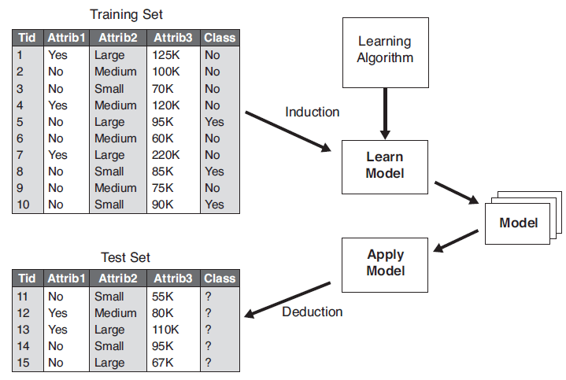
Illustrating Classification Task

Slide 10
Supervised vs. Unsupervised Learning
Supervised learning (for classification, regression)
  Data: lebed data (The class labels of training data is known)
  Supervision: The training data (observations, measurements, etc.) are accompanied by labels indicating the class of the observations
  New data is classified based on the training set
Unsupervised learning (for clustering)
  Data: unalebed data (The class labels of training data is unknown)
  Given a set of measurements, observations, etc. with the aim of establishing the existence of classes or clusters in the data.

Slide 11
Classification Methods
Decision Tree-based Methods
Rule-based Methods
Naive Bayes Classifiers
Bayesian Belief Networks
Nearest-Neighbor Classifiers (KNN)
Artificial Neural Networks (ANN)
Support Vector Machines (SVM)
Etc...

Slide 12
Decision Tree Method

Slide 13
Decison Tree Methods
A decision tree is a flowchart-like structure in which each internal node represents a "test" on an attribute, each branch represents the outcome of the test and each leaf node represents a class label (decision taken after computing all attributes).
Ross Quinlan (ID3: 1986), (C4.5: 1993)
Breimanetal (CaRT: 1984) from statistics

Slide 14
Decison Tree Methods
The tree has three types of nodes:
  root node that has no incoming edges and zero or more outgoing edges.
  Internal nodes, each of which has exactly one incoming edge and two or more outgoing edges.
  Leaf or terminal nodes, each of which has exactly one incoming edge and no outgoing edges. Here, each leaf node is assigned a class label.
The paths from root to leaf represents classification rules

Slide 15
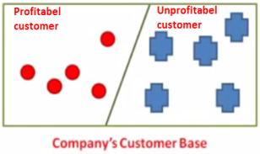

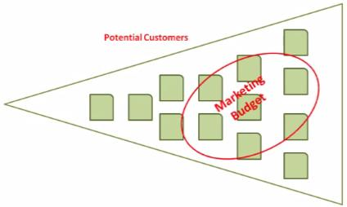
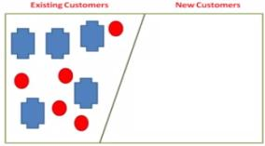
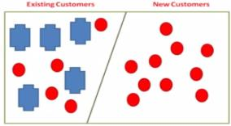
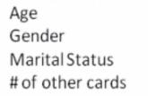
Case Study

Slide 16
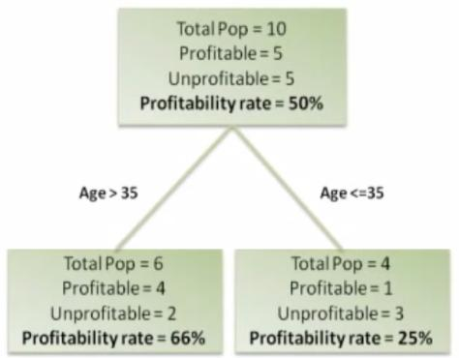
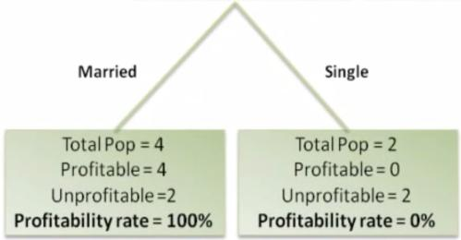
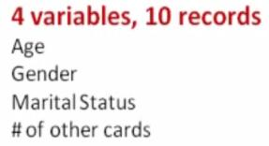
Case Study
Age | Gender | Marital Status | Number of Credit Card | Profitability
36 | M | Yes | 1 | Yes
32 | M | No | 3 | No
38 | M | Yes | 2 | Yes
40 | M | S | 1 | No
44 | M | Yes | 0 | Yes
56 | F | Yes | 0 | Yes
58 | F | S | 1 | No
30 | F | S | 2 | Yes
28 | F | Yes | 1 | No
26 | F | Yes | 0 | No

Slide 17
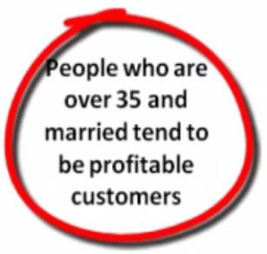
Case Study

Slide 18
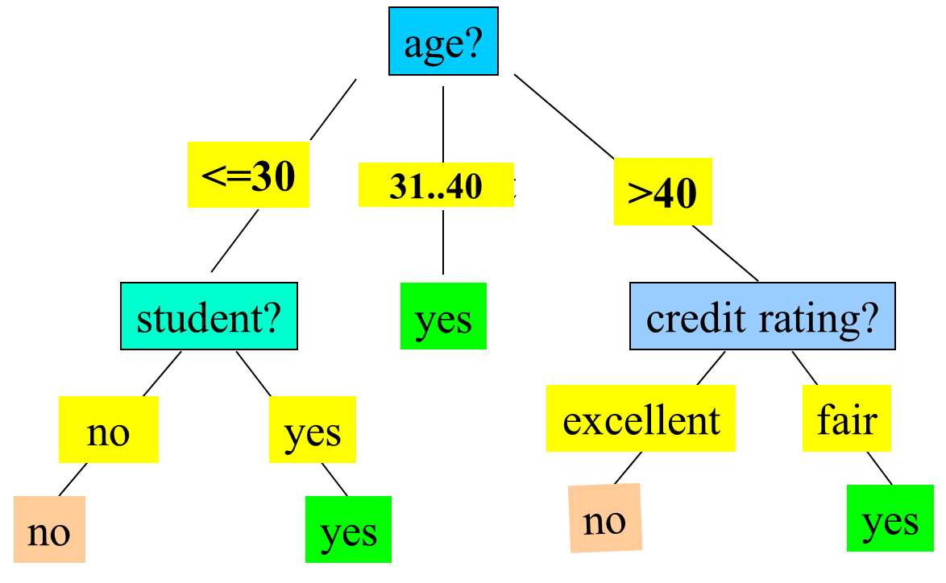
Decision Tree Induction: An Example
Training data set: Buys_computer
The data set follows an example of Quinlan’s ID3 (Playing Tennis)
Resulting tree:

Slide 19
Rule Extraction from a Decision Tree
age?
Example: Rule extraction from our buys_computer decision-tree
  IF age = young AND student = no THEN buys_computer = no
  IF age = young AND student = yes THEN buys_computer = yes
  IF age = mid-age THEN buys_computer = yes
  IF age = old AND creditrating = excellent THEN buys_computer = no
  IF age = old AND creditrating = fair THEN buys_computer = yes
young
Mid-age
senior
student?
credit rating?
yes
no
yes
excellent
fair
no
yes
no
yes

Slide 20
Algorithm for Decision Tree Induction
Basic algorithm (a greedy algorithm)
  Tree is constructed in a top-down recursive divide-and-conquer manner
  At start, all the training examples are at the root
  Attributes are categorical (if continuous-valued, they are discretized in advance)
  Examples are partitioned recursively based on selected attributes
  Test attributes are selected on the basis of a heuristic or statistical measure (e.g., information gain, gini index, ...)
Conditions for stopping partitioning
  All samples for a given node belong to the same class
  There are no remaining attributes for further partitioning – majority voting is employed for classifying the leaf
  There are no samples left

Slide 21
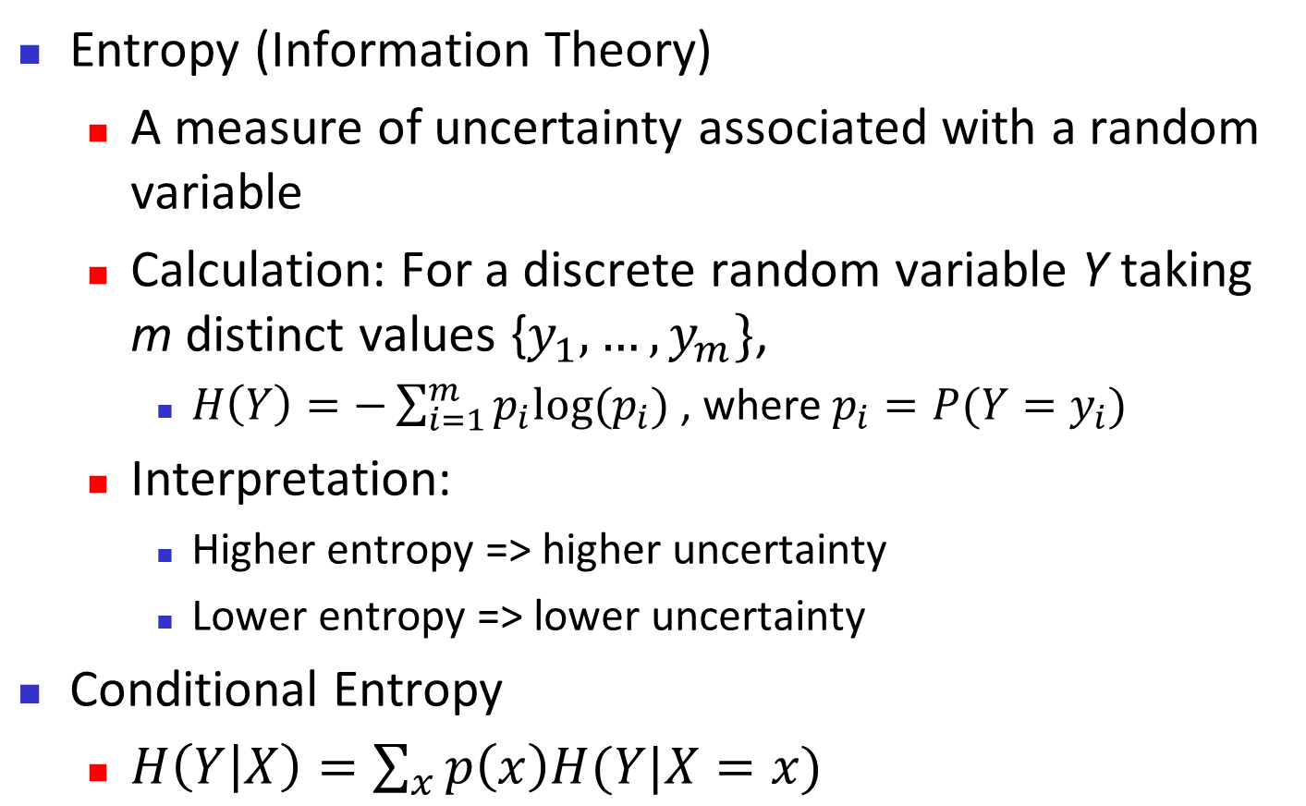
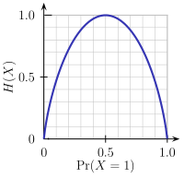
Brief Review of Entropy
m = 2

Slide 22
Attribute Selection Measure: Information Gain (ID3/C4.5)
Select the attribute with the highest information gain
Let p_{i} be the probability that an arbitrary tuple in D belongs to class C_{i}, estimated by |C_{i, D}|/|D|
Expected information (entropy) needed to classify a tuple in D:
Information needed (after using A to split D into v partitions) to classify D:
Information gained by branching on attribute A
Notes:
I : the expected information needed to classify a given sample
E (entropy) : expected information based on the partitioning into subsets by A

Slide 23
Attribute Selection: Information Gain
Class P: buys_computer = “yes”
Class N: buys_computer = “no”
means “age <=30” has 5 out of 14 samples, with 2 yes’es and 3 no’s. Hence
Similarly,

Slide 24
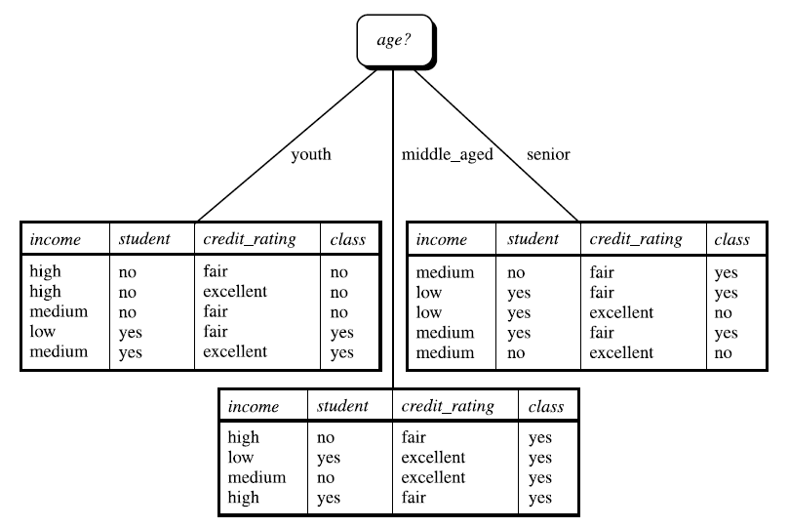
Attribute Selection: Information Gain

Slide 25
Computing Information-Gain for Continuous-Valued Attributes
Let attribute A be a continuous-valued attribute
Must determine the best split point for A
  Sort the value A in increasing order
  Typically, the midpoint between each pair of adjacent values is considered as a possible split point
    (a_{i}+a_{i+1})/2 is the midpoint between the values of a_{i} and a_{i+1}
  The point with the minimum expected information requirement for A is selected as the split-point for A
Split:
  D1 is the set of tuples in D satisfying A ≤ split-point, and D2 is the set of tuples in D satisfying A > split-point

Slide 26
Gain Ratio for Attribute Selection (C4.5)
Information gain measure is biased towards attributes with a large number of values
C4.5 (a successor of ID3) uses gain ratio to overcome the problem (normalization to information gain)
  GainRatio(A) = Gain(A)/SplitInfo(A)
Ex.
  gain_ratio(income) = 0.029/1.557 = 0.019
The attribute with the maximum gain ratio is selected as the splitting attribute

Slide 27
Gini Index (CART, IBM IntelligentMiner)
If a data set D contains examples from n classes, gini index, gini(D) is defined as
where p_{j} is the relative frequency of class j in D
If a data set D is split on A into two subsets D₁ and D₂, the gini index gini(D) is defined as
Reduction in Impurity:
The attribute provides the smallest gini_{split}(D) (or the largest reduction in impurity) is chosen to split the node (need to enumerate all the possible splitting points for each attribute)

Slide 28
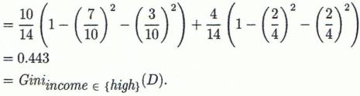
Computation of Gini Index
Ex. D has 9 tuples in buys_computer = “yes” and 5 in “no”
Suppose the attribute income partitions D into 10 in D₁: {low, medium} and 4 in D₂
  Gini_{{low,high}} = 0.458 < Gini_{{medium,high}} = 0.450.
  Thus, split on the {low,medium} (and {high}) since it has the lowest Gini index

Slide 29
All attributes are assumed continuous-valued
May need other tools, e.g., clustering, to get the possible split values
Can be modified for categorical attributes

Slide 30
Comparing Attribute Selection Measures
The three measures, in general, return good results but
  Information gain:
    biased towards multivalued attributes
  Gain ratio:
    tends to prefer unbalanced splits in which one partition is much smaller than the others
  Gini index:
    biased to multivalued attributes
    has difficulty when # of classes is large
    tends to favor tests that result in equal-sized partitions and purity in both partitions

Slide 31
Other Attribute Selection Measures
CHAID: a popular decision tree algorithm, measure based on χ² test for independence
C-SEP: performs better than info. gain and gini index in certain cases
G-statistic: has a close approximation to χ² distribution
MDL (Minimal Description Length) principle (i.e., the simplest solution is preferred):
  The best tree as the one that requires the fewest # of bits to both (1) encode the tree, and (2) encode the exceptions to the tree
Multivariate splits (partition based on multiple variable combinations)
  CART: finds multivariate splits based on a linear comb. of attrs.
Which attribute selection measure is the best?
  Most give good results, none is significantly superior than others

Slide 32
Overfitting and Tree Pruning
Overfitting: An induced tree may overfit the training data
  Too many branches, some may reflect anomalies due to noise or outliers
  Poor accuracy for unseen samples
Two approaches to avoid overfitting
  Prepruning: Halt tree construction early ̵ do not split a node if this would result in the goodness measure falling below a threshold
    Difficult to choose an appropriate threshold
  Postpruning: Remove branches from a “fully grown” tree—get a sequence of progressively pruned trees
    Use a set of data different from the training data to decide which is the “best pruned tree”

Slide 33
Enhancements to Basic Decision Tree Induction
Allow for continuous-valued attributes
  Dynamically define new discrete-valued attributes that partition the continuous attribute value into a discrete set of intervals
Handle missing attribute values
  Assign the most common value of the attribute
  Assign probability to each of the possible values
Attribute construction
  Create new attributes based on existing ones that are sparsely represented
  This reduces fragmentation, repetition, and replication

Slide 34
Classification in Large Databases
Classification—a classical problem extensively studied by statisticians and machine learning researchers
Scalability: Classifying data sets with millions of examples and hundreds of attributes with reasonable speed
Why is decision tree induction popular?
  relatively faster learning speed (than other classification methods)
  convertible to simple and easy to understand classification rules
  can use SQL queries for accessing databases
  comparable classification accuracy with other methods
RainForest (VLDB’98 — Gehrke, Ramakrishnan & Ganti)
  Builds an AVC-list (attribute, value, class label)

Slide 35
Scalability Framework for RainForest
Separates the scalability aspects from the criteria that determine the quality of the tree
Builds an AVC-list: AVC (Attribute, Value, Class_label)
AVC-set (of an attribute X )
  Projection of training dataset onto the attribute X and class label where counts of individual class label are aggregated
AVC-group (of a node n )
  Set of AVC-sets of all predictor attributes at the node n

Slide 36
Rainforest: Training Set and Its AVC Sets
AVC-set on Age
AVC-set on income
Training Examples
Age | Buy_Computer
 | yes | no
<=30 | 2 | 3
31..40 | 4 | 0
>40 | 3 | 2
income | Buy_Computer
 | yes | no
high | 2 | 2
medium | 4 | 2
low | 3 | 1
AVC-set on Student
AVC-set on credit_rating
student | Buy_Computer
 | yes | no
yes | 6 | 1
no | 3 | 4
Credit rating | Buy_Computer
 | yes | no
fair | 6 | 2
excellent | 3 | 3

Slide 37
BOAT (Bootstrapped Optimistic Algorithm for Tree Construction)
Use a statistical technique called bootstrapping to create several smaller samples (subsets), each fits in memory
Each subset is used to create a tree, resulting in several trees
These trees are examined and used to construct a new tree T’
  It turns out that T’ is very close to the tree that would be generated using the whole data set together
Adv: requires only two scans of DB, an incremental alg.
37
Notes:
37

Slide 38
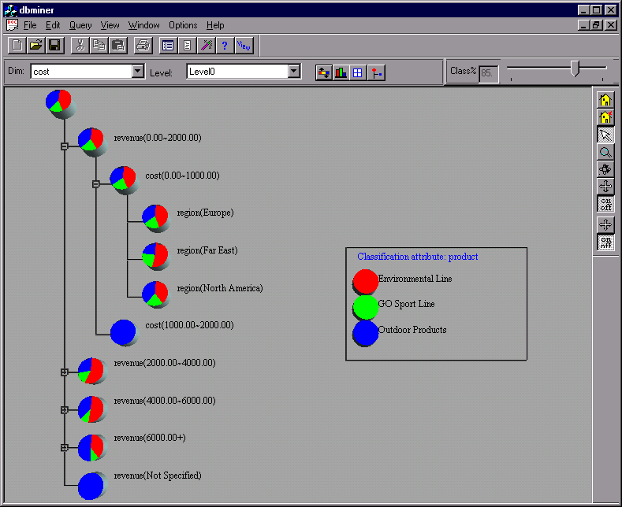
Presentation of Classification Results

Slide 39
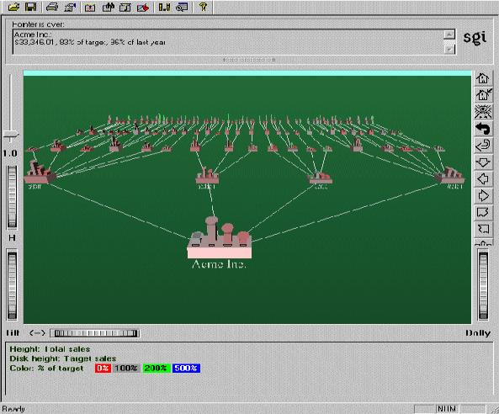
Visualization of a Decision Tree in SGI/MineSet 3.0

Slide 40
Rule-based Classifiers

Slide 41
Using IF-THEN Rules for Classification
Represent the knowledge in the form of IF-THEN rules
  R: IF age = youth AND student = yes THEN buys_computer = yes
  Rule antecedent/precondition vs. rule consequent
Assessment of a rule: coverage and accuracy
  n_{covers} = # of tuples covered by R
  n_{correct} = # of tuples correctly classified by R
  coverage(R) = n_{covers} /|D| /* D: training data set */
  accuracy(R) = n_{correct} / n_{covers}
If more than one rule are triggered, need conflict resolution
  Size ordering: assign the highest priority to the triggering rules that has the “toughest” requirement (i.e., with the most attribute tests)
  Class-based ordering: decreasing order of prevalence or misclassification cost per class
  Rule-based ordering (decision list): rules are organized into one long priority list, according to some measure of rule quality or by experts

Slide 42
Rule Extraction from a Decision Tree
Example: Rule extraction from our buys_computer decision-tree
  IF age = young AND student = no THEN buys_computer = no
  IF age = young AND student = yes THEN buys_computer = yes
  IF age = mid-age THEN buys_computer = yes
  IF age = old AND credit_rating = excellent THEN buys_computer = no
  IF age = old AND credit_rating = fair THEN buys_computer = yes
age?
Rules are easier to understand than large trees
One rule is created for each path from the root to a leaf
Each attribute-value pair along a path forms a conjunction: the leaf holds the class prediction
Rules are mutually exclusive and exhaustive
<=30
31..40
>40
student?
yes
credit rating?
no
yes
excellent
fair
no
yes
no
yes

Slide 43
Rule Induction: Sequential Covering Method
Sequential covering algorithm: Extracts rules directly from training data
Typical sequential covering algorithms: FOIL, AQ, CN2, RIPPER
Rules are learned sequentially, each for a given class C_{i} will cover many tuples of C_{i} but none (or few) of the tuples of other classes
Steps:
  Rules are learned one at a time
  Each time a rule is learned, the tuples covered by the rules are removed
  Repeat the process on the remaining tuples until termination condition, e.g., when no more training examples or when the quality of a rule returned is below a user-specified threshold
Comp. w. decision-tree induction: learning a set of rules simultaneously

Slide 44
Sequential Covering Algorithm
while (enough target tuples left)
  generate a rule
  remove positive target tuples satisfying this rule
Examples covered
by Rule 2
Examples covered
by Rule 1
Examples covered
by Rule 3
Positive examples

Slide 45
Rule Generation
To generate a rule
  while(true)
  find the best predicate p
  if foil-gain(p) > threshold then add p to current rule
  else break
A3=1
A3=1&&A1=2
A3=1&&A1=2
&&A8=5
Positive examples
Negative examples

Slide 46
How to Learn-One-Rule?
Start with the most general rule possible: condition = empty
Adding new attributes by adopting a greedy depth-first strategy
  Picks the one that most improves the rule quality
Rule-Quality measures: consider both coverage and accuracy
  Foil-gain (in FOIL & RIPPER): assesses info_gain by extending condition
    favors rules that have high accuracy and cover many positive tuples
Rule pruning based on an independent set of test tuples
    Pos/neg are # of positive/negative tuples covered by R.
    If FOIL_Prune is higher for the pruned version of R, prune R

Slide 47
K-Nearest-Neighbor

Slide 48
Lazy Learning vs Eager Learning
Lazy vs. eager learning
  Lazy learning (e.g., instance-based learning): Simply stores training data (or only minor processing) and waits until it is given a test tuple
  Eager learning (the above discussed methods): Given a set of training tuples, constructs a classification model before receiving new (e.g., test) data to classify
Lazy: less time in training but more time in predicting
Accuracy
  Lazy method effectively uses a richer hypothesis space since it uses many local linear functions to form an implicit global approximation to the target function
  Eager: must commit to a single hypothesis that covers the entire instance space

Slide 49
Lazy Learner: Instance-Based Methods
Instance-based learning:
  Store training examples and delay the processing (“lazy evaluation”) until a new instance must be classified
Typical approaches
  k-nearest neighbor approach
    Instances represented as points in a Euclidean space.
  Locally weighted regression
    Constructs local approximation
  Case-based reasoning
    Uses symbolic representations and knowledge-based inference

Slide 50
Nearest Neighbor Classifiers
Basic idea:
  If it walks like a duck, quacks like a duck, then it’s probably a duck
Compute Distance
Test Record
Choose k of the “nearest” records
Training Records

Slide 51
Nearest-Neighbor Classifiers
Requires three things
  The set of stored records
  Distance Metric to compute distance between records
  The value of k, the number of nearest neighbors to retrieve
To classify an unknown record:
  Compute distance to other training records
  Identify k nearest neighbors
  Use class labels of nearest neighbors to determine the class label of unknown record (e.g., by taking majority vote)

Slide 52
Definition of Nearest Neighbor
K-nearest neighbors of a record x are data points that have the k smallest distance to x

Slide 53
k-Nearest Neighbor Algorithm
All instances correspond to points in the n-D space
Compute distance between two points:
  The nearest neighbor are defined in terms of Euclidean distance, dist(X₁, X₂). Euclidean distance
Determine the class from nearest neighbor list
  take the majority vote of class labels among the k-nearest neighbors
  Weigh the vote according to distance
    weight factor, w = 1/d²

Slide 54
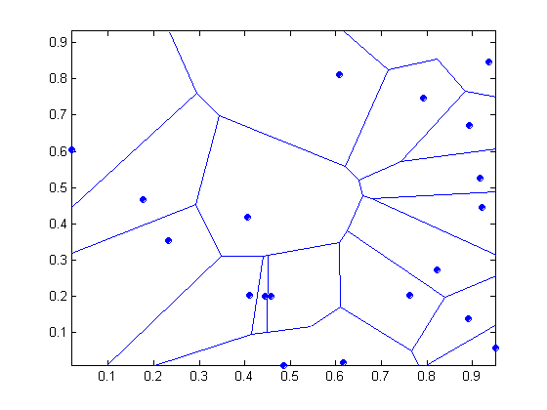
1 nearest-neighbor
Vonoroi diagram: the decision surface induced by 1-NN for a typical set of training examples

Slide 55
Discussion on the k-NN Algorithm
k-NN for real-valued prediction for a given unknown tuple
  Returns the mean values of the k nearest neighbors
Distance-weighted nearest neighbor algorithm
  Weight the contribution of each of the k neighbors according to their distance to the query x_{q}
    Give greater weight to closer neighbors
Robust to noisy data by averaging k-nearest neighbors
Curse of dimensionality: distance between neighbors could be dominated by irrelevant attributes
  To overcome it, axes stretch or elimination of the least relevant attributes

Slide 56
Discussion on the k-NN Algorithm
k-NN classifiers are lazy learners
  It does not build models explicitly
  Unlike eager learners such as decision tree induction and rule-based systems
  Classifying unknown records are relatively expensive

Slide 57
Summary
Classification is a form of data analysis that extracts models describing important data classes.
Effective and scalable methods have been developed for decision tree induction, Naive Bayesian classification, rule-based classification, nearest neighbor classification and many other classification methods.
57

Slide 58
References
Han, J., Kamber, M., & Pei, Y. (2006). “Data Mining: Concepts and Technique”. Edisi 3. Morgan Kaufman. San Francisco
Tan, P.N., Steinbach, M., & Kumar, V. (2006). “Introduction to Data Mining”. Addison-Wesley. Michigan
Witten, I. H., & Frank, E. (2005). “Data Mining : Practical Machine Learning Tools and Techniques”. Second edition. Morgan Kaufmann. San Francisco

