Slide 1
Knowledge Data Discovery
TOPIC 12 - Cluster Analysis: Advanced Methods
Antoni Wibowo

Slide 2
Course outline
Model-based Clustering Concept
Fuzzy clustering: FCM
Probability-based clustering: Gaussian Mixture Models and EM Algorithm
Self-Organizing Map (SOM)
Clustering High-Dimensional Data
Issues on clustering

Slide 3
Note:
This slides are based on the additional material provided with the textbook that we use: J. Han, M. Kamber and J. Pei, “Data Mining: Concepts and Techniques” and P. Tan, M. Steinbach, and V. Kumar "Introduction to Data Mining“.

Slide 4
Fuzzy Clustering

Slide 5
Basic Concepts
Fuzzy function to model similarity measures
In non-fuzzy or hard clustering discussed so far, data is divided into crisp clusters, where every data object is assigned to exactly one cluster.
Fuzzy set theory proposed by Lotfi Zadeh in 1965 gave an idea of uncertainty of belonging which was described by a membership function.
In fuzzy clustering, a data point can belong to more than one cluster according to fuzzy membership grades which the data point belong to the different clusters.

Slide 6
Fuzzy Clustering
Assume every data object belongs to K cluster according to fuzzy membership as model
Soft version of K-means clustering
Determine fuzzy membership function
Need to find cluster fuzzy membership matrix
Learning process is to minimize value of objective function

Slide 7
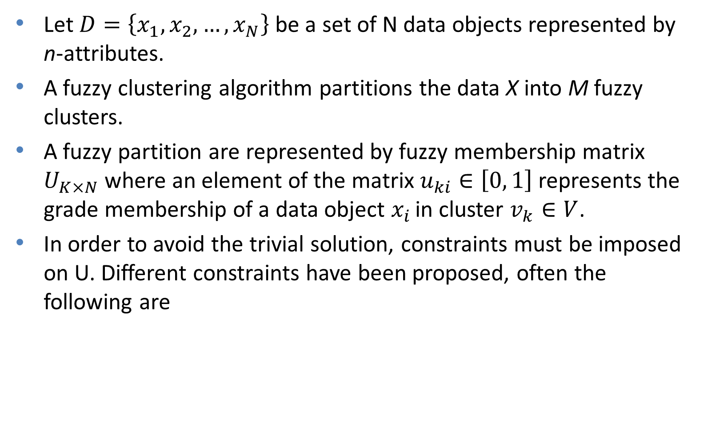
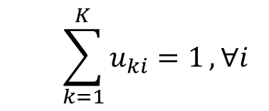
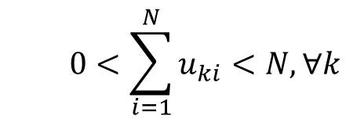
Fuzzy Clustering (2)

Slide 8
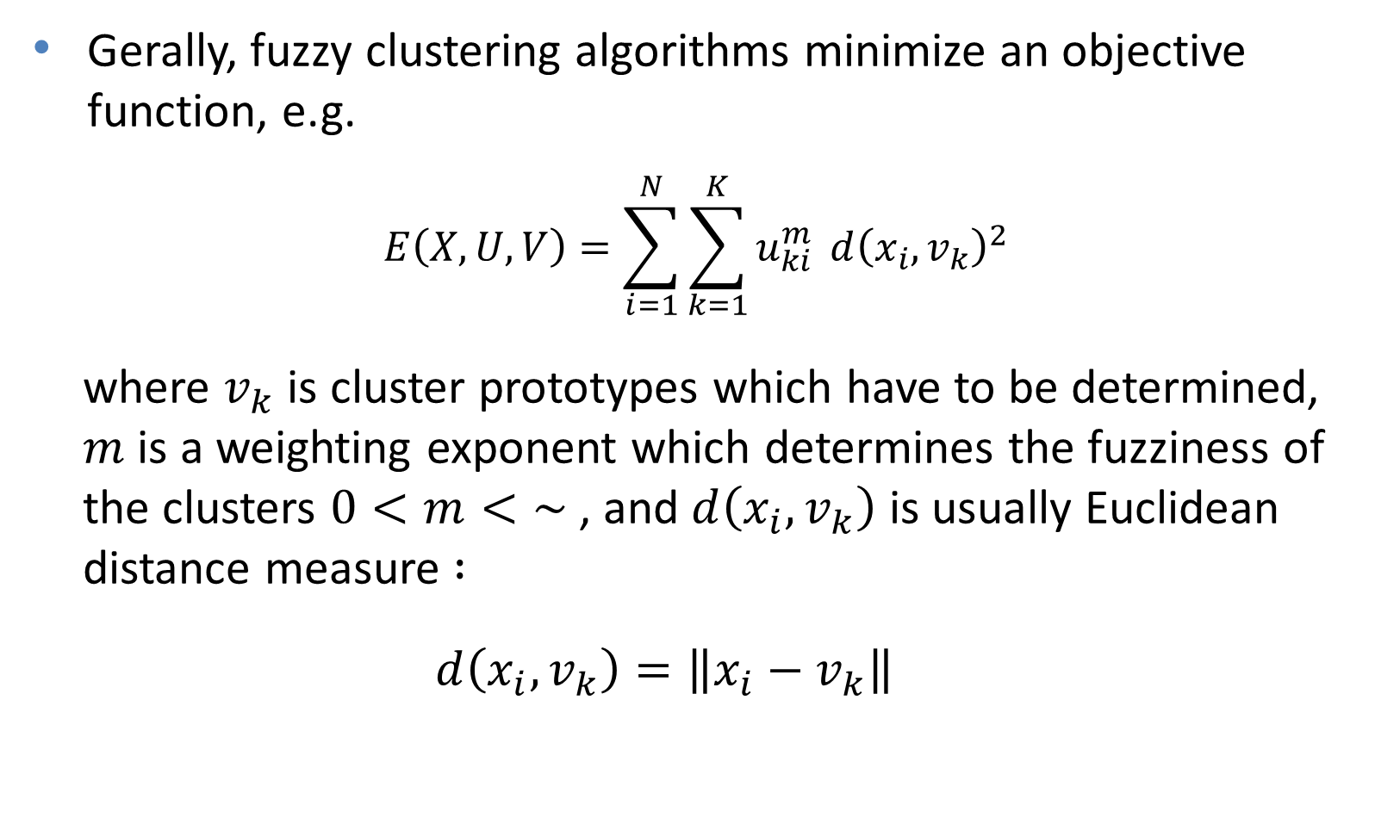
Fuzzy Clustering (3)

Slide 9

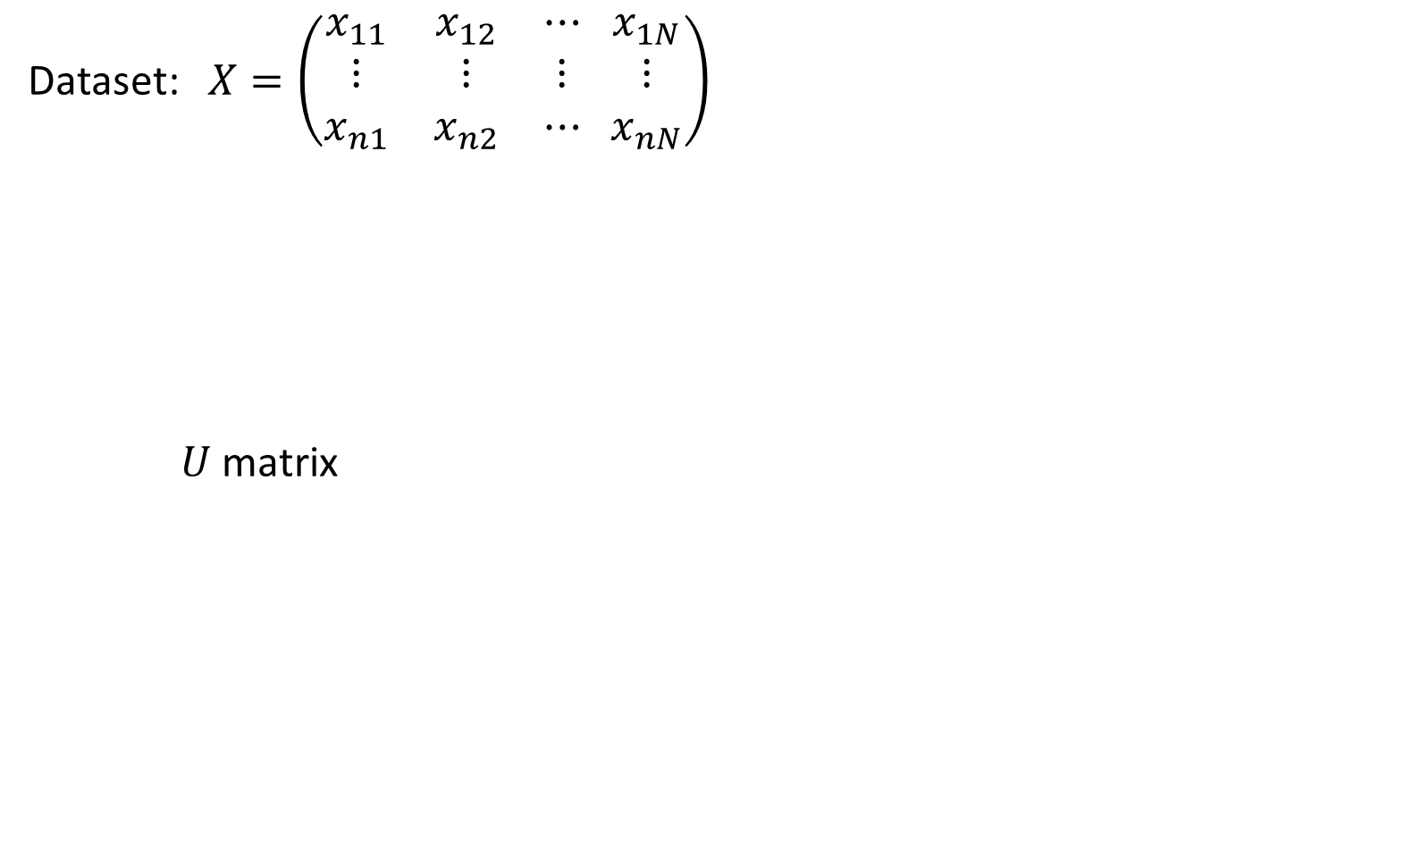

Fuzzy Clustering (4)
0.2399 0.6813 0.5901 ... 0.2478
0.6709 0.0603 0.4823 ... 0.9169
 | x1 | x2 | x3 | x4 | x5 | x6 | x7 | x8 | x9 | x10 | x11
K=1 | 0.9427 | 0.1096 | 0.9606 | 0.0804 | 0.0915 | 0.0641 | 0.7952 | 0.0316 | 0.0494 | 0.1799 | 0.9637
K=2 | 0.0573 | 0.8904 | 0.0394 | 0.9196 | 0.9085 | 0.9359 | 0.2048 | 0.9684 | 0.9506 | 0.8201 | 0.0363

Slide 10
Fuzzy Clustering Algorithms
Fuzzy c-Means (FCM) algorithm
  FCM is better than k-Means algorithm at avoiding local minima, FCM can still converge to local minima of the squared error criterion.
Extention of FCM algorithm:
  Algorithms using an adaptive distance measure:
    the Gustafson-Kessel algorithm (Gustafson and Kessel, 1979), the fuzzy maximum likelihood estimation algorithm (Gath and Geva, 1989).
  Algorithms based on hyperplanar or functional prototypes, or prototypes defined by functions:
    Fuzzy c-varieties (Bezdek, 1981), fuzzy c-elliptotypes (Bezdek, et al., 1981), fuzzy regression models (Hathaway & Bezdek,1993).

Slide 11
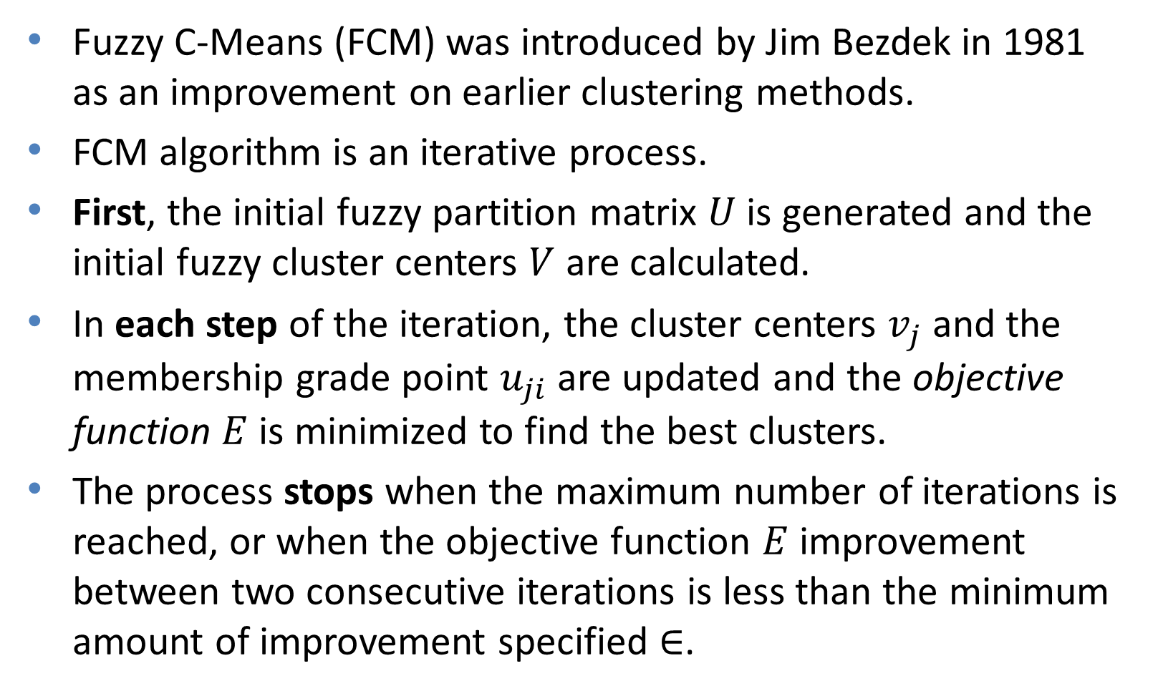
The Fuzzy c-Means Algorithm

Slide 12
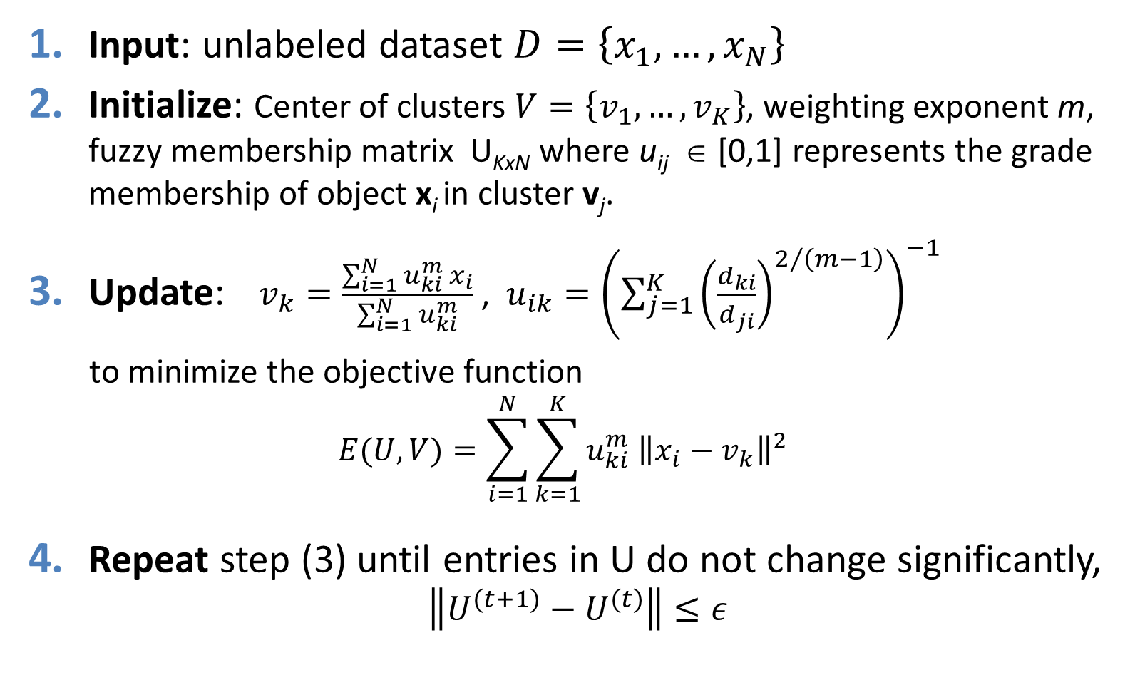
FCM Algorithm: Steps

Slide 13
FCM Algorithm: Learning process
data =
0.2399 0.6709
0.6813 0.0603
0.1475 0.8762
0.5872 0.4737
0.5901 0.4823
0.5561 0.1584
0.4088 0.6728
0.5649 0.4232
0.4885 0.2418
0.6513 0.5449
0.2478 0.9169
Iteration count = 1, E = 0.667717
Iteration count = 2, E = 0.546202
...
Iteration count = 6, E = 0.284894
Iteration count = 7, E = 0.284786
Iteration count = 8, E = 0.284780

Slide 14


FCM Algorithm: Result
Clustering
Defuzzyfication:
Convert fuzzy membership
to crisp clustering
 | U matrix
 | x1 | x2 | x3 | x4 | x5 | x6 | x7 | x8 | x9 | x10 | x11
K=1 | 0.9427 | 0.1096 | 0.9606 | 0.0804 | 0.0915 | 0.0641 | 0.7952 | 0.0316 | 0.0494 | 0.1799 | 0.9637
K=2 | 0.0573 | 0.8904 | 0.0394 | 0.9196 | 0.9085 | 0.9359 | 0.2048 | 0.9684 | 0.9506 | 0.8201 | 0.0363

Slide 15
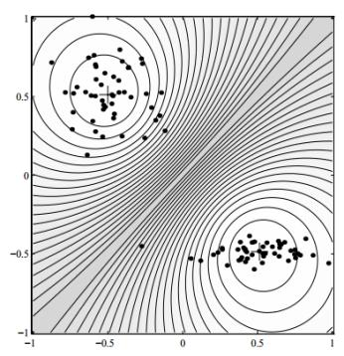
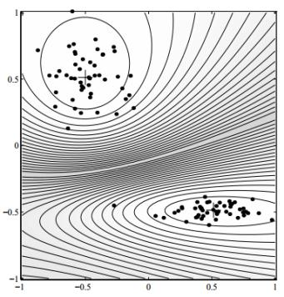
Experiment Results
FCM algorithm imposes a spherical shape on the clusters, regardless of the actual data distribu-tion. The dots represent the data points, ‘+’ are the cluster means.
The Gustafson–Kessel algorithm can detect clusters of different shape and
orientation.

Slide 16
Probabilistic Model-Based Clustering

Slide 17
Probabilistic Model-Based Clustering
Probabilistic model-based clustering frameworks assume:
  A hidden category is a distribution over the data space, which can be mathematically represented using a probability density function.
  Data has been generated from K probability distributions
  The data we can described by finding the statistical model that best fits the data.
The statistical process involves
  deciding on a statistical model, e.g. Gaussian Mixture Models, and
  estimating the distribution parameters of the model from the data
EM Algorithm

Slide 18
Mixture Models (1)
Mixture models view the data as a set of observations (observed objects) from a mixture of probability distributions independently.
Each distribution corresponds to a cluster and the parameters of each distribution provide a description of the corresponding cluster, typically: center (μ) and spread of clusters (σ).
Out task: infer a set of M distributions that is mostly likely to generate dataset D using the above data generation process

Slide 19
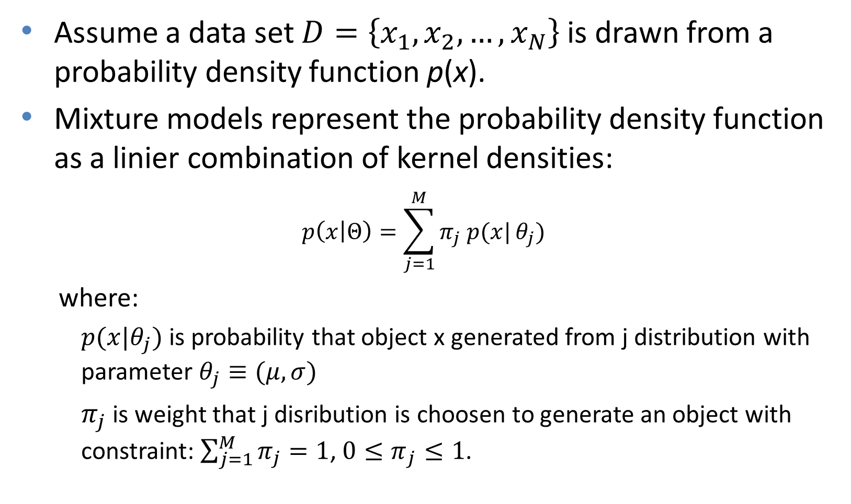
Mixture Models (2)

Slide 20
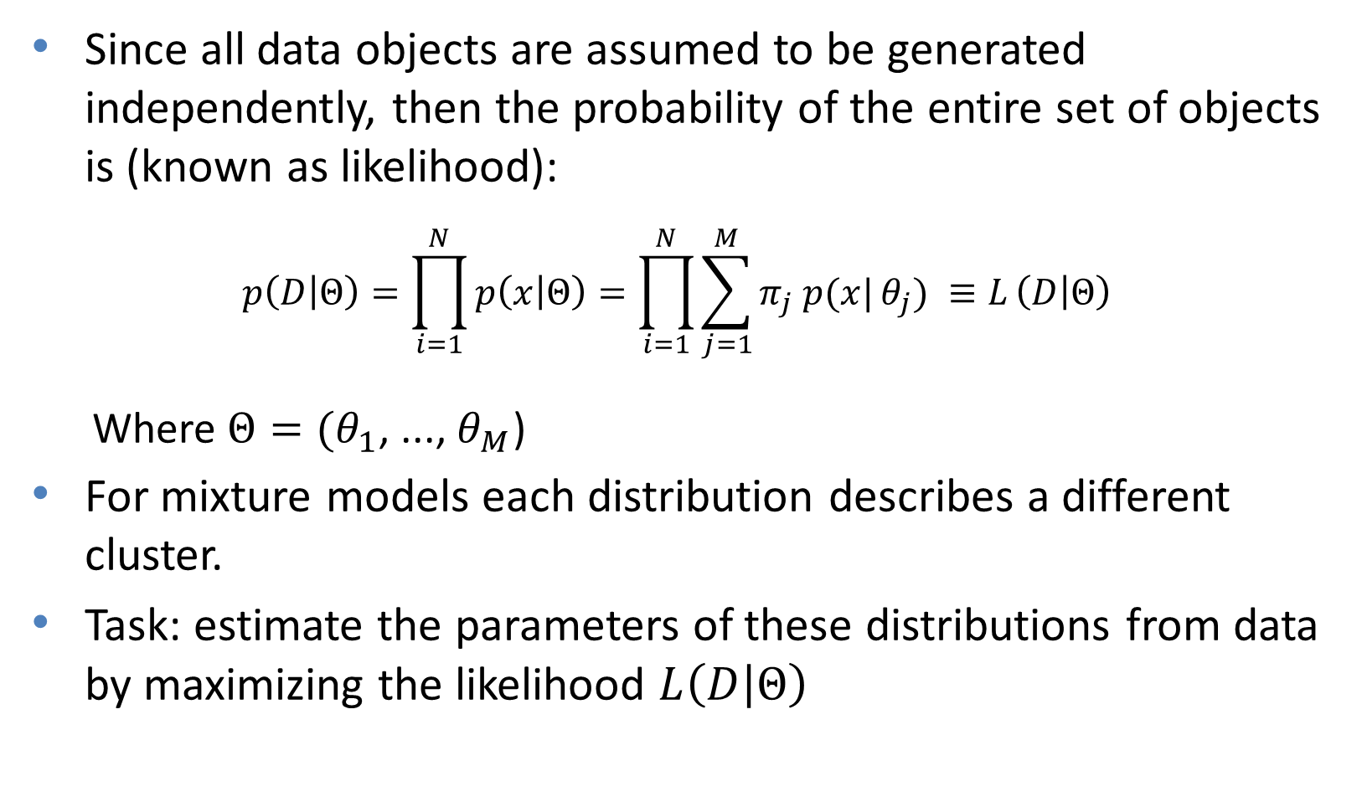
Mixture Models (3)

Slide 21
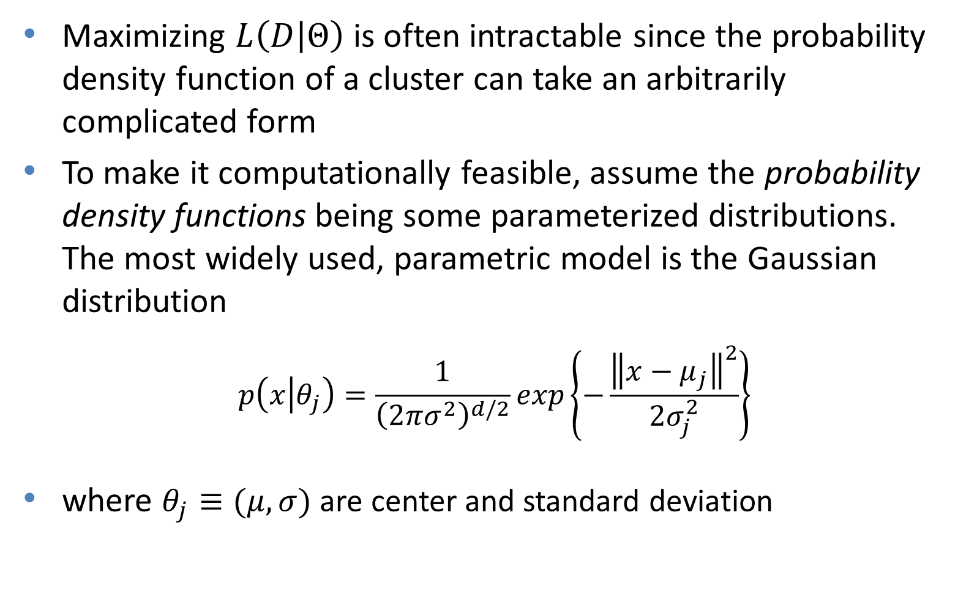
Gaussian Mixture Models

Slide 22
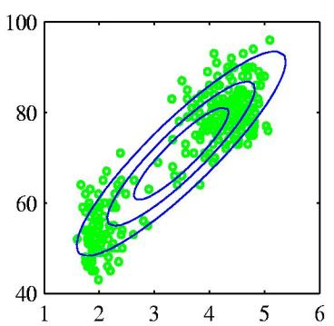
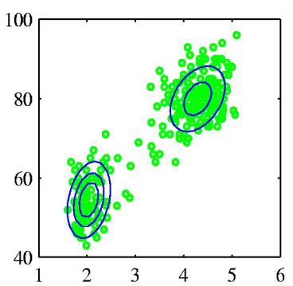
Gaussian Mixture Models (2)
Single Gaussian
Mixture of two Gaussians

Slide 23
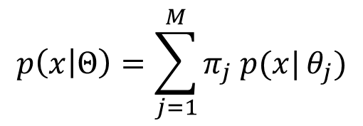
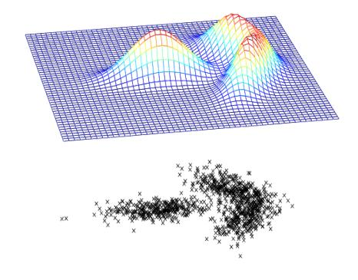
Gaussian Mixture Models (3)
Mixing coefficients
Probability density function
Gaussian distribution
Mixture of three Gaussians

Slide 24
The EM Algorithm
In general situation we do not know which points were generated by which distribution.
Finding of maximum-likelihood to estimate distribution parameters is a non-linear constrained optimization problem which difficult to solve.
EM algorithm is a framework to approach maximum likelihood to estimate distribution parameters.
EM Algorithm is an iterative method, each iteration of EM consist of two steps: Expectation (E-step) and Maximization (M-step).

Slide 25
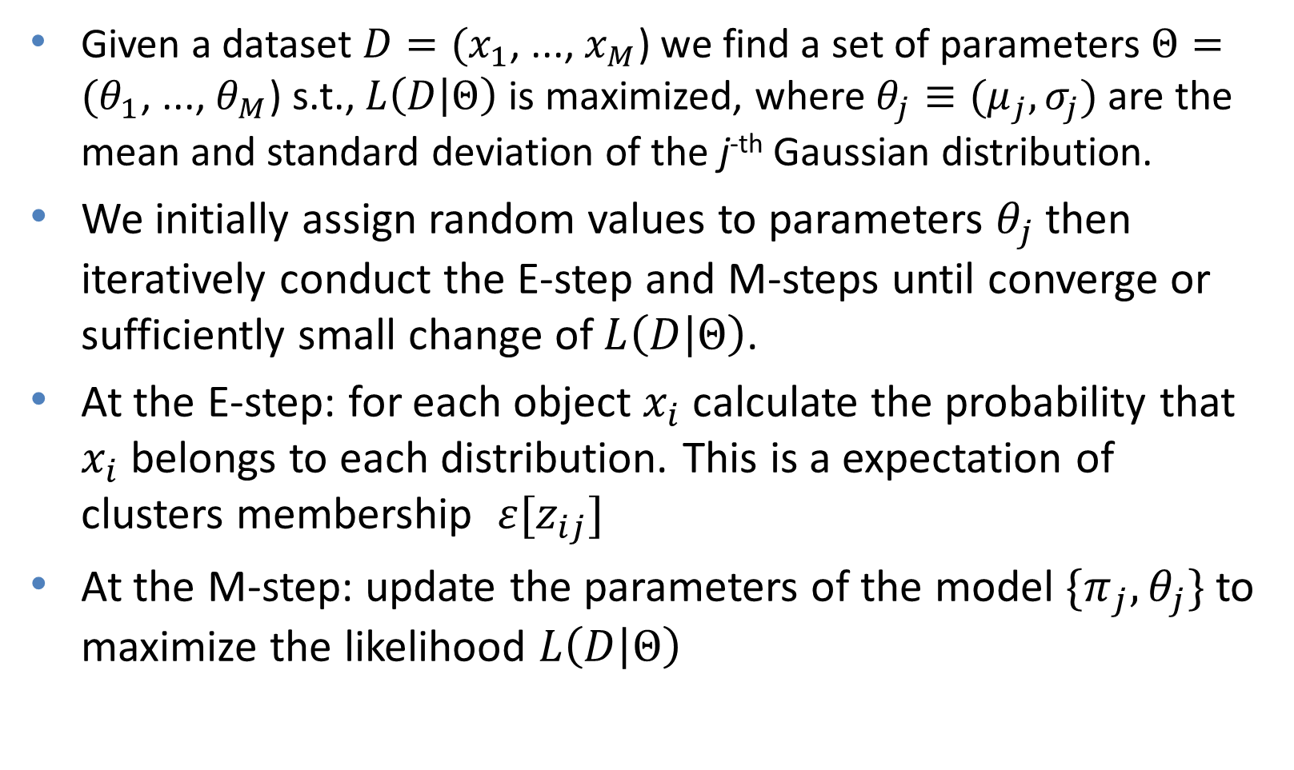
The EM Algorithm (2)

Slide 26
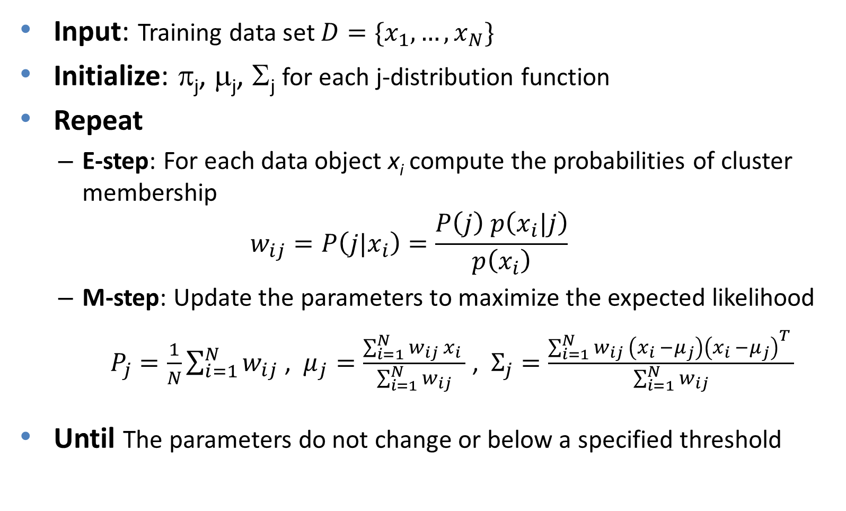
The EM Algorithm (3)

Slide 27
E-Step and M-Step

Slide 28
E-Step and M-Step
Note that some points still have “mixed" colour, indicating that they belong with signicant probability to more than one component/cluster.

Slide 29
E-Step and M-Step

Slide 30
E-Step and M-Step
EM algorithm is usefull since a weakness of the k-means is not able to work well when clusters may overlap and may be “wider” than others.

Slide 31
Advantages and Disadvantages of
Mixture Models
Strength
  Mixture models are more general than partitioning and fuzzy clustering
  Clusters can be characterized by a small number of parameters
  The results may satisfy the statistical assumptions of the generative models
Weakness
  Converge to local optimal
  Computationally expensive if the number of distributions is large, or the data set contains very few observed data points
  Need large data sets
  Hard to estimate the number of clusters
31

Slide 32
Self-Organizing Map (SOM)

Slide 33
Neural Network Approaches
Neural Networks approaches
  Represent each cluster as an exemplar, acting as a “prototype” of the cluster
  New objects are distributed to the cluster whose exemplar is the most similar according to some distance measure
Typical methods
  SOM (Soft-Organizing feature Map)
  Competitive Learning
    Involves a hierarchical architecture of several units (neurons)
    Neurons compete in a “winner-takes-all” fashion for the object currently being presented
33
Notes:
33

Slide 34
Self-Organizing Map (SOM)
A self-organizing map (SOM) or self-organizing feature map (SOFM) is clustering and data visualization technique based on a neural networks viewpoint that is trained using competitive learning.
SOM is able to map high-dimensional data in a lower dimension, typically two dimension, that makes SOMs useful for visualizing low-dimensional views of high-dimensional data.
The 2D map is useful in
  Identifying clusters
  Analyzing and discovering pattern in the input space
  Detecting non-linear correlation between features
34
Notes:
34

Slide 35
Self-Organizing Map (SOM)
SOMs operate in two modes: training and mapping:
  Training builds the map using input examples (a competitive process, also called vector quantization),
  Mapping classifies automatically a new input vector.
A SOM consists of nodes or neurons associated with weight vectors of the same dimension as the input data, and a position in the map space.
The nodes usually are arranged in a two-dimensional rectangular grid or hexagonal grid lattice.
The procedure for placing a vector from data space onto the map is to find the node with the closest weight vector to the data space vector.

Slide 36
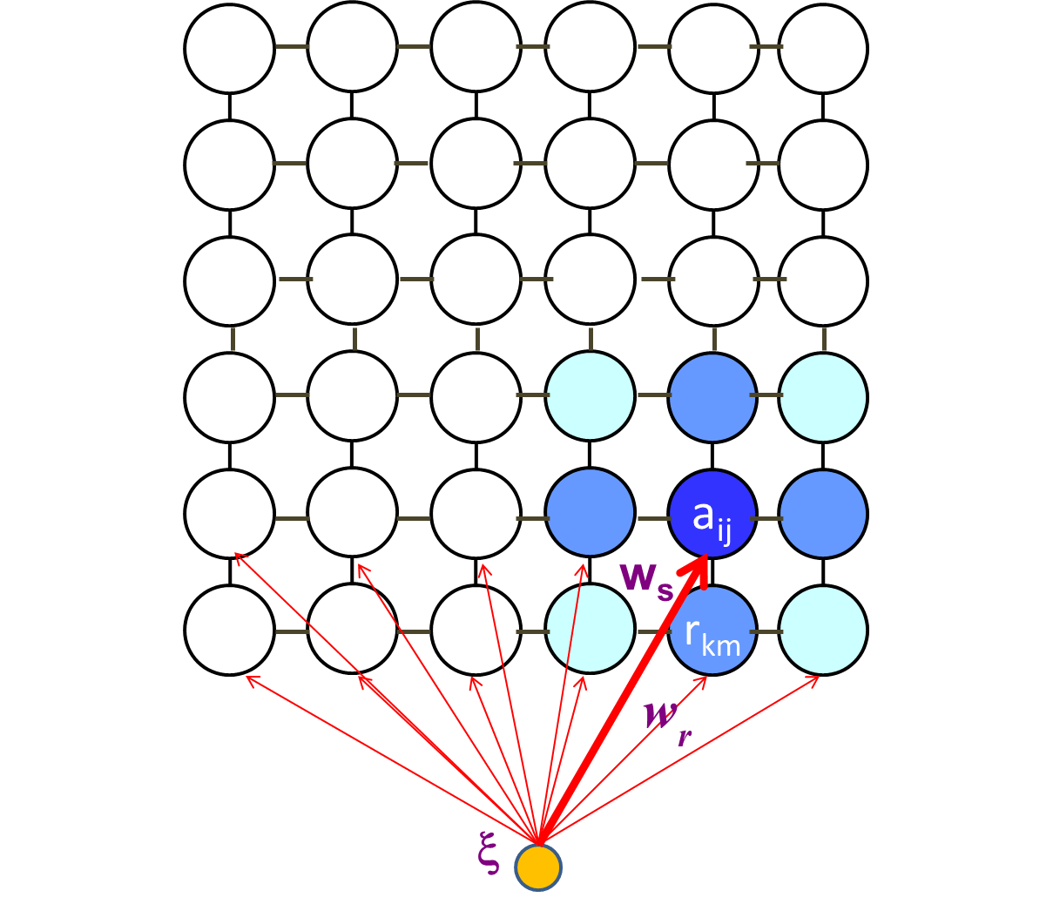
SOM: Architecture of the networks
SOM Map (6x6)
SOM architecture consist in two layers (feed-foreward)
  Input layer
  Output layer (competitive)
Neurons are arranged in a 2D grid lattice
Neighboring relations between neurons
Each neuron contains a weight vector w (called also prototype vector or reference vector)
N-dimensional weight vector
(represent a neuron)
N-dimensional input vector
(an object)

Slide 37
SOM Learning Process (1)
The goal of learning in SOM is to cause different parts of the network to respond similarly to certain input patterns.
SOM essential processes:
  Competition: When an input object is presented to the network, discriminant function is computed for all weight vectors. Neuron with most similar weigh vector to the input object is called the best matching unit (BMU) and the “winner” of competition.
  Cooperation: the BMU determines the spatial location of a topological neighborhood of “excited” neurons, thereby providing the basis for cooperaion among such neighboring neurons. This neighboring will depend on the type of lattice used and neighborhood radius.
  Adaptation: The last process enable the exited neurons to increase their resemblance to the input pattern through suitable adjustments made to their weight vectors.

Slide 38
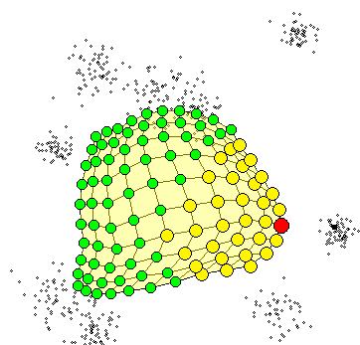
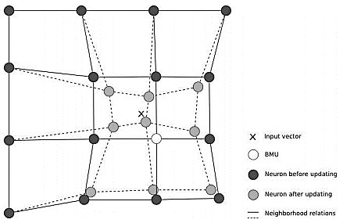
SOM Learning Process (2)
Adaptation process of weigh vectors to
next input vector (data object)
input vector
“winner”

Slide 39
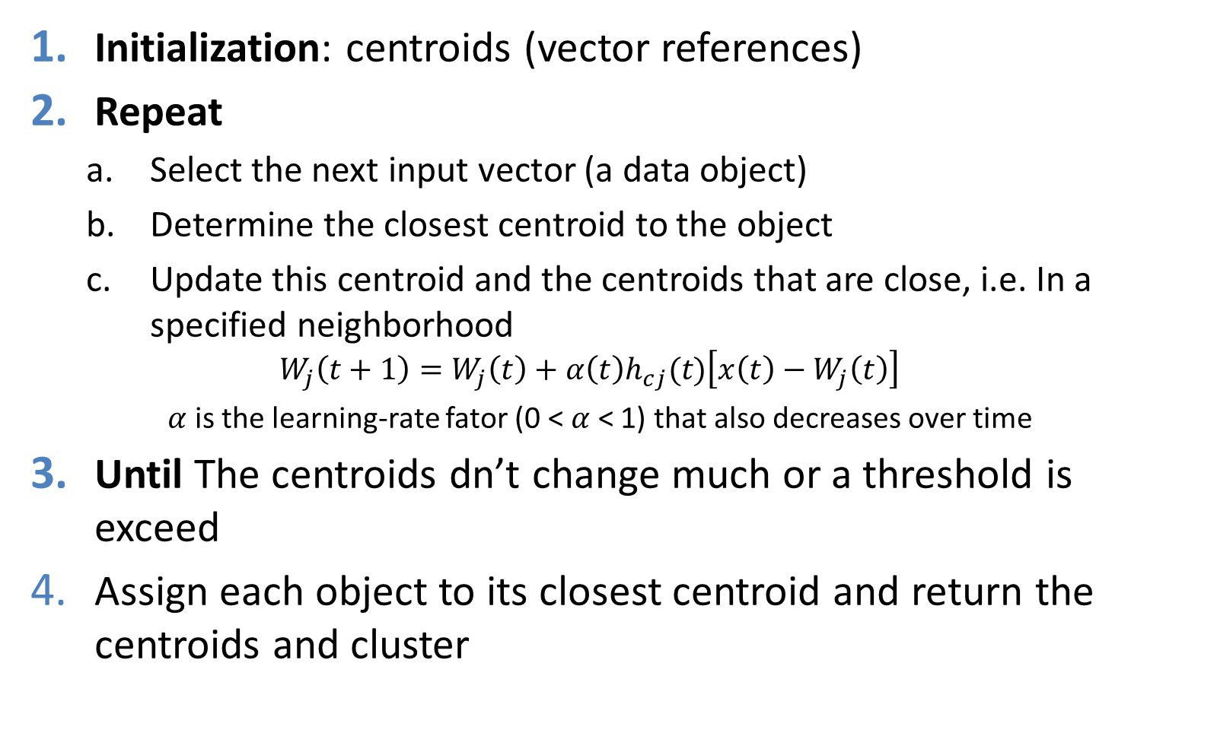
SOM Learning Algorithm

Slide 40
Visualization Techniques
The U-matrix (unified distance matrix) is a representation of a self-organizing map (SOM) where the Euclidean distance between the weight vectors of neighboring neurons is depicted in a grayscale image.
This image is used to visualize the data in a high-dimensional space using a 2D image.
In cluster analysis U-Matrix provides a simple way to visualize cluster structure of SOM:
  For each node in the map, compute the average of the distances between its weight vector and those of its immediate neighbors
  Average distance is a measure of a node’s similarity between it and its neighbors

Slide 41
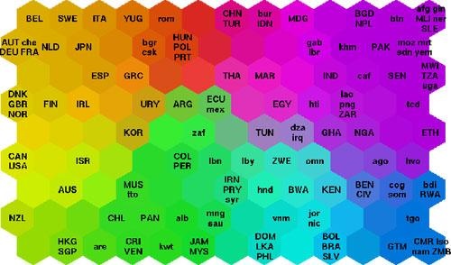
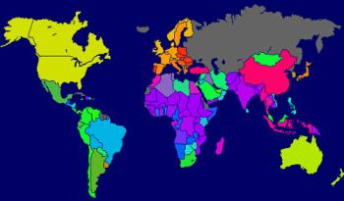
U-Matrix: an application
Information about welfare and poverty-related aspects of 77 countries are treated by the SOM algorithm.
The hexagonal grid is a unified distance matrix, commonly known as a U-matrix. Each hexagon represents a node in the SOM.
SOM for identification statistical data describing various quality-of-life factors (such as state of health, nutrition, educational services etc.) Countries with similar quality-of-life factors end up clustered together.

Slide 42
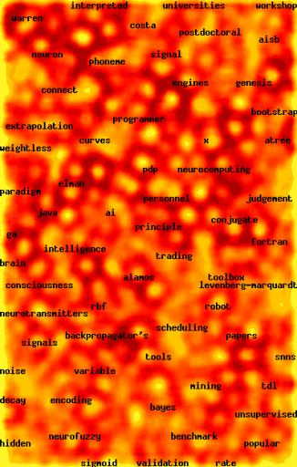
Web Document Clustering Using SOM
The result of SOM clustering of 12,088 Web articles
The picture on the right: drilling down on the keyword “mining”
Based on websom.hut.fi
42
Notes:
42

Slide 43
SOM Issues
The algorithm is complicated and there are a lot of parameters (such as the “learning rate”) - these settings will affect the results
The idea of a topology in high dimensional gene expression spaces is not exactly obvious
  How do we know what topologies are appropriate?
  In practice people often choose nearly square grids for no particularly good reason
As with k-means, we still have to worry about how many clusters to specify…

Slide 44
Semi-Supervised Learning

Slide 45
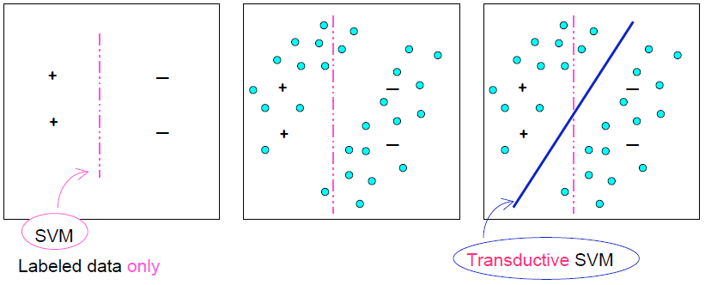
Semi-Supervised Learning
Sparsity in data: training examples cannot cover the data space well
unlabeled data can help to address sparsity
45

Slide 46
Semi-Supervised Learning Methods
Many methods exist: EM with generative mixture models, self-training, co-training, data-based methods, transductive SVM, graph-based methods, …
Inductive methods and Transductive methods
  Transductive methods: only label the available unlabeled data – not generating a classifier
  Inductive methods: not only produce labels for unlabeled data, but also generate a classifier
Algorithmic methods
  Classifier-based methods: start from an initial classifier, and iteratively enhance it
  Data-based methods: find an inherent geometry in the data, and use the geometry to find a good classifier
46

Slide 47
Clustering High-Dimensional Data

Slide 48
Clustering High-Dimensional Data
Clustering high-dimensional data
  Many applications: text documents, DNA micro-array data
  Major challenges:
    Many irrelevant dimensions may mask clusters
    Distance measure becomes meaningless—due to equi-distance
    Clusters may exist only in some subspaces
Methods
  Subspace-clustering: find clusters in all the possible subspaces
    CLIQUE, ProClus, and bi-clustering approach
  Dimensionality reduction approaches: Construct a much lower dimensional space and search for clusters there (may construct new dimensions by combining some dimensions in the original data)
    Dimensionality reduction methods and spectral clustering

Slide 49
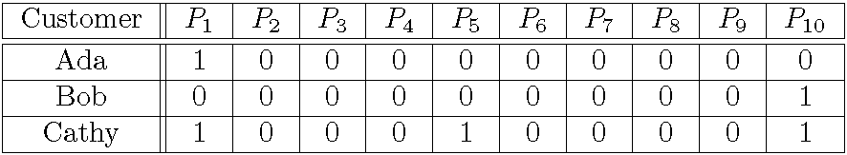
Traditional Distance Measures May Not Be Effective on High-D Data
Traditional distance measure could be dominated by noises in many dimensions
Ex. Which pairs of customers are more similar?
By Euclidean distance, we get,
  despite Ada and Cathy look more similar
Clustering should not only consider dimensions but also attributes (features)
  Feature transformation: effective if most dimensions are relevant (PCA & SVD useful when features are highly correlated/redundant)
  Feature selection: useful to find a subspace where the data have nice clusters

Slide 50
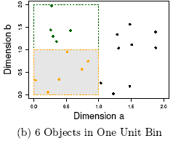
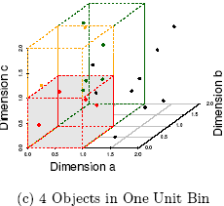
The Curse of Dimensionality
(graphs adapted from Parsons et al. KDD Explorations 2004)
Data in only one dimension is relatively packed
Adding a dimension “stretch” the points across that dimension, making them further apart
Adding more dimensions will make the points further apart—high dimensional data is extremely sparse
Distance measure becomes meaningless—due to equi-distance
50
Notes:
50

Slide 51
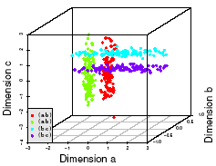
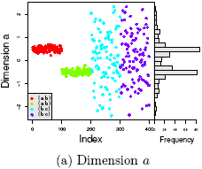
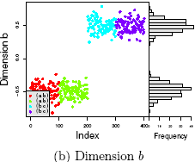
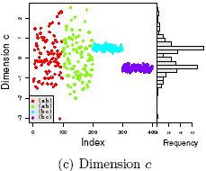
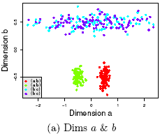
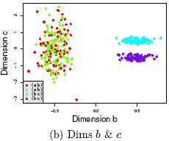
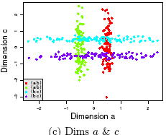
Why Subspace Clustering?
(adapted from Parsons et al. SIGKDD Explorations 2004)
Clusters may exist only in some subspaces
Subspace-clustering: find clusters in some of the subspaces

Slide 52
Subspace Clustering Methods
Subspace search methods: Search various subspaces to find clusters
  Bottom-up approaches
  Top-down approaches
Correlation-based clustering methods
  E.g., PCA based approaches
Bi-clustering methods
  Optimization-based methods
  Enumeration methods

Slide 53
Subspace Clustering Method (I): Subspace Search Methods
Search various subspaces to find clusters
Bottom-up approaches
  Start from low-D subspaces and search higher-D subspaces only when there may be clusters in such subspaces
  Various pruning techniques to reduce the number of higher-D subspaces to be searched
  Ex. CLIQUE (Agrawal et al. 1998)
Top-down approaches
  Start from full space and search smaller subspaces recursively
  Effective only if the locality assumption holds: restricts that the subspace of a cluster can be determined by the local neighborhood
  Ex. PROCLUS (Aggarwal et al. 1999): a k-medoid-like method

Slide 54
CLIQUE (Clustering In QUEst)
Agrawal, Gehrke, Gunopulos, Raghavan (SIGMOD’98)
Automatically identifying subspaces of a high dimensional data space that allow better clustering than original space
CLIQUE can be considered as both density-based and grid-based
  It partitions each dimension into the same number of equal length interval
  It partitions an m-dimensional data space into non-overlapping rectangular units
  A unit is dense if the fraction of total data points contained in the unit exceeds the input model parameter
  A cluster is a maximal set of connected dense units within a subspace

Slide 55
CLIQUE: The Major Steps
Partition the data space and find the number of points that lie inside each cell of the partition.
Identify the subspaces that contain clusters using the Apriori principle
Identify clusters
  Determine dense units in all subspaces of interests
  Determine connected dense units in all subspaces of interests.
Generate minimal description for the clusters
  Determine maximal regions that cover a cluster of connected dense units for each cluster
  Determination of minimal cover for each cluster

Slide 56
CLIQUE: SubSpace Clustering with Aprori Pruning
Salary (10,000)
Vacation (week)
7
7
6
6
5
5
4
4
3
3
2
2
1
1
0
age
0
age
20
30
40
50
60
20
30
40
50
60
τ = 3
Vacation
Salary
30
50
age
56
Notes:
56

Slide 57
Strength and Weakness of CLIQUE
Strength
  automatically finds subspaces of the highest dimensionality such that high density clusters exist in those subspaces
  insensitive to the order of records in input and does not presume some canonical data distribution
  scales linearly with the size of input and has good scalability as the number of dimensions in the data increases
Weakness
  The accuracy of the clustering result may be degraded at the expense of simplicity of the method

Slide 58
Summary
We already studied several advances clustering algorithms
  Fuzzy clustering: FCM
  Probability-based clustering: Gaussian Mixture Models and EM Algorithm
  Self-Organizing Map (SOM)
Clustering high-dimensional data has many applications in real world.
Several clustering algorithm are complicated and there are a lot of parameters such that its tuning parameters is a time consuming.

Slide 59
References
Han, J., Kamber, M., & Pei, Y. (2006). “Data Mining: Concepts and Technique”. Edisi 3. Morgan Kaufman. San Francisco
Tan, P.N., Steinbach, M., & Kumar, V. (2006). “Introduction to Data Mining”. Addison-Wesley. Michigan
Witten, I. H., & Frank, E. (2005). “Data Mining : Practical Machine Learning Tools and Techniques”. Second edition. Morgan Kaufmann. San Francisco

