Slide 1
Network Governance
SESSION 4 – Designing Models for Addressing and
Naming
D5727 – Dr. Eng. Nico Surantha, ST., MT.

Slide 2
Outline
Using a Hierarchical Model for Assigning Addresses
Designing a Model for Naming

Slide 3
Guidelines for Addressing and Naming
Use a structured model for addressing and naming
Assign addresses and names hierarchically
Decide in advance if you will use
  Central or distributed authority for addressing and naming
  Public or private addressing
  Static or dynamic addressing and naming

Slide 4
Structured model for addressing and naming
Addresses are meaningful, hierarchical, and planned
Notes:
Meaningful: represent the organization structure. ?
Hierarchical:
Planned : consider about the growth of network (scalability)

Slide 5
Advantages of Structured Models for Addressing & Naming
It makes it easier to
  Read network maps
  Operate network management software
  Recognize devices in protocol analyzer traces
  Meet goals for usability
  Design filters on firewalls and routers
  Implement route summarization

Slide 6
Public IP Addresses
Managed by the Internet Assigned Numbers Authority (IANA)
Users are assigned IP addresses by Internet service providers (ISPs).
ISPs obtain allocations of IP addresses from their appropriate Regional Internet Registry (RIR)

Slide 7
Regional Internet Registries (RIR)
APNIC (Asia Pacific Network Information Centre) – Asia/Pacific Region
ARIN (American Registry for Internet Numbers) – North America and Sub-Sahara Africa
LACNIC (Regional Latin-American and Caribbean IP Address Registry) – Latin America and some Caribbean Islands
RIPE NCC (Réseaux IP Européens) – Europe, the Middle East, Central Asia, and African countries located north of the equator

Slide 8
Private Addressing
10.0.0.0 – 10.255.255.255
172.16.0.0 – 172.31.255.255
192.168.0.0 – 192.168.255.255
which addressing scheme for your organization?
Notes:
10.0.0.0 – 10.255.255.255>> allow 255 class b; most number of addresses
172.16.0.0 – 172.31.255.255 >> allow 16 class b address space
192.168.0.0 – 192.168.255.255 >> allow 1 class b address space

Slide 9
Criteria for Using Static Vs. Dynamic Addressing
The number of end systems
The likelihood of needing to renumber
The need for high availability
Security requirements
The importance of tracking addresses
Whether end systems need additional information
  (DHCP can provide more than just an address)

Slide 10
The Two Parts of an IP Address
32 Bits
Prefix
Host
Prefix Length

Slide 11
Prefix Length
An IP address is accompanied by an indication of the prefix length
  Subnet mask
  /Length
Examples
  192.168.10.1 255.255.255.0
  192.168.10.1/24

Slide 12
Subnet Mask
32 bits long
Specifies which part of an IP address is the network/subnet field and which part is the host field
  The network/subnet portion of the mask is all 1s in binary.
  The host portion of the mask is all 0s in binary.
  Convert the binary expression back to dotted-decimal notation for entering into configurations.
Alternative
  Use slash notation (for example /24)
  Specifies the number of 1s

Slide 13
Subnet Mask Example
11111111 11111111 11111111 00000000
What is this in slash notation?
What is this in dotted-decimal notation?

Slide 14
Another Subnet Mask Example
11111111 11111111 11110000 00000000
What is this in slash notation?
What is this in dotted-decimal notation?

Slide 15
One More Subnet Mask Example
11111111 11111111 11111000 00000000
What is this in slash notation?
What is this in dotted-decimal notation?

Slide 16
Designing Networks with Subnets
Determining subnet size
Computing subnet mask
Computing IP addresses

Slide 17
Addresses to Avoid When Subnetting
A node address of all ones (broadcast)
A node address of all zeros (network)
A subnet address of all ones (all subnets)
A subnet address of all zeros (confusing)
  Cisco IOS configuration permits a subnet address of all zeros with the ip subnet-zero command

Slide 18
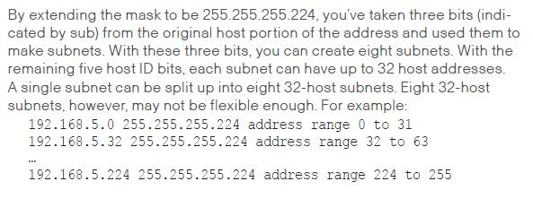
Designing Networks with Subnets

Slide 19
Practice
Network is 172.16.0.0
You want to divide the network into subnets.
You will allow 600 nodes per subnet.
What subnet mask should you use?
What is the address of the first node on the first subnet?
What address would this node use to send to all devices on its subnet?
Notes:
Network 172.16.0.0
Subnet mask : 255.255.252.0
Address first node: 172.16.4.1
Broadcast address: 172.16.7.255

Slide 20
More Practice
Network is 172.16.0.0
You have eight LANs, each of which will be its own subnet.
What subnet mask should you use?
What is the address of the first node on the first subnet?
What address would this node use to send to all devices on its subnet?

Slide 21
One More
Network is 192.168.55.0
You want to divide the network into subnets.
You will have approximately 25 nodes per subnet.
What subnet mask should you use?
What is the address of the last node on the last subnet?
What address would this node use to send to all devices on its subnet?
Notes:
Subnet mask : 255.255. 255. 224
Address last node last subnet: 255.255.11011110

Slide 22
IP Address Classes
Classes are now considered obsolete
But you have to learn them because
  Everyone in the industry still talks about them!
  You may run into a device whose configuration is affected by the classful system

Slide 23
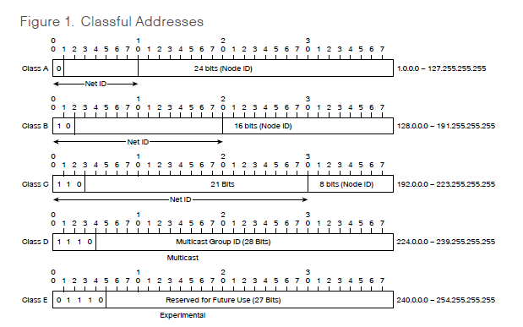
Classful IP Addressing

Slide 24
Classful IP Addressing (2)
Class First First Byte Prefix Intent
Few Bits Length
A 0 1-126* 8 Very large networks
B 10 128-191 16 Large networks
C 110 192-223 24 Small networks
D 1110 224-239 NA IP multicast
E 1111 240-255 NA Experimental
*Addresses starting with 127 are reserved for IP traffic local to a host.

Slide 25
Division of the Classful Address Space
Class Prefix Number of Addresses
Length per Network
A 8 2²⁴-2 = 16,777,214
B 16 2¹⁶-2 = 65,534
C 24 2⁸-2 = 254

Slide 26
Classful IP is Wasteful
Class A uses 50% of address space
Class B uses 25% of address space
Class C uses 12.5% of address space
Class D and E use 12.5% of address space

Slide 27
Classless Addressing
Prefix/host boundary can be anywhere
Less wasteful
Supports route summarization
  Also known as
    Aggregation
    Supernetting
    Classless routing
    Classless inter-domain routing (CIDR)
    Prefix routing

Slide 28
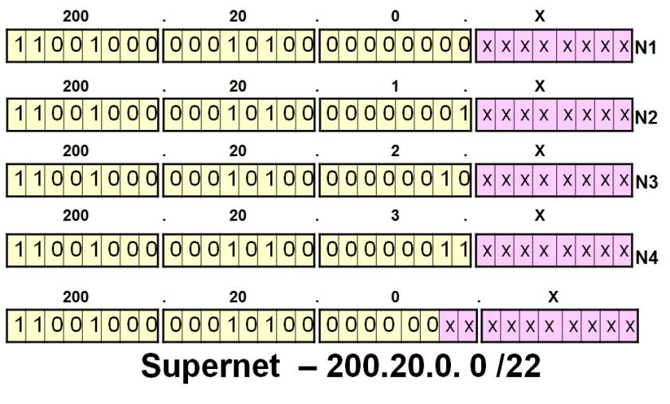
Supernetting

Slide 29
Supernetting
172.16.0.0
172.17.0.0
172.18.0.0
Branch-Office Router
172.19.0.0
Enterprise Core Network
Branch-Office Networks
Move prefix boundary to the left
Branch office advertises 172.16.0.0/14

Slide 30
172.16.0.0/14 Summarization
Second Octet in Decimal Second Octet in Binary
16 00010000
17 00010001
18 00010010
19 00010011

Slide 31
Discontiguous Subnets
Area 0
Network 192.168.49.0
Router A
Router B
Area 1
Subnets 10.108.16.0 - 10.108.31.0
Area 2
Subnets 10.108.32.0 - 10.108.47.0

Slide 32
A Mobile Host
Router A
Router B
Subnets 10.108.16.0 - 10.108.31.0
Host 10.108.16.1

Slide 33
IPv6 Aggregatable Global Unicast Address Format
3 13 8 24 16 64 bits
FP
TLA
ID
RES
NLA
ID
SLA
ID
Interface ID
Public topology
Site
Topology
FP Format Prefix (001)
TLA ID Top-Level Aggregation Identifier
RES Reserved for future use
NLA ID Next-Level Aggregation Identifier
SLA ID Site-Level Aggregation Identifier
Interface ID Interface Identifier

Slide 34
Upgrading to IPv6
Dual stack
Tunneling
Translation
Notes:
Dual stack. Both IPv4 and IPv6 stacks run on the system. The system is able to communicate with both IPv6 and IPv4 devices. The choice of IP version is based on name lookup and application preference. This is the most appropriate for campus and access-layer networks during the transition period and is the preferred technique for transition to IPv6. Operating systems that support a dual stack include FreeBSD, Linux, Sun Solaris, and Windows 2000/XP.
Tunneling. This method encapsulates IPv6 packets for traversal across an IPv4 network. By using tunnels, isolated IPv6 networks can communicate without requiring an upgrade to the IPv4 infrastructure. Both routers and hosts can use tunneling.
Translation. This method translates one type of address to the other to facilitate communication between an IPv4 and an IPv6 network. Translation will mainly be used for legacy equipment that will not be upgraded to IPv6. An IPv6 node behind a translation device has full connectivity to other IPv6 nodes and has NAT functionality for communicating with IPv4 devices. Translation can be handled by Application Level Gateways (ALGs) or by an application programming interface (API) on every host. The two main translation solutions are NAT-Protocol Translation (NAT-PT) and Dual-Stack Transition Mechanism (DSTM).

Slide 35
Guidelines for Assigning Names
Names should be
  Short
  Meaningful
  Unambiguous
  Distinct
  Case insensitive
Avoid names with unusual characters
  Hyphens, underscores, asterisks, and so on

Slide 36
Domain Name System (DNS)
Maps names to IP addresses
Supports hierarchical naming
  example: frodo.rivendell.middle-earth.com
A DNS server has a database of resource records (RRs) that maps names to addresses in the server’s “zone of authority”
Client queries server
  Uses UDP port 53 for name queries and replies
  Uses TCP port 53 for zone transfers

Slide 37
DNS Details
Client/server model
Client is configured with the IP address of a DNS server
  Manually or DHCP can provide the address
DNS resolver software on the client machine sends a query to the DNS server. Client may ask for recursive lookup.

Slide 38
DNS Recursion
A DNS server may offer recursion, which allows the server to ask other servers
  Each server is configured with the IP address of one or more root DNS servers.
When a DNS server receives a response from another server, it replies to the resolver client software. The server also caches the information for future requests.
  The network administrator of the authoritative DNS server for a name defines the length of time that a non-authoritative server may cache information.

Slide 39
Conclusion
Use a systematic, structured, top-down approach to addressing and naming
Assign addresses in a hierarchical fashion
Distribute authority for addressing and naming where appropriate
IPv6 looms in our future

Slide 40
DAFTAR PUSTAKA/SUMBER
Oppenheimer, Priscilla. (2013). Top Down Network Design. 3rd Edition. Cisco Press. Indianapolis. ISBN: 978-1-58705-152-4.

