Slide 1
Network Governance
SESSION 8 – Developing Network Management Strategies
D5727 – Dr. Eng. Nico Surantha, ST., MT.

Slide 2
Outline
Network Management Design
Network Management Architectures
Selecting Network Management Tools and Protocols

Slide 3
Network Management
Helps an organization achieve availability, performance, and security goals
Helps an organization measure how well design goals are being met and adjust network parameters if they are not being met
Facilitates scalability
  Helps an organization analyze current network behavior, apply upgrades appropriately, and troubleshoot any problems with upgrades
Notes:
Akan membantu tercapainya ketersediaan, performance, dan tujuan sekuriti
Pertanyaan : Ada yang bisa menerangkan “availability, performance, and security goals?”"
- Availability refers to the amount of time a network is available to users
contoh jika network available 165 jam dari 168 total jam, makan availability = 98.21%
sometimes availability is also linked to
- reliability (accuracy, error rates, stability )
- redundancy (duplicate links or devices to a network to avoid downtime)
- resiliency (how much stress a network can handle and how quickly the network can rebound from problems including security breaches,
natural and unnatural disasters, human error )
Tujuan performance?
■Capacity (bandwidth): The data-carrying capability of a circuit or network, usually
measured in bits per second (bps)
■ Utilization: The percent of total available capacity in use
■ Optimum utilization: Maximum average utilization before the network is considered
saturated
■ Throughput: Quantity of error-free data successfully transferred between nodes per
unit of time, usually seconds
■ Offered load: Sum of all the data all network nodes have ready to send at a particular
time
■ Accuracy: The amount of useful traffic that is correctly transmitted, relative to
total traffic
■ Efficiency: An analysis of how much effort is required to produce a certain amount
of data throughput
■ Delay (latency): Time between a frame being ready for transmission from a node
and delivery of the frame elsewhere in the network
■ Delay variation: The amount of time average delay varies
■ Response time: The amount of time between a request for some network service and
a response to the request
Tujuan security?
- Increased threats from both inside and outside the enterprise
network require the most up-to-date security rules and technologies.
- An overall goal that most companies have is that security problems should not disrupt the company’s
ability to conduct business
achieving security goals means making tradeoffs.
- Security implementations can add to the cost of deploying and operating
a network.
- Strict security policies can also affect the productivity of users, especially
if some ease of use must be sacrificed to protect resources and data.
- Poor security implementations can annoy users, causing them to think of ways to get around security policies.
Scalability refers to how much growth a network design must support.
Many large companies add
users, applications, additional sites, and external network connections at a rapid rate. The
network design you propose to a customer should be able to adapt to increases in network
usage and scope.

Slide 4
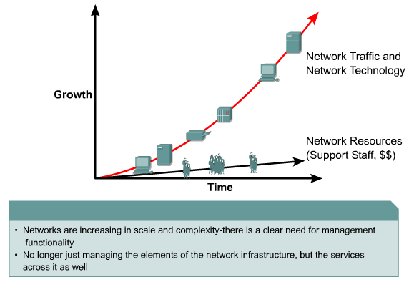
Evolution of Network Management
Notes:
Peningkatan dari network traffic dan network technology exponensial
Sedangkan, peningkatan dari network resources (support staff, uang) linier
Oleh karena itu dibutuhkan network management

Slide 5
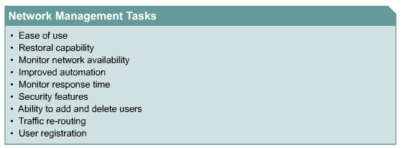
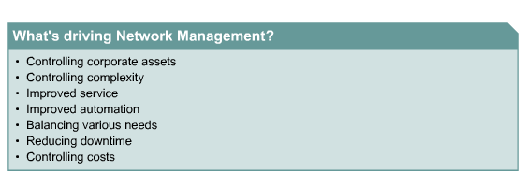
Network Management Requirements
Notes:
Network management tasks (apa saja sih yang menjadi tugas/task dari network management)
Ease of use : kemudahan menggunakan sumber daya jaringan (tradeoff dengan security)

Slide 6
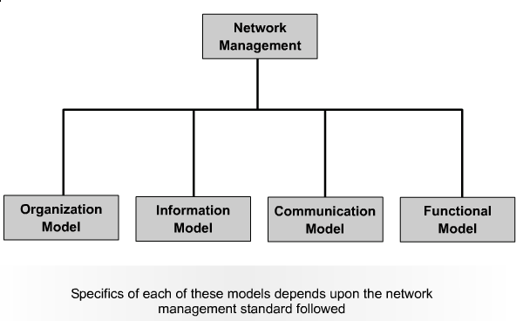
Network Management Model
Notes:
Pertanyaan: ada yang bisa menjelaskan organization model, information model, communication model, functional model?
Organization model:
Manager
Agent
Object
Information model
Structure of management information (SMI)
Management Information Base (MIB)
Communication model
Protocol Data Unit (PDU)
Functional model
Configuration model
Fault management
Seurity management
Accounting management

Slide 7
Network Management Design
Consider scalability, traffic patterns, data formats, cost/benefit tradeoffs
Determine which resources should be monitored
Determine metrics for measuring performance
Determine which and how much data to collect
Notes:
Consider scalability, traffic patterns, data formats, cost/benefit tradeoffs
Cost/benefit tradeoffs: Network management bisa sangat mahal, tapi bisa juga mempunyai efek negatif ke performa network
Consider Heisenberg uncertainty principle: act of observing something can alter what it is observed.
Network management system usually poll a remote station. This polling travve can be load for network
Should analyze customer requirement for polling timer
Determine which resources should be monitored
* Determine metrics for measuring performance
Determine which and how much data to collect
Too much data to to collect, storage habis, dsb
Format of stored data (general purpose data formats)

Slide 8
Proactive Network Management
Plan to check the health of the network during normal operation, not just when there are problems
Recognize potential problems as they develop
Optimize performance
Plan upgrades appropriately
Notes:
For example:
Collect statistics dan melakukan test seperti response-time measurement secara rutin
Hasilnya digunakan untuk menyampaikan trend dan kondisi network to management dan users
Write monthly report about the quality of network service for last period, measured against service goals
Need to invest for the proactive network management (compared to the reactive one)

Slide 9
Network Management Processes According to the ISO
Performance management
Fault management
Configuration management
Security management
Accounting management

Slide 10
Performance Management
Monitor end-to-end performance
Also monitor component performance (individual links and devices)
Test reachability
Measure response times
Measure traffic flow and volume
Record route changes
Notes:
Measure behaviour and effectiveness
It is related to performance goals
Pertanyaan: ada yg tau end-to-end performance parameter?
Monitor end-to-end performance
measure availability, capacity, utilization, delay, delay variation, throughput, reachability,
response time, errors, and the burstiness of traffic
Also monitor component performance (individual links and devices)
For example, throughput and utilization on a particular network segment can be
measured. Additionally, routers and switches can be monitored for throughput (packets
per second), memory and CPU usage, and errors.
Test reachability
Measure response times
Sending ping and measure round-trip time (RTT).
On large networks, reachability and RTT studies can be impractical. For example, on a
network with 10,000 devices, some commercially available network management systems
take hours to poll the devices, cause significant network traffic
Measure traffic flow and volume
To record traffic loads between important sources and destinations. The objective is to document
the megabytes per second between pairs of autonomous systems, networks, hosts,
or applications. Source/destination traffic-load documentation is useful for capacity planning, troubleshooting.
- Record route changes
Tools: ICMP echo packets with the IP record-route option turned on
Tracking route changes can be useful for troubleshooting reachability and performance
problems.

Slide 11
Fault Management
Detect, isolate, diagnose, and correct problems
Report status to end users and managers
Track trends related to problems
Notes:
Detect, isolate, diagnose, and correct problems
- Report status to end users and managers
Track trends related to problems
All efforts to solve the problem
Tools : SNMP and RMON (Remote Monitoring)

Slide 12
Configuration Management
Keep track of network devices and their configurations
Maintain an inventory of network assets
Log versions of operating systems and applications
Notes:
Keep track of network devices and their configurations
Can define and save a default configuration for similar devices
Modify the default configuration
Load the configuration on devics
Maintain an inventory of network assets
amount of RAM, the size of flash memory, and the type of cabling that the devices use.
Log versions of operating systems and applications
-Version-logging refers to keeping track of the version of operatin systems or applications running on network devices

Slide 13
Security Management
Maintain and distribute user names and passwords
Generate, distribute, and store encryption keys
Analyze router, switch, and server configurations for compliance with security policies and procedures
Collect, store, and examine security audit logs
Notes:
Maintain and distribute user names and passwords
Generate, distribute, and store encryption keys
Analyze router, switch, and server configurations for compliance with security policies and procedures
Collect, store, and examine security audit logs
The required storage can be minimized by
- keeping data for a short period of time and summarizing the data ( weakness: it is harder to investigate security
Incidents)
- Compressing the data, instead of keeping less data, is often a better solution.
- It is also a good idea to encrypt audit logs. A hacker who accesses audit logs can cause a lot of damage to a network if the audit log is not encrypted. The hacker can alter the log without detection and also glean sensitive information from the log.
A variety of tools exist for maintaining security logs, including Event Viewer on
Windows systems and syslog on UNIX and Cisco IOS devices.

Slide 14
Accounting Management
Keep track of network usage by departments or individuals
Facilitate usage-based billing
Find abusers who use more resources than they should
Notes:
Accounting management facilitates usage-based billing, whereby individual departments
or projects are charged for network services.
The abuse could be
- intentional (for example, a discontented employee or former employee causing network problems)
- or unintentional. (People playing network games do not intend to harm the network but could cause excessive traffic nonetheless.)
A practical reason to track unexpected traffic growth is so that the traffic can be considered during the next capacity-planning phase.

Slide 15
Network Management Components
A managed device is a network node that collects and stores management information
An agent is network-management software that resides in a managed device
A network-management system (NMS) runs applications to display management data, monitor and control managed devices, and communicate with agents
Notes:
A managed device is a network node that collects and stores management information
It can be routers, servers, switches, bridges, hubs, end systems, or printers
An agent is network-management software that resides in a managed device
An agent tracks local management information and uses a protocol such as SNMP to send information to NMSs.
A network-management system (NMS) runs applications to display management data, monitor and control managed devices, and communicate with agents
An NMS is generally a powerful workstation that has sophisticated graphics, memory, storage, and processing capabilities. The NMS is typically located in a network operations center (NOC).

Slide 16
Network Management Architecture
NMS
Agent
Agent
Agent
Management Database
Management Database
Management Database
Managed Devices
Notes:
Traffic flow and load between NMSs and managed devices should be considered. A decision
should be made about whether management traffic flows in-band (with other network
traffic) or out-of-band (outside normal traffic flow). A redundant topology should be
considered. A decision should be made about a centralized or distributed management
topology.

Slide 17
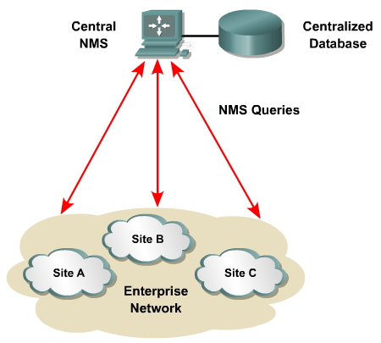
Centralized Network Management Architecture
Notes:
One centralized database
Send queries directly to central NM
Semua NMS berada di satu area network, biasanya di corporate NOC
Agent didistribusikan ke enterprise network dan mereka akan mengirimkan SNMP responses to centralized NMSs

Slide 18
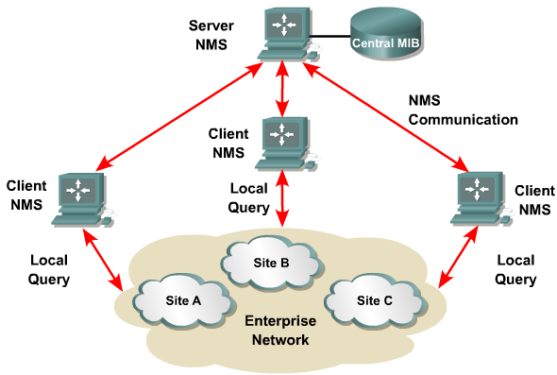
Hierarchical Network Management Architecture
Notes:
NMS and agents disebar ke internetwork
Client NMS sent to server NMS through (manager of manager) architecture
Server-client NMS
There is client NMS
Local query is sent to client NMS
Not all queries directed to central NMS (filtered)

Slide 19
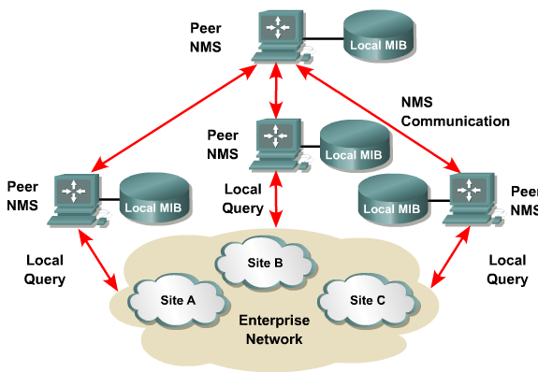
Distributed Network
Management Architecture
Notes:
In an MoM architecture, distributed NMSs can filter data before sending it to the centralized
stations, thus reducing the amount of network management data that flows on
the internetwork.
Another advantage with distributed management is that the distributed
systems can often gather data even when parts of the internetwork are failing.
Local MIB distributed to peer NMS
Local query
The disadvantage is complex and hard to manage
Difficult to control security
Keep track of management devices
Simple is better

Slide 20
Architecture Concerns
In-band versus out-of-band monitoring
  In-band is easier to develop, but results in management data being impacted by network problems
Centralized versus distributed monitoring
  Centralized management is simpler to develop and maintain, but may require huge amounts of information to travel back to a centralized network operations center (NOC)
Notes:
In band :
- simple to implement
- Network management data nyampur dengan problem dari internet work (make it hard to troubleshoot)
Out band
Use different path
More complex dan expensive

Slide 21
Selecting Tools for Network Management
Tools should support numerous features that can be used for performance, fault, configuration, security, and accounting management.
should include tools for isolating, diagnosing, and reporting problems to facilitate quick repair and recovery.
Ideally, the system should also incorporate intelligence to identify trends that can predict a potential failure.
Notes:
- To ensure high network availability, management tools should support numerous features that can be used for performance, fault, configuration, security, and accounting management.
- At a minimum, a network management solution should include tools for isolating, diagnosing, and reporting problems to facilitate quick repair and recovery.
- Ideally, the system should also incorporate intelligence to identify trends that can predict a potential failure so that a network manager can take action before a fault condition occurs.

Slide 22
Selecting Tools for Network Management (2)
Tools should provide an intuitive user interface that can react quickly to user input.
If the tools allow dynamic configuration of devices, configuration changes should take effect without requiring a reboot of the device
should also check the validity of any configuration changes and automatically restore operation to the last known configuration or software image in case of error.
should require authentication to avoid an unauthorized user making changes.
Notes:
Network management tools should provide a intuitive user interface that can react quickly to user input. In many cases, having both a
browser interface and command-line interface (CLI) is beneficial.
If the tools allow dynamic configuration of devices, configuration changes should take
effect without requiring a reboot of the device, if the device supports this, because disruption
of service for a critical device could potentially impact thousands of users.

Slide 23
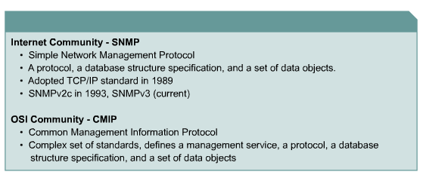
SNMP and CMIP Standards

Slide 24
Simple Network Management Protocol (SNMP)
Most popular network management protocol
Easy to implement, install, and use
Interoperability between SNMP implementations from different vendors can be achieved
Notes:
Interoperability between SNMP implementations from different vendors can be achieved with minimal effort because SNMP is so simple.
SNMP 1 dan 2 tidak ada feature authentication yg memungkinkan unauthorized user to exercise ＳＮＭＰ network management, to do eavesdropping

Slide 25
Simple Network Management Protocol (SNMP) (2)
SNMPv3 should gradually supplant versions 1 and 2 because
  it offers better authentication
  Secure set of operations for the remote configuration of SNMP-managed devices
SNMP works with Management Information Bases (MIBs)
Management Information Bases (MIB) define management parameters that are accessible via SNMP.
Notes:
Interoperability between SNMP implementations from different vendors can be achieved with minimal effort because SNMP is so simple.
SNMP 1 dan 2 tidak ada feature authentication yg memungkinkan unauthorized user to exercise ＳＮＭＰ network management, to do eavesdropping

Slide 26
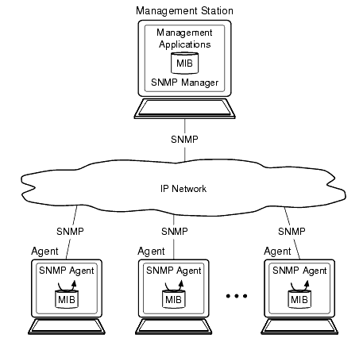
Simple Network Management Protocol (SNMP) (3)

Slide 27
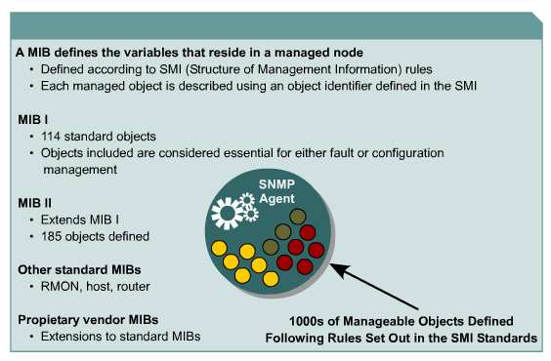
Management Information Bases
Notes:
Object identifier (unique)
Structured as a tree
Similar objects are group unders the same branch of the MIB tree
Various interface counters are grouped under the interfaces branch of the MIB II (RFC 123) tree
Sfdsafsafs
A MIB stores information gathered by the local management agent on a managed device.
Each object in a MIB has a unique identifier.
Network management applications use the identifier to retrieve a specific object.

Slide 28
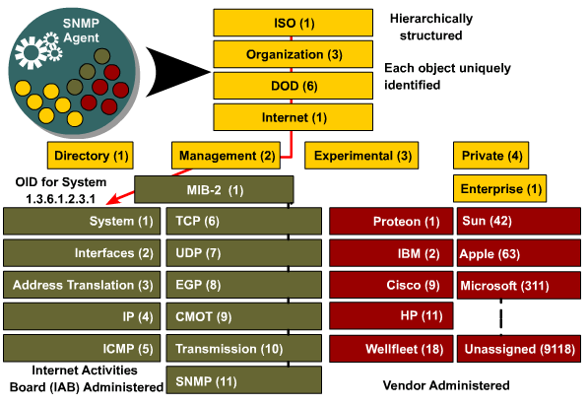
Object Identifiers
Notes:
The MIB is structured as a tree. Similar objects are grouped under the same branch of the MIB tree.
For example, various interface counters are grouped under the Interfaces branch of the MIB II (RFC 1213) tree.
MIB II defines the following groups of managed objects for TCP/IP networks:
■ System
■ Interfaces
■ Address Translation
■ IP
■ ICMP
■ TCP
■ UDP
■ EGP
■ Transmission
■ SNMP
In addition to standard MIBs, such as MIB II for TCP/IP objects, there are vendor-specific
MIB definitions. Vendors can obtain their own branch for the private definition of a MIB
subtree and create custom managed objects under that branch.
To use private definitions
of managed objects, a network manager must import the definitions into an NMS.

Slide 29
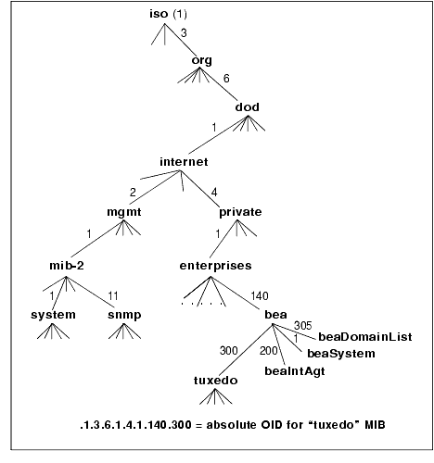
Object Identifiers
Notes:
The MIB is structured as a tree. Similar objects are grouped under the same branch of the MIB tree.
For example, various interface counters are grouped under the Interfaces branch of the MIB II (RFC 1213) tree.
MIB II defines the following groups of managed objects for TCP/IP networks:
■ System
■ Interfaces
■ Address Translation
■ IP
■ ICMP
■ TCP
■ UDP
■ EGP
■ Transmission
■ SNMP
In addition to standard MIBs, such as MIB II for TCP/IP objects, there are vendor-specific
MIB definitions. Vendors can obtain their own branch for the private definition of a MIB
subtree and create custom managed objects under that branch.
To use private definitions
of managed objects, a network manager must import the definitions into an NMS.

Slide 30
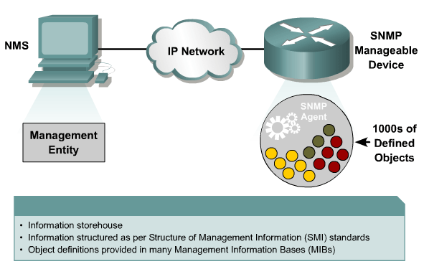
SNMP Protocol: Understanding the Agent

Slide 31
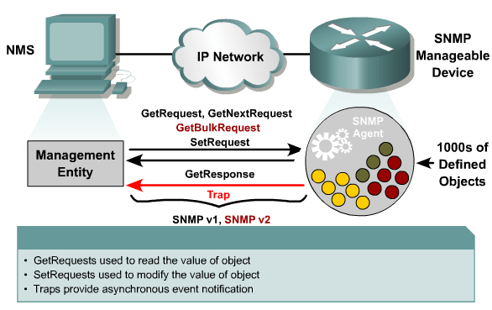
SNMP Protocol: Understanding the Protocol
Notes:
SNMP has seven types of packets:
■ Get Request: Sent by an NMS to an agent to collect a management parameter
■ Get-Next Request: Sent by an NMS to collect the next parameter in a list or table of
parameters
■ Get-Bulk Request: Sent by an NMS to retrieve large blocks of data, such as multiple
rows in a table (not in SNMPv1)
■ Response: Sent by an agent to an NMS in response to a request
■ Set Request: Sent by an NMS to an agent to configure a parameter on a managed
device
■ Trap: Sent autonomously (not in response to a request) by an agent to an NMS to
notify the NMS of an event
■ Inform: Sent by an NMS to notify another NMS of information in a MIB view that is
remote to the receiving application (not in SNMPv1, supports MoM architectures)

Slide 32
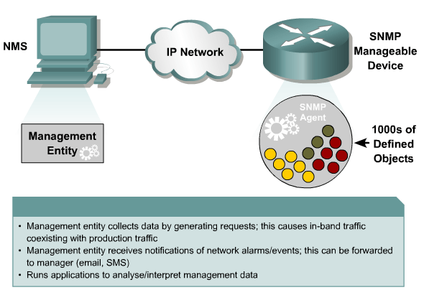
SNMP Protocol: Understanding the Management Entity

Slide 33
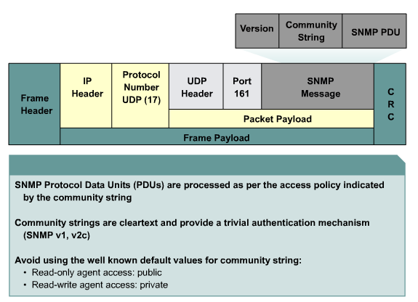
SNMP Protocol: Understanding Community Strings
Notes:
For authentication >> communicy string >> part of SNMP message

Slide 34
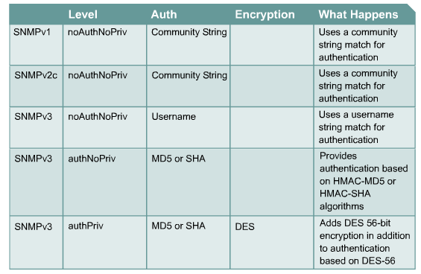
Management Protocols and Features

Slide 35
Remote Monitoring (RMON)
Developed by the IETF in the early 1990s to address shortcomings in standard MIBs
  Provides information on data link and physical layer parameters
  Nine groups of data for Ethernet
  The statistics group tracks packets, octets, packet-size distribution, broadcasts, collisions, dropped packets, fragments, CRC and alignment errors, jabbers, and undersized and oversized packets
Notes:
The RMON MIB was developed by the IETF in the early 1990s to address shortcomings
in the standard MIBs, which lacked the capability to provide statistics on data link and
physical layer parameters.
The IETF developed the RMON MIB to provide Ethernet traffic
statistics and fault diagnosis.
RMON agents gather statistics on cyclic redundancy check (CRC) errors, Ethernet collisions,
packet-size distribution, the number of packets in and out, and the rate of broadcast
packets.

Slide 36
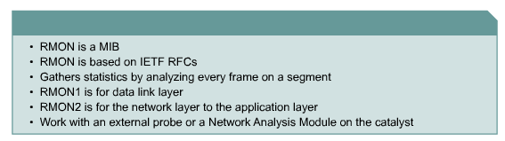
RMON

Slide 37
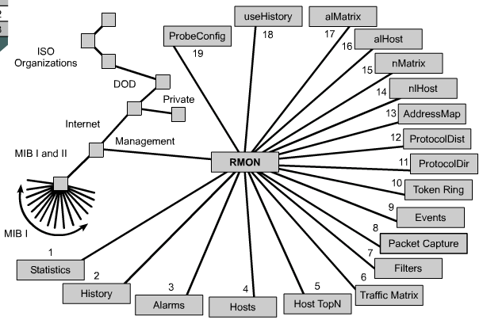
RMON MIB
Notes:
Group of parameters
Statistics
Tracks packets, octets, packet-size distribution, broadcasts, collisions, dropped
packets, fragments, CRC/alignment errors, jabbers, and undersized and oversized
Packets
2. History
Stores multiple samples of values from the Statistics group for the comparison of
the current behavior of a selected variable to its performance over the specified
period.
3. alarms

Slide 38
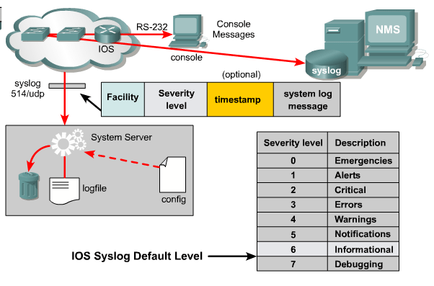
The Syslog Facility
Notes:
For fault management

Slide 39
Conclusion
Determine which resources to monitor, which data about these resources to collect, and how to interpret that data
Develop processes that address performance, fault, configuration, security, and accounting management
Develop a network management architecture
Select management protocols and tools

Slide 40
DAFTAR PUSTAKA/SUMBER
Oppenheimer, Priscilla. (2013). Top Down Network Design. 3rd Edition. Cisco Press. Indianapolis. ISBN: 978-1-58705-152-4.
Hummel, S. L. (2015). Cisco Design Fundamentals: Multilayered Network Architecture and Design for Network Engineers.
Bruno, A., & Jordan, S. (2016). CCDA 200-310 Official Cert Guide. Cisco Press.

