Slide 1
Network Governance
SESSION 9 – Selecting Technologies and Devices for Campus Networks
D5727 – Dr. Eng. Nico Surantha, ST., MT.

Slide 2
Outline
LAN Cabling Plant Design
LAN Technologies
Selecting Internetworking Devices for a Campus Network Design

Slide 3
Selecting Technologies and Devices
We now know what the network will look like
We also know what capabilities the network will need
We are now ready to start picking out technologies and devices
Chapter 10 of the text book has guidelines for campus networks and Chapter 11 for enterprise network

Slide 4
Campus Network Design Steps
Develop a cabling plant design
Select the types of cabling
Select the data-link-layer technologies
Select internetworking devices
  Meet with vendors

Slide 5
Cabling Plant Design Considerations
Campus and building cabling topologies
The types and lengths of cables between buildings
Within buildings
  The location of telecommunications closets and cross-connect rooms
  The types and lengths of cables for vertical cabling between floors
  The types and lengths of cables for horizontal cabling within floors
  The types and lengths of cables for work-area cabling going from telecommunications closets to workstations
Notes:
Telecommunications closet?
Cross-connect room?
Work area cabling?

Slide 6
Centralized Versus Distributed Cabling Topologies
AT&T, IBM, Hewlett-Packard have all published cabling specifications and guideline for developing a cabling technology
Electronics Industry Association and the Telecommunications Industry Association (EIA/TIA) guidelines for UTP cabling and installation
The guideline purpose is to help a network engineer develop a structured cabling system that is manageable and scalable

Slide 7
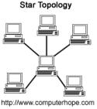
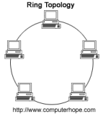
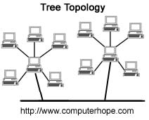
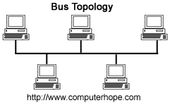
Centralized Versus Distributed Cabling Topologies (2)
A centralized cabling scheme terminates most or all of the cable runs in one area of the design environment.
example:
A distributed cabling scheme terminates cable runs throughout the design environment.
example:

Slide 8
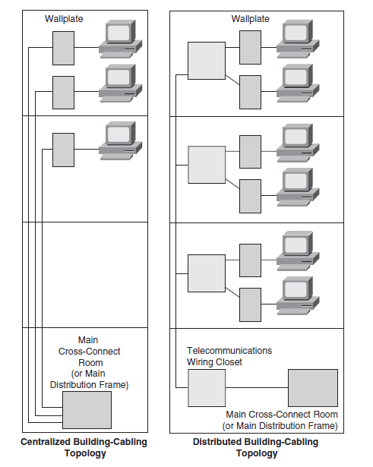
Building Cabling Topologies
Distributed topology
More scalable
Less manageable
Centralized topology
More manageable
Less scalable
Notes:
Assumption: workstations no more than 100 meters from telecommunication closets

Slide 9
Centralized Campus Cabling
Building B
Building C
Building D
Cable Bundle
Campus outdoor cabling prone to natural disasters or manmade disasters
Building A

Slide 10
Centralized Campus Cabling
Building B
Building C
Building D
Cable Bundle
Loss of interbuilding connection!!
Building A

Slide 11
Distributed Campus Cabling
Building B
Building C
Building D
Building A

Slide 12

Distributed Campus Cabling
Building B
Building C
Building D
Others are still interconnected!
Building A
Question: Right of way problem?

Slide 13
Types of Media Used in Campus Networks
Copper media
Optical media
Wireless media

Slide 14
Copper Media Advantages
Conducts electric current well
Does not rust
Can be drawn into thin wires
Easy to shape
Hard to break

Slide 15
Copper Media Advantages
Copper Media
Coaxial
Twisted-Pair
Shielded Twisted-Pair (STP)
Unshielded Twisted-Pair (UTP)

Slide 16
Twisted Pair Wire
• One or more pairs of single conductor wires that have been twisted around each other
• Twisted pair wire is classified by category 1-7
Note: Categories 1, 2 and 4 are nearly obsolete
• Twisting the wires helps to eliminate electromagnetic interference between the two wires
• Shielding can further help to eliminate interference
Data Communications and Computer Networks: A Business User's Approach, Sixth Edition
Notes:
16

Slide 17
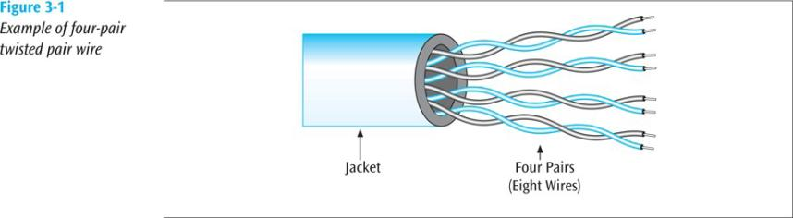
Twisted Pair Wire (Continued)
Data Communications and Computer Networks: A Business User's Approach, Sixth Edition
Notes:
17

Slide 18
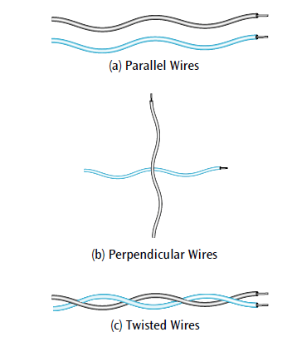

Twisted Pair Wire (Continued)
Crosstalk
Crosstalk ?!#>_<
Crosstalk
Crosstalk
Data Communications and Computer Networks: A Business User's Approach, Sixth Edition
Notes:
18

Slide 19
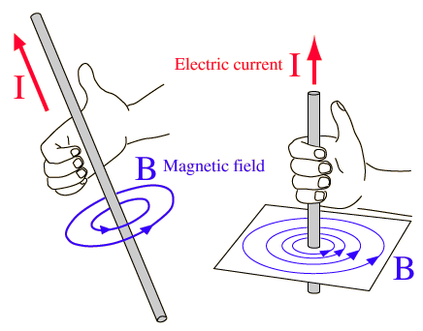

Twisted Pair Wire (Continued) :
Law of Physics
A current passing >> magnetic field around
A magnetic field passing >> a current in that wire
Unwanted current (interference)
Data Communications and Computer Networks: A Business User's Approach, Sixth Edition
Notes:
19

Slide 20
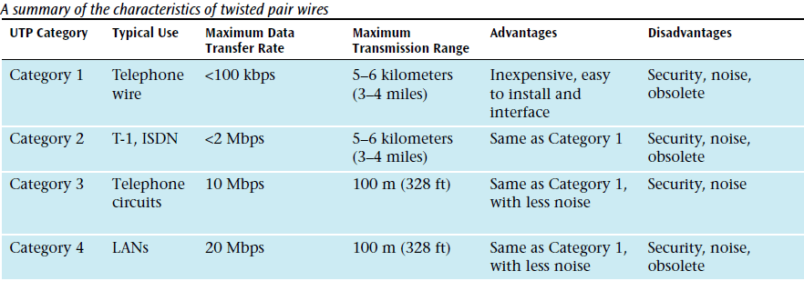
Twisted Pair Wire (Continued
Data Communications and Computer Networks: A Business User's Approach, Sixth Edition
Notes:
20

Slide 21
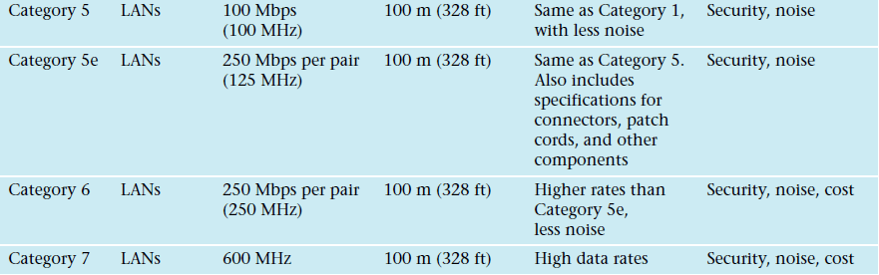
Twisted Pair Wire (Continued)
Data Communications and Computer Networks: A Business User's Approach, Sixth Edition
Notes:
21

Slide 22
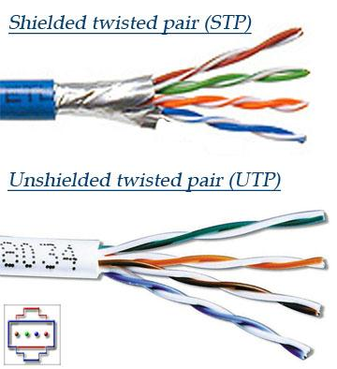

Twisted Pair Wire (Continued
STP? UTP?
Data Communications and Computer Networks: A Business User's Approach, Sixth Edition
Notes:
22

Slide 23
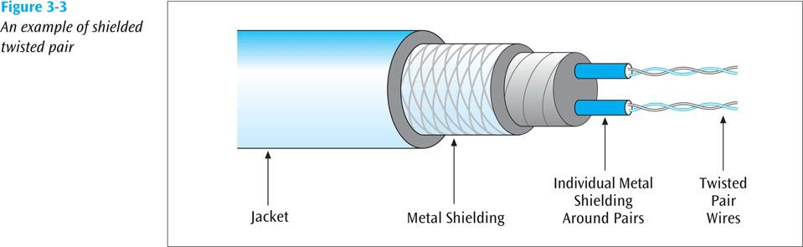
Twisted Pair Wire (Continued)
Data Communications and Computer Networks: A Business User's Approach, Sixth Edition
Notes:
23

Slide 24
Twisted Pair Wire Summary :
• Most common form of wire
• Relatively inexpensive
• Easy to install
• Carries high data rates (but not the highest)
• Can suffer from electromagnetic noise
• Can be easily wire-tapped
• Comes in shielded and unshielded forms
Data Communications and Computer Networks: A Business User's Approach, Sixth Edition
Notes:
24

Slide 25
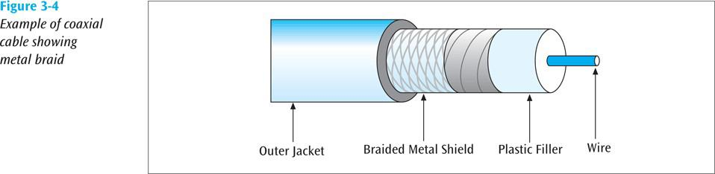
Coaxial Cable
• A single wire wrapped in a foam insulation surrounded by a braided metal shield, then covered in a plastic jacket. Cable comes in various thicknesses
Data Communications and Computer Networks: A Business User's Approach, Sixth Edition
Notes:
25

Slide 26
Coaxial Cable (Continued)
• Baseband coaxial technology
- transmit digital signal
- 1 channel
- 10 to 100 Mbps signal
- ex. Interconnection between LAN
• Broadband coaxial technology
- transmits analog signals
- multiple channels
- up to 600 MHz bandwith (@6 MHz)
- ex. Cable TV
Data Communications and Computer Networks: A Business User's Approach, Sixth Edition
Notes:
26

Slide 27
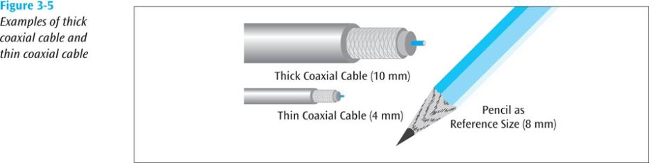
Coaxial Cable (Continued)
For broadband coaxial
For baseband coaxial
Data Communications and Computer Networks: A Business User's Approach, Sixth Edition
Notes:
27

Slide 28
Coaxial Cable Summary
• A single wire surrounded by a braided shield
• Because of shielding, can carry a wide bandwidth of frequencies
• Thus is good with applications such as cable television
• Not as easy to install as twisted pair
• More expensive than twisted pair
Data Communications and Computer Networks: A Business User's Approach, Sixth Edition
Notes:
28

Slide 29
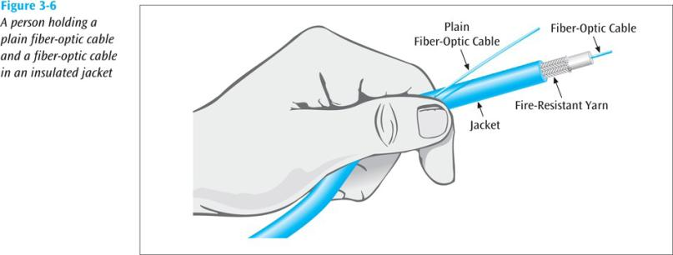
Fiber-Optic Cable
• A thin glass cable surrounded by a plastic coating and packaged into an insulated cable
A little thicker than human hair
Data Communications and Computer Networks: A Business User's Approach, Sixth Edition
Notes:
29

Slide 30
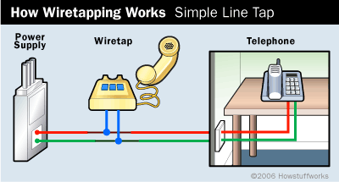
Fiber-Optic Cable
• So far, weakness of twisted pair and coaxial cable are:
- electromagnetic interference
- prone to wiretapping
Data Communications and Computer Networks: A Business User's Approach, Sixth Edition
Notes:
30

Slide 31
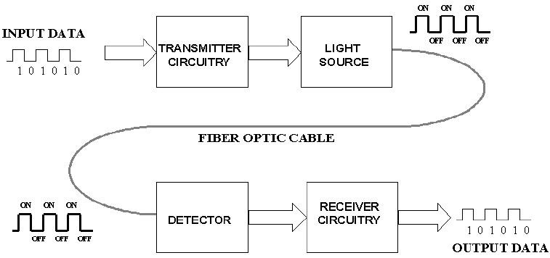
Fiber-Optic Cable (Continued) :
LED
Laser
Light pulse transmission
Impossible to wiretap
Optic sensor
https://www.elprocus.com/wp-content/uploads/2014/03/23.jpg
Notes:
31

Slide 32
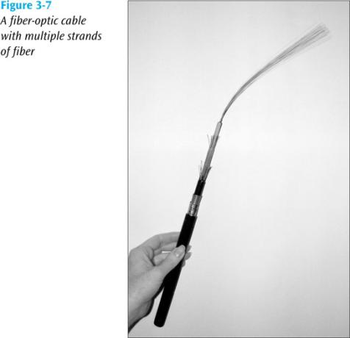
Fiber-Optic Cable (Continued) :
Fiber-optic cable is capable of supporting millions of bits per second for 1000s of meters
Data Communications and Computer Networks: A Business User's Approach, Sixth Edition
Notes:
32

Slide 33
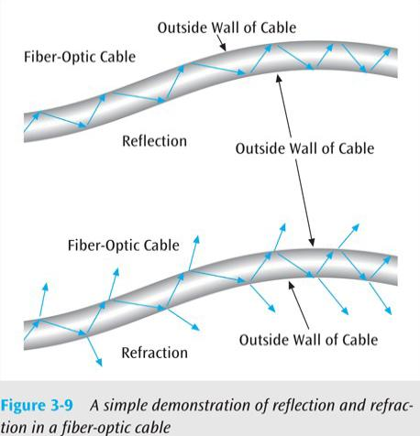
Fiber-Optic Cable (continued)
Reflection?
Refraction?
Data Communications and Computer Networks: A Business User's Approach, Sixth Edition
Notes:
33

Slide 34
Fiber-Optic Cable (Continued) :
 | Single mode: | Step index multimode:
Light source | Laser | LED
Cable thickness | Thin (8.3/125 microns) | Thick (62.5/125 microns)
Reflection | Very little | Prone to ray collision
Transmission distance | Long distance | Short distance
Data Communications and Computer Networks: A Business User's Approach, Sixth Edition
Notes:
34

Slide 35
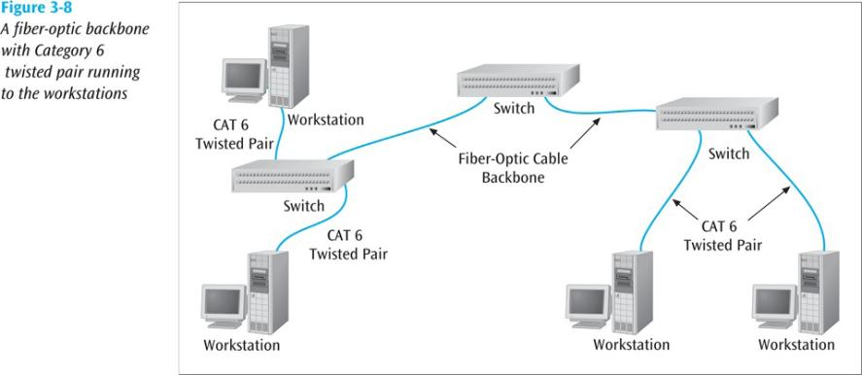
Fiber-Optic Cable (Continued) :
Data Communications and Computer Networks: A Business User's Approach, Sixth Edition
Notes:
35

Slide 36
Fiber-Optic Cable Summary
Fiber optic cable can carry the highest data rate for the longest distances
Initial cost-wise, more expensive than twisted pair, but less than coaxial cable
But when you consider the superiority of fiber, initial costs outweighed by capacities
Need two fibers for a round-trip connection
Not affected by electromagnetic noise and cannot be easily wiretapped, but still noise
Data Communications and Computer Networks: A Business User's Approach, Sixth Edition
Notes:
36

Slide 37
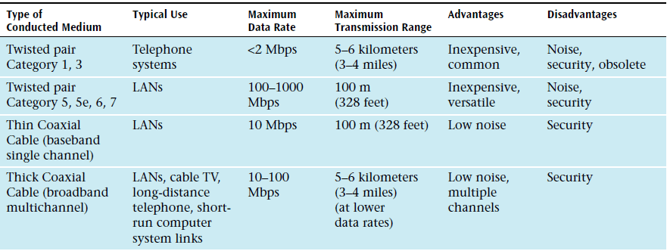
Conducted Media
Data Communications and Computer Networks: A Business User's Approach, Sixth Edition
Notes:
37

Slide 38

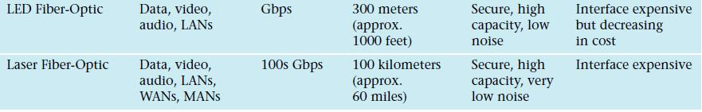
Conducted Media
Data Communications and Computer Networks: A Business User's Approach, Sixth Edition
Notes:
38

Slide 39
Wireless Media
IEEE 802.11a, b, and g
Laser
Microwave
Cellular
Satellite

Slide 40
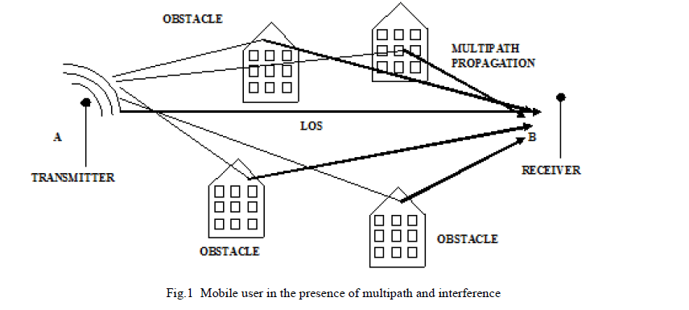
Wireless Media (Continued)
Multipath propagation?
Line of sight (LOS) ?
http://www.rroij.com/articles-images/IJAREEIE-1849-g001.gif
Notes:
40

Slide 41
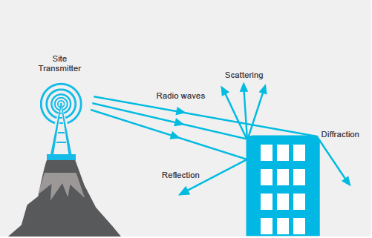
Wireless Media (Continued)
Data Communications and Computer Networks: A Business User's Approach, Sixth Edition
Notes:
41

Slide 42
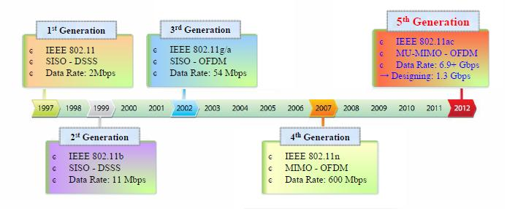
Wireless Local Area Networks
(IEEE 802.11)
Data Communications and Computer Networks: A Business User's Approach, Sixth Edition
Notes:
42

Slide 43
ZigBee
• Based upon IEEE 802.15.4 standard
• Used for low data transfer rates (20-250 Kbps)
• Also uses low power consumption
• Ideal for heating, cooling, security, lighting, and
smoke and CO detector systems
• ZigBee can use a mesh design – a ZigBeeenabled
device can both accept and then pass on
ZigBee signals
Data Communications and Computer Networks: A Business User's Approach, Sixth Edition
Notes:
43

Slide 44
LAN Technologies
Half-duplex Ethernet (becoming obsolete)
Full-duplex Ethernet
10-Mbps Ethernet (becoming obsolete)
100-Mbps Ethernet
1000-Mbps (1-Gbps or Gigabit) Ethernet
10-Gbps Ethernet
Metro Ethernet
Long Range Ethernet (LRE)
Cisco’s EtherChannel
Notes:
These days, use at least 100-Mbps Ethernet to the desktop and 100-Mbps, Gigabit, or 10-Gbps Ethernet in backbones. Also, use full-duplex Ethernet whenever possible.

Slide 45
IEEE 802.3 10-Mbps Ethernet
10 Mbps Ethernet
10Base5
10BaseT
10BaseF
Thick coax cable 500 meters
2 pairs Category-3 or better UTP 100 meters
2 multimode optical fibers
10Base2
10Broad36
Thin coax cable 185 meters
3 channels of a private CATV system 3600 meters

Slide 46
IEEE 802.3 100-Mbps Ethernet
100BaseT
100BaseX
100BaseT4
100BaseT2
4 pairs Category-3 or better UTP 100 meters
2 pairs Category-3 or better UTP 100 meters
100BaseTX
100BaseFX
2 pairs Category-5 or better UTP 100 meters
2 multimode optical fibers 2000 meters (full duplex)

Slide 47
IEEE 802.3 Gigabit Ethernet
1000BaseX
1000BaseSX
1000BaseLX
1000BaseCX
1000BaseT
2 multimode optical fibers using shortwave laser optics 550 meters
2 multimode or single-mode optical fibers using longwave laser optics
550 meters multimode, 5000 meters single-mode
2 pairs STP 25 meters
4 pairs Category-5 UTP
100 meters

Slide 48
IEEE 802.3 10-Gbps Ethernet
10GBaseX
10GBaseLX4
10GBaseS
10GBaseL
10GBaseE
Multimode or single-mode optical fibers
300 meters multimode, 10 km single-mode
Multimode optical fibers 300 meters
Single-mode optical fibers 10 km
Single-mode optical fibers 40 km

Slide 49
Metro Ethernet
Service offered by providers and carriers that traditionally had only classic WAN offerings
The customer can use a standard Ethernet interface to reach a MAN or WAN
The customer can add bandwidth as needed with a simple configuration change

Slide 50
Long-Reach Ethernet
Enables the use of Ethernet over existing, unconditioned, voice-grade copper twisted-pair cabling
Used to connect buildings and rooms within buildings
  Rural areas
  Old cities where upgrading cabling is impractical
  Multi-unit structures such as hotels, apartment complexes, business complexes, and government agencies

Slide 51
Internetworking Devices for Campus Networks
Hubs (becoming obsolete)
Switches
Routers
Wireless access points
Wireless bridges
Notes:
These days, switches and routers are the norm, rather than hubs and bridges, (although wireless bridges are somewhat common).

Slide 52
Selection Criteria for Internetworking Devices
The number of ports
Processing speed
The amount of memory
Latency when device relays data
Throughput when device relays data
LAN and WAN technologies supported
Media supported

Slide 53
More Selection Criteria for Internetworking Devices
Cost
Ease of configuration and management
MTBF and MTTR
Support for hot-swappable components
Support for redundant power supplies
Quality of technical support, documentation, and training
Etc.

Slide 54
Conclusion
Once the logical design is completed, the physical design can start
A major task during physical design is selecting technologies and devices for campus networks
  Media
  Data-link layer technology
  Internetworking devices
Also, at this point, the logical topology design can be developed further by specifying cabling topologies

Slide 55
DAFTAR PUSTAKA/SUMBER
Oppenheimer, Priscilla. (2013). Top Down Network Design. 3rd Edition. Cisco Press. Indianapolis. ISBN: 978-1-58705-152-4.
Hummel, S. L. (2015). Cisco Design Fundamentals: Multilayered Network Architecture and Design for Network Engineers.
Bruno, A., & Jordan, S. (2016). CCDA 200-310 Official Cert Guide. Cisco Press.

