Slide 1
Network Governance
SESSION 12 – Optimizing the Network Design
D5727 – Dr. Eng. Nico Surantha, ST., MT.

Slide 2
Outline
Optimizing Bandwidth Usage with IP Multicast Technologies
Reducing Serialization Delay
Optimizing Network Performance to Meet Quality of Service Requirements

Slide 3
Reasons to Optimize
Meet key business and technical goals
Use bandwidth efficiently
Control delay and jitter
Reduce serialization delay
Support preferential service for essential applications
Meet Quality of Service (QoS) requirements
Notes:
Optimization is a critical design step for organizations that use high-bandwidth and delay-sensitive applications.
you should work with your customer to classify network applications into
service categories so that you can determine which optimization and quality of service (QoS) options the applications will require. After you have classified an application, you should fill in the “QoS Requirements” column

Slide 4
IP Multicast Helps Optimize Bandwidth Usage
Traditional approach to do broadcast
  Use unicast point-to-point protocol
  Send single stream to broadcast destination address
With IP multicast, you can send a high-volume multimedia stream just once instead of once for each user
Requires support for
  Multicast addressing
  Multicast registration (IGMP)
  Multicast routing protocols
Notes:
Use unicast point-to-point protocol >> waste of bandwidth
Send single stream to broadcast destination address >> user yg tidak request juga menerima (mempengaruhi performa jaringan)

Slide 5
IP Multicast Addressing
Uses Class D multicast destination address
  224.0.0.0 to 239.255.255.255
A multicast group is also identified by a MAC layer multicast address
.The range of addresses for Ethernet is 01:00:5E:00:00:00 to 01:00:5E:7F:FF:FF
Converted to a MAC-layer multicast destination address
  The low-order 23 bits of the Class D address become the low-order 23 bits of the MAC-layer address
  The top 9 bits of the Class D address are not used
  The top 25 bits of the MAC-layer address are 0x01:00:5E followed by a binary 0
Notes:
Using a MAC layer multicast address optimizes network performance by allowing network interface
cards (NIC) that are not part of a group to ignore a data stream that is not for them.

Slide 6
IP multicast addressing (2)
As another example, when a host sends to the 239.192.44.56 multicast IP address, What is the converted MAC address for IP adress above?

Slide 7
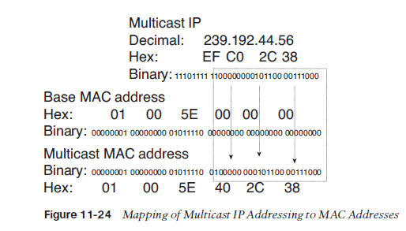
IP multicast addressing (2)

Slide 8
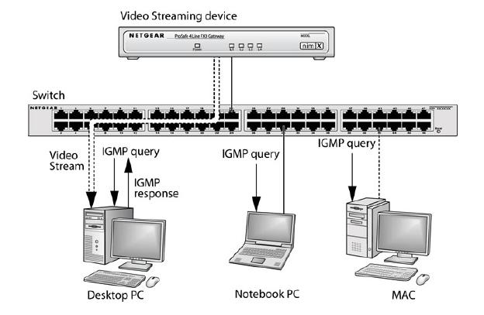
Internet Group Management Protocol (IGMP)

Slide 9
Internet Group Management Protocol (2)
Allows a host to join a multicast group
Host transmits a membership-report message to inform routers on the segment that traffic for a group should be multicast to the host’s segment
only needs to recognize that a group has at least one member on a segment, so that it sends traffic to that segment using the IP and MAC multicast addresses for the group.
IGMPv2 has support for a router more quickly learning that the last host on a segment has left a group

Slide 10
Multicast Routing Protocols
In addition to determining which local network segments should receive traffic for particular multicast groups, a router must also learn how to route multicast traffic across an internetwork. Multicast routing protocols provide this function.
Becoming obsolete
  Multicast OSPF (MOSPF)
  Distance Vector Multicast Routing Protocol (DVMRP)
Still used
  Protocol Independent Multicast (PIM)
    Dense-Mode PIM
    Sparse-Mode PIM

Slide 11
Reducing Serialization Delay
The time to output a packet is called transmission delay or serialization delay.
Serialization delay becomes an issue when a WAN link is used by applications that send large packets, such as file transfer, and applications that are delay-sensitive, such as voice, video, and interactive applications such as Telnet.
Solution:
  Link-layer fragmentation and interleaving (LFI)
  Compression for multimedia packet headers

Slide 12
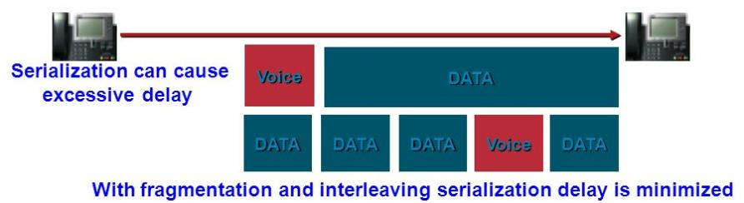
Reducing Serialization Delay (2)
Link-layer fragmentation and interleaving
  Breaks up and reassembles frames
  Multilink PPP
  Frame Relay FRF.12

Slide 13
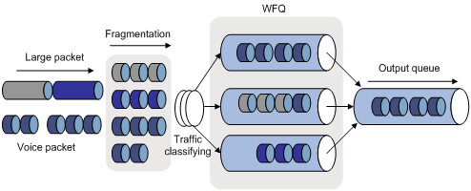
Reducing Serialization Delay (3)
WFQ (Weighted Fair Queueing)

Slide 14
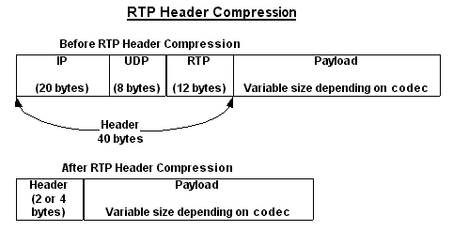
Reducing Serialization Delay (4)
Compressed Real Time Protocol
  RTP is used for voice and video
  Compressed RTP compresses the RTP, UDP, and IP header from 40 bytes to 2 to 4 bytes

Slide 15
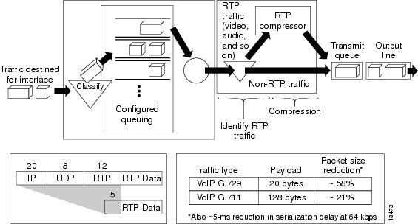
Reducing Serialization Delay (5)
Compressed Real Time Protocol

Slide 16
A Few Technologies for Meeting QoS Requirements
IETF controlled load service
IETF guaranteed service
IP precedence
IP differentiated services

Slide 17
IP Type of Service Field
The type of service field in the IP header is divided into two subfields
  The 3-bit precedence subfield supports eight levels of priority
  The 4-bit type of service subfield supports four types of service
Although IP precedence is still used, the type of service subfield was hardly ever used

Slide 18
IP Type of Service Field
Type of Service Subfield
Bit
0
3
4
5
6
7
D = Delay
T = Throughput
R = Reliability
C = Cost
Precedence
D
T
R
C
0
Bit
0
8
15
24
31
Version
Header Length
Type of Service
Total Length
Identification
Flags
Fragment Offset
Time to Live
Protocol
Header Checksum
Source IP Address
Destination IP Address
Options
Padding

Slide 19
IP Differentiated Services (DS) Field
RFC 2474 redefines the type of service field as the Differentiated Services (DS) field
  Bits 0 through 5 are the Differentiated Services Codepoint (DSCP) subfield
    Has essentially the same goal as the precedence subfield
    Influences queuing and packet dropping decisions for IP packets at a router output interface
  Bits 6 and 7 are the Explicit Congestion Notification (ECN) subfield

Slide 20
IP Differentiated Services (DS) Field
0
6
Differentiated Services Codepoint
Explicit Congestion Notification
0
8
15
24
31
Version
Header Length
Differentiated Services
Total Length

Slide 21
Classifying LAN Traffic
IEEE 802.1p
Classifies traffic at the data-link layer
Supports eight classes of service
A switch can have a separate queue for each class and service the highest-priority queues first

Slide 22
Cisco Switching Techniques
Process switching
Fast switching
Autonomous, silicon, and optimum switching
NetFlow switching
Cisco Express Forwarding (CEF)

Slide 23
Cisco Queuing Services
First in, first out (FIFO) queuing
Priority queuing
Custom queuing
Weighted fair queuing (WFQ)
Class-based WFQ (CBWFQ)
Low latency queuing (LLQ)

Slide 24
Priority Queuing
START
Packet in high queue?
NO
Packet in medium queue?
NO
YES
Packet in normal queue?
NO
YES
Packet in low queue?
NO
YES
YES
Dispatch Packet
Continue

Slide 25
Custom Queuing
START (with Queue 1)
NO
Packet in Queue?
YES
Reached transmission window size?
YES
NO
Next Queue
Dispatch Packet

Slide 26
Low-Latency Queuing
One queue always gets the green light
  Use this for voice
Combine this with class-based weighted fair queuing
  Define traffic classes based on protocols, access control lists, and input interfaces
  Assign characteristics to classes such as bandwidth required and the maximum number of packets that can be queued for the class

Slide 27
Random Early Detection (RED)
Congestion avoidance rather than congestion management
Monitors traffic loads and randomly discards packets if congestion increases
Source nodes detect dropped packets and slow down
  Works best with TCP
Weighted Random Early Detection
    Cisco’s implementation uses IP precedence or the DS field instead of just randomly dropping packets

Slide 28
Traffic Shaping
Manage and control network traffic to avoid bottlenecks
Avoid overwhelming a downstream router or link
Reduce outbound traffic for a flow to a configured bit rate
  Queue bursts of traffic for that flow

Slide 29
Committed Access Rate (CAR)
Cisco feature for classifying and policing traffic on an incoming interface
Supports policies regarding how traffic that exceeds a certain bandwidth allocation should be handled
Can drop a packet or change the IP precedence or DSCP bits

Slide 30
More about QoS
Why/What/Where of QoS
What QoS Does
What Effects Does QoS Have on a Network?
Designing QoS
Implementing QoS
Tools to manage QoS
QoS in our network

Slide 31
Why QoS?
QoS is used on delay sensitive network applications
  Video
  Voice
  Database

Slide 32
What Is QoS?
QoS is the ability of a network to service an application efficiently, without affecting its function or performance.
In essence, QoS is an application insurance policy.

Slide 33
Where Is QoS Implemented?
QoS is in all components of a network
  Hosts
  Routes/Switches
  Links

Slide 34
What QoS Does
QoS is a set of techniques to manage:
  Bandwidth - The perceived width of the pipe
  Delay - The perceived length of the pipe
  Jitter - The perceived variation in the length
  Packet Loss - The perceived leak in the pipe
Notes:
Began in fall of 1999
Equipment and lines located in Denver
Only 3 members
Cost of internet connectivity went up/no free rides
Long battle to get multiple carriers
BPOP is composed of NOAA/NIST and NCAR
Gives NCAR a back-door internet access in Boulder

Slide 35
Why Is Bandwidth not Enough?
Many items may effect the delay of a packet
  Speed Mismatch
  Aggregation
  Data Transfer

Slide 36
Speed Mismatch Problem
Ethernet
Switch
1000Mbps
100Mbps

Slide 37
Aggregation Problem
1000Mbps
1000Mbps

Slide 38
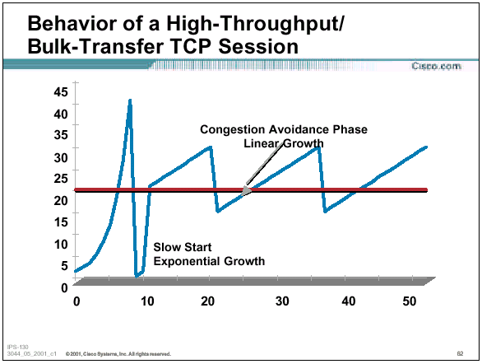
Data Transfer Problem

Slide 39
What Happens without QoS
Listen to these samples
  Sample 1: No congestion
  Sample 2: Sample 1 with 142msec delay, and 12% packet loss
  Sample 3: Sample 1 with

Slide 40
What Effects Does QoS Have on a Network?
Example of a congested highway with a carpool lane
Network traffic is divided into business classes

Slide 41
QoS Operation
Differentiated Services (DiffServ)
    RFC-2474,2475,2597,2598
    1998/99
  Simply defines service levels
    Gold
    Silver
    Bronze
  Per-Hop Behaviors (PHB)

Slide 42
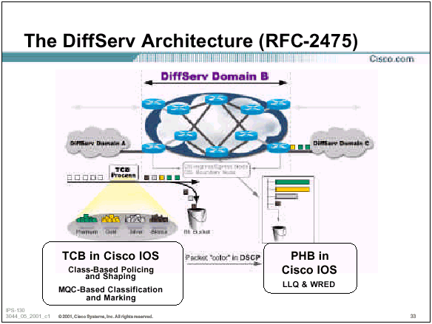

Slide 43
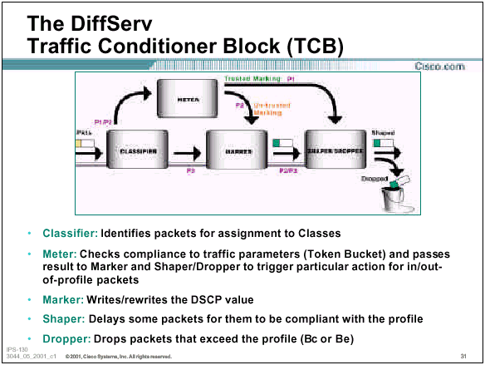
DiffServ TCB

Slide 44
DiffServ Techniques
IP Differentiated Services Code Point (DSCP) - Layer 3
MPLS EXP Bits - Layer 2.5
ATM CLP Bit - Layer 2
Frame-Relay DE Bit - Layer 2
IEEE 802.1Q/p User Priority Bits - Layer 2
  VoIP packets are marked IP DSCP Premium Class

Slide 45
QoS Operation - Layer 2

Slide 46
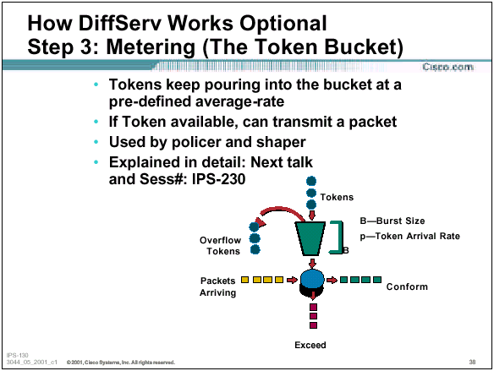
QoS Operation - Layer 3

Slide 47
DiffServ Congestion Avoidance
Congestion avoidance aims to prevent buffer exhaustion and future congestion by dropping packets in anticipation of the sources backing off.

Slide 48
Designing QoS into a Network
Categorize WAN/LAN Links
Define classes of service
  Usually 3-5 different levels
Redundancy?
Switch changes
Router changes
Host changes

Slide 49
Implementing QoS
Set Queuing on Ethernet Switches
Set Queuing/DiffServ on Routers
Phased approach
  Test bed
  Switches
  Routers

Slide 50
Tools to Manage QoS
Cisco QoS Device Manager (QDM)
Cisco QoS Policy Manager (QPM)

Slide 51
Conclusion
We can use QoS tomorrow to solve our voice over IP issues
We will be ready to solve other delay problems as they become apparent - video, special protocols, maybe LDAP, DNS, etc.
Cisco Networkers Presentations
  http://www.cisco.com/networkers/nw01/pres/

Slide 52
Conclusion
Optimization provides the high bandwidth, low delay, and controlled jitter required by many critical business applications
To minimize bandwidth utilization by multimedia applications, use IP multicast
To reduce serialization delay, use link fragmentation and compressed RTP
To support QoS and optimize performance, use IP precedence, DSCP, 802.1p. advanced switching and queuing methods, RED, CAR, etc.

Slide 53
DAFTAR PUSTAKA/SUMBER
Oppenheimer, Priscilla. (2013). Top Down Network Design. 3rd Edition. Cisco Press. Indianapolis. ISBN: 978-1-58705-152-4.

