Slide 1
Teori aliran daya radial

Slide 2
Teori aliran daya pada sistem distribusi
Aliran daya merupakan analisis yang sangat penting untuk mengetahui apakah kondisi sistem stabil atau tidak.
Tujuan utama dari analisis aliran daya adalah untuk mengetahui besar daya aktif dan reaktif yang mengalir di setiap saluran bersama dengan besarnya dan fase-fase dari tiap tegangan pada setiap bus sistem untuk kondisi pembebanan tertentu.
Secara umum sistem tenaga dibagi menjadi dua kategori:
Sistem transmisi
Sistem distribusi

Slide 3
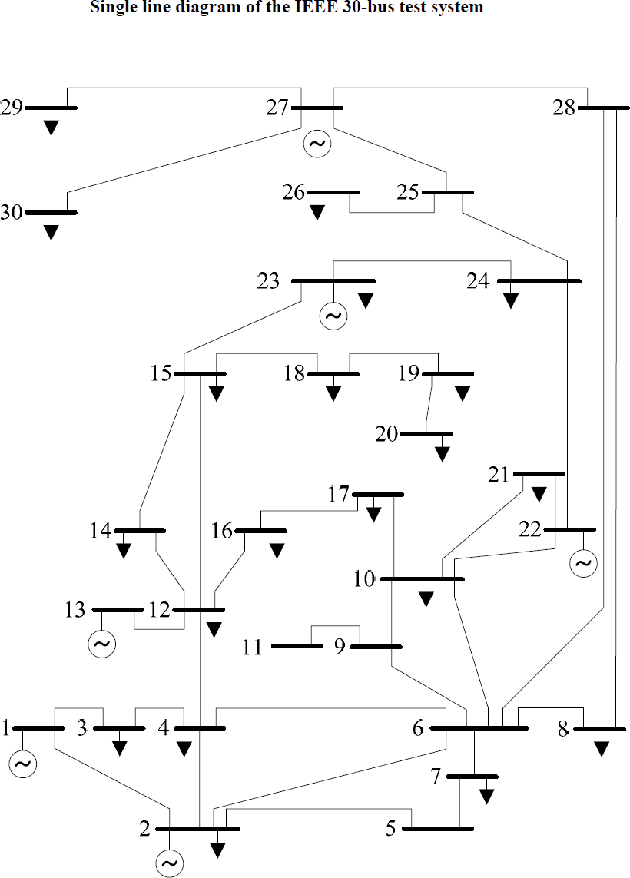
1. Transmission Systems

Slide 4
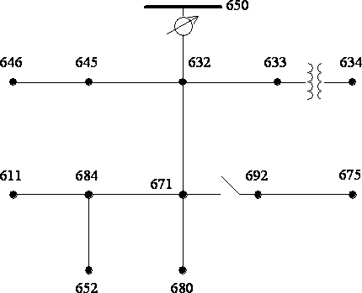
IEEE 13 Node Test Feeder
2. Distribution Systems

Slide 5
Sistem distribusi memiliki beberapa karakteristik yang berbeda dari sistem transmisi:
Memiliki struktur radial
Saluran yang tidak ditransposisikan
Memiliki jumlah node yang besar
Beban yang tidak seimbang, bersama dengan lateral satu fase dan dua fase
Rasio R/X yang tinggi
Fitur-fitur ini perlu diperhitungkan saat melakukan analisis aliran daya untuk sistem distribusi. Sistem distribusi perlu dianalisis berdasarkan tiga fase, tidak seperti sistem transmisi yang dapat dianalisis berdasarkan fase tunggal. Karena alasan ini. Metode Newton Raphson fase tunggal tradisional atau aliran daya untuk sistem ring tidak memadai untuk studi aliran daya distribusi [2].
[2] S. M. Moghaddas-Tafreshi, Elahe Mashhour, "Distributed generation modeling for power flow studies and a three-phase unbalanced power flow solution for radial distribution systems considering distributed generation," Electric Power Systems Research, Vol. 79, pp. 680-686, 2009.

Slide 6
Metode yang biasa digunakan dalam analisis aliran daya untuk system distribusi adalah:
Modified Newton Rhapson
Implicit Z-bus Method
Modified Gauss-Seidel Method
Forward-backward Sweep method
Network Topology Based Method
etc

Slide 7




I. FORWARD-BACKWARD ITERATIVE TECHNIQUE
1. Linear Network
Z12
2
Z23
3
Z34
4
Z45
5
1
+
Vs
I12
I23
I34
I45
-
ZL2
I2
ZL3
I3
ZL4
I4
ZL5
I5
Figure 1.1 Linear Network
Linear network, load is Constant load impedance.
From that figure:
Assuming that all of impedance and all of the load is known.

Slide 8










FORWARD SWEEP
Start from the end of the node.
Assuming is known (Initial guest).
1
Z12
2
Z23
3
Z34
4
Z45
5
Look at the end of the node.
+
Vs
I12
I23
I34
I45
-
ZL2
I2
ZL3
I3
ZL4
I4
ZL5
I5
Calculate :

Slide 9








Using Kirchoff’s current law:
1
Z12
2
Z23
3
Z34
4
Z45
5
+
Vs
I12
I23
I34
I45
Continue until calculate .
Compare and to know the error.
If error is less then tolerance its mean the solution is achieved Else
Continue to backward sweep.
-
ZL2
I2
ZL3
I3
ZL4
I4 ZL5
I5

Slide 10













BACKWARD SWEEP
Calculate V2:
1
Z12
2
Z23
3
Z34
4
Z45
5
+
Vs
I12
I23
I34
I45
-
ZL2
I2
ZL3
I3
ZL4
I4
ZL5
I5
And then calculate
using:
Continue until

Slide 11
2. Non Linear Network
The linear network of figure 1.1 is modified to a non linear network by replacing all of constant load impedance by constant complex power load.
Z12
2
Z23
3
Z34
4
Z45
5
1
+
Vs
I12
S2
I23
S3
I34
S4
I45
S5
I2
I3
I4
I5
-
Figure 1.2 Non Linear Network
FORWARD SWEEP
The differences of calculation between linear network and non linear network is how to calculate

Slide 12









Assuming
is known (Initial guest).
1
Z12
2
Z23
3
Z34
4
Z45
5
+
Vs
I12
I23
I34
I45
S2
I2
S3
I3
S4
I4
S5
Look at the end of the node.
-
Calculate :

Slide 13
Using Kirchoff’s current law:
1
Z12
2
Z23
3
Z34
4
Z45
5
+
Vs
I12
I23
I34
I45
S2
I2
S3
I3
S4
I4
S5
-
Continue until calculate .
Compare and to know the error.
If error is less then tolerance it’s mean the solution is achieved Else
Continue to backward sweep.

Slide 14
BACKWARD SWEEP
Calculate V2:
And then calculate
using:
1
Z12
2
Z23
3
Z34
4
Z45
5
Continue until
+
Vs
I12
I23
I34
I45
S2
I2
S3
I3
S4
I4
S5
-

Slide 15







EXAMPLE:
Z12
2
Z23
3
1
+
Vs
I12
S2
I23
S3
I2
I3
-
Impedance data:
Load data:

Slide 16























SOLUTION:
FORWARD SWEEP
Step 1: Assume
1
Z12
2
Z23
3
+
Vs
I12
I23
S2
I2
S3
I3
.
-

Slide 17












Step 2:
Z12
Z23
1
2
3
Look at the end of the node.
+
Vs
I12
I23
S2
I2
S3
I3
-
Calculate
Step 3:
Calculate load current at node 2:

Slide 18























1
Z12
2
Z23
3
+
Vs
I12
I23
Step 4:
Calculate current in line segment 1-2:
S2
I2
S3
I3
-
Step 5:
Compute voltage at source node( :

Slide 19




















Step 6:
1
Z12
2
Z23
3
Check the error.
I23
+
Vs
I12
S2
I2
S3
I3
-
Usually the error tolerance is

Slide 20

















BACKWARD SWEEP
Z12
Z23
Step 7:
Calculate :
1
2
3
+
Vs
I12
I23
S2
I2
S3
I3
-
Step 8:
Calculate :

Slide 21




Go to step 1 to calculate
using updated
And repeat until error tolerance is less than
1
Z12
2
Z23
3
One line usually used in Power system
+
Vs
I12
I23
S2
I2
S3
I3
-
1
2
3
G
S2
S3

Slide 22
3. General Feeder
Source node
1
2
3
4
10
11
8
5
12
9
7
6
13

Slide 23
The ladder iterative technique for
the feeder would proceed as
follows:
1
Source node
Assume three-phase voltages at the end nodes (6, 8, 9, 11, and 13). The usual assumption is to use nominal voltages.
Starting at Node 13, compute the
2
3
8
4
10
11
5
12
node current (load current plus
9
7
current capacitor if present).
6
13
With this current, apply Kirchhoff’s voltage law (KVL) to calculate the node voltages at 12 and 10.
Node 10 is referred to as a ”junction” node since laterals branch in two directions from the node. For this feeder go to Node 11 and compute the node current.

Slide 24
Use that current to compute the
voltage at Node 10. This will be referred to as “the most recent voltage at Node 10”.
5. Using the most recent value of the
1
Source node
2
voltage at
Node 10, the node Node 10 (if any) is
3
current at
10
11
computed.
8
4
6. Apply Kirchhoff’s current law (KCL) to determine the current
5
12
9
7
flowing from Node 4 toward Node 10.
Compute the voltage at Node 4.
Node 4 is junction node. An end node downstream from Node 4 is selected to start the forward sweep toward Node 4.
Select Node 6, compute the node current, and then compute the voltage at junction Node 5.
6
13

Slide 25
10. Go to downstream end node 8.
Compute the node current and then the voltage at junction Node 7.
Go to downstream end node 9.
Compute the node current and then the voltage at junction Node 7.
Compute the node current at Node 7 using the most recent value of the Node 7 voltage.
Apply KCL at Node 7 to compute
1
Source node
2
3
8
4
10
11
5
12
9
7
the current flowing on the line segment from Node 5 to Node 7.
Compute the voltage at Node 5.
Compute the node current at Node 5
Apply KCL at Node 5 to determine the current flowing from
Node 4 toward Node 5.
Compute the voltage at Node 5.
Compute the node current at Node 5.
6
13

Slide 26
19. Apply KCL at Node 5 to
determine the current flowing from Node 3 to Node 4
1
Source node
20. Calculate the voltage at Node 4.
21. Compute the node current at node 4.
2
3
Apply KCL at Node 3 to compute the current flowing from Node 2 to Node 4
Calculate the voltage at Node 2
Compute the node current at node 2
Apply KCL at Node2.
Calculate the voltage at Node 1.
Compare the calculated voltage at
8
4
10
11
5
12
9
7
6
13
Node11 to the specified source voltage.
28. If not within tolerance, use the
specified source voltage and the

Slide 27
forward sweep current flowing
from Node 1 to Node 2, and
compute the new voltage at Node 2.
29. The backward sweep continues,
1
Source node
using the new upstream voltage and line segment current from the
2
forward sweep to compute the new downstream voltage.
The backward sweep is completed
when new voltage at all end nodes have been completed.
This completes the first iteration.
Repeat the forward and backward sweeps until the calculated voltage at the source is within a specified tolerance of the source voltage.
3
8
4
10
11
5
12
9
7
6
13
33. Continue the forward and backward sweeps until the calculated voltage at the source is

Slide 28
within a
specified tolerance of
source voltage.
34. At this point the voltages are
Source node
known at all nodes, and the current flowing in all line segments are known. An output report can be
1
2
produced giving all desired results.
3
8
4
10
11
5
12
9
7
6
13
Reference:
1. William H. Kersting, “ Distribution System Modeling and Analysis” CRC PRESS 2002 . Pages 269-290

