Slide 1

LEANACCOUNTING
Theory and Practices
LEAN
ACCOUNTING?
An approach that covers all the concepts and techniques that aim to simplify the business to the essential activities that are needed to meet the needs of customers with a more effective and profitable way.

Slide 2
LEANACCOUNTING
Theory and Practices
ANTI-LEAN?
Large, complex, wasteful processes
Requiring huge amounts of non-value work
Labor efficiency report motivate large batch inventory
Few people understand its own reports
Misleading decisions making

Slide 3
LEANACCOUNTING
Theory and Practices
LEAN?
Value Oriented
Non-stop process
Focus on clearing waste
Customer-drive production
Continuous improvement

Slide 4

LEANACCOUNTING
Theory and Practices
MAIN PURPOSE
Lean accounting drive the practices of lean manufacturing
Reporting focus into waste removal and continuous improvemment

Slide 5
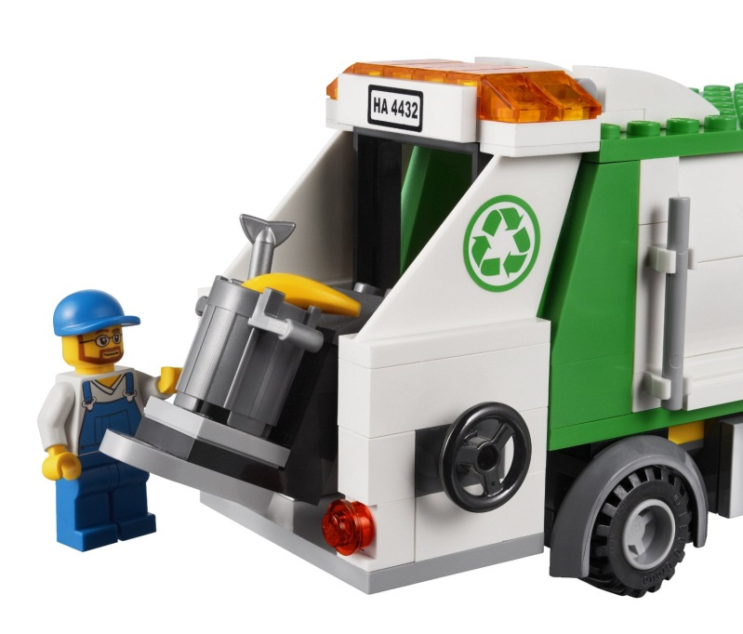
LEANACCOUNTING
Theory and Practices
TYPE OF WASTE?
Idle Time
Transporting
Overproduction
Defects, errors, and mistakes
Overstocking Inventories
Unnecessary processing
Improper goods/services
Untapped human potential

Slide 6

PRINCIPLES
LEANACCOUNTING
Theory and Practices
Customer Value
Value Stream Mapping
Continuous Flow
Pull System
Continuous Improvement

Slide 7
PRINCIPLES
LEANACCOUNTING
Theory and Practices
Customer Value
Identitify value from customer perspective
Value Stream Mapping
Mapping the “value stream” inside the business
Continuous Flow
Reducing waste while keep producing product/service
Pull System
Continuous Improvement
Customer driven approach to the company supply chain.
Never ending process on improving current state

Slide 8

Kaizen
Workcell design
Standardized Work
Takt Time
5-S
Kanban
Pull System
Training Within Industry
Value Stream Mapping
Root Cause and Corrective Action
TOOLS
LEANACCOUNTING
Theory and Practices

Slide 9
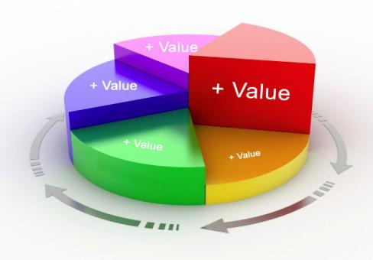
TOOLS
LEANACCOUNTING
Theory and Practices
Value Stream Mapping
Analyzing the current state and designing a future state for the series of events that take a product or service from its beginning through to the customer
Methodology:
Identify
Draw Current State
Score
Draw Expected State
Improve

Slide 10
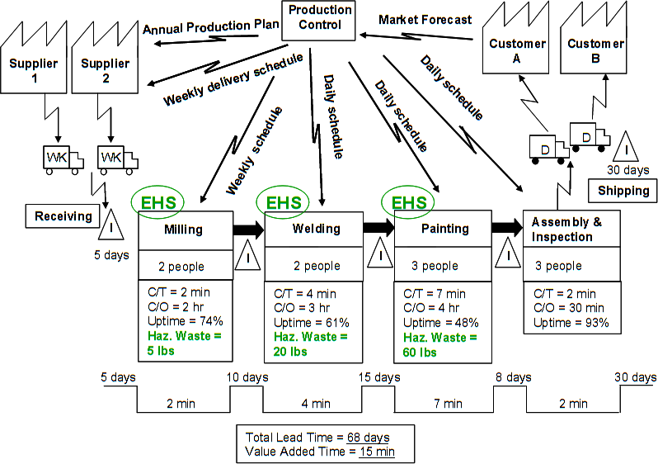
TOOLS
LEANACCOUNTING
Theory and Practices
Value Stream Mapping

Slide 11
TOOLS
LEANACCOUNTING
Theory and Practices
5-S (Seiri, Seiton, Seiso, Seiketsu, Seitsuke)
The list describes how to organize a work space for efficiency and effectiveness by identifying and storing the items used, maintaining the area and items, and sustaining the new order.
Sort | Set in Order | Shine | Standardize | Sustain
Eliminating obstacles Remove unnecessary items Remove unused tools Waste Removal | Arrange neccessary items Smooth workflow Close proximity arranging | Prevent deterioration Clean workplace Detect problems within 50 feet in 5 second | Standardize best practice Right thing on right place Maintain high standards | Do without being told Training and discipline Goal oriented process

Slide 12
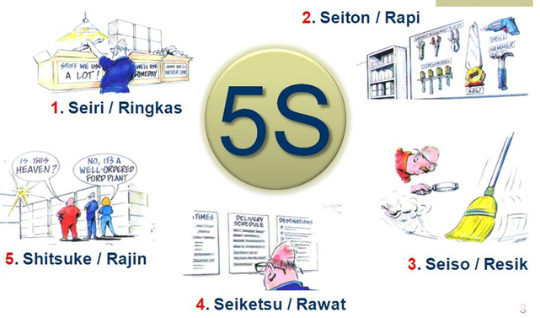
TOOLS
LEANACCOUNTING
Theory and Practices
5-S (Seiri, Seiton, Seiso, Seiketsu, Seitsuke)

Slide 13
TOOLS
LEANACCOUNTING
Theory and Practices
Takt Time
Is the average time between the start of production of one unit and the start of production of the next unit, when these production starts are set to match the rate of customer demand. For example, if a customer wants 10 units per week, then, given a 40-hour work week and steady flow through the production line, the average time between production starts should be 4 hours, yielding 10 units produced per week.
Formulation:
T = NT/TD
T : Takt Time
NT : Net time available to work, e.g. [work time per period]
TD : Demand (customer demand), e.g. [units required per period]
In reality, people and machines cannot maintain 100% efficiency and there will be stoppages for other reasons. Allowances should be made for these instances, and thus the line will be set up to run at a faster rate to account for this.

Slide 14
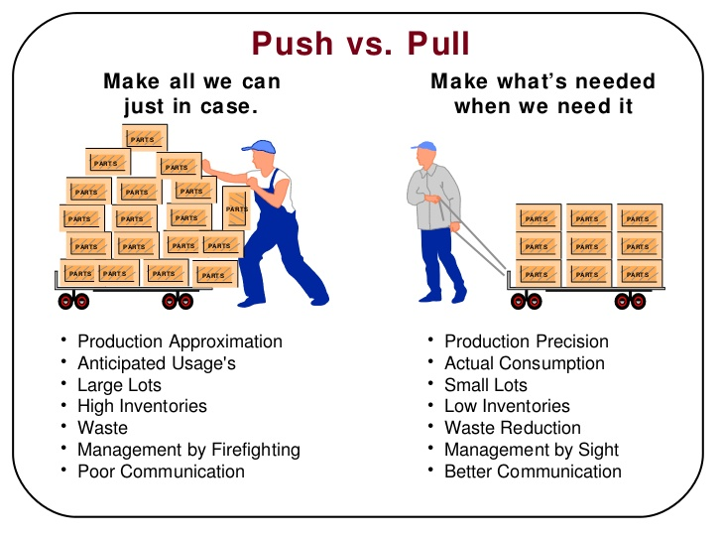
TOOLS
LEANACCOUNTING
Theory and Practices
Pull System

Slide 15
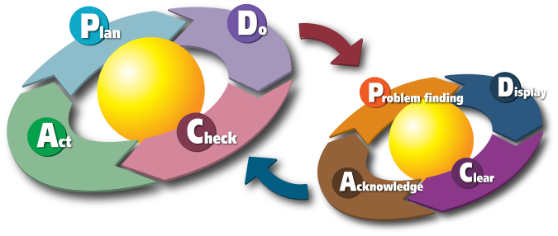

TOOLS
LEANACCOUNTING
Theory and Practices
Kaizen
Japanese for "improvement." When used in the business sense and applied to the workplace, kaizen refers to activities that continuously improve all functions and involve all employees from the CEO to the assembly line workers. It also applies to processes, such as purchasing and logistics, that cross organizational boundaries into the supply chain.
Methodology:

Slide 16
TOOLS
LEANACCOUNTING
Theory and Practices
Training Within Industry
The Training Within Industry (TWI) service was created by the United States Department of War, running from 1940 to 1945 within the War Manpower Commission. It was apparent that the shortage of trained and skilled personnel at precisely the time they were needed most would impose a hardship on those industries, and that only improved methods of job training would address the shortfall.
Job Instruction (JI) - a course that taught trainers (supervisors and experienced workers) to train inexperienced workers faster.
Job Methods (JM) - a course that taught workers to objectively evaluate the efficiency of their jobs and to methodically evaluate and suggest improvements.
Job Relations (JR) - a course that taught supervisors to deal with workers effectively and fairly.

Slide 17
ACCOUNTING PROCESS
LEANACCOUNTING
Theory and Practices
Visual Performance Measurement
Value Stream Costing
Target Costing
Tools: Box Scores

Slide 18

ACCOUNTING PROCESS
LEANACCOUNTING
Theory and Practices
Visual Performance Measurement
Principle 7 in The Toyota Way – use visual control so no problems are hidden
to see instantly what is going on in a workplace
to expose problems such as waste, ineffective systems, opportunities for improvement
empowers employees to use initiative
improve feedback between actions and outcomes

Slide 19
The Approach To Measurement
ACCOUNTING PROCESS
what is meaningful and has an impact on the company
those which are influenced by operators
non-financial measures
engaging employees, eradicating any blame culture
highlighting system problems and reducing waste

Slide 20
ACCOUNTING PROCESS
LEANACCOUNTING
Theory and Practices
Value Stream Costing
Cost and profitability reporting is achieved using Value Stream Costing, a simple summary direct costing of the value streams.
The value stream costs are typically collected weekly and there is little or no allocation of "overheads.” This provides financial information that can be clearly understood by everybody in the value stream which in turn leads to good decisions, motivation to lean improvement across the entire value stream, and clear accountability for cost and profitability.

Slide 21
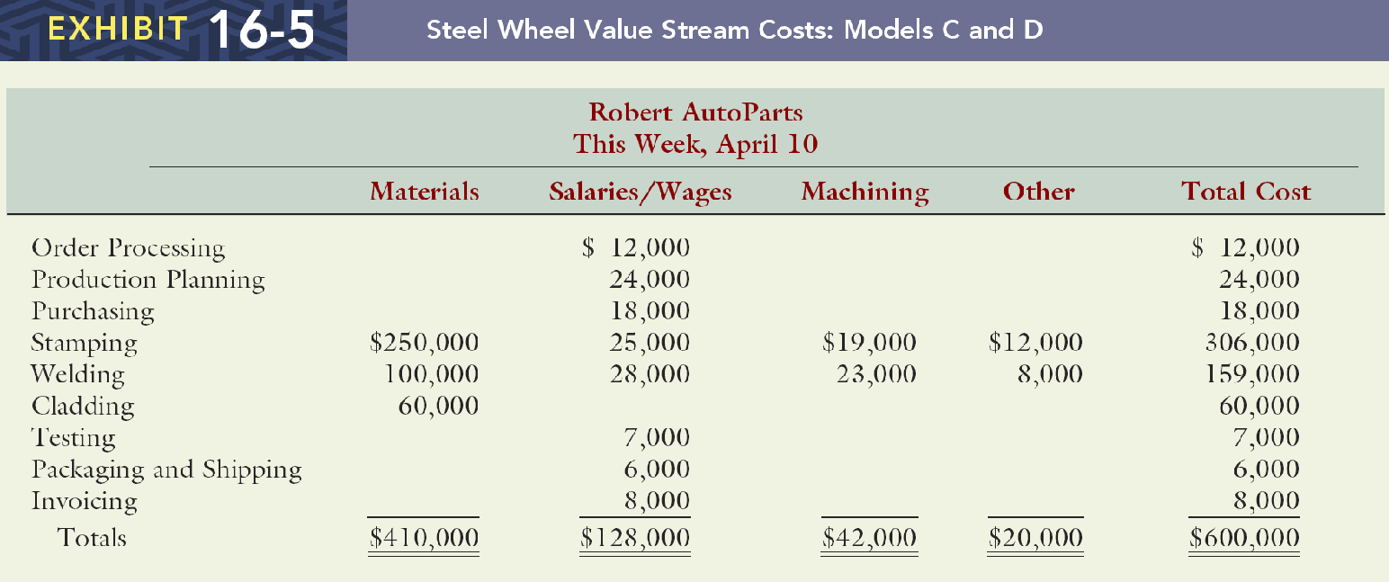

Slide 22
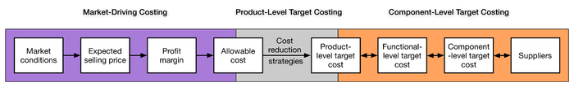
ACCOUNTING PROCESS
LEANACCOUNTING
Theory and Practices
Target costing
An approach to determine a product’s life-cycle cost which should be sufficient to develop specified functionality and quality, while ensuring its desired profit.
It involves setting a target cost by subtracting a desired profit margin from a competitive market price.
A target cost is the maximum amount of cost that can be incurred on a product, however, the firm can still earn the required profit margin from that product at a particular selling price.
Target costing decomposes the target cost from product level to component level. Through this decomposition, target costing spread the competitive pressure faced by the company to product’s designers and suppliers.

Slide 23
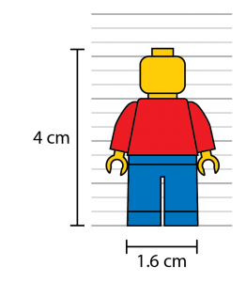
ACCOUNTING PROCESS
LEANACCOUNTING
Theory and Practices
Box-Scores
Box Scores are used widely within lean accounting. The standard format of the box score shows a 3-dimensional view of value stream performance; operational performance measurements, financial performance, and how the value stream capacity is being used.
The capacity information shows how much of the capacity within the value stream is used productively, how much is used to do non-productive activities, and how much value stream capacity is available for use.
The box score shows the value stream performance on a single sheet of paper and using a simple and accessible format.

Slide 24
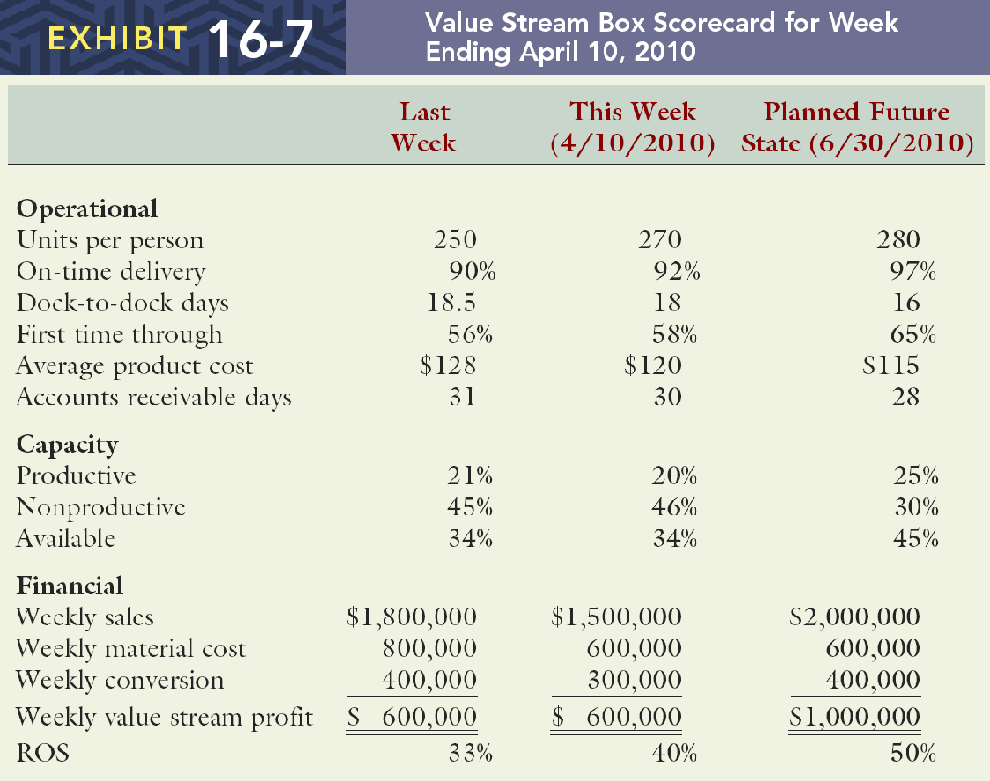
ACCOUNTING PROCESS
LEANACCOUNTING
Theory and Practices
Value Stream Costing Box-Scores

Slide 25

LEANACCOUNTING
Theory and Practices
PRACTICE
Applying Lean Accounting into business

Slide 26

SUCCES KEY
LEANACCOUNTING
Theory and Practices
Leadership
Process
People
Enablers
Strategy

Slide 27
Implement
LEANACCOUNTING
Theory and Practices
Principles | Practices | Tools
Customer Value | Follow customer demand and service/product profiling | Six Sigma Define, Measure, Analyze, Improve, Control
Value Stream Mapping | Visual Observation and Training | Analitycal dan commnunication tools RCCA Work Sequence, Standard Work in Process Box-Scores
Continuous Flow | Prevent bottlenecks in manufacturing process | Training Within Industry 5-S
Pull System | Matching rate of products and rate of sales | JIT, Kanban, Takt Time Work Cell Design Target Costing
Continuous Improvement | Never ending process on improving business | PDCA, Kaizen Value Stream Performance Board

Slide 28

DISCUSION
LEANACCOUNTING
Theory and Practices

