Slide 1
KSBS
Purnawan Junadi
2014

Slide 2
Motto
Tidak ada salah dalam
  bertanya,
  berkomentar,
  dalam berargumen
Yang salah yg
tidak bertanya,
tidak berkomentar
tidak berargumen

Slide 3
Motto
Silahkan tanya apa saja
Belum tentu saya bisa menjawab

Slide 4

Who Am I
Do you know your self?
Your advantages?
Your weaknesses
Do you know how to improve your self

Slide 5
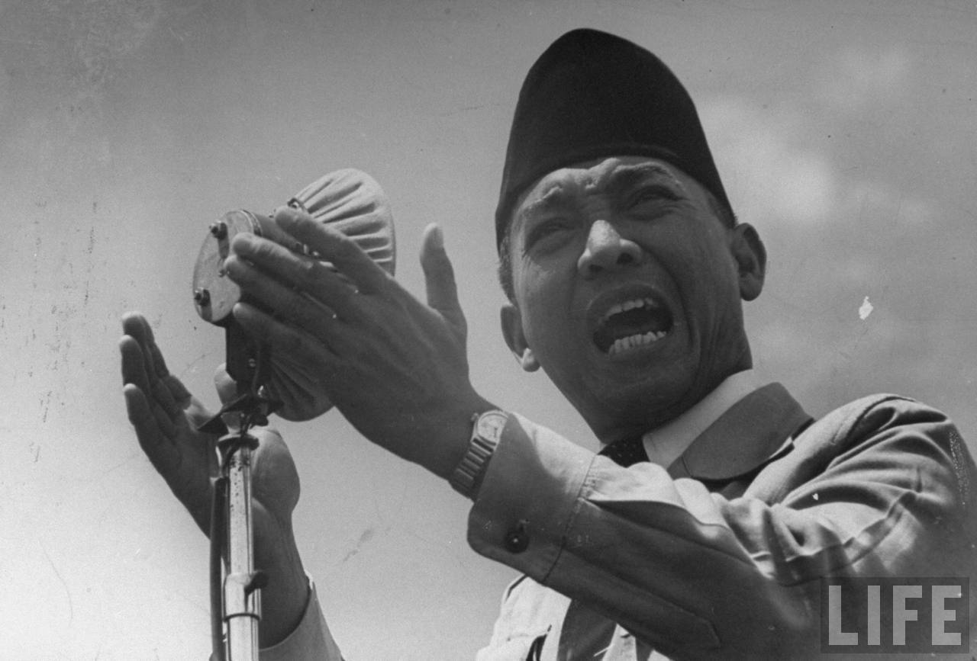
Siapa Pemimpin?
Notes:
BEM? MPM?
Ketua Kelas?

Slide 6
Apa kepemimpinan itu?

Slide 8

Kepemimpinan itu membebaskan
Bersabar Atas Rejeki yang kau terima
Bersyukur atas Musibah yang kau alami

Slide 9
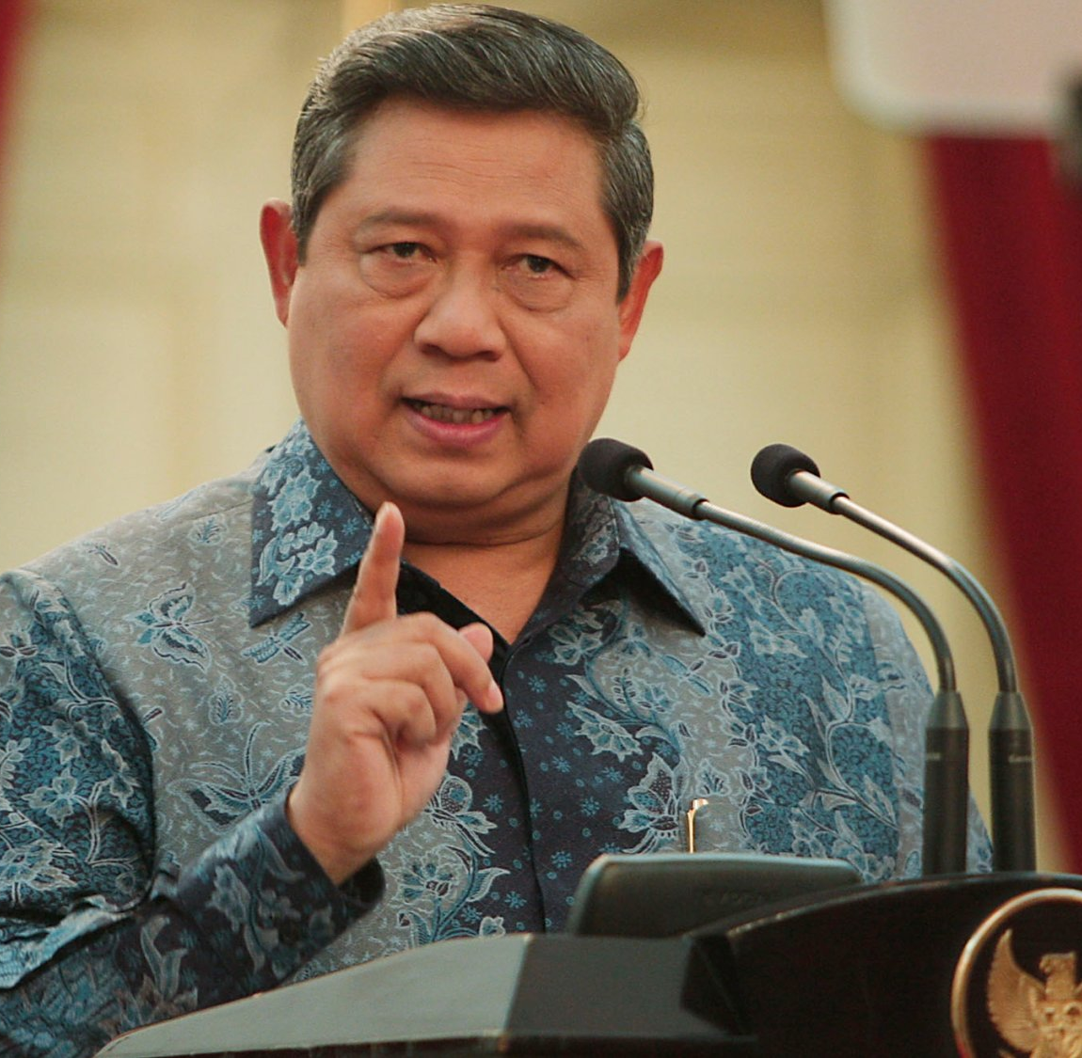
Siapakah Pemimpin?
Presiden
?

Slide 10

Siapa Pemimpin

Slide 11
Hadis
Semua kamu adalah pemimpin dan bertanggung jawab atas kepemimpinannya.
(HR Buchari)

Slide 12
Hadis
Dari Abdullah bin Umar r.a bahwa Rasulullah SAW bersabda: “Semua kamu adalah pemimpin dan bertanggung jawab atas kepemimpinannya. Seorang imam (amir) pemimpin dan bertanggung jawab atas rakyatnya. Seorang suami pemimpin dalam keluarganya dan bertanggung jawab atas kepemimpinannya. Seorang isteri pemimpin dan bertanggung jawab atas penggunaan harta suaminya. Seorang pelayan (karyawan) bertanggung jawab atas harta majikannya. Seorang anak bertanggung jawab atas penggunaan harta ayahnya. (HR. Bukhari)

Slide 13
Jadi Pemimpin Perlu jabatan?
Presiden, Governur, Bupati, Camat, Lurah, Ketua RW, Ketua RT?
Rektor, Dekan, Kepala departemen, Kepala Program Studi?
Ketua BEM, Ketua Kelas?

Slide 14

Siapa Bisa Jadi Pemimpin?

Slide 15
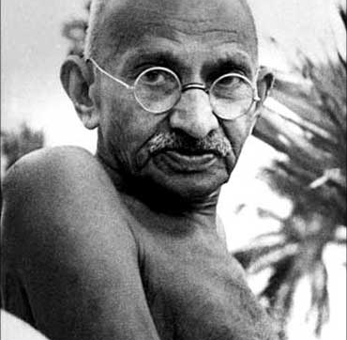

Apa syarat jadi Pemimpin
Keturunan ?
?

Slide 16


Oprah Winfrey Named Forbes' Most Influential Person of 2013

Slide 17
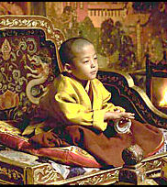
Apa Prasyarat jadi Pemimpin
Umur?
TOI India

Slide 18

Apa Prasyarat jadi Pemimpin
Bijaksana ?

Slide 19
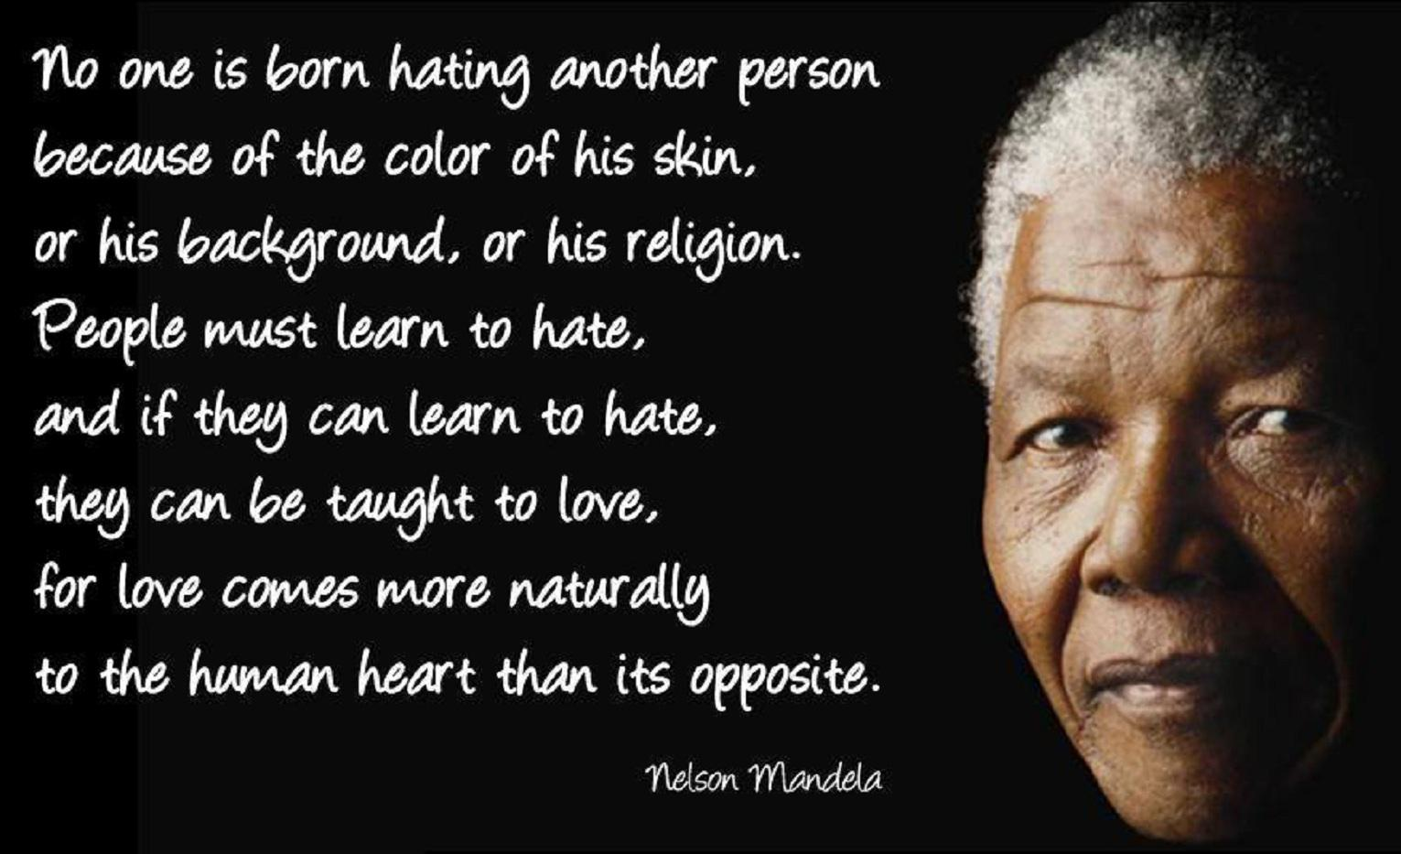
What is the Key Word?

Slide 20
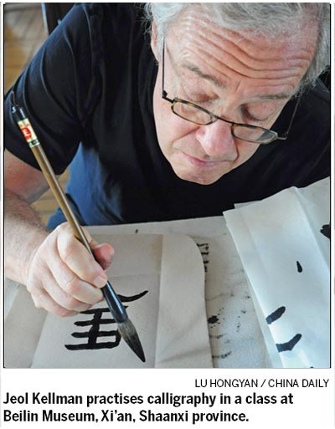
Learning

Slide 21
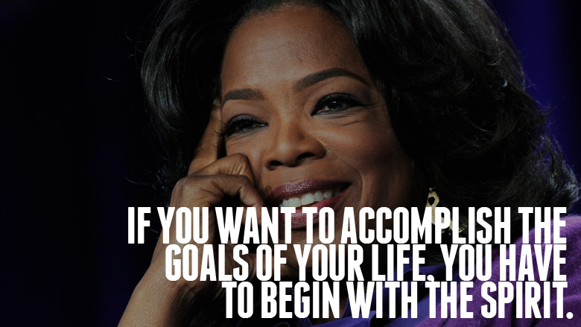
Learning key words

Slide 22

Impossible is Nothing !

Slide 23
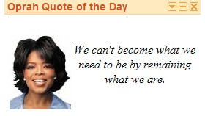
Learning key words

Slide 24
Mengapa sulit Berubah?
Dari ke pastian ke tidak pasti an
Menggelisahkan
Menakutkan

Slide 25
Mengapa takut Berubah?
Perubahan adalah kepastian
Menggelisahkan
Menakutkan

Slide 26
To learn is to move from comfort to discomfort
To be uncertain means to consider the possibility that our perceptions are wrong,
and that there are still many things we need to learn

Slide 27
Bagaimana mengubah yg kau PIMPIN?

Slide 28
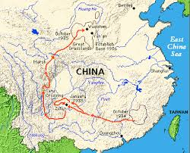
Long March MAO 1934-35
9600 km dalam 368 hari
Dari 87000 tentara menjadi tinggal kurang dari 10000
Leadership of a Dancing Guy

Slide 29
Leadership in Learning Organization
Ketrampilan nurturing change pada organisasi pembelajaran melalui:
1. Personal mastery
2. Mental models
3. Team learning
4. Systems thinking
5. Shared vision

Slide 30
Learning through the fifth discipline
MENTAL
MODEL
Visi
Bersama
Pembelajaran
individu
Berpikir
Sistem
Pembelajaran
tim
Keahlian
Pribadi
Pembelajaran
Tim

Slide 31
Leadership is skill
Sharpen personal mastery
Inspire shared visions
Align people, resources and practices.
Learn to listen, listen to learn
Nurture values and systems thinking

Slide 32
Kepemimpinan
Ilmu dan Seni
Logika dan Intuisi
Aturan dan Judgment

Slide 33
Belajar
Belajar: simbol mengumpulkan ilmu pengetahuan diatas anak yang berdiri di jalan pintu masuk
Berlatih terus: simbol burung yang belajar terbang, yang dapat dibagi lagi atas simbol terbang diatas simbol kepemudaan

Slide 34
With me ….so far ?

Slide 35
Learning through the fifth discipline
MENTAL
MODEL
Visi
Bersama
Pembelajaran
individu
Berpikir
Sistem
Pembelajaran
tim
Keahlian
Pribadi
Pembelajaran
Tim

Slide 36
Personal Mastery
“Personal mastery is the discipline of continually clarifying and deepening our personal vision, of focusing our energies, of developing patience, and of seeing reality objectively.”
Peter Senge, The Fifth Discipline, p 9

Slide 37

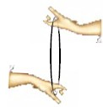

Creative Tension
Visi saya
Realitas
Saat ini
Lena

Slide 38
Learning through the fifth discipline
MENTAL
MODEL
Visi
Bersama
Pembelajaran
individu
Berpikir
Sistem
Pembelajaran
tim
Keahlian
Pribadi
Pembelajaran
Tim

Slide 39
Mental Model
Mental models are deeply ingrained assumptions, generalizations, or even pictures or images that influence how we understand the world and how we take action.”
Peter Senge, The Fifth Discipline, p.8

Slide 40

Sunset di Jogja ?

Slide 41


Slide 42
Learning through the fifth discipline
MENTAL
MODEL
Visi
Bersama
Pembelajaran
individu
Berpikir
Sistem
Pembelajaran
tim
Keahlian
Pribadi
Pembelajaran
Tim

Slide 43
Systems Thinking
The “Fifth Discipline” - a discipline for seeing things whole.
“Systems thinking is a … body of knowledge and tools that has been developed … to make full patterns clearer and to help us see how to change them effectively.”
Peter Senge: The Fifth Discipline, p7

Slide 44
System
A system is something that maintains its existence and functions as a whole through the interaction of its parts
A system has properties above and beyond the properties of the parts that comprise them. These are called “emergent” properties

Slide 45
Mengapa tidak berhasil
Mengapa pemberian tablet Fe pada ibu hamil dengan anemia tidak bisa menanggulangi anemia?
Mengapa meskipun diberikan PMT pemulihan untuk balita dengan malnutrisi diseluruh Indonesia, angka malnutrisi Balita tidak turun?

Slide 47
Siapa Bertanggung jawab?
15 % Kesalahan berkaitan dengan Orang
85 % Kesalahan berkaitan dengan System
Pemimpin bertanggung jawab mengatur system !

Slide 48
Learning through the fifth discipline
MENTAL
MODEL
Visi
Bersama
Pembelajaran
individu
Berpikir
Sistem
Pembelajaran
tim
Keahlian
Pribadi
Pembelajaran
Tim

Slide 49
Team Learning
The process of aligning and developing the capacity of a team
to create the results its members truly desire.

Slide 50
Diskusi Mahir
Debat yang kasar
Diskusi yang sopan
Dialog
Diskusi Mahir
Lebih
Konvensional
Lebih disesuaikan dengan sumber-sumber pemikiran kelompok dan membawanya ke permukaan

Slide 51
Insert Team Theme

Slide 52
Learning through the fifth discipline
MENTAL
MODEL
Visi
Bersama
Pembelajaran
individu
Berpikir
Sistem
Pembelajaran
tim
Keahlian
Pribadi
Pembelajaran
Tim

Slide 53
Vision
Personal Vision: “What do I want to happen or create?”
Shared Vision: “What do we want to happen or create?”

Slide 54
Personal and shared vision
Shared visions emerge from personal visions.
Personal visions come from an individual’s deep caring.
Shared visions come from a common caring.

Slide 55
Some issues
1. Should a vision be achievable under present conditions?
2. Should a vision really be shared by all?

Slide 57
People are not the problems of development
People are the solutions to the problems of development
Our people are our best resource
  Singapur !
  Jepang !

Slide 58


Slide 59
Think big
Beyond Imagination
That’s Impossible
Looks Difficult
Easy to do

Slide 60
Start small - Act now
  Blame no one,
    expect nothing,
        do something.

Slide 62
  Exercise everyday. Stop smoking. Eat nutritious food. Practice safer sex. Take vitamins daily. Sleep early. The quick brown fox jumped over the lazy dog. Now is the best time for all good men to come to the aid of their country. Less is more. Take long walks. Choose a sport and maintain fitness by practicing your sport regularly. Study and read daily. Have a medical checkup every year. See your dentist at least twice a year. Love everyone. Stop hate.

Slide 63
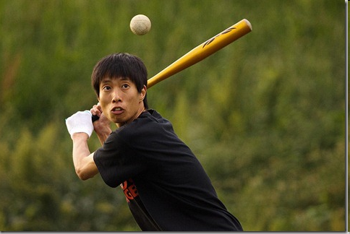
Exercise daily !

Slide 64
After log

Slide 66

Respons thd “Error”

Slide 67

Respons thd “Error”

Slide 68
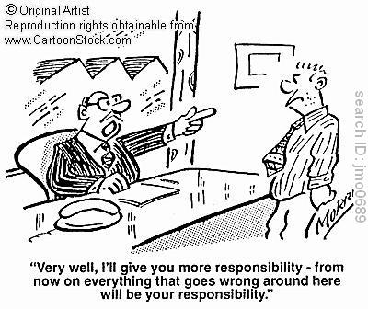
Respons thd “Error”
Externalize

Slide 69
Core problems and solutions may lie outside current awareness
Core problems
Low
High
Current awareness
Solutions

Slide 70
Paradigm shift
Unlearning must often taken place for true learning to happen
What counts most is what we learn when we think we already know everything

Slide 71
Organizations and change
Poor organizations do not change
Good organizations react quickly to change
Great organizations create change

Slide 72
Insert Believe Theme

