Slide 1
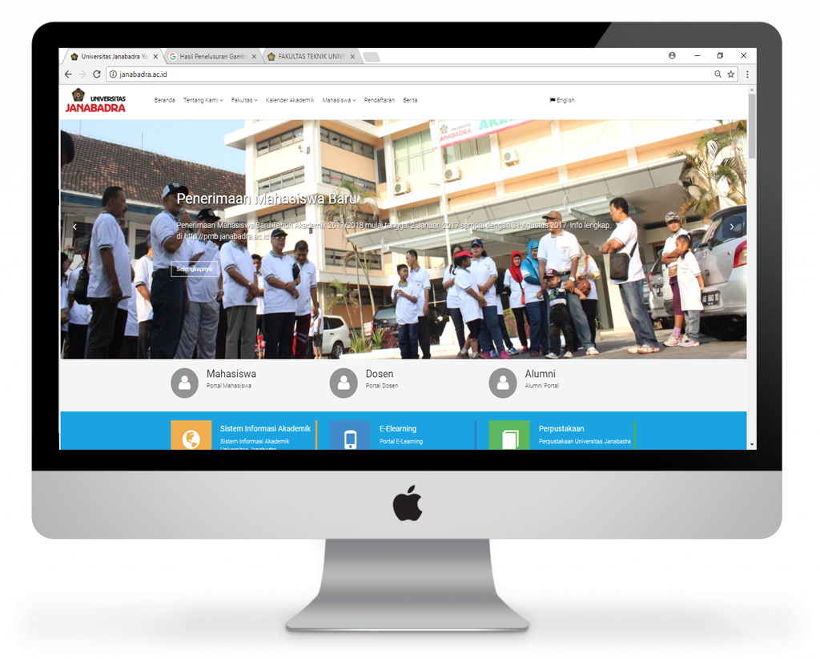
FRAMEWORK DALAM aplikasi web
Lecturer: Eri Haryanto, S.Kom., M.Kom.
Informatic Engineering of Universitas Janabadra
Notes:
NOTE:
To change the image on this slide, select the picture and delete it. Then click the Pictures icon in the placeholder to insert your own image.

Slide 2
Overview
Framework
Mengurangi redudancy pekerjaan yang terkait dengan kegiatan umum yang dilakukan dalam pengembangan web, misalnya:
menyediakan library untuk mengakses database,
framework template,
manajemen session,
adanya code reuse

Slide 3
Framework Update
Laravel https://laravel.com/
Phalcon https://phalconphp.com/en/
Symfony https://symfony.com/
CodeIgniter https://www.codeigniter.com/
CakePHP http://cakephp.org/
Zend https://framework.zend.com/
FuelPHP http://fuelphp.com/
Slim http://www.slimframework.com/
Phpixie https://phpixie.com/
Fat-Free https://fatfreeframework.com/home
Aura http://auraphp.com/
SilverStripe https://www.silverstripe.org/software/framework

Slide 4
Framework Logos

Slide 5
Pilih Mana???

Slide 6
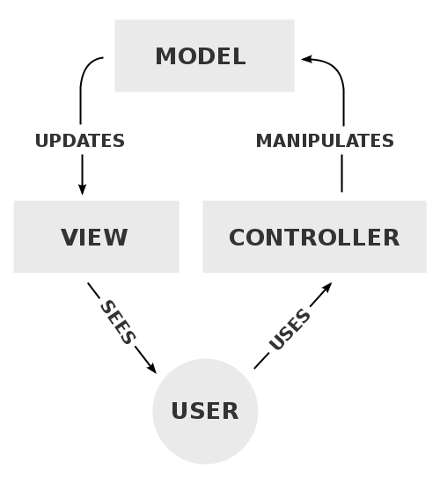
MVC Technology or Concept
Kebanyakan aplikasi framework berdasarkan pada pola model-view-controller(MVC)
Memisahkan layer tampilan, database dan routing halaman

Slide 7
Separate of MVC Concept
Model
Handles all the "business logic" of the application
Stores the application state
View
Responsible for generating a view for the user of the data from the model
Usually a simple templating system to display the data from the model
Controller
Responsible for taking input from the user, fetching the correct data from the model, then calling the correct view to display the data
Should be very simple

Slide 8
Framework Feature
MVC
PUSH DAN PULL
AJAX
FORM VALIDATION
CACHING
SECURITY
TEMPLATE
Framework

Slide 9
Discussion Materials
Pelajari Konsep Framework khususnya framework dalam aplikasi web

