Slide 1
Business Intelligence and Analytics:
Session 1: Business Intelligence, Data Science and Data Mining

Slide 2
Meta Introduction:
Overall goals of this class
 Know how to solve business problems by data-analytic thinking
 Have an overview about principles of how to model and how to solve business problems in a non-rigorous manner
 Know several tools and ways of how to practically implement solution methods

Slide 3
Main focus areas
 Data Warehousing / Data Engineering
   How to store and access huge amounts of data?
 Data Mining / Data Science
   How to derive knowledge and profitable business action out of large databases?
 Simulation
   How to model and analyse complex relationships in order to derive profitable business action?

Slide 4
Main literature
Provost, F.; Fawcett, T.: Data Science for Business; Fundamental Principles of Data Mining and Data- Analytic Thinking. O‘Reilly, CA 95472, 2013.
Steve Williams: Business Intelligence Strategy and Big Data Analytics, Morgan Kaufman Elsevier, 2016
Michael R. Berthold, Christian Borgelt, Frank Höppner, Frank Klawonn, Guide to Intelligent Data Analysis, Springer-Verlag London Limited, 2010
Carlo Vecellis, Business Intelligence, John Wiley & Sons, 2009
Eibe Frank, Mark A. Hall, and Ian H. Witten : The Weka Workbench, M Morgan Kaufman Elsevier, 2016.
Jason Brownlee, Machine Learning Mastery With Weka, E-Book, 2017
Nikhil Ketkar, Deep Learning with Python, Apress, 2017
François Chollet, Deep Learning with Python, Manning Publications Co., 2018.

Slide 5

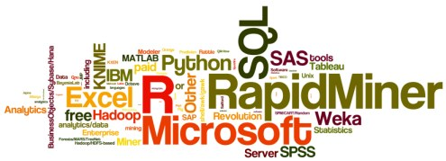
Software
The 15th annual KDnuggets Software Poll
https://www.kdnuggets.com/polls/2014/analytics-data-mining-data-science-software-used.html
Huge attention from analytics and data mining community and vendors, attracting over 3,000 voters.

Slide 6
Software
The top 10 tools by share of users were
  RapidMiner, 44.2% share ( 39.2% in 2013)
  R, 38.5% ( 37.4% in 2013)
  Excel, 25.8% ( 28.0% in 2013)
  SQL, 25.3% ( na in 2013)
  Python, 19.5% ( 13.3% in 2013)
  Weka, 17.0% ( 14.3% in 2013)
  KNIME, 15.0% ( 5.9% in 2013)
  Hadoop, 12.7% ( 9.3% in 2013)
  SAS base, 10.9% ( 10.7% in 2013)
  Microsoft SQL Server, 10.5% (7.0% in 2013)

Slide 7
Decision Support Systems
 Decision Support Systems in the broadest sense can be defined as
   Computer technology solutions that can be used to support complex decision making and problem solving. [Shim et al. 2002]
 Broad definition that encompasses many areas
   Application systems
   Mathematical modeling
   Data driven modeling
   Subjective modeling

Slide 8
Ubiquity of data opportunities
Technological development
   More powerful computers, networks, algorithms
 Collect data throughout the enterprise
   Operations, manufacturing, supply-chain management, customer behavior, marketing campaigns, …
 Exploit data for competitive advantage

Slide 9

Business Intelligence: Definition (1/2)
 There is no unique or mathematical definition of Business Intelligence
 The Data Warehousing Institute defines Business Intelligence as…
  The process, technologies and tools needed
    to turn data into information,
    information into knowledge and
    knowledge into plans that drive profitable business action.
  Business intelligence encompasses data warehousing, business analytics tools, and content/knowledge management.
   http://www.tdwi.org/

Slide 10
Benefits of Business Intelligence (1/2)
 Increased profitability
   Distinguish between profitable and non-profitable customers
 Decreased costs
   Lower operational costs, improve logistics management
 Improved Customer-Relationship-Management
   Analysis of aggregated customer information to provide better customer service, increase customer loyalty
 Decreased risk
   Apply Business Intelligence methods to credit data can improve credit risk estimation

Slide 11
Benefits of Business Intelligence (2/2)
Business Intelligence can help improve businesses in a variety of fields:
Customer analysis → customer profiling
Behavior analysis → fraud detection, shopping trends, web activity, social network analysis
Human capital productivity analysis
Business productivity analysis → defect analysis, capacity planning and optimization, risk management
Sales channel analysis
Supply chain analysis → supply and vendor management, shipping, distribution analysis

Slide 12

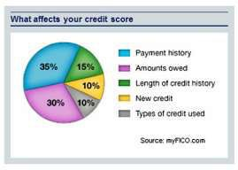

Some more examples
 Marketing
 Online advertising
 Recommendations for cross-selling
 Customer relationship management
 Finance
 Credit scoring and trading
 Fraud detection
 Workforce management
 Retail
 Wal-Mart, Amazon etc.

Slide 13

Example 2: Predicting customer churn
 Many cellphone companies have major problems
with customer retention
 Cellphone market is saturated
 Customer churn is expensive for companies
 Keep your customers by predicting who should get a retention offer

Slide 14
Data science vs. data mining
 Data science: a set of fundamental principles that guide the extraction of knowledge from data
 Data mining: extraction of knowledge from data via tools/ technologies that incorporate the principles
 In this class, we do both!

Slide 15
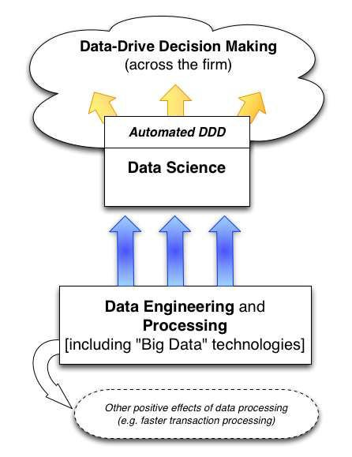
Data Driven Decision-making (DDD)
 DDD: practice of making decisions based on the analysis of data (rather than intuition)
 Type-1 decision: “discover”
something new in your data
 Wal-Mart/Target example
 Type-2 decision: repeat decisions at massive scale (automatic decision making)
 Customer churn example

Slide 16
CONCLUSION
Success in today’s data-oriented business environment requires being able to think about how these fundamental concepts apply to particular business problems—to think data analytically.
An understanding of these fundamental concepts is important not only for data scientists themselves, but for any one working with data scientists, employing data scientists, investing in data-heavy ventures, or directing the application of analytics in an organization.
Understanding the process and the stages helps to structure our data-analytic thinking, and to make it more systematic and therefore less prone to errors and omissions.

Slide 17
Literature
Provost, F.; Fawcett, T.: Data Science for Business; Fundamental Principles of Data Mining and Data- Analytic Thinking. O‘Reilly, CA 95472, 2013.
Steve Williams: Business Intelligence Strategy and Big Data Analytics, Morgan Kaufman Elsevier, 2016
Michael R. Berthold, Christian Borgelt, Frank Höppner, Frank Klawonn, Guide to Intelligent Data Analysis, Springer-Verlag London Limited, 2010
Carlo Vecellis, Business Intelligence, John Wiley & Sons, 2009
Eibe Frank, Mark A. Hall, and Ian H. Witten : The Weka Workbench, M Morgan Kaufman Elsevier, 2016.
Jason Brownlee, Machine Learning Mastery With Weka, E-Book, 2017
Nikhil Ketkar, Deep Learning with Python, Apress, 2017
François Chollet, Deep Learning with Python, Manning Publications Co., 2018.
Sharda, R., Delen, D., Turban, E., (2018). Business intelligence, Analytics, and Data Science: A Managerial Perspective, 4th Edition, Pearson.

