Slide 1
Business Intelligence and Business Analytics
Session 2: Business Problems and Data Science Solutions

Slide 2
Agenda
 The need for data mining
 From business problems to data mining tasks
 Supervised vs. unsupervised methods
 The data mining process

Slide 3
The need for data mining
 “80% of the knowledge of interest in a business context can be extracted from data using conventional tools.”
   reporting
   query-languages (SQL, QBE, …)
   OLAP and spreadsheets
 Disadvantages of the conventional tools:
   Often quite simple questions can be answered only
   Automation difficult
   Only small amounts of data may be handled (esp. spreadsheets)
   Only primitive statistical methods involved
   OLAP: query-focused and low complexity of analysis

Slide 4
Major roots of data mining
Data Mining
Statistics
Machine learning / AI
Business economics / marketing
Database systems
„business application“
view
„mathematical modeling“
view
„computational algorithm“
view
„data processing“
view

Slide 5
Data mining: definition (1/3)
data mining
large datasets
observational data
relationships and summaries
novel
understandable

Slide 6
Data mining: definition (2/3)
 Useful definition:
  “Data mining is the analysis of (often large) observational data sets to find unsuspected relationships and to summarize the data in novel ways that are both understandable and useful to the data owner.” [Hand, Mannila, Smyth]
 Key elements of the definition:
 Often large datasets:
 Small datasets ⇒ exploratory data analysis in statistics
 Large datasets (as they exist in DWHs) provoke new problems
 Storage and access of data, runtime issues
 Determination of representativeness of data
 Difficulty to decide whether an apparent relationship is merely a chance occurrence or not
 Standard statistical approaches may fail, due to nature of sample data

Slide 7
Data mining: definition (3/3)
 Observational data:
 Data often collected for some other purpose than data mining
⇒ Objectives of the data mining exercise play no role in data collection strategy
 e.g., DWH data relying on an airline reservation system or a bank account administration system
 opposite: experimental data (as it is used quite often in statistics)
 Relationships and summaries:
 often referred to as models or patterns
 e.g., linear equations, tree structures, clusters, patterns in time series, …
 Novel:
 Novelty should be measured relative to users prior knowledge
 Understandable:
 Novelty is not sufficient to qualify relationships worth finding
 Simple relationships may be preferred to complicated ones

Slide 8
Model vs. pattern
► In data mining, different kinds of relations are expressed in different ways of representations.
► Representations of relations may be characterized by the distinction of global models and local patterns.
Model:
Pattern:
 A model is a global summary of a data set
 Makes statements about any point in the full measurement space
 Example of a simple
model structure:
Y= ax+c
Example of a simple model:
𝑦 = 2𝑥 + 3.5
 Make statements only about restricted regions of the space spanned by the variables
 Only a few data records may behave in the specified way
 Example of a simple pattern structure:
 Example of a simple pattern:

Slide 9


Illustration of model vs. pattern
► Analogy (not perfect, but illustrative):
Transmitting an Image I from a transmitter T to a receiver R
Two possible strategies:
  Transmit pixels of I exactly
  Transmit compressed version of I (≈ data mining)
Compression may be achieved by transformation to a smaller resolution
⇒ reconstruction of a summary of the whole picture possible
⇒ loss in fidelity describing special local parts of the image
(“partially obscured circular object in the upper left corner of the picture”)
⇒ reconstruction of a summary of the whole picture not possible
10

Slide 10
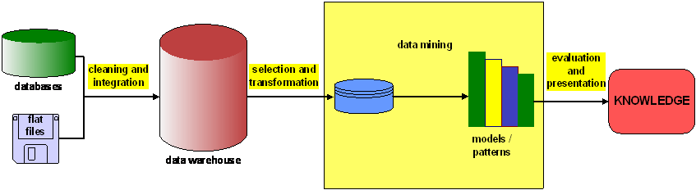
Data mining in the context of the KDD process
► Data mining is often set in the broader context of knowledge discovery in databases (KDD)
► The precise boundaries of the data mining part within the KDD process are not easy to state
► Alternative, more industry-driven view of KDD:
CRISP

Slide 11
Related techniques and technologies: Statistics
 Meaning 1: “Catch-all term” for the computation of particular numeric values of interest from data
 “Summary statistics”: sums, averages, rates
 Consider distribution of data
 E.g. distribution of income may be highly skewed
 Mean income $60,000, median income $44,389 (US 2004)
 Meaning 2: Statistics as a field
 Understand different data distributions
 How to use data to test hypotheses
 Estimate uncertainty of conclusions
 Many of the DM techniques have their roots in statistics
 Quantification of uncertainty by confidence intervals

Slide 12
Related techniques and technologies: Database querying
A query is a specific request for a subset of data or for statistics about data, formulated in a technical language and posed to a database system
  Structured Query Language (SQL)
  Query-By-Example (QBE)
No discovery of patterns or models
Appropriate when an analyst already has an idea of what might be an interesting subpart of the data
Extract the data you need for DM

Slide 13
Related techniques and technologies: Data Warehousing and OLAP
 Data Warehouses collect data from across an enterprise, often from multiple transaction- processing systems
 May be seen as a facilitating technology of DM
 OLAP provides an easy-to-use GUI to explore large data collections, often in a Data Warehouse context
 Dimensions of analysis must be pre-programmed into the OLAP system
 No modeling or automatic pattern finding

Slide 14
Agenda
 The need for data mining
 From business problems to data mining tasks
 Supervised vs. unsupervised methods
 The data mining process

Slide 15
Introduction
 Data mining is a process with well-understood
stages based on
 application of information technology
 analyst‘s creativity
 business knowledge
 common sense
 We look at typical tasks and examples, then at the
process

Slide 16
From business problems to data mining
 Decompose a data analytics problem into pieces such that you can solve a known task with a tool
 There is a large number of data mining algorithms available, but only a limited number of data mining tasks
 We will illustrate the fundamental concepts based on
   Classification
   Regression

Slide 17
Classification
 Classification attempts to predict, for each individual in a population, which of a (small) set of classes that individual belongs to
 “Among all the customers of a cellphone company,
which are likely to correspond to a given offer?”
 Classification algorithms provide models that determine which class a new individual belongs to
 Classification is related to scoring

Slide 18
Regression
 Regression (value estimation) attempts to estimate or predict, for each individual, the numerical value for that individual
 “How much will a given customer use the service?”
   Predicted variable: service usage
 Generate regression model by looking at other, similar individuals in the population

Slide 19
Similarity matching
 Similarity matching attempts to identify similar individuals based on the data known about the individuals
 Find similar entitites
 Basis for making product recommendations
   Find people who are similar to you in terms of the products they have liked or purchased
20

Slide 20
Clustering
 Clustering attempts to group individuals in a population together by their similarity, but without regard to any specific purpose
 Do customers form natural groups or segments?
 Result: groupings of the individuals of a population
 Useful in preliminary domain exploration

Slide 21

Co-occurence grouping
Attempts to find associations between entities based on transactions involving them aka association rules or market-basket analysis
“What items are commonly purchased together?”
Considers similarity of objects based on their appearing together in transactions
Included in recommendation systems (people who bought X also bought Y)
Result: a description of items that occur together

Slide 22

Profiling
 Attempts to characterize the typical behavior of a
group or population
 Aka behavior description
 “What is the typical cellphone usage of this customer segment?”
 Often used to establish behavioral norms for anomaly detection (fraud detection)

Slide 23

Some more data mining tasks
 Link prediction attempts to predict connections
between data items (→ social network systems)
 Since you and Karen share ten friends, maybe you‘d like to be Karen‘s friend?
 Data reduction attempts to take a large data set of data and replace it with a smaller set of data that contains the relevant information
 Easier processing, but often loss of information

Slide 24
Agenda
 The need for data mining
 From business problems to data mining tasks
 Supervised vs. unsupervised methods
 The data mining process

Slide 25
Supervised vs. unsupervised
“Do our customers naturally fall into different groups?” → no specific target → unsupervised
“Can we find groups of customers who have particularly high likelihoods of cancelling their service soon after their contracts expire?”
→ specific target → supervised
Supervised and unsupervised tasks require different techniques
There is no guarantee that unsupervised tasks provide meaningful results

Slide 26
Supervised and unsupervised techniques
 Classification and regression are generally solved with supervised techniques
 Clustering, co-occurence grouping, and profiling are
generally unsupervised
 Similarity matching and link prediction could be
either

Slide 27
Examples
 Will this customer purchase service S1 if given
incentive I? → classification problem
 Which service package (S1, S2, or none) will a
customer purchase if given incentive I?
→ classification
 How much will this customer use the service?
→ regression

Slide 28
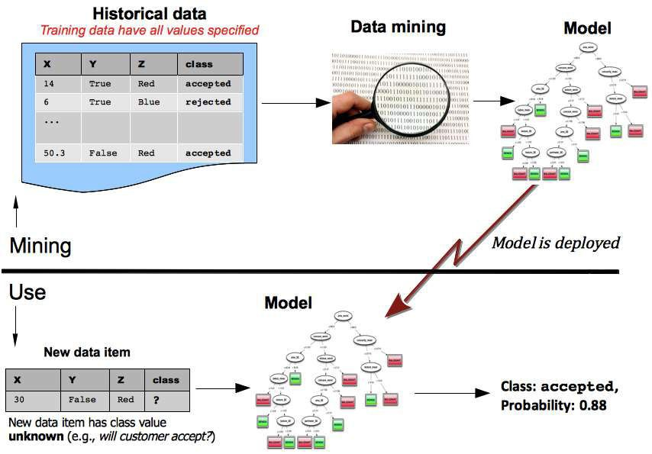
Data mining and its use

Slide 29
Agenda
 The need for data mining
 From business problems to data mining tasks
 Supervised vs. unsupervised methods
 The data mining process
30

Slide 30
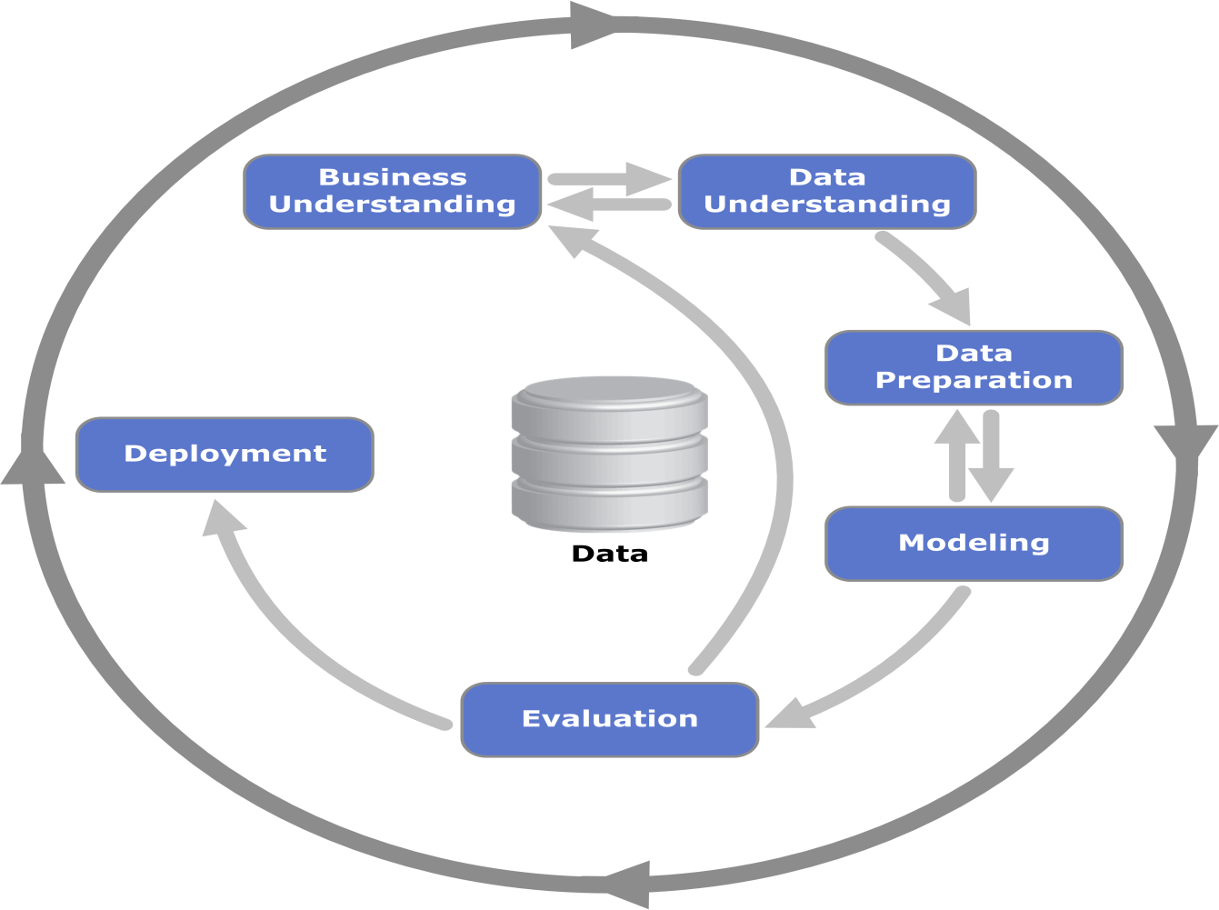
CRISP - DM
Iteration is the rule rather than the exception
Notes:
Iteration is the rule rather than the exception. Going through the process once without having solved the problem is not a failure. After the first iteration the data science team knows much more.
CRISP-DM, which stands for Cross-Industry Standard Process for Data Mining, is an industry-proven way to guide your data mining efforts. 
As a methodology, it includes descriptions of the typical phases of a project, the tasks involved with each phase, and an explanation of the relationships between these tasks. 
As a process model, CRISP-DM provides an overview of the data mining life cycle. The life cycle model consists of six phases with arrows indicating the most important and frequent dependencies between phases. The sequence of the phases is not strict. In fact, most projects move back and forth between phases as necessary.
The CRISP-DM model is flexible and can be customized easily. For example, if your organization aims to detect money laundering, it is likely that you will sift through large amounts of data without a specific modeling goal. Instead of modeling, your work will focus on data exploration and visualization to uncover suspicious patterns in financial data. CRISP-DM allows you to create a data mining model that fits your particular needs. In such a situation, the modeling, evaluation, and deployment phases might be less relevant than the data understanding and preparation phases. However, it is still important to consider some of the questions raised during these later phases for long-term planning and future data mining goals.

Slide 31
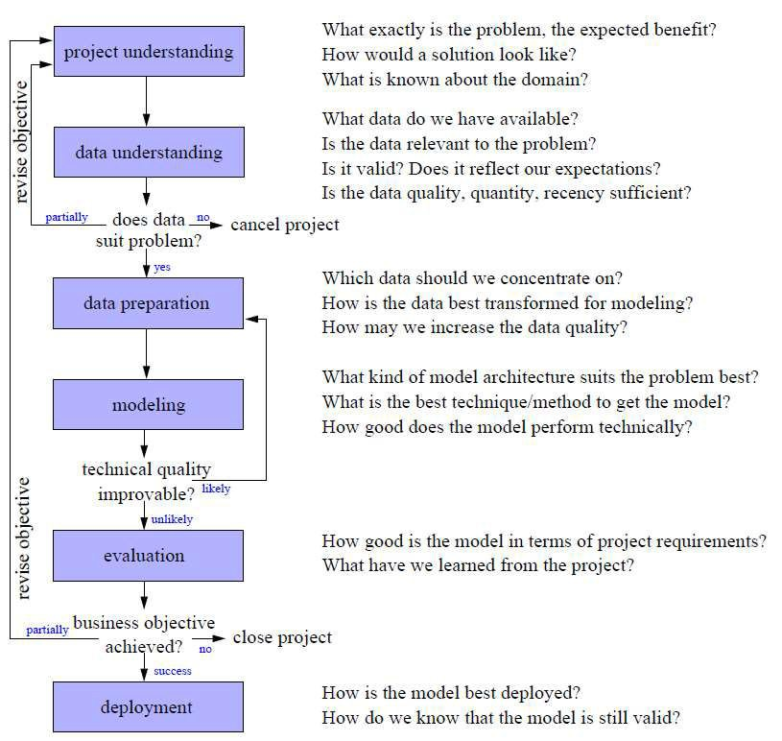
CRISP-DM
 Cross
Industry Standard Process for Data Mining
 Iteration as a rule
 Process of data exploration

Slide 32
CRISP: Project understanding
 Understand the problem to be solved!
 Designing the solution is an iterative process of discovery
 Analyst’s creativity plays an important role
 Structure the problem such that one or more subproblems involve building models for classification, regression, …

Slide 33
CRISP: Data Understanding
 Data are the available raw materials from which the solution will be built
 Historical data are often collected for purposes unrelated to the current business problem
 Estimate costs and benefits of each data source
   Is further investment merited?
 Match business problem to one or several data mining tasks

Slide 34
CRISP: Data preparation
 Data often need to be manipulated and converted
into forms that yield better results
 Convert data to tabular format
 Remove or infer missing values
 Convert data to different types
 Match data and requirements of DM techniques
 Select the relevant variables
 Normalize or scale numerical variables

Slide 35
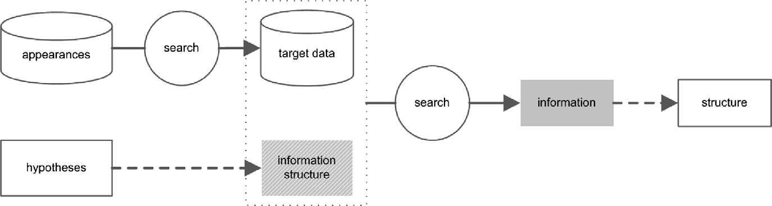
CRISP: Modeling
This is the primary place where DM techniques are applied to the data
This will be a core part of this class!
But: we will look into the details later.
© Meisel, Mattfeld (2010)

Slide 36

CRISP: Evaluation (1/2)
 Assess the DM results rigorously
 Gain confidence that results are valid and reliable
 Ensure that the model satisfies the original
business goals (support decision making!)
 Example: spam detection
 A spam detection model may be extremely accurate
 Evaluation shows that it produces too many false alarms
 What is the cost of dealing with false alarms?

Slide 37
CRISP: Evaluation (2/2)
 Stakeholders need to “sign off” on the deployment of the models
 Ensure comprehensibility of the model to stakeholders
Comprehensive evaluation “in production” is difficult
  Evaluation framework needed (testbed environments)
 Design experiments for tests in live systems
 Behavior may change due to model deployment

Slide 38
CRISP: Deployment
Models are put into real use in order to realize some return on investment
     Implement a predictive model in some business process
     Example: predict the likelihood of churn in order to send special offers to customers who are predicted to be particularly at risk
Trend: DM techniques themselves are deployed
     Systems automatically build and test models in production
  Rule discovery: simply use discovered rules
“Your model is not what the data scientists design, it’s what the engineers build.”
Involve data scientists into final deployment

Slide 39
Why DM is different from software development
 CRISP looks similar to a software development cycle
 But: DM is closer to research (explorative analysis) than it is to engineering
   Outcomes are far less certain
   Results may change the fundamental understanding of problem
   Do not deploy results of DM directly
 DM requires skills that may not be common among programmers
   Formulate problems well, analyze results
   Prototype solutions quickly
   Design experiments that represent good investments
   Make reasonable assumptions for ill-structured problems

Slide 40
Examples for business questions and DM approaches (1/2)
 Who are the most profitable customers?
   Straightforward database query if “profitable” can be defined clearly based on existing data
  Standard query tool
 Is there really a difference between the profitable customers and the average customer?
   Question about hypothesis
   Statistical hypothesis testing required
40

Slide 41
Examples for business questions and DM approaches (2/2)
 But who really are these customers? Can I characterize them?
   Individual customers: database query
   Summary statistics
   Deeper analysis: determine characteristics that differentiate profitable customers from the rest (→ DM)
 Will a given new customer be profitable? How much revenue should I expect this customer to generate?
   DM techniques that examine historical customer records and produce predictive models of profitability

Slide 42
Conclusion
To a business manager, the data mining process is useful as a framework for analyzing a data mining project or proposal. The process provides a systematic organization, including a set of questions that can be asked about a project or a proposed project to help understand whether the project is well conceived or is fundamentally flawed.

Slide 43
References
Provost, F.; Fawcett, T.: Data Science for Business; Fundamental Principles of Data Mining and Data- Analytic Thinking. O‘Reilly, CA 95472, 2013.
Carlo Vecellis, Business Intelligence, John Wiley & Sons, 2009
Eibe Frank, Mark A. Hall, and Ian H. Witten : The Weka Workbench, M Morgan Kaufman Elsevier, 2016.

