Slide 1
Business Intelligence and Business Analytics
Session 3
: Project Understanding, Data Understanding and Data Preparation

Slide 2
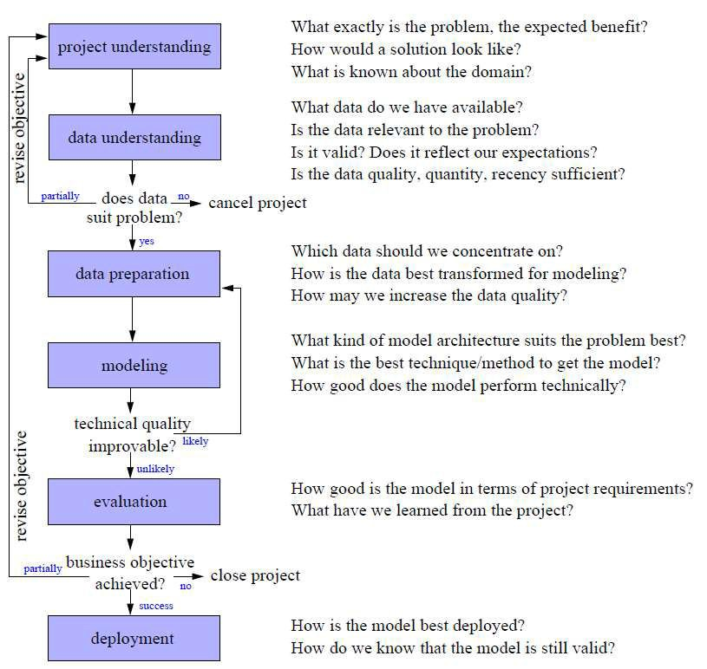
CRISP-DM
 Cross
Industry Standard Process for Data Mining
 Iteration as a rule
 Process of data exploration

Slide 3
Agenda
Project Understanding
Data Understanding I
 Attribute Understanding
 Data Quality
 Data Visualization

Slide 4
Project understanding
 Problem formulation
 Map the problem formulation to a data analysis task
 Understand the situation (available data, suitability
of the data, …)
 Average time spent for project and data understanding within the CRISP-DM model: 20%
 Importance for success: 80% (Contribution to Success)

Slide 5
Determine the project objective
 The aim of the project should be clearly defined
 Criteria to measure the success of the project should be agreed upon
 Example:
   Objective: increase revenues (per campaign and or/per customer) in direct mailing campaigns by personalized offer and individual customer selection
   Deliverable: software that automatically selects a specified number of customers from the database to whom the mailing shall be sent, runtime max. half-day
   Success criteria: improve order rate by 5% or total revenues by 5%, measured within 4 weeks after mailing was sent

Slide 6
Problems between domain and data analysis expert
Problem source | Project owner perspective | Analyst perspective
Communication | Does not understand the technical terms of the analyst | Does not understand the terms of the domain
Lack of understanding | Was not sure what the analyst could do or achieve | Found it hard to understand how to help the project owner
Organization | Requirements had to be adopted in later stages as problems with data became evident | Project owner was an unpredictable group (not so concerned with the project)

Slide 7
Assess the situation (1/2)
 Estimate chances of a successful data analysis project
   Resources (data!), requirements and risks
 Does the given data satisfy the project‘s needs?
 Typical requirements and constraints:
   Model requirements
  e.g., model has to be explanatory, because decisions must be justified clearly
   Ethical, political, legal issues
  e.g., variables such as gender, age, race must not be used
 Technical constraints
  e.g., applying the technical solution must not take more than n seconds
10

Slide 8
Assess the situation (2/2)
 Assumptions
   Representativeness: If conclusions about a specific target group are to be derived, a sufficiently large number of cases from this group must be contained in the database and the sample in the database must be representative for the whole population
   Informativeness: To cover all aspects by the model, most of the influencing factors (identified in the cognitive map) should be represented by attributes in the database.
   Good data quality: The relevant data must be correct, complete, up-to-date and unambiguous thanks to the available documentation.
   Presence of external factors: We may assume that the external world does not change constantly

Slide 9
Determine analysis goals (1/3)
 Determine DM tasks
   Classification, regression, cluster analysis, …
 Specify the requirements for the models that will be constructed by the DM tasks
 There is no unique best method for a task
 Interpretability
   If the goal of the analysis is a report that sketches possible explanations for a certain situation, the ultimate goal is to understand the delivered model.
   For some black box models it is hard to comprehend how the final decision is made, and their model lacks interpretability.

Slide 10
Determine analysis goals (2/3)
 Reproducibility/stability
   If the analysis is carried out more than once, we may achieve similar performance – but not necessarily similar models.
   This does no harm if the model is used as a black box, but hinders a direct comparison of subsequent models to investigate their differences.
 Model flexibility/adequacy
   A flexible model can adapt to more (complicated) situations than an inflexible model, which typically makes more assumptions about the real world and requires less parameters.
   If the problem domain is complex, the model learned from data must also be complex to be successful. With flexible models the risk of overfitting increases (see class 10).

Slide 11
Determine analysis goals (3/3)
 Runtime
   If restrictive runtime requirements are given (either for building or applying the model), this may exclude some computationally expensive approaches.
 Interestingness and use of expert knowledge
   The more an expert already knows, the more challenging it is to surprise her with new findings.
   Some techniques are known for their large number of findings, many of them redundant and thus uninteresting.
   So if there is a possibility of including any kind of previous knowledge, this may ease the search for the best model considerably and may prevent us from re-discovering too many well-known artefacts.

Slide 12
CRISP-DM
 Cross
Industry Standard Process for Data Mining
 Iteration as a rule
 Process of data exploration

Slide 13
Agenda
Project Understanding
Data Understanding I
 Attribute Understanding
 Data Quality
 Data Visualization

Slide 14

Goals of data understanding
 Gain general insights about the data (independent
of the project goal)
 Checking the assumptions made during the project understanding phase (representativeness, informativeness, data quality, presence/absence of external factors, dependencies, …)
 Checking the specified domain knowledge
 Suitability of the data for the project goals
 Never trust any data as long as you have not carried out some simple plausibility checks!

Slide 15
Attribute understanding
 We often assume that the data set is provided in
form of a simple table
 | Attribute 1 | … | Attribute M
Record 1
…
Record n
 The rows of the table are called instances, records or data objects
 The columns of the table are called attributes, features or variables

Slide 16
Types of attributes
 Categorical (nominal): finite domain. The values of a categorical attribute are often called classes or categories
   Examples: {female,male}, {ordered,sent,received}
 Ordinal: finite domain with a linear ordering on the domain.
   Example: {B.Sc.,M.Sc.,Ph.D.}
 Numerical: values are numbers
   Discrete: categorical attribute or numerical attribute whose domain is a subset of the integer number
   Continuous: numerical attribute with values in the real numbers or in an interval

Slide 17
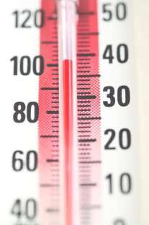
Scales for numerical attributes
 Interval scale: the definition of the value 0 is arbitrary. Ratios are meaningless.
   Examples: date (Unix standard time: time point zero is in the year 1970), temperature (°C or °F)
 Ratio scale: 0 has a canonical meaning. Ratios make sense.
   Examples: distance, duration
 Absolute scale: domain with a unique measurement unit.
   Examples: any kind of counting process (number of children, number of visits to the doctor)
20

Slide 18
Specific problems of categorical attributes (1/2)
 Different levels of granularity might be definable.
 Examples: product categories/types:
   General category: drinks, food, clothes, …
   More refined categories for drinks: water, beer, wine, …
   Further refinement for water based on the producer.
   Further refinement of the of each producer based on the bottle size (0.33 l, 0.5 l, 1 l, 1.5 l)
 The most refined level provides the most detailed information, but will not help to discover general associations like “Wine and cheese are often bought together”

Slide 19
Specific problems of categorical attributes (2/2)
 Dynamic domains: The possible values of the domain might change over time.
   Example: certain product categories or products might not be sold anymore. New product categories or products are introduced.
 The analysis of such data will be biased to values (example: products) that have been in the domain for a long time.

Slide 20
Agenda
Project Understanding
Data Understanding I
 Attribute Understanding
 Data Quality
 Data Visualization

Slide 21
Data quality
 Low data quality makes it impossible to trust analysis results (“garbage in, garbage out”)
 Accuracy: closeness between the value in the data
and the true value
   Low accuracy of numerical attributes due to noisy measurements, limited precision, wrong measurements, transposition of digits when entered manually.
   Low accuracy of categorical attributes due to erroneous entries and typos.

Slide 22
Data quality – syntactic accuracy
 Syntactic accuracy is violated if an entry does not belong to the domain of the attribute
 The entry fmale for the categorical attribute gender
 Text entries for numerical attributes
 Values out of range for numerical attributes (negative
numbers for weight, distance, counting process, …)
 Syntactic accuracy can be checked quite easily

Slide 23
Data quality – semantic accuracy
 Semantic accuracy is violated if an entry is not correct although it belongs to the domain of the attribute
   The entry female for the categorical attribute gender in the record with name entry John Smith is within the domain of the attribute gender, but obviously incorrect given that the name is correct.
 Semantic accuracy is more difficult to check than syntactic accuracy.
 Can only be investigated based on “business rules” and plausibility checks.

Slide 24
Data quality – completeness
 w.r.t. attribute values: fraction of “null” entries for an attribute.
   Note that missing values are not always marked explicitly as missing, for instance in the case of default entries!
 w.r.t. records: complete records might be missing.
   Example 1: Three years ago, a new system was introduced and not all customer data were transferred to the new system.
   Example 2: The data set is biased, e.g., a bank might have rejected customers with no income, but they did not protocol it.

Slide 25

Data quality – unbalanced data and timeliness
 Unbalanced data: the data set might be biased extremely to one type of records
   Production line for goods including quality control → defective goods will be a very small fraction of all records!
 Timeliness: are the available data up to date to be
considered to be representative?

Slide 26
Agenda
Project Understanding
Data Understanding I
 Attribute Understanding
 Data Quality
 Data Visualization

Slide 27
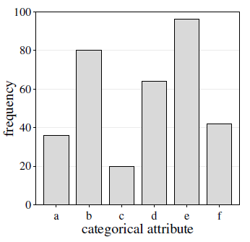
Bar charts
 A bar chart is a simple way to depict the
frequencies of the values of a categorical attribute.

Slide 28
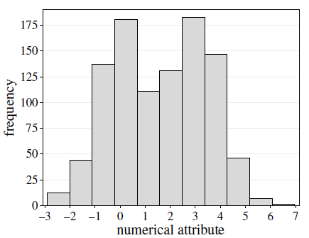
Histograms (1/4)
 A histogram shows the frequency distribution for a
numerical attribute.
 The range of numerical attribute is discretized into a fixed number of intervals (“bins”), usually of equal length.
 For each interval, the (absolute) frequency of values falling into it is indicated by the height of a bar.
 The number of bins is very important.

Slide 29
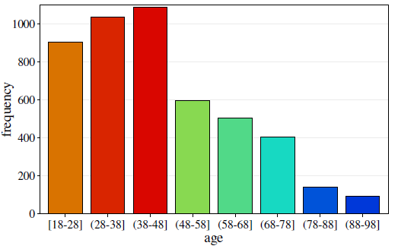
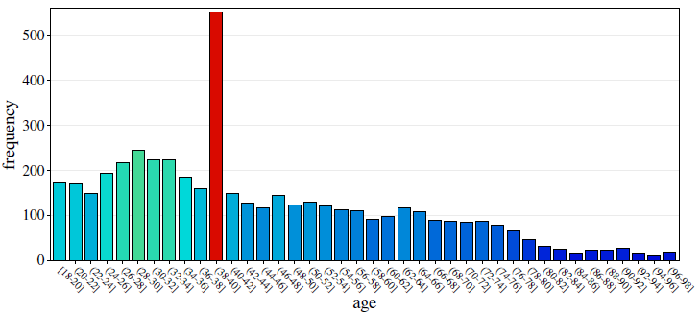
Histograms (2/4)

Slide 30
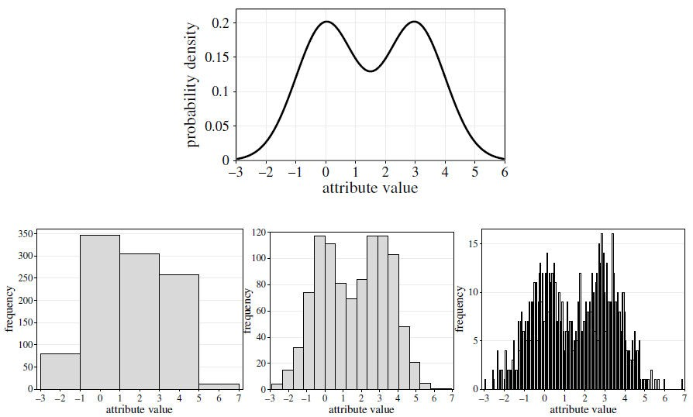
Histograms (3/4)

Slide 31
Histograms (4/4)
 A rule of thumb for the determination of the “correct”
number of bins is Sturge’s rule:
 Sturge’s rule is suitable for data from normal
distributions and from data sets of moderate size.

Slide 32
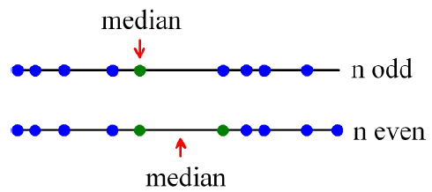
Reminder: median, quantiles, quartiles, interquartile range
 Median: the value in the middle (for the values given in increasing order)
 q%-quantile (0<q<100): The value for which q% of the values are smaller and 100-q% are larger. The median is the 50%-quantile.
 Quartiles: 25%-quantile (1st), median (2nd), 75%- quantile (3rd)
 Interquartile range: 3rd quantile – 1st quantile

Slide 33


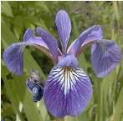
Example data set: Iris data (1/2)
Borsten-Schwertlilie
Iris Setosa
 Collected by E. Anderson in 1935
 Contains measurements of four real- valued variables of 150 iris flowers of types Iris Setosa, Iris Versicolor, Iris Virginica
   Sepal length
   Sepal widths
   Petal lengths
   Petal widths
 The fifth attribute is the name of the flower type
Iris Versicolor
Versch-f. Schwertl.
Sumpf-Schwertlilie
Iris Virginica

Slide 34
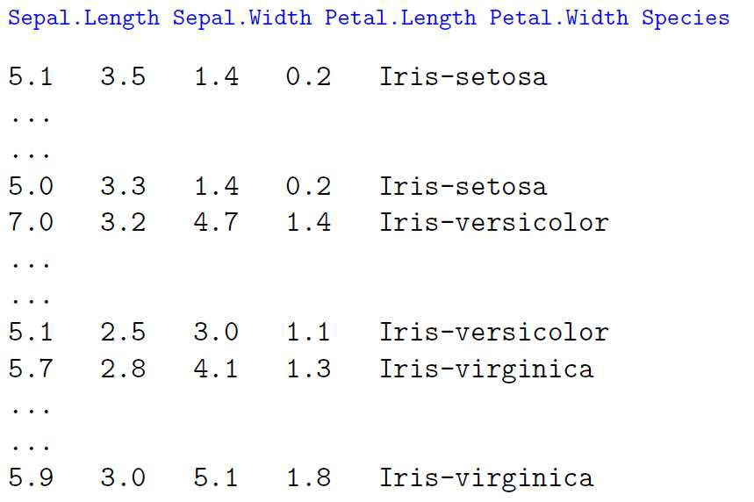
Example data set: Iris data (2/2)

Slide 35
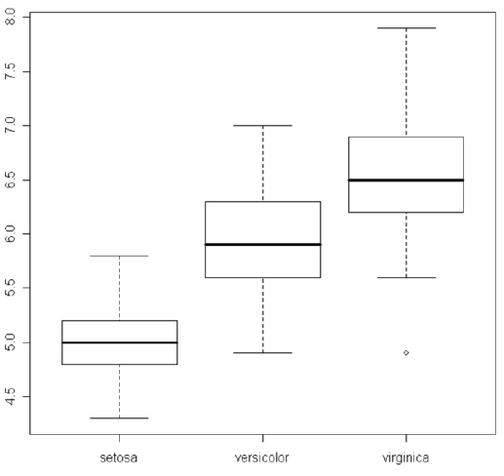
Iris data set: boxplots
 Boxplots are a very compact way to visualize and summarize main characteristics of a sample from a numerical attribute
 Line in the middle = median
 Box = interquartile range
 Whiskers = 1.5 x interquartile range
40

Slide 36
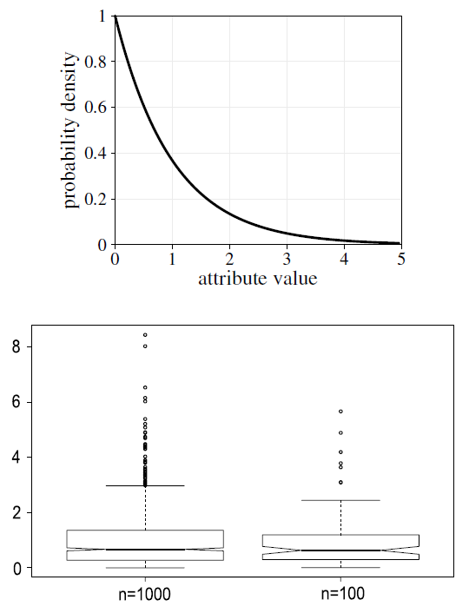
Boxplots for asymmetric distribution

Slide 37
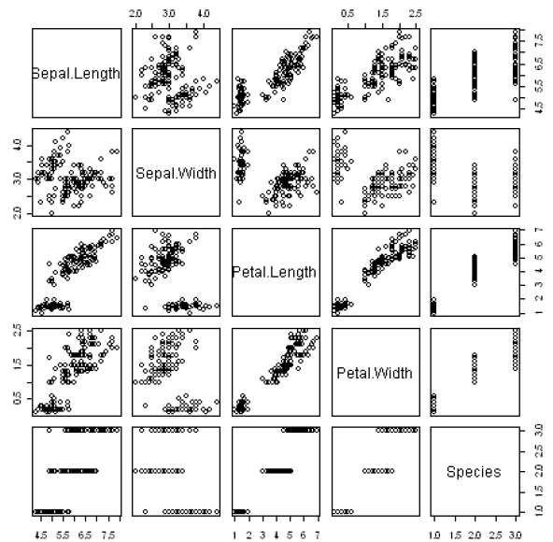
Scatter plots
Scatter plots visualize two variables in a two- dimensional plot
 Each axes corre- sponds to one variable
 Not suited for larger data sets

Slide 38
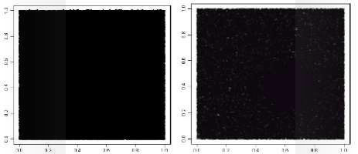
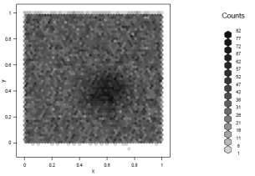
Scatter plots: density
 For large data sets, points are plotted over each other and density information is lost.
 Left: 1000000 objects
 Middle: Instead of solid points, semitransparent points are plotted
 Right: hexagonal binning. Grey intensity denotes number of points

Slide 39
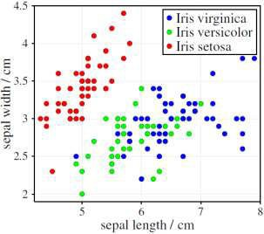
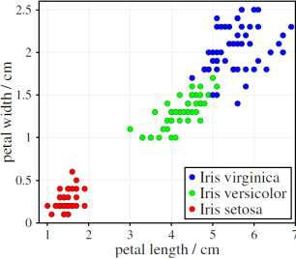
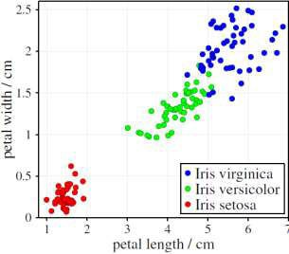
Scatter plots: further elaboration
 Scatter plots can be enriched with additional information: color or different symbols incorporate a third attribute in the scatter plot.
 ^
 Data objects with the same values cannot be distinguished in a scatter plot → jitter

Slide 40
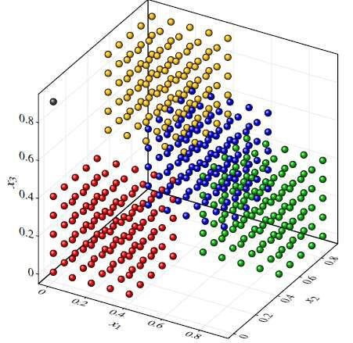
3D scatter plots
 For data sets of moderate size, scatter plots can be
extended to three dimensions.

Slide 41
Data Preparation
Agenda
 Data selection
 Data cleaning
 Data transformation
 Data integration

Slide 42
Feature extraction
 Feature extraction refers to constructing (new) features from the given attributes.
 Example: We are interested in finding the best workers in a company.
   There are attributes available like
   the tasks a worker has finished within each month,
   the number of hours he/she has worked each month,
   the number of hours that are normally needed to finish each task.
   In principle, these attributes contain information about the efficiency of the worker.
   It might be more useful to define a new attribute “efficiency”, which is the proportion of hours spent to finish a task to hours normally needed to finish a task.

Slide 43
Dimensionality reduction for feature extraction
 Dimensionality reduction techniques like PCA can also be considered as feature extraction methods.
 But such automatic feature extraction methods usually lead to features that can no longer be interpreted in a meaningful way.
   How to understand a feature that is a linear combination of 10 attributes?
 Therefore, in most cases, either knowledge-based, problem-dependent feature extraction methods or feature selection techniques are preferred.

Slide 44
Feature extraction and selection
 Feature extraction is especially relevant for complex
data types:
   Text data analysis – frequency of keywords, …
   Time series and image data analysis – fourier or wavelet coefficients, …
   Graph data analysis – number of vertices and edges
 Feature selection refers to techniques that choose a subset of the features (attributes) that is as small as possible and sufficient for data analysis.
   Remove (more or less) irrelevant features
   Remove redundant features.

Slide 45
Removing irrelevant/redundant features
 For removing irrelevant features, a performance measure is needed that indicates how well a feature or subset of features performs w.r.t. the considered data analysis task.
 For removing redundant features, either a performance measure for subsets of features or a correlation measure is needed.

Slide 46
Feature selection techniques (1/2)
 For classification tasks with a target attribute, typical performance measures are
   𝝌^{𝟐} test for independence. It measures the deviation of the sample marginal distributions from the marginal distribution one would obtain assuming the considered attribute and the target variable are independent.
   Information gain. Based on entropy reduction (see decision trees)
 Wrapper methods can be applied when the model class (e.g. decision trees) is already specified.
   Train the model with different subsets of features and choose the features that lead to the model with the best performance.
10

Slide 47
Feature selection techniques (2/2)
 Selecting the top-ranked features (single features)
   Choose the features with the best evaluation.
 Selecting the top-ranked subset
   Choose the subset of features with the best performance. This requires exhaustive search and is impossible for larger numbers of features.
 Forward selection
   Start with an empty set of features. Add features one by one. Consider which one yields the best improvement.
 Backward elimination
   Start with the full set of features and remove features one by one. In each step, remove the feature that yields to the least decrease in performance.

Slide 48
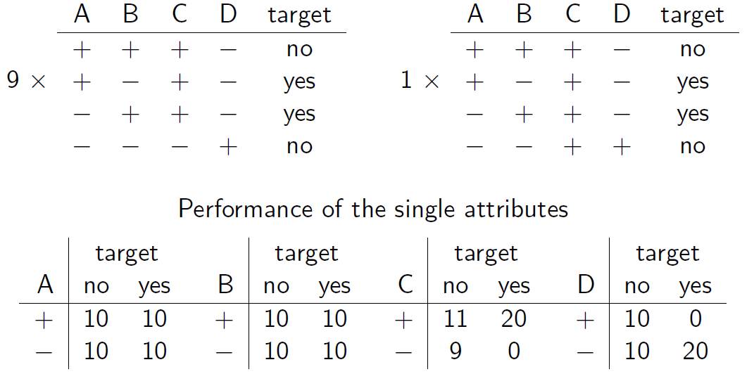
Feature selection – example (1/2)
 Consider the following classification task that consists of 9 repetitions of the four data records in the first table and the four records in the second table.

Slide 49
Feature selection – example (2/2)
Which set of attributes should be selected for classification?
  A greedy strategy selecting those attributes with the best performance would choose attributes C and D first.
  Attributes C and D together cannot perfectly predict the target value, though.
  Attributes A and B alone provide no information about the target value.
  However, attributes A and B together are sufficient to perfectly predict the target value.
Evaluation of the performance of isolated attributes does usually not provide proper information about their performance in combination.

Slide 50
Record selection
 Timeliness
     If data have been collected over a long period, some of the older data might not be useful or even misleading for the data analysis task. Only the recent data should be selected.
 Representativeness
     The sample in the database might not be representative for the whole population. When we have information about the distribution of the population, we can draw a representative subsample from our database.
 Rare events
     When we are interested in predicting rare events (e.g. stock market crashes, failures of a production line), it can be helpful to incorporate this in the cost function or to artificially increase the proportion of these rare events in the data set.

Slide 51
Agenda
 Data selection
 Data cleaning
 Data transformation
 Data integration

Slide 52

Data clean(s)ing (1/2)
 Data clean(s)ing or data scrubbing refers to detecting and correcting or removing inaccurate, incorrect or incomplete data records from a data set.
 Improve data quality
   Turn all characters into capital letters to level case sensitivity
   Remove spaces and nonprinting characters
   Fix the format of numbers, data and time (decimal point!)
   Split fields that carry mixed information into separate ones (“Chocolate, 100g” → “Chocolate” and “100.0”)

Slide 53
Data clean(s)ing (2/2)
 Improve data quality (continued)
   Use spell-checker or stemming to normalize spelling
   Replace abbreviations by their long form (dictionary)
   Normalize the writing of addresses and names, possibly ignoring the order of title, surname, forename, etc. to ease their re-identification
   Convert numerical values into standard units, especially if data from different sources and different countries are used
   Use dictionaries containing all possible values of an attribute to assure that all values comply with the domain knowledge

Slide 54
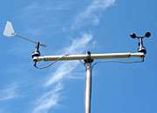
Missing values
 For some instances, values of single attributes might be missing.
 Causes for missing values:
   Broken sensors
   Refusal to answer a question
   Irrelevant attribute for the corresponding object (pregnant (yes/no) for men)
 Missing value might not necessarily be indicated as missing (instead: zero or default values)!

Slide 55
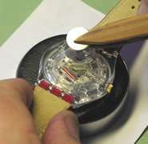

Types of missing values (1/3)

 Missing completely at random (MCAR)
 The probability that a value for X is missing does neither depend on the true value of X nor on other variables →
 Example: The maintenance staff sometimes forgets to change the batteries of a sensor so that the sensor sometimes does not provide any measurements
 MCAR is also called Observed At Random (OAR).

Slide 56
Types of missing values (2/3)
Missing at random (MAR)
  The probability that a value for X is missing does not depend on the true value of X
  Example: The maintenance staff does not change the batteries of a sensor when it rains. Thus, the sensor does not always provide measurements when it rains.
 Nonignorable
 The probability that a value for X is missing depends on the true value of X.
 Example: A sensor for the temperature will not work when there is frost.
20

Slide 57

Types of missing values (3/3)
 For MCAR and MAR, the missing values can be estimated
   At least in principle, when the data set is large enough – based on the values of the other attributes
   The cause for the missing values is ignorable
   For MCAR, it can be assumed that the missing values follow the same distribution as the observed values of X
   For MAR, the missing values might not follow the distribution of X. But by taking the other attributes into account, it is possible to derive reasonable imputations for the missing values.
 For nonignorable missing values it is impossible to provide sensible estimations for the missing values

Slide 58
How to determine the type of missing values (1/2)
 If domain knowledge does not help which kind of missing values can be expected, the following strategy can be applied
   Turn the considered attribute X into a binary attribute, replacing all measured values by “yes” and all missing values by “no”
 Build a classifier with the now binary attribute X as the target attribute, and use all other attributes for the prediction of the class values “yes” and “no”
 Determine the misclassification rate, which is the proportion of data objects that are not assigned to the correct class by the classifier.

Slide 59
How to determine the type of missing values (2/2)
 …
  For MCAR, the other attributes should not provide any information, whether ܺ has a missing value or not. Therefore, the misclassification rate should not differ significantly from pure guessing.
  If there are 10% missing values for the attribute ܺ, the misclassification rate of the classifier should not be much smaller than 10%.
  If the misclassification rate is significantly better than pure guessing, this is an indicator that there is a correlation between missing values for ܺ and the values of the other attributes. The missing values are not MCAR.
  MAR and nonignorable cannot be distinguished in this way.

Slide 60
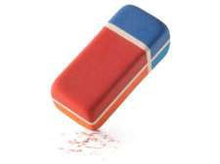
How to handle missing values
 Ignorance/Deletion
 If only a few records have missing values, and it can be assumed that the values are MCAR, these records can be deleted for the following data analysis step.
 Imputation
 The missing values may be replaced by some estimate.
 Mean, median or mode of the attribute (MCAR required!)
 By an estimation based on the other attributes (MAR required!)
 Explicit value
 Missing values are characterized by a specific value („MISSING“). The selected model must be able to hand these specified missing values (most models assume MCAR)!

Slide 61
Agenda
 Data selection
 Data cleaning
 Data transformation
 Data integration

Slide 62
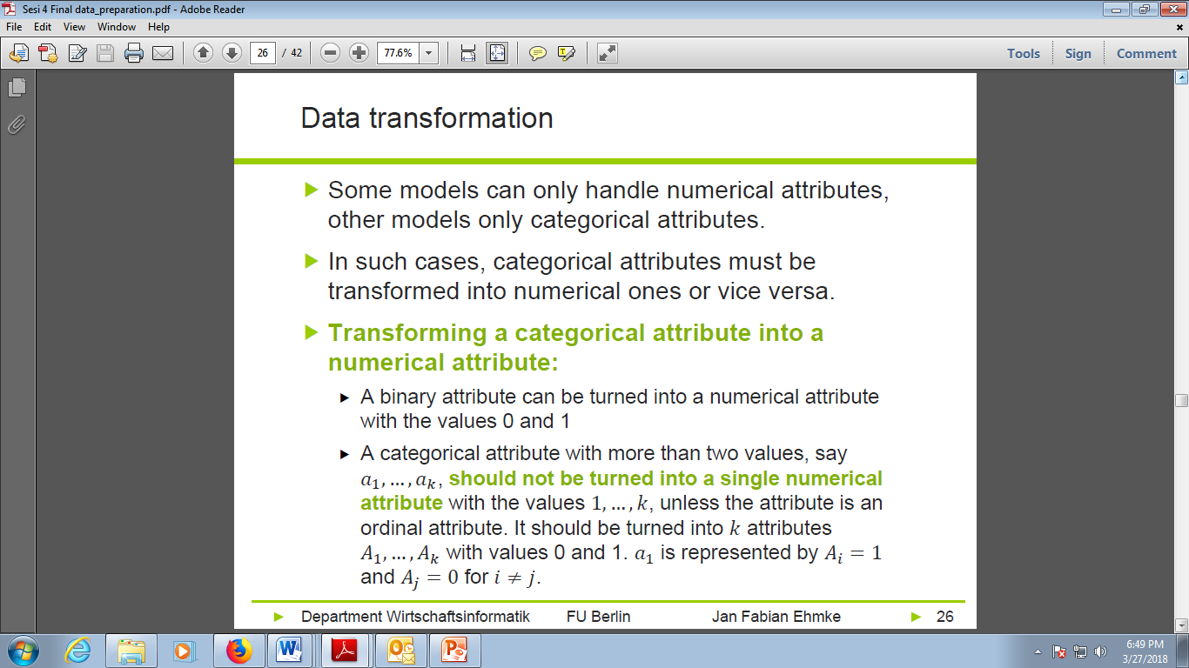
Data transformation
 Some models can only handle numerical attributes, other models only categorical attributes.
 In such cases, categorical attributes must be transformed into numerical ones or vice versa.

Slide 63
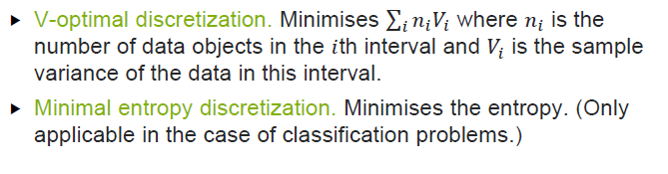
Discretization (1/2)
 Discretization techniques refer to splitting a numerical range into a number of finite bins.
  Equi-width discretization. Splits the range into intervals (bins) of the same length.
  Equi-frequency discretization. Splits the range into intervals such that each interval (bin) contains (roughly) the same number of records.

Slide 64
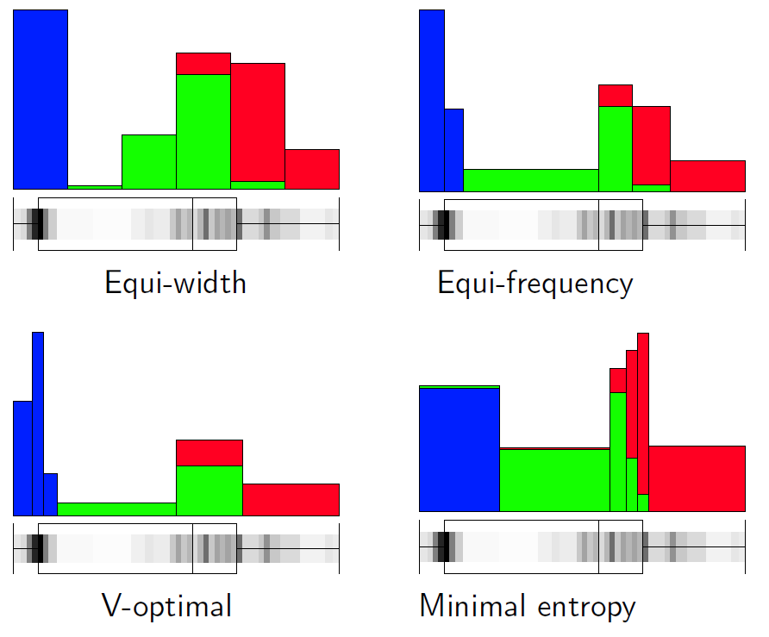
Discretization (2/2)

Slide 65
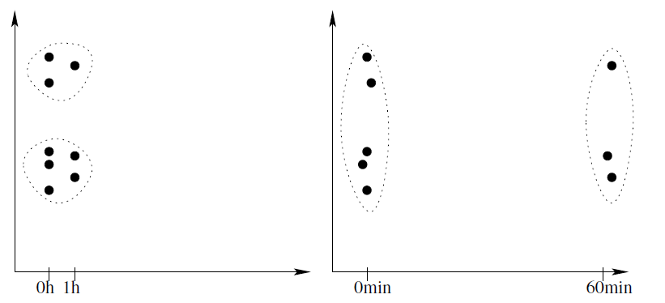
Normalization / Standardization (1/2)
For some data analysis techniques (PCA, MDS, cluster analysis) the influence of an attribute depends on the scale or measurement unit.
To guarantee impartiality, some kind of standardization or normalization should be applied.

Slide 66
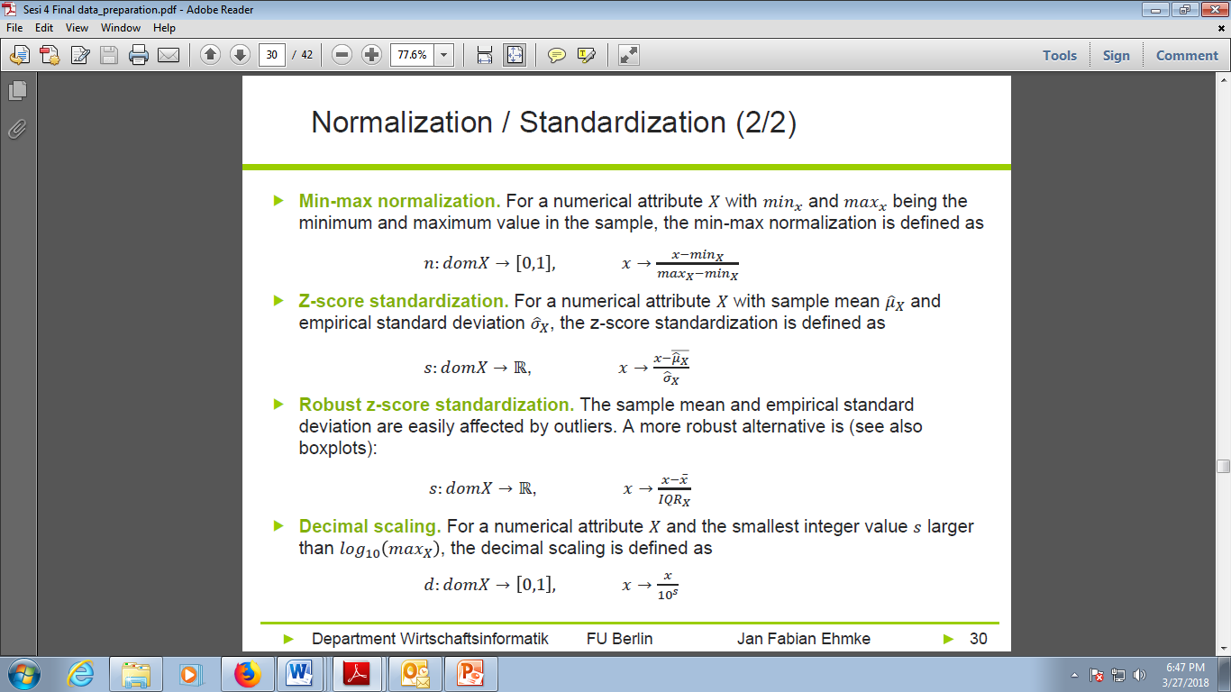
Normalization / Standardization (2/2)
30

Slide 67
Agenda
 Data selection
 Data cleaning
 Data transformation
 Data integration

Slide 68
Data integration (1/2)
 Relevant information may be spread over several tables and databases
 Vertical data integration: concatenation of tables / databases that essentially hold the same information
   Define a joint format
   Define a derived identifier
   Deal with duplicates, missing values
 Horizontal data integration: enrich existing information, e.g., concatenate existing entries from one database with the entries of the second one

Slide 69
Data integration (2/2)
 Horizontal integration
   Pull information from the combination of several data sets
   Identify rows in data sets that belong together (→ join)
 Issues of horizontal integration
   overrepresentation of items
   data explosion
 Types of joins
   Inner join: creates a row in the output table if at least one entry in the left and right table can be found with matching id
   Left (right) join: creates at least one row in the output table for each row of the left (right) input table.
   Outer join: creates at least one row for every row in the left and right table

Slide 70
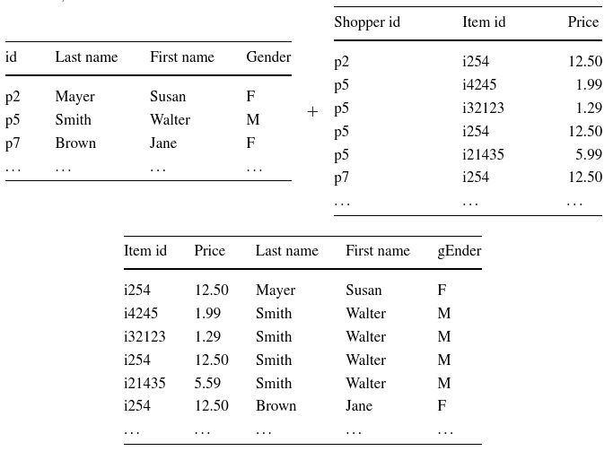
Data integration – example

Slide 71
Conclusion
Data mining is a craft. As with many crafts, there is a well-defined process that can help to increase the likelihood of a successful result. This process is a crucial conceptual tool for thinking about data science projects. In turn, understanding the fundamentals of data science substantially improves the chances of success as an enterprise invokes the data mining process.
A successful data mining project involves an intelligent compromise between what the data can do (i.e., what they can predict, and how well) and the project goals. For this reason it is important to keep in mind how data mining results will be used, and use this to inform the data mining process itself.

Slide 72
References
Michael R. Berthold, Christian Borgelt, Frank Höppner, Frank Klawonn, Guide to Intelligent Data Analysis, Springer-Verlag London Limited, 2010
Provost, F.; Fawcett, T.: Data Science for Business; Fundamental Principles of Data Mining and Data- Analytic Thinking. O‘Reilly, CA 95472, 2013.
Steve Williams: Business Intelligence Strategy and Big Data Analytics, Morgan Kaufman Elsevier, 2016
Eibe Frank, Mark A. Hall, and Ian H. Witten : The Weka Workbench, M Morgan Kaufman Elsevier, 2016.

