Slide 1
Business Intelligence and Analytics: Fitting a model to data
Session 5

Slide 2
Introduction
 So far: we produced both the structure of the model (the particular tree model) and the numeric parameters of the model from the data
 Now: we specify the structure of the model,
but leave certain numeric parameters unspecified
 Data Mining calculates the best parameter values given a particular set of training data
 The form of the model and the attributes is specified
 The goal of DM is to tune the parameters so that the model fits the data as well as possible (parameter learning)

Slide 3
Simplifying assumptions
 For classification and class probability estimation,
we will consider only binary classes.
 We assume that all attributes are numeric.
 We ignore the need to normalize numeric
measurements to a common scale
→ see data preparation

Slide 4
Agenda
 Linear classifiers
 Linear regression
 Logistic regression
 Example: tree induction vs. logistic regression

Slide 5
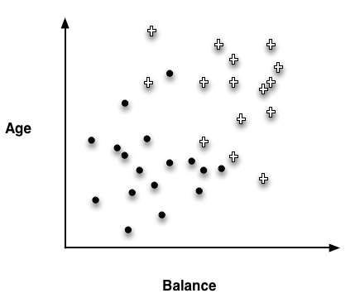
Linear classifiers (1/2)
 Instance-space view: shows the space broken up
into regions by decision boundaries
 Examples in each space should have similar values for the target variable
 Homogeneous regions help predicting the target variable of a new, unseen instance
 We can separate the instance almost perfectly (by class) if we are allowed to introduce a boundary that is still a straight line, but is
not perpendicular to the axes
 Linear classifier

Slide 6
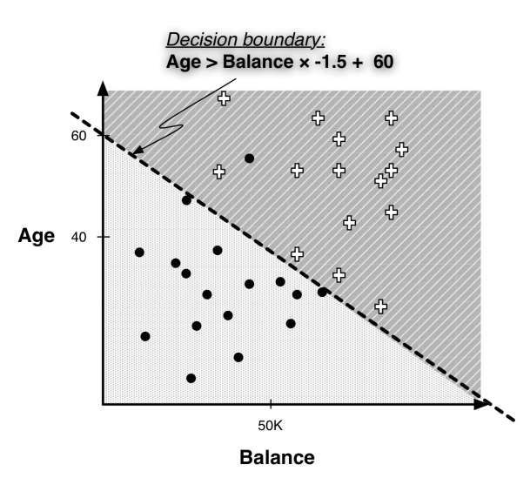
Linear classifiers (2/2)

Slide 7

Linear discriminant functions (1/2)
 Equation of a line:𝑦 = 𝑚𝑥 + 𝑏 with m being the
slope and b the y intercept
 Line in figure on slide 7: 𝐴𝑔𝑒 = −1.5 ∗ 𝐵𝑎𝑙𝑎𝑛𝑐𝑒 + 60
 We would classify an instance ݔ as a “+” if it is above the line, and as a “•” if it is below the line.
 Mathematically:
 Linear discriminant discriminates between the classes
 Supervised segmentation by creating a mathematical function of multiple attributes
 A linear discriminant function is a numeric classification model, which can be written as

Slide 8
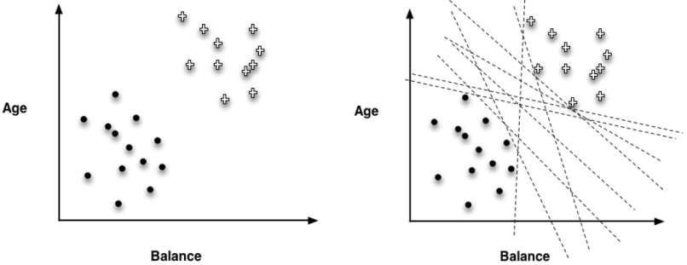
Linear discriminant functions (2/2)
 Fit parameters 𝑤𝑖 to a particular data set
 Find a good set of weights w.r.t. to the features
 Weights may be interpreted as importance indicators
 The larger the magnitude of a weight, the more important
 What is the „best“ line to separate the classes?

Slide 9
Optimizing an objective function
 What should be our objective in choosing the
parameters?
 What weights should we choose?
 We need to define an objective function that represents our goal sufficiently
 Optimal solution is found by minimizing or maximizing
 Creating an objective function that matches the true goal of DM is usually impossible
 We will consider
 Support Vector Machines
 Linear regression
 Logistic regression
10

Slide 10
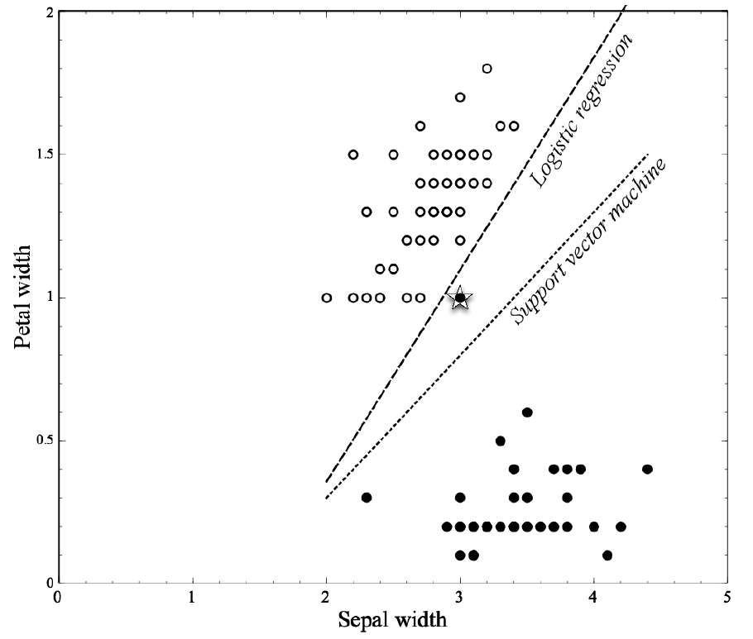
Mining a linear discriminant for the Iris data set

Slide 11

Linear discriminant functions for scoring and ranking instances
 Sometimes, we want some notion of which
examples more or less likely to belong to a class
 Which customers are most likely to respond to this offer?
 Remember class membership probability
 Sometimes, we don‘t need a precise probability estimate – a ranking is sufficient
 Linear discriminant functions provide rankings
 f(x) will be small when x
is near the boundary
 f(x) gives an intuitively satisfying ranking of the instances by their (estimated) likelihood of belonging to the class of interest

Slide 12
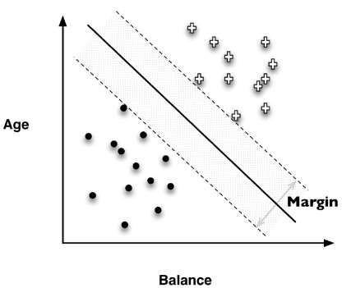
An intuitive approach to Support Vector Machines (1/2)
 Support Vector Machines (SVM) are linear
discriminants
 Classify instances based on a linear function of the features
 Objective function based on a simple idea:
maximize the margin
 Fit the fattest bar between the classes
 Once the widest bar is found, the linear discriminant will be the center line through the bar
 The margin-maximizing boundary gives the maximal leeway for classifying new points

Slide 13
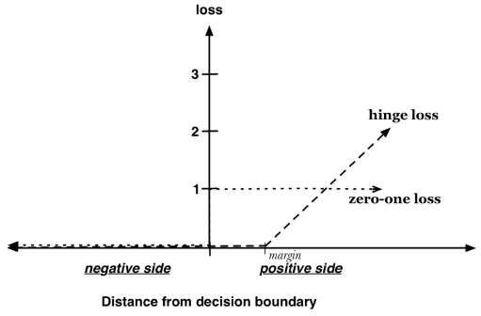
An intuitive approach to Support Vector Machines (2/2)
 How to handle data points that are misclassified by
the model, i.e., if there is no perfect separating line?
 In the objective function, a training point is penalized for being on the wrong side of the decision boundary
 If the data are linearly separable, no penalty is incurred and the margin is simply maximized
 If the data are not linearly separable, the best fit is some balance between a fat margin and
a low total error penalty
 The penalty is proportional to the distance from the decision boundary

Slide 14
Agenda
 Linear classifiers
 Linear regression
 Logistic regression
 Example: tree induction vs. logistic regression

Slide 15
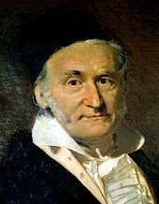
Linear regression (1/2)
 Remember
 Which objective function should we use to optimize a
model‘s fit to the data?
 Most common choice: how far away are the estimated values from the true values of the training data?
 Minimize the error of the fitted model, i.e., minimize the distance between estimated values and true values!
 Regression procedures choose the model that fits the data best w.r.t. the sum of errors
 Sum of absolute errors
 Sum of squared errors
 Standard linear regression is convenient (mathematically)!

Slide 16
Linear regression (2/2)
 Linear regressions minimizes the squarred error
 Squared error strongly penalizes large errors
 Squared error is very sensitive to the data
 erroneous or outlying data points can severely skew the
resulting linear function
 For systems that build and apply models automatically, modeling needs to be much more robust
 Choose the objective function to optimize with the ultimate business application in mind

Slide 17
Agenda
 Linear classifiers
 Linear regression
 Logistic regression
 Example: tree induction vs. logistic regression

Slide 18
Logistic regression (1/5)
 For many applications, we would like to estimate the probability that a new instance belongs to the class of interest
 Fraud detection: where is the company‘s monetary loss expected to be the highest?
 Select different objective function to give accurate
estimates of class probability
 Well calibrated and discriminative
 Recall: an instance being further from the separating boundary leads to a higher probability of being in one class or the other, and f(x) gives the distance from the separating boundary
 But a probability should range from zero to one!

Slide 19
Logistic regression (2/5)
 The likelihood of an event can expressed by odds
 The odds of an event is the ratio of the probability of the
event occurring to the probability of the event not occurring
 Log-odds convert the scale to −∞ to +∞
Probability | Odds | Corresponding log-odds
0.5 | 50:50 or 1 | 0
0.9 | 90:10 or 9 | 2.19
0.999 | 999:1 or 999 | 6.9
0.01 | 1:99 or 0.0101 | -4.6
0.001 | 1:999 or 0.001001 | -6.9
 Logistic regression model: f(x) is used as a measure of the log-odds of the “event” of interest
 f(x) is a an estimation of the log-odds that x belongs to the positive class
20

Slide 20
Logistic regression (3/5)
 How to translate log-odds into the probability of

Slide 21
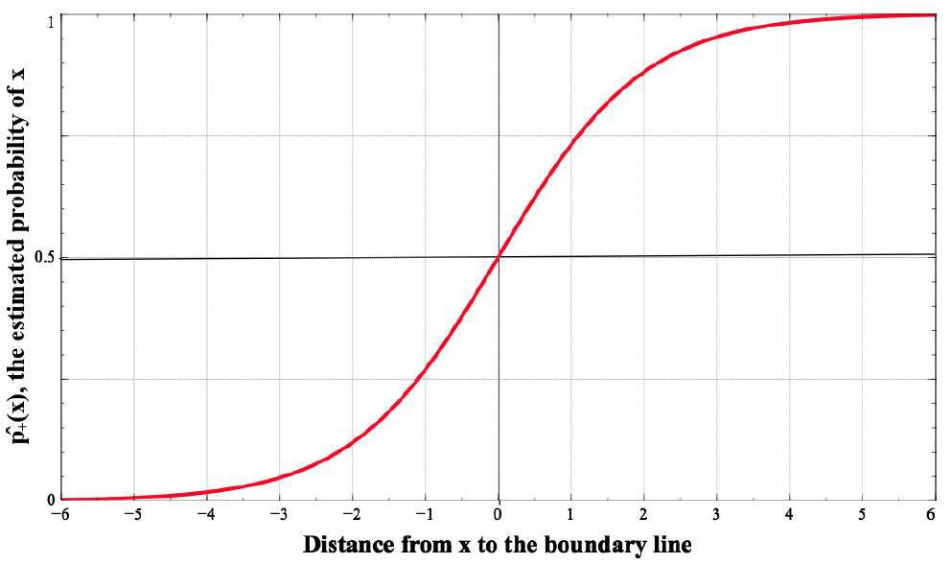
Logistic regression (4/5)

Slide 22

Logistic regression (5/5)
 What does the objective function look like?
 Ideally, any positive example x₊ would have
and any negative example x● would have
 Probabilities are never pure when real-world data is considered
 Compute the likelihood of a particular labeled example given a set of parameters w that produces class probability estimates

 The g function gives the model’s estimated probability of
Seeing x’s actual class given x’s features
 For different parameterized models, sum the ݃ values across all examples in a labeled data set

Slide 23
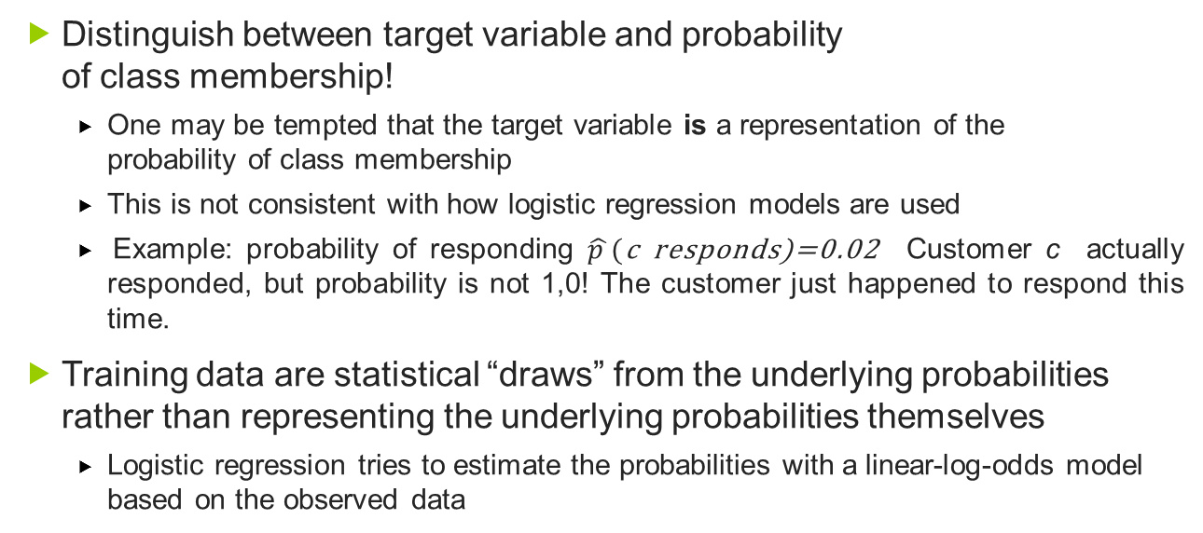
Class labels and probabilities
 Distinguish between target variable and probability
of class membership!
 One may be tempted that the target variable is a representation of the probability of class membership
 This is not consistent with how logistic regression models are used
 Example: probability of responding $\hat{p }$(c responds)=0.02 Customer c actually responded, but probability is not 1,0! The customer just happened to respond this time.
 Training data are statistical “draws” from the underlying probabilities rather than representing the underlying probabilities themselves
 Logistic regression tries to estimate the probabilities with a linear-log-odds model based on the observed data

Slide 24
Agenda
 Linear classifiers
 Linear regression
 Logistic regression
 Example: tree induction vs. logistic regression

Slide 25
Example: Tree induction vs. logistic regression (1/4)
 Important differences between trees and linear
classifiers
 A classification tree uses decision boundaries that are
perpendicular to the instance-space axes.
 The linear classifier can use decision boundaries of any direction or orientation
 A classification tree is a is a “piecewise” classifier that segments the instance space recursively → cut in arbitrarily small regions possible.
 The linear classifier places a single decision surface
through the entire space.
 Which of these characteristics are a better match to a given data set?

Slide 26
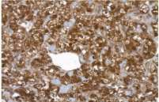
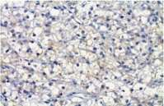
Example: Tree induction vs. logistic regression (2/4)
 Consider the background of the stakeholders
 A decision tree may be considerably more understandable to
someone without a strong background in statistics
 Data Mining team does not have the ultimate say how models are used or implemented!
 Example: Wisconsin Breast Cancer Dataset
 http://archive.ics.uci.edu/ml/datasets/Breast+Cancer+Wisconsin+(Diagnostic)
 Each record describes characteristics of a cell nuclei image, which has been labeled as either “benign” or “malignant” (cancerous)
 Ten fundamental characteristics were extracted and summarized in a mean (_mean), standard error (_SE) and mean of the three largest values (_worst) → 30 measured attributes
 357 benign images and 212 malignant images
From Mu et al. (2011) doi:10.1038/ncomms1332

Slide 27
Example: Tree induction vs. logistic regression (3/4)
 Results of logistic regression
 Weights of linear model
 Ordered from highest to lowest
 Performance: only six mistakes on the entire dataset, accuracy 98.9%
 Comparison with classification
tree from same dataset
 Weka‘s J48 implementation
 25 nodes with 13 leaf nodes
 Accuracy: 99.1%
 Are these good models?
 How confident should we be in this evaluation?
Attribute | Weight
Smoothness_worst | 22.30
Concave_mean | 19.47
Concave_worst | 11.68
Symmetry_worst | 4.99
Concavity_worst | 2.86
Concavity_mean | 2.34
Radius_worst | 0.25
Texture_worst | 0.13
Area_SE | 0.06
Texture_mean | 0.03
Texture_SE | -0.29
Compactness_mean | -7.10
Compactness_SE | -27.87
ݓ₀ (intercept) | -17.70

Slide 28
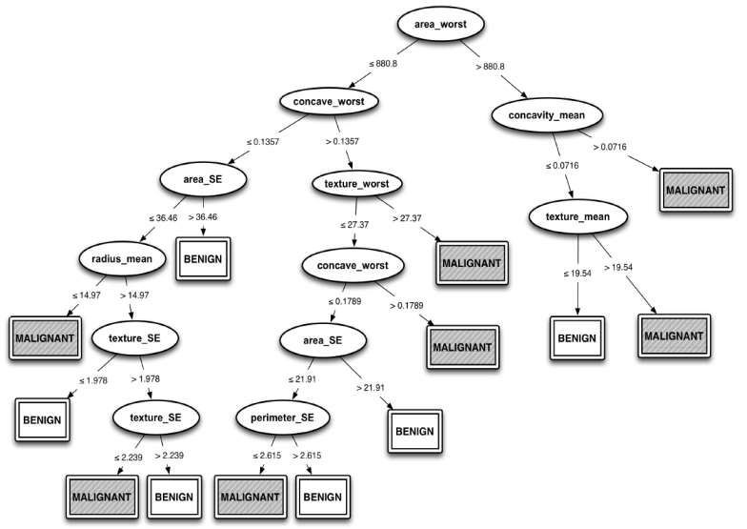
Example: Tree induction vs. logistic regression (4/4)

Slide 29
Conclusion
This Session introduced a second type of predictive modeling technique called function
fitting or parametric modeling. In this case the model is a partially specified equation:
a numeric function of the data attributes, with some unspecified numeric parameters.
The task of the data mining procedure is to “fit” the model to the data by finding the
best set of parameters, in some sense of “best.”

Slide 30
References
Provost, F.; Fawcett, T.: Data Science for Business; Fundamental Principles of Data Mining and Data- Analytic Thinking. O‘Reilly, CA 95472, 2013.
Michael R. Berthold, Christian Borgelt, Frank Höppner, Frank Klawonn, Guide to Intelligent Data Analysis, Springer-Verlag London Limited, 2010
Carlo Vecellis, Business Intelligence, John Wiley & Sons, 2009
Eibe Frank, Mark A. Hall, and Ian H. Witten : The Weka Workbench, M Morgan Kaufman Elsevier, 2016.

