Slide 1
Business Intelligence and Analytics
Avoidance of overfitting
Session 6

Slide 2
Introduction
 Fundamental trade-off in DM between overfitting
and generalization
 If we allow ourselves enough flexibility in searching, we will find patterns
 Unfortunately, these patterns may be just chance
occurences in the data…
 We are interested in patterns that generalize, i.e., that predict well for instances that we have not yet observed
 Overfitting: finding chance occurences in data that look like interesting patterns, but which do not generalize

Slide 3
Agenda
 Generalization and Overfitting
 From holdout evaluation to cross-validation
 Learning curves
 Overfitting avoidance and complexity control

Slide 4
Generalization (1/2)
 Example: churn data set
 Historical data on customers who have stayed with the company, and customers who have departed within six months of contract expiration
 Task: build a model to distinguish customers who are likely to churn based on some features
 We test the model based on historical data, and the model is 100% accurate, identifying correctly all the churners as well as the non-churners!?
 We can always build a perfect model!
 Store the feature vector for each customer who churned (table model)
 Look the customer up when determining the likelihood of churning

Slide 5
Generalization (2/2)
 A table model memorizes the training data and performs no generalization
 Useless in practice! Previously unseen customer‘s would all end up with “0% likelihood of churning”
 Generalization is the property of a model or modeling process whereby the model applies to data that were not used to build the model
 If models do not generalize at all, they fit perfectly to the training data → they overfit.
 DM needs to create models that generalize beyond training data

Slide 6
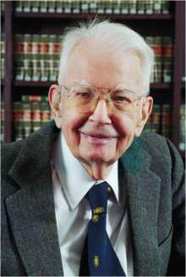
Overfitting
 Overfitting is the tendency of DM procedures to tailor models to the training data, at the expense of generalization to previously unseen data points.
 „If you torture the data long enough, it will confess.“ (Ronald Coase)
 All DM procedures tend to overfitting
 Trade-off between model complexity and the
possibility of overfitting
 Recognize overfitting and manage complexity in a principled way

Slide 7
Holdout data
 Evaluation on training data provides no assessment of how well the model generalizes to unseen cases
 Idea: „Hold out“ some data for which we know the value of the target variable, but which will not be used to build the model → „lab test“
 Predict the values of the „holdout data“ (aka „test set“) with the model and compare them with the hidden true values → generalization performance
 There is likely to be a difference between the model‘s accuracy („in-sample“ accuracy) and the model‘s generalization accuracy

Slide 8
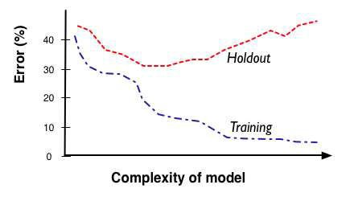
Fitting graph
 A fitting graph shows the accuracy of a model as a function of complexity
 Generally, there will be more overfitting as one allows the model to be more complex

Slide 9
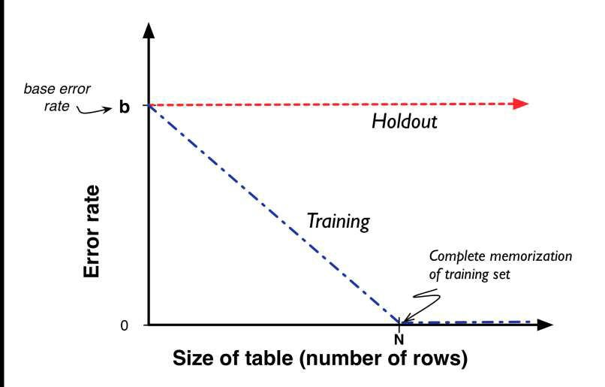
A fitting graph for the churn example
10

Slide 10
Overfitting in tree induction (1/2)
 Recall tree induction: find important, predictive individual attributes recursively to smaller and smaller data subsets
 Eventually, the subsets will be pure – we have found the leaves of our decision tree
 The accuracy of this tree will be perfect!
 This is the same as the table model, i.e., an extreme example of overfitting!
 This tree should be slightly better than the lookup table, because every previously unseen instance also will arrive at some classification rather than just failing to match
 Useful for comparison of how well the accuracy on the training data tends to correspond to the accuracy on test data

Slide 11
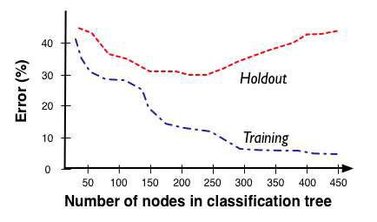
Overfitting in tree induction (2/2)
 Generally: A procedure that grows trees until the
leaves are pure tends to overfit
 If allowed to grow without bound, decision trees can fit any data to arbitrary precision
 The complexity of a tree lies in the number of
nodes

Slide 12
Overfitting mathematical functions
 There are different ways to allow more or less
complexity in mathematical functions
 Add more variables (more attributes):
 Add attributes that are non-linear, i.e.,
or
 As you increase the dimensionality, you can
perfectly fit larger and larger sets of arbitrary points
 Often, modelers carefully prune the attributes in order to avoid overfitting → manual selection
 Automatic feature selection

Slide 13
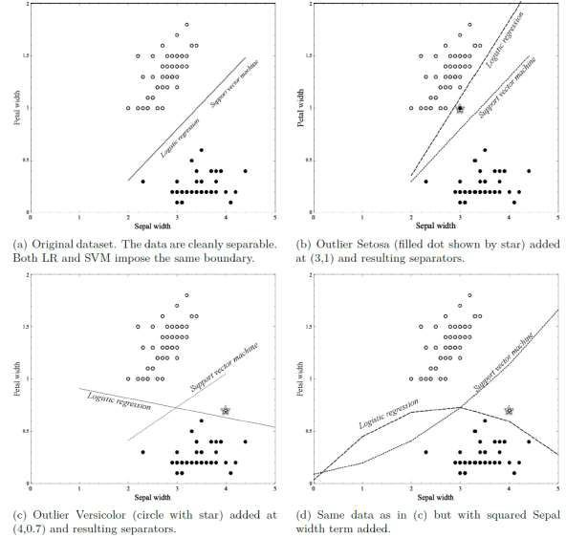
Example: Overfitting linear functions (1/2)

Slide 14
Example: Overfitting linear functions (2/2)
Original Iris data set
► both logistic regression and support vector machines
place separating boundaries in the middle
A single new example has been added (3,1)
► logistics regression still separates the groups perfectly,
while the SVM line barely moves at all
A different outlier has been added (4,0.7)
► again, SVM only moves very little – logistic regression appears to be overfitting considerably
Add a squared term of the sepal width
► More flexibility in fitting the data – seperating line becomes a parabola

Slide 15
Example: Why is overfitting bad? (1/4)
 Why is overfitting causing a model to become
worse?
 As a model gets more complex, it is allowed to pick up harmful „spurious“ correlations
 These correlations do not represent characteristics of the
population in general
 They may become harmful when they produce incorrect
generalizations in the model
 Example: a simple two-class problem

Slide 16
Example: Why is overfitting bad? (2/4)
 Example: a simple two-class problem
 Classes c₁ and 𝑐₂ attributes x and y
 An evenly balanced population of examples
 X has two values, p and q, and y has two values, r and s
 x=p occurs 75% of the time in class 𝑐1 examples and in 25% of 𝑐₂ examples ➔ x provides some prediction of that class
 Both of y’s values occur in both classes equally ➔ y has no predictive value at all
 The instances in the domain are difficult to separate, with only x providing some predictive leverage (75% accuracy)

Slide 17
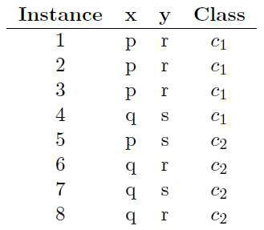
Example: Why is overfitting bad? (3/4)
 Small training set of examples
 A tree learner would split on x and
produce a tree (a) with error 25%
 In this particular dataset,y’s values of r and s are not evenly split between the classes, so y seems to provide some predictness
 Tree induction would achieve information gain by splitting on y’s values and create tree (b)
 Tree (b) performs better than (a)
 Because y=r purely by chance correlates with class ci in this data sample
 The extra branch in (b) is not extraneous, it is harmful!
The spurios y=s branch predicts 𝑐₂, which is wrong.
(error rate: 30%)

Slide 18
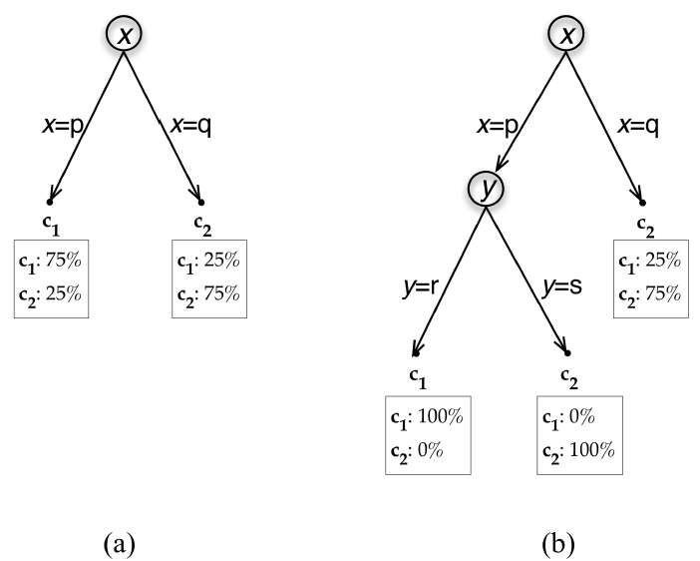
Example: Why is overfitting bad? (4/4)
 This phenomenon is not particular to decision trees
 It is also not because of atypical training data
 There is no general analytic way to avoid overfitting

Slide 19
Agenda
 Generalization and Overfitting
 From holdout evaluation to cross-validation
 Learning curves
 Overfitting avoidance and complexity control
20

Slide 20
Holdout training and testing
 Cross-validation is a more sophisticated training
and testing procedure
 Not only a simple estimate of the generalization performance, but also some statistics on the estimated performance (mean, variance, …)
 How does the performance vary across data sets?
→ assessing confidence in the performance estimate
 Cross-validation computes its estimates over all the data by performing multiple splits and systematically swapping out samples for testing
 Split a data set into 𝑘 partitions called folds (𝑘 = 5 or 10)
 Iterate training and testing 𝑘 times
 In each iteration, a different fold is chosen as the test data.
The other 𝑘 − 1 folds are combined to form the training data.

Slide 21
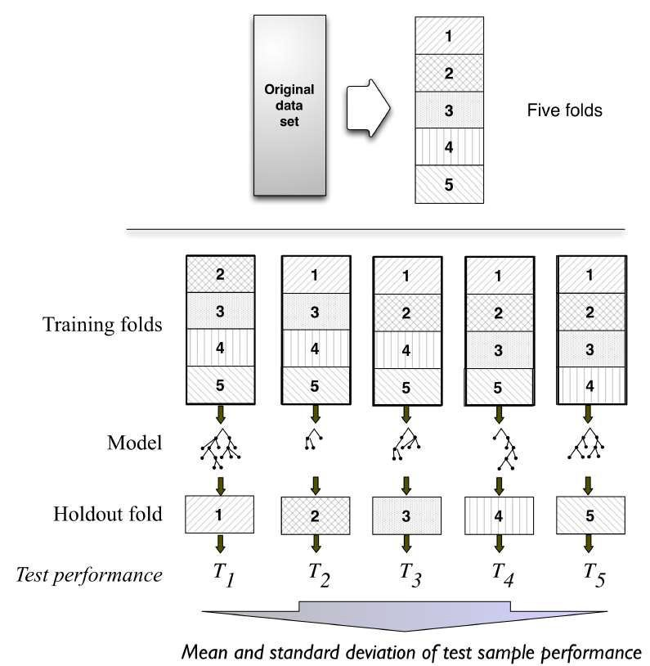
Illustration of cross-validation
 Every
example will have been used only once for testing but
𝑘 − 1 times for training
 Compute average and standard deviation from
𝑘 folds

Slide 22
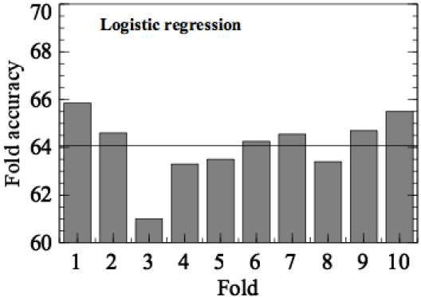
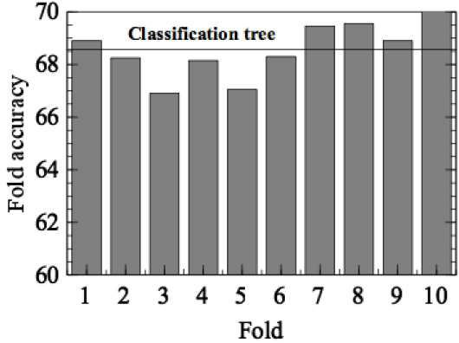
Cross-validation for the churn data set
Recall churn dataset with an accuracy of 73%
Cross-validation: the dataset was first shuffled,
then divided into ten partitions
 Classification trees: avg accuracy is 68.6% (std 1.1)
 Logistic regression models: avg accuracy is 64.1% (std 1.3)

Slide 23
Learning curves
 Generalization and Overfitting
 From holdout evaluation to cross-validation
 Learning curves
 Overfitting avoidance and complexity control

Slide 24
Learning curves
 Learning curve = a plot of the generalization performance (testing data) against the amount of training data
 Reflects that generalization performance improves as more training data are available
 Characteristic shape: steep initially, but then marginal advantage of more data decreases
 Fitting curve = shows the performance on the training and the testing data against model complexity (for a fixed amount of training data)

Slide 25
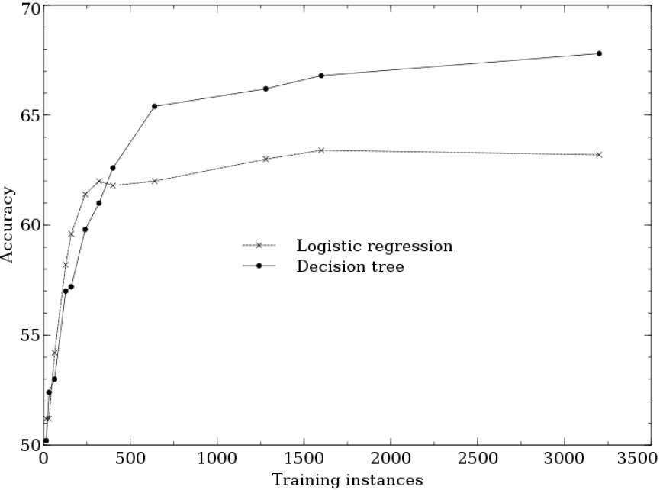
Learning curves: example (1/2)

Slide 26
Learning curves: example (2/2)
 Same data – different generalization performance:
 For smaller training-set sizes, logistic regression yields
better generalization accuracy
 For larger training-set sizes, tree induction soon is more accurate
 Classification trees are a more flexible model
representation than linear logistic regression
 Smaller data: tree induction will tend to overfit more
 Flexibility of tree induction for larger training sets
 Learning curve may give recommendations on how
much to invest in training data

Slide 27
Learning curves
 Generalization and Overfitting
 From holdout evaluation to cross-validation
 Learning curves
 Overfitting avoidance and complexity control

Slide 28
Avoiding overfitting for tree induction (1/3)
 Tree induction will likely result in large, overly
complex trees that overfit the data
 Stop growing the tree before it gets too complex
 Prune back a tree that is too large (reduce its size)
30

Slide 29
Avoiding overfitting for tree induction (2/3)
 Simplest method to limit tree size: specify a minimum number of instances that must be present in a leaf
 Automatically grow the tree branches that have a lot of data and cut short branches that have less data
 What threshold should we use?
 Experience
 Conduct a hypothesis test at every leaf to determine whether the observed difference in information gain could have been due to chance (e.g., p-value below 5%)
 Accept split if it was likely not due to chance

Slide 30
Avoiding overfitting for tree induction (3/3)
 Prune an overly large tree = cut off leaves and
branches and replace them with leaves
 Estimate whether replacing a set of leaves or a branch with a leaf would reduce accuracy
 If not, prune
 Continue process iteratively, until any removal or replacement would reduce accuracy
 Build trees with all sorts of different complexities and estimate their generalization performance
 Pick the one that is estimated to be the best

Slide 31
A general method for avoiding overfitting (1/2)
 How to estimate the generalization performance of
models with different complexities?
 Test data should be strictly independent of model building…
 Nested holdout testing
 Split the training data set into a training subset and a testing subset
 Build models on the training subset (sub-training) and pick the best model based on the testing subset (validation)
 Validation set is separate from final test set

Slide 32
A general method for avoiding overfitting (2/2)
 Use the sub-training/validation split to pick the
best complexity without tainting the set
 Build a model of this best complexity on the entire training set
 Example for classification trees
 Induce trees of many complexities from sub-training set
 Estimate generalization performance from validation set
 E.g., the best model has a complexity of 122 nodes
 Estimate the actual generalization performance on final holdout set
 For the given complexity, induce a new tree with 122 nodes from the original training set

Slide 33
Nested cross-validation
 Choose the complexity experimentally
 Cross-validation to assess the generalization accuracy of a new modeling technique with complexity parameter C
 Run cross-validation as described before
 Before building the model for each fold, we perform an
experiment on the training set
 Run another entire cross validation on just that training set to find the value of C estimated to give the best accuracy
 Set the value of C to build the actual model for that fold

Slide 34
Sequential forward selection
 Based on nested cross-validation
 Process:
 Pick the best individual feature by looking at all models
built using just one feature
 Then, test all models that add a second feature to this first chosen feature, and select the best pair
 Proceed similarly with three, four, … features
 Lots of computational power required

Slide 35
Avoiding overfitting for parameter optimization (1/3)
 How to find the right balance between the fit to the
data and the complexity of the model?
 Choose the right set of attributes
 Regularization = combined optimization of fit and
simplicity
 Models will be better if they fit the data better and if they are simpler

Slide 36
Avoiding overfitting for parameter optimization (2/3)
 Recall: in order to fit a model involving numerical parameters w we need to find a set of parameters that maximize some objective function
 Complexity control: penalize complexity
with 𝜆 expressing how important the penalty is
 Example logistic regression: regularized maximum
likelihood model

Slide 37
Avoiding overfitting for parameter optimization (3/3)
 Most commonly used penalty: L2-norm
 Sum of the squares of the weights
 Functions can fit data better if they are allowed to have very large positive and negative weights
 Sum of squares give a large penalty when weights have
large values
 L1-norm in linear regression → lasso
 Zeroes out many coefficients
 Performs an automatic form of feature selection

Slide 38
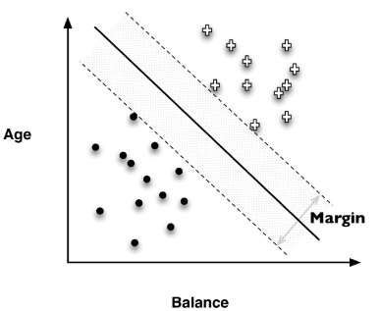
Detour: Support Vector Machine
 Remember: SVM maximizes the margin between
the classes by fitting in the fattest bar
 Penalization of errors by hinge loss
 Linear SVM learning is almost equivalent to L2-regularized logistic regression
 SVM optimizes this equation:
 Lower hinge loss is better
40

Slide 39
Beware of multiple comparisons
 Example: If you flip 1000 fair coins many times each, one of them will have come up heads much more than 50% of the time
 But this is not the “best” coin!
 Beware whenever someone does many tests and
then picks the results that look good!
 The actual significance of the results may be dubious
 Also procedures for avoiding overfitting undertake multiple comparisons, e.g., choosing the best complexity for a model by comparing many complexities

Slide 40
Conclusion
Data mining involves a fundamental trade-off between model complexity and the possibility of overfitting. A complex model may be necessary if the phenomenon producing the data is itself complex, but complex models run the risk of overfitting training data (i.e., modeling details of the data that are not found in the general population). An overfit model will not generalize to other data well, even if they are from the same population.

Slide 41
References
Provost, F.; Fawcett, T.: Data Science for Business; Fundamental Principles of Data Mining and Data- Analytic Thinking. O‘Reilly, CA 95472, 2013.
Eibe Frank, Mark A. Hall, and Ian H. Witten : The Weka Workbench, M Morgan Kaufman Elsevier, 2016.

