Slide 1
Business Intelligence and Analytics:
Similarity and cluster analysis
Session 7

Slide 2
Agenda
 Similarity and distance
 Introduction to cluster analysis
 Major clustering techniques and algorithms
 Validation of Clusterings
 Case Study

Slide 3
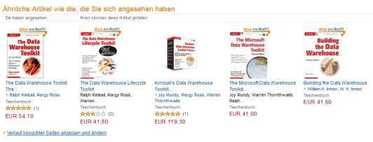
Similarity and distance
Similarity is at the core of many DM methods
If two things are similar in some ways, they often share
other characteristics as well
Some business cases
Use similarity for classification and regression
Group similar items together into clusters
Provide recommendations to people (Amazon, Netflix)
Reasoning from similar cases (medicine, law)

Slide 4
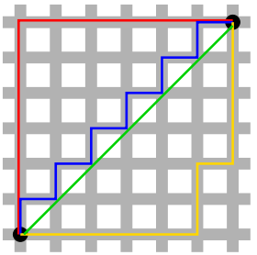
(Dis)similarity functions
 Typically, distances between data objects are used
for the determination of similarity
 Euclidean distance between two p-dimensional data objects i and j
d (i, j) =
| x − x |² + | x − x |² +...+ | x − x |²
i1 j1 i 2 j 2 ip jp
 Manhattan distance (more robust)
d(i, j) =| x_{i1} − x_{j1} | + | x_{i 2} − x_{j 2} | +...+ | x_{ip} − x _{jp} |
 Minkowski distance (generalization)
q q
q 1/ q
d(i, j) = (| x_{i1} − x_{j1} | + | x_{i 2} − x_{j 2} | +...
+ | x − x | )
ip jp
 Special distance functions for binary, nominal and ordinal scaled variables

Slide 5
Nearest neighbors for predictive modeling
 Idea of similarity in predictive modeling:
 Given a new example whose target variable we want to predict, we scan through all the training examples and choose several that are the most similar to the new example.
 Then we predict the new example‘s target value, based on the nearest neighbors‘ (known) target values
 Classification: look for the nearest neighbors and
derive target class for new example
 Regression: derive target value from the mean or
median of the neighbors

Slide 6
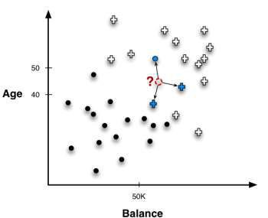
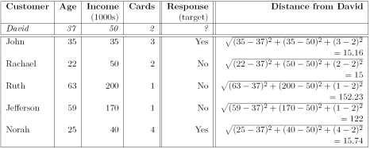
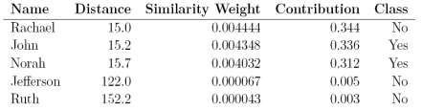
Nearest neighbor in classification (1/2)
 Majority vote
 How many neighbors?
 Also consider the distance to vary the influence of the neighbors

Slide 7
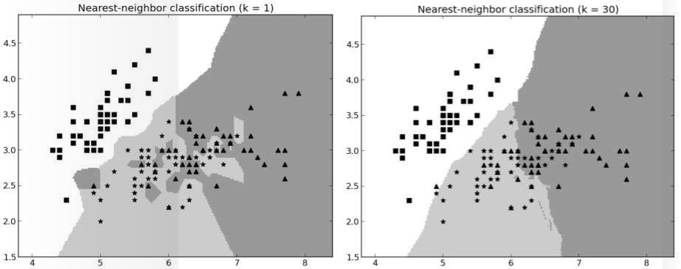
Nearest neighbor in classification (2/2)
 Nearest neighbor classifiers follow very specific boundaries
 1-NN strongly tends to overfit (k is a complexity parameter!)
 Use cross-validation or nested holdout testing

Slide 8
Issues with nearest neighbor methods
 Intelligibility
 Decisions can be explained along the contributions of the neighbors: „The movie Billy Elliot was recommended based on your interest in Amadeus, The Constant Gardener and Little Miss Sunshine“
 NN methods lack of specific decision models
 Dimensionality
 Having too many/irrelevant attributes may confuse distance calculations → course of dimensionality
 Solution 1: Feature selection
 Solution 2: Inject domain knowledge in distance calculation
 Computational Efficiency
 Querying the database for prediction can be very expensive

Slide 9
Agenda
 Similarity and distance
 Introduction to cluster analysis
 Major clustering techniques and algorithms
 Validation of Clusterings
 Case Study
10

Slide 10
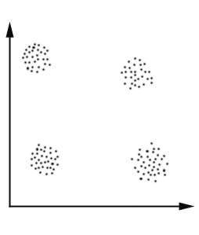
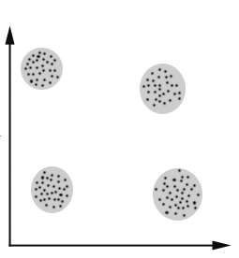
What is cluster analysis? (1/2)
 “Clustering is the process of grouping data into classes or cluster so that objects within a cluster have high similarity in comparison to one another, but are very dissimilar to objects in other clusters.”
 Cluster = collection of data objects that are similar to each other
 Two main purposes:
 Discovery of overall distribution patterns and interesting correlations among data attributes
 Data reduction: a cluster can be treated collectively as one group in many applications
 Clustering is an example of unsupervised
learning

Slide 11
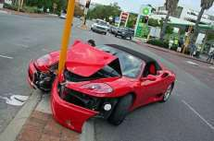
Typical applications of clustering
 Help marketers discover distinct groups in their customer databases and characterize customer groups based on purchasing patterns
 Derive plant and animal taxonomies in biology, categorize genes with similar functionality
 Identification of groups of automobile insurance policy holders with a high average claim cost
 Classify documents on the web for
information discovery
 Gain insight into the distribution of data
 Preprocessing step for other tasks such as classification

Slide 12
Typical requirements of clustering in data mining (1/2)
 Many cluster algorithms work well on small low
dimensional data sets and numerical attributes
 In large data sets, algorithms must be able to deal
with the following circumstances:
 Scalability (e.g., handle millions of data objects)
 Different types of attributes (e.g., binary, nominal, ordinal)
 Discover clusters with arbitrary shape
(not all clusters are shaped like a circle)

Slide 13
Typical requirements of clustering in data mining (2/2)
 Domain knowledge required to determine input
parameters and evaluate results
 Deal with noisy data
 outliers can massively influence the clustering
 Insensitivity to the order of input records
 High dimensionality
 Interpretability and usability

Slide 14
Agenda
 Similarity and distance
 Introduction to cluster analysis
 Major clustering techniques and algorithms
 Validation of Clusterings
 Case Study

Slide 15
Major clustering techniques and algorithms (1/2)
 A large number of clustering algorithm exists
 The choice of cluster algorithm depends on
 the type of data available
 the particular purpose and application
 The user has to choose the clustering technique carefully
 domain knowledge required
 Clustering algorithms compare data objects regarding to their similarity or dissimilarity

Slide 16



Major clustering techniques and algorithms (2/2)
selectionof dataobjects andvariables
selectionand executionof clustering
validation ofclustering results
interpretation
ofresults
database
target dataset
resultsof
clustering
validated
results
information
aboutstructure
(adapted from Halkidi et al. (2001))
 Criteria for appropriate selection of clustering algorithm (Tan et al. (2009)):
type and structure of clustering
type and definition of clusters
features of the data set
number of data objects and variables
representation of results

Slide 17
Partitioning based clustering
 Given a database of 𝑛 objects, a partitioning method constructs 𝒌 partitions of the data (k≤n) Each partition represents a cluster.
 Result: the data is classified into k groups
 Each group must contain at least one object
 Each object must belong to exactly one group
 General approach
 Create an initial partitioning
 Improve the partitioning by an iterative relocation technique, i.e., move data objects from one group to another
 Criteria: objects in the same group are “close” to each other, whereas objects of different clusters are “far apart”

Slide 18
Partitioning based clustering: k-means (1/3)
 Input: number of clusters k and a database
containing 𝑛 objects
 Output: set of k clusters that minimizes the squared-error criterion
 Method:
 arbitrarily choose k objects as the initial cluster centers;
 repeat
 (re)assign each object to the cluster to which the object is the most similar, based on the mean value of the objects in the
cluster;
 update the cluster means, i.e.,
calculate the mean value of the objects or each cluster;
E =
∑
k
i=1
∑
| p − m | ²
p∈C
i
i
p = data point
 until no change;
 Squared-error criterion:
m_{i} = mean of Cluster C_{i}

Slide 19
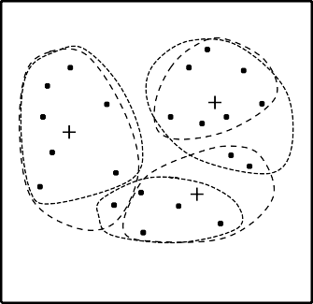
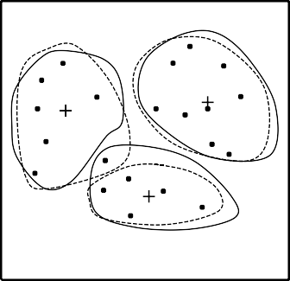
Partitioning based clustering: k-means (2/3)
 Example:
a b c
 General remarks:
 works well when clusters are compact clouds and well separated
 scalable and efficient in large data sets
 often terminates at local optimum (→ random initial partitioning!)
 mean must be defined
(e.g., not suitable for categorical attributes)
 sensitive to noisy and outlier data (→ mean calculation)
20

Slide 20
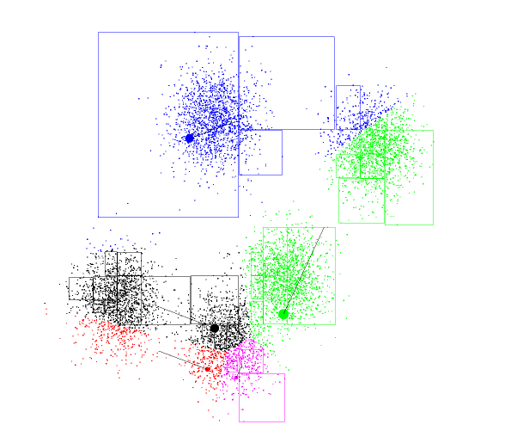
Partitioning based clustering: k-means (3/3)
Interactive demonstration of k-means algorithm: http://home.dei.polimi.it/matteucc/Clustering/tutorial_html/AppletKM.html

Slide 21
Partitioning based clustering: k-medoids
 instead of taking the mean value as a reference, the
medoid is used
 medoid = most centrally located object in a cluster
 main idea:
 Find k clusters in 𝑛 objects by first arbitrarily determining a representative object (= medoid) for each cluster
 each remaining object is clustered with the medoid to which it is the most similar
 the medoids are iteratively replaced by one of the non- medoids as long as the quality of clustering is improved (i.e., the actual square-error 𝐸 is reduced)
 k-medoids is more robust than k-means
 processing is more costly than the k-means

Slide 22
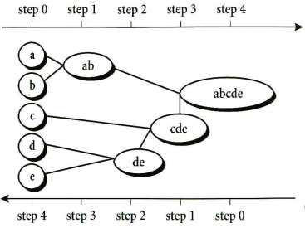
Hierarchical based clustering (1/2)
 Creates a hierarchical decomposition of a set of data objects
 Two main approaches:
 Agglomerative approach (bottom up): start with each object as a separate group, then successively merge groups until a certain termination condition holds
 Divisive approach (top-down): start with all objects in one cluster,
then successively split up into smaller clusters until a certain termination condition holds
 Main disadvantage: Once a merge or split is done, it can never be undone, i.e., erroneous decisions cannot be corrected
Han et. al

Slide 23


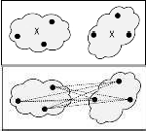
Hierarchical based clustering (2/2)
 Measures for distances between two clusters:
 Minimum distance between two data points
 Maximum distance between two data points
 Mean distance, i.e., distance between the mean of the clusters
 Average distance, (the avg of all single distances)
 The user can specify the desired number of clusters as a termination condition
 Critical decision: where to split or merge groups?
→ Risk of low-quality clusters
 No well scaling since the decision of merge or split needs to examine and evaluate a good number of
objects or clusters

Slide 24
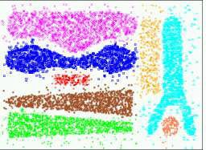
Hierarchical based clustering: Chameleon (1/3)
 explores dynamic modeling of the neighborhood in hierarchical clustering
 counteracts disadvantages of common hierarchical algorithms
 two clusters are merged if the
interconnectivity and closeness between two clusters are highly related to the internal interconnectivity and closeness of objects within the clusters
 general approach:
 use a graph partitioning algorithm to cluster the data objects into a large number of relatively small temporary clusters
 combine or merge sub-clusters with an agglomerative hierarchical cluster algorithm
Karypis et al.

Slide 25
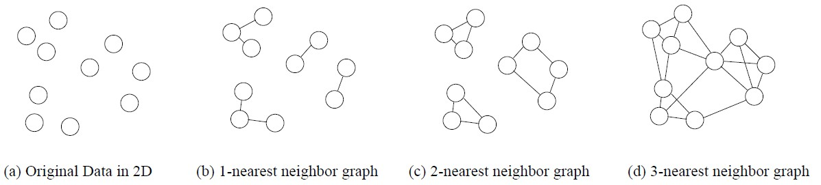
Hierarchical based clustering: Chameleon (2/3)
 K-nearest neighbor graph
 each vertex represents a data object
 two vertices are connected if one object is among the k-most similar objects of the other
Karypis et al.

Slide 26
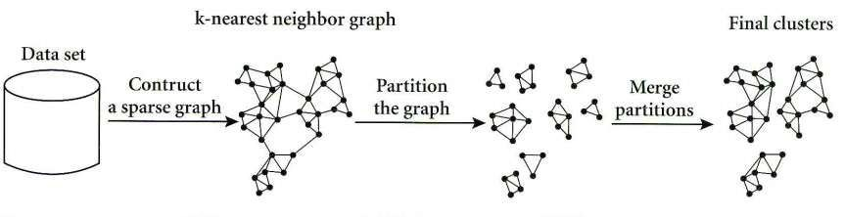
Hierarchical based clustering: Chameleon (3/3)
 The neighborhood radius of an object is determined by the density of the region in which this object resides
 In a dense region, the neighborhood is defined narrowly
 In a sparse region, it is defined more widely
 ⇒ The edge of a dense region tends to weigh more than
that of a sparse region
Han et. al

Slide 27
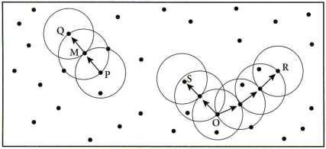
Density-based clustering
 continues growing the given clusters as long as the density (i.e., the number of objects or data points) in the “neighborhood” exceeds some threshold
 discovers clusters with arbitrary shapes due to not using the distance between data objects for clustering
 DBSCAN algorithm (simplified):
 check the neighborhood of each point in the database
 find satisfying neighborhoods
 merge satisfying neighborhoods
which are connected
Han et. al

Slide 28
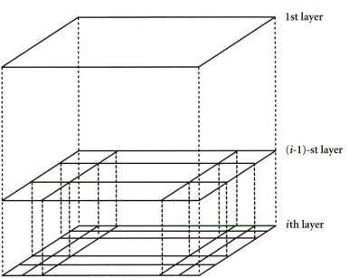
Grid-based clustering: STING (1/2)
 Divide the object space into a finite number of
cells that form a grid structure
 Main advantage: fast processing time, which is typically independent of the number of data objects
 Typical example: STING
(STatistical INformation Grid)
 Spatial area is divided into rectangular cells
 Hierarchical structure
 Statistical information (mean, max, min, …) regarding the attributes in each grid cell are
pre-computed and stored
Han et. al

Slide 29
Grid-based clustering: STING (2/2)
 Advantages:
 Grid structure facilitates parallel processing and
incremental updating
 The method is very efficient:
 STING goes through the database once to compute the statistical parameters
 The query processing time is much smaller due to the small number of grid cells at the lowest level
 General remarks:
 The quality of STING depends on the granularity of the lowest level of the grid structure
 The shapes of the resulting clusters are either horizontal or vertical, no diagonal boundary is detected
30

Slide 30
Agenda
 Similarity and distance
 Introduction to cluster analysis
 Major clustering techniques and algorithms
 Validation of Clusterings
 Case Study
31

Slide 31
Validation of clusterings
 Visualize results of cluster analysis
(→ exploratory data analysis)
 Internal measures
 define the quality of a clustering based on the given data set
 cluster cohesion / cluster separation
 e.g., Davies-Bouldin index
 External measures
 compare the results of a clustering with established structure or information
(e.g. manual clustering by an expert)
 Relative measures
 are derived from internal and external measures
 compare several clusterings regarding a given hypothesis

Slide 32
Davies-Bouldin index
 internal measure for validation of clusterings
 compare variation of data objects
 within the clusters i and j [s(𝐶𝑖), s(𝐶𝑗)]
 to distance between the clusters i and j [d(𝐶𝑖, 𝐶𝑗)]
 calculation for every pair i,j :
 𝑅𝑖𝑗 is small when distances between clusters are large and variations in clusters are small (“good clustering”)
 overall calculation:
 take the maximum 𝑅𝑖𝑗 for every instance of k :
 calculate overall index

Slide 33
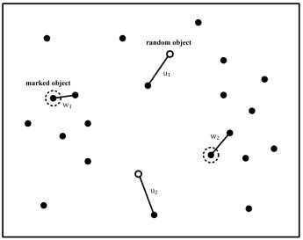
Clustering tendency
 Does the given data set tend to
natural clusters?
 Test on spatial randomness
of the data set
 Hopkins statistic
 Generate 𝑝 objects in 𝑑-dimensional data space randomly
 Mark 𝑝 objects in the original data set randomly
∑
p
_{u}d
H =
i=1 i
∑
p
d
∑
p
d
i
u +
w
i=1
i
i=1
 Find nearest neighbors for both sets and add distances
 H ≤ 0.5 → data set is randomly distributed
 H > 0.5 → data set tends to clusters

Slide 34
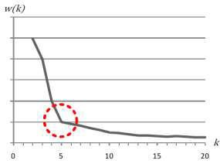
Determination of the number of clusters
 Many cluster algorithms require
the number k of clusters
 Idea: approximate determination of k
 A data set is clustered several times with varying k
 For every clustering, (w_{k}) is calculated
 (w_{k}) is visualized, indicating possible values of k
 w k : use the squared-error criterion or an internal
measure like the Davies-Bouldin index as function
𝑤 and search for a local optimum as an indication for an appropriate number k ݇
 K is application specific → visualization necessary

Slide 35
References
Provost, F.; Fawcett, T.: Data Science for Business; Fundamental Principles of Data Mining and Data- Analytic Thinking. O‘Reilly, CA 95472, 2013.
Carlo Vecellis, Business Intelligence, John Wiley & Sons, 2009
Eibe Frank, Mark A. Hall, and Ian H. Witten : The Weka Workbench, M Morgan Kaufman Elsevier, 2016.
Jason Brownlee, Machine Learning Mastery With Weka, E-Book, 2017

