Slide 1
Business Intelligence and Analytics:
What is a good model?
Session 8

Slide 2
Introduction
 What is desired from data mining results?
 How would you measure that your model is any good?
 How to measure performance in a meaningful way?
 Model evaluation is application-specific
 We look at common issues and themes in evaluation
 Frameworks and metrics for classification and instance scoring

Slide 3
Bad positives and harmless negatives
 Classification terminology
 a bad outcome → a “positive” example [alarm!]
 a good outcome → a “negative” example [uninteresting]
 Further examples
 medical test: positive test → disease is present
 fraud detector: positive test → unusual activity on account
 A classifier tries to distinguish the majority of cases (negatives, the uninteresting) from the small number of alarming cases (positives, alarming)
 number of mistakes made on negative examples (false positive errors) will be relatively high
 cost of each mistake made on a positive example (false negative error) will be relatively high

Slide 4
Agenda
 Measuring accuracy
 Confusion matrix
 Unbalanced classes
 A key analytical framework: Expected value
 Evaluate classifier use
 Frame classifier evaluation
 Evaluation and baseline performance

Slide 5

Measuring accuracy and its problems
 Up to now: measure a model‘s performance by
some simple metric
 classifier error rate, accuracy, …
 Simple example: accuracy
 Classification accuracy is popular, but usually too simplistic for applications of data mining to real business problems
 Decompose and count the different types of correct and incorrect decisions made by a classifier

Slide 6
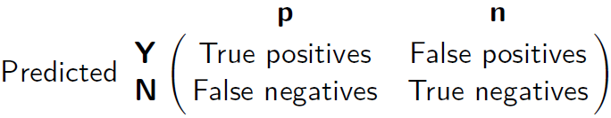
The confusion matrix
 A confusion matrix for a problem involving n classes
Is an nxn matrix with the columns labeled with actual classes and the rows labels with predicted classes
 Each example in a test set has an actual class label and the class predicted by the classifier
 The confusion matrix separates out the decisions
made by the classifier
 actual/true classes: p(ositive), n(egative)
 predicted classes: Y(es), N(o)
 The main diagonal contains the count of correct decisions

Slide 7
Unbalanced classes (1/3)
 In practical classification problems, one class is
often rare
 Classification is used to find a relatively small number of unusual ones (defrauded customers, defective parts, targeting consumers who actually would respond, …)
 The class distribution is unbalanced (“skewed”)
 Evaluation based on accuracy does not work
 Example: 999:1 ratio – always choose the most prevalent class – 99.9% accuracy!
 Fraud detection: skews of 10²
 Is a model with 80% accuracy always better than a model with 37% accuracy?
 We need to know more details about the population

Slide 8
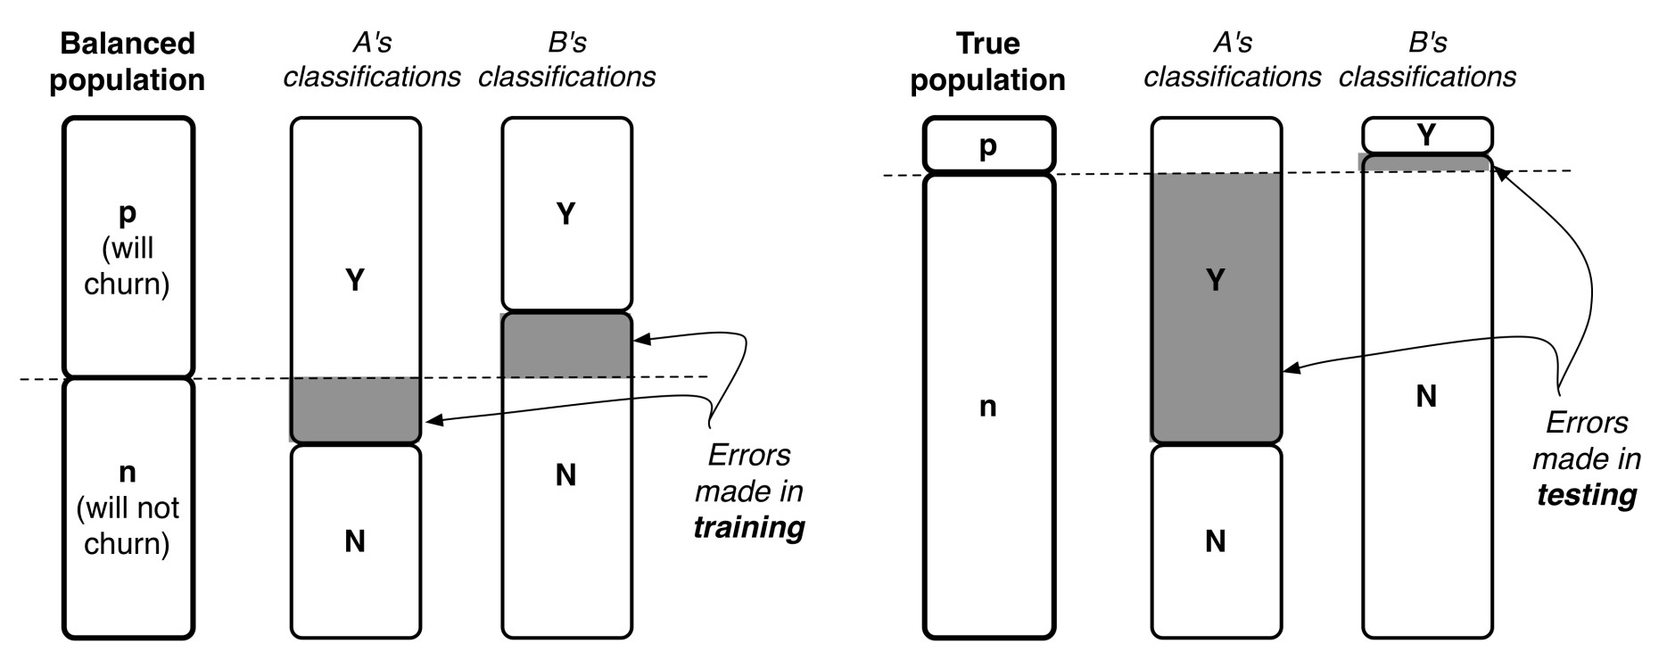
Unbalanced classes (2/3)
 Consider two models A and B for the churn
example (1000 customers, 1:9 ratio of churning)
 Both models correctly classify 80% of the balanced pop.
 Classifier A often falsely predicts that customers will churn
 Classifier B makes many opposite errors

Slide 9
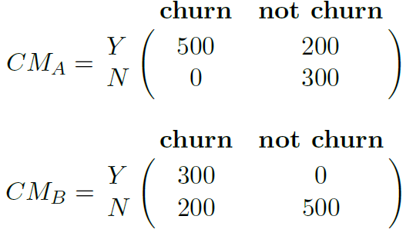
Unbalanced classes (3/3)
 Note the different performances of the models in
form of a confusion matrix:
 Model A achieves 80% accuracy on the balanced
sample
 Unbalanced population: A‘s accuracy is 37%,
B‘s accuracy is 93%
 Which model is better?
10

Slide 10
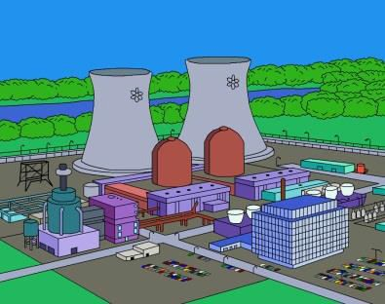
Unequal costs and benefits
 How much do we care about the different errors
and correct decisions?
 Classification accuracy makes no distinction between false positive and false negative errors
 In real-world applications, different kinds of errors lead to different consequences!
 Examples for medical diagnosis:
 a patient has cancer (although he does not)
→ false positive error, expensive, but not life threatening
 a patient has cancer, but she is told that she has not
→ false negative error, more serious
 Errors should be counted separately
 Estimate cost or benefit of each decision

Slide 11
A look beyond classification
 Another example: how to measure the accuracy /
quality of a regression model?
 Predict how much a given customer will like a given movie
 Typical accuracy of regression: mean-squared error
 What does the mean-squared error describe?
 Value of the target variable, e.g., the number of stars that a user would give as a rating for the movie
 Is the mean-squared error a meaningful metric?

Slide 12
Agenda
 Measuring accuracy
 Confusion matrix
 Unbalanced classes
 A key analytical framework: Expected value
 Evaluate classifier use
 Frame classifier evaluation
 Evaluation and baseline performance

Slide 13
The expected value framework
 Expected value calculation includes enumeration
of the possible outcomes of a situation
 Expected value = weighted average of the values of different possible outcomes, where the weight given to each value is the probability of its occurrence
 Example: different levels of profit
 We focus on the maximization of expected profit
 General form of expected value computation:
 Probabilities can be estimated from available data

Slide 14
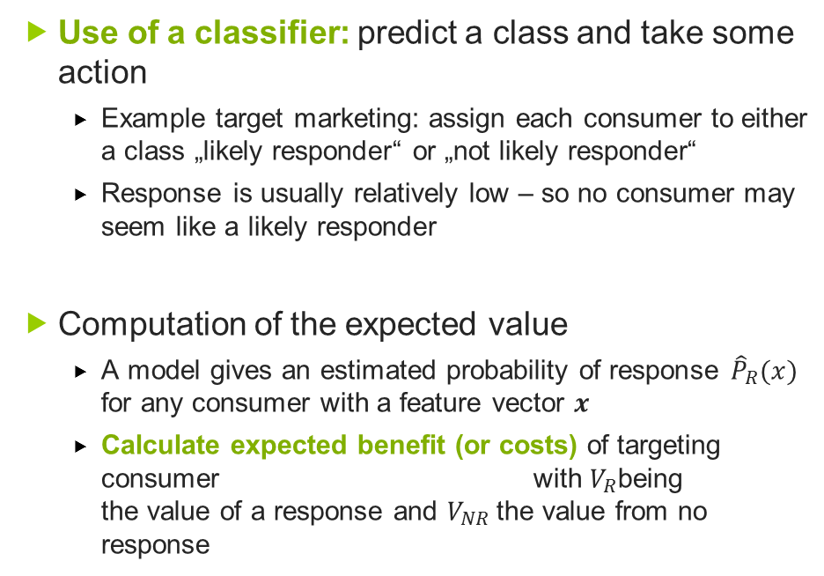
Expected value for use of a classifier (1/2)
 Use of a classifier: predict a class and take some
action
 Example target marketing: assign each consumer to either a class „likely responder“ or „not likely responder“
 Response is usually relatively low – so no consumer may seem like a likely responder
 Computation of the expected value
 A model gives an estimated probability of response ${\hat{P}}_{R}(x)$
for any consumer with a feature vector 𝒙
 Calculate expected benefit (or costs) of targeting consumer with $V_{R}$being the value of a response and $V_{NR}$the value from no response

Slide 15
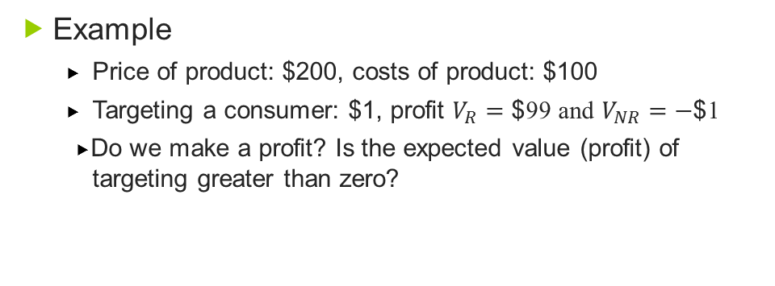
Expected value for use of a classifier (2/2)
 Example
 Price of product: $200, costs of product: $100
 Targeting a consumer: $1, profit $V_{R}=\text{\$}$99 and $V_{NR}=\text{−}\text{\$}$1
 Do we make a profit? Is the expected value (profit) of
targeting greater than zero?
 We should target the consumer as long as the estimated
probability of responding is greater than 1%!

Slide 16

Expected value for evaluation of a classifier
 Goal: compare the quality of different models
with each other
 Does the data-driven model perform better than a hand-crafted model?
 Does a classification tree work better than a linear discriminant model?
 Do any of the models perform substantially better than a baseline model?
 In aggregate: how well does each model do – what
is its expected value?

Slide 17
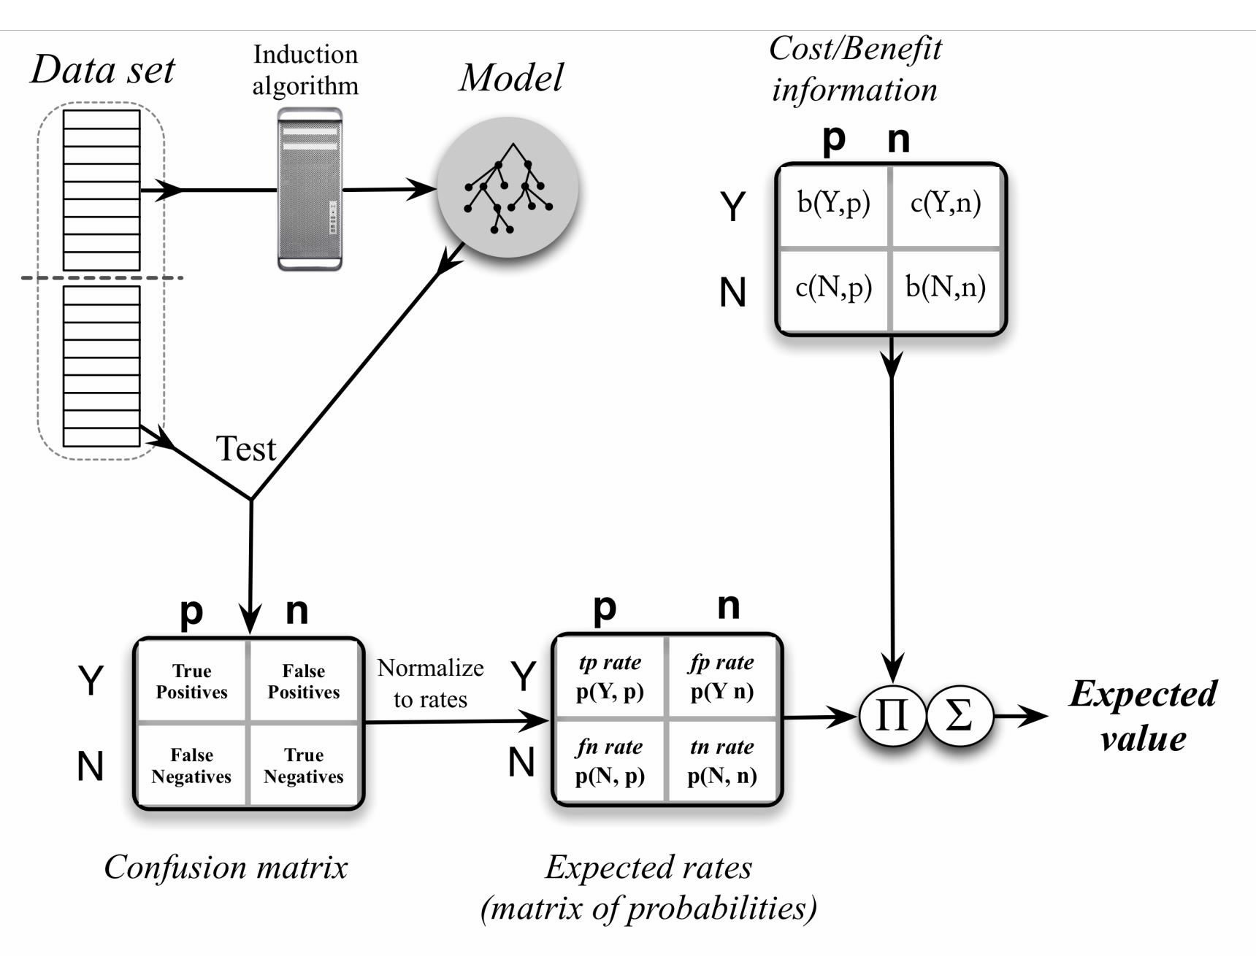
Expected value calculation

Slide 18
Expected value for evaluation of a classifier
 Aggregate together all the different cases:
 When we target consumers, what is the probability that
they (do not) respond?
 What about when we do not target consumers, would they have responded?
 This information is available in the confusion matrix
 Each ݋_{𝑖} corresponds to one of the possible combinations of the class we predict/the actual class
 Example confusion matrix/estimates of probability
Predicted | Actual
 |  | p | n
 | Y | 56 | 7
 | N | 5 | 42

Slide 19
Error rates
 Where do the probabilities of errors and correct
decisions actually come from?
 Each cell of the confusion matrix contains a count of the number of decisions corresponding to the combination of (predicted, actual) 𝑐𝑜𝑢𝑛𝑡(ℎ,𝑎)
Compute estimated probabilities as
𝑝(ℎ,𝑎)=𝑐𝑜𝑢𝑛𝑡(ℎ,𝑎)/𝑇
20

Slide 20
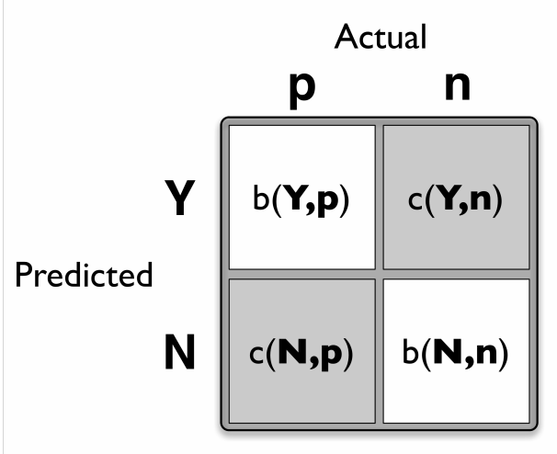
Costs and benefits
 Compute cost-benefit values for each decision pair
 A cost-benefit matrix specifies for each (predicted,actual) pair the cost or benefit making such a decision
  Correct classifications (true positives and negatives) correspond to 𝑏(𝑌,𝑝) and 𝑏(𝑁,𝑛), respectively.
  Incorrect classifications (false positives and negatives) correspond to 𝑏(𝑌,𝑛) and 𝑏(𝑁,𝑛), respectively [often negative benefits or costs]
 Costs and benefits cannot be estimated from data
 How much is it really worth us to retain a customer?
 Often use of average estimated costs and benefits

Slide 21
Costs and benefits - example
 Targeted marketing example
False positive occurs when we classify a consumer as a likely responder and therefore target her, but she does not respond → benefit 𝑏(𝑌,n) =−1
False negative is a consumer who was predicted not to be a likely responder, but would have bought if offered. No money spent, nothing gained → benefit 𝑏(𝑁,p)=0
True positive is a consumer who is offered the product and buys it → benefit 𝑏(𝑌,p)=200−100−1=99
True negative is a consumer who was not offered a deal but who would not have bought it → benefit 𝑏(𝑁,n)=0
 Sum up in cost-benefit matrix
Predicted | Actual
 |  | P | N
 | Y | 99 | -1
 | N | 0 | 0

Slide 22
Expected profit computation (1/2)
 Compute expected profit by cell-wise multiplication of the matrix of costs and benefits against the matrix of probabilities:
 Sufficient for comparison of various models
 Alternative calculation: factor out the probabilities
of seeing each class (class priors)
 Class priors P(p) and P(n) specify the likelihood of seeing positive versus negative instances
 Factoring out allows us to separate the influence of class imbalance from the predictive power of the model

Slide 23
Expected profit computation (2/2)
 Factoring out priors yields the following alternative
expression for expected profit
 The first component corresponds to the expected profit from the positive examples, whereas the second corresonds to the expected profit from the negative examples

Slide 24
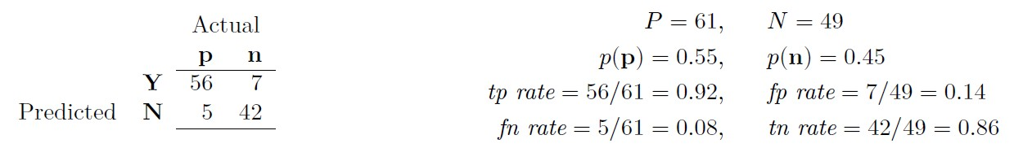
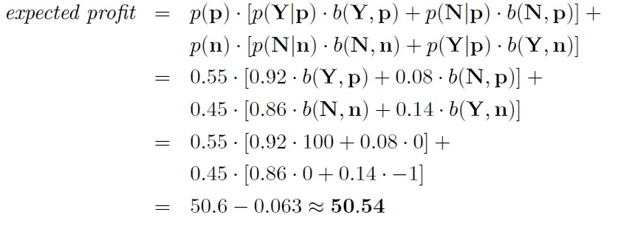
Costs and benefits – example alternative expression
 This expected value means that if we apply this model to a population of prospective customers and mail offers to those it classifies as positive, we can expect to make an average of about $50.54 profit per consumer.

Slide 25

Further insights
 In sum: instead of computing accuracies for competing models, we would compute expected values
 We can compare two models even though one is based on a representative distribution and one is based on a class-balanced data set
 Just replace the priors
 Balanced distribution → P(p)=0.5 P(n)= 0.5
 Make sure that the signs of quantities in the
cost-benefit matrix are consistent
 Do not double count by putting a benefit in one cell and a negative cost for the same
thing in another cell

Slide 26

Other evaluation metrics
 Based on the entries of the confusion matrix, we
can describe various evaluation metrics
 True positive rate (Recall):
𝑇𝑃
𝑇𝑃+𝐹𝑁
 False negative rate:
𝐹𝑁
𝑇𝑃+𝐹𝑁
 Precision (accuracy over the cases predicted to be
positive):
𝑇𝑃
𝑇𝑃+𝐹𝑃
 F-measure (harmonic mean):
 Sensitivity:
𝑇𝑁
𝑇𝑁+𝐹𝑃
𝑇𝑃
 Specificity:
𝑇𝑃+𝐹𝑁
 Accuracy (count of correct decisions): ^{𝑇𝑃+𝑇𝑁}
𝑃+𝑁

Slide 27
Agenda
 Measuring accuracy
 Confusion matrix
 Unbalanced classes
 A key analytical framework: Expected value
 Evaluate classifier use
 Frame classifier evaluation
 Evaluation and baseline performance

Slide 28
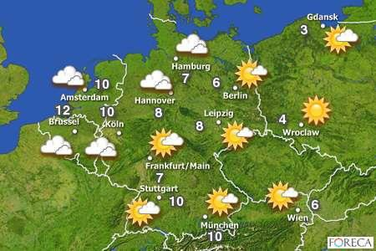
Baseline performance (1/3)
 Consider what would be a reasonable baseline
against which to compare model performance
 Demonstrate stakeholder that data mining has added value (or not)
 What is the appropriate baseline for comparison?
 Depends on the actual application
 Nate Silver on weather forecasting:
 There are two basic tests that any weather forecast must pass to demonstrate its merit: (1) It must do better than what meteorologists call persistence: the assumption that the weather will be the same tomorrow (and the next day) as it
was today. (2) It must also beat climatology, the long-term historical average of conditions on a particular date in a particular area.

Slide 29
Baseline performance (2/3)
 Baseline performance for classification
 Compare to a completely random model (very easy)
 Implement a simple (but not simplistic) alternative model
 Majority classifier = a naive classifier that always chooses the majority class of the training data set
 May be challenging to outperform: classification accuracy of 94%, but only 6% of the instances are positive
→ majority classifier also would have an accuracy of 94%!
 Pitfall: don‘t be surprised that many models simply predict everything to be of the majority class
 Maximizing simple prediction accuracy is usually not an appropriate goal
30

Slide 30
Baseline performance (3/3)
 Further alternative: how well does a simple
“conditional” model perform?
 Conditional → prediction different based on the value of the features
 Just use the most informative variable for prediction
 Decision tree: build a tree with only one internal node (decision stump) → tree induction selects the single most informative feature to make a decision
 Compare quality of models based on data sources
 Quantify the value of each source
 Implement models that are based on domain knowledge

Slide 31
References
Provost, F.; Fawcett, T.: Data Science for Business; Fundamental Principles of Data Mining and Data- Analytic Thinking. O‘Reilly, CA 95472, 2013.
Carlo Vecellis, Business Intelligence, John Wiley & Sons, 2009
Eibe Frank, Mark A. Hall, and Ian H. Witten : The Weka Workbench, M Morgan Kaufman Elsevier, 2016.
Jason Brownlee, Machine Learning Mastery With Weka, E-Book, 2017

