Slide 1
Course : ISYS8036-Business Intelligence and Analytics
VISUALIZING MODEL PERFORMANCE
Session 9

Slide 2
Agenda
Instance Ranking
Profit Curves
ROC Graph and ROC Curve
Area Under ROC (AUC)
LIFT Curves

Slide 3
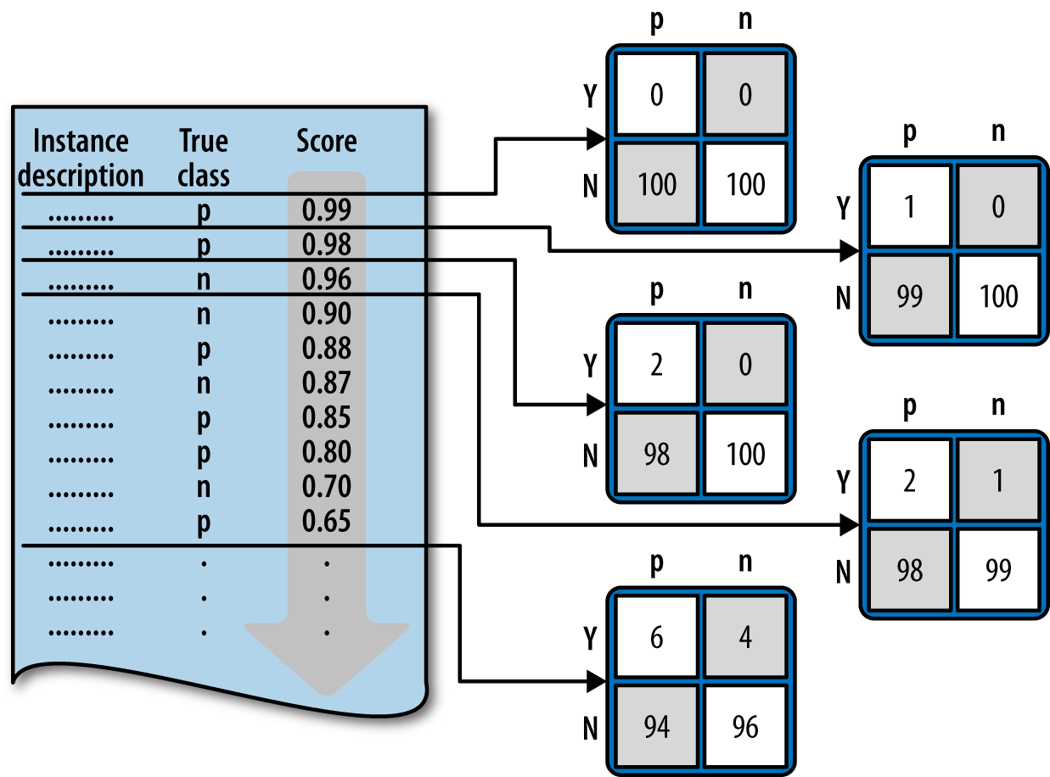
Ranking Instead of Classifying

Slide 4
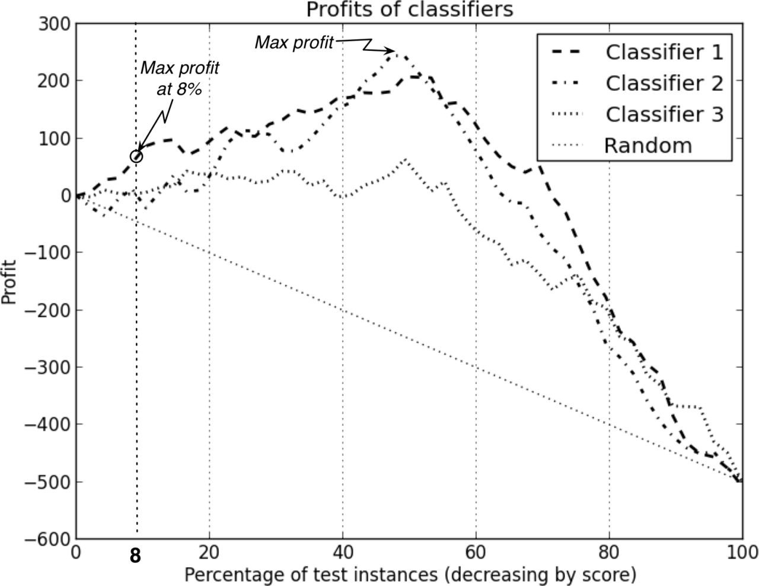
Profit Curves

Slide 5
Profit Curves
There are two critical conditions underlying the profit calculation:
The class priors
  The proportion of positive and negative instances in the target population
The costs and benefits
  The expected profit is specifically sensitive to the relative levels of costs and benefits for the different cells of the cost-benefit matrix
Reality..???

Slide 6
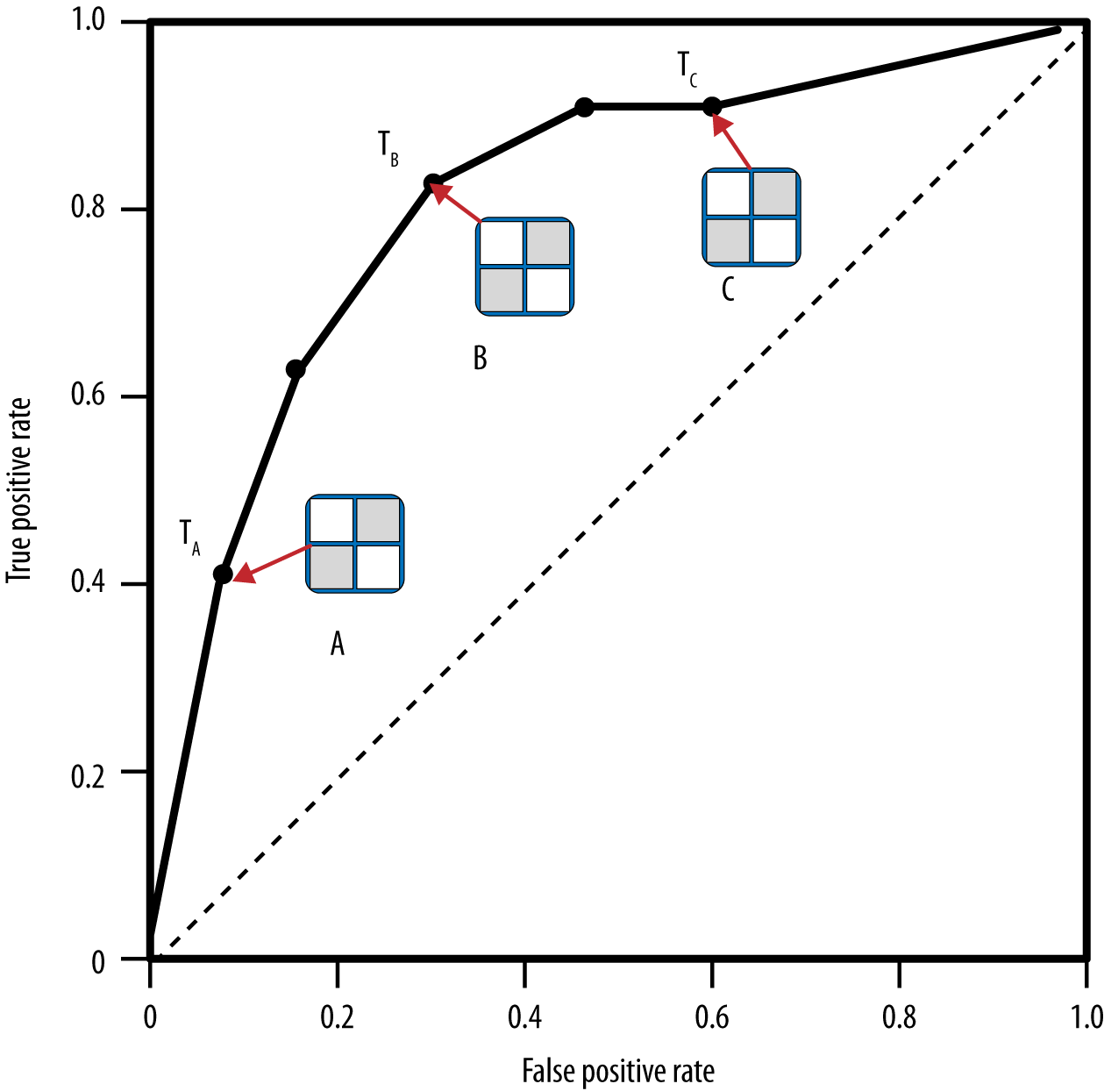
ROC Graphs and Curves

Slide 7
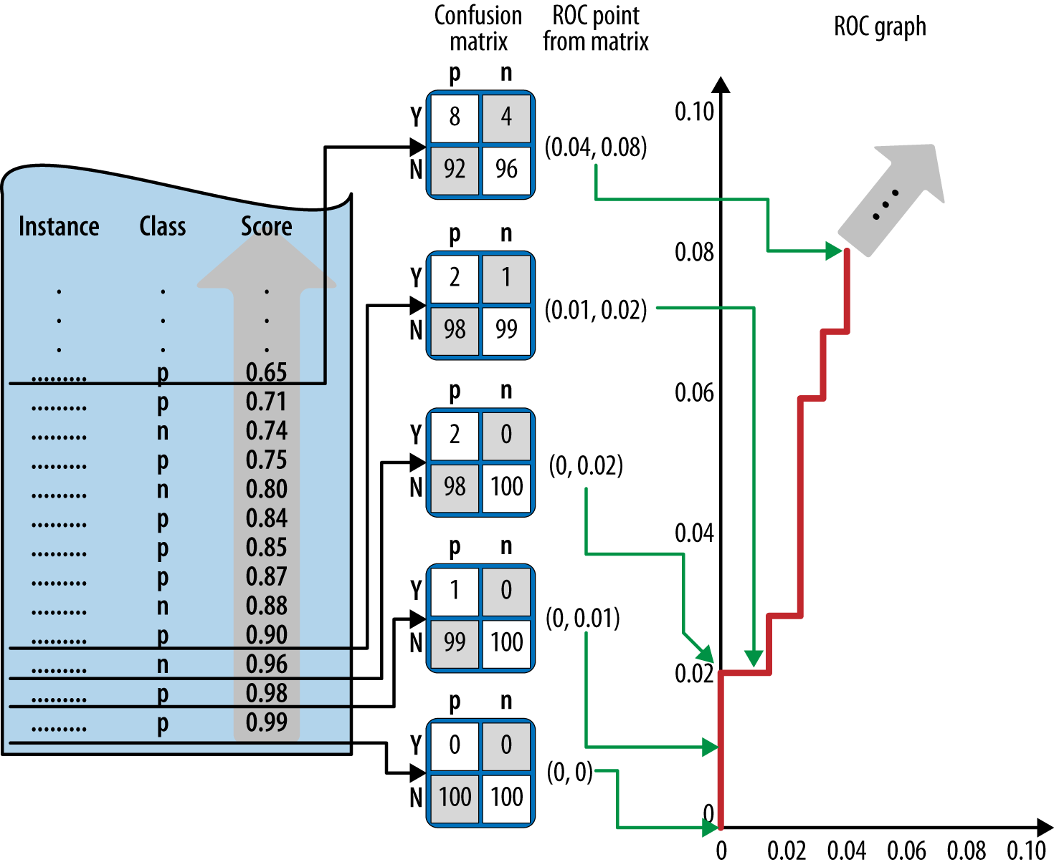
ROC Graphs and Curves

Slide 8
Generating ROC curve: Algorithm
Sort the test set by the model predictions
Start with cutoff = max (prediction)
Decrease cutoff, after each step count the number of true positives TP (positives with prediction above the cutoff) and false positives FP (negatives above the cutoff)
Calculate TP rate (TP/P) and FP (FP/N) rate
Plot current number of TP/P as a function of current FP/N

Slide 9
ROC Graphs and Curves
ROC graphs decouple classifier performance from the conditions under which the classifiers will be used
ROC graphs are independent of the class proportions as well as the
costs and benefits
Not the most intuitive visualization for many business stakeholders

Slide 10
Area Under the ROC Curve (AUC)
The area under a classifier’s curve expressed as a fraction of the unit square
  Its value ranges from zero to one
The AUC is useful when a single number is needed to summarize performance, or when nothing is known about the operating conditions
  A ROC curve provides more information than its area
Equivalent to the Mann-Whitney-Wilcoxon measure
  Also equivalent to the Gini Coefficient (with a minor algebraic transformation)
  Both are equivalent to the probability that a randomly chosen positive instance will be ranked ahead of a randomly chosen negative instance

Slide 11
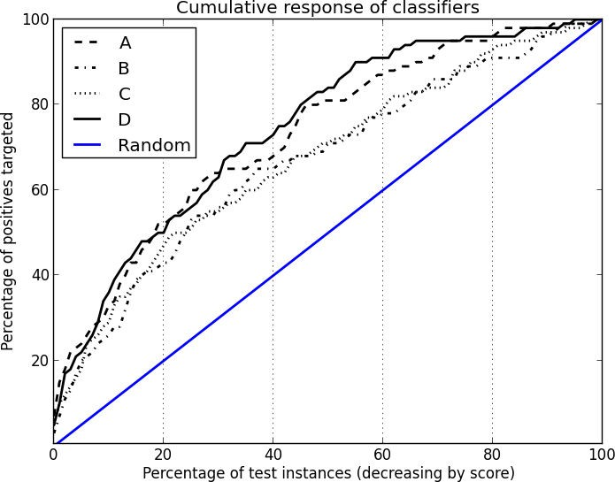
Cumulative Response curve

Slide 12
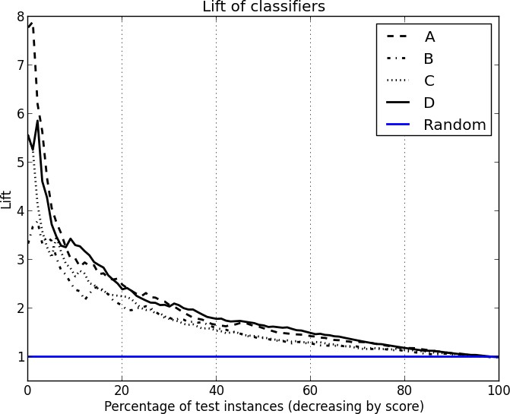
Lift Curve

Slide 13
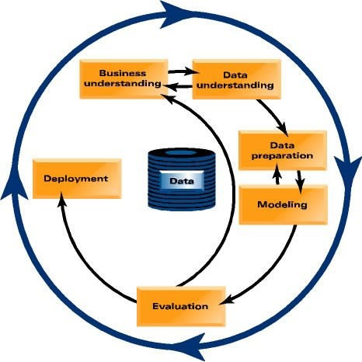

Let’s focus back in on actually mining the data..
Which model should TelCo select in order to target customers with a special offer, prior to contract expiration?

Slide 14
Performance Evaluation
Training Set:
Model | Accuracy
Classification Tree | 95%
Logistic Regression | 93%
𝑘-Nearest Neighbors | 100%
Naïve Bays | 76%
Test Set:
Model | Accuracy | AUC
Classification Tree | 91.8%±0.0 | 0.614±0.014
Logistic Regression | 93.0%±0.1 | 0.574±0.023
𝑘-Nearest Neighbors | 93.0%±0.0 | 0.537±0.015
Naïve Bays | 76.5%±0.6 | 0.632±0.019

Slide 15
Performance Evaluation
Naïve Bayes confusion matrix:
 | p | n
Y | 127 (3%) | 848 (18%)
N | 200 (4%) | 3518 (75%)
𝑘-Nearest Neighbors confusion matrix:
 | p | n
Y | 3 (0%) | 15 (0%)
N | 324 (7%) | 4351 (93%)

Slide 16
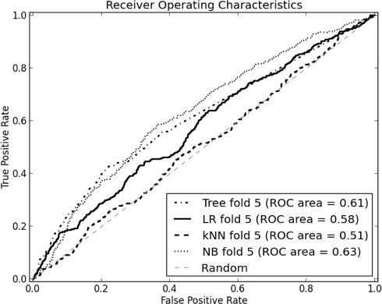
ROC Curve

Slide 17
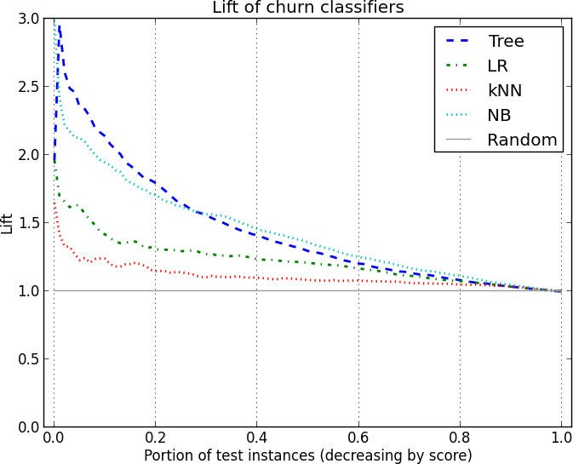
Lift Curve

Slide 18
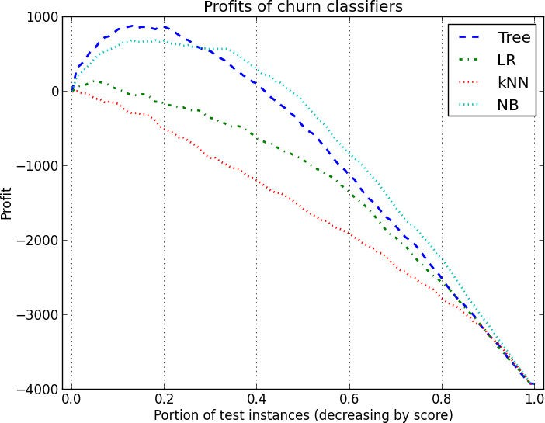
Profit Curves

Slide 19
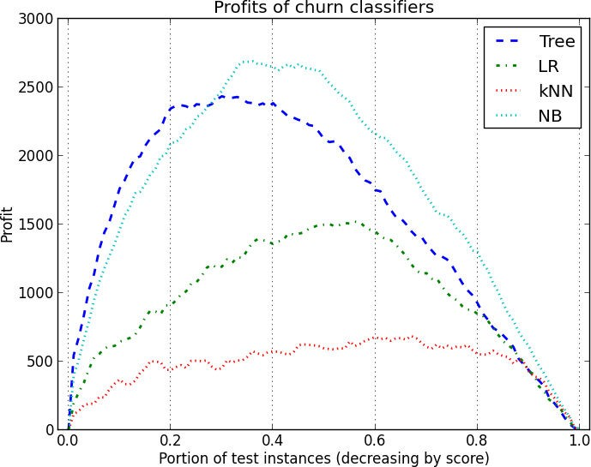
Profit Curves

Slide 20
References
Provost, F.; Fawcett, T.: Data Science for Business; Fundamental Principles of Data Mining and Data- Analytic Thinking. O‘Reilly, CA 95472, 2013.

