Slide 1
Business Intelligence and Analytics:
Evidence and Probability
Session 10

Slide 2
Agenda
 Introduction
 Bayes‘ Rule
 Applying Bayes‘ rule to data science
 Naive Bayes
 Advantages and Disadvantages of Naive Bayes
 Example

Slide 3
Introductory example (1/2)
 So far: using data to draw conclusions about
some unknown quantity of a data instance
 Now: analyse data instances as evidence
for or against different values of the target
 Example: target online displays to consumers based on webpages they have visited in the past
 Run a targeted campaign for, e.g., a luxury hotel
 Target variable: will the consumer book a hotel room within one week after having seen the advertisement?
 Cookies allow for observing which consumers book rooms

Slide 4
Introductory example (2/2)
 (…)
 A consumer is characterized by the set of websites we
have observed her to have visited previously (cookies!)
 We assume that some of these websites are more likely to be visited by good prospects for the luxury hotel
 Problem: we do not have the resources to estimate the evidence potential for each site manually
 Idea: use historical data to estimate both the direction and the strength of the evidence
 Combine the evidence to estimate the
resulting likelihood of class membership
 Similar problem: spam detection

Slide 5
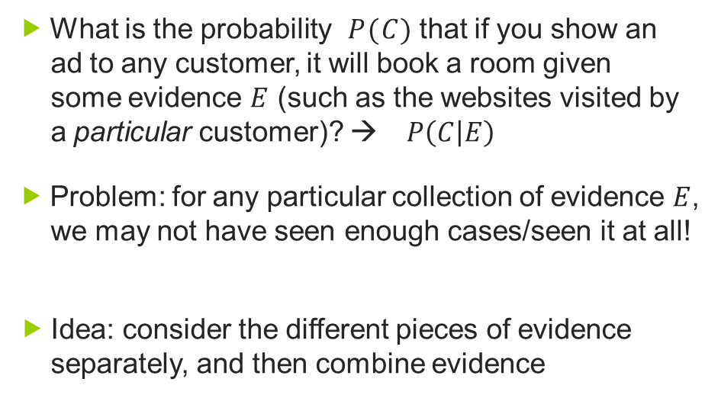
Combining evidence probabilistically
 What is the probability $P(C)$ that if you show an ad to any customer, it will book a room given some evidence 𝐸 (such as the websites visited by a particular customer)? → $P\left(C | E\right)$
 Problem: for any particular collection of evidence 𝐸, we may not have seen enough cases/seen it at all!
 Idea: consider the different pieces of evidence separately, and then combine evidence

Slide 6
Reminder: statistical (in)dependence
 If the events A and B are statistically independent, then we can compute the probability that both A and B occur as
$$p\left(AB\right)=p\left(A\right)∙p\left(B | A\right)$$
 Example: rolling a fair dice
 The general formular for combining probabilities that take care of dependencies between events is
$$p\left(AB\right)=p\left(A\right)p\left(B | A\right)$$
 Given that you know A, what is the probability of B

Slide 7
Agenda
 Introduction
 Bayes‘ Rule
 Applying Bayes‘ rule to data science
 Naive Bayes
 Advantages and Disadvantages of Naive Bayes
 Example

Slide 8
Bayes‘ rule (2/2)
 Bayes‘ rule says
 that we can compute the probability of our hypothesis 𝐻 given some evidence 𝐸 by instead looking at the probability of the evidence given the hypothesis as well as the unconditional probability of the hypothesis and the evidence.
 Example: medical diagnosis
 Hypothesis 𝐻 = measles, Evidence 𝐸 = red spots
 In order to directly estimate 𝑝(𝑚𝑒𝑎𝑠𝑙𝑒𝑠|𝑟𝑒𝑑 𝑠𝑝𝑜𝑡𝑠) we would need to think through all the different reasons a person might exhibit red spots and what proportion of them would be measles.
 Instead: 𝑝(𝐸|𝐻) is the prob. that one has red spots given that one has measles. 𝑝(𝐻) is simply the prob. that someone has measles, and 𝑝(𝐸) that someone has red spots.
10

Slide 9
Applying Bayes‘ rule to data science (1/2)
 A lot of DM methods are based on Bayes‘ rule
 Bayes‘ rule for classification of the probability that the target variable C takes on the class of interest ܿ after taking the evidence 𝐸 (feature values) into account:
 𝑝 (𝐶 = 𝑐) is the 'prior' probability of the class, i.e., the probability we would assign to the class before seeing any evidence [e.g., the prevalence of c in the population = percentage of all examples that are of class c.
 𝑝 (𝐸|𝐶 = 𝑐) is the likelihood of seeing the evidence 𝐸 [the percentage of examples of class c that have 𝐸]
 𝑝 (𝐸) is the likelihood of the evidence [occurence of 𝐸]
11

Slide 10
Applying Bayes‘ rule to data science (2/2)
 (…)
 Estimating these values, we could use $p\left(C=c | E\right)$ as an
estimate of class probability
 Alternatively, we could use the values as a score to rank instances
 Drawback: if 𝐸 is a usual vector of attribute values, we would require knowing the full joint probability of the example
 This is difficult to measure
 We may never see a specific example in the training data
that matches a given 𝐸 in our test data
 Make a particular assumption of independence!

Slide 11
Naive Bayes (1/2)
 Conditional independence: use the class of the
example as condition
 This allows for easy combination of probabilities:
$$p\left(AB | C\right)=p\left(A | C\right)∙p\left(B | C\right)$$
 In other words: we assume that the attributes are
conditionally independent, i.e.
Each of the terms p(e_{i}|c) can be computed directly
from the data (count up the prop. we see e_{i} in c)

Slide 12
Naive Bayes (2/2)
 Naive Bayes classifies a new example by estimating the probability that the example belongs to each class and reports the class with highest probability
 Note that the denominator P(E) never actually has
to be calculated
 We can focus on the nominator for comparison of different classes ܿ, because the denominator is always the same
 If we need probability estimates, the probabilities will add
up to one, so we can derive it from the other quantities

Slide 13
(Dis)Advantages of Naive Bayes
 Naive Bayes
 is a simple classifier, although it takes all the feature
evidence into account
 is very efficient in terms of storage space and comp. time
 performs surprisingly well for classification
 is an „incremental learner“
 Note that the independence assumption does not hurt classification performance very much
 To some extent, we double the evidence
 Tends to make the probability estimates more extreme in the correct direction
 Don‘t use the probability estimates themselves!
 But ranking is ok!

Slide 14
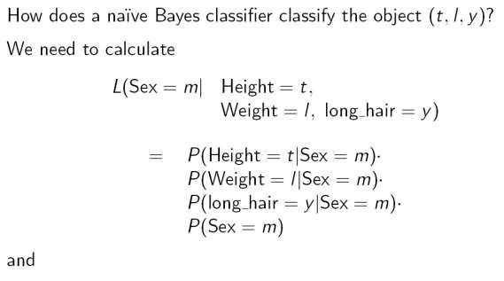
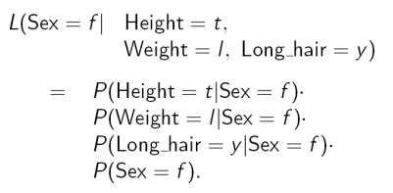
Example: Naive Bayes classifier (1/5)

Slide 15
Questions
 Introduction
 Bayes‘ Rule
 Applying Bayes‘ rule to data science
 Naive Bayes
 Advantages and Disadvantages of Naive Bayes
 Example
21

Slide 16
References
Provost, F.; Fawcett, T.: Data Science for Business; Fundamental Principles of Data Mining and Data- Analytic Thinking. O‘Reilly, CA 95472, 2013.
Sharda, R., Delen, D., Turban, E., (2018). Business intelligence, Analytics, and Data Science: A Managerial Perspective, 4th Edition, Pearson.

