Slide 1
Business Intelligence and Analytics:
Representing and Mining Text
Session 11

Slide 2
Agenda
Text Representation
Text Preprocessing
Term Frequency and IDF
Case Study

Slide 3
Dealing with Text
Data are represented in ways natural to problems from which they were derived
Vast amount of text..
If we want to apply the many data mining tools that we have at our disposal, we must
  either engineer the data representation to match the tools
(representation engineering), or
  build new tools to match the data

Slide 4
Why Text is Difficult
Text is “unstructured”
  Linguistic structure is intended for human communication and not
computers
Word order matters sometimes
Text can be dirty
  People write ungrammatically, misspell words, abbreviate unpredictably, and punctuate randomly
  Synonyms, homograms, abbreviations, etc.
Context matters

Slide 5
Text Representation
Goal: Take a set of documents –each of which is a relatively free- form sequence of words– and turn it into our familiar feature-vector form
A collection of documents is called a corpus
A document is composed of individual tokens or terms
Each document is one instance
  but we don’t know in advance what the features will be

Slide 6
“Bag of Words”
Treat every document as just a collection of individual words
  Ignore grammar, word order, sentence structure, and (usually)
punctuation
  Treat every word in a document as a potentially important keyword of the document
What will be the feature’s value in a given document?
  Each document is represented by a one (if the token is present in the document) or a zero (the token is not present in the document)
Straightforward representation
Inexpensive to generate
Tends to work well for many tasks

Slide 7
Pre-processing of Text
The following steps should be performed:
The case should be normalized
  Every term is in lowercase
Words should be stemmed
  Suffixes are removed
  E.g., noun plurals are transformed to singular forms
Stop-words should be removed
  A stop-word is a very common word in English (or whatever language is being parsed)
  Typical words such as the words the, and, of, and on are removed

Slide 8
Term Frequency
Use the word count (frequency) in the document instead of just a zero or one
  Differentiates between how many times a word is used

Slide 9
Normalized Term Frequency
Documents of various lengths
Words of different frequencies
  Words should not be too common or too rare
  Both upper and lower limit on the number (or fraction) of documents in which a word may occur
  Feature selection is often employed
The raw term frequencies are normalized in some way,
  such as by dividing each by the total number of words in the document
  or the frequency of the specific term in the corpus

Slide 10
TF-IDF
TFIDF 𝑡, 𝑑
= TF 𝑡, 𝑑
× IDF 𝑡
Inverse Document Frequency (IDF) of a term
Total number of documents
IDF 𝑡
= 1 + log
Number of documents containing 𝑡

Slide 11
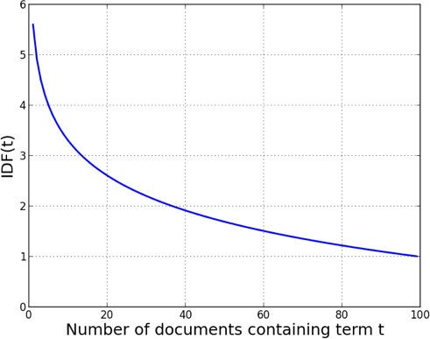
TFIDF
Source: Data Science for Business; Fundamental Principles of Data Mining and Data- Analytic Thinking.

Slide 12
Example: Jazz Musicians
15 prominent jazz musicians and excerpts of their biographies from Wikipedia
Nearly 2,000 features after stemming and stop-word removal!
Consider the sample phrase “Famous jazz saxophonist born in Kansas who played bebop and latin”

Slide 13
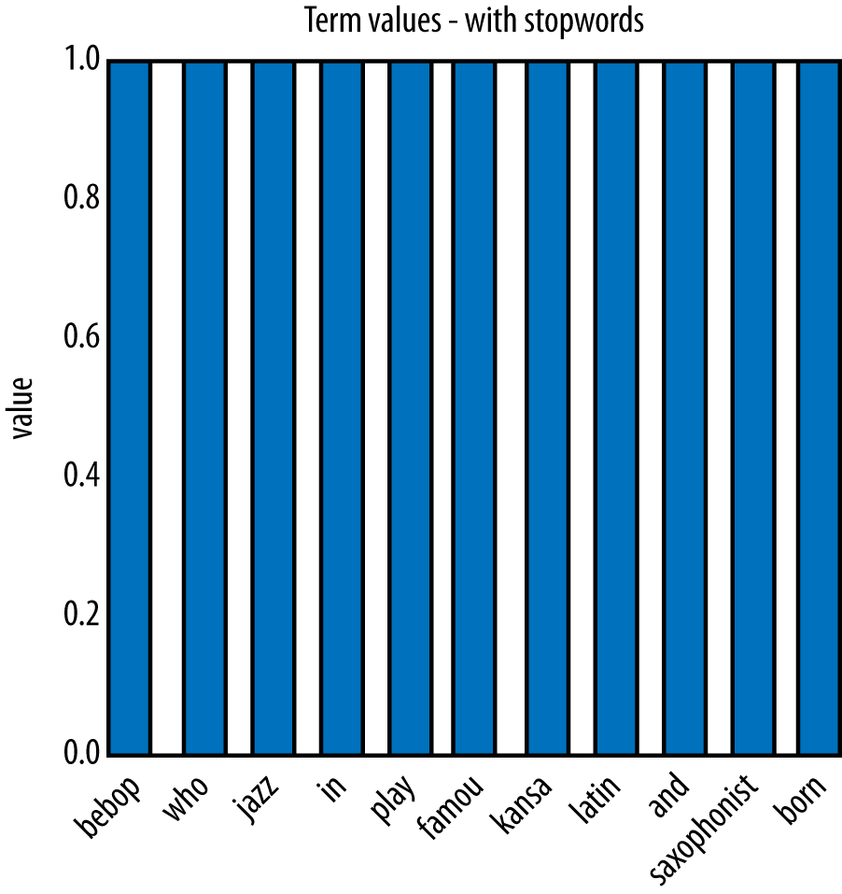
Example: Jazz Musicians
Source: Data Science for Business; Fundamental Principles of Data Mining and Data- Analytic Thinking.

Slide 14
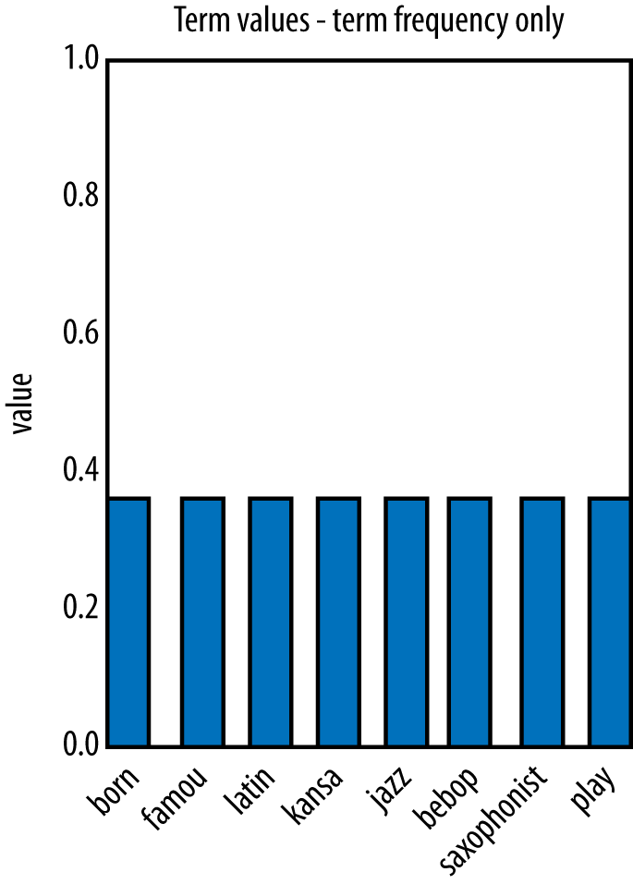
Example: Jazz Musicians
Source: Data Science for Business; Fundamental Principles of Data Mining and Data- Analytic Thinking.

Slide 15
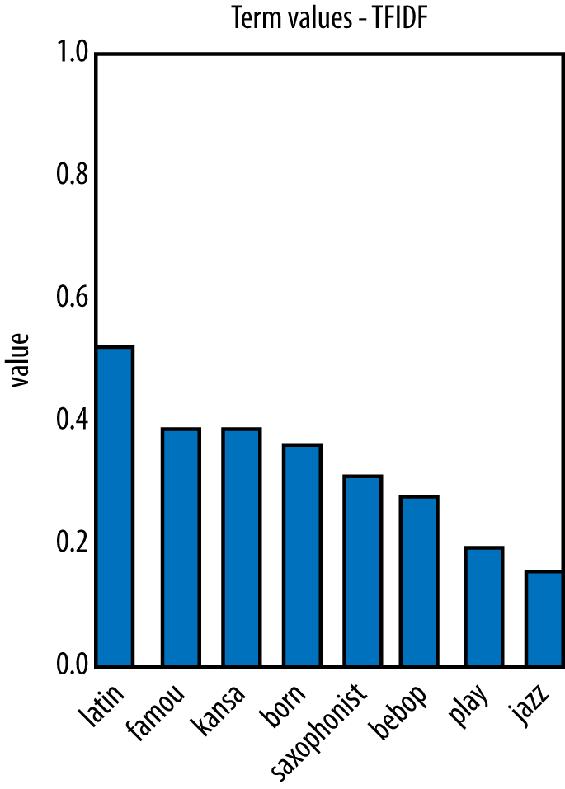
Example: Jazz Musicians
Source: Data Science for Business; Fundamental Principles of Data Mining and Data- Analytic Thinking.

Slide 16
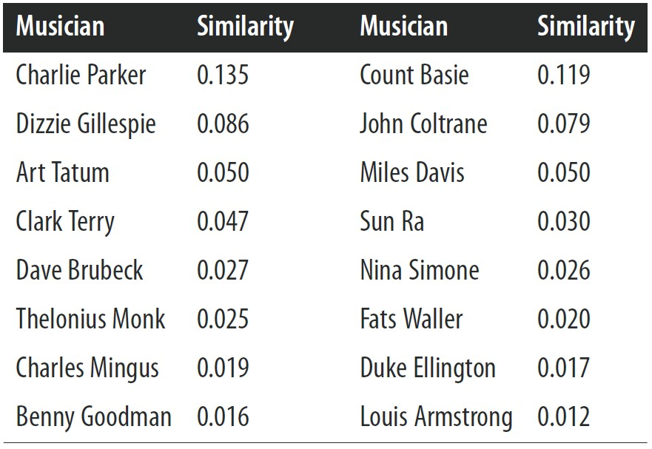
Example: Jazz Musicians

Slide 17
Beyond “Bag of Words”
𝑁-gram Sequences
Named Entity Extraction
Topic Models

Slide 18
N-gram Sequences
In some cases, word order is important and you want to preserve some information about it in the representation
A next step up in complexity is to include sequences of adjacent
words as terms
Adjacent pairs are commonly called bi-grams
Example: “The quick brown fox jumps”
  It would be transformed into {quick, brown, fox, jumps, quick_brown, brown_fox, fox_jumps}
N-grams they greatly increase the size of the feature set

Slide 19
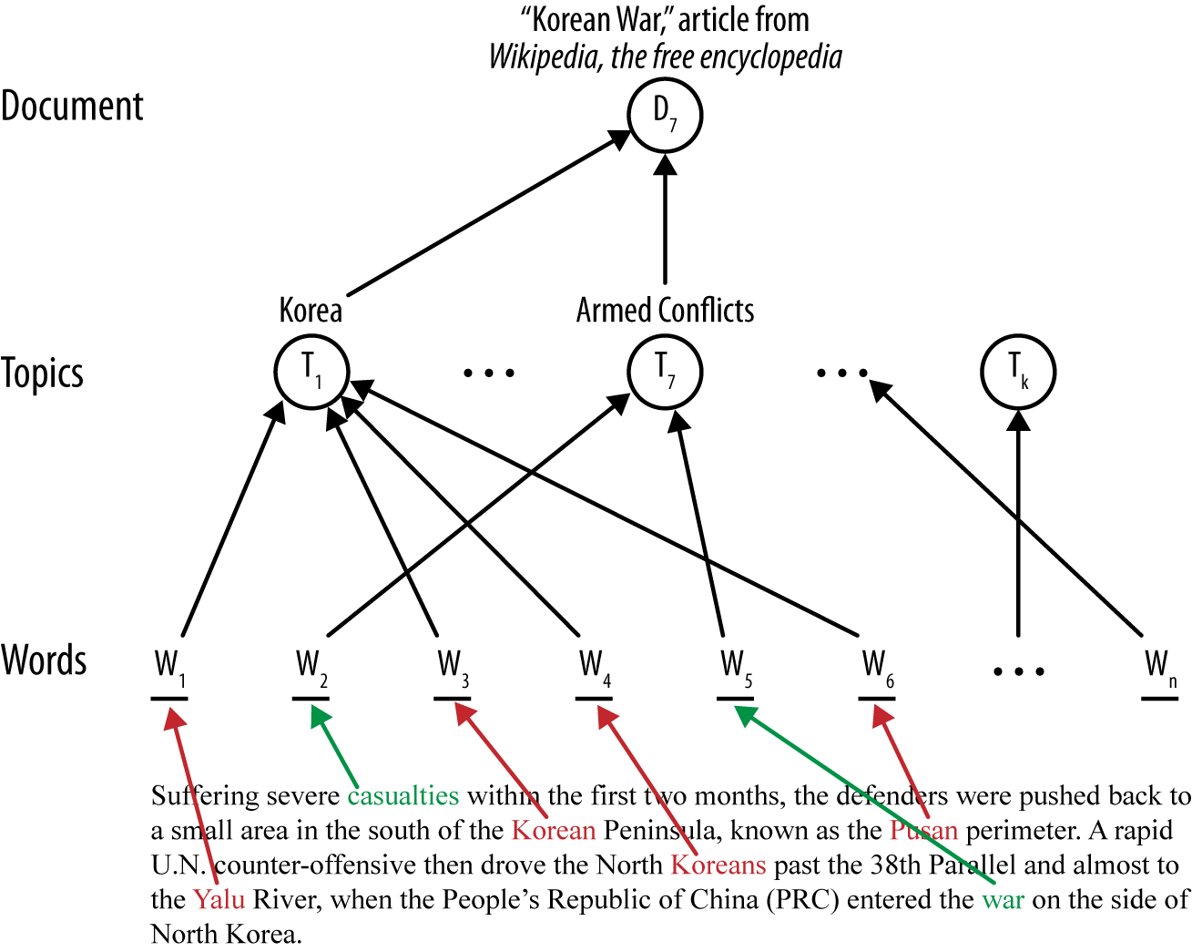
Topic Models
Source: Data Science for Business; Fundamental Principles of Data Mining and Data- Analytic Thinking.

Slide 20
Text Mining Example
Task: predict the stock market based on the stories that appear on the news wires

Slide 21
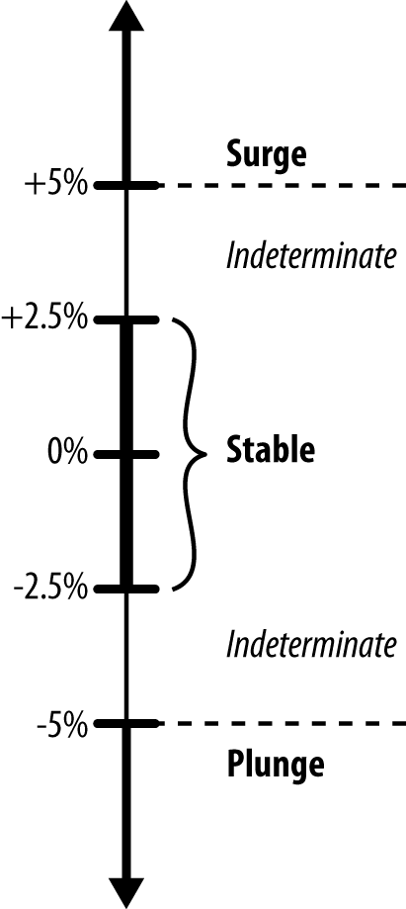
Mining News Stories to Predict Stock Price Movement
Source: Data Science for Business; Fundamental Principles of Data Mining and Data- Analytic Thinking.

Slide 22
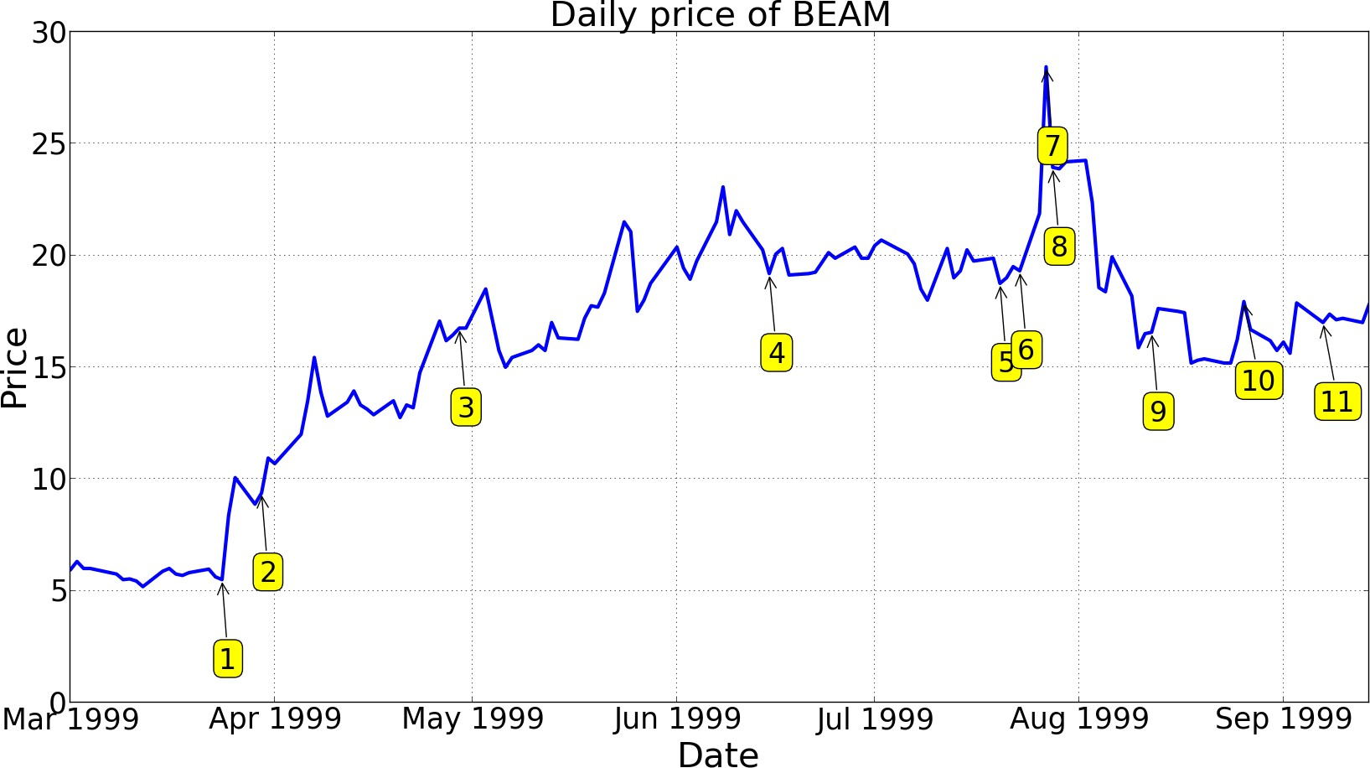
Mining News Stories to Predict Stock Price Movement
Source: Data Science for Business; Fundamental Principles of Data Mining and Data- Analytic Thinking.

Slide 23
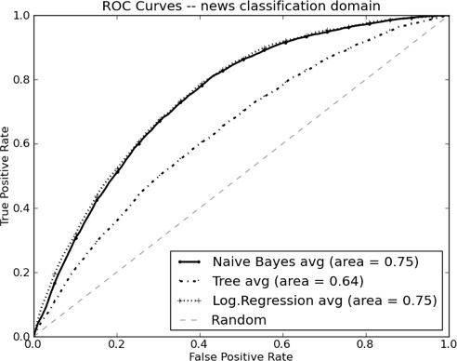
Mining News Stories to Predict Stock Price Movement
Source: Data Science for Business; Fundamental Principles of Data Mining and Data- Analytic Thinking.

Slide 24
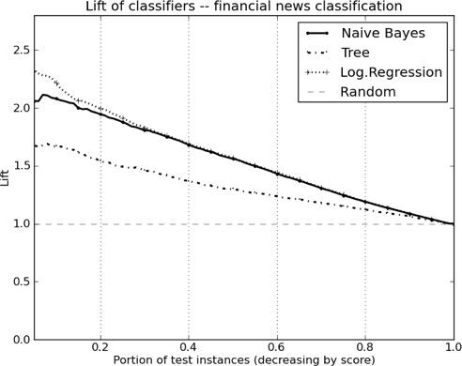
Mining News Stories to Predict Stock Price Movement
Source: Data Science for Business; Fundamental Principles of Data Mining and Data- Analytic Thinking.

Slide 25
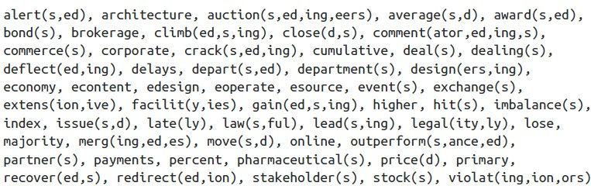
Mining News Stories to Predict Stock Price Movement

Slide 27
References
Provost, F.; Fawcett, T.: Data Science for Business; Fundamental Principles of Data Mining and Data- Analytic Thinking. O‘Reilly, CA 95472, 2013.
Eibe Frank, Mark A. Hall, and Ian H. Witten : The Weka Workbench, M Morgan Kaufman Elsevier, 2016.
Jason Brownlee, Machine Learning Mastery With Weka, E-Book, 2017
Sharda, R., Delen, D., Turban, E., (2018). Business intelligence, Analytics, and Data Science: A Managerial Perspective, 4th Edition, Pearson.

