Slide 1
Force System Resultants
Statics
Week #5

Slide 2
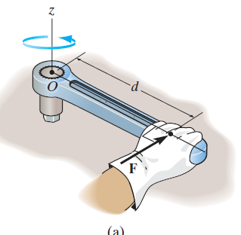
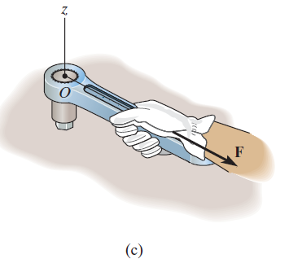
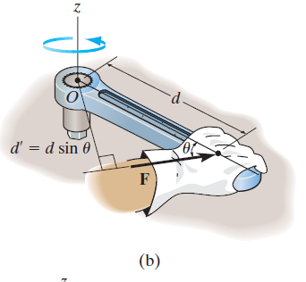
Moment of a Force (scalar formulation)
When a force is applied to a body it will produce a tendency for the body
to rotate about a point that is not on the line of action of the force.
Torque/
moment

Slide 3
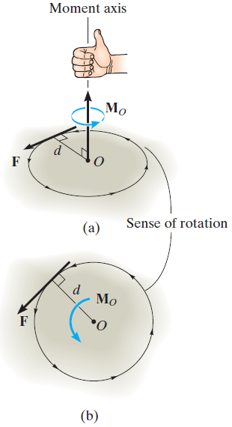
Magnitude and Direction of a Moment
Very important to understand this!
The magnitude of M_{o} is
where d is the moment arm or perpendicular distance
from the axis at point O to the line of action of the force.
The direction of M_{o} is defined by its moment axis, which is perpendicular to the plane that contains the force F and its moment arm d. See figure (a).
The right-hand rule is then used to establish the
sense of direction (direction of rotation) of M_{o}.

Slide 4
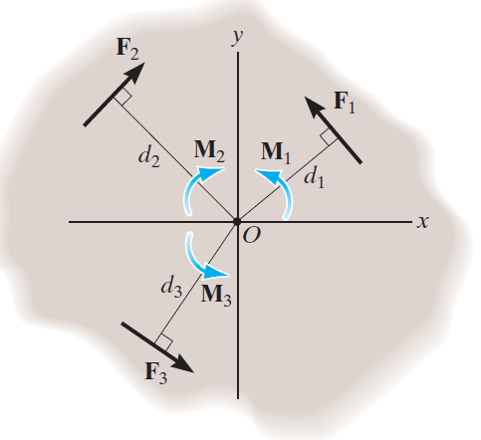
Resultant Moment
For two-dimensional problems
As a convention,
we will generally consider positive moments as counter clockwise since they are directed along the positive z axis (out of the page).
Clockwise moments will be negative (into the page).

Slide 5
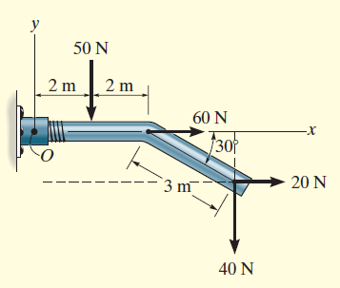
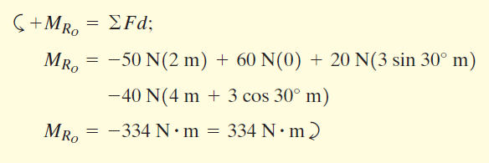
Example
Determine the resultant moment of the four forces acting on the rod shown in the Figure about point O.

Slide 6
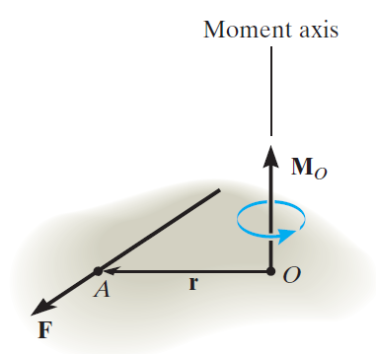
Moment of a Force (vector formulation)
The moment of a force F about point O can be expressed using the vector cross product as,
r represents a position vector directed from O to any point on the line of action of F

Slide 7
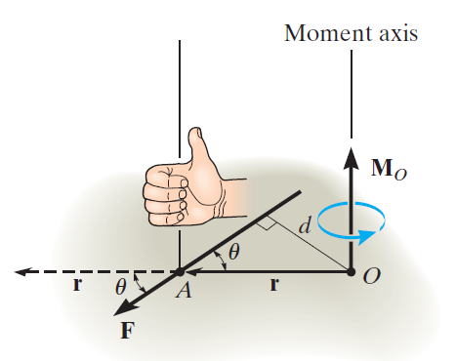
Moment of a Force (vector formulation)
The magnitude of the cross product is defined as
M_{O} = r F sin θ where the angle is measured between the tails of r and F.
The direction and sense of M_{O} are determined
by the right-hand rule as it applies to the cross product.

Slide 8
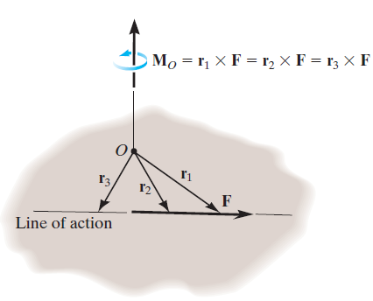
Moment of a Force (vector formulation)
Principle of Transmissibility
We can use any position vector r measured from
point O to any point on the line of action of
the force F.

Slide 9
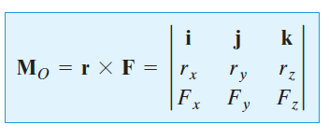
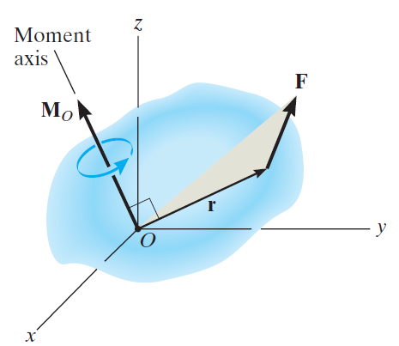
Moment of a Force (vector formulation)
Cartesian Vector Formulation

Slide 10
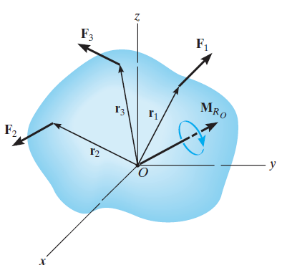
Moment of a Force (vector formulation)
Resultant Moment of a System of Forces

Slide 11
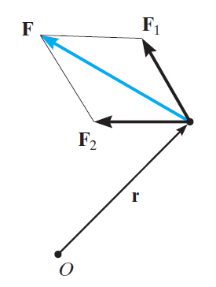
Principle of Moments (Verignon’s theorem)
‘the moment of a force about a point is equal to the sum of the moments of the components of the force about the point’

Slide 12
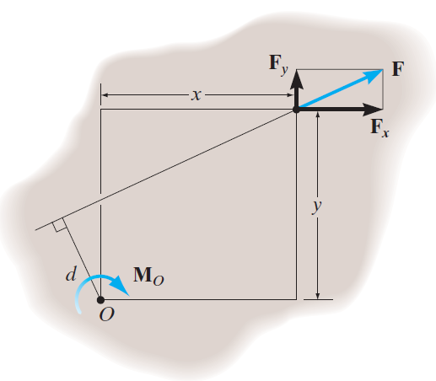
Principle of Moments (Verignon’s theorem)
For two dimensional problems
This method is generally easier than finding the same moment using M_{O} = F d.

Slide 13
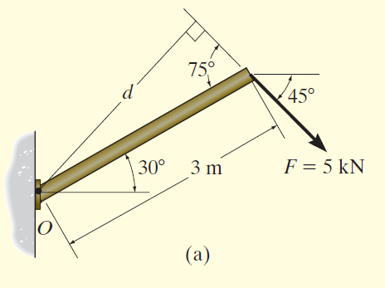
Examples
Determine the moment of the force in the Figure below about point O.

Slide 14
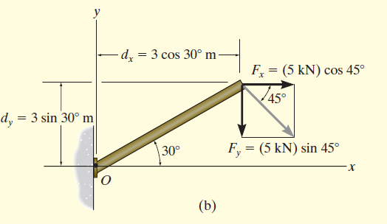
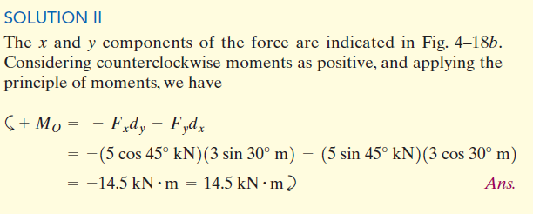

Slide 15
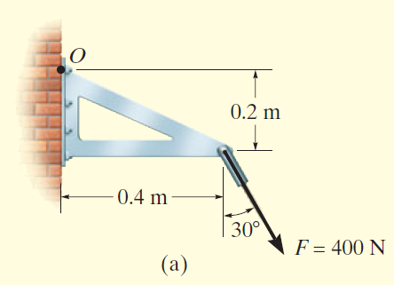
Examples

Slide 16
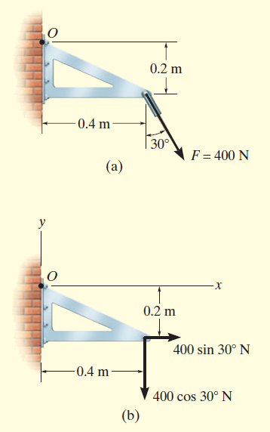
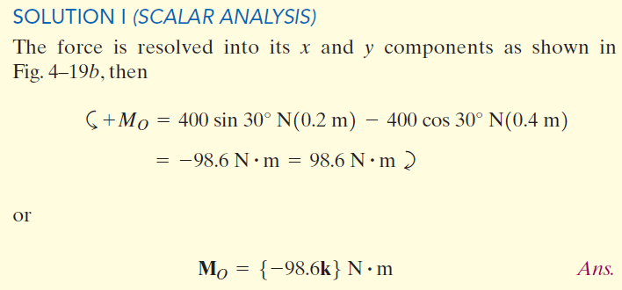
Free body diagram

Slide 17
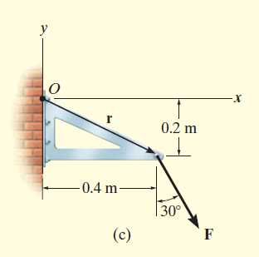
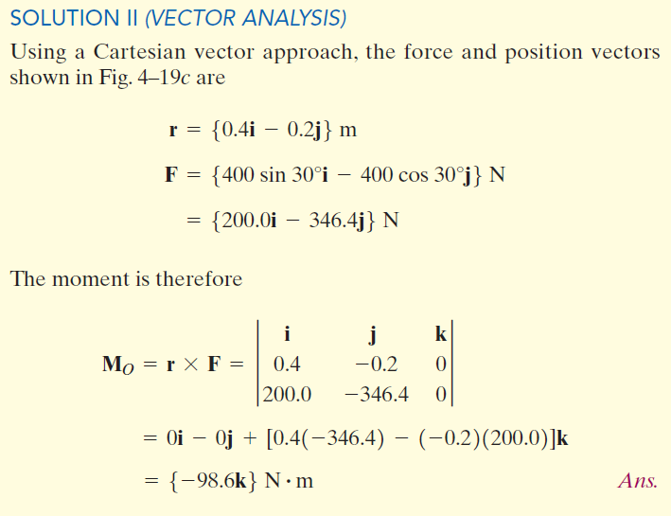

Slide 18
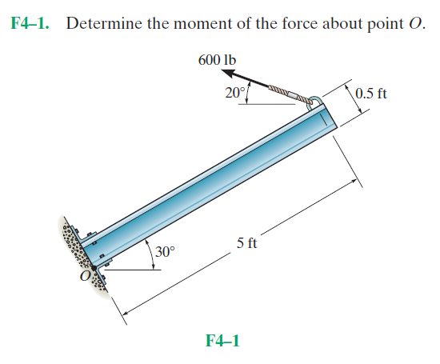
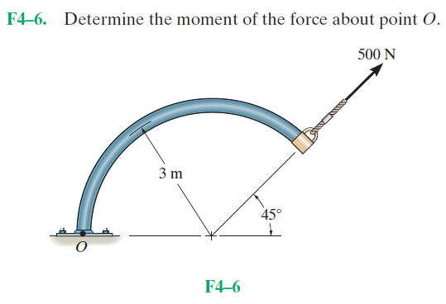
Fundamental Problems

Slide 19
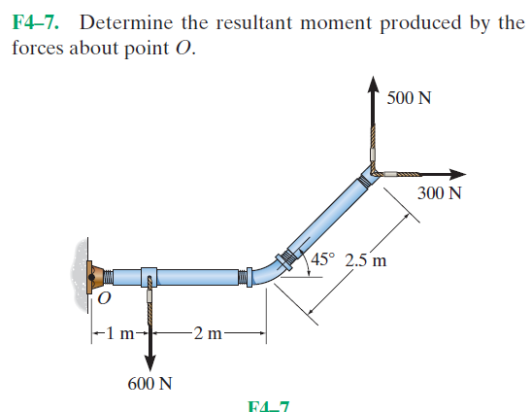
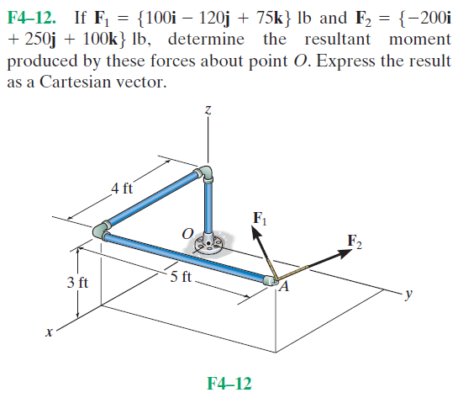
Fundamental Problems

Slide 20
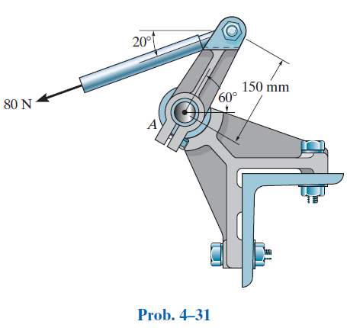
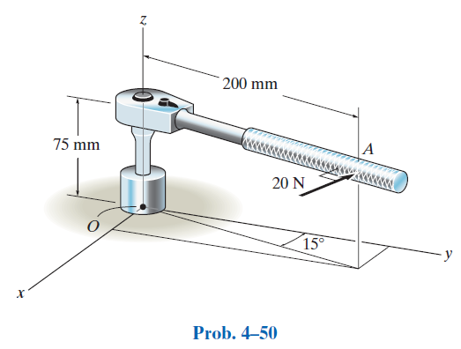
Advanced Problems

