Slide 1
Center of Gravity, Center of Mass, and the Centroid of a Body
Week #10

Slide 2
Center of Gravity
A body is composed of an infinite number of particles of differential size, and so if the body is located within a gravitational field, then each of these particles will have a weight dW, Fig. 9–1a. These weights will form an approximately parallel force system, and the resultant of this system is the total weight of the body, which passes through a single point called the center of gravity, G, Fig. 9–1b.*

Slide 3
the weight of the body is the sum of the weights of all of its particles, that is
The location of the center of gravity, measured from the y axis, is determined by equating the moment of W about the y axis, Fig. 9–1b, to the sum of the moments of the weights of the particles about this same axis. If dW is located at point (x,y,z ), Fig. 9–1a, then

Slide 4
Similarly, if moments are summed about the x axis,
and about the z axis,
Therefore, the location of the center of gravity G with respect to the x, y,
z axes becomes

Slide 5
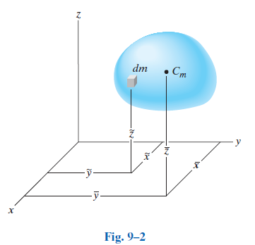
Center of Mass of a Body
In order to study the dynamic response or accelerated motion of a body, it becomes important to locate the body’s center of mass C_{m}, Fig. 9–2. This location can be determined by substituting dW = g dm into Eqs. 9–1. Since g is constant, it cancels out, and so

Slide 6
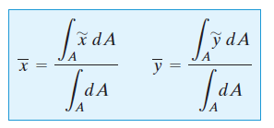
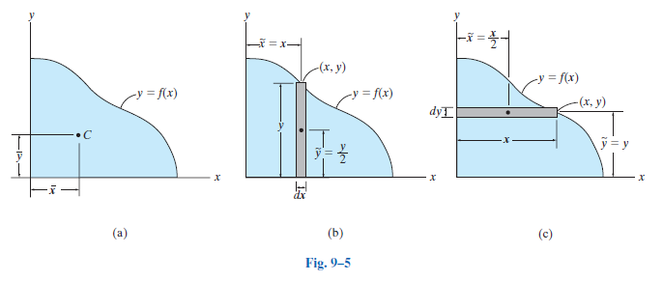
Centroid of an Area
If an area lies in the x–y plane and is bounded by the curve , as shown in Fig. 9–5a, then its centroid will be in this plane and can be determined from,

Slide 7
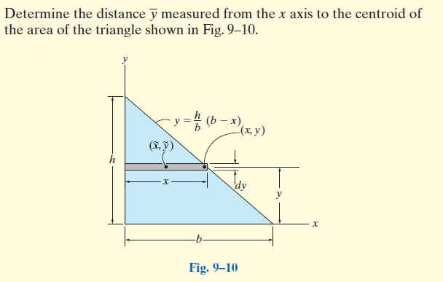
Example

Slide 8
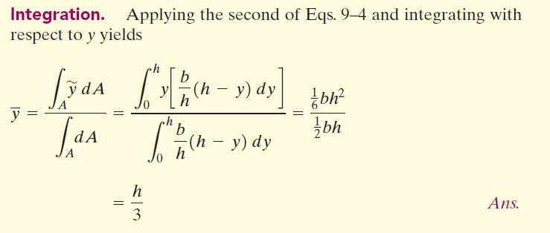

Slide 9
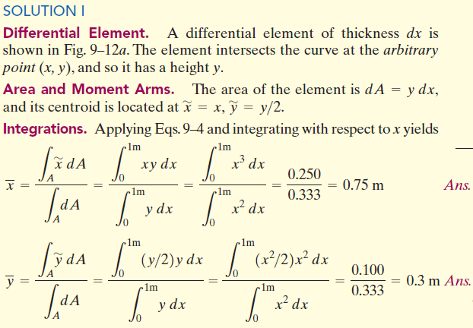
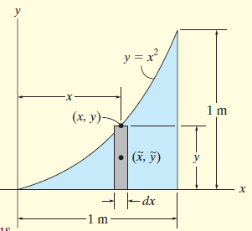
Example
Locate the centroid of the area

Slide 10
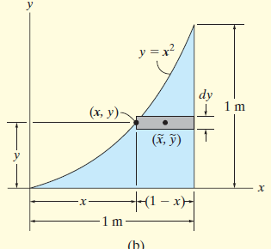
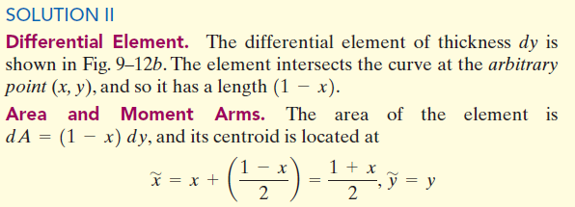
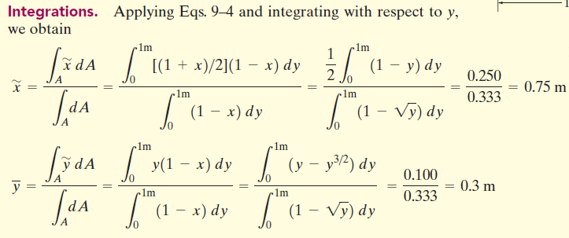

Slide 11
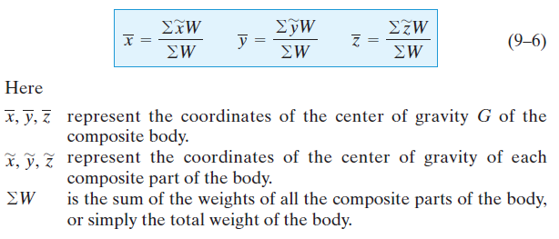
Composite Bodies
A composite body consists of a series of connected “simpler” shaped bodies, which may be rectangular, triangular, semicircular, etc

Slide 12
When the body has a constant density or specific weight, the center of gravity coincides with the centroid of the body.The centroid for composite lines, areas, and volumes can be found using relations analogous to Eqs. 9–6; however, the W’s are replaced by L, A, and V, respectively.

Slide 13
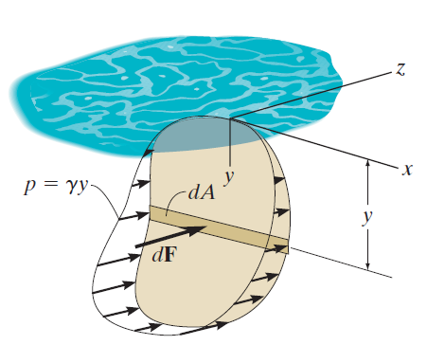
Moments of Inertia for Area
The pressure p varies linearly with the depth, such that: $p=γy,$ where $γ$ is the specific weight of the fluid.
The force acting on the differential area dA of the plate is
$$dF=pdA=\left(γy\right)dA$$
The moment of the force about the x axis is therefore:
$$dM=ydF=γy^{2}dA$$
Integrating dM over the entire area of the plate yields:
$$M=γ\int{y^{2}dA}$$
The integral $\int{y^{2}dA}$ is called the moment of inertia $I_{x}$ of the area about the x axis.
Integral of this form often arises in formulas used in fluid mechanics, mechanics of materials, structural mechanics, and mechanical design.

Slide 14
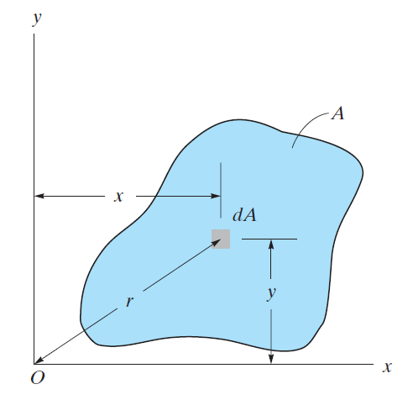
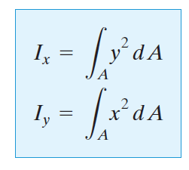
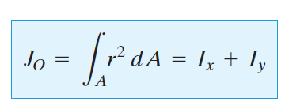
Moment of Inertia
The moment of inertia about the “pole” O or z axis is referred to as the polar moment of inertia which is defined as

Slide 15
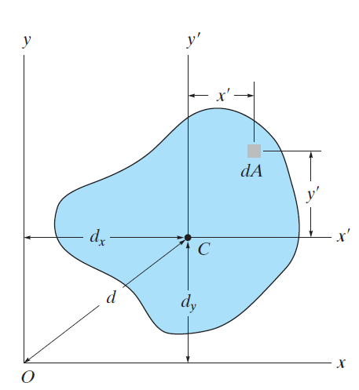
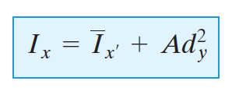
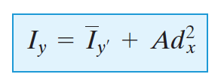
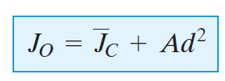
Parallel-Axis Theorem for an Area
An similar expression can be written for $I_{y}$
An for the polar moment of inertia:

Slide 16
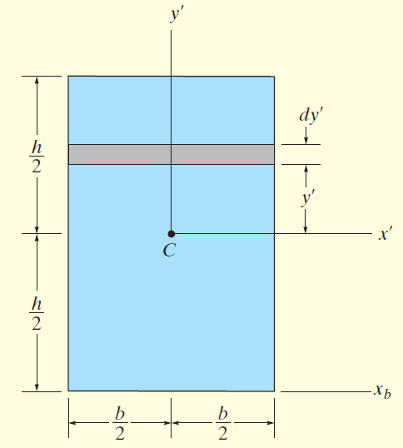
Determine the moment of inertia for the rectangular area shown in the Figure with respect to (a) the centroidal x’ axis, (b) the axis xb passing through the base of the rectangular, and (c) the pole or z’ axis perpendicular to the x’-y’ plane and passing through the centroidal C.
SOLUTION part (a)

Slide 17
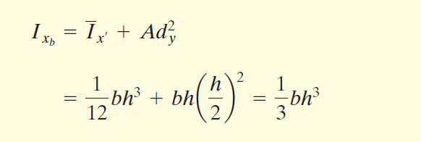
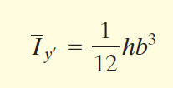
SOLUTION part (b)
SOLUTION part (c)

Slide 18
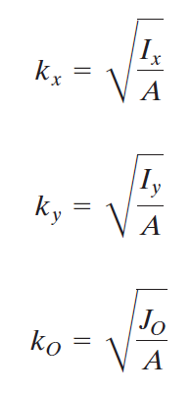
Radius of Gyration of an Area
The radius of gyration of an area is determined from the formulas:

Slide 19
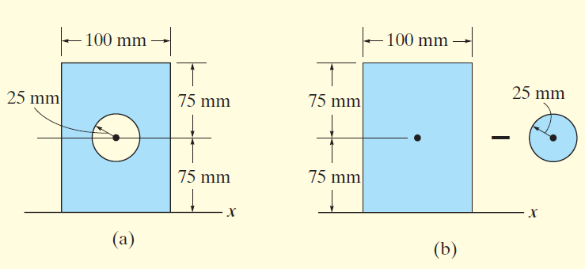
Moments of Inertia for Composite Areas
Determine the moment of inertia of the area shown in Figure (a) about the x axis.
SOLUTION
The area can be obtained by subtracting the circle from the rectangle shown in Figure (b).

Slide 20
The moment of inertia for the area is therefore:

Slide 21
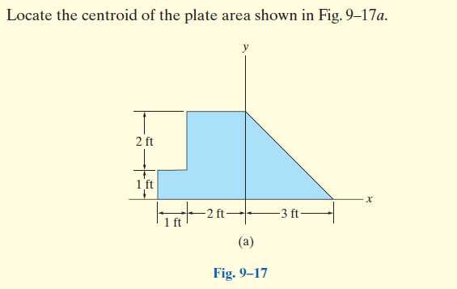
Example

Slide 22
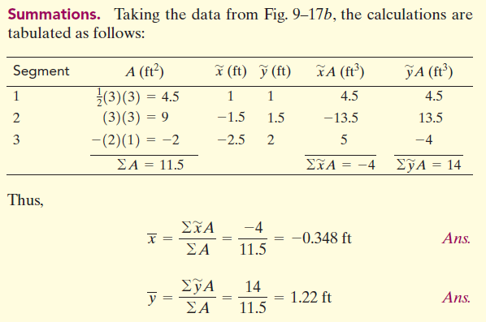
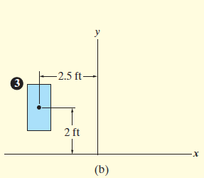

Slide 23
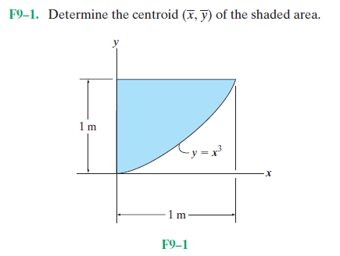
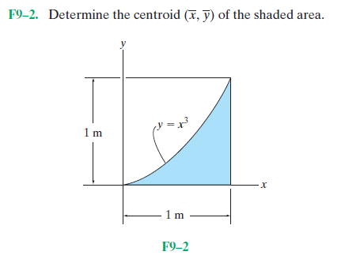
Problems

Slide 24
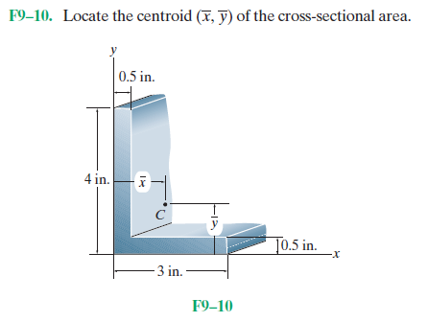
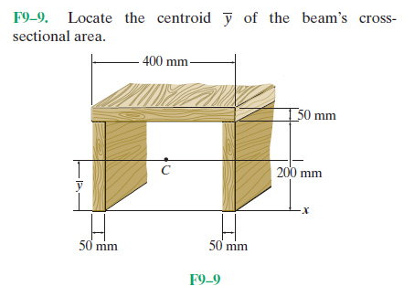
Problems

