Slide 1
Structural Analysis
Statics
week #7

Slide 2
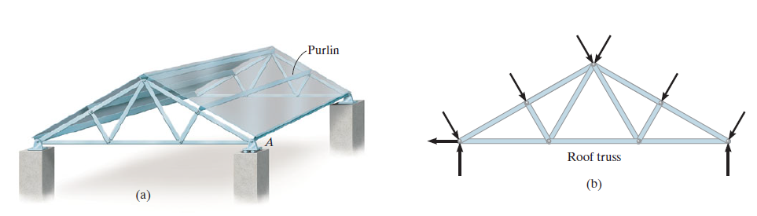
Simple Trusses
A truss is a structure composed of slender members joined together at
their end points

Slide 3
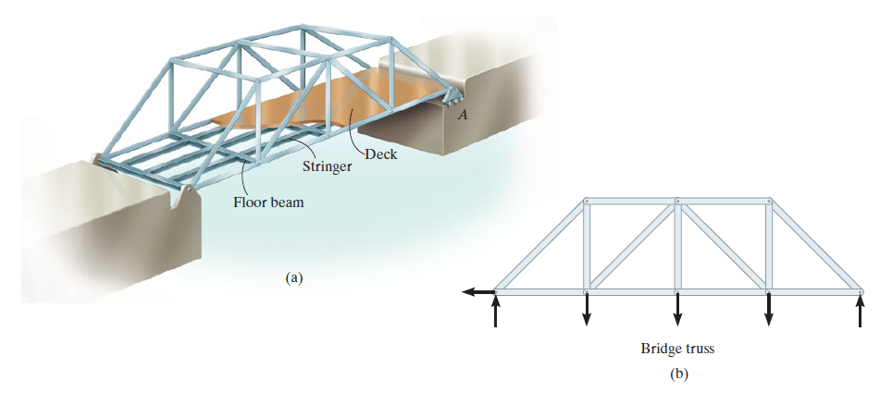

Slide 4
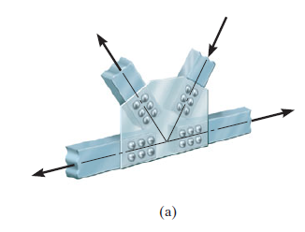
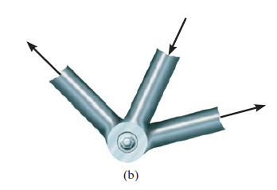
Assumptions for Design
All loadings are applied at the joints
The members are joined together by smooth pins

Slide 5
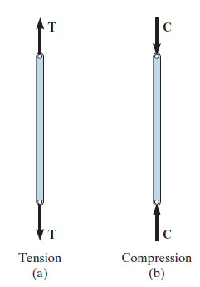
Because of these two assumptions, each truss member will act as a two force
member, and therefore the force acting at each end of the member
will be directed along the axis of the member

Slide 6
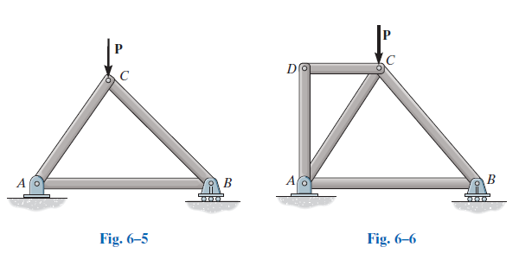
Simple Truss
If three members are pin connected at their ends they form a triangular truss that will be rigid, Fig. 6–5.
Attaching two more members and connecting these members to a new joint D forms a larger truss, Fig. 6–6
If a truss can be constructed by expanding the basic triangular truss in this way, it is called a simple truss

Slide 7
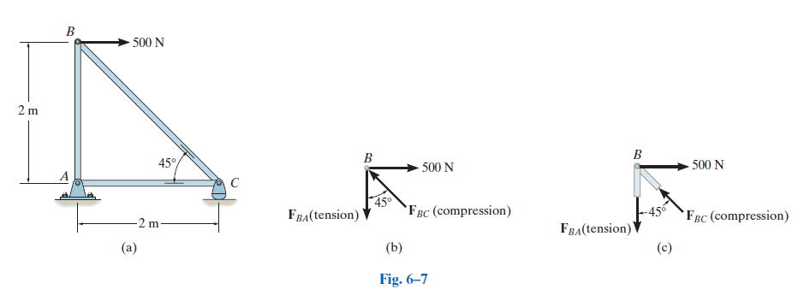
The Method of Joints

Slide 8
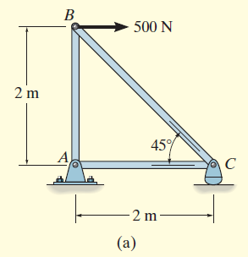
Examples
Determine the force in each member of the truss shown in Fig. 6–8a
and indicate whether the members are in tension or compression

Slide 9
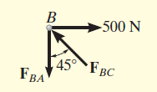
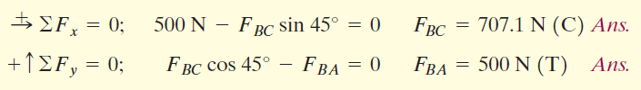
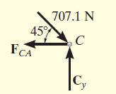
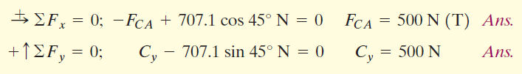
Joint B
Joint C

Slide 10
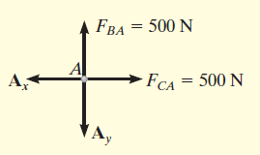
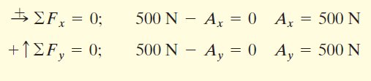
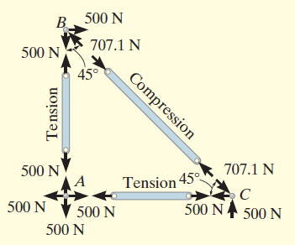
Joint A

Slide 11
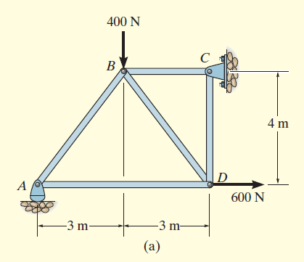
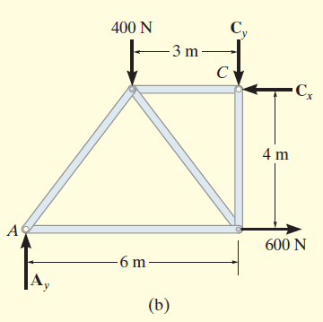
Determine the force in each member of the truss shown in Fig. 6–10a.
Indicate whether the members are in tension or compression

Slide 12
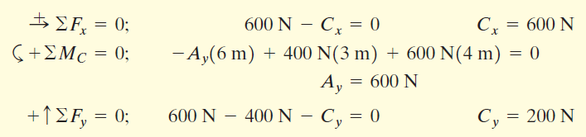
Support Reactions.
No joint can be analyzed until the support reactions are determined, because each joint has more than three unknown forces acting on it
The analysis can now start at either joint A or C. The choice is arbitrary since there are one known and two unknown member forces acting on the pin at each of these joints

Slide 13
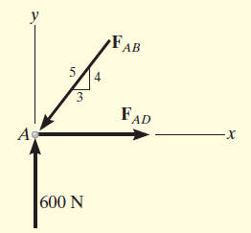

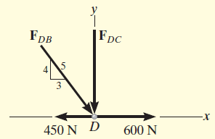
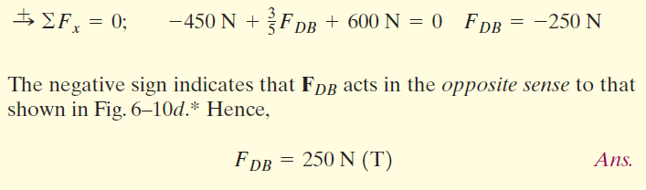
Joint A
Joint D

Slide 14
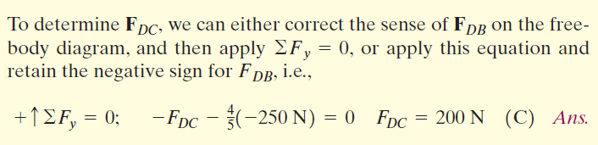
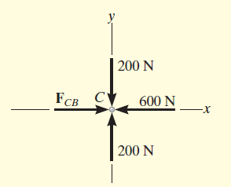

Joint C

Slide 15
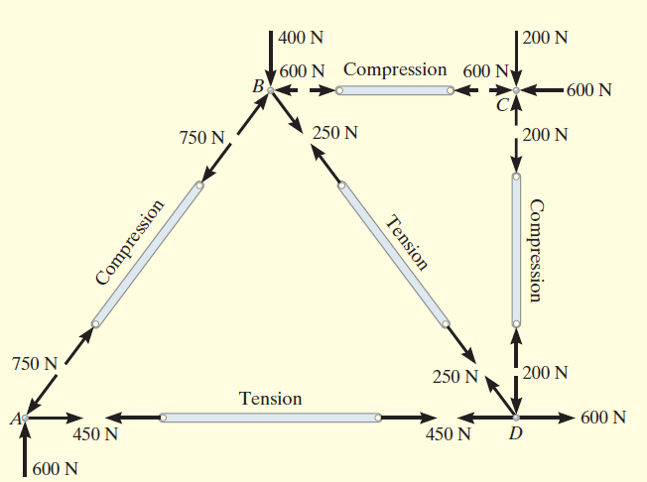

Slide 16
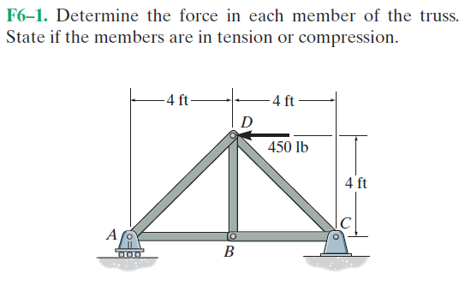
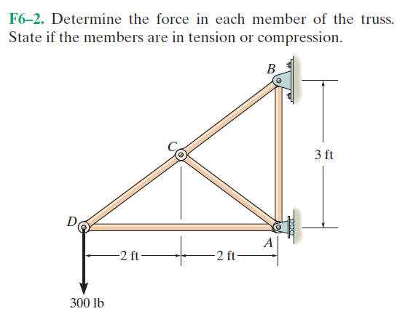
Fundamental Problems

Slide 17
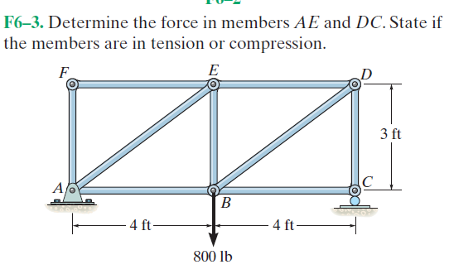
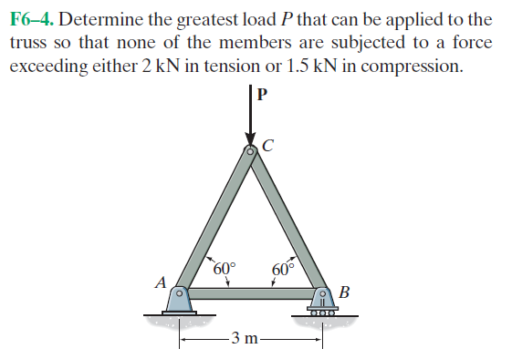

Slide 18
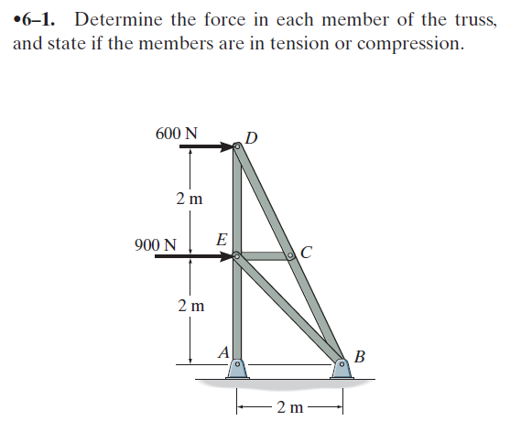
Advanced Problems

Slide 19
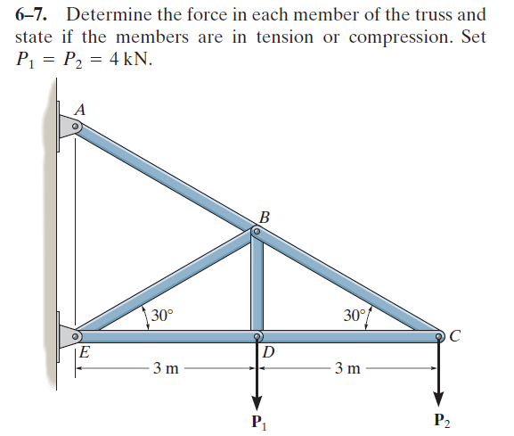

Slide 20
