Slide 1
E commerce
Pertemuan 10
Rahmat Jatmika MBA

Slide 2
CHAPTER 10: E-COMMERCE: DIGITAL MARKETS, DIGITAL GOODS
E-commerce and the Internet
E-commerce saat ini:
  Penggunaan Internet dan Web untuk transaksi bisnis, digital memungkinkan terjadinya transaksi
  Dimulai pada tahun 1995 dan tumbuh secara eksponensial, masih tumbuh bahkan dalam resesi
  Perusahaan yang selamat dari Gelembung dot-com (dot-com bubble) meledak dan sekarang berkembang
  Revolusi E-commerce masih dalam tahap awal
Notes:
This slide discusses what e-commerce is, and what the state of e-commerce is today. The text states that e-commerce history mirrors those of other technology innovations. What other innovations is e-commerce similar to? Students probably will not know about the early days of radio and TV, but perhaps they will remember cassette music, VHS video tapes, and even CDs which though still with us are definitely declining in sales. There are many current trends in e-commerce, from e-books to mobile purchasing. Ask the students to work with you to list some of these new trends in e-commerce.

Slide 3
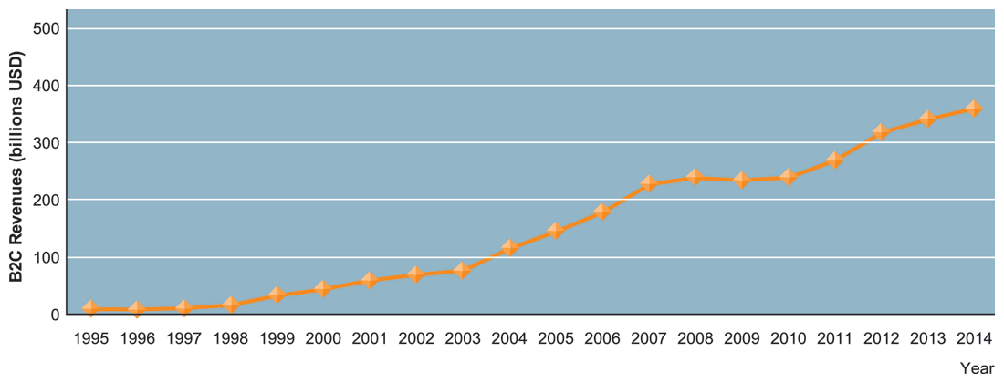
CHAPTER 10: E-COMMERCE: DIGITAL MARKETS, DIGITAL GOODS
E-commerce and the Internet
PERKEMBANGAN E-COMMERCE
FIGURE 10-1
Pendapatan e-commerce ritel tumbuh 15-25 persen per tahun sampai resesi 2008-2009, ketika mereka melambat terukur. Pada tahun 2010, pendapatan e-commerce tumbuh lagi di diperkirakan 12 persen per tahun.
Notes:
This graphic illustrates the continuing growth of e-commerce. From the text: “E-commerce grew at double-digit rates until the recession of 2008–2009 when growth slowed to a crawl. In 2009, e-commerce revenues were flat, not bad considering that traditional retail sales were shrinking by 5 percent annually. In fact, e-commerce during the recession was the only stable segment in retail. Despite the recession, in 2010, the number of online buyers increased by 6 percent to 133 million, and the average annual purchase is up 5 percent to $1,139. Amazon’s sales grew by 28 percent in the year.

Slide 4
CHAPTER 10: E-COMMERCE: DIGITAL MARKETS, DIGITAL GOODS
E-commerce and the Internet
Konsep-konsep utama dalam e-commerce
  Pasar digital mengurangi
    asimetri informasi
    biaya pencarian
    biaya transaksi
    biaya menu
  Digital markets enable
    Price discrimination
    Dynamic pricing
    Disintermediation
Notes:
This slide introduces digital markets and discusses the effects of digital markets on the ways companies conduct business. Ask students to define the terms listed here, and also to explain how each of these effects (lowered information asymmetry, etc.) are created by digital markets. Go through each of the three types of costs involving in any marketplace. Students may not be familiar with these words, but they will be familiar with the phenomenon. For instance, all students will recognize that it takes time and money to go to a mall to find a shirt (this is a search cost). The same shirt can be bought on the Web today with minimal search costs.
Information asymmetry: when one party in a transaction has more information that is important for the transaction than the other party
Search costs: The effort to find suitable products
Transaction costs: The cost of participating in a market
Menu costs: Merchants’ costs of changing prices
Price discrimination: Selling the same goods, or nearly the same goods, to different targeted groups at different prices.
Dynamic pricing: The price of a product varies depending on the demand characteristics of the customer or the supply situation of the seller
Disintermediation: The removal of organizations or business process layers responsible for intermediary steps in a value chain

Slide 5
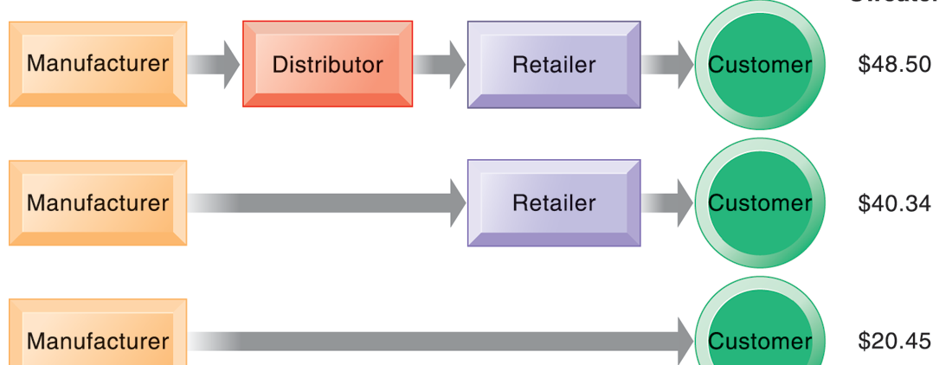
CHAPTER 10: E-COMMERCE: DIGITAL MARKETS, DIGITAL GOODS
E-commerce and the Internet
THE BENEFITS OF DISINTERMEDIATION TO THE CONSUMER
FIGURE 10-2
The typical distribution channel has several intermediary layers, each of which adds to the final cost of a product, such as a sweater. Removing layers lowers the final cost to the consumer.
Notes:
This graphic illustrates how disintermediation reduces prices to consumers. It also allows manufacturers to earn more profit for the product by eliminating the middle man. Are middle men really necessary? You should ask students who they think is a “middle man.” Walmart is, for instance, a distributor and retailer. Do they provide an important function? Why can’t manufacturers just ignore Walmart and sell directly to the customer? Even though market disintermediation sounds like a good thing because costs and prices go down, for the most part manufacturers kept their distribution partners and channels. Walmart is still needed by manufacturers like P&G to sell soap.

Slide 6
CHAPTER 10: E-COMMERCE: DIGITAL MARKETS, DIGITAL GOODS
E-commerce: Business and Technology
Types of e-commerce
  Business-to-consumer (B2C)
  Business-to-business (B2B)
  Consumer-to-consumer (C2C)
  Mobile commerce (m-commerce)
Notes:
This slide introduces the types of e-commerce. B2C, B2B, and C2C e-commerce are categorized according to the nature of the participants. M-commerce is a category based on the nature of the connection to the Internet. Ask students to provide examples of the different types of e-commerce listed here. Most students will find it hard to come up with a B2B example. One place you can visit on the Web is grainger.com, one of the largest B2B marketplaces in the U.S. Another is mcmaster.com, and also elemica.com (chemical industry).

Slide 7
Quiz
Buatlah contoh iklan menggunakan media sosial

