Slide 1
Bakteriofag:
Sejarah, Klasifikasi & Daur Hidup

Slide 2
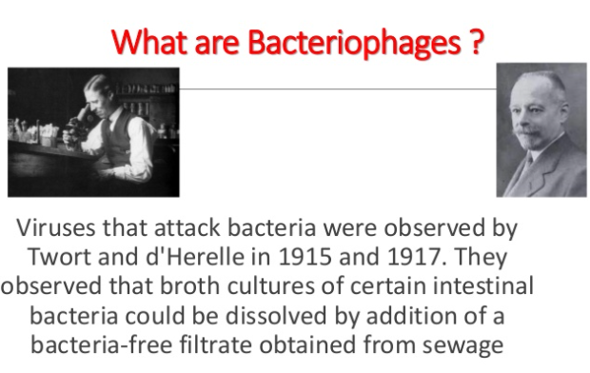
History of Bacteriophage

Slide 3
Bacteriophages: Definition & History
Bacteriophages are viruses that can infect and destroy bacteria.
They have been referred to as bacterial parasites, with each phage type depending on a single strain of bacteria to act as host.

Slide 4
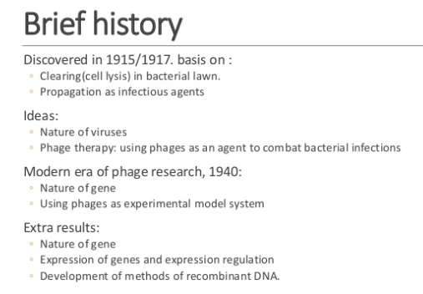

Slide 5
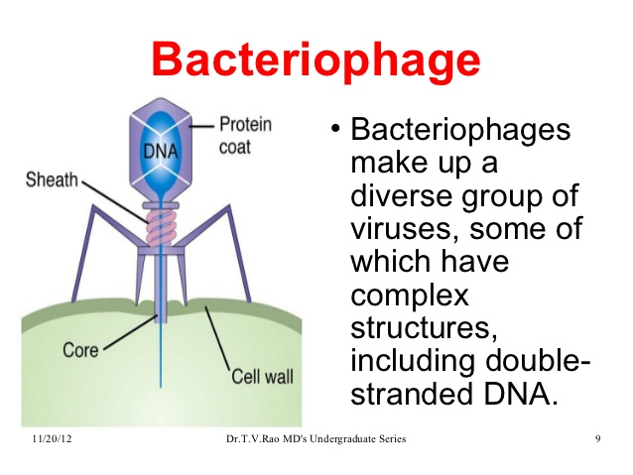
Characteristisc of Bacteriophage
Bacteriophages or simply phage are viruses that infects bacteria.
Obligate intracellular parasites that multiply inside bacteria by making use of some or all of the host biosynthetic machinery
Bacteriophages have varying shapes with very small sizes

Slide 6
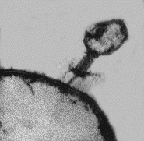
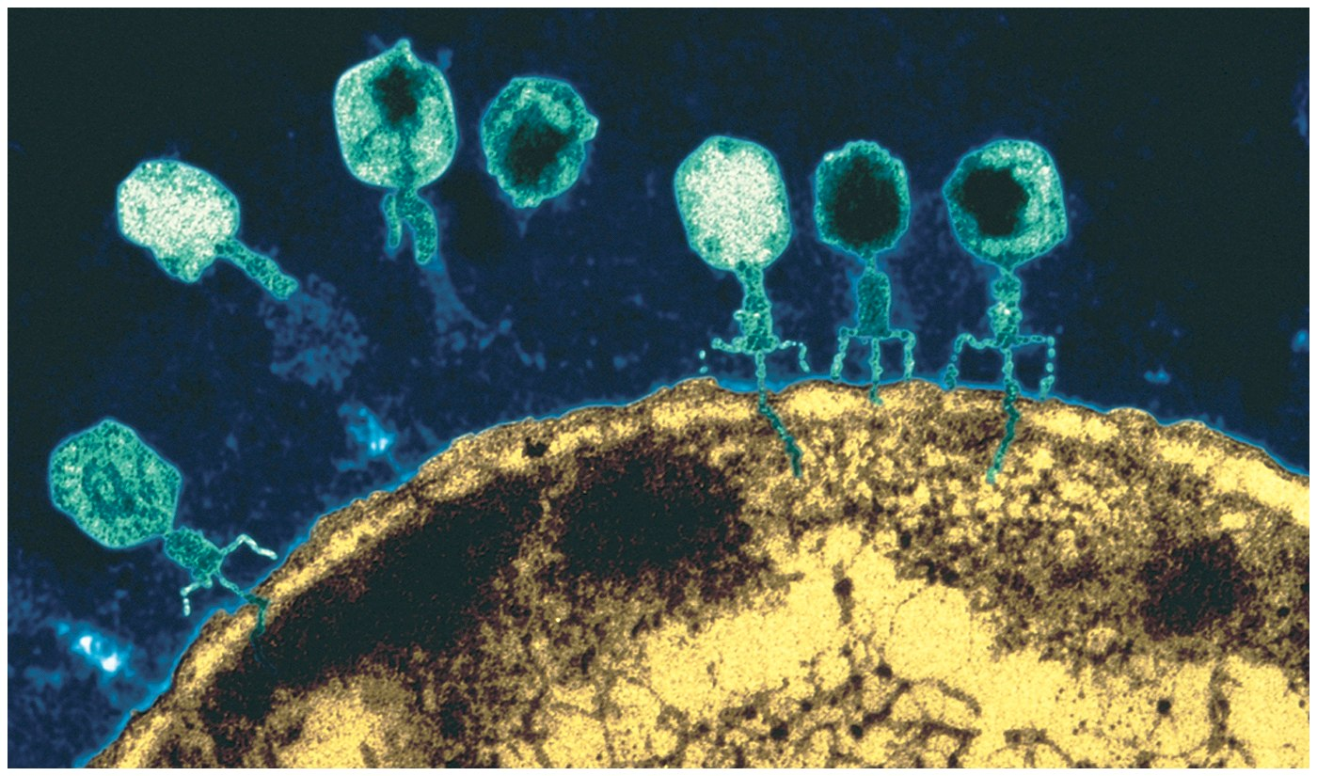
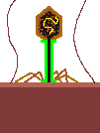
Bacteriophage
from the greek phagein, meaning "to eat“
Eaters or destroyers of bacteria
First described in 1915

Slide 7
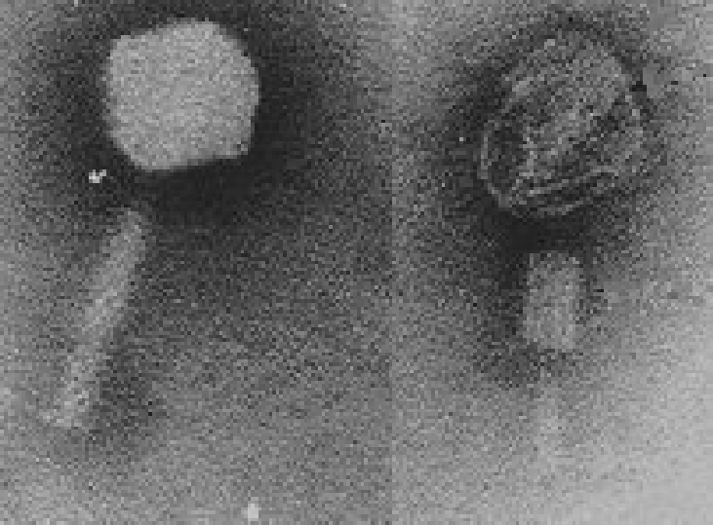
SEM of Phage

Slide 8
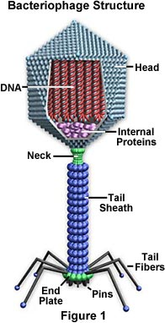
Structure of Bacteriophage
Phage head: composed of coat protein and genome in the core
Genome: DNA codes for enzymes and proteins necessary to replicate more viruses
Tail Sheath: DNA travels from head to bacteria through sheath
Tail fiber: helps anchor the phage on the cell membrane

Slide 9
Bacteriophages:
Virulence Factors Carried On Phage
Temperate phage can go through one of two life cycles upon entering a host cell.
  Lytic:
  Is when growth results in lysis of the host and release of progeny phage.
  Lysogenic:
  Is when growth results in integration of the phage DNA into the host chromosome or stable replication as a plasmid.
  Most of the gene products of the lysogenic phage remains dormant until it is induced to enter the lytic cycle.

Slide 10
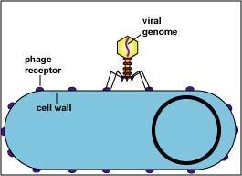
Adsorption by Lytic Bacteriophage
The bacteriophage binds to specific receptors on the bacterial cell wall.
Tail conformation changes/contracts →central core penetrates cell wall

Slide 11
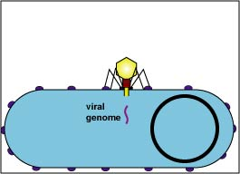
Penetration
The bacteriophage injects its genome into the bacterium's cytoplasm

Slide 12
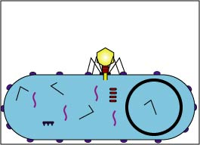
Early Replication
Phage-coded enzymes shut down host’s DNA,RNA,protein synthesis
Early function inovolve the takeover of the host cell and the synthesis of early viral mRNA
Late functions include the subsequent synthesis of other proteins and assembly of the nucleocapsid.
Replication phage DNA protected from host restriction endonucleaes

Slide 13
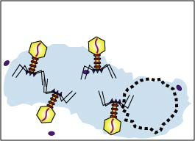
Phage Release
A bacteriophage-coded enzyme break down the peptidoglycan in the bacterial cell wall
causing osmotic lysis.

Slide 14
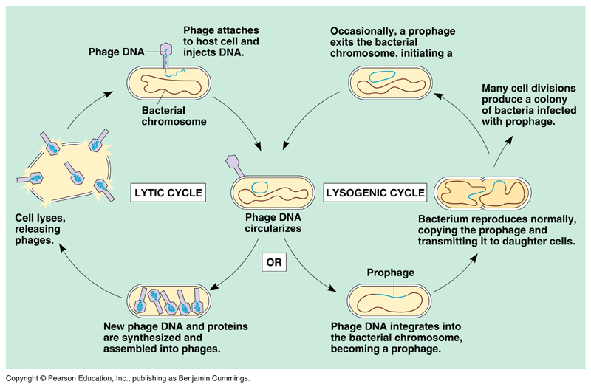

Slide 15
Bacteriophages: Lysogenic Conversion
Some lysogenic phage carry genes that can enhance the virulence of the bacterial host.
  For example, some phage carry genes that encode toxins.
These genes, once integrated into the bacterial chromosome, can cause the once harmless bacteria to release potent toxins that can cause disease.

Slide 16
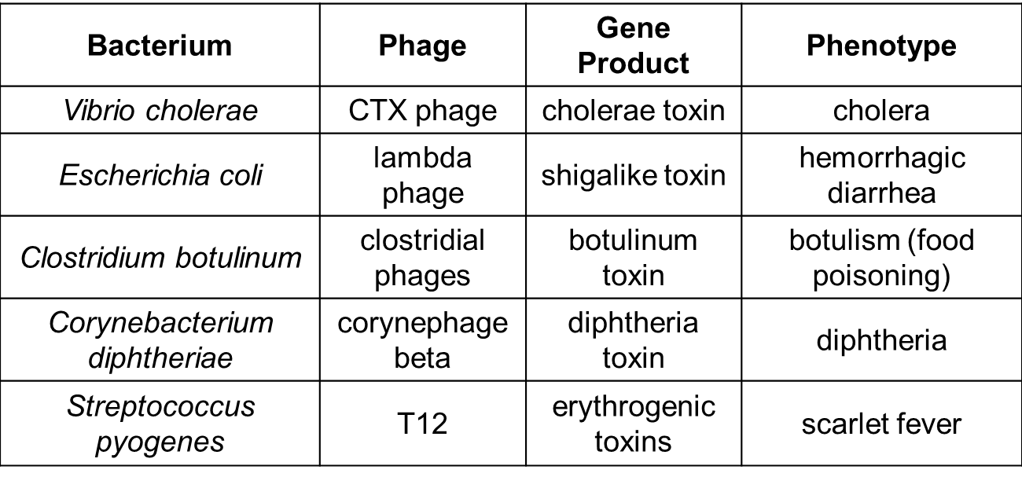
Bacteriophages: Lysogenic Conversion
Examples of Virulence Factors Carried by Phage

Slide 17
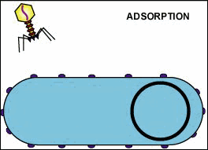
Bacteriophages: Lysogenic Cycle

Slide 18
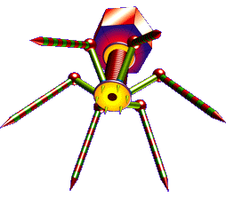
Bacteriophages:
Classification
Based on two major criteria:
phage morphology (electron microscopy)
nucleic acid properties

Slide 19
Bacteriophages:
Classification
At present, over 5000 bacteriophages have been studied by electron microscopy and can be divided into 13 virus families.

Slide 20
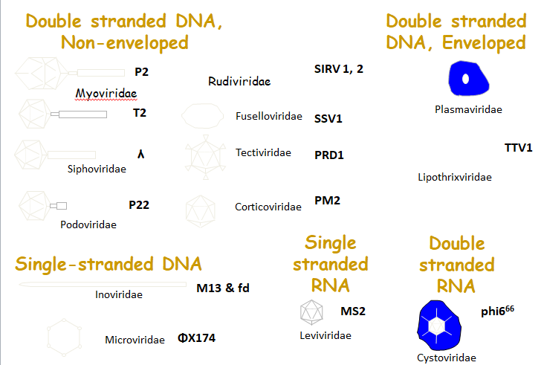
13 Bacteriophage families

Slide 21
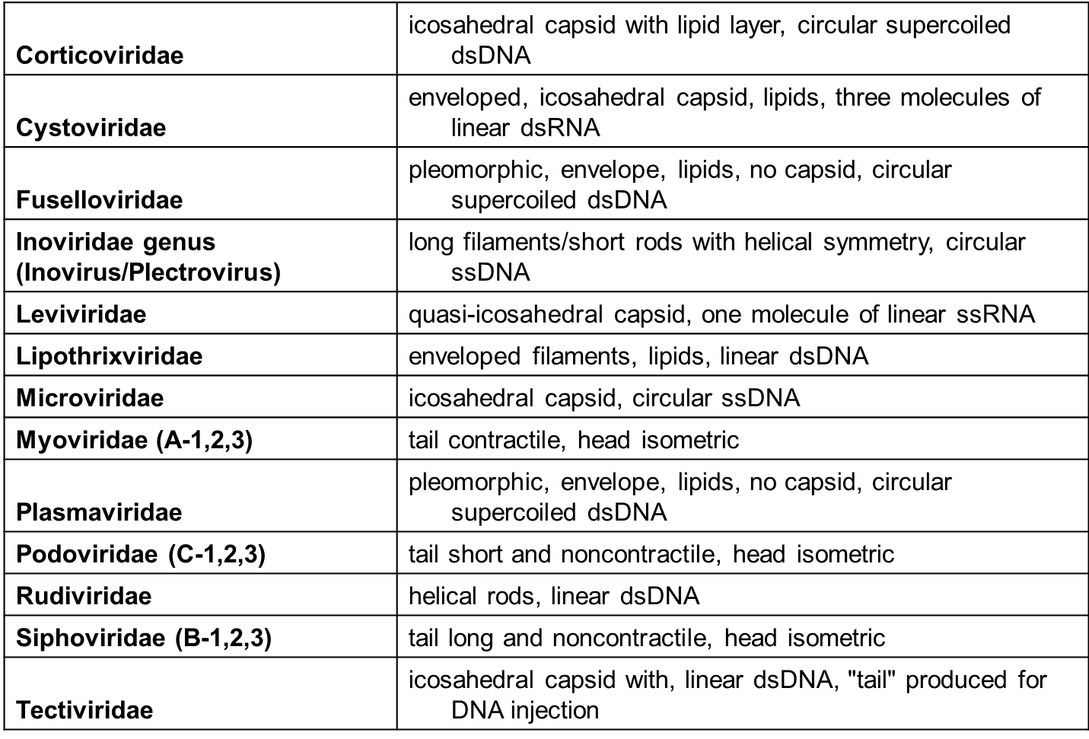
13 Bacteriophage families

Slide 22
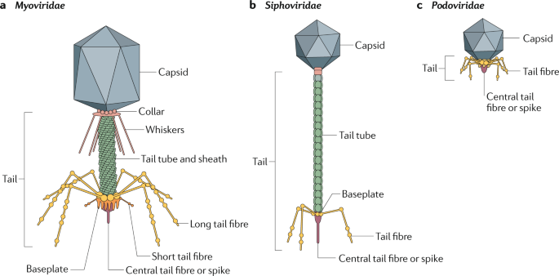
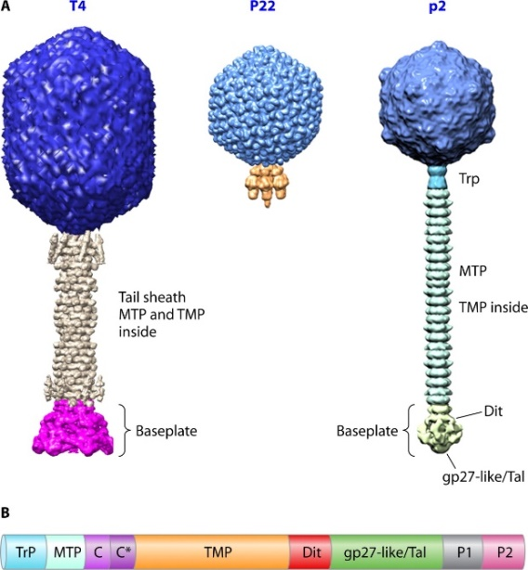
EVOLUTION OF BACTERIOPHAGE
Tailed phages are the oldest viruses and originated before the separation of eubacteria.
Siphoviruses with isometric heads correspond morphologically, to primordial tailed phages because of their overwhelming frequency.
However, myoviruses must be nearly as old because they occur in eubacteria and the archaeon, Halobacterium.
The relative frequency of tailed phage families is related to bacterial speciation

Slide 23

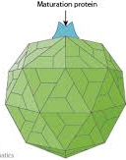

EVOLUTION OF BACTERIOPHAGE
Crenarchaeota constitute a distinct host domain characterized by the apparent absence of tailed phages and the presence of two types of filamentous phages.
The hosts of polyhedral, filamentous, and pleomorphic phages constitute ecological niches. Various phage types arose there independently and some of them spread via plasmid transfer
Tectiviruses, filamentous inoviruses, and leviviruses arose in enterobacterial-like Gram-negatives and spread from there following plasmids.

Slide 24
EVOLUTION OF BACTERIOPHAGE
Rod-shaped inoviruses and plasmaviruses arose in mycoplasmas and did not spread because of their dependence on the host plasma membrane for adsorption
Fuselloviridae, Lipothrixviridae, and Rudiviridae originated in archaea and did not spread to eubacteria. The last two families seem to be confined to Crenarchaeota.

Slide 25
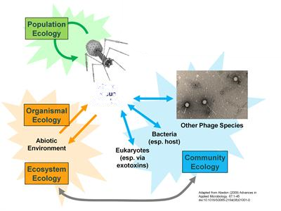

Slide 26
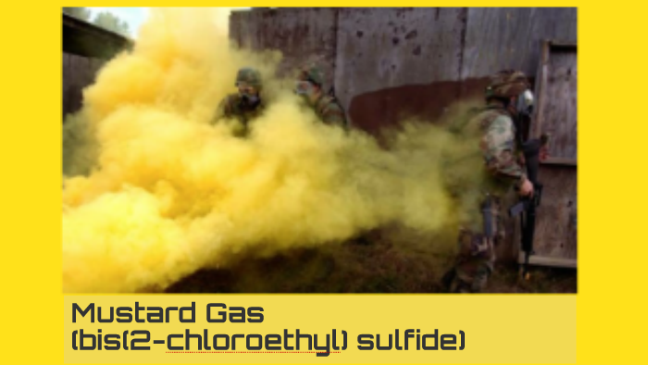
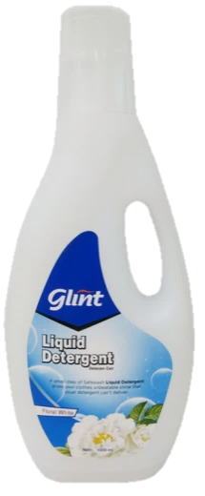
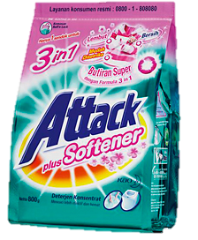
EFFECTS OF PHYSICAL AND CHEMICAL AGENTS ON BACTERIOPHAGE PARTICLES EXCEPT RADIATION
Ph
Urea and Urethane
Detergen
Cleathing agents
Mustard gas
Sonic Vibration
Heat

