Slide 1
Project Team Building, Conflict, and Negotiation
Topic 4
Project Management

Slide 2
Learning Objectives
After completing this chapter, you should be able to:
Understand the steps involved in project team building.
Know the characteristics of effective project teams and why teams fail.
Know the stages in the development of groups.
Describe how to achieve cross-functional cooperation in teams.

Slide 3
Learning Objectives
After completing this chapter, you should be able to:
See the advantages and challenges of project teams.
Understand the nature of conflict and evaluate response method.
Understand the importance of negotiation skills in project management.

Slide 4
OUTLINE
Pengembangan tim proyek
Karakteristik dari tim proyek yang efektif
Mengapa tim proyek gagal
Tahapan dalam pengembangan tim
Mewujudkan kerjasama antar fungsi
Tim proyek virtual
Manajemen konflik
Negosiasi
Copyright ©2019 Pearson Education, Ltd.

Slide 5
Pengembangan tim proyek

Slide 6
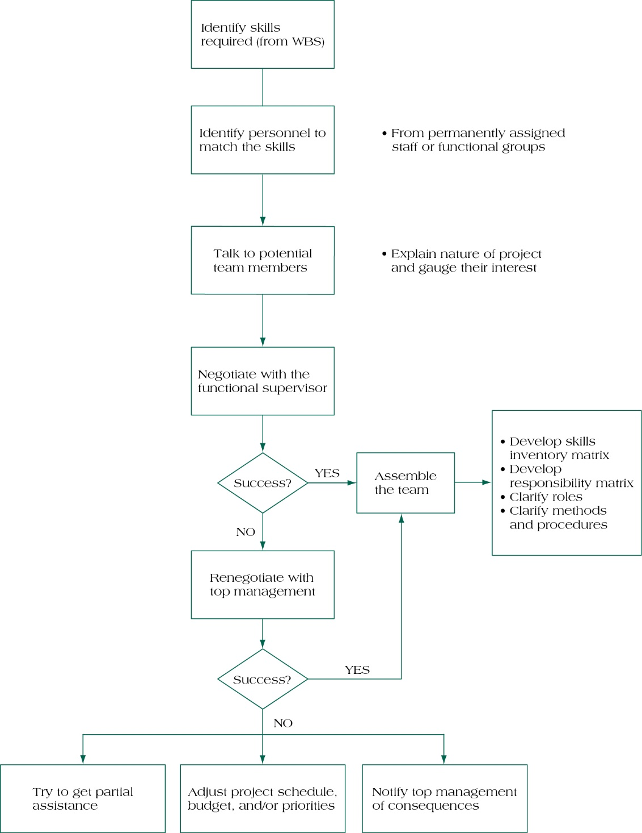
Basic Steps
in Assembling
a Project Team
FIGURE 4,1.
Copyright ©2019 Pearson Education, Ltd.

Slide 7
Karakteristik dari tim proyek yang efektif

Slide 8
Effective Project Teams
Clear Sense of Mission
Productive Interdependency
Cohesiveness
Trust
Enthusiasm
Results Orientation
Copyright ©2019 Pearson Education, Ltd.

Slide 9
Mengapa tim proyek gagal

Slide 10
Reasons Why Teams Fail
Poorly developed or unclear goals
Poorly defined project team roles & interdependencies
Lack of project team motivation
Poor communication
Poor leadership
Turnover among project team members
Dysfunctional behavior
Copyright ©2019 Pearson Education, Ltd.

Slide 11
Tahapan dalam pengembangan tim

Slide 12
Stages in Group Development
Forming – members become acquainted
Storming – conflict begins
Norming – members reach agreement
Performing – members work together
Adjourning – group disbands
Punctuated Equilibrium is a different model.
Copyright ©2019 Pearson Education, Ltd.

Slide 13
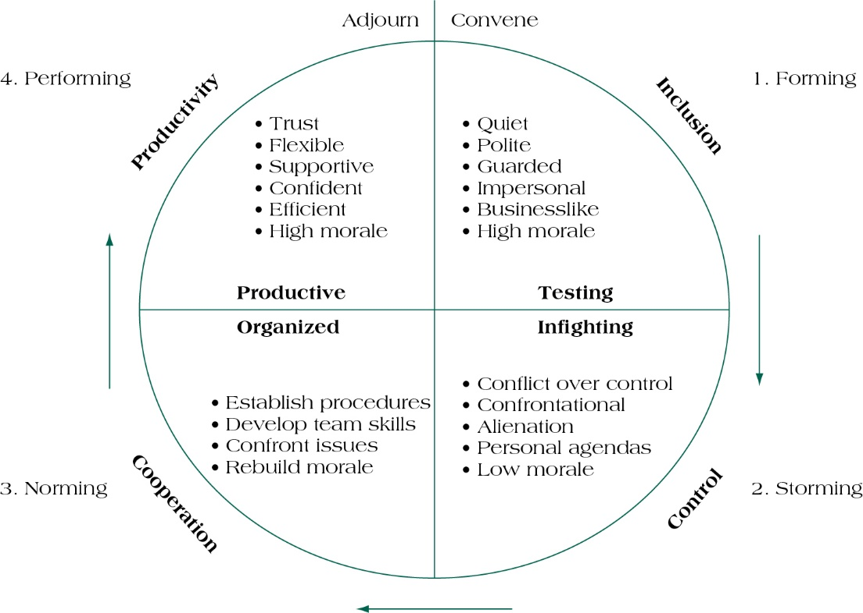
Team Development Stages
(figure 4.2)
Copyright ©2019 Pearson Education, Ltd.

Slide 14
Mewujudkan kerjasama antar fungsi

Slide 15
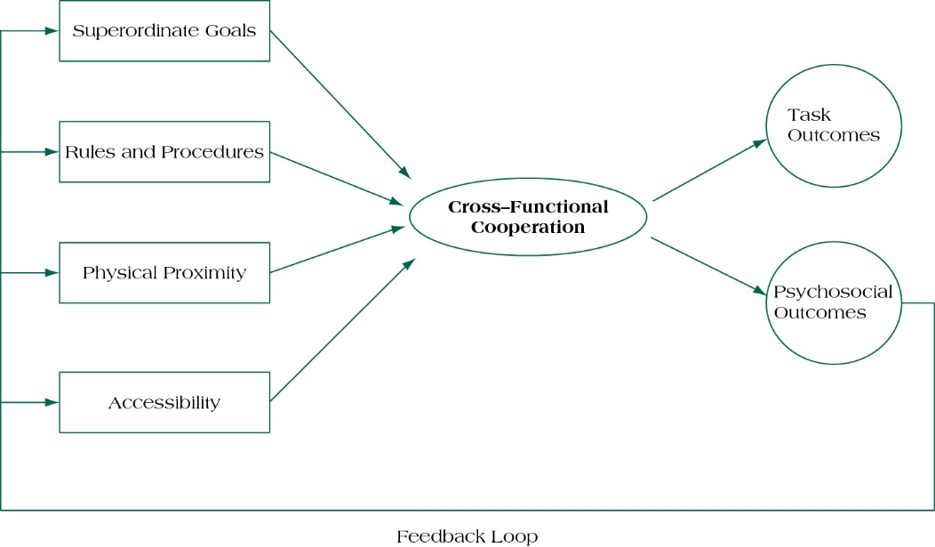
Achieving Cross-Functional Cooperation
(figure 4.3)
Copyright ©2019 Pearson Education, Ltd.

Slide 16
Building High-Performing Teams
Make the project team tangible.
  Publicity
  Terminology & language
Reward good behavior.
  Flexibility
  Creativity
  Pragmatism
Develop a personal touch.
  Lead by example
  Positive feedback for good performance
  Accessibility & consistency
Copyright ©2019 Pearson Education, Ltd.

Slide 17
Tim proyek virtual

Slide 18
Virtual Project Teams
Use electronic media to link members of a geographically dispersed project team.
How Can Virtual Teams Be Improved?
Use face-to-face communication when possible.
Don’t let team members disappear.
Establish a code of conduct.
Keep everyone in the communication loop.
Create a process for addressing conflict.
Copyright ©2019 Pearson Education, Ltd.

Slide 19
Manajemen konflik

Slide 20
Conflict Management
Conflict is a process that begins when you perceive that someone has frustrated or is about to frustrate a major concern of yours.
Categories
Goal-oriented
Administrative
Interpersonal
Views
Traditional
Behavioral
Interactionist
Copyright ©2019 Pearson Education, Ltd.

Slide 21
Sources of Conflict
Organizational
Reward systems
Scarce resources
Uncertainty
Differentiation
Interpersonal
Faulty attributions
Faulty communication
Personal grudges & prejudices
Copyright ©2019 Pearson Education, Ltd.

Slide 22
Conflict Resolution
Mediate – diffusion/confrontation
Arbitrate – judgment
Control – cool down period
Accept – unmanageable
Eliminate – transfer
Conflict is often evidence of progress!
Copyright ©2019 Pearson Education, Ltd.

Slide 23
Negosiasi

Slide 24
Negotiation
Negotiation is a process that is predicated on a manager’s ability to use influence productively.
Questions to Ask Prior to Entering a Negotiation
How much power do I have?
What sort of time pressures are there?
Do I trust my opponent?
Copyright ©2019 Pearson Education, Ltd.

Slide 25
Principled Negotiation
Separate the people from the problem.
Focus on interests, not positions.
Invent options for mutual gain.
Insist on using objective criteria.

Slide 26
Summary

Slide 27
Summary
Understand the steps involved in project team building.
Know the characteristics of effective project teams and why teams fail.
Know the stages in the development of groups.
Describe how to achieve cross-functional cooperation in teams.
Understand
Know
Know
Describe
Copyright ©2019 Pearson Education, Ltd.

Slide 28
Summary
See the advantages and challenges of project teams.
Understand the nature of conflict and evaluate response method.
Understand the importance of negotiation skills in project management.
Copyright ©2019 Pearson Education, Ltd.

Slide 29
REFERENCES
Pinto. J.K. (2019). Project Management: Achieving Competitive Advantage. Pearson Education Limited. London. ISBN:9781292269146
Copyright ©2019 Pearson Education, Ltd.

