Slide 1
Project Management
Topic 5
1. Project Selection and Portfolio
Management
2. Leadership And The Project Manager

Slide 2
LEARNING OUTCOMES
After completing this chapter, you should be able to:
Explain six criteria for a useful project selection/ screening model.
Learn how to use financial concepts, such as the efficient frontier and risk/return models.
Identify the elements in the project portfolio selection process and discuss how they work in a logical sequence to maximize a portfolio.
Understand how project management is a “leader-intensive” profession.
Distinguish between the role of a manager and the characteristics of a leader.
Understand the key behaviors in which project leaders engage to support their

Slide 3
Outline
Project Selection
Approaches to Project Screening and Selection
Financial Models
Project Portfolio Management
Leadership vs manager
How the Project Manager Leads
Traits of Effective Project Leaders
Project Champions
The New Project Leadership
Project Management Professionalism

Slide 4
Project Selection

Slide 5
Screening Models
Screening models help managers pick winners from a pool of projects.
Realism
Capability
Ease of use
Cost effective-ness
Comparability
Flexibility

Slide 6
Approaches to Project Screening and Selection

Slide 7
Method of Selection
Checklist Model
Simplified Scoring Models
The Analytical Hierarchy Process
Profile Models

Slide 8
Financial Models

Slide 9

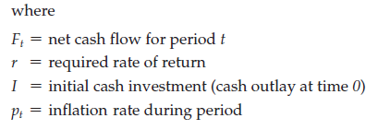
Net Present Value
Projects the change in the firm’s stock value if a project is undertaken.
Higher NPV values are better

Slide 10
    Discounted Payback Period
The discounted payback period is a measure of how long it takes until the cumulated discounted net cash flows offset the initial investment in an asset or a project.
Formula : DPP = y + abs(n) / p,
where
y = the period preceding the period in which the cumulative cash flow turns positive,
p = discounted value of the cash flow of the period in which the cumulative cash flow is => 0,
abs(n) = absolute value of the cumulative discounted cash flow in period y.

Slide 11

Internal Rate of Return
A project must meet a minimum rate of return before it is worthy of consideration.
where
ACF^{t} = annual after-tax cash flow for time period t
IO = initial cash outlay
n = project’s expected life
IRR = project’s internal rate of return
Higher IRR values are better!

Slide 12
example
Suppose that a project required an initial cash investment of $5,000 and was expected to generate inflows of $2,500, $2,000, and $2,000 for the next three years. Further, assume that our company’s required rate of return for new projects is 10%. The question is, is this project worth funding?

Slide 13
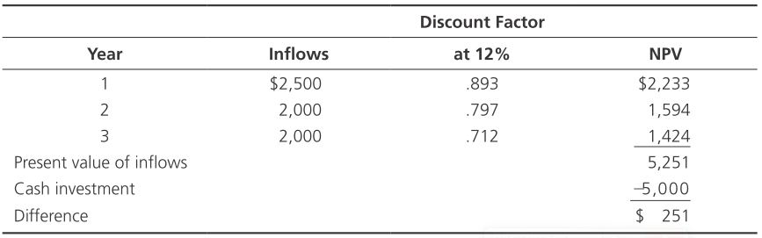
example
Cash investment = $5,000
Year 1 inflow = $2,500
Year 2 inflow = $2,000
Year 3 inflow = $2,000
Required rate of return = 10%
Step One: Try 12%.
Decision: Present value difference at 12% is 250.50, which is too high. Try a higher discount rate.

Slide 14
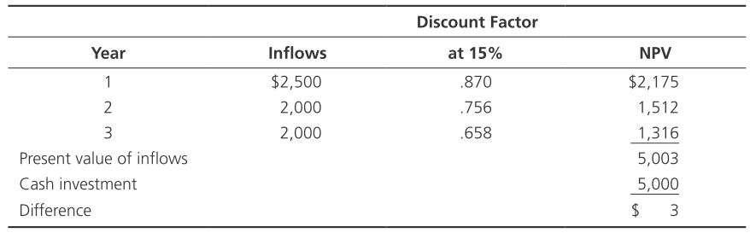
example
Step Two: Try 15%.
Decision: Present value difference at 15% is $3, which suggests that 15% is a close approximation of the IRR.

Slide 15
Project Portfolio Management

Slide 16
Project Portfolio Management
The systematic process of selecting, supporting, and managing the firm’s collection of projects.
Project portfolio management should have four goals:
maximizing the value of the portfolio—the goal is to ensure that the total worth of projects in the pipeline yields maximum value to the company,
achieving the right balance of projects in the portfolio—there should be a balance between high-risk and low-risk, short-term and long-term, genuine new products and product improvement projects,
achieving a strategically-aligned portfolio—leading companies have a clear product innovation strategy that directs their R&D project investments,
resource balancing—having the right number of projects in the portfolio is critical

Slide 17
Objectives And Initiatives
Portfolio management, therefore, entails decision making, prioritization, review, realignment, and reprioritization of a firm’s projects

Slide 18
Developing A Proactive Portfolio
Three factors determined that successfully managed project portfolios :
Flexible structure and freedom of communication
Low-cost environmental scanning
Time-paced transition

Slide 19
Leaders Versus Managers

Slide 20
Leadership
Leadership is a difficult concept to examine because we all have our own definition of leadership, our own examples of leaders in action, and our own beliefs about what makes leaders work.
Project management has been viewed as one of the most leader-intensive undertakings within an organization.

Slide 21
Partnership Idea
Four things are necessary to promote the partnership idea between the project manager and the team:
Exchange of purpose
A right to say no
Joint accountability
Absolute honesty

Slide 22
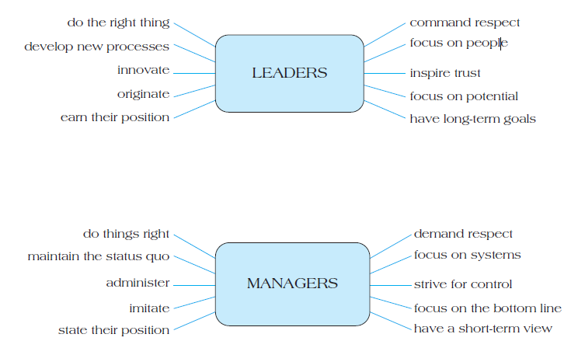
Leaders Versus Managers

Slide 23
How the Project Manager Leads

Slide 24
How the Project Manager
Acquiring Project Resources
Motivating and Building Teams
Having a Vision and Fighting Fires
Communicating

Slide 25
Traits of Effective Project Leaders

Slide 26
Five Characteristics Closely Associated
Five characteristics closely associated with effective project team leaders:
Credibility
Creative problem-solver
Tolerance for ambiguity
Flexible management style
Effective communication skills

Slide 27
Project Champions

Slide 28
How To Make A Champion
Identify And Encourage The Emergence Of Champions
Encourage And Reward Risk Takers
Remember That Champions Are Connected Emotionally To Their Projects
Don’t Tie Champions Too Tightly To Traditional Project Management DutieS

Slide 29
The New Project Leadership

Slide 30
Four competencies
Four competencies that determine our success as project leaders
The new leader understands and practices the power of appreciation. These project leaders are connoisseurs of talent, more curators than creators
The new leader keeps reminding people of what’s important
The new leader generates and sustains trust
The new leader and the led are intimate allies

Slide 31
Project Management Professionalism

Slide 32
Professionalism
Growing professionalism of the project management discipline
First, for more and more organizations, project work is becoming the standard
Second, there is a critical need to upgrade the skills of those doing project work
Third, project management professionalism recognizes the need to create a clear career path for those who serve as project managers and support personnel

Slide 33
Reference
Jeffrey Pinto, 2021, Project Management Achieving Competitive Advantage, Fifth Edition, Pearson Education Limited, United Kingdom, ISBN 978-1-292-26914-6. Chapter 3 and 4

