Slide 1
Scope Management
Topic 6
Project Management

Slide 2
LEARNING OUTCOMES
After completing this chapter, you should be able to:
  Understand the importance of scope management for project success.
  Understand the significance of developing a scope statement.
  Construct a Work Breakdown Structure for a project.
  Develop a Responsibility Assignment Matrix for a project.
  Describe the roles of changes and configuration management in assessing project scope.

Slide 3
OUTLINE
Gambaran umum tentang lingkup proyek
Work Breakdown Structure (WBS): Konsep dan Aplikasi
Pentingnya pengelolaan lingkup di dalam proyek

Slide 4
PMBOK Core Concepts
Project Management Body of Knowledge (PMBoK) covered in this chapter includes:
Develop Project Charter (PMBoK 4.1)
Plan Scope Management (PMBoK 5.1)
Collect Requirements (PMBoK 5.2)
Define Scope (PMBoK 5.3)
Create WBS (PMBoK 5.4)
Validate Scope (PMBoK 5.5)
Control Scope (PMBoK 5.6)

Slide 5
Gambaran umum tentang lingkup proyek

Slide 6
Project Scope
Project scope is everything about a project – work content as well as expected outcomes.
Scope management is the function of controlling a project in terms of its goals and objectives and consists of:
1) Conceptual development 4) Scope reporting
2) Scope statement 5) Control systems
3) Work authorization 6) Project closeout

Slide 7
Conceptual Development
The process that addresses project objectives by finding the best ways to meet them
Key steps in information development:
Problem or need statement
Requirements gathering
Information gathering
Constraints
Alternative analysis
Project objectives
Business case

Slide 8
Statement of Work (SOW)
A SOW is a detailed narrative description of the work required for a project.
Effective SOWs contain:
Introduction and background
Technical description of the project
Timeline and milestones

Slide 9
Statement of Work Components
Background
Objectives
Scope
Task or Requirements
Selection Criteria
Deliverables or Delivery Schedule
Security
Place of Performance
Period of Performance

Slide 10
Project charter
Many organizations establish after the SOW
A document issued by the project initiator or sponsor formally sanctioning existence of project and authorizes project manager to begin applying organizational resources to project activities
Is created once project sponsors have done their “homework” to verify that there is:
  a business case for the project
  elements of project are understood
  company-specific information for the project has been applied
Demonstrates formal company approval of the project

Slide 11
Scope Statement
Establish project goal criteria to include:
  cost
  schedule
  performance
  deliverables
  review and approval “gates”
Develop management plan for project
Establish a Work Breakdown Structure
Create a scope baseline

Slide 12
Work Breakdown Structure (WBS): Konsep dan Aplikasi

Slide 13
Work Breakdown Structure (WBS)
A deliverable-oriented grouping of project elements which organizes and defines the total scope of the project. Each descending level represents an increasingly detailed definition of a project component. Project component may be products or services.

Slide 14
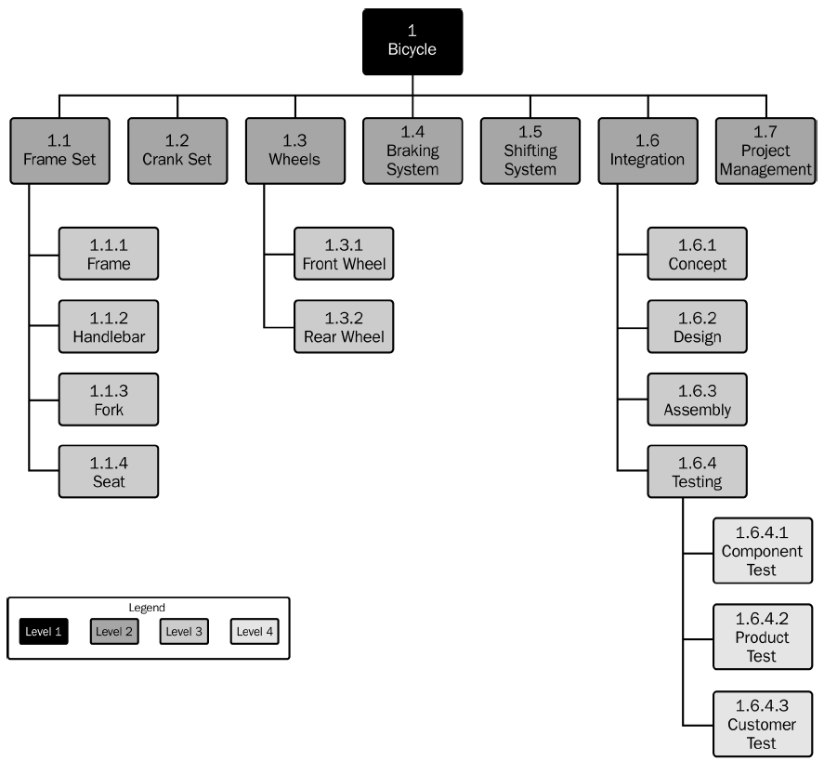
Sample of Work Breakdown Structure
The smallest level of WBS is called work package
Activities are set under work packages
Project Management Institute (2017) Practice Standard WBS, 2 Ed, Pennsylvania, p. 156

Slide 15
Work Breakdown Structure purpose
WBS serves six main purposes:
Echoes project objectives
Organization chart for the project
Creates logic for tracking costs, schedule, and performance specifications
Communicates project status
Improves project communication
Demonstrates control structure

Slide 16
Defining a Work Package
Lowest level in WBS
Deliverable result
One owner
Miniature projects
Milestones
Fits organization
Trackable

Slide 17
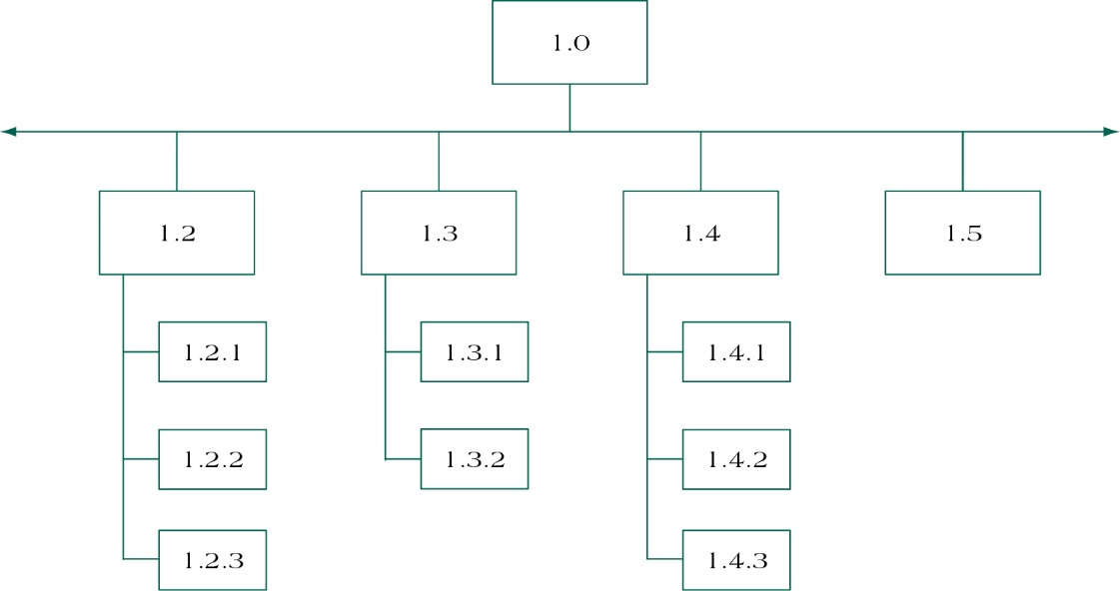
Partial WBS
(figure 5.3)
Deliverables are major project components
Work Packages are individual project activities (lowest level in WBS)

Slide 18
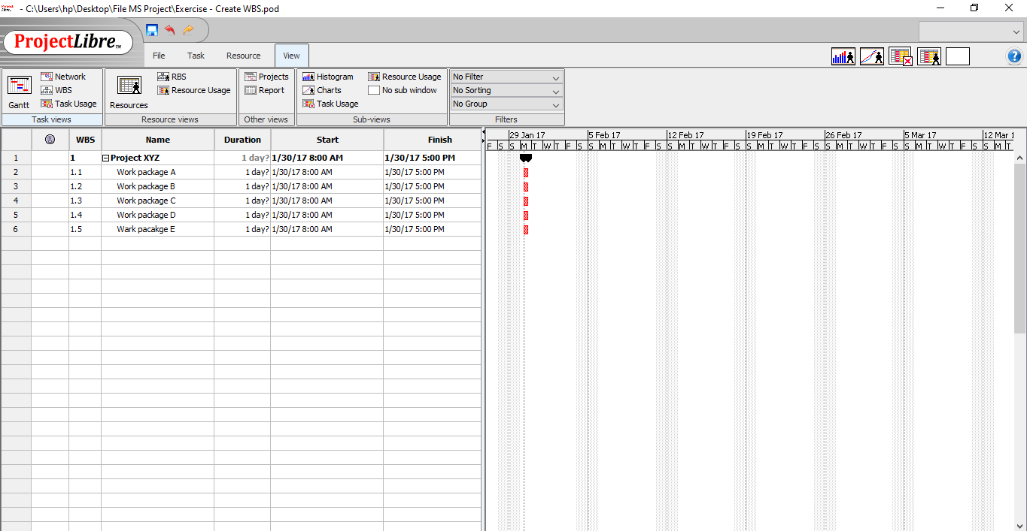
Sample WBS in Project Libre
Level 1
Level 2

Slide 19
Organizational Breakdown Structure
Organizational Breakdown Structure (OBS) allows
Work definition
Owner assignment of work packages
Budget assignment to departments
OBS links cost, activity & responsibility

Slide 20
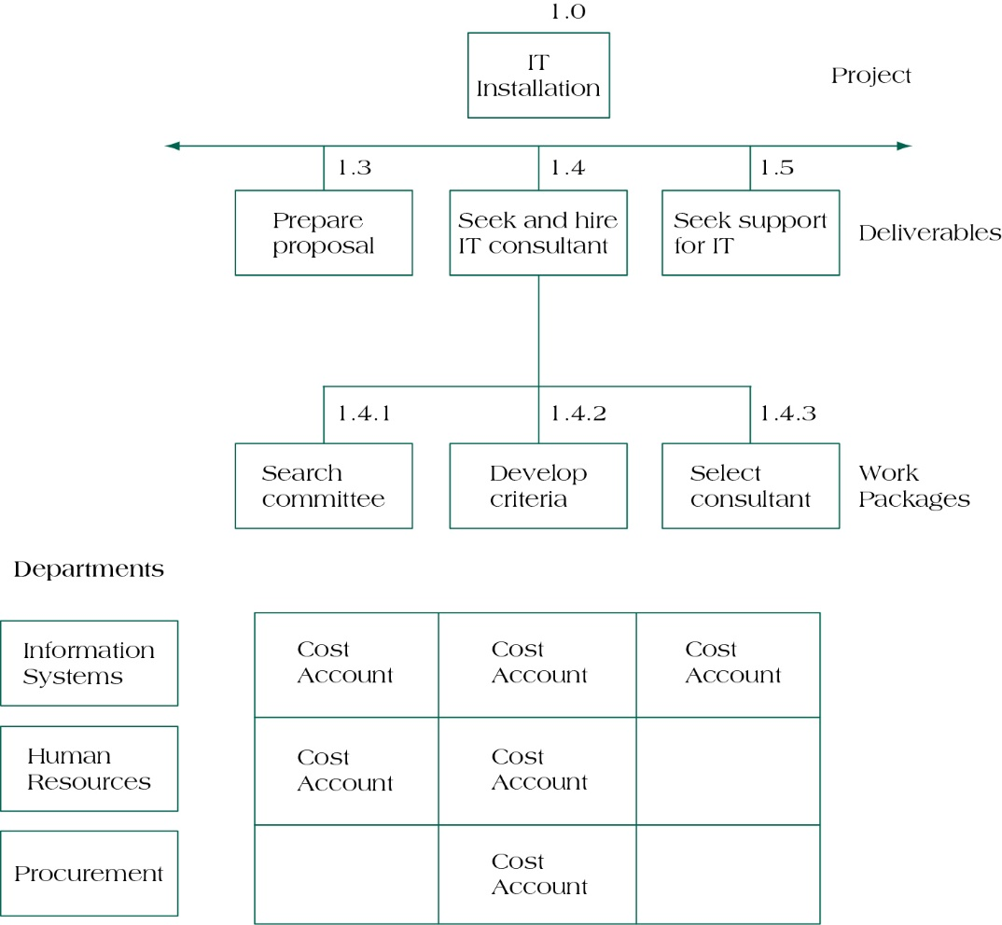
Intersection of the WBS and OBS
WBS
OBS: Organization Breakdown Structure

Slide 21
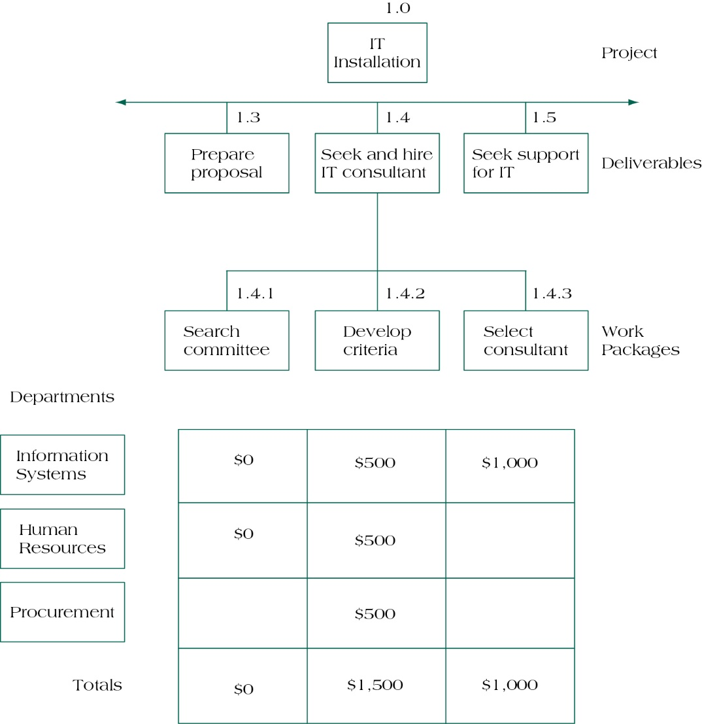
Cost Account Rollup Using OBS
(figure 5.9)

Slide 22
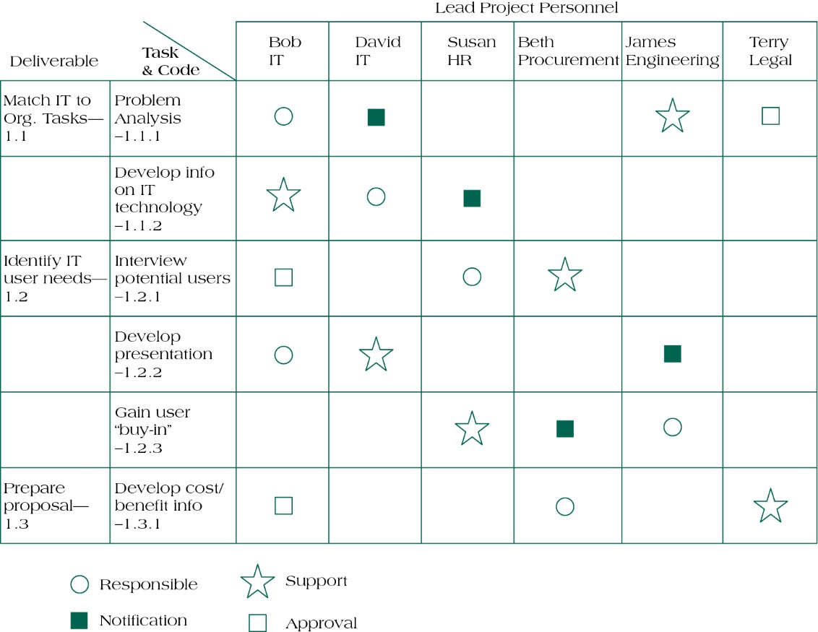
Responsibility Assignment Matrix
(figure 5.10)

Slide 23
Defining a Project Work Package
Work package forms lowest level in WBS.
Work package has a deliverable result.
Work package has one owner.
Work package may be considered by its owner as a project in itself.
Work package may include several milestones.
Work package should fit organizational procedures and culture.
The optimal size of a work package may be expressed in terms on labor hours, calendar time, cost, reporting period, and risks.

Slide 24
Work Authorization
The formal “go ahead” to begin work.
Contractual documentation possesses some key identifiable features:
Contractual requirements
Valid consideration
Contracted terms
Contracts range from:
Lump Sum or
Turnkey
Cost Plus

Slide 25
Scope Reporting
Determines what types of information reported, who receives copies, and when and how information is acquired and disseminated.
Typical project reports contain:
Cost status
Schedule status
Technical performance status

Slide 26
Pentingnya pengelolaan lingkup di dalam proyek

Slide 27
Reasons Why Projects Fail
Politics
Naïve promises
Naïve optimism of youth
Startup mentality of fledgling entrepreneurial companies
“Marine Corps” mentality
Intense competition caused by globalization
Intense competition caused by appearance of new technologies
Intense pressure caused by unexpected government regulations
Unexpected and/or unplanned crises

Slide 28
Types of Control Systems
Configuration control
Design control
Trend monitoring
Document control
Acquisition control
Specification control

Slide 29
Configuration management
Configuration Management is defined as:
A system of procedures that monitors emerging project scope against the baseline. It requires documentation and management approval on any change to the baseline.
Baseline is defined as:
The project’s scope fixed at a specific point in time – for example, the project’s scheduled start date.

Slide 30
Project changes
Occur for one of several reasons:
Initial planning errors, either technological or human
Additional knowledge of project or environmental conditions
Uncontrollable mandates
Client requests

Slide 31
Project Closeout
The job is not over until the paperwork is done…
Closeout documentation is used to:
Resolve disputes
Train project managers
Facilitate auditing
Closeout documentation includes:
Historical records
Post project analysis
Financial closeout

Slide 32
Summary
Understand the importance of scope management for project success.
Understand the significance of developing a scope statement.
Construct a Work Breakdown Structure for a project.
Develop a Responsibility Assignment Matrix for a project.
Describe the roles of changes and configuration management in assessing project scope.

Slide 33
REFERENCES
Pinto. J.K. (2016). Project Management: Achieving Competitive Advantage. Pearson Education Limited. London. ISBN:978-1-292-09479-3, Chapter 5

