Slide 1
Risk Management
Topic 7
Project Management

Slide 2
LEARNING OUTCOMES
After completing this chapter, you should be able to:
Define project risk.
Recognize four key stages in project risk management and the steps necessary to manage risk.
Understand five primary causes of project risk and four major approaches to risk identification.
Recognize four primary risk mitigation strategies.
Explain the Project Risk Analysis and Management (PRAM) process.

Slide 3
OUTLINE
Gambaran umum tentang lingkup proyek
Work Breakdown Structure (WBS): Konsep dan Aplikasi
Pentingnya pengelolaan lingkup di dalam proyek

Slide 4
PMBOK Core Concepts
Project Management Body of Knowledge (PMBoK) covered in this chapter includes:
Plan Risk Management (PMBoK 11.1)
Identify Risks (PMBoK 11.2)
Perform Qualitative Risk Analysis (PMBoK 11.3)
Perform Quantitative Risk Analysis (PMBoK 11.4)
Plan Risk Responses (PMBoK 11.5)
Control Risks (PMBoK 11.6)

Slide 5
Gambaran umum tentang manajemen risiko proyek

Slide 6
Project Risk Management
Risk management – the art and science of identifying, analyzing, and responding to risk factors throughout the life of a project and in the best interest of its objectives.
Project risk – an uncertain event or condition that, if it occurs, has a positive or negative effect on one or more project objectives such as scope, schedule, cost, or quality.
Risk = (Probability of Event) * (Consequences of Event)

Slide 7
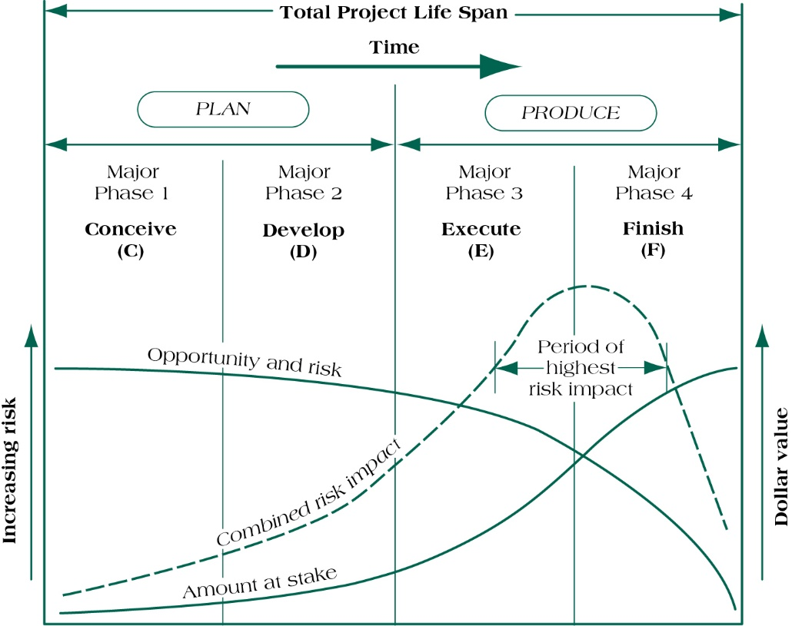
Risk versus Amount at Stake:
Challenge in Risk Management
(figure 7.2)
Source : Pinto (2016)

Slide 8
Proses di dalam pengelolaan risiko proyek

Slide 9
Four stages of risk management
Risk identification
Analysis of probability and consequences
Risk mitigation strategies
Control and documentation

Slide 10
Risk Clusters
Common Types of Risks
Absenteeism
Resignation
Staff pulled away
Time overruns
Skills unavailable
Ineffective training
Specs incomplete
Change orders
Financial
Technical
Commercial
Execution
Contractual or Legal Risk

Slide 11
Risk Factor Identification
Brainstorming meetings
Expert opinion
Past history
Multiple (or team based) assessments

Slide 12
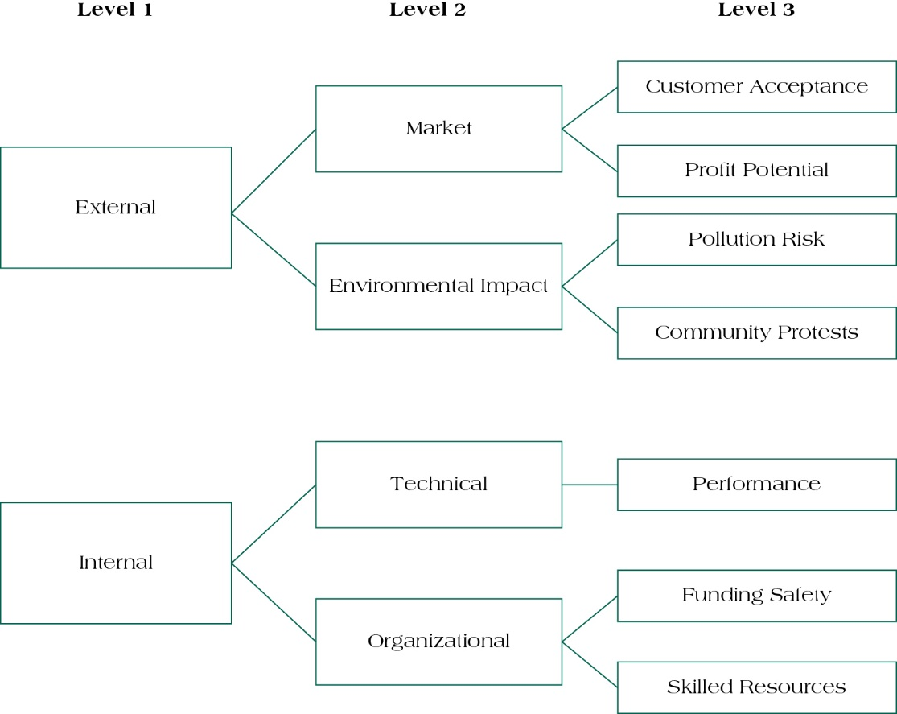
Risk Breakdown Structure (RBS)
Source: Pinto (2016)

Slide 13
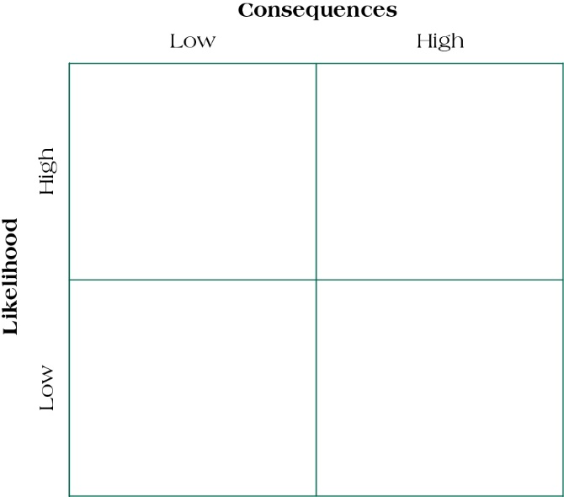
Risk Impact Matrix
Source: Pinto (2016)

Slide 14
Project Risk Scoring
Use project team’s consensus to determine the score for each Probability of Failure category: Maturity (P_{m}), Complexity (P_{c}), and Dependency (P_{d}).
Calculate overall probability.
Use project team’s consensus to determine the score for each Consequence of Failure category: Cost (C_{c}), Schedule (C_{s}), Reliability (C_{r}), and Performance (C_{p}).

Slide 15
Project Risk Scoring
Calculate C_{f} by adding the four categories and dividing by 4:
Calculate Overall Risk factor for the project by using the formula:
Rule of Thumb:
Low Risk RF < 0.30
Medium Risk RF = 0.30 to 0.70
High Risk RF > 0.70

Slide 16
Risk Mitigation Strategies
Accept
Minimize
Share
Transfer
Contingency Reserves
  Task contingency
  Managerial contingency
  Insurance
Other Mitigation Strategies
  Mentoring
  Cross training
Control and Documentation
  Change management

Slide 17
Control & Documentation
Helps managers classify and codify risks, responses, and outcomes
Change management report system answers:
What?
Who?
When?
Why?
How?

Slide 18
Project Risk Analysis & Management (PRAM)

Slide 19
Project Risk Analysis & Management (PRAM)
PRAM presents a generic methodology that can be applied to
multiple project environments, and encompasses the key
components of project risk management
Key Features of PRAM
Risk management follows a life cycle.
Risk management strategy changes over the project life cycle.
Synthesized, coherent approach

Slide 20
Nine Phases of Risk Assessment
Define
Focus
Identify
Structure
Clarify ownership of risks
Estimate
Evaluate
Plan
Manage

Slide 21
Summary
Define project risk.
Recognize four key stages in project risk management and the steps necessary to manage risk.
Understand five primary causes of project risk and four major approaches to risk identification.
Recognize four primary risk mitigation strategies.
Explain the Project Risk Analysis and Management (PRAM) process.

Slide 22
REFERENCES
Pinto. J.K. (2016). Project Management: Achieving Competitive Advantage. Pearson Education Limited. London. ISBN:978-1-292-09479-3, Chapter 5

