Slide 1
Project Scheduling: Lagging, Crashing, And Activity Networks
Topic 8
Project Management

Slide 2
LEARNING OUTCOMES
After completing this chapter, you should be able to:
Apply lag relationships to project activities.
Construct and comprehend Gantt charts.
Recognize alternative means to accelerate projects, including their benefits and drawbacks.
Understand the trade-offs required in the decision to crash project activities.
Develop activity networks using Activity-on-Arrow techniques.
Understand the differences in AON and AOA and recognize the advantages and disadvantages of each technique.

Slide 3
OUTLINE
Optimasi Jadwal: Menerapkan Leads, Lags dan Crashing
Membangun Jaringan Aktivitas dengan teknik Activity on Arrow

Slide 4
PMBOK Core Concepts
Project Management Body of Knowledge (PMB0K) covered in this chapter includes:
Plan Schedule Management (PMBoK 6.1)
Define Activities (PMBoK 6.2)
Sequence Activities (PMBoK 6.3)
Precedence Diagramming Method (PMBoK 6.3.2.1)
Leads and Lags (PMBoK 6.3.2.3)

Slide 5
PMBOK Core Concepts
Project Management Body of Knowledge (PMB0K) covered in this chapter includes:
Estimate Activity Resources (PMBoK 6.4)
Estimate Activity Durations (PMBoK 6.5)
Develop Schedule (PMBoK 6.6)
Schedule Compression (PMBoK 6.6.2.7)
Control Schedule (PMBoK 6.7)

Slide 6
Optimasi Jadwal: Menerapkan Leads, Lags dan Crashing

Slide 7
Project Scheduling
Project scheduling requires us to follow some carefully
laid-out steps, in order, for the schedule to take shape. PMBoK
states, “an output of a schedule model that presents linked
activities with planned dates, durations, milestones, and resources.”
Project planning, as it relates to the scheduling process, has been defined by the PMBoK as:
  The identification of the project objectives and the ordered activity necessary to complete the project including the identification of resource types and quantities required to carry out each activity or task.

Slide 8
Lags in Precedence Relationships
The logical relationship between the start and finish of one
activity and the start and finish of another activity.
Four logical relationships between tasks:
Finish to Start
Finish to Finish
Start to Start
Start to Finish

Slide 9
Finish to Start Lag
Most common type of sequencing
Shown on the line joining the modes
  Added during forward pass
  Subtracted during backward pass
This lag is not the same as activity slack.
0 A 6
Spec Design
6
6 B 11
Design Check
5
15 C 22
Blueprinting
7
Lag 4
Source: Pinto (2016)

Slide 10
Finish to Finish
Two activities share a similar completion point (wiring and HVAC).
  The under construction cannot happen until wiring, plumbing, and HVAC installation are complete.
30 R 36
Wiring
6
31 S 33
Plumbing
2
33 T 36
HVAC
3
36 U 42
Under construction
6
Source: Pinto (2016)

Slide 11
Finish to Finish Lag
It may be appropriate for two or more activities to conclude at the same time. For example, a contractor building an office complex cannot begin interior wall construction until all wiring, plumbing, and HVAC have been installed; she may include lag to ensure the completion of all preceding activities all occur at the same time.
30 R 36
Wiring
6
Lag 3
34 S 36
Plumbing
2
36 T 39
HVAC
3
39 U 45
Under construction
6
Source: Pinto (2016)

Slide 12
Start to Start Lag
  Logic must be maintained by both forward and backward pass.
30 R 36
Wiring
6
Lag 3
33 T 36
HVAC
3
36 U 42
Under construction
6
31 S 33
Plumbing
2
Source: Pinto (2016)

Slide 13
Start to Finish Lag
Least common type of lag relationship
Successor’s finish dependent on predecessor’s start
20 W 26
6
Lag 3
18 X 20
2
20 Y 23
3
23 Z 29
6
Source: Pinto (2016)

Slide 14
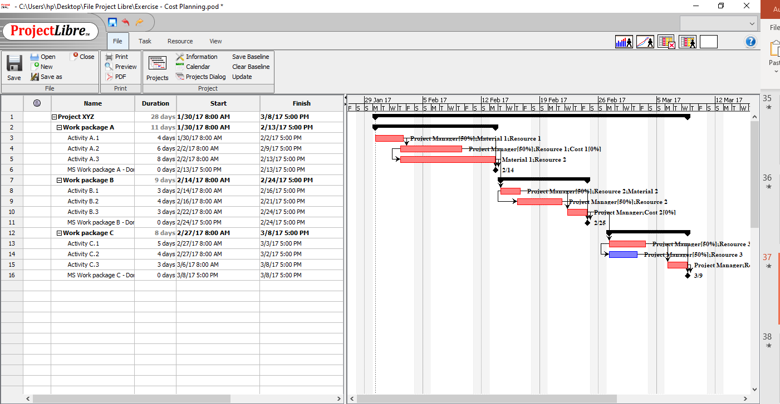
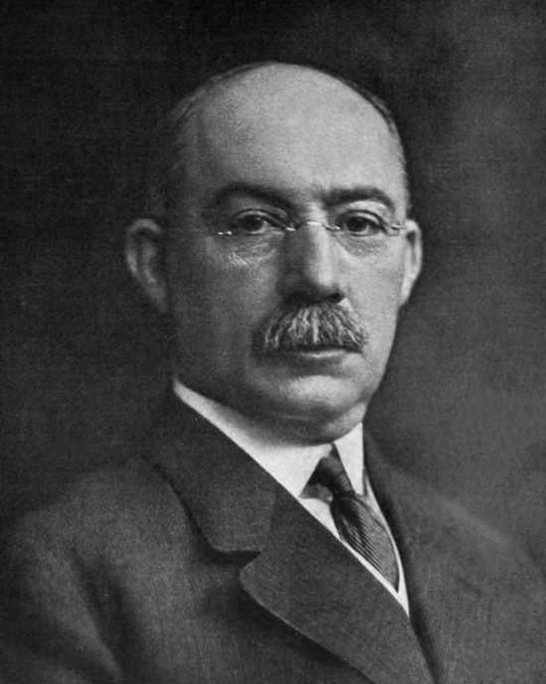
Gantt Charts
Establish a time-phased network
Can be used as a tracking tool
Benefits of Gantt charts
Easy to comprehend
Identify the schedule baseline network
Allow for updating and control
Identify resource needs
Easy to create
Gantt Chart was invented by Henry Gantt in 1910

Slide 15
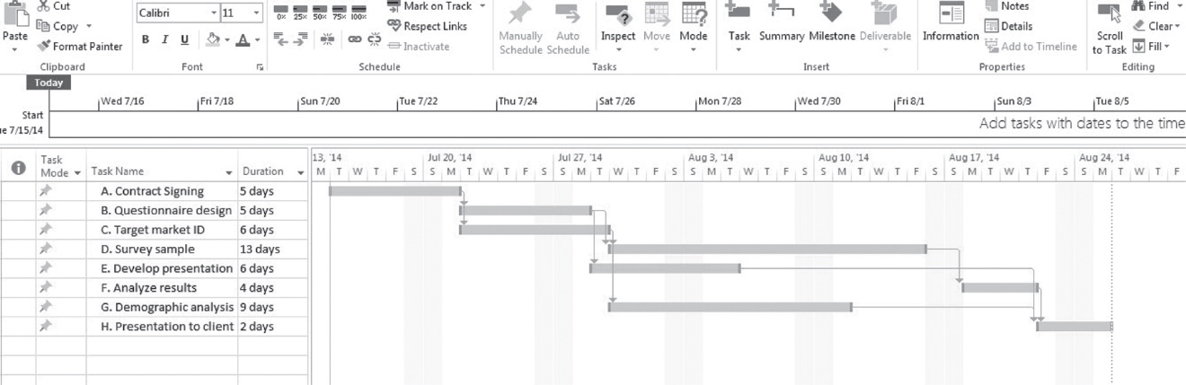
Completed Gantt Chart for Project Delta
(figure 10.8)
Source: Pinto (2016)

Slide 16
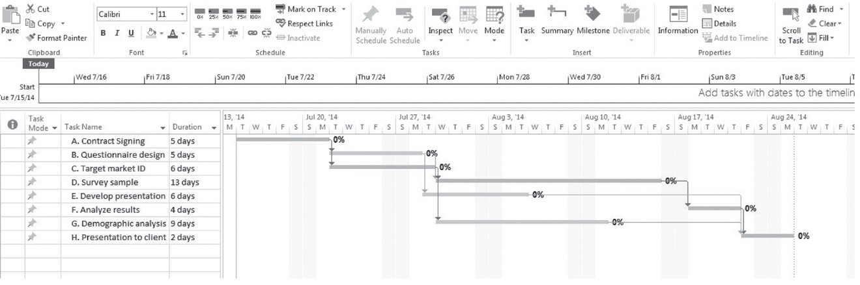
Gantt Chart for Project Delta with Critical Path Highlighted
(figure 10.9)
Source: Pinto (2016)

Slide 17
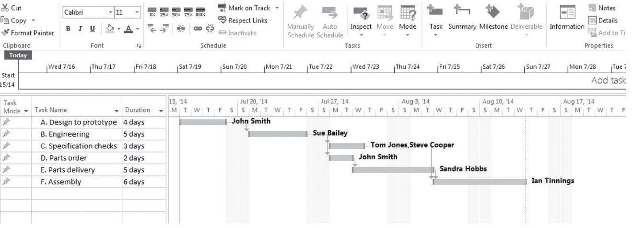
Gantt Chart with Resources Specified
(figure 10.10)
Source: Pinto (2016)

Slide 18
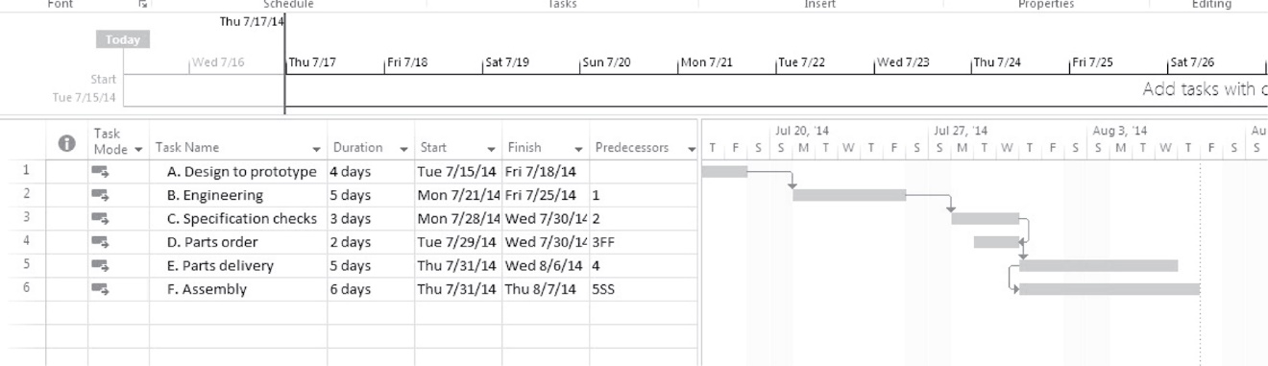
Gantt Chart with Lag Relationships
(figure 10.11)
Source: Pinto (2016)

Slide 19
Crashing
The process of accelerating a project
Primary methods for crashing:
Improving existing resources’ productivity
Changing work methods
Compromise quality and/or reduce project scope
Institute fast-tracking
Work overtime
Increasing the quantity of resources

Slide 20
Crash process
Determine activity fixed and variable costs
The crash point is the fully expedited activity
Optimize time-cost tradeoffs
Shorten activities on the critical path
Cease crashing when:
  the target completion time is reached
  the crashing cost exceeds the penalty cost

Slide 21
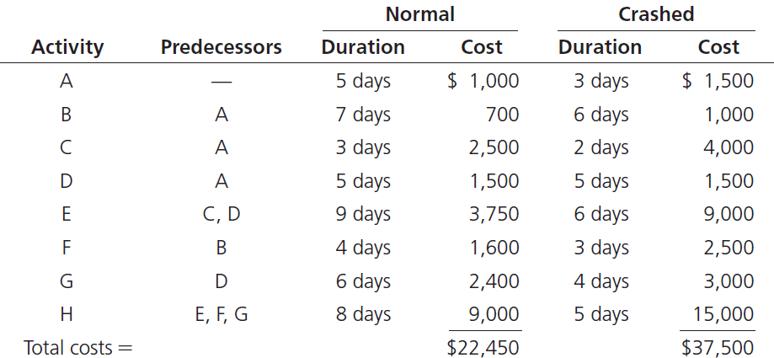
Project Activities and Costs
(table 10.1)
Source: Pinto (2016)

Slide 22
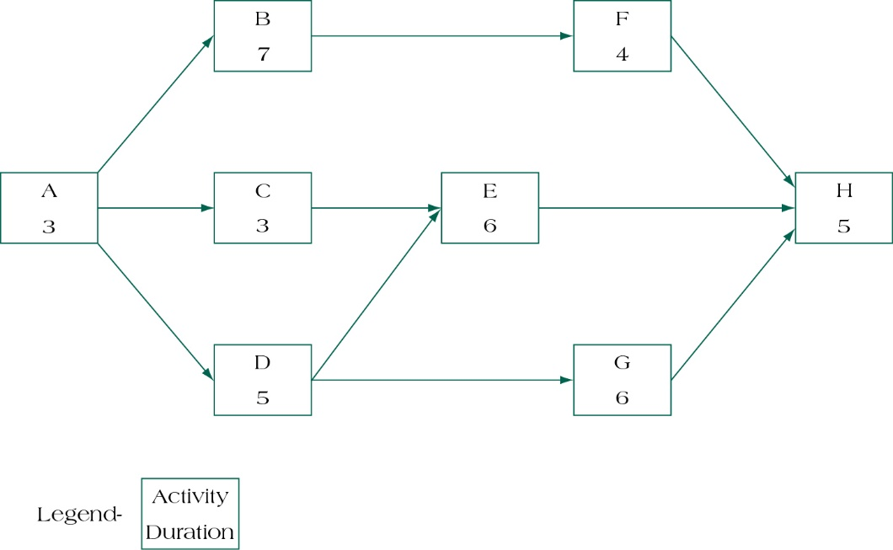
Fully crashed project activity network
(figure 10.15)
Source: Pinto (2016)

Slide 23
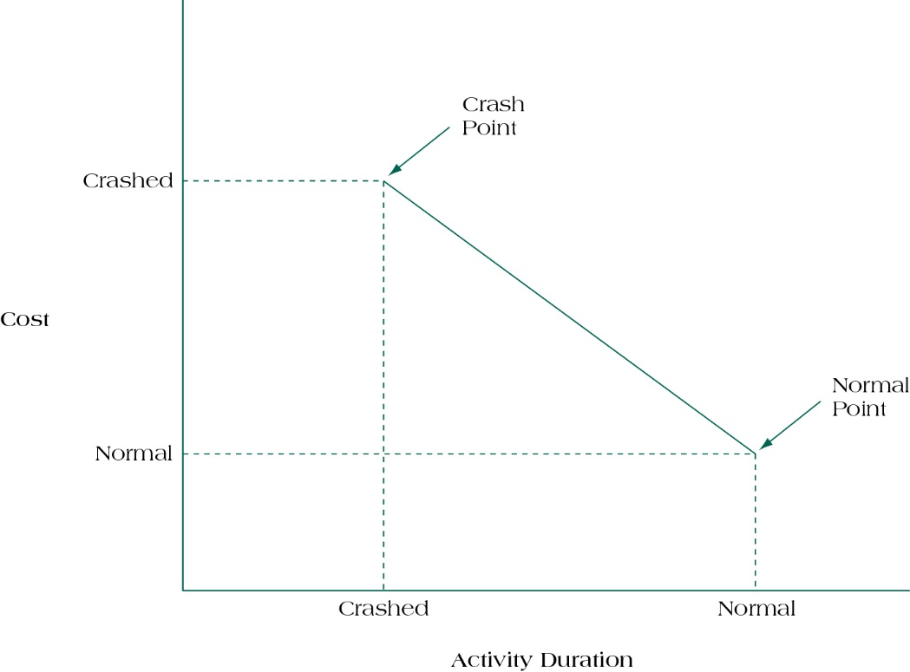
Time/cost trade-offs for crashing activities
(figure 10.14)
Source: Pinto (2016)

Slide 24
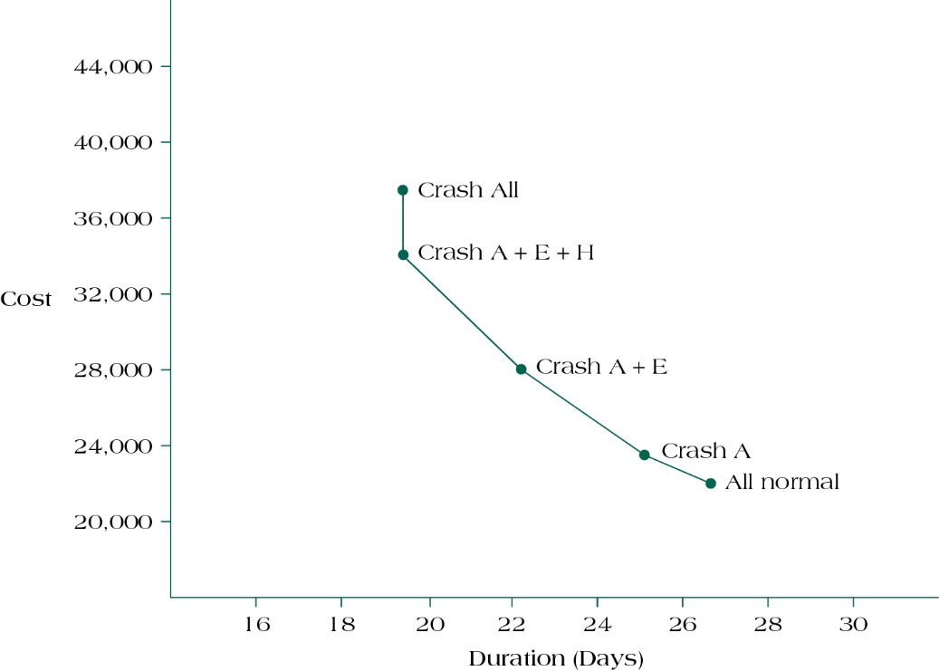
Relationship between cost and days saved in crashed project
(figure 10.16)
Source: Pinto (2016)

Slide 25
Membangun Jaringan Aktivitas dengan Activty on Arrow (AoA)

Slide 26
Activity on Arrow Networks
Activities represented by arrows
Widely used in construction
Event nodes easy to flag
Forward and backward pass logic similar to AON
Two activities may not begin and end at common nodes
Dummy activities may be required

Slide 27
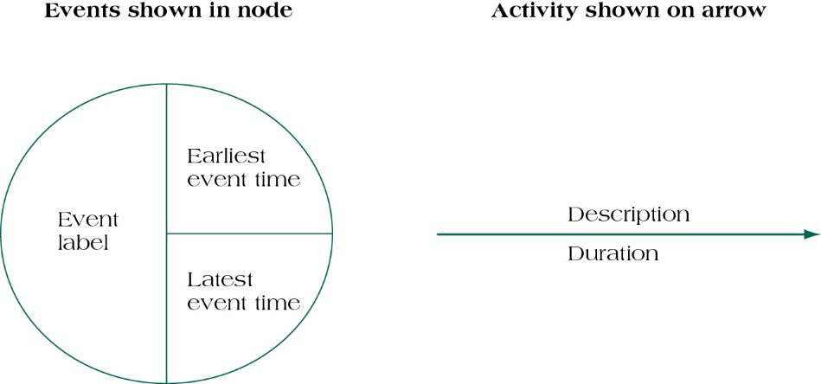
Notation for Activity-on-Arrow (AOA) Networks
(figure 10.18)
Source: Pinto (2016)

Slide 28
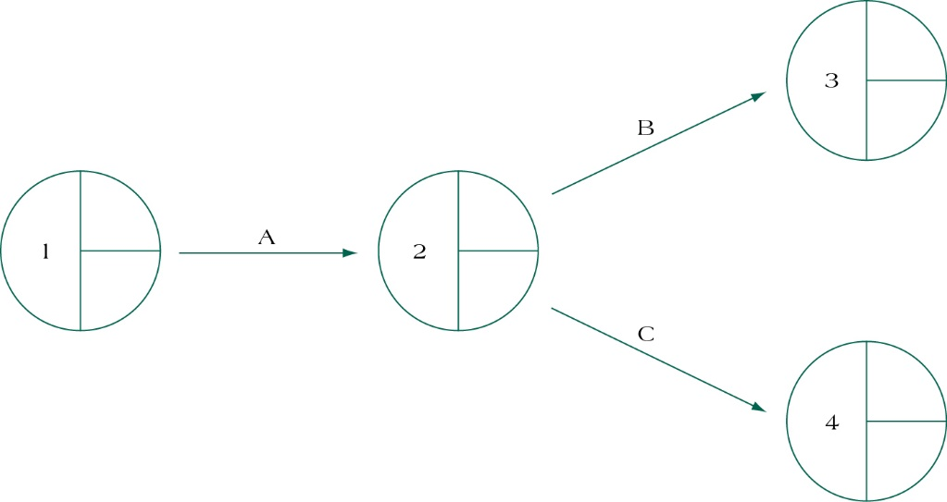
Sample Network Diagram Using AOA Approach
(figure 10.19)
Source: Pinto (2016)

Slide 29
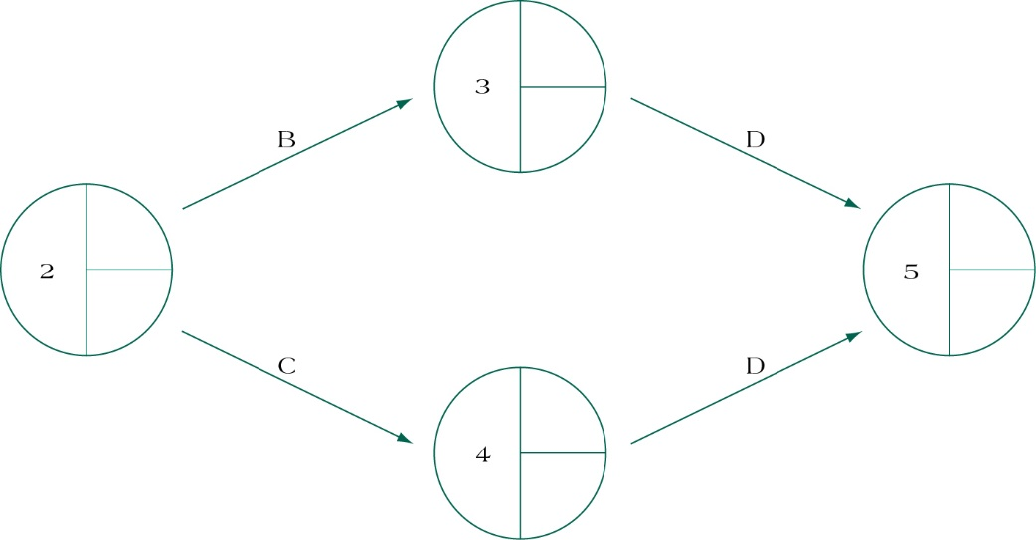
Representing Activities with Two or More Immediate Successors (Wrong)
(figure 10.20a)
Source: Pinto (2016)

Slide 30
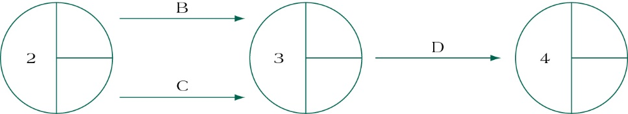
Alternative Way to Represent Activities with Two or More Immediate Successors (Wrong)
(figure 10.20B)
Source: Pinto (2016)

Slide 31
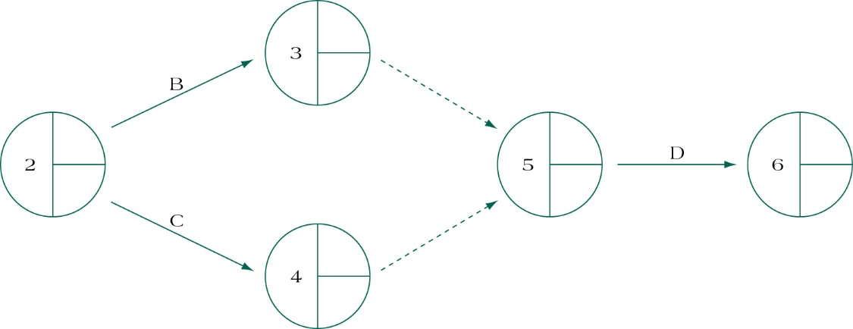
Representing Activities with Two or More Immediate Successors Using Dummy Activities (Better)
(figure 10.20C)
Source: Pinto (2016)

Slide 32
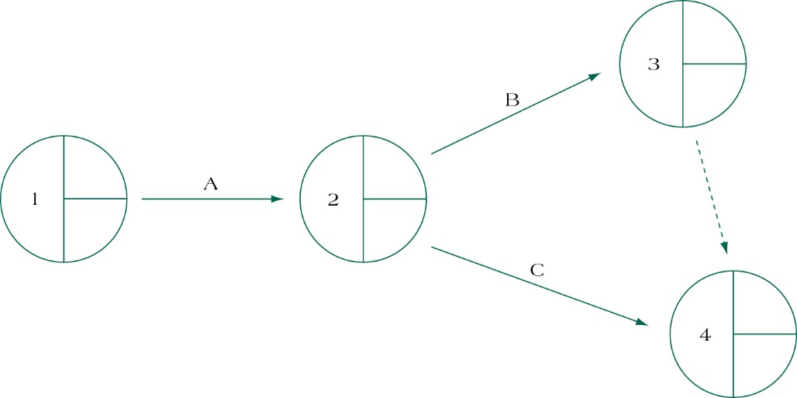
Partial Project Delta Network Using AOA Notation
(figure 10.21)
Source: Pinto (2016)

Slide 33
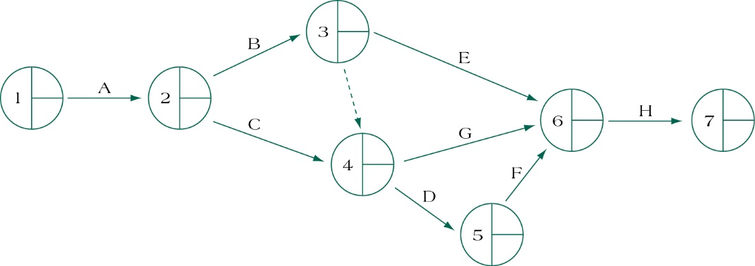
Completed Project Delta AOA Network
(figure 10.22)
Source: Pinto (2016)

Slide 34
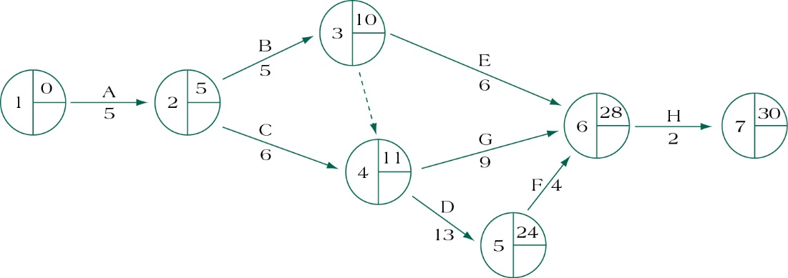
Project Delta Forward Pass Using AOA Network
(figure 10.23)
Source: Pinto (2016)

Slide 35
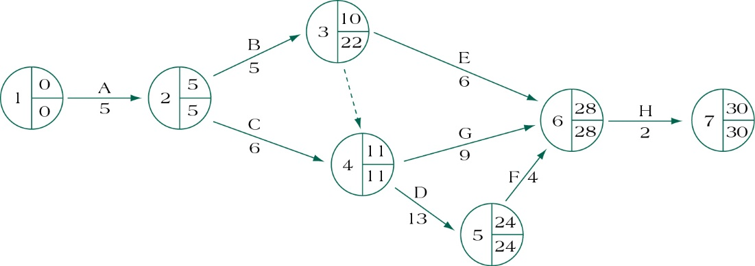
Project Delta Backward Pass Using AOA Network
(figure 10.24)
Source: Pinto (2016)

Slide 36
Controversies in the Use of Networks
Networks can be too complex.
Poor network construction creates problems.
Networks may be used inappropriately.
Networks pose special dangers because contractors may create their own networks.
Positive bias exists in PERT networks.

Slide 37
Summary
Apply lag relationships to project activities.
Construct and comprehend Gantt charts.
Recognize alternative means to accelerate projects, including their benefits and drawbacks.
Understand the trade-offs required in the decision to crash project activities.
Develop activity networks using Activity-on-Arrow techniques.
Understand the differences in AON and AOA and recognize the advantages and disadvantages of each technique.

Slide 38
REFERENCES
Pinto. J.K. (2016). Project Management: Achieving Competitive Advantage. Pearson Education Limited. London. ISBN:978-1-292-09479-3, Chapter 5

