Slide 1
Project Scheduling: Networks, Duration Estimation, And Critical Path
Session 9
Project Management

Slide 2
LEARNING OUTCOMES
After completing this chapter, you should be able to:
Understand and apply key scheduling terminology.
Apply the logic used to create activity networks, including predecessor and successor tasks.
Develop an activity network using Activity-on-Node (AON) techniques.
Perform activity duration estimation based on the use of probabilistic estimating techniques.

Slide 3
LEARNING OUTCOMES
After completing this chapter, you should be able to:
Construct the critical path for a project schedule network using forward and backward passes.
Identify activity float and the manner in which it is determined.
Calculate the probability of a project finishing on time under PERT estimates.
Understand the steps that can be employed to reduce the critical path.

Slide 4
OUTLINE
Membentuk Diagram Jaringan
Proses Estimasi Durasi Proyek
Penentuan Jalur Kritis Dalam Diagram Jaringan

Slide 5
PMBOK Core Concepts
Project Management Body of Knowledge (PMB0K) covered in this chapter includes:
Plan Schedule Management (PMBoK 6.1)
Define Activities (PMBoK 6.2)
Sequence Activities (PMBoK 6.3)
Estimate Activity Resources (PMBoK 6.4)
Estimate Activity Durations (PMBoK 6.5)
Develop Schedule (PMBoK 6.6)
Control Schedule (PMBoK 6.7)

Slide 6
Membentuk Diagram Jaringan

Slide 7
Project Scheduling
Project scheduling requires us to follow some carefully
laid-out steps, in order, for the schedule to take shape. PMBoK
states, “an output of a schedule model that presents linked
activities with planned dates, durations, milestones, and resources.”
Project planning, as it relates to the scheduling process, has been defined by the PMBoK as:
  The identification of the project objectives and the ordered activity necessary to complete the project including the identification of resource types and quantities required to carry out each activity or task.

Slide 8
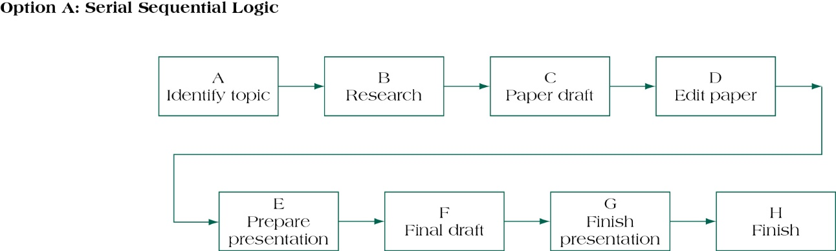
NETWORK DIAGRAM – SERIAL
SEQUENTIAL LOGIC
(FIGURE 9.2A)
Source: Pinto (2016)

Slide 9
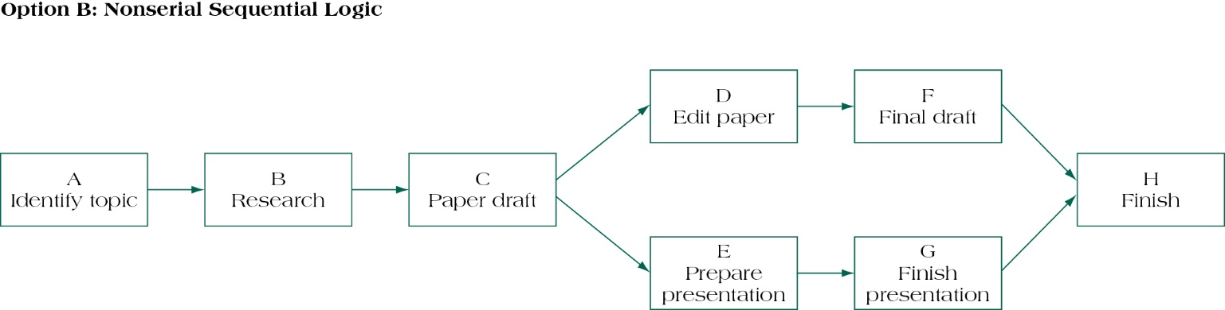
NETWORK DIAGRAM – NONSERIAL SEQUENTIAL LOGIC
(FIGURE 9.2B)
Source: Pinto (2016)

Slide 10
Project Scheduling Terms
Project Network Diagram: Any schematic display of the logical relationships of project activities.
Path: A sequence of activities defined by the project network logic.
Event: A point when an activity is either started or completed.
Node: One of the defining points of a network; a junction point joined to some or all of the other dependency lines (paths).

Slide 11
Project Scheduling Terms
Predecessors: Those activities that must be completed prior to initiation of a later activity in the network.
Successors: Activities that cannot be started until previous activities have been completed. These activities follow predecessor tasks.
Early start (ES) date: The earliest possible date the uncompleted portions of an activity can start.
Late start (LS) date: The latest possible date that an activity may begin without delaying a specified milestone.

Slide 12
Project Scheduling Terms
Forward pass: Network calculations to determine earliest start/earliest finish for an activity through working forward through each activity in network.
Backward pass: Network calculations to determine late start/late finish for uncompleted tasks through working backward through each activity in network.
Merge activity: An activity with two or more immediate predecessors.
Burst activity: An activity with two or more immediate successors.

Slide 13
Project Scheduling Terms
Float: The amount of time an activity may be delayed from its early start without delaying the finish of the project.
Critical path: The path through project network with the longest duration.
Critical Path Method: A network analysis technique used to determine the amount of schedule flexibility on logical network paths in project schedule network and to determine minimum project duration.
Resource-limited schedule: Start and finish dates reflect expected resource availability.

Slide 14
AOA Versus AON
The same mini-project is shown with activities on arc…
D
E
B
F
C
…and activities on node.
D
E
B
F
C
Source: Pinto (2016)

Slide 15
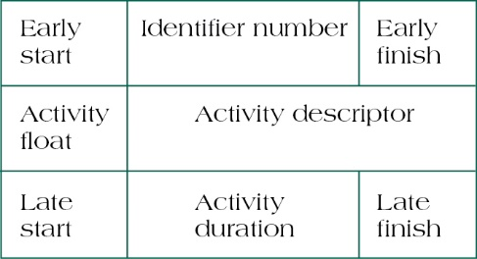
Node Labels
(figure 9.3)
Source: Pinto (2016)

Slide 16

Serial Activities
(figure 9.5)
Serial activities are those that flow from one to
the next, in sequence.
Source: Pinto (2016)

Slide 17
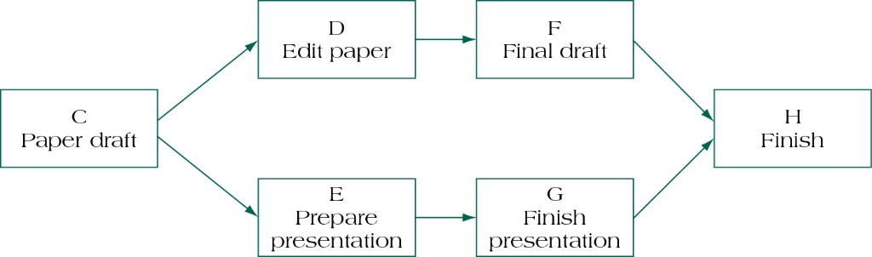
Concurrent activities
(figure 9.6)
When the nature of the work allows for more than one activity to be accomplished at the same time, these activities are called concurrent, and parallel project paths are constructed through the network.
Source: Pinto (2016)

Slide 18
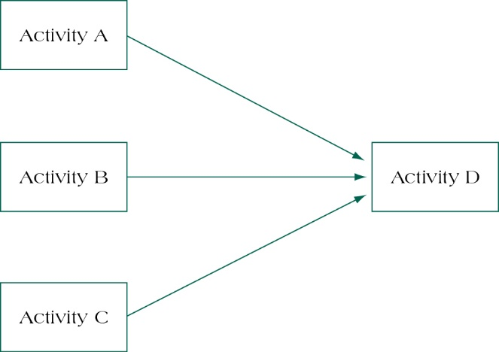
Merge Activity
(figure 9.7)
Source: Pinto (2016)

Slide 19
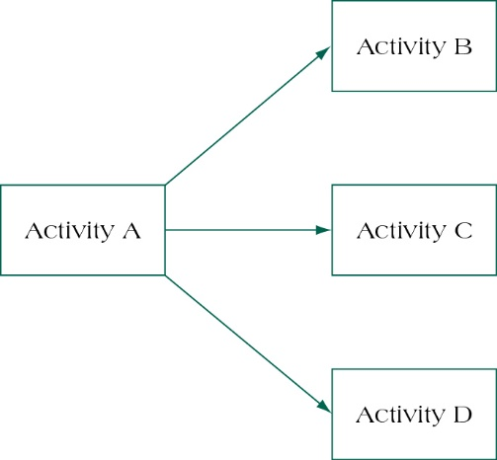
Burst Activity
(figure 9.8)
Source: Pinto (2016)

Slide 20
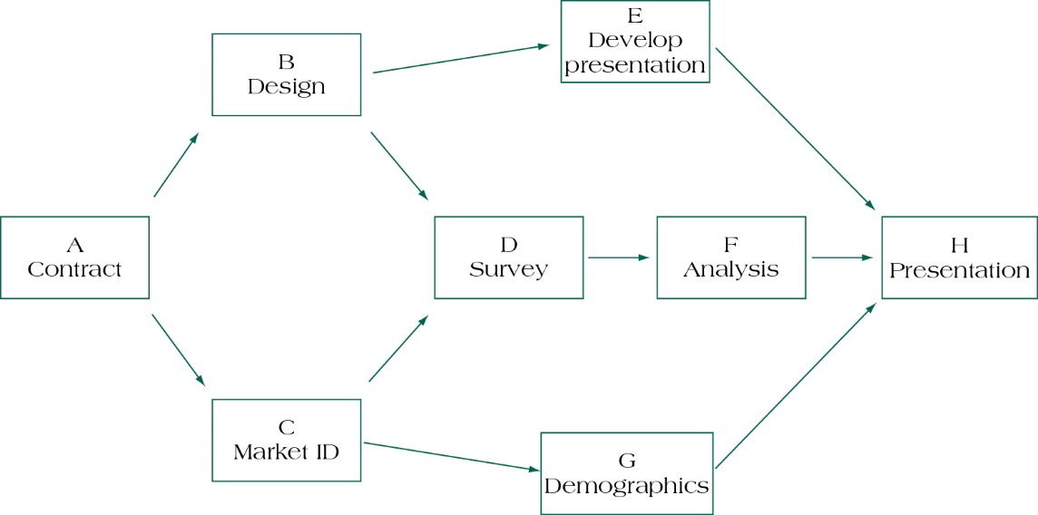
Complete Activity Network
(figure 9.10)
Source: Pinto (2016)

Slide 21
Proses Estimasi Durasi Proyek

Slide 22
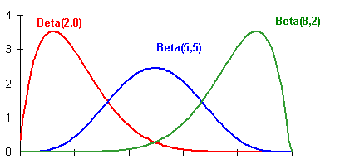
Duration Estimation
Experience
Expert opinion
Mathematical derivation – Beta distribution
  Most likely (m)
  Most pessimistic (b)
  Most optimistic (a)
Source: vosesoftware.com

Slide 23
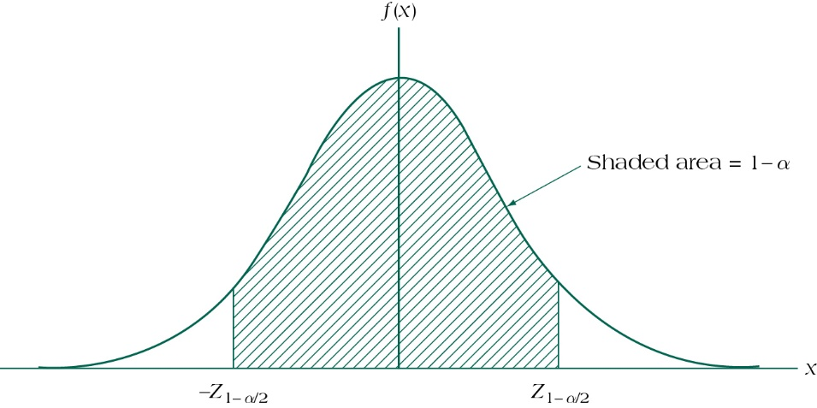
Symmetrical (normal) distribution for activity duration estimation
(figure 9.14)
Source: Pinto (2016)

Slide 24
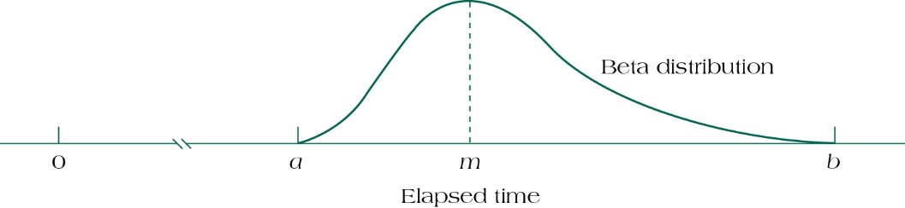
Asymmetrical (beta) distribution for activity duration estimation
(figure 9.15)
Source: Pinto (2016)

Slide 25
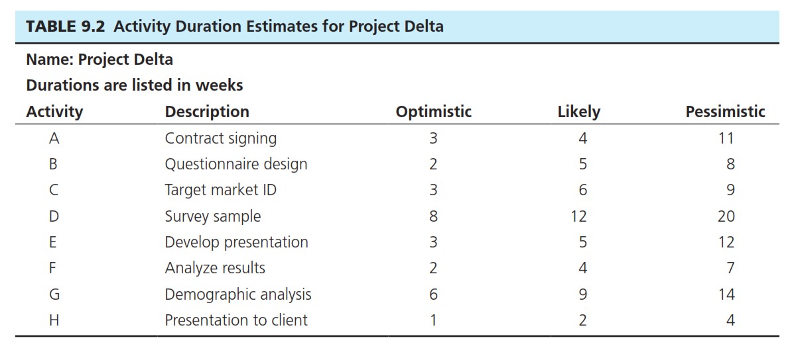
Activity Duration and Variance
(table 9.2)
Source: Pinto (2016)

Slide 26
Penentuan Jalur Kritis Dalam Diagram Jaringan

Slide 27
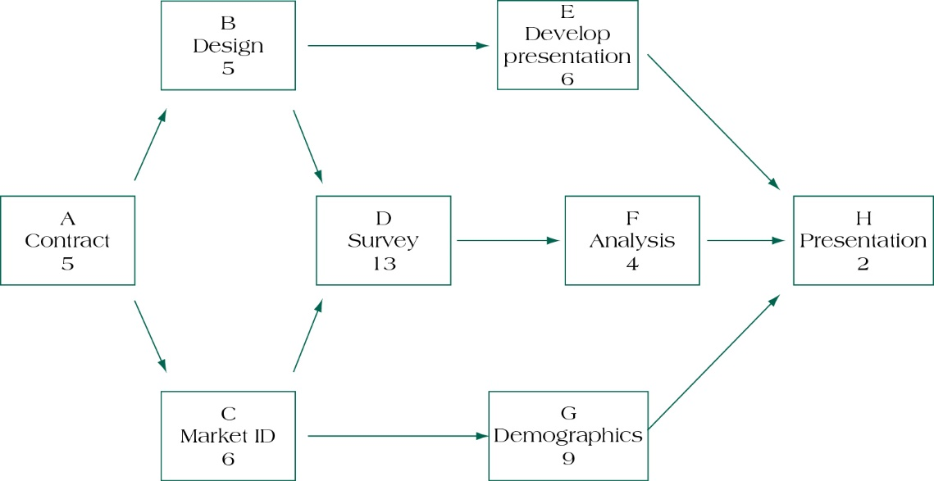
Partial project activity network with task durations
(figure 9.16)
Source: Pinto (2016)

Slide 28
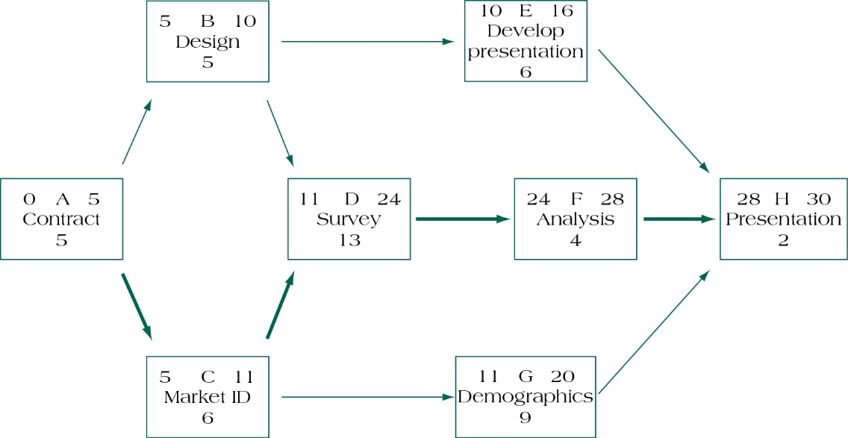
Activity Network with Forward Pass
(figure 9.18)
Source: Pinto (2016)

Slide 29
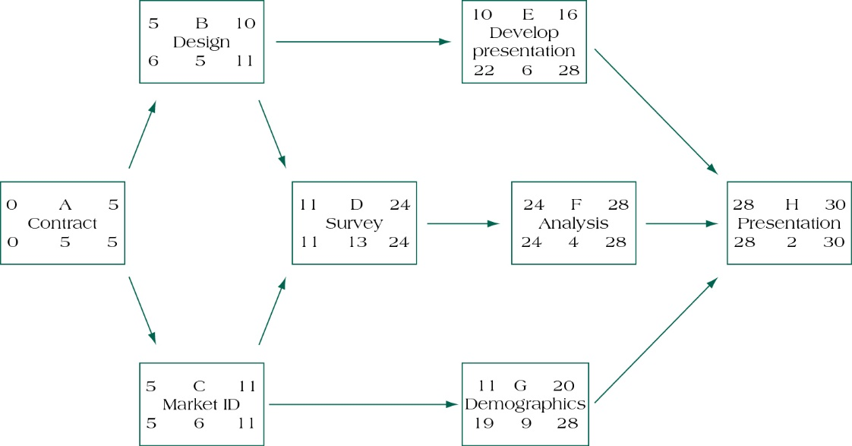
Activity Network with Backward Pass
(figure 9.19)
Source: Pinto (2016)

Slide 30
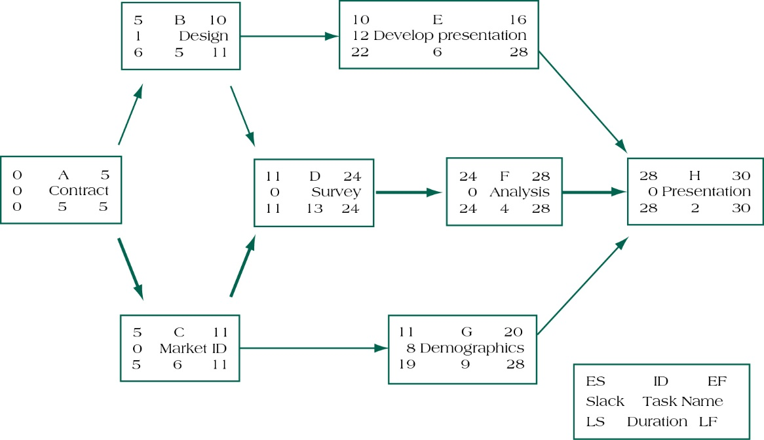
Project Network with Activity Slack and Critical Path
(figure 9.20)
Source: Pinto (2016)

Slide 31
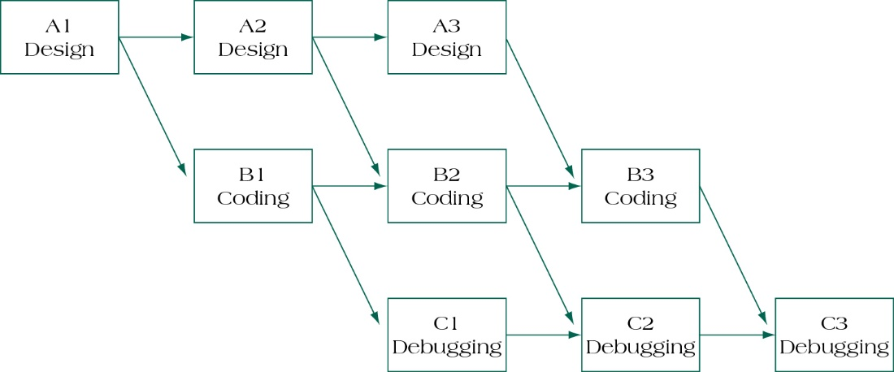
AON Network with Laddering Effect
(figure 9.24)
Source: Pinto (2016)

Slide 32
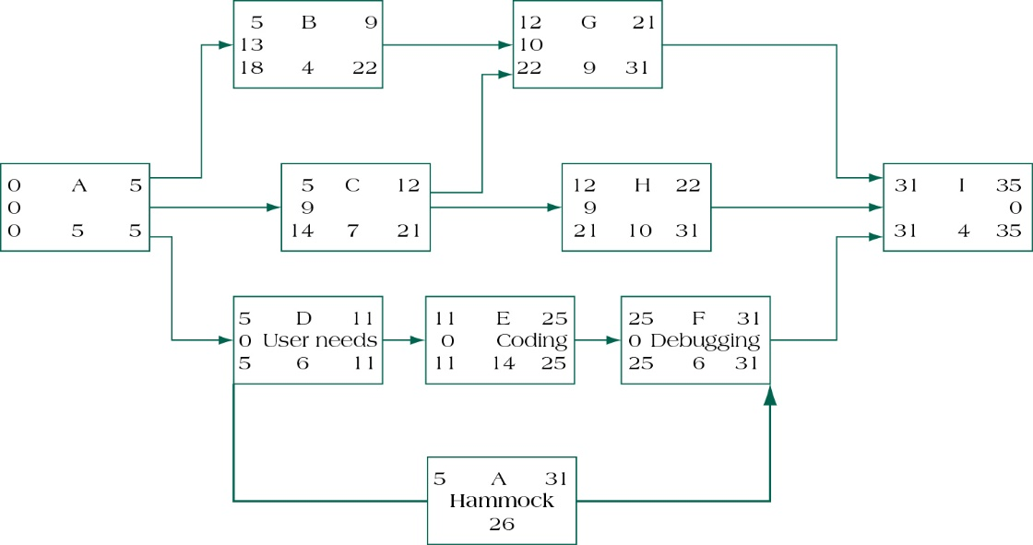
Example of a Hammock Activity
(figure 9.25)
Source: Pinto (2016)

Slide 33
Options for Reducing the Critical Path
Eliminate tasks on the critical path.
Replan serial paths to be in parallel.
Overlap sequential tasks.
Shorten the duration on critical path tasks.
Shorten early tasks.
Shorten longest tasks.
Shorten easiest tasks.
Shorten tasks that cost the least to speed up.

Slide 34
Constructing the Critical Path
Forward pass – an additive move through the network from start to finish
Backward pass – a subtractive move through the network from finish to start
Critical path – the longest path from end to end which determines the shortest project length

Slide 35
Summary
Understand and apply key scheduling terminology.
Apply the logic used to create activity networks, including predecessor and successor tasks.
Develop an activity network using Activity-on-Node (AON) techniques.
Perform activity duration estimation based on the use of probabilistic estimating techniques.

Slide 36
Summary
Construct the critical path for a project schedule network using forward and backward passes.
Identify activity float and the manner in which it is determined.
Calculate the probability of a project finishing on time under PERT estimates.
Understand the steps that can be employed to reduce the critical path.

Slide 37
REFERENCES
Pinto. J.K. (2016). Project Management: Achieving Competitive Advantage. Pearson Education Limited. London. ISBN:978-1-292-09479-3, Chapter 5

