Slide 1
Hotel Organization Chart
Meeting 3

Slide 2
Purposes of Hotel Organization
to carry out the daily operations
to help divide tasks
to specify the job for each department
to delegate authority within and among departments

Slide 3
SAMPLES OF HOTEL ORGANIZATION CHART

Slide 4
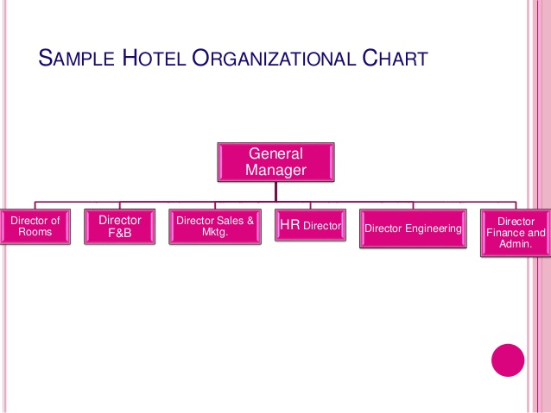
Sample 1:
A Small Hotel

Slide 5
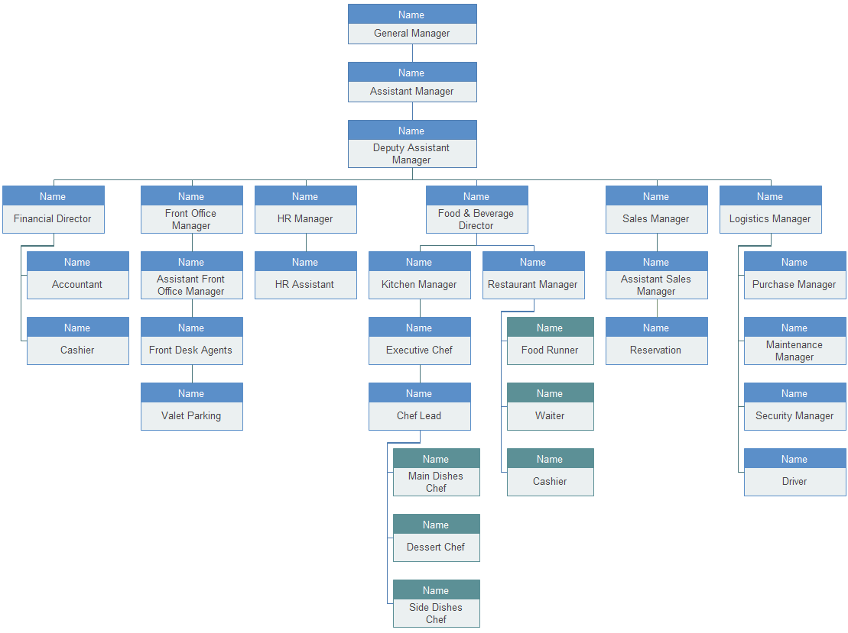
Sample 2:A Large Hotel

Slide 6
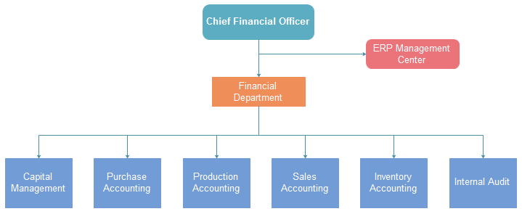
Sample 3
Financial Department

Slide 7
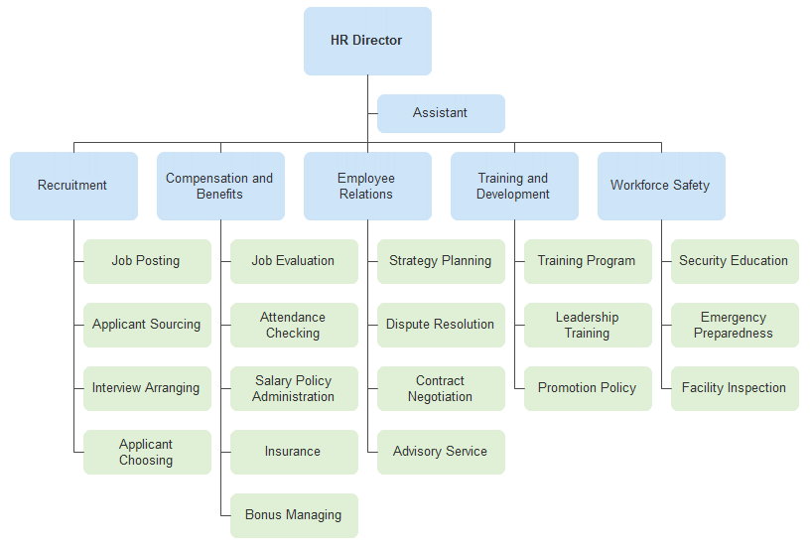
Sample 4
Human Resource Department

Slide 8
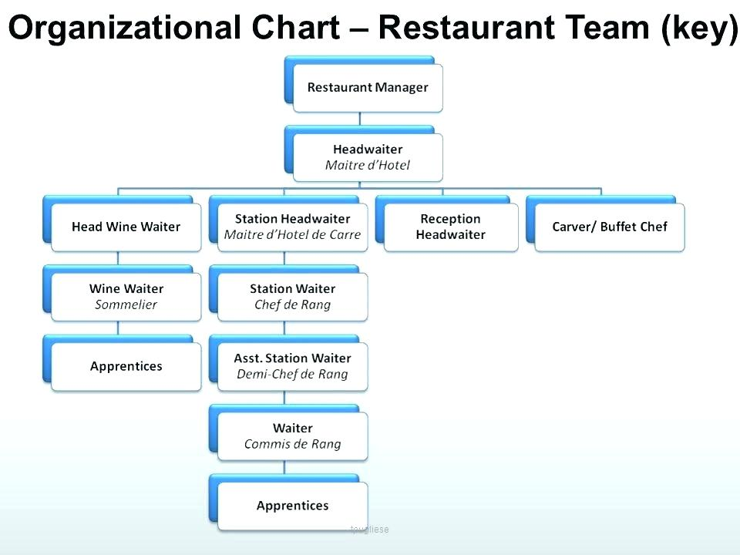
Sample 5

Slide 9
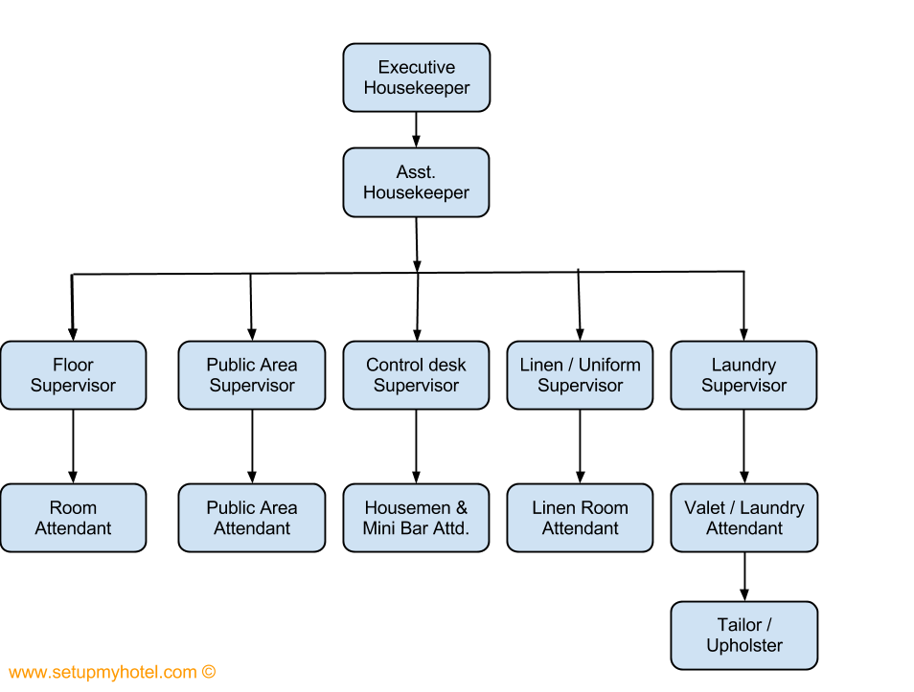
Sample 6
Housekeeping Department

