Slide 1
Introduction to Restaurant
Meeting 9

Slide 2
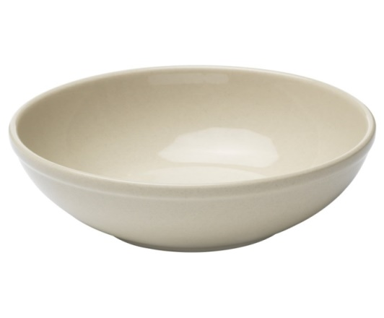
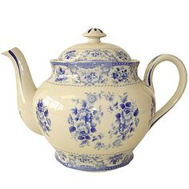
Some Appliances at the Restaurant
a bowl
a glass
a cup and a saucer
a chinese kettle

Slide 3
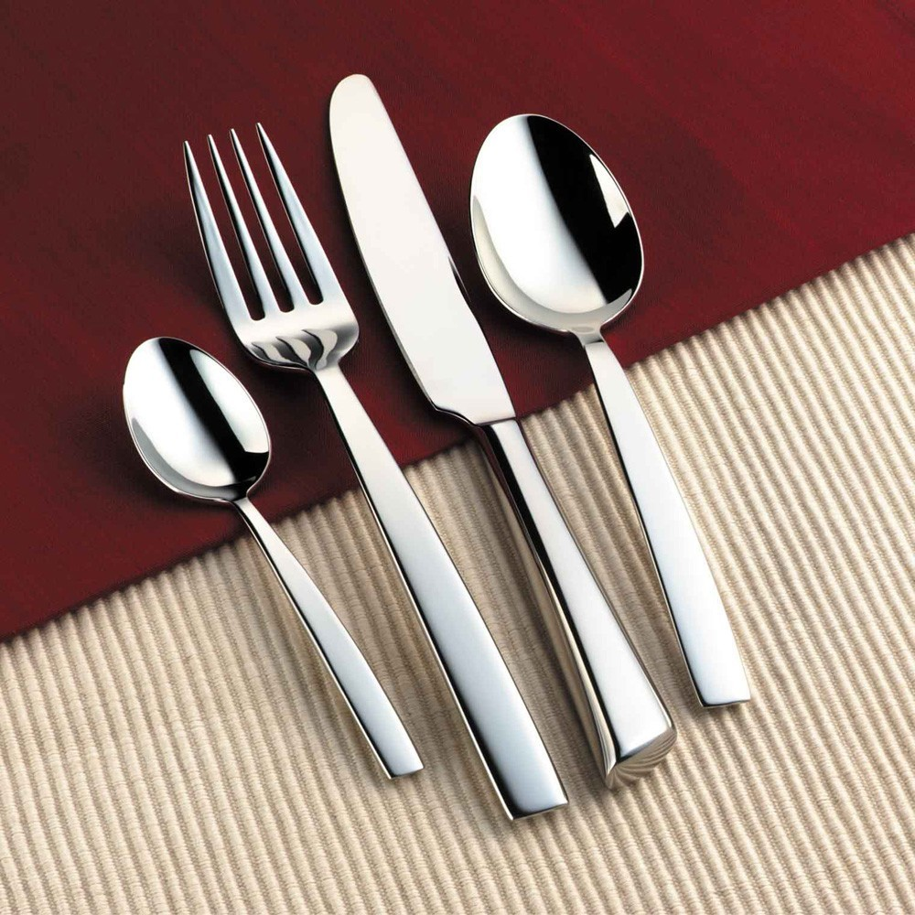
Cutlery/Silverware/Flatware

Slide 4
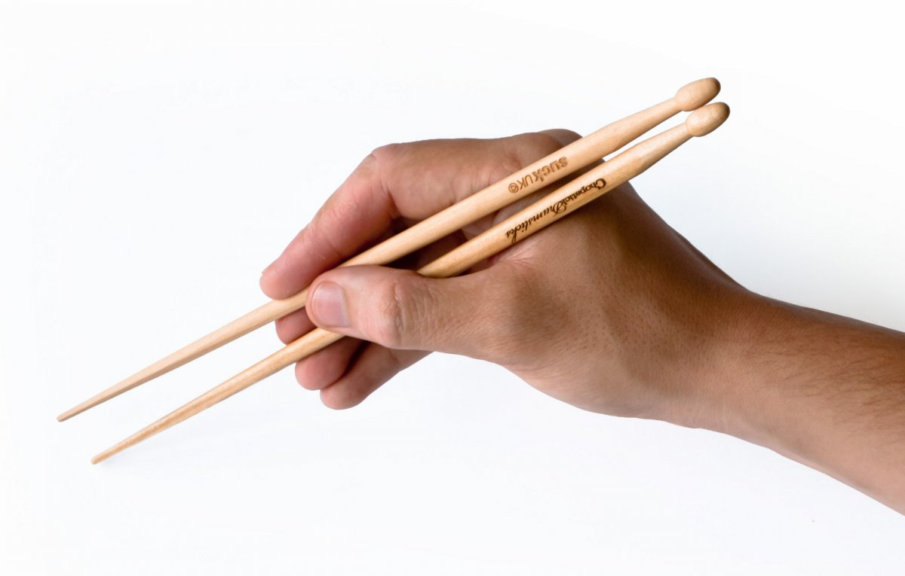
Chopstick

Slide 5
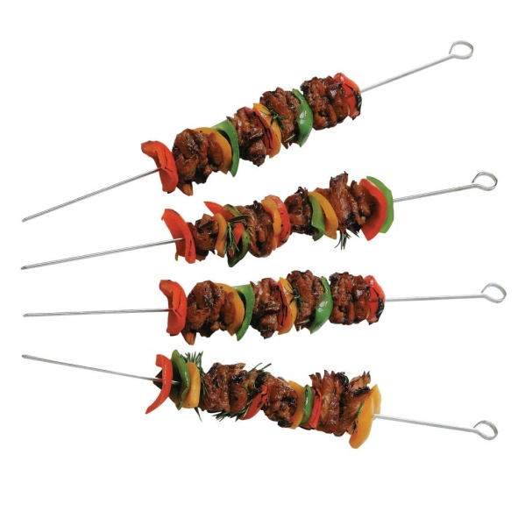
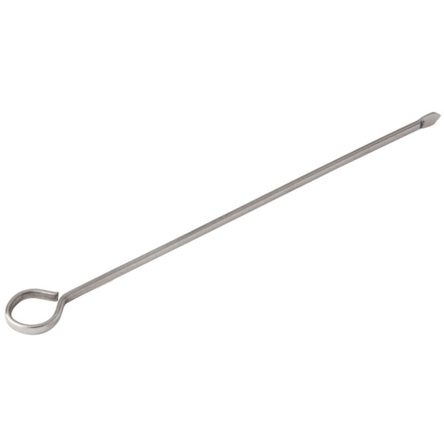
Skewer

Slide 6
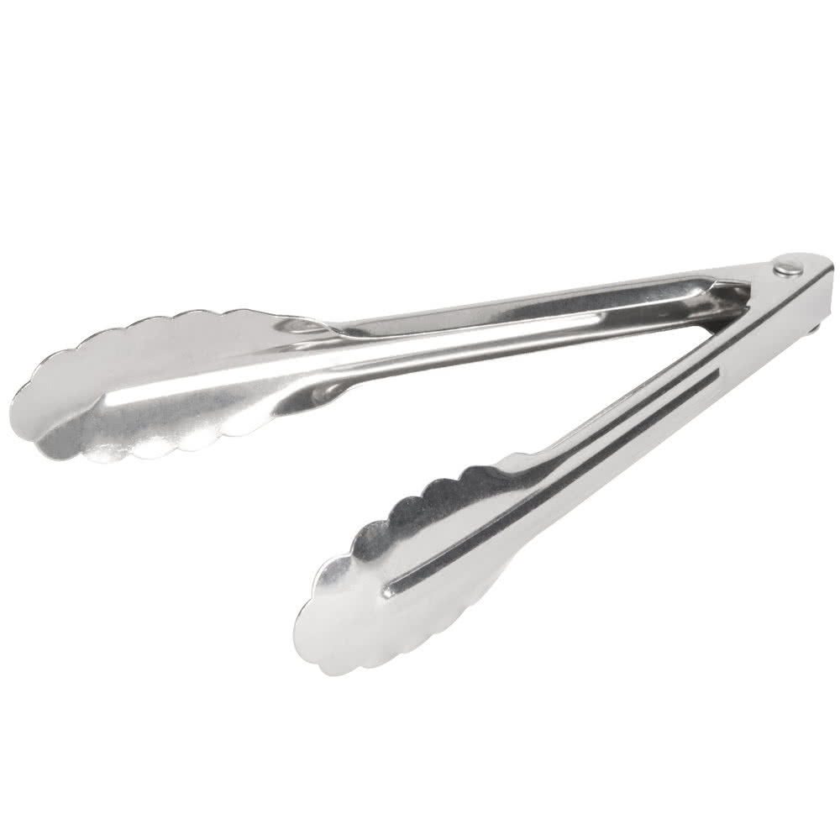
Tongs

Slide 7
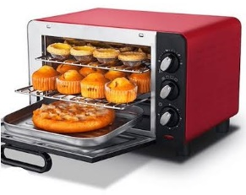
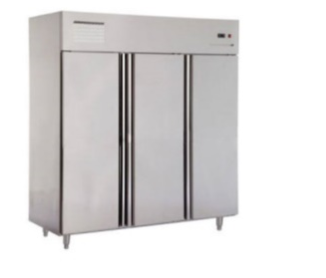
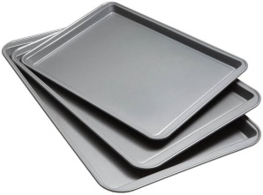
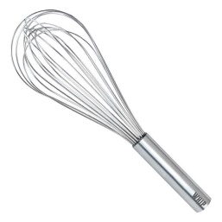
Some Appliances in the Kitchen
Oven
Freezer
Baking tray
Whisker

Slide 8
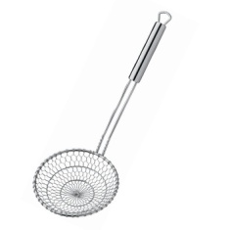
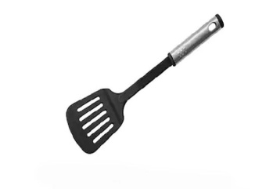
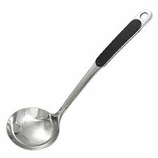
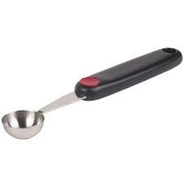
Some Appliances in the Kitchen
Spider skimmer
Spatula
Ladle
Melon baller

Slide 9
A few Phrases
in the Restaurant

Slide 10
All you can eat
Welcome to our restaurant, we provide all you can eat services by paying only 100.000 IDR.
Apron
We require each chef in our restaurant to use a clean apron every time they want to cook to keep the cleanliness.
Black coffee
We recommend black coffee to increase your concentration in work.
Coffee round
Our barista provides a complete range of coffee rounds.
Corkscrew
Our sommelier need corkscrew to open a bottle of wine.

Slide 11
Types of Menu

Slide 12
Kinds of Dish
Appetizer/Starter
Main course/Entrée/Main meal
Dessert

Slide 13
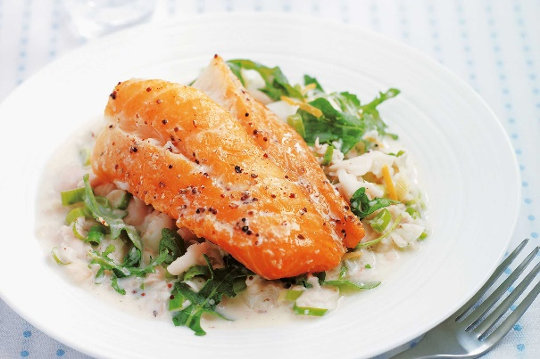
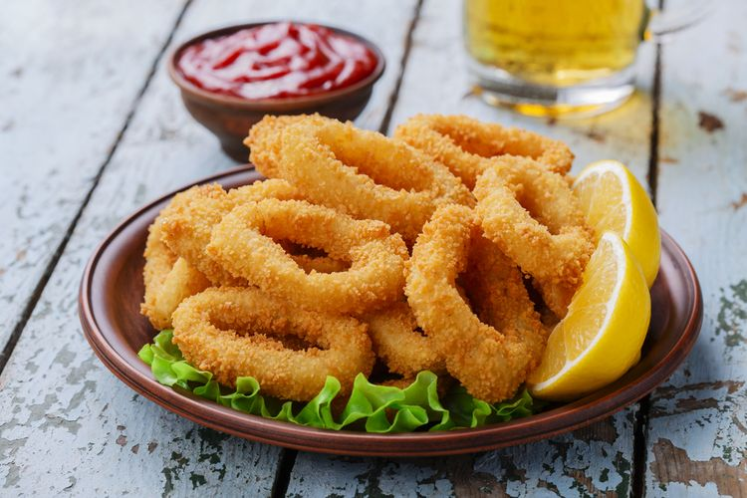
Kinds of APPETIZER/STARTER
creamy soup
Smoked cod
Slices of cod served with brown bread and butter
Pan Fried or Grilled Calamari
Fries & chips

Slide 14
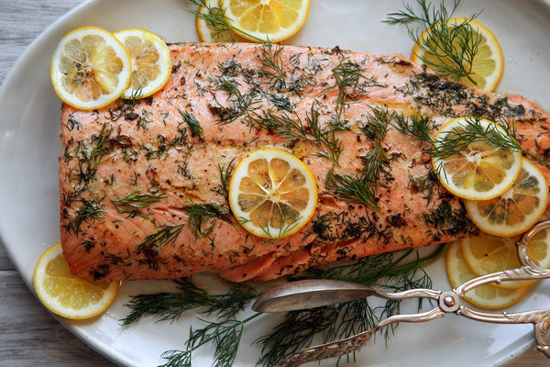
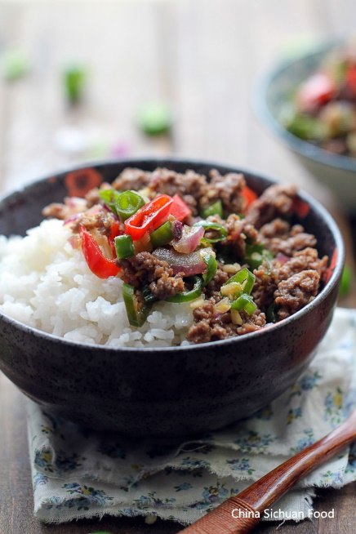
Kinds of MAIN DISHES
Roasted Atlantic Salmon
Fried Chicken and Rice
Chopped Spicy Meat and Rice
Spaghetti

Slide 15
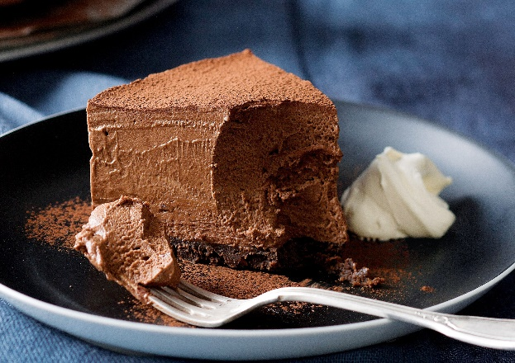
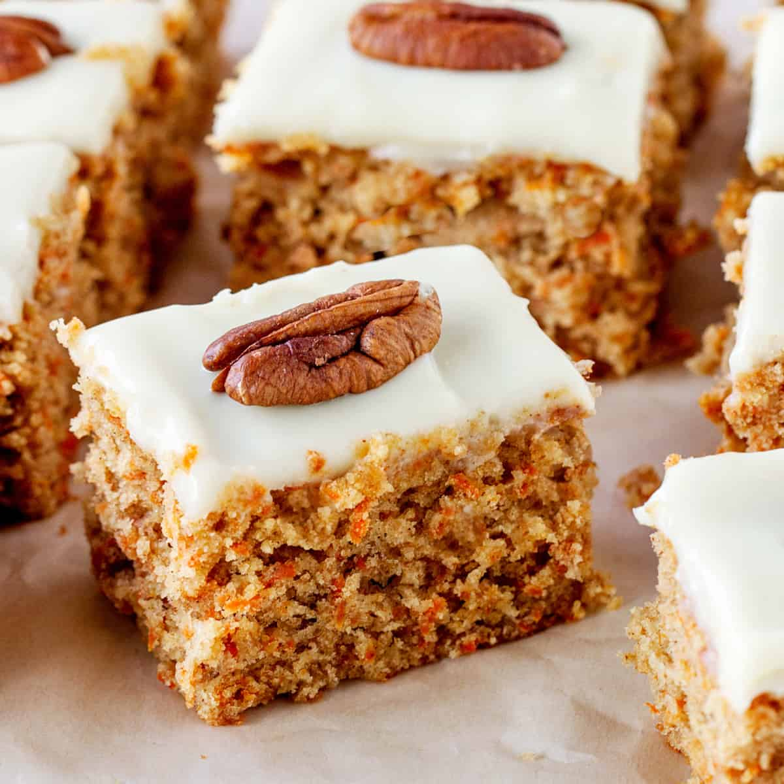
Kinds of DESSERTS
Chocolate Mousse Cake
Carrot Cake
Cheese Cake
Pudding

Slide 16
What are the types of dish in Indonesia, particularly in Makassar?

Slide 17
Types of dish in Makassar
APPETIZER:
MAIN COURSE:
DESSERT:

Slide 18
SAMPLES OF MENU LIST

